Slide 1
Amazing Grace, pt. 10
“Unstable as Water”

Slide 2
Not a Happy Place!
He had everything and he had nothing. He was born into a world of abundant, abundant hope, but it was corroded with hatred, heartache, and grief.
He had laid before him everything this world could offer and everything the next world had to offer too. His grandfather and great grandfather had talked with the very God of heaven and his dad had seen a vision. Where would his future go? Toward heaven or toward hell?

Slide 3
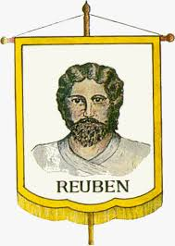
The Pain/Product of Polygamy
“ And he went in also unto Rachel, and he loved also Rachel more than Leah, and served with him yet seven other years. And when the LORD saw that Leah was hated, he opened her womb: but Rachel was barren. And Leah conceived, and bare a son, and she called his name Reuben: for she said, Surely the LORD hath looked upon my affliction; now therefore my husband will love me.” Gen. 29:30-32

Slide 4
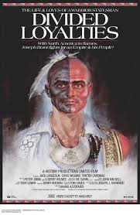
Home of Hatred
Reuben grew up in a home where his dad was highly respected and his mother, Leah, was horribly despised. Because of the sister wife, Rachel, Leah was an outcast in her own home. Being raised in this environment was very difficult for Reuben. Divided loyalties, wanting the approval of both; this was tough on the little boy and young man!

Slide 5
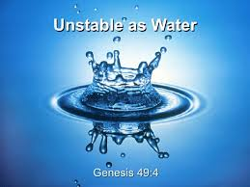
The Path of Least Resistance
Where divided loyalties reside, a child has to learn to play games in order to survive. He isn’t really sure where to stand on things because he wants to please both parents and that is very difficult! The benediction of Jacob for Reuben now makes sense! ‘Unstable as Water!’

Slide 6
Another Window to Reuben!
“And Reuben went in the days of wheat harvest, and found mandrakes in the field, and brought them unto his mother Leah. Then Rachel said to Leah, Give me, I pray thee, of thy son's mandrakes. And she said unto her, Is it a small matter that thou hast taken my husband? and wouldest thou take away my son's mandrakes also? And Rachel said, Therefore he shall lie with thee to night for thy son's mandrakes. And Jacob came out of the field in the evening, and Leah went out to meet him, and said, Thou must come in unto me; for surely I have hired thee with my son's mandrakes. And he lay with her that night. And God hearkened unto Leah, and she conceived, and bare Jacob the fifth son.” Genesis 30:14-17

Slide 7
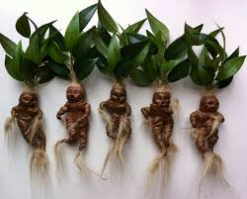
Reuben’s Mother was Prostituted
What a sight for young, impressionable Reuben! His mother is sold to the other wife, Rachel, for some mandrakes! Now, his dad will sleep with his mom for the price of prostitution!! What a horrible picture of the marriage relationship for Reuben! Do you think he might have some wrong ideas about sex and marriage?

Slide 8
Does it Surprise You?
“ And Rachel died, and was buried in the way to Ephrath, which is Bethlehem. And Jacob set a pillar upon her grave: that is the pillar of Rachel's grave unto this day. And Israel journeyed, and spread his tent beyond the tower of Edar. And it came to pass, when Israel dwelt in that land, that Reuben went and lay with Bilhah his father's concubine: and Israel heard it. Now the sons of Jacob were twelve: The sons of Leah; Reuben, Jacob's firstborn,” Gen. 35:19-23

Slide 9

Lust and Incest!
Reuben harbored evil thoughts of his dad’s concubine, Bilhah! He allowed the evil desires to smolder until they manifested themselves in this wicked crime against his dad and family! It was this evil infatuation, unharnessed, that sealed Reuben’s forfeiture of the birthright!

Slide 10
Jacob’s Benediction
“ And Jacob called unto his sons, and said, Gather yourselves together, that I may tell you that which shall befall you in the last days. Gather yourselves together, and hear, ye sons of Jacob; and hearken unto Israel your father. Reuben, thou art my firstborn, my might, and the beginning of my strength, the excellency of dignity, and the excellency of power: Unstable as water, thou shalt not excel; because thou wentest up to thy father's bed; then defiledst thou it: he went up to my couch.” Genesis 49:1-4

Slide 11
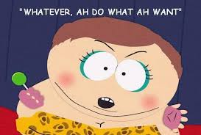
A Lifestyle of Unbridled Desire!
Jacob declared that Reuben was unstable. He never sought to bring under control his evil desires and lusts. He did what he wanted to do. He always looked for the path of least resistance. Just like water. For this, Reuben lost the birthright blessing of temporal and spiritual preeminence among the brothers!

Slide 12
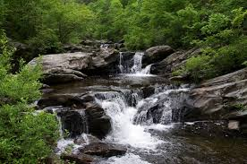
The Profane
Reuben lost the double portion of temporal blessing that goes to the first born. He also lost the position of spiritual head of the family/ the priesthood. He also lost the blessing of the Messiah coming through his seed! Like his Uncle Esau, Reuben was a profane person!

Slide 13
Crisis Time/ Reuben Revealed!
“ Come now therefore, and let us slay him, and cast him into some pit, and we will say, Some evil beast hath devoured him: and we shall see what will become of his dreams. And Reuben heard it, and he delivered him out of their hands; and said, Let us not kill him. And Reuben said unto them, Shed no blood, but cast him into this pit that is in the wilderness, and lay no hand upon him; that he might rid him out of their hands, to deliver him to his father again. And it came to pass, when Joseph was come unto his brethren, that they stript Joseph out of his coat, his coat of many colors that was on him; And they took him, and cast him into a pit: and the pit was empty, there was no water in it. And they sat down to eat bread: and they lifted up their eyes and looked, and, behold, a company of Ishmeelites came from Gilead with their camels bearing spicery and balm and myrrh, going to carry it down to Egypt. And Judah said unto his brethren, What profit is it if we slay our brother, and conceal his blood? Come, and let us sell him to the Ishmeelites, and let not our hand be upon him; for he is our brother and our flesh. And his brethren were content. Then there passed by Midianites merchantmen; and they drew and lifted up Joseph out of the pit, and sold Joseph to the Ishmeelites for twenty pieces of silver: and they brought Joseph into Egypt. And Reuben returned unto the pit; and, behold, Joseph was not in the pit; and he rent his clothes. And he returned unto his brethren, and said, The child is not; and I, whither shall I go?” Gen. 37:19-30

Slide 14
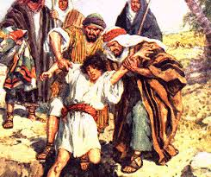
Reuben Coulda, Shoulda, Woulda, but NO!
Reuben had the authority as the firstborn to stop this foolishness. He could have protected Joseph. He knew it was the right thing to do, but he didn’t do it! He parlayed with his brothers, thinking to secretly rescue him later but………………

Slide 15
Unstable as Water!
“They would have executed their purpose but for Reuben. He shrank from participating in the murder of his brother, and proposed that Joseph be cast alive into a pit, and left there to perish; secretly intending, however, to rescue him and return him to his father. Having persuaded all to consent to this plan, Reuben left the company, fearing that he might fail to control his feelings, and that his real intentions would be discovered……. Reuben returned to the pit, but Joseph was not there. In alarm and self-reproach he rent his garments, and sought his brothers, exclaiming, "The child is not; and I, whither shall I go?" Upon learning the fate of Joseph, and that it would now be impossible to recover him, Reuben was induced to unite with the rest in the attempt to conceal their guilt. Having killed a kid, they dipped Joseph's coat in its blood, and took it to their father, telling him that they had found it in the fields, and that they feared it was their brother's.” PP, pgs. 211,212

Slide 16
Crisis Again!
“And bring your youngest brother unto me: then shall I know that ye are no spies, but that ye are true men: so will I deliver you your brother, and ye shall traffick in the land. And it came to pass as they emptied their sacks, that, behold, every man's bundle of money was in his sack: and when both they and their father saw the bundles of money, they were afraid. And Jacob their father said unto them, Me have ye bereaved of my children: Joseph is not, and Simeon is not, and ye will take Benjamin away: all these things are against me. And Reuben spake unto his father, saying, Slay my two sons, if I bring him not to thee: deliver him into my hand, and I will bring him to thee again. And he said, My son shall not go down with you; for his brother is dead, and he is left alone: if mischief befall him by the way in the which ye go, then shall ye bring down my gray hairs with sorrow to the grave.” Gen. 42:34-38

Slide 17
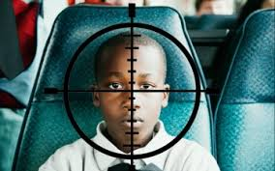
Kill MY Boys!
There was something missing in Reuben’s head. His answer if Benjamin doesn’t come home would be for Jacob to kill two of his grand sons! Are you kidding? Jacob was repulsed by the stupidity of his firstborn. Sin was taking a toll on Reuben!

Slide 18
Hope for the Unstable
“Joseph was satisfied. He had seen in his brothers the fruits of true repentance. Upon hearing Judah's noble offer he gave orders that all but these men should withdraw; then, weeping aloud, he cried, "I am Joseph; doth my father yet live?... “Men whom God favored, and to whom He entrusted great responsibilities, were sometimes overcome by temptation and committed sin, even as we at the present day strive, waver, and frequently fall into error. Their lives, with all their faults and follies, are open before us, both for our encouragement and warning. If they had been represented as without fault, we, with our sinful nature, might despair at our own mistakes and failures. But seeing where others struggled through discouragements like our own, where they fell under temptations as we have done, and yet took heart again and conquered through the grace of God, we are encouraged in our striving after righteousness. As they, though sometimes beaten back, recovered their ground, and were blessed of God, so we too may be overcomers in the strength of Jesus. On the other hand, the record of their lives may serve as a warning to us. It shows that God will by no means clear the guilty. He sees sin in His most favored ones, and He deals with it in them even more strictly than in those who have less light and responsibility.” PP, pg. 230, 238

Slide 19
Hope for Reuben
Water naturally flows down the path of least resistance. This had been Reuben. But, when water is corralled and heated, it turns to steam and it can be very powerful. It can lift, empower, and push forward! Rightly harnessed, and heated, water can be a cleansing agent. Through the furnace of affliction, Reuben began to learn the lessons of repentance, submission, and humility. We will see Reuben again!

Slide 20
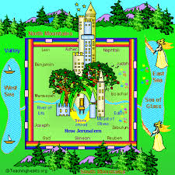
Reuben Made IT!
“And I heard the number of them which were sealed: and there were sealed an hundred and forty and four thousand of all the tribes of the children of Israel. Of the tribe of Juda were sealed twelve thousand. Of the tribe of Reuben were sealed twelve thousand. Of the tribe of Gad were sealed twelve thousand.” Rev. 7:4,5
“And had a wall great and high, and had twelve gates, and at the gates twelve angels, and names written thereon, which are the names of the twelve tribes of the children of Israel:” Rev. 21:12

