Slide 1
Paul’s Twister’s
Hard to be Understood

Slide 2
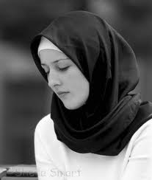
Women, cover your head!
But every woman that prayeth or prophesieth with [her] head uncovered dishonoureth her head: for that is even all one as if she were shaven…. Judge in yourselves: is it comely that a woman pray unto God uncovered?” 1 Corinthians 11:5,13

Slide 3

Women, be silent!
Let your women keep silence in the churches: for it is not permitted unto them to speak; but [they are commanded] to be under obedience, as also saith the law. And if they will learn any thing, let them ask their husbands at home: for it is a shame for women to speak in the church.” 1 Corinthians 14:34,35

Slide 4

What a Weakling!
“Now the Spirit speaketh expressly, that in the latter times some shall depart from the faith, giving heed to seducing spirits, and doctrines of devils; Speaking lies in hypocrisy; having their conscience seared with a hot iron; Forbidding to marry, [and commanding] to abstain from meats, which God hath created to be received with thanksgiving of them which believe and know the truth. For every creature of God is good, and nothing to be refused, if it be received with thanksgiving: For it is sanctified by the word of God and prayer.”
1 Timothy 4:1-5

Slide 5
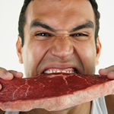
He is a He man!
“Him that is weak in the faith receive ye, but not to doubtful disputations. For one believeth that he may eat all things: another, who is weak, eateth herbs.” Romans 14:1,2

Slide 6

I Like My Sunday’s
“One man esteemeth one day above another: another esteemeth every day alike. Let every man be fully persuaded in his own mind. He that regardeth the day, regardeth it unto the Lord; and he that regardeth not the day, to the Lord he doth not regard it.” Romans 14:5,6
“Let no man therefore judge you in meat, or in drink, or in respect of an holyday, or of the new moon, or of the sabbath days:” Col. 2:16
“Ye observe days, and months, and times, and years.” Gal. 4:10

Slide 7
The Ministration of Death-GONE!
“But if the ministration of death, written and engraven in stones, was glorious, so that the children of Israel could not stedfastly behold the face of Moses for the glory of his countenance; which glory was to be done away: How shall not the ministration of the spirit be rather glorious?” 2 Corinthians 3:7,8

