Slide 1
Against All Odds, pt. 1

Slide 2
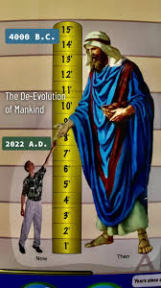
A Few People
“The human race yet retained much of its early vigor. But a few generations had passed since Adam had access to the tree which was to prolong life; and man's existence was still measured by centuries. Had that long-lived people, with their rare powers to plan and execute, devoted themselves to the service of God, they would have made their Creator's name a praise in the earth, and would have answered the purpose for which He gave them life. But they failed to do this. There were many giants, men of great stature and strength, renowned for wisdom, skillful in devising the most cunning and wonderful works; but their guilt in giving loose rein to iniquity was in proportion to their skill and mental ability.” PP, pg. 90

Slide 3

Monster Race!!
Giants in stature, several time the height of people today. Giants in intellect, having retained nearly 100% brain capacity, capable of just about anything and using all their gifts to glorify themselves and reek havoc in the earth, this monster race had arrayed themselves against the Lord God of heaven!! The Lord had come to the end of His exhaustless patience!

Slide 4
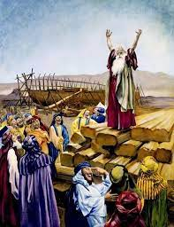
The Singular Preacher
“And the LORD said, My spirit shall not always strive with man, for that he also is flesh: yet his days shall be an hundred and twenty years. There were giants in the earth in those days; and also after that, when the sons of God came in unto the daughters of men, and they bare children to them, the same became mighty men which were of old, men of renown. And GOD saw that the wickedness of man was great in the earth, and that every imagination of the thoughts of his heart was only evil continually.” Genesis 6:3-5

Slide 5
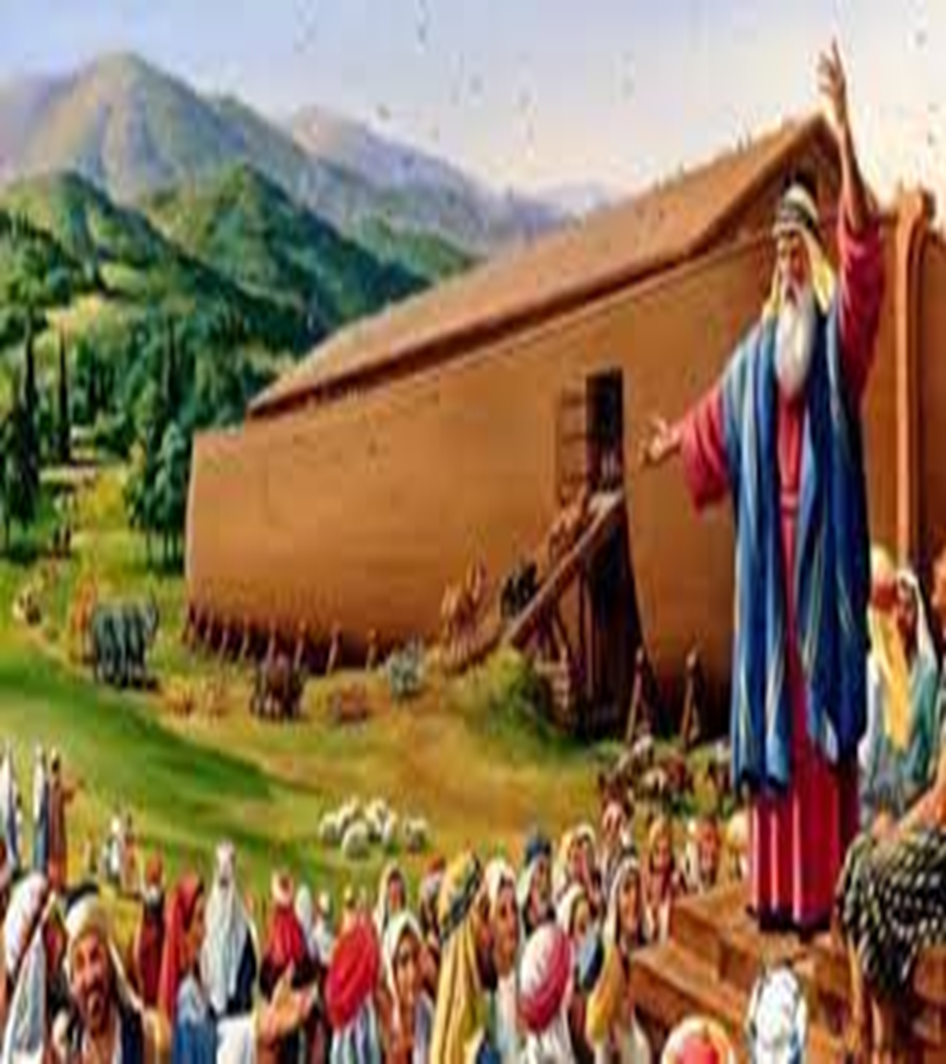
Preacher of Righteousness
“But without faith it is impossible to please him: for he that cometh to God must believe that he is, and that he is a rewarder of them that diligently seek him. By faith Noah, being warned of God of things not seen as yet, moved with fear, prepared an ark to the saving of his house; by the which he condemned the world, and became heir of the righteousness which is by faith.” Hebrews 11:5,6

Slide 6
When Few is Enough!
“Amid the prevailing corruption, Methuselah, Noah, and many others labored to keep alive the knowledge of the true God and to stay the tide of moral evil. A hundred and twenty years before the Flood, the Lord by a holy angel declared to Noah His purpose, and directed him to build an ark. While building the ark he was to preach that God would bring a flood of water upon the earth to destroy the wicked. Those who would believe the message, and would prepare for that event by repentance and reformation, should find pardon and be saved. Enoch had repeated to his children what God had shown him in regard to the Flood, and Methuselah and his sons, who lived to hear the preaching of Noah, assisted in building the ark.” PP, pg. 92

Slide 7
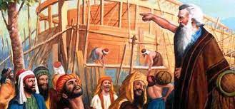
A Few Shook the World!
It has ever been the truth that the voice of right is not held by the majority! If you find yourself with a large class of people then history speaks that it is the wrong side! Noah and the faithful few stood firm against the insanity of their age and proclaimed the grand truths of heaven!

Slide 8
Small Group Against the World
“Had the men of that generation obeyed the divine law, they would have recognized the voice of God in the warning of His servant; but their minds had become so blinded by rejection of light that they really believed Noah's message to be a delusion. It was not multitudes or majorities that were on the side of right. The world was arrayed against God's justice and His laws, and Noah was regarded as a fanatic. Satan, when tempting Eve to disobey God, said to her, “Ye shall not surely die.” Genesis 3:4. Great men, worldly, honored, and wise men, repeated the same. “The threatenings of God,” they said, “are for the purpose of intimidating, and will never be verified. You need not be alarmed. Such an event as the destruction of the world by the God who made it, and the punishment of the beings He has created, will never take place. Be at peace; fear not. Noah is a wild fanatic.” The world made merry at the folly of the deluded old man. Instead of humbling the heart before God, they continued their disobedience and wickedness, the same as though God had not spoken to them through His servant. But Noah stood like a rock amid the tempest. Surrounded by popular contempt and ridicule, he distinguished himself by his holy integrity and unwavering faithfulness.

Slide 9
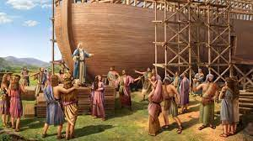
A Magnificent Building
“God was the designer, and Noah the master builder. It was constructed like the hull of a ship, that it might float upon the water, but in some respects it more nearly resembled a house. It was three stories high, with but one door, which was in the side…. The material employed in the construction of the ark was the cypress, or gopher wood, which would be untouched by decay for hundreds of years. The building of this immense structure was a slow and laborious process. On account of the great size of the trees and the nature of the wood, much more labor was required then than now to prepare timber, even with the greater strength which men then possessed. All that man could do was done to render the work perfect, yet the ark could not of itself have withstood the storm which was to come upon the earth. God alone could preserve His servants upon the tempestuous waters.” PP, pg. 92

Slide 10
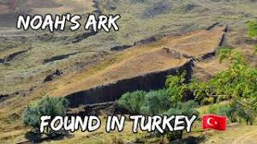
Still in Existence Today
This incredible structure of Noah’s ark has been found and been witnessed to by many people! The Bible tells us that the ark rested in the mountains of Ararat. “And the ark rested in the seventh month, on the seventeenth day of the month, upon the mountains of Ararat.” Genesis 8:4 That is where the ark of Noah has been found!

Slide 11
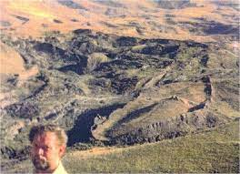
Noah Preached
“But Noah stood like a rock amid the tempest. Surrounded by popular contempt and ridicule, he distinguished himself by his holy integrity and unwavering faithfulness. A power attended his words, for it was the voice of God to man through His servant. Connection with God made him strong in the strength of infinite power, while for one hundred and twenty years his solemn voice fell upon the ears of that generation in regard to events, which, so far as human wisdom could judge, were impossible.” PP, pg. 96

Slide 12
Yahweh Sabaoth to the Rescue
The God of the armies of the universe had taken the field, nerved His servant to sound the warning, build the ark to the saving of his house, and had stood with his feeble, erring servant through it all! The Same One who had stood with Joshua at the Battle of Jericho, the Same One who had stood with David in the Valley of Elah, the Same One who had stood with Luther at the Diet of Worms; this Same One, Yahweh Sabaoth, the God of the armies of the universe strengthened His feeble servant to withstand the teeming, wicked multitudes!!

Slide 13
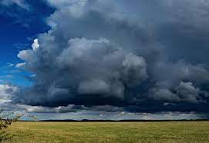
Rain is Coming
“And after these things I saw another angel come down from heaven, having great power; and the earth was lightened with his glory. And he cried mightily with a strong voice, saying, Babylon the great is fallen, is fallen, and is become the habitation of devils, and the hold of every foul spirit, and a cage of every unclean and hateful bird. For all nations have drunk of the wine of the wrath of her fornication, and the kings of the earth have committed fornication with her, and the merchants of the earth are waxed rich through the abundance of her delicacies. And I heard another voice from heaven, saying, Come out of her, my people, that ye be not partakers of her sins, and that ye receive not of her plagues. For her sins have reached unto heaven, and God hath remembered her iniquities.” Revelation 18:1-5

Slide 14
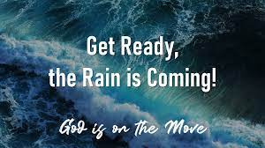
Help is on the Way!!
“I saw the latter rain is coming suddenly, as the midnight cry and with ten times the power.” Ellen White letter, Spalding-Megan Collection, pages 3,4
“In the parable of Matthew 25 the time of waiting and slumber is followed by the coming of the bridegroom. This was in accordance with the arguments just presented, both from prophecy and from the types. They carried strong conviction of their truthfulness; and the "midnight cry" was heralded by thousands of believers.
Like a tidal wave the movement swept over the land. From city to city, from village to village, and into remote country places it went, until the waiting people of God were fully aroused.” GC, pg. 400

