Slide 1
The Book of Romans, pt. 6
Romans 3:21-31

Slide 2
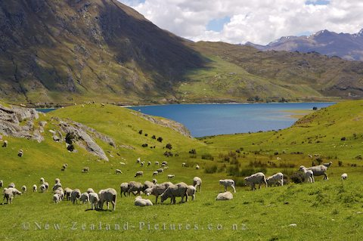
Summary of Romans 3:1-20
1. The Jews had great advantages over other people.
2. In spite of their failures, God was never bound by them. His purposes were accomplished by those who were faithful.
3.Regardless of man’s failings, God has been just and kind.
4. Mankind all stands doomed before Heaven.

Slide 3

Romans 3:21,22
“But now the righteousness of God without the law is manifested, being witnessed by the law and the prophets; Even the righteousness of God which is by faith of Jesus Christ unto all and upon all them that believe: for there is no difference:” Romans 3:21,22

Slide 4
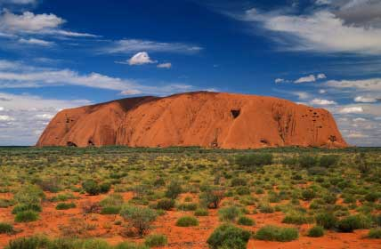
Righteousness
Righteousness is found in two places; the 10 commandments and in the person of Jesus Christ. Christ was and is the embodiment of the law. The only way whereby a person can attain righteousness is through faith in Him.

Slide 5

Romans 3:23,24
“For all have sinned, and come short of the glory of God; Being justified freely by his grace through the redemption that is in Christ Jesus:” Romans 3:23,24

Slide 6

Mankind’s Failure
Mankind has all failed. All have fallen short of God’s perfect righteousness. In man’s hopeless condition, Jesus Christ came to save man from eternal ruin. Mankind, individually can and must accept Christ for He is man’s only hope for righteousness.

Slide 7
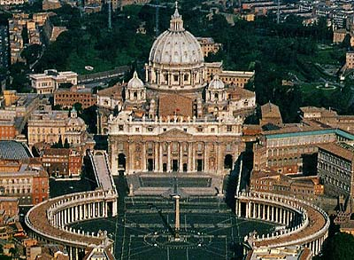
Congratulations!
If any man can find good in himself, then Christ need not have died. If any man believes he is inherently good, and that his righteousness is sufficient, then he has attained to the seat of the pope, who has attained godhood by himself!

Slide 8

Christ the Mercy Seat
“Whom God hath set forth to be a propitiation through faith in his blood, to declare his righteousness for the remission of sins that are past, through the forbearance of God; To declare, I say, at this time his righteousness: that he might be just, and the justifier of him which believeth in Jesus.” Romans 3:25,26

Slide 9
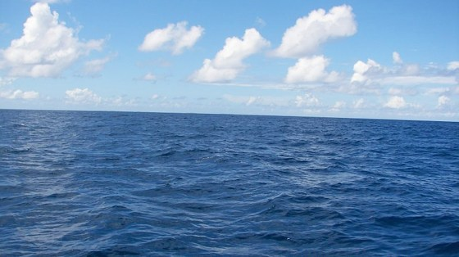
No Fishing Allowed
God forgives, wipes away the past for anyone who has faith in Jesus. “He will turn again, he will have compassion upon us; he will subdue our iniquities; and thou wilt cast all their sins into the depths of the sea.” Micah 7:19

Slide 10
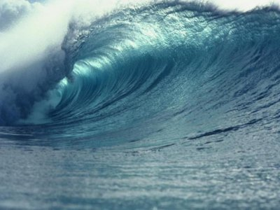
The Law Remains
Justice is satisfied; the claims of God’s holy law have been met by the perfect life of Christ. The law of God, which is His character, still remains intact. Man is forgiven.

Slide 11
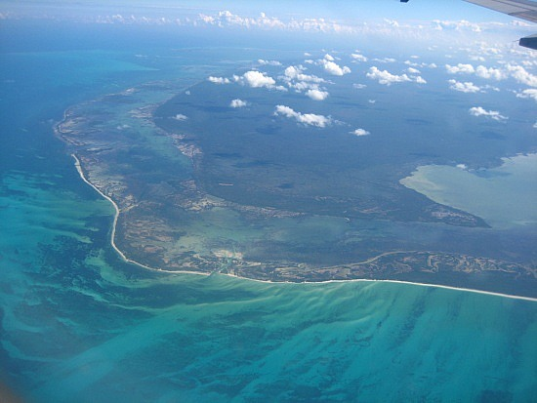
Shall we Boast?
“Where is boasting then? It is excluded. By what law? of works? Nay: but by the law of faith.” Romans 3:27
In what will we boast? On what will we depend? On our efforts to keep a law that we have all shamelessly broken? Can we boast because we are better than others? Aren’t we better than the heathen?

Slide 12
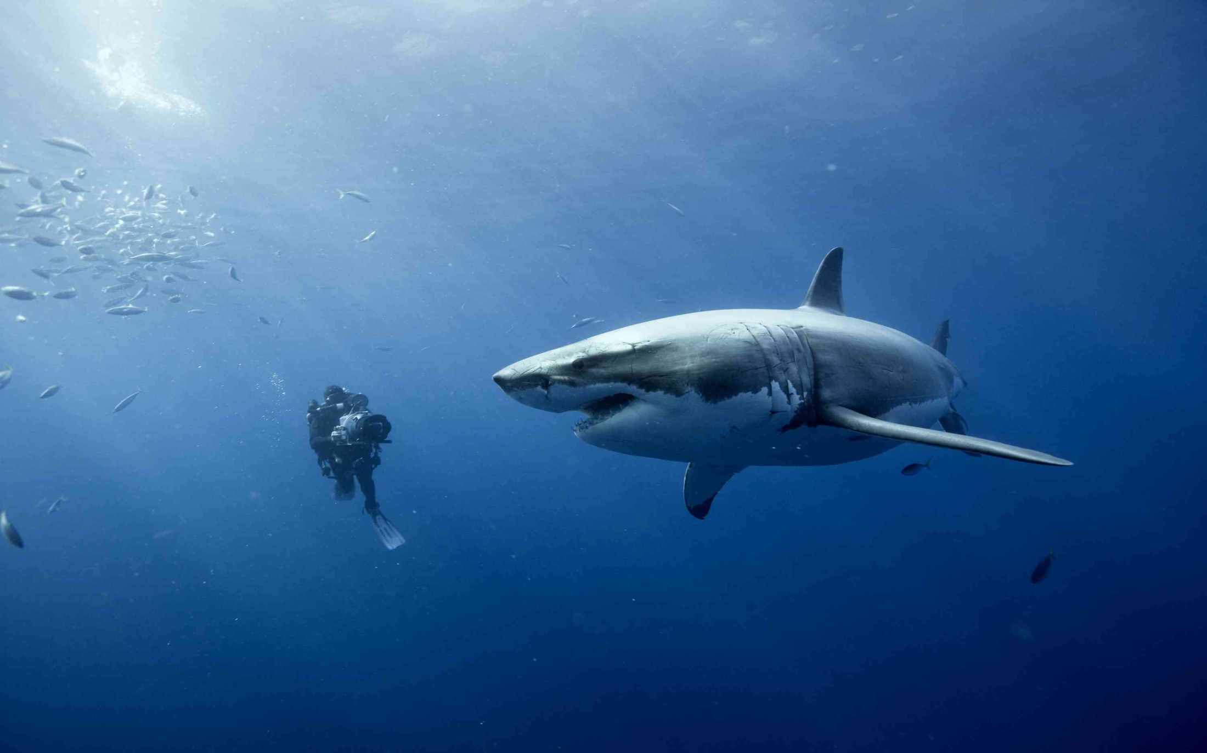
God Forbid!
“But God forbid that I should glory, save in the cross of our Lord Jesus Christ, by whom the world is crucified unto me, and I unto the world.” Galatians 6:14

Slide 13
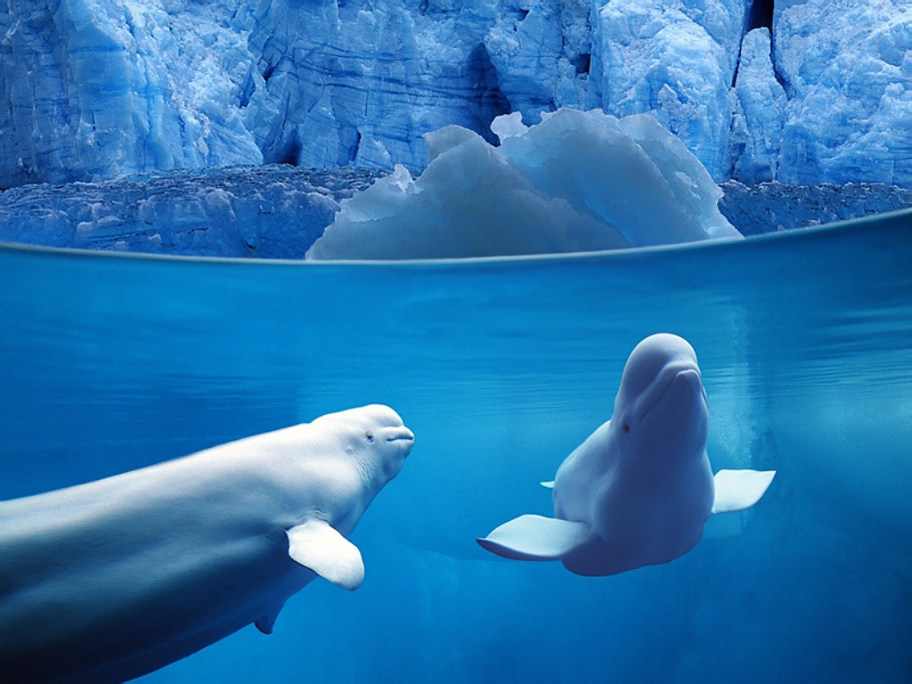
In Law? Or in Grace?
“Therefore we conclude that a man is justified by faith without the deeds of the law.” Romans 3:28 Paul emphatically declares that acceptance before God comes solely as we accept Christ’s gift by faith!

Slide 14
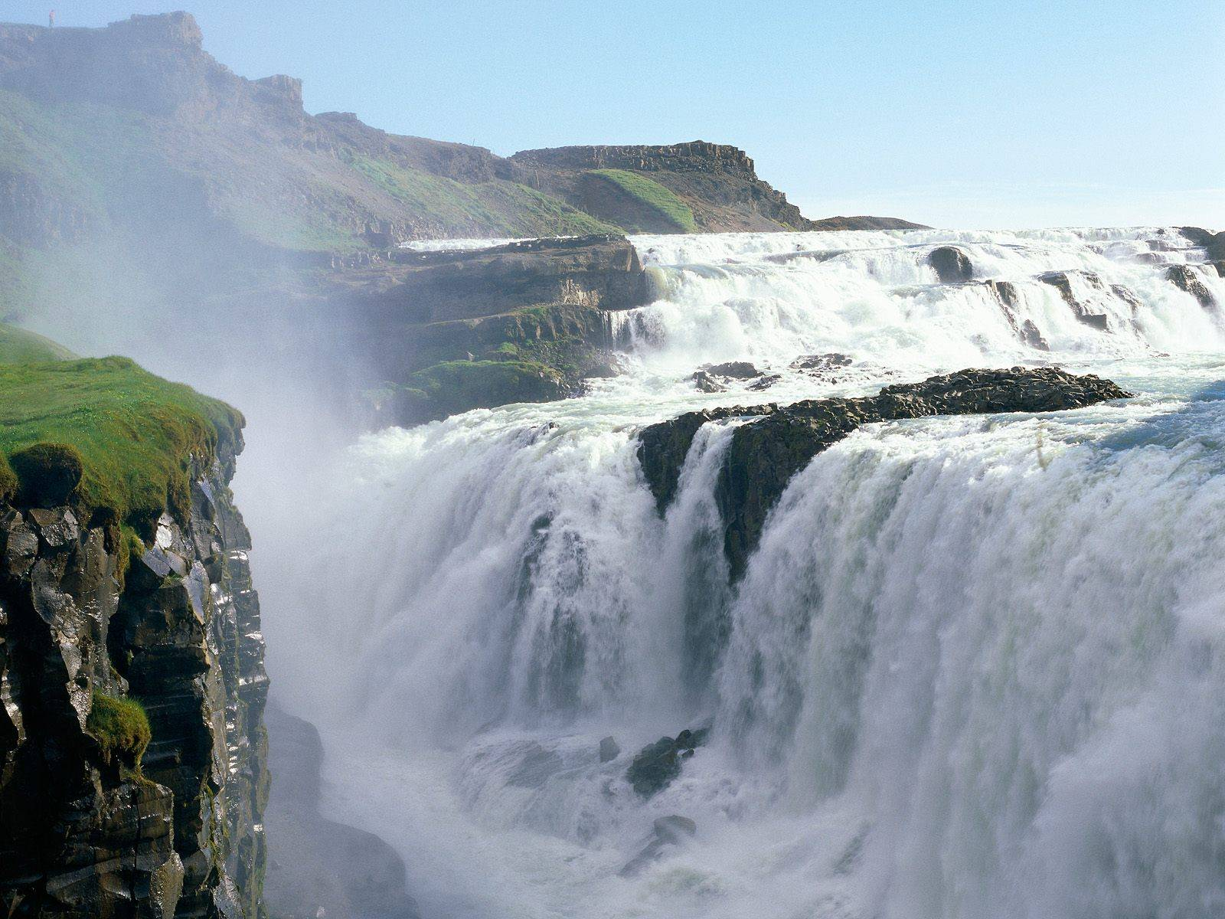
It is Free
“For by grace are ye saved through faith; and that not of yourselves: it is the gift of God: Not of works, lest any man should boast.” Ephesians 2:8,9

Slide 15
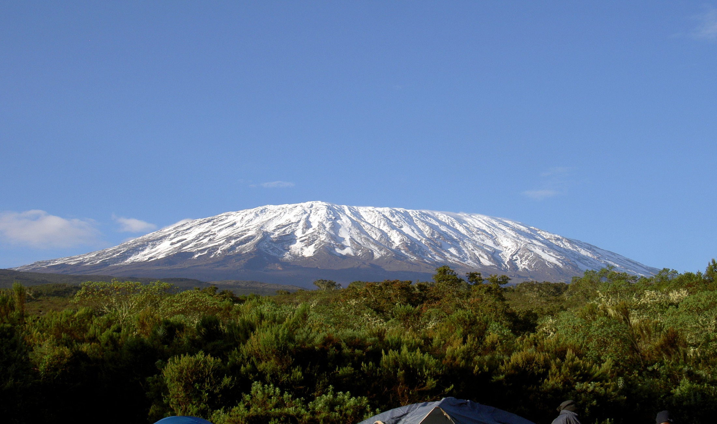
Without any Merit on our Part
God treats everyone the same. All have fallen. Christ died for all. No one can ever earn God’s forgiveness; it is solely a free gift that we must receive and accept for ourselves. “Ho, every one that thirsteth, come ye to the waters, and he that hath no money; come ye, buy, and eat; yea, come, buy wine and milk without money and without price.” Isaiah 55:1

Slide 16
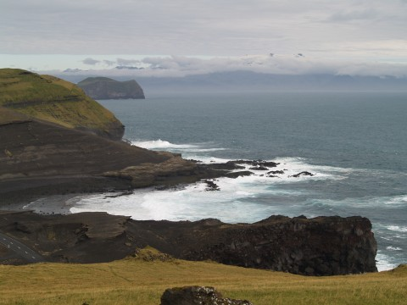
All the Same
“Is he the God of the Jews only? is he not also of the Gentiles? Yes, of the Gentiles also: Seeing it is one God, which shall justify the circumcision by faith, and uncircumcision through faith.” Romans 3:29,30

Slide 17
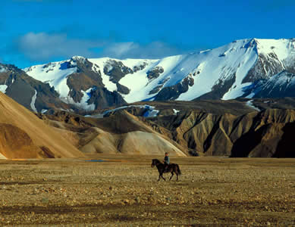
No difference
There are no distinctions to be made between the Jew and the Gentile. God is no respecter of persons. He accepts everyone the same and treats all the same. Before Abraham became the father of the Jewish nation, he was a Babylonian from Ur of the Chaldees. Those who accept His gift, He forgives. Those who reject His gift, He tries again to reach.

Slide 18
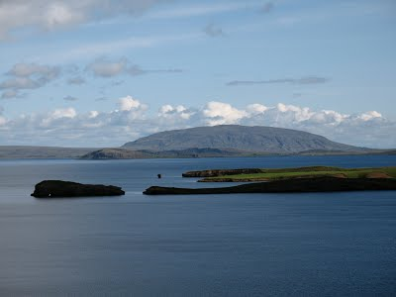
What Happens to the Law of God?
“Do we then make void the law through faith? God forbid: yea, we establish the law.” Romans 3:31
“Think not that I am come to destroy the law, or the prophets: I am not come to destroy, but to fulfill. For verily I say unto you, Till heaven and earth pass, one jot or one tittle shall in no wise pass from the law, till all be fulfilled.” Matthew 5:17,18

Slide 19
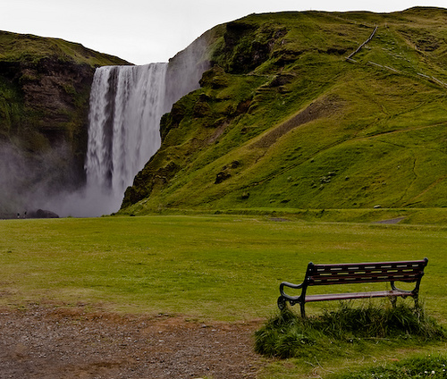
Did it Disappear? Is it Void?
Does the free gift of Christ’s righteousness make void the 10 commandments? Does faith lead one to disobey the 10 commandments? Does faith allow for license to do as one pleases? Paul emphatically says ‘NEVER’.

Slide 20

Saving Faith
The same faith that grasps God’s promise for forgiveness also grasps God’s promise to dwell in our lives by faith to enable us to walk in God’s commandments. The promise of God that forgives is the same promise that lifts above sin and can keep God’s commandments.
“Whereby are given unto us exceeding great and precious promises: that by these ye might be partakers of the divine nature, having escaped the corruption that is in the world through lust.” 2Peter 1:4

Slide 21
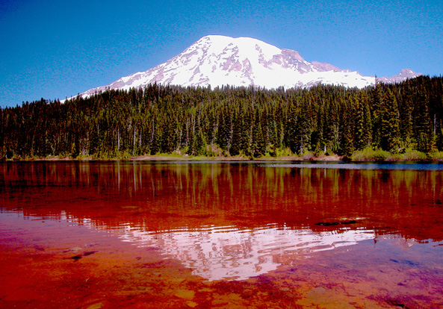
The Law Remains Eternal, Unchangeable
The reason Paul says so little here about the law is because the point is so obvious; he doesn’t see the need to say a lot.
“By this we know that we love the children of God, when we love God, and keep his commandments. For this is the love of God, that we keep his commandments: and his commandments are not grievous.” 1John 5:2,3

