Slide 1
What is Up Ahead?

Slide 2
Even in Free America!
“The dignitaries of church and state will unite to bribe, persuade, or compel all classes to honor the Sunday. The lack of divine authority will be supplied by oppressive enactments. Political corruption is destroying love of justice and regard for truth; and even in free America, rulers and legislators, in order to secure public favor, will yield to the popular demand for a law enforcing Sunday observance. Liberty of conscience, which has cost so great a sacrifice, will no longer be respected. In the soon-coming conflict we shall see exemplified the prophet's words: “The dragon was wroth with the woman, and went to make war with the remnant of her seed, which keep the commandments of God, and have the testimony of Jesus Christ.” Revelation 12:17.” GC, pg. 592

Slide 3
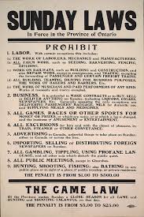
A Sunday Law?
There will be Sunday Laws set up in the United States. It will be mandatory for everyone to attend church on that day. What will happen at this time? How will Sunday keepers respond? How will Sabbath keepers respond? What will be going on in heaven at that time? These are a few of the questions that we will answer.

