Slide 1
Common Good, Common Goal, Common Destiny!

Slide 2
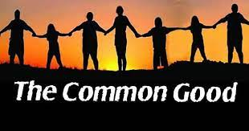
It Sounds So Good
Do things for the common good! It sounds like that should go next to hot dogs, apple pie, and Chevrolet. In most venues, it is a good thing. HOWEVER, in a religious setting, it is DEADLY!! Today, the common good has a common goal, and a common destiny, and the last two are DEADLY!!

Slide 3
Biden’s Common Good!
On Thursday, February 3, 2022, at the National Prayer Breakfast, President Joe Biden used his speech to make an appeal for unity. Biden acknowledged the division that has paralyzed and polarized members of the US Congress. As a result, the President’s speech to opposing political parties and to the general public was a rallying cry to unify around the “common good,” the Catholic social doctrine that is the basis of Pope Francis’s solutions for our world. Listen to Biden, “The issue for us is unity. How do we unite us again? Unity is illusive but it’s really actually necessary. Unity doesn’t mean that we have to agree on everything, but unity is where enough of us believe in a core of basic things, the common good.”

Slide 4
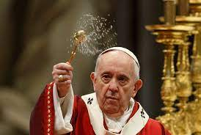
Francis Agrees!
“Common good or to integral and sustainable human development.” (Laudato Si’ #18).
“The climate is a common good, belonging to all and meant for all.” (Laudato Si’ #23).
“An integral ecology is inseparable from the notion of the common good.” (Laudato Si’ #156).
“Love for society and commitment to the common good are outstanding expressions of a charity…” (Laudato Si’ #231).

Slide 5
Biden Calls and Adventists Agree
And now, at the 2022 National Prayer Breakfast, President Joe Biden is calling for the nation to unite for the “common good.” This is a clarion call for the Washington, DC political parties. It’s also a battle cry for all churches and people across the United States to unite together!
On December 20, 2021, Pastor Andres Ploompuu, the President of the Adventist Church in Estonia, met with the President of the Republic of Estonia, Alar Karis, along with other “members” of the Estonian Council of Churches, which includes Lutherans, Methodists, Roman Catholics, Baptists, Orthodox, Pentecostals and Seventh-day Adventists. The Adventist President, Andres Ploompuu, offered the following observations concerning the meeting between the churches and the head of state:
“It was nice to hear all of the heads of different churches proclaim that we have good relationships while we all have our own mission. This kind of Council of Churches which we have in Estonia is not seen in many other places in the world,” added Ploompuu. “It was a day of building bridges. The president was exceedingly friendly and it was obvious that he really was interested in hearing about the role of churches in our society.”

Slide 6
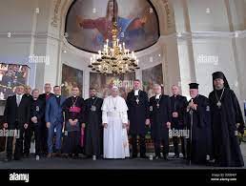
Churches Together!
“And the woman was arrayed in purple and scarlet colour, and decked with gold and precious stones and pearls, having a golden cup in her hand full of abominations and filthiness of her fornication: And upon her forehead was a name written, MYSTERY, BABYLON THE GREAT, THE MOTHER OF HARLOTS AND ABOMINATIONS OF THE EARTH.” Revelation 17:4,5

Slide 7
How long will this be condoned?
Here is the big problem. This is the same Estonian Council of Churches that is working to build bridges with the Pope of Rome.
The member churches met with Pope Francis and expressed “gratitude on behalf of the Council of Estonian Churches.” They specifically reported that the Pope was “greeted by the leaders” of the “member churches.” During their meeting with Pope Francis, Roman Catholic Archbishop Andres Põder, President of the Estonian Council of Churches, gave the following remarks:
“It is a great joy, Holy Father, that meeting with you builds this living bridge between the past and the future, earthly and heavenly, and helps us to experience the unifying love and presence of Christ.” [3] https://ted.adventist.org/news/adventists-among-church-leaders-meeting-with-the-president-of-estonia/
[4] http://www.ekn.ee/uudis.php?id=373

Slide 8
Vomit Time!!
From October 12-14, 2021, Ganoune Diop met with more than 30 religious leaders of various faiths during the Conference of the Secretaries of the Christian World Communion to discuss “ecumenical relations.” The meeting was chaired by the Quaker Gretchen Castle, while Ganoune Diop served as the event’s acting secretary. Representing Pope Francis were Bishop Brian Farrell and Reverend Andrzej Choromanski from the Pontifical Council for Promoting Christian Unity. [1]
The Christian World Communion, made up of Adventists, Catholics, Pentecostals, Baptists, Lutherans, Methodists and other Evangelicals, described its 2021 ecumenical forum in the following words:
“This informal ecumenical forum, dating back to 1957, sees itself as ‘communions of churches belonging to the same tradition and held together by this common heritage, conscious of living in the same universal fellowship and giving to this consciousness at least some structured visible expression.’ ” [2]

Slide 9
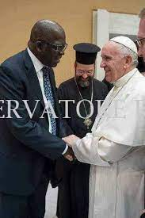
Throughout Adventism
From the highest echelons of the General Conference, to the Union conferences, and onto the local churches, ecumenism and the common good is the order of the day among Seventh-day Adventists. Adventism is united to Rome, Babylon the Great, and all of her harlot daughters!!
Friend, what say you??

Slide 10
Common Goal!
“The wide diversity of belief in the Protestant churches is regarded by many as decisive proof that no effort to secure a forced uniformity can ever be made. But there has been for years, in churches of the Protestant faith, a strong and growing sentiment in favor of a union based upon common points of doctrine. To secure such a union, the discussion of subjects upon which all were not agreed—however important they might be from a Bible standpoint—must necessarily be waived…. When the leading churches of the United States, uniting upon such points of doctrine as are held by them in common, shall influence the state to enforce their decrees and to sustain their institutions, then Protestant America will have formed an image of the Roman hierarchy, and the infliction of civil penalties upon dissenters will inevitably result.” GC. Pgs. 444,445

Slide 11
Sunday- the Mark of the Beast!
“Prove to me from the Bible alone that I am bound to keep Sunday holy. There is no such law in the Bible. It is a law of the holy Catholic Church alone. The Bible says ‘Remember the Sabbath day to keep it holy.’ The Catholic Church says, No. By my divine power I abolish the Sabbath day and command you to keep holy the first day of the week. And lo! The entire civilized world bows down in reverent obedience to the command of the Holy Catholic Church. — Thomas Enright, CSSR, President, Redemptorist College (Roman Catholic), Kansas City, MO., February 18, 1884.

Slide 12
Creator/Sanctifier
“The duty to worship God is based upon the fact that He is the Creator and that to Him all other beings owe their existence. And wherever, in the Bible, His claim to reverence and worship, above the gods of the heathen, is presented, there is cited the evidence of His creative power. “All the gods of the nations are idols: but the Lord made the heavens.” Psalm 96:5. “To whom then will ye liken Me, or shall I be equal? saith the Holy One. Lift up your eyes on high, and behold who hath created these things.” “Thus saith the Lord that created the heavens; God Himself that formed the earth and made it: ... I am the Lord; and there is none else.” Isaiah 40:25, 26; 45:18. Says the psalmist: “Know ye that the Lord He is God: it is He that hath made us, and not we ourselves.” “O come, let us worship and bow down: let us kneel before the Lord our Maker.” Psalm 100:3; 95:6. And the holy beings who worship God in heaven state, as the reason why their homage is due to Him: “Thou art worthy, O Lord, to receive glory and honor and power: for Thou hast created all things.” Revelation 4:11.” GC, pg. 436

Slide 13
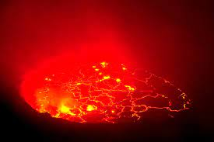
Common Destiny
“And the first went, and poured out his vial upon the earth; and there fell a noisome and grievous sore upon the men which had the mark of the beast, and upon them which worshipped his image.” Revelation 16:2
The first plague will fall on those who accept the mark/Sunday of the papacy, and who honor the Sunday tradition of apostate Protestantism! What is Adventism doing uniting with these powers?

Slide 14
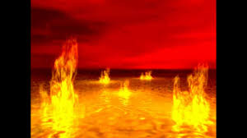
Lake of Fire
“And the beast was taken, and with him the false prophet that wrought miracles before him, with which he deceived them that had received the mark of the beast, and them that worshipped his image. These both were cast alive into a lake of fire burning with brimstone.” Revelation 19:20

Slide 15
Papacy, A. Protestantism, and Apostate Adventism
“The Lord has a controversy with his professed people in these last days. In this controversy men in responsible positions will take a course directly opposite to that pursued by Nehemiah. They will not only ignore and despise the Sabbath themselves, but they will try to keep it from others by burying it beneath the rubbish of custom and tradition. In churches and in large gatherings in the open air, ministers will urge upon the people the necessity of keeping the first day of the week. There are calamities on sea and land: and these calamities will increase, one disaster following close upon another; and the little band of conscientious Sabbath-keepers will be pointed out as the ones who are bringing the wrath of God upon the world by their disregard of Sunday.” RH, March 18,1884

