Slide 1
COP-30 Jesuits, Adventists, and Ecology

Slide 2

COP 30
The 2025 United Nations Climate Change Conference, also known as the Conference of the Parties to the UNFCCC, is the 30th session of the United Nations Climate Change Conference. It is being held at the Hangar Convention Centre in Belém, Brazil, from 10 to 21 November 2025… To put it simply, the COP is where the world comes together to agree on the actions to address the climate crisis, such as limiting the global temperature rise to 1.5 degrees Celsius, helping vulnerable communities adapt to the effects of climate change, and achieving net-zero emissions by 2050.

Slide 3

Picking up where Francis Left it
“JESC is part of Jesuits for Climate Justice, a worldwide initiative uniting Jesuit institutions and partners in advocacy for a just and sustainable future. Together with EcoJesuit and our global network, we are working in the lead-up to COP30, the UN climate summit taking place this November in Belém, Brazil. COP30 will be a decisive moment for international leaders to move from words to action. The climate crisis is not only an environmental challenge, it is a crucial matter of justice, especially for vulnerable communities and for future generations.” Jesuit European Social Centre

Slide 4
Who are They??
“Throughout Christendom, Protestantism was menaced by formidable foes. The first triumphs of the Reformation past, Rome summoned new forces, hoping to accomplish its destruction. At this time the order of the Jesuits was created, the most cruel, unscrupulous, and powerful of all the champions of popery. Cut off from earthly ties and human interests, dead to the claims of natural affection, reason and conscience wholly silenced, they knew no rule, no tie, but that of their order, and no duty but to extend its power. (See Appendix.) The gospel of Christ had enabled its adherents to meet danger and endure suffering, undismayed by cold, hunger, toil, and poverty, to uphold the banner of truth in face of the rack, the dungeon, and the stake. To combat these forces, Jesuitism inspired its followers with a fanaticism that enabled them to endure like dangers, and to oppose to the power of truth all the weapons of deception. There was no crime too great for them to commit, no deception too base for them to practice, no disguise too difficult for them to assume. Vowed to perpetual poverty and humility, it was their studied aim to secure wealth and power, to be devoted to the overthrow of Protestantism, and the re-establishment of the papal supremacy.” GC, pg. 234

Slide 5
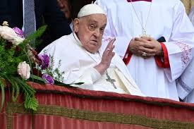
Saving the Soil, not Souls
Climate change was part of the agenda of previous Pope Francis. He spoke about this at length in his encyclical entitled Laudato Si. In fact, this encyclical makes it very plain what the ultimate goal of the climate change agenda really is!

Slide 6
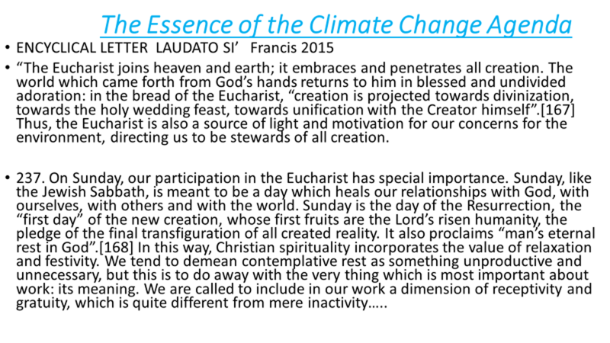

Slide 7
Climate Agenda and Sunday!!!
“In accidents and calamities by sea and by land, in great conflagrations, in fierce tornadoes and terrific hailstorms, in tempests, floods, cyclones, tidal waves, and earthquakes, in every place and in a thousand forms, Satan is exercising his power. He sweeps away the ripening harvest, and famine and distress follow. He imparts to the air a deadly taint, and thousands perish by the pestilence. These visitations are to become more and more frequent and disastrous. Destruction will be upon both man and beast. “The earth mourneth and fadeth away,” “the haughty people ... do languish. The earth also is defiled under the inhabitants thereof; because they have transgressed the laws, changed the ordinance, broken the everlasting covenant.” Isaiah 24:4, 5. And then the great deceiver will persuade men that those who serve God are causing these evils. The class that have provoked the displeasure of Heaven will charge all their troubles upon those whose obedience to God's commandments is a perpetual reproof to transgressors. It will be declared that men are offending God by the violation of the Sunday sabbath; that this sin has brought calamities which will not cease until Sunday observance shall be strictly enforced; and that those who present the claims of the fourth commandment, thus destroying reverence for Sunday, are troublers of the people, preventing their restoration to divine favor and temporal prosperity. Thus the accusation urged of old against the servant of God will be repeated and upon grounds equally well established: “And it came to pass, when Ahab saw Elijah, that Ahab said unto him, Art thou he that troubleth Israel? And he answered, I have not troubled Israel; but thou, and thy father's house, in that ye have forsaken the commandments of the Lord, and thou hast followed Baalim.” 1 Kings 18:17, 18. As the wrath of the people shall be excited by false charges, they will pursue a course toward God's ambassadors very similar to that which apostate Israel pursued toward Elijah.” GC, pgs. 589,590

Slide 8

Right in the Heart of It All!!!
Clearly, the Vatican, the UN, and the Jesuits are firmly behind and in control of this agenda! Seeing this only makes the following information that much more shocking!
““As the world prepares to gather in Belém, Brazil, for COP30, ADRA calls upon our global church family to join us in prayer, reflection, and action for creation, for justice, and for those most affected by the degeneration of the creation that has been gifted to us as stewards.” November 5, 2025, ADRA

Slide 9
Wow: Is this our Mission??
“We call on governments and institutions to provide direct, accessible, and fair climate finance—resources that reach local actors, faith-based organizations, and NGOs working hand in hand with communities. Faith in action means investing where it matters most: where lives are rebuilt and futures are shaped. Food and nutrition security is a moral and spiritual concern. Extreme weather and environmental degradation are threatening the right to adequate food and the livelihoods of millions. ADRA continues to support sustainable agriculture, regenerative land use, and climate-resilient livelihoods that preserve both people and the planet. As followers of Christ, we are called to nurture the earth and ensure that every person has enough to eat. Faith in Action: Rooted in Justice, Compassion, and Love. Our work is guided by the conviction that climate action is not only about emissions and finance—it is about people, dignity, and the shared future of our world.” ADRA, November 5, 2025

Slide 10
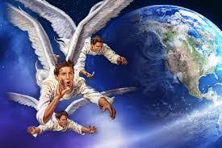
This is Our Work!!!
“This is our work. The light that we have upon the third angel’s message is the true light. The mark of the beast is exactly what it has been proclaimed to be. All in regard to this matter is not yet understood, and will not be understood until the unrolling of the scroll, but a most solemn work is to be accomplished in our world. The Lord’s command to His servants is “Cry aloud, spare not, lift up thy voice like a trumpet, and shew my people their transgression, and the house of Jacob their sins.” There is to be no change in the features of our work. It is to stand as clear and distinct as prophecy has made it. We are to enter into no confederacy with the world, supposing that by so doing we could accomplish more. If any stand in the way, to hinder the advancement of the work in the lines that God has appointed, they will displease God. No line of our faith that has made us what we are is to be weakened. We have the old landmarks of truth, experience, and duty; we are to stand firmly in defense of our principles, in full view of the world.”
Christ Triumphant - Page 350

Slide 11
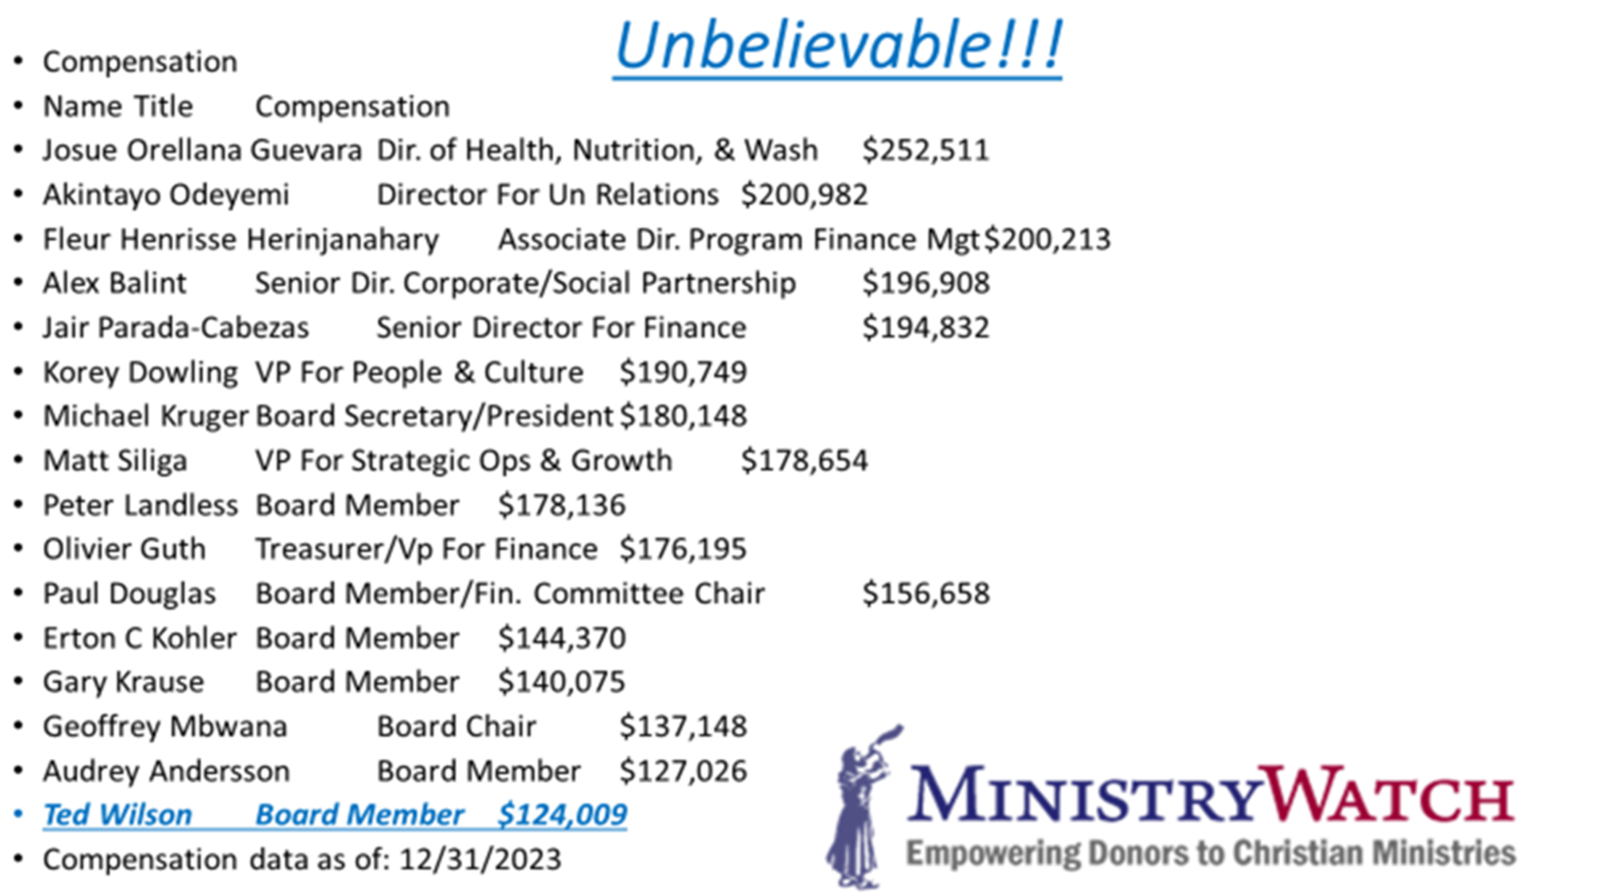
Why????

Slide 12
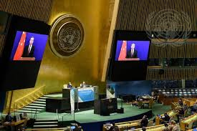
ADRA, UN, and the Vatican in Unison!!
In order to maintain the money flow coming into ADRA coffers from the UN, ADRA is going along with the Sunday agenda of these enemies of God’s people!! How easy it will be for Adventism to continue this partnership at the time of the national Sunday Law!! Shocking!!

Slide 13
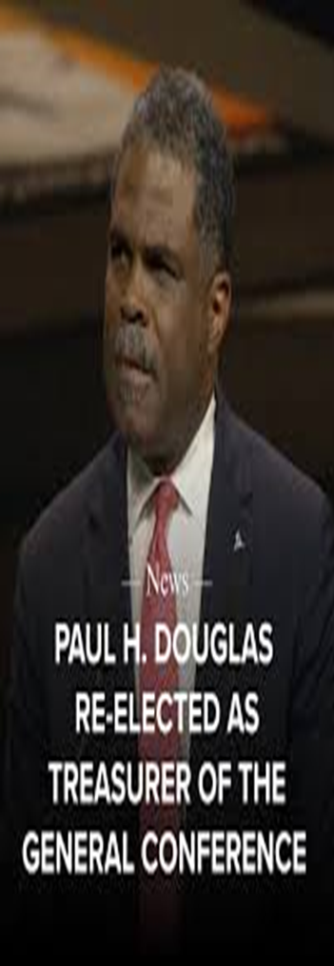
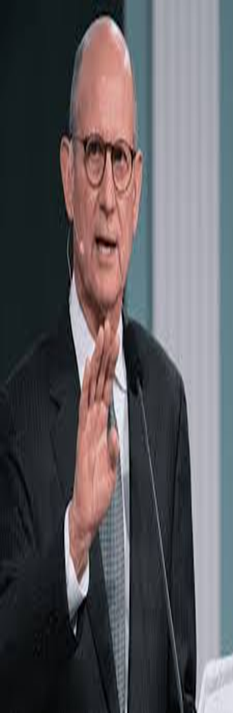

Easy Transition!!
“The Lord has a controversy with his professed people in these last days. In this controversy men in responsible positions will take a course directly opposite to that pursued by Nehemiah. They will not only ignore and despise the Sabbath themselves, but they will try to keep it from others by burying it beneath the rubbish of custom and tradition. In churches and in large gatherings in the open air, ministers will urge upon the people the necessity of keeping the first day of the week. There are calamities on sea and land: and these calamities will increase, one disaster following close upon another; and the little band of conscientious Sabbath-keepers will be pointed out as the ones who are bringing the wrath of God upon the world by their disregard of Sunday.” RH, March 18,1884

Slide 14
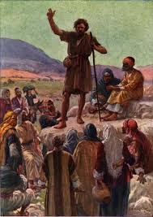
Proclaim the Truth!!
“He looked upon the King in His beauty, and self was forgotten. He beheld the majesty of holiness, and felt himself to be inefficient and unworthy. He was ready to go forth as Heaven’s messenger, unawed by the human, because he had looked upon the Divine. He could stand erect and fearless in the presence of earthly monarchs, because he had bowed low before the King of kings.” DA, pg. 103

