Slide 1
Walter Rea: Plagiarist,pt.2!

Slide 2
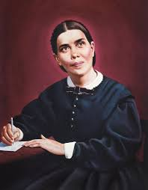
Numbers and Rea and Dart!!
Both Ronald Numbers and Walter Rea came out with books to try and destroy the writings of Ellen White. Their lies were promoted by LA Times writer John Dart in October of 1981 and eventually spread all over the world! If God’s people would not spread the books of Ellen White like the leaves of autumn, then the Lord would allow unkind things to be said about His penman in order to agitate drowsy minds!

Slide 3
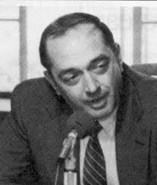
Catholic Attorney, Vincent Ramik
Vincent Ramik, a Catholic attorney, researched very thoroughly the writings of Ellen White and he found that Ellen white was well within the law and had done absolutely nothing wrong in her writing. In fact, Ramik declared that her writings had been a great blessing to him.

Slide 4
Ramik on Ellen White
“Mrs. White's sternest critics offer the best evidence available supportive of noninfringement. As an example, the "88 different authors and 400 references" refer to The Great Controversy, and it is suggested strongly that such utilization by Mrs. White (if true) of this vast reference material evidences skill and use of common materials and common sources of knowledge, and not merely "colorable alterations and variations only to disguise the use thereof."[40] It is inconceivable that even if Mrs. White used 88 different authors and 400 references in The Great Controversy, she could have taken the value of any one of the original works to the degree that it be "sensibly diminished, or the labors of the original author (be) substantially to an injurious extent, appropriated" by her usages.
What in The Great Controversy or any other book of Ellen White's, when "taken as a whole, is substantially a copy" of the works of earlier authors? Here again, when a comparison is equitably made on a one-on-one, book-versus-book basis, and such is the only comparison that can be properly made in law, nowhere have we found the books of Ellen G. White to be virtually the "same plan and character throughout" as those of her predecessors.[41]

Slide 5
PERCENTAGES OF DOCUMENTED LITERARY PARALLELS BY BOOK TITLE
Title Parallel Lines Percentage of Book
Acts of the Apostles, The 426 3.05
Adventist Home, The 55 0.41
Child Guidance 61 0.50
Christ’s Object Lessons 70 0.60
Christian Service 60 0.80
Counsels on Diet and Foods 15 0.11
Counsels on Health 83 0.48
Counsels on Sabbath School Work 13 0.32
Counsels on Stewardship 58 0.80
Counsels to Parents, Teachers and Students 64 0.49
Counsels to Writers and Editors 14 0.34
Early Writings 10 0.14
Education 71 0.88
Evangelism 50 0.30
Faith and Works 73 2.97
Fundamentals of Christian Education 159 0.91
Gospel Workers 99 0.81
Great Controversy, The (credited citations) 3241 15.11
Great Controversy, The (additional uncredited parallels) 1084 5.05

Slide 6
Conclusion
Nor have we found or have critics made reference to any intention of Ellen White to "supersede the other(s) in the market with the same class of readers and purchasers by introducing no considerable new matter or little or nothing new except colorable deviations."[42]
The sheer "compilation" of the works of Ellen G. White necessarily reflects her labor and skill. So long as she had not, and the evidence clearly establishes that she did not, draw from any prior works "to a substantial degree," she remains well within the legal bounds of "fair use." Moreover, so long as the materials were selected from a variety of sources, and were "arranged and combined with certain chosen passages of the text of the original work, and in a manner showing the exercise of discretion, skill, learning, experience, and judgment," the use was "fair."[43] Ramik

Slide 7
Amazing!
“Thus, all of the books listed earlier herein which were published and uncopyrighted which may have been used as sources by Mrs. White could not give rise then or now to any proper or responsible accusation of "copying," "piracy," or "plagiarism." These books included, for example, "The Life of Christ" by Hanna, "The Great Teacher" by Harris, "Sketches from the Life of Paul" by Conybeare and Howson, and the remainder of the uncopyrighted works earlier listed herein under the caption "LIBRARY OF CONGRESS.“ A "book -- becomes (when not protected by copyright) public property by the act of publication."[38] Accordingly, all of the earlier noted published, uncopyrighted works were from the time of publication dedications or gifts to the world at large for anyone or all to use legally, freely and unhesitatingly as they wished to any degree and in any manner, with or without acknowledgements. Assuming, however, that all of these earlier works noted herein were copyrighted, could a successful suit have been brought against the early Seventh-day Adventist writer? The answer is again in the negative. The issue of copyright infringement, quite simply, is "whether the book of the defendant, taken as a whole, is substantially a copy of the plaintiff."[39] No critics have in any of the comparisons set forth earlier herein alleged nor could they have equitably alleged than any book of Ellen G. White's, taken as a whole, is legally substantially a copy of her predecessors.” Vincent Ramik, DILLER, RAMIK & WIGHT, LTD.
PATENT & TRADEMARK CAUSES
WESTBRIDGE SUITE 675
2550 M STREET, N. W.
WASHINGTON, D. C. 20037
DONALD M. WIGHT

Slide 8
Ellen White and a Catholic Lawyer
Review: What did you find in her messages, Mr. Ramik? How did they affect you?
Ramik: Mrs. White moved me! In all candor, she moved me. I am a Roman Catholic; but, Catholic, Protestant, whatever—she moved me. And I think her writings should move anyone, unless he is permanently biased and is unswayable.
Review: Would you explain what you mean by this?
Ramik: Well, a person can walk this earth doing good deeds and saying to himself (and maybe to others): “I’m a nice person.” And after a time you really come to believe that you are. But when was the last time that you really looked inside yourself and found out what you were really like? Now, there are a lot of things that Mrs. White has put down on paper that will, if read seriously, perhaps cause a person to look inwardly, honestly. And if you do, the true self comes out. I think I know a little more today about the real Vince Ramik than I did before I started reading the message of Ellen White, not simply her writings.
Review: Were you surprised at this reaction?
Ramik: I guess “pleasantly surprised” would be a very mild understatement. But she says some very deep things, quite frankly, even if they sound as if they’ve been said before. Quite honestly, I think I’ve left this task with more than I’ve put into it. And it’s simply her messages. It’s simply what you receive from reading something. It makes you believe a little more firmly in things you may have believed a little bit less in the past. I’m not a religious person; I am not a practicing Roman Catholic. I was born one; but my wife happens to be a Protestant; one child is baptized a Catholic, one is baptized a Protestant. I guess you could say we are an “ecumenical” family! Essentially, my outlook on anything, including this work and in my daily life, is searching for God’s will for me; and then, I hope, having the wisdom and courage to carry it out. I do have a God of my understanding. Mrs. White has made me understand Him a bit better. And for that, I think I’m a better person today than when I started this project.

Slide 9
The Defense Rests Again!
The best evidence of the intention of Mrs. White rests in what has been characterized as the grand central theme of her writings, "God's original purpose for the world," "the rise of the great controversy" between God and Satan, and "the work of redemption."[52]
One certainly perceives from Mrs. White's writings that she was motivated by "the influence of the Holy Ghost"[53] which itself belies wrongful intent, and proceeding with but the highest of motivations and intentions she in fact legally modified, exalted and improved much which others may have thought and expressed. It is impossible to imagine that the intention of Ellen G. White, as reflected in her writings and the unquestionably prodigious efforts involved therein, was anything other than a sincerely motivated and unselfish effort to place the understandings of Biblical truths in a coherent form for all to see and comprehend. Most certainly, the nature and content of her writings had but one hope and intent, namely, the furthering of mankind's understanding of the word of God.” Ramik,
THE RAMIK REPORT
Memorandum of Law
Literary Property Rights
1790 - 1915
August 14, 1981

Slide 10

Did Other Writers Borrow?
The amount of borrowing is not the most important question, however. An instructive parallel is found in the relationship of the Gospels. More than 90 percent of the Gospel of Mark is paralleled by passages in Matthew and Luke. Even so, contemporary critical Biblical scholars are coming more and more to the conclusion that although Matthew, Mark, and Luke used common materials, each was a distinct author in his own right.[11] Thus even "higher critics" have a more analytical approach to the study of literary sources than does The White Lie.

Slide 11
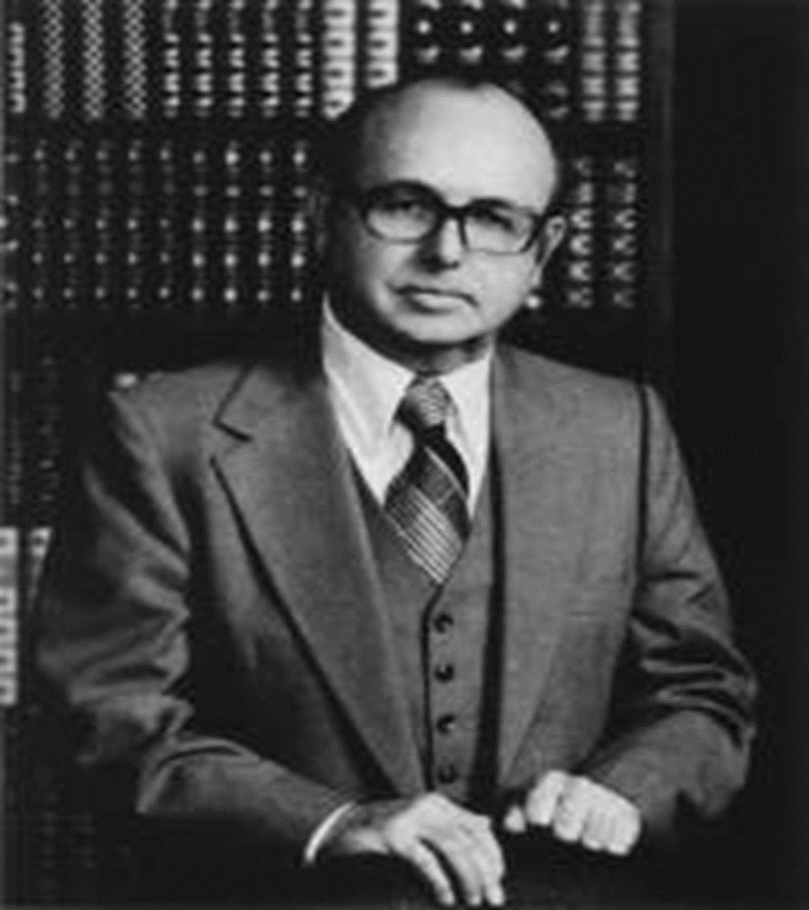
Do We Throw Them Out Too?
We first had occasion to speak with Walter Rea, the author of The White Lie, around January of 2000. In our conversation, we asked him if the weapons used against Mrs. White could also be used to discredit the Bible writers. Indeed liberal theologians have accused the Bible writers of plagiarism for a long time, the same type of accusation Rea levels at Ellen White.
Rea responded to our question by saying that he:
does not take the Bible literally,
does not believe in a world-wide flood, does not believe that God told Abraham to offer up Isaac, and does not believe God told the Israelites to slay the Canaanites. “ www.ellenwhite.info

Slide 12
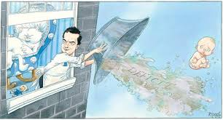
Surprised???
Walter Rea had trouble with how Ellen white wrote her books. A lawyer, Vincent Ramik, whose expertise was copyright and trademark law, said Ellen White was well within the framework of fair use and had done nothing wrong! From there, Rae proceeded to throw out large portions of the Bible too. Surprised??? The same Spirit that inspired Ellen White inspired the Bible writers. It is only reasonable to throw out both if you care to tamper with them!!!

Slide 13

Wow!!! Walter Rea Became a Heathen!!
The Holy Spirit, that inspired the Bible and Ellen White, is rejected in the SOP and eventually leads to rejection of the other-the Bible!!! “And they rose early in the morning, and went forth into the wilderness of Tekoa: and as they went forth, Jehoshaphat stood and said, Hear me, O Judah, and ye inhabitants of Jerusalem; Believe in the LORD your God, so shall ye be established; believe his prophets, so shall ye prosper.” 2 Chronicles 20: 20

Slide 14
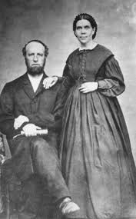
Ellen White’s Fair Usage
Ellen White used what other people said only so that the message would be clearer than what she may have said. In her human frailty, she recognized weakness in doing the colossal task the Lord requested of her! Amazingly, as she borrowed from other writers, she always knew what to borrow and what not to borrow!! The Lord revealed to her what was truth and what was error!! Her intent was always and only that the truth of God would go around the world! It was never her intent to one up another writer!

Slide 15
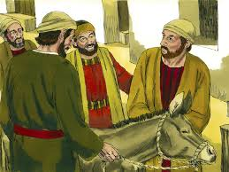
The Lord Needs Them!
“And when they drew nigh unto Jerusalem, and were come to Bethphage, unto the mount of Olives, then sent Jesus two disciples, Saying unto them, Go into the village over against you, and straightway ye shall find an ass tied, and a colt with her: loose them, and bring them unto me. And if any man say ought unto you, ye shall say, The Lord hath need of them; and straightway he will send them.” Matthew 21:1-3

Slide 16
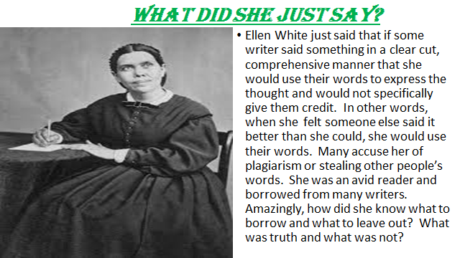

Slide 17
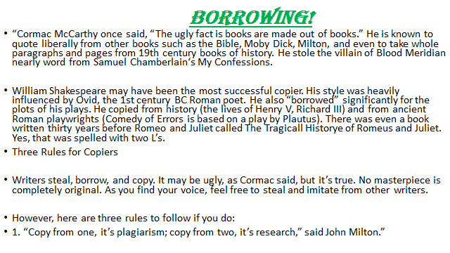

Slide 18
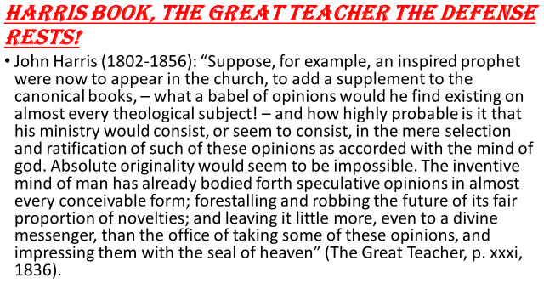

Slide 19
