Slide 1
Daniel, chapter 6
“Feeling the Lion’s Breathe”

Slide 2
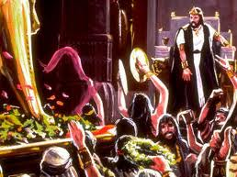
Media/Persia Reigns
”It pleased Darius to set over the kingdom an hundred and twenty princes, which should be over the whole kingdom; And over these three presidents; of whom Daniel was first: that the princes might give accounts unto them, and the king should have no damage. Then this Daniel was preferred above the presidents and princes, because an excellent spirit was in him; and the king thought to set him over the whole realm.” Daniel 6:1-3

Slide 3
Babylon Falls
In 539 BC, Babylon fell to the forces of Cyrus. The chest and arms of silver had replaced the head of gold. Babylon had ruled from 605 BC-539 BC.
Daniel had been taken as a castrated captive to the Babylonian courts and by 602 BC, he was one of the wise men in the courts of Babylon. ‘Daniel was but a youth when carried away captive into Babylon. He was about fifteen or sixteen years old, for he is called a child, which means that he was in his youth.’ UL, pg. 83 For around 63 years, he served in the Babylonian regime. With the fall of Babylon, the almost 80 year old prophet and statesmen was ready to call it quits, but Darius the Mede was so impressed by him and his reputation that Daniel was placed high up in the new government!

Slide 4
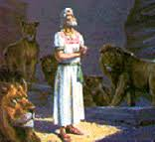
His Success
“Strict compliance with the requirements of Heaven brings temporal as well as spiritual blessings. Unwavering in his allegiance to God, unyielding in his mastery of self, Daniel, by his noble dignity and unswerving integrity, while yet a young man, won the "favor and tender love" of the heathen officer in whose charge he had been placed. Daniel 1:9.” PK, pg. 546

Slide 5
What a Testimony!
“The same characteristics marked his afterlife. He rose speedily to the position of prime minister of the kingdom of Babylon. Through the reign of successive monarchs, the downfall of the nation, and the establishment of another world empire, such were his wisdom and statesmanship, so perfect his tact, his courtesy, his genuine goodness of heart, his fidelity to principle, that even his enemies were forced to the confession that "they could find none occasion nor fault; forasmuch as he was faithful.“ PK, pg. 546

Slide 6
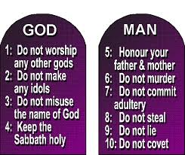
Only One Way
“ Then the presidents and princes sought to find occasion against Daniel concerning the kingdom; but they could find none occasion nor fault; forasmuch as he was faithful, neither was there any error or fault found in him. Then said these men, We shall not find any occasion against this Daniel, except we find it against him concerning the law of his God.” Daniel 6:4,5

Slide 7
”Then these presidents and princes assembled together to the king, and said thus unto him, King Darius, live for ever. All the presidents of the kingdom, the governors, and the princes, the counsellors, and the captains, have consulted together to establish a royal statute, and to make a firm decree, that whosoever shall ask a petition of any God or man for thirty days, save of thee, O king, he shall be cast into the den of lions. Now, O king, establish the decree, and sign the writing, that it be not changed, according to the law of the Medes and Persians, which altereth not. Wherefore king Darius signed the writing and the decree. Now when Daniel knew that the writing was signed, he went into his house; and his windows being open in his chamber toward Jerusalem, he kneeled upon his knees three times a day, and prayed, and gave thanks before his God, as he did aforetime. Then these men assembled, and found Daniel praying and making supplication before his God. Then they came near, and spake before the king concerning the king's decree; Hast thou not signed a decree, that every man that shall ask a petition of any God or man within thirty days, save of thee, O king, shall be cast into the den of lions? The king answered and said, The thing is true, according to the law of the Medes and Persians, which altereth not. Then answered they and said before the king, That Daniel, which is of the children of the captivity of Judah, regardeth not thee, O king, nor the decree that thou hast signed, but maketh his petition three times a day.” Daniel 6:6-13

Slide 8
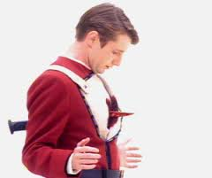
Dagger at Daniel’s Heart
1. Aimed to destroy him.
2. Didn’t fight for his rights.
3. Continued to pray as always.
4. Totally denied the right of any sovereign to dictate his relationship to God! He ‘spit on his head’!!

Slide 9
“Personal revenge is not becoming to a child of God. If he is abused, he is to take it patiently; if defrauded of that which is his just due, he is not to appeal to unbelievers in courts of justice. Rather, let him suffer loss and wrong. The one wronged may feel injured, and may be tempted to cause oppression to his fellow man; but if he follows this course, he reveals that he has not the Spirit of Christ.
Christians need not contend for their rights. They stand under the protection of the banner of Christ. They are to acknowledge the supreme authority of the King of kings and Lord of lords. In matters of difficulty between them and their brethren, they are not to appeal to Caesar or to Pilate. An account is kept of all these matters; and in his own good time, Christ will avenge his own elect. God will deal with the one who defrauds his brother and the cause of God. “Vengeance is mine,” he says; “I will repay.” {RH January 3, 1899)

Slide 10
Noble Protest!
“To protect liberty of conscience is the duty of the state, and this is the limit of its authority in matters of religion. Every secular government that attempts to regulate or enforce religious observances by civil authority is sacrificing the very principle for which the evangelical Christian so nobly struggled…In matters of conscience, the majority has no power.” GC, pg. 201 The protesters had moreover affirmed their right to utter freely their convictions of truth. They would not only believe and obey, but teach what the word of God presents, and they denied the right of priest or magistrate to interfere. The Protest of Spires was a solemn witness against religious intolerance, and an assertion of the right of all men to worship God according to the dictates of their own consciences.” GC, pg. 204

Slide 11
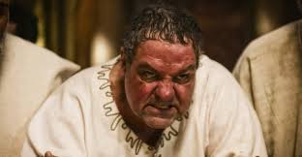
Darius-Too Proud to Back Down!
Darius did something dumb. He was deceived into making a dumb law. That law was directed at his friend, advisor, and cohort, Daniel. The king could do whatever he wanted. In order to save his own face and protect his own dignity, he would trample on justice and allow an innocent man to die! Just like Herod with John and Pilate with Jesus!!

Slide 12
Unhappy Night!
“Full of satanic exultation, Daniel’s enemies returned to their homes. They drank freely of wine, and congratulated themselves on their success in putting out of the way one whom they could not bribe to forsake the path of integrity.
Not so did Darius pass the night. Daniel’s testimony had made a deep impression on his mind. He had some knowledge of the dealing of God with the people of Israel, and Daniel’s conduct sent home to his heart the conviction, that the God of the Hebrews was the true God. He was filled with remorse for having signed the decree brought to him. His conscience was awakened, and he passed a sleepless and troubled night. The chamber of royalty was one of sorrow and prayer. All music was hushed. All amusements were laid aside. No comforters were admitted.
During that sleepless night the king thought as he had never thought before. Early the next morning, hoping and yet despairing, condemning himself, and praying to him whom he began to recognize as the true God, Darius went to the lions’ den.” YI November 1, 1900

Slide 13
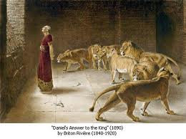
Is He?
And when he came to the den, he cried with a lamentable voice unto Daniel: and the king spake and said to Daniel, O Daniel, servant of the living God, is thy God, whom thou servest continually, able to deliver thee from the lions? Then said Daniel unto the king, O king, live for ever. My God hath sent his angel, and hath shut the lions' mouths, that they have not hurt me: forasmuch as before him innocency was found in me; and also before thee, O king, have I done no hurt.” Daniel 6:20-22

Slide 14
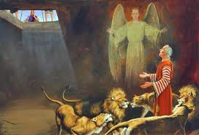
Great Assurance
The Lord Jesus still shuts lion’s mouths. “ Be sober, be vigilant; because your adversary the devil, as a roaring lion, walketh about, seeking whom he may devour: Whom resist steadfast in the faith, knowing that the same afflictions are accomplished in your brethren that are in the world.” 1 Peter 5:8,9

Slide 15
Will Happen Again!
Oppressive religious laws, a National and then Universal Sunday Law, in homage to Rome, will be passed in the near future. “And he exerciseth all the power of the first beast before him, and causeth the earth and them which dwell therein to worship the first beast, whose deadly wound was healed.” Rev. 13:12
God’s people will be thrown into seasons of distress as was Daniel. The Lord Jesus will shut the lions mouth for the 144,000 who live to see Christ come! Daniel and the 144,000 have a work to do and they are immortal as long as the Lord says so!!!

Slide 16
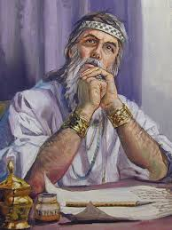
Daniel Preserved for a Reason!
Jeremiah had foretold 70 years of captivity. Daniel had been in Babylon and now Medo-Persia for a combined 68 years. The time was about to transpire. Someone would have to tell Cyrus his duty; someone with influence would have to tell him what God wanted him to do!

Slide 17
Build the Temple!
“That saith of Cyrus, He is my shepherd, and shall perform all my pleasure: even saying to Jerusalem, Thou shalt be built; and to the temple, Thy foundation shall be laid.” Isa. 44:28
“ For Jacob my servant's sake, and Israel mine elect, I have even called thee by thy name: I have surnamed thee, though thou hast not known me…” "I have raised him up in righteousness, and I will direct all his ways: he shall build My city, and he shall let go My captives, not for price nor reward, saith the Lord of hosts." Isaiah 44:28;Isa. 45:4,13

Slide 18
Let My People Go!
“The deliverance of Daniel from the den of lions had been used of God to create a favorable impression upon the mind of Cyrus the Great. The sterling qualities of the man of God as a statesman of farseeing ability led the Persian ruler to show him marked respect and to honor his judgment. And now, just at the time God had said He would cause His temple at Jerusalem to be rebuilt, He moved upon Cyrus as His agent to discern the prophecies concerning himself, with which Daniel was so familiar, and to grant the Jewish people their liberty.
As the king saw the words foretelling, more than a hundred years before his birth, the manner in which Babylon should be taken; as he read the message addressed to him by the Ruler of the universe,…his heart was profoundly moved, and he determined to fulfill his divinely appointed mission… He would let the Judean captives go free; he would help them restore the temple of Jehovah.” PK, pgs. 557,558

Slide 19
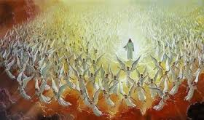
Preservation of the 144,000
As Daniel was preserved by God, so to will the 144,000 be preserved during the time of the Sunday law, the 7 last plagues, and the death decree. God’s angels will shield His children against all the wicked assaults of the enemy. They will stand to see Christ appear and vindicate His character in the worst moment of earth’s history!

