Slide 1
Jesus Life, pt. 19 “Capernaum”

Slide 2
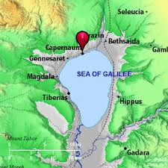
“At Capernaum Jesus dwelt in the intervals of His journeys to and fro, and it came to be known as “His own city.” It was on the shores of the Sea of Galilee, and near the borders of the beautiful plain of Gennesaret, if not actually upon it. The deep depression of the lake gives to the plain that skirts its shores the genial climate of the south. Here in the days of Christ flourished the palm tree and the olive, here were orchards and vineyards, green fields, and brightly blooming flowers in rich luxuriance, all watered by living streams bursting from the cliffs. The shores of the lake, and the hills that at a little distance encircle it, were dotted with towns and villages. The lake was covered with fishing boats. Everywhere was the stir of busy, active life.” DA, pg. 252

Slide 3
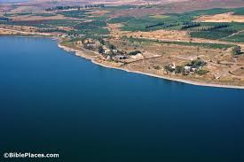
Capernaum was a fishing village established during the time of the Hasmoneans, located on the northern shore of the Sea of Galilee. It had a population of about 1,500. Archaeological excavations have revealed two ancient synagogues built one over the other. A house turned into a church by the Byzantines is believed to have been the home of Saint Peter.

Slide 4
What Consumed the Life of Jesus!
“Capernaum itself was well adapted to be the center of the Saviour's work. Being on the highway from Damascus to Jerusalem and Egypt, and to the Mediterranean Sea, it was a great thoroughfare of travel. People from many lands passed through the city, or tarried for rest in their journeyings to and fro. Here Jesus could meet all nations and all ranks, the rich and great as well as the poor and lowly, and His lessons would be carried to other countries and into many households. Investigation of the prophecies would thus be excited, attention would be directed to the Saviour, and His mission would be brought before the world.” DA, pg. 252

Slide 5
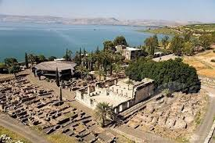
Evangelism
“And he entered into a ship, and passed over, and came into his own city.” Matthew 9:1 “At Capernaum Jesus dwelt in the intervals of His journeys to and fro, and it came to be known as “His own city.” DA, pg. 252

Slide 6
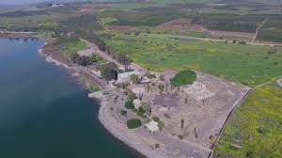
Many Converts There!
“So Jesus came again into Cana of Galilee, where he made the water wine. And there was a certain nobleman, whose son was sick at Capernaum. When he heard that Jesus was come out of Judaea into Galilee, he went unto him, and besought him that he would come down, and heal his son: for he was at the point of death. Then said Jesus unto him, Except ye see signs and wonders, ye will not believe.” John 4:46-48
“Now when he had ended all his sayings in the audience of the people, he entered into Capernaum. And a certain centurion's servant, who was dear unto him, was sick, and ready to die. And when he heard of Jesus, he sent unto him the elders of the Jews, beseeching him that he would come and heal his servant.” Luke 7:1-3

Slide 7
Man Sick of the Palsy and Levi Matthew
“And he entered into a ship, and passed over, and came into his own city. And, behold, they brought to him a man sick of the palsy, lying on a bed: and Jesus seeing their faith said unto the sick of the palsy; Son, be of good cheer; thy sins be forgiven thee. And, behold, certain of the scribes said within themselves, This man blasphemeth. And Jesus knowing their thoughts said, Wherefore think ye evil in your hearts? For whether is easier, to say, Thy sins be forgiven thee; or to say, Arise, and walk?” Matthew 9:1-5
“And as Jesus passed forth from thence, he saw a man, named Matthew, sitting at the receipt of custom: and he saith unto him, Follow me. And he arose, and followed him. And it came to pass, as Jesus sat at meat in the house, behold, many publicans and sinners came and sat down with him and his disciples. And when the Pharisees saw it, they said unto his disciples, Why eateth your Master with publicans and sinners? But when Jesus heard that, he said unto them, They that be whole need not a physician, but they that are sick.” Matthew 9:9-12

Slide 8
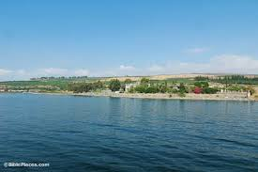
Evangelism to the Hilt!
Jairus daughter and the Woman with issue of blood!
“While he spake these things unto them, behold, there came a certain ruler, and worshipped him, saying, My daughter is even now dead: but come and lay thy hand upon her, and she shall live. And Jesus arose, and followed him, and so did his disciples. And, behold, a woman, which was diseased with an issue of blood twelve years, came behind him, and touched the hem of his garment: For she said within herself, If I may but touch his garment, I shall be whole. But Jesus turned him about, and when he saw her, he said, Daughter, be of good comfort; thy faith hath made thee whole. And the woman was made whole from that hour.” Matthew 9:18-22

Slide 9
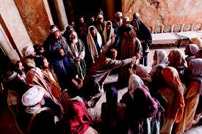
Many lives had been changed in Capernaum! Many well known people were transformed by the power of Christ! Matthew, the nobleman’s son, the centurion, the woman with the issue of blood, and Jairus’ daughter! All had experienced the touch of Christ, the power of His word to change a repentant human life!

Slide 10
And, there was one More!
“And came down to Capernaum, a city of Galilee, and taught them on the sabbath days. And they were astonished at his doctrine: for his word was with power. And in the synagogue there was a man, which had a spirit of an unclean devil, and cried out with a loud voice, Saying, Let us alone; what have we to do with thee, thou Jesus of Nazareth? art thou come to destroy us? I know thee who thou art; the Holy One of God. And Jesus rebuked him, saying, Hold thy peace, and come out of him. And when the devil had thrown him in the midst, he came out of him, and hurt him not. And they were all amazed, and spake among themselves, saying, What a word is this! for with authority and power he commandeth the unclean spirits, and they come out.” Luke 4:31-36

Slide 11
Deliverance!
“The mind of this wretched sufferer had been darkened by Satan, but in the Saviour's presence a ray of light had pierced the gloom. He was roused to long for freedom from Satan's control; but the demon resisted the power of Christ. When the man tried to appeal to Jesus for help, the evil spirit put words into his mouth, and he cried out in an agony of fear. The demoniac partially comprehended that he was in the presence of One who could set him free; but when he tried to come within reach of that mighty hand, another's will held him, another's words found utterance through him. The conflict between the power of Satan and his own desire for freedom was terrible. He who had conquered Satan in the wilderness of temptation was again brought face to face with His enemy. The demon exerted all his power to retain control of his victim. To lose ground here would be to give Jesus a victory. It seemed that the tortured man must lose his life in the struggle with the foe that had been the ruin of his manhood. But the Saviour spoke with authority, and set the captive free. The man who had been possessed stood before the wondering people happy in the freedom of self-possession. Even the demon had testified to the divine power of the Saviour.” DA, pg. 255, 256

Slide 12
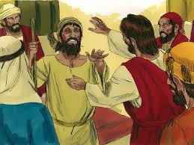
Another Trophy of Christ’s Power and Love!
“Remorse came too late. When he would have sacrificed wealth and pleasure to regain his lost manhood, he had become helpless in the grasp of the evil one. He had placed himself on the enemy's ground, and Satan had taken possession of all his faculties. The tempter had allured him with many charming presentations; but when once the wretched man was in his power, the fiend became relentless in his cruelty, and terrible in his angry visitations. So it will be with all who yield to evil; the fascinating pleasure of their early career ends in the darkness of despair or the madness of a ruined soul…. The man praised God for his deliverance. The eye that had so lately glared with the fire of insanity, now beamed with intelligence, and overflowed with grateful tears.” DA, pg. 256

Slide 13
Different Classes of People!
1. Some, like the demon possessed man, were set free from their sins.
2. Some hunted Christ and hated Him for His rebuking of their wickedness and sins.
3. Some caviled about worthless matters and engaged in fanciful theories that helped no one!
4. Some followed Jesus and did the work of evangelism that consumed His life!

Slide 14
Spies and Messengers to Denounce Him!
“Jesus knew that the priests and rabbis were determined to take His life; yet He clearly explained to them His unity with the Father, and His relation to the world. They saw that their opposition to Him was without excuse, yet their murderous hatred was not quenched. Fear seized them as they witnessed the convincing power that attended His ministry; but they resisted His appeals, and locked themselves in darkness. They had signally failed to subvert the authority of Jesus or to alienate the respect and attention of the people, many of whom were convicted by His words. The rulers themselves had felt deep condemnation as He had pressed their guilt home upon their consciences; yet this only made them the more bitter against Him. They were determined to take His life. They sent messengers all over the country to warn the people against Jesus as an impostor. Spies were sent to watch Him, and report what He said and did. The precious Saviour was now most surely standing under the shadow of the cross.” DA, pg. 213

Slide 15
“All who heard the Saviour “were astonished at His doctrine: for His word was with power.” “He taught them as one having authority, and not as the scribes.” Luke 4:32; Matthew 7:29. The teaching of the scribes and elders was cold and formal, like a lesson learned by rote. To them the word of God possessed no vital power. Their own ideas and traditions were substituted for its teaching. In the accustomed round of service they professed to explain the law, but no inspiration from God stirred their own hearts or the hearts of their hearers. Jesus had nothing to do with the various subjects of dissension among the Jews. It was His work to present the truth. His words shed a flood of light upon the teachings of patriarchs and prophets, and the Scriptures came to men as a new revelation. Never before had His hearers perceived such a depth of meaning in the word of God. Jesus met the people on their own ground, as one who was acquainted with their perplexities. He made truth beautiful by presenting it in the most direct and simple way. His language was pure, refined, and clear as a running stream. His voice was as music to those who had listened to the monotonous tones of the rabbis. But while His teaching was simple, He spoke as one having authority. This characteristic set His teaching in contrast with that of all others. The rabbis spoke with doubt and hesitancy, as if the Scriptures might be interpreted to mean one thing or exactly the opposite.” DA, pg. 253

Slide 16
Woe to Capernaum and Bethsaida!
“Those who look thus upon the members of other churches, have need to humble themselves under the mighty hand of God. Those whom they condemn may have had but little light, few opportunities and privileges. If they had had the light that many of the members of our churches have had, they might have advanced at a far greater rate, and have better represented their faith to the world. Of those who boast of their light, and yet fail to walk in it, Christ says, “But I say unto you, It shall be more tolerable for Tyre and Sidon at the day of judgment, than for you. And thou, Capernaum [Seventh-day Adventists, who have had great light], which art exalted unto heaven [in point of privilege], shalt be brought down to hell: for if the mighty works, which have been done in thee, had been done in Sodom, it would have remained until this day. But I say unto you, That it shall be more tolerable for the land of Sodom in the day of judgment, than for thee.” At that time Jesus answered and said, “I thank thee, O Father, Lord of heaven and earth, because thou hast hid these things from the wise and prudent [in their own estimation], and hast revealed them unto babes.” RH, Aug. 1, 1893

