Slide 1
The Book of Romans, pt. 8
The Father of the Faithful

Slide 2
Recap of Romans 4:1-13
1. Abraham was justified/forgiven by faith in the righteousness of Christ.
2. James declares that true faith is always revealed in works of righteousness.
3. David expressed the joy of trusting Christ for forgiveness and cleansing.
4. The outward sign of circumcision was given to Abraham after he had experienced Christ’s righteousness in his life; not before. Outward acts of obedience are not necessary to receiving Christ’s righteousness in the life!

Slide 3

Justified by Faith
“With great clearness and power the apostle presented the doctrine of justification by faith in Christ. He hoped that other churches also might be helped by the instruction sent to the Christians at Rome; but how dimly could he foresee the far-reaching influence of his words! Through all the ages the great truth of justification by faith has stood as a mighty beacon to guide repentant sinners into the way of life. It was this light that scattered the darkness which enveloped Luther's mind and revealed to him the power of the blood of Christ to cleanse from sin. The same light has guided thousands of sin-burdened souls to the true Source of pardon and peace. For the epistle to the church at Rome, every Christian has reason to thank God.” AA, 373,374

Slide 4

Romans 4:14,15
“For if they which are of the law be heirs, faith is made void, and the promise made of none effect: Because the law worketh wrath: for where no law is, there is no transgression.” Romans 4:14,15

Slide 5
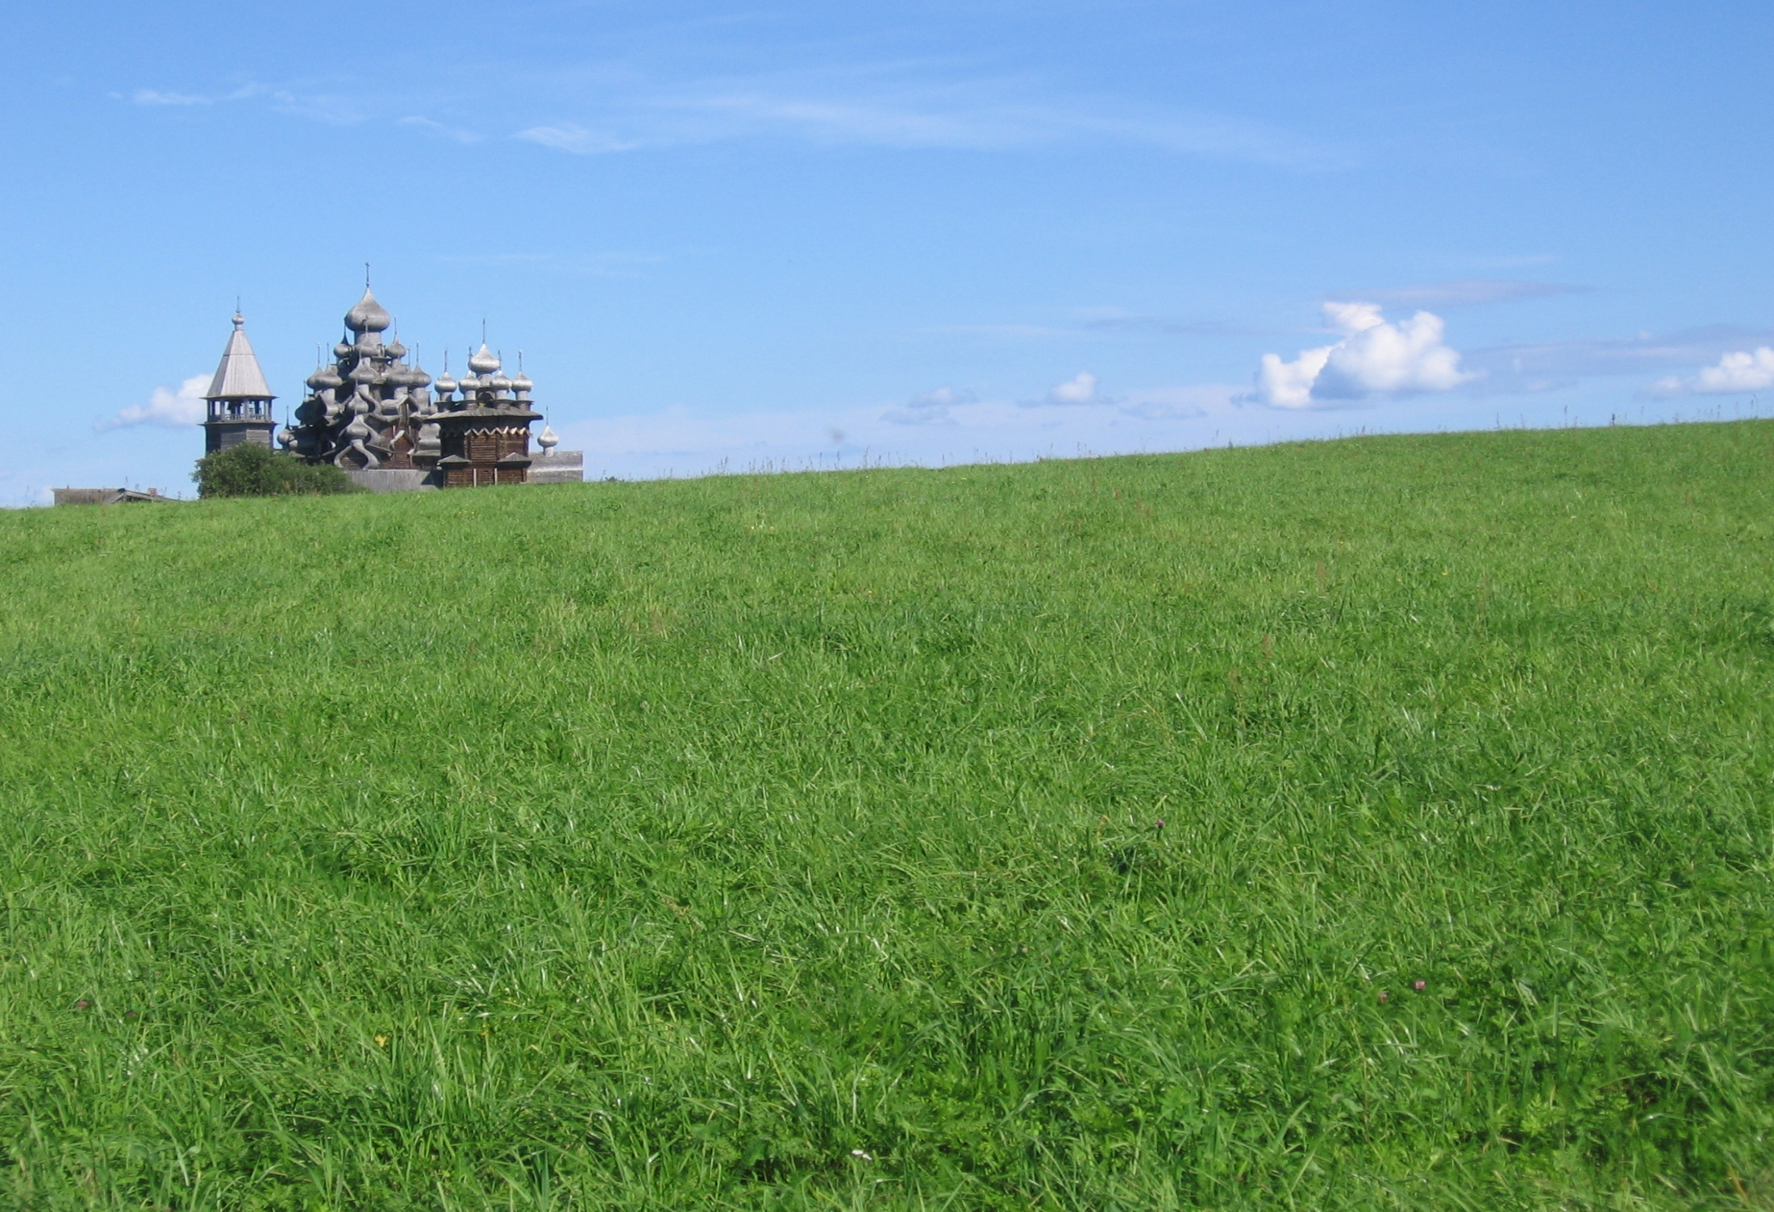
The Law’s Purpose
If heir ship to heaven is based solely on outward acts of obedience, then the promise of Christ is voided. The law functions to reveal sin and our need for Christ; it doesn’t function to show us what we must do apart from Him!

Slide 6

The Law Remains
The law of God reveals man’s sin. Without the law, there is no absolute that declares what is right and wrong. Man is free to do as he pleases without any remorse, because the miserable mind of man can justify anything. How important the law is to reveal God’s ideal and our need for Christ!

Slide 7
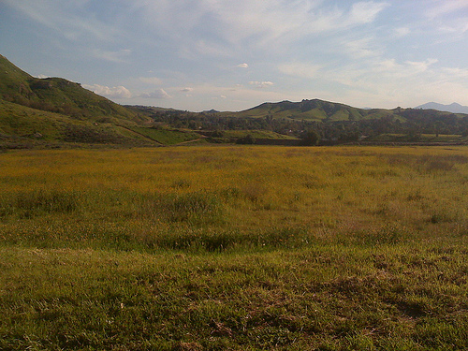
1John 3:4,5
“Whosoever committeth sin transgresseth also the law: for sin is the transgression of the law. And ye know that he was manifested to take away our sins; and in him is no sin.” 1John 3:4,5

Slide 8
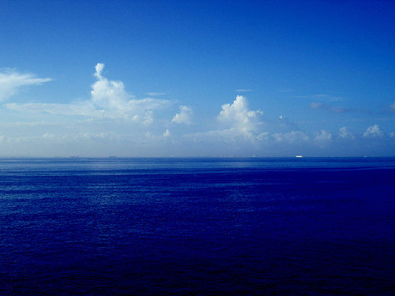
Romans 4:16
“Therefore it is of faith, that it might be by grace; to the end the promise might be sure to all the seed; not to that only which is of the law, but to that also which is of the faith of Abraham; who is the father of us all,” Romans 4:16

Slide 9

No difference
Lest anyone boast of their accomplishments or their advantages, the playing field is the same for all; repentance for sin and faith in Jesus Christ for forgiveness; and faith in Christ that empowers us to perform works of righteousness.

Slide 10

Hope Against Hope
“As it is written, I have made thee a father of many nations,) before him whom he believed, even God, who quickeneth the dead, and calleth those things which be not as though they were. Who against hope believed in hope, that he might become the father of many nations; according to that which was spoken, So shall thy seed be.” Romans 4:17,18

Slide 11
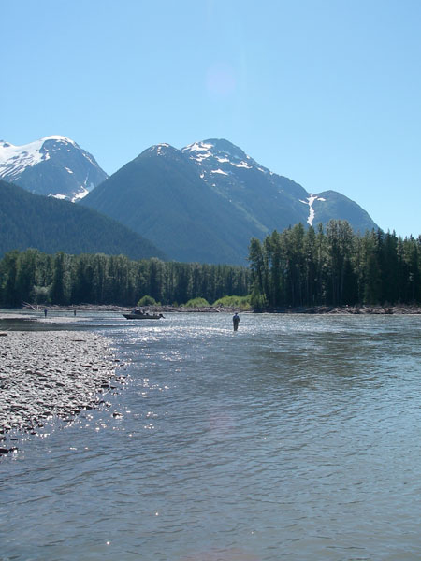
Faith
God declares things as so because He sees the future. It is faith which accepts His promise and holds on to it until the promise is seen. It is believing something, His word, while there is no outward evidence of its fulfillment. “Now faith is the substance of things hoped for, the evidence of things not seen.” Hebrews 11:1

Slide 12
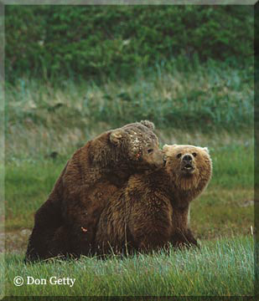
Romans 4:19-21
“And being not weak in faith, he considered not his own body now dead, when he was about an hundred years old, neither yet the deadness of Sara's womb: He staggered not at the promise of God through unbelief; but was strong in faith, giving glory to God; And being fully persuaded that, what he had promised, he was able also to perform.” Romans 4:19-21

Slide 13
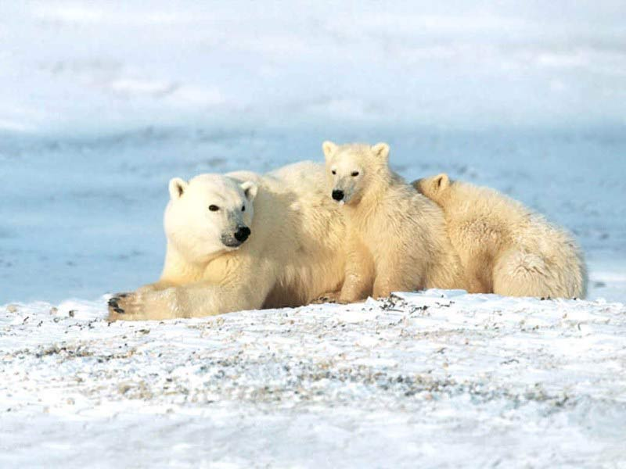
Trusting
Abraham had strong faith, believing that God could do exactly as He promised. The promise was for a son through Sarah and, even though she was beyond child bearing years, Abraham believed God would and could do it.

Slide 14
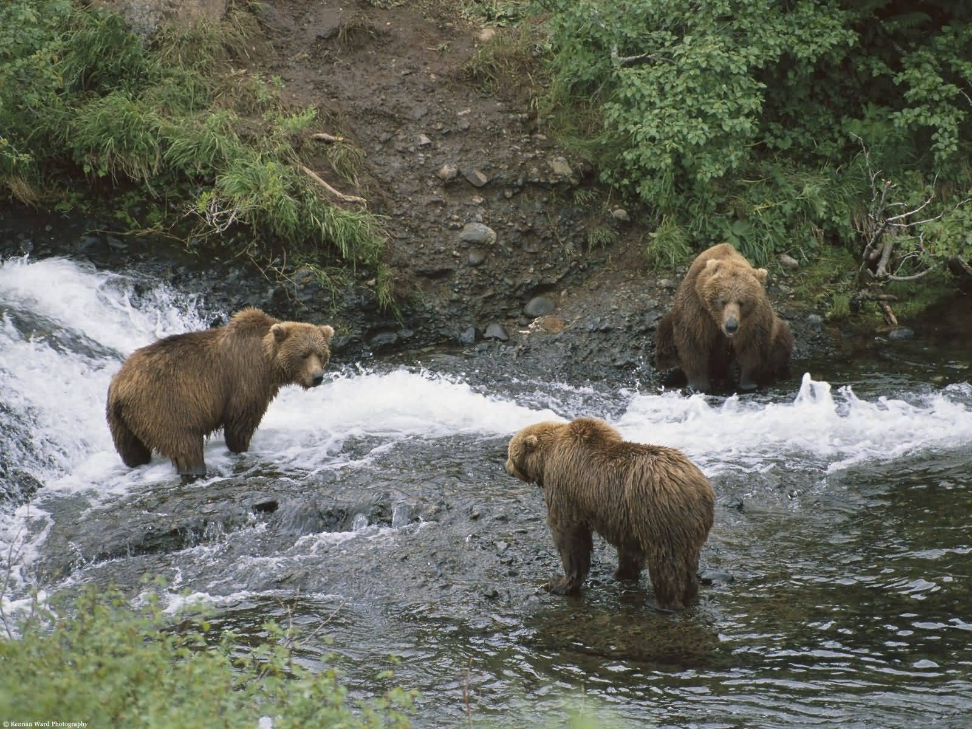
Not Always
From the time the promise was first given, when Abraham was 75, he had waited some 10 years for the promise to happen. When it didn’t, he did marry Hagar and have a child thru her. This was distrusting God’s promise. When God appeared to Abraham 14 years later, Abraham then, didn’t show much faith either. He laughed when God made the promise again.

Slide 15
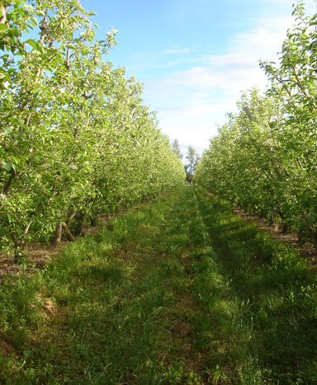
Isaac-Laughter
“Then Abraham fell upon his face, and laughed, and said in his heart, Shall a child be born unto him that is an hundred years old? and shall Sarah, that is ninety years old, bear? And Abraham said unto God, O that Ishmael might live before thee!” Genesis 17:17,18

Slide 16
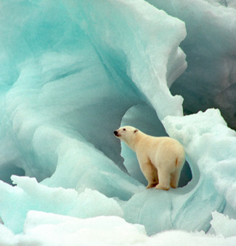
Faithful
Abraham failed to show faith twice in 25 years. These the Bible record for us. For this reason, the apostle Paul could say, “He staggered not at the promise of God through unbelief; but was strong in faith, giving glory to God; And being fully persuaded that, what he had promised, he was able also to perform.”

Slide 17
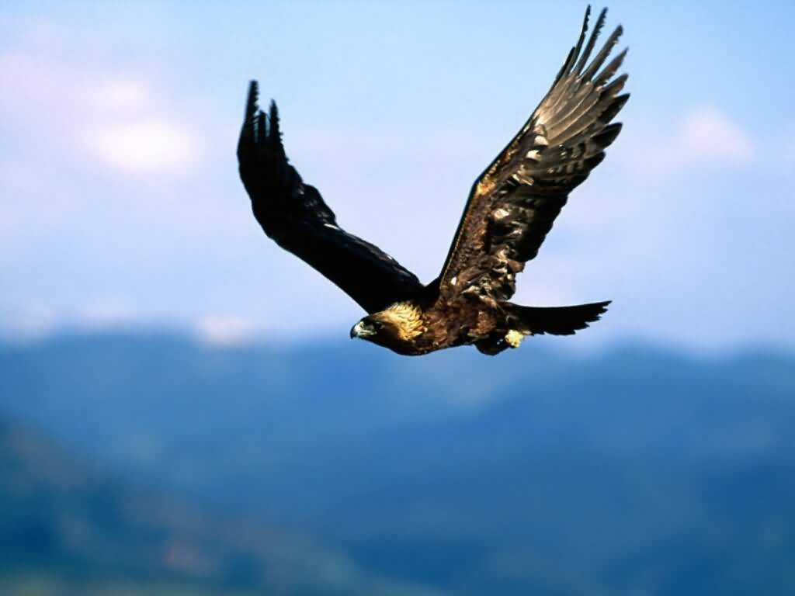
The First Angel’s Message
Claiming God’s promises, when we can’t see them, is showing faith and this declares that we believe God is faithful to do what He says. This is part of the first angel’s message. “Fear God, and give glory to Him for the hour….” Rev. 14:7

Slide 18
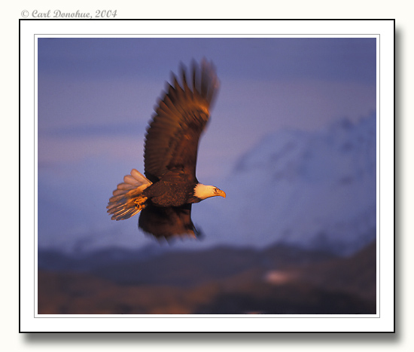
Romans 4:22
“And therefore it was imputed to him for righteousness.” Abraham’s living faith in the promises of God brought to him the righteousness of Christ. We have the same experience when we accept God’s word to us thru faith.

Slide 19
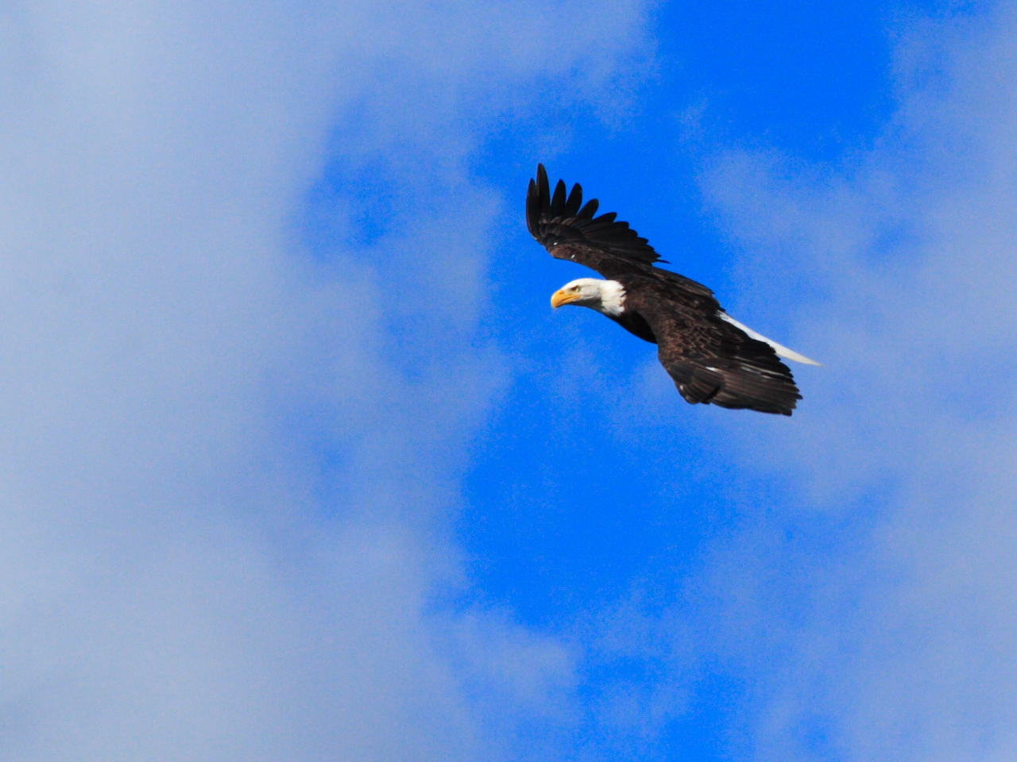
Romans 4:23-25
“Now it was not written for his sake alone, that it was imputed to him; But for us also, to whom it shall be imputed, if we believe on him that raised up Jesus our Lord from the dead; Who was delivered for our offences, and was raised again for our justification.”

Slide 20
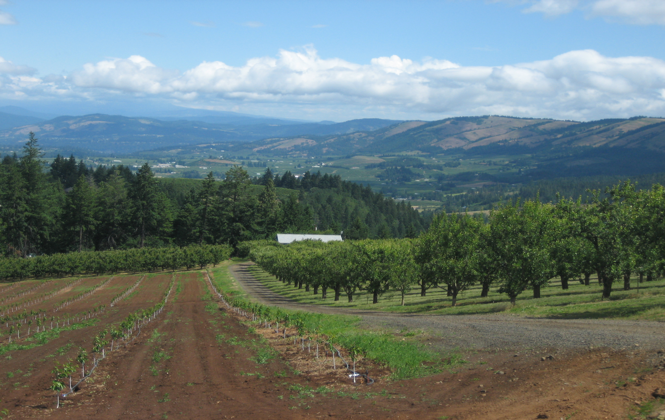
Embracing the Word
Abraham trusted in God’s promise to do what it said. This faith was counted as righteousness. This faith produced works of righteousness. When we embrace God’s promise by faith, righteousness is counted to us as well. This faith will also produce righteous acts.

Slide 21

Clouds of forgiveness
The promise for forgiveness- “Remember these, O Jacob and Israel; for thou art my servant: I have formed thee; thou art my servant: O Israel, thou shalt not be forgotten of me. I have blotted out, as a thick cloud, thy transgressions, and, as a cloud, thy sins: return unto me; for I have redeemed thee.” Isaiah 44:21,22

Slide 22

Promise of Power
To Overcome- “When the enemy shall come in like a flood, the Spirit of the LORD shall lift up a standard against him.“ Isaiah 59:19
“The LORD shall fight for you, and ye shall hold your peace.” Exodus 14:14
“For all the promises of God in him are yea, and in him Amen, unto the glory of God by us.” 2Corinthians 1:20

