Slide 1
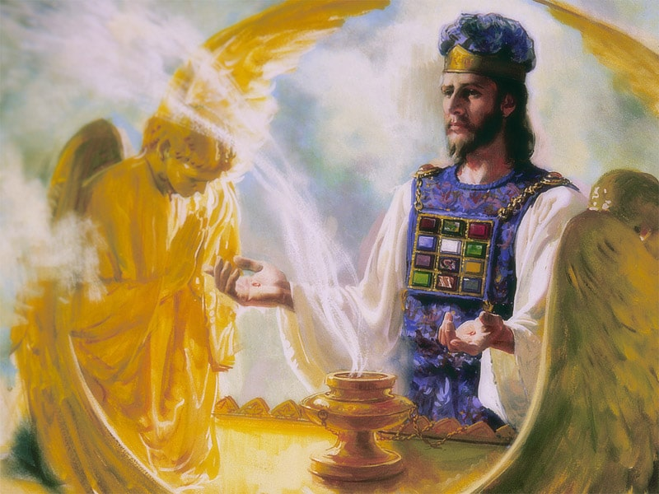
The Sanctuary pt 56: The Day of Atonement 3: The Daily and Yearly

Slide 2
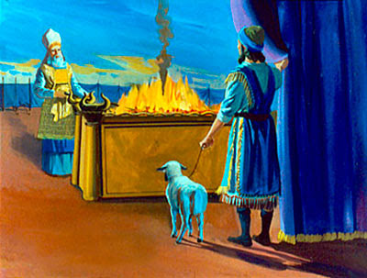
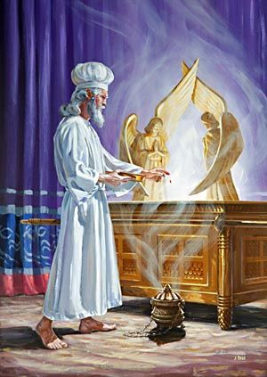
The Daily Vs The Yearly
Heb. 9:1-7 “Then verily the first covenant had also ordinances of divine service, and a worldly sanctuary. For there was a tabernacle made; the first, wherein was the candlestick, and the table, and the shewbread; which is called the sanctuary. And after the second veil, the tabernacle which is called the Holiest of all; Which had the golden censer, and the ark of the covenant overlaid round about with gold, wherein was the golden pot that had manna, and Aaron's rod that budded, and the tables of the covenant; And over it the cherubims of glory shadowing the mercyseat; of which we cannot now speak particularly. Now when these things were thus ordained, the priests went always into the first tabernacle, accomplishing the service of God. But into the second went the high priest alone once every year, not without blood, which he offered for himself, and for the errors of the people”

Slide 3
What is Daniel 8 Talking About???
Daniel 8:9-14 “And out of one of them came forth a little horn, which waxed exceeding great, toward the south, and toward the east, and toward the pleasant land. And it waxed great, even to the host of heaven; and it cast down some of the host and of the stars to the ground, and stamped upon them. Yea, he magnified himself even to the prince of the host, and by him the daily sacrifice was taken away, and the place of the sanctuary was cast down. And an host was given him against the daily sacrifice by reason of transgression, and it cast down the truth to the ground; and it practised, and prospered. Then I heard one saint speaking, and another saint said unto that certain saint which spake, How long shall be the vision concerning the daily sacrifice, and the transgression of desolation, to give both the sanctuary and the host to be trodden under foot? And he said unto me, Unto two thousand and three hundred days; then shall the sanctuary be cleansed.”

Slide 4
Who’s Exalting Themselves Against God?
To believe that our Lord God the Pope has not the power to decree as he is decreed, is to be deemed heretical." (the Gloss "Extravagantes" o.f Pope John XXII Cum inter, Tit. XIV, Cap. IV. Ad Callem Sexti Decretalium, Paris, 1685)
"Hence the Pope is crowned with a triple crown, as king of heaven and of earth and of the lower regions." (Ferraris, «Prompta Bibliotheca», 1763, Volume VI, 'Papa II', p.26)
"The Saviour Himself is the door of the sheepfold: 'I am the door of the sheep.' Into this fold of Jesus Christ, no man may enter unless he be led by the Sovereign Pontiff; and only if they be united to him can men be saved, for the Roman Pontiff is the Vicar of Christ and His personal representative on earth." (Pope John XXIII in his homily to the Bishops and faithful assisting at his coronation on November 4, 1958)

Slide 5
Even to the Prince of the Host…
“The Pope and God are the same, so he has all power in Heaven and earth”—Pope Pius V (1566-1572), Barclay, Cities Petrus Bertanous Chapter XXVII: 218
“We may according to the fulness of our power, dispose of the law and dispense above the law. Those whom the Pope of Rome doth separate, it is not a man that separates them but God. For the Pope holdeth place on earth, not simply of a man but of the true God.”—Pope Innocent III (1198-1216), Decretals of Gregory IX, Bk 1, ch. 3
“We declare, assert, define and pronounce to be subject to the Roman Pontiff is to every creature altogether necessary for salvation. . . I have the authority of the King of Kings. I am all in all, and above all, so that God Himself and I, the Vicar of Christ, have but one consistory, and I am able to do almost all that God can do. What therefore, can you make of me but God?”—Pope Boniface VIII (1294-1303), Papal Bull Unam Sanctum, 1302AD

Slide 6
“I alone . . . am the successor of the apostles, the vicar of Christ. I am the way, the truth, and the life”—Pope Pius XI (1922-1939), quoted in Henry Charles Sheldon, History of the Christian Church, p. 59
“All names which the Scriptures are applied to Christ, by virtue of which it is established that he is over the church, all the same names are applied to the Pope.”—Robert Bellarmine, On the Authority of Councils, Vol. 2: 266
“The Pope takes the place of Christ on earth. . . by divine right the Pope has supreme and full power in faith, in morals over each and every pastor and his flock. He is the true vicar, the head of the entire church, the father and teacher of all Christians. He is the infallible ruler, the founder of dogmas, the author of and the judge of all, being judged by no one, God himself on earth”—New York Catechism

Slide 7
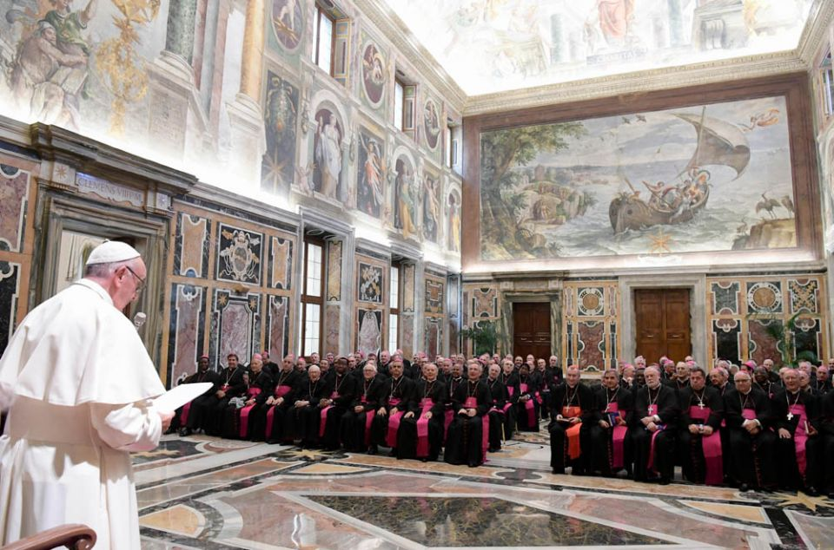
The Papacy Stands up against Christ! Who’s Your Authority?
"Not the Creator of Universe, in Genesis 2:1-3,-but the Catholic Church can claim the honor of having granted man a pause to his work every seven days." (S. C. Mosna, Storia della Domenica, 1969, pp. 366-367)
"The Pope is of great authority and power that he can modify, explain, or interpret even divine laws... The Pope can modify divine law, since his power is not of man, but of God, and he acts as vicegerent of God upon earth." (Lucius Ferraris, Prompta Bibliotheca, Papa, art. 2, translated)
"The authority of the church could therefore not be bound to the authority of the Scriptures, because the Church had changed...the Sabbath into Sunday, not by command of Christ, but by its own authority." (Canon and Tradition, p. 263)

Slide 8
One Compromise After Another…
Prayers for the dead 300s Martyrdom of Polycarp
Veneration of angels and dead saints 300s Discussed at martyrdom of Polycarp
The Mass, as a daily celebration, adopted 300s Augustine writings…
Holy Water 300s In the Apostolic Constitutions
The worship of Mary 431 Council of Ephesus
Purgatory 593 Established by Pope Gregory the Great
Every Altar Must contain a Relic (relic idolatry) 767 Nicaean Council
Extreme Unction 800s Became a Sacrament
The Rosary 800s Irish Monks and 150 Psalm Chants
Celibacy of the priesthood 1022 Decree of Boniface VII
The sale of Indulgences, commonly regarded as a purchase of 1088 Pope Urban II in support of Crusades
The Inquisition 1184 Council of Verona
Transubstantiation 1215 Innocent III
Confession once a year minimum 1215 Innocent III in Lateran Council
The adoration of the wafer (Host) 1220 Pope Honorius
The Bible forbidden to laymen 1229 Council of Valencia
Tradition equal with Scripture 1545 Council of Trent
The apocryphal books declared inspired 1546 Council of Trent
The Immaculate Conception 1834 Pope Pius IX
Papal Infallibility 1870 Pope Pius IX
Assumption of Mary 1950 Pope Pius XII

Slide 9
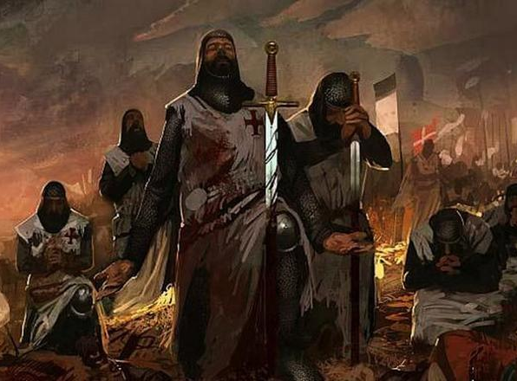
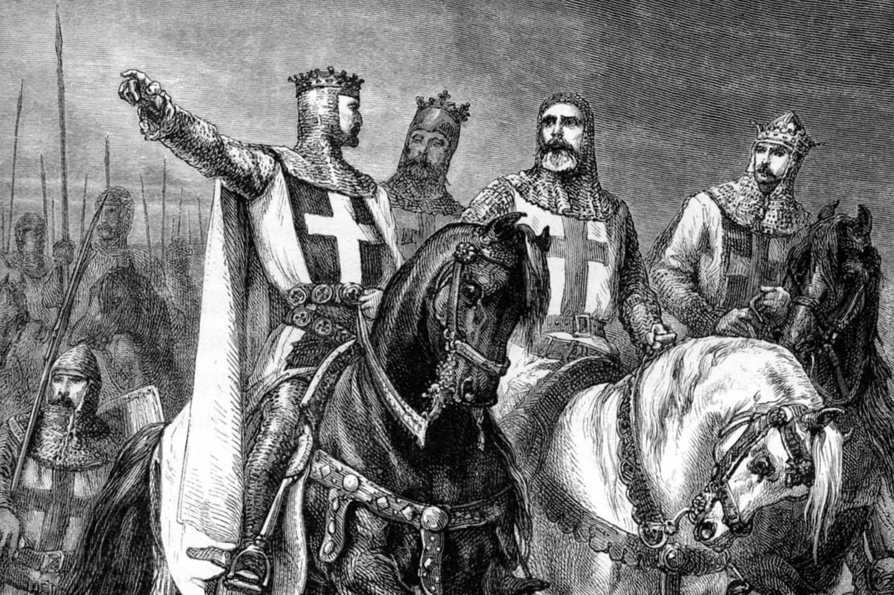
“From the birth of Popery in 606 to the present time, it is estimated by careful and credible historians, that more than fifty millions of the human family, have been slaughtered for the crime of heresy by popish persecutors, an average of more than forty thousand religious murders for every year of the existence of popery." -- "History of Romanism," pp. 541, 542. New York: 1871.
“Need I speak to you of the thirty years’ war in Germany, which was mainly instigated by the Jesuits, in order to deprive the Protestants of the right of free religious worship, secured to them by the treaty of Augsburg? Or of the Irish rebellion, of the inhuman butchery of about fifteen millions of Indians in South America, Mexico and Cuba, by the Spanish papists? In short, it is calculated by authentic historians, that papal Rome has shed the blood of sixty-eight millions of the human race in order to establish her unfounded claims to religious dominion (citing Dr. Brownlee’s “Popery an enemy to civil liberty”, p. 105).

Slide 10
Caesar Pope
Nero (64-68 AD) because of the Great Fire of Rome
Domitian (81 AD) Once brought to the tribunal, Christians must be killed if unwilling to renounce their religion
Trajan (108 AD)
Marcus Aurelius (162 AD)
Severus (192-232 AD)
Maximus (235 AD)
Decius (249-251 AD) Empire-wide
Valerian (257 AD)
Aurelian (274 AD)
Diocletian (284-305 AD) Empire-wide
St. Bartholomew’s Day Massacre 1572 (ends in 70,000 killed in France)
Irish Massacre 1641 (300,000 killed)
30 Years War 1618-1648 (12 million)
The Great Massacre of 1655 Waldenses (1,700 most brutal)
Inquisitions, Crusades, various dates (50 million)
Age of Exploration Conquistadors (15 million American Natives)
Wars with Waldenses and Albigenses (1 million)
Nazi Germany (11 million-not including WWII victims)

Slide 11
4th Beast
Progression of Rome through time…
Little Horn
Daniel 7
Progression of Rome through time…
Little Horn
Little Horn
Daniel 8

Slide 12
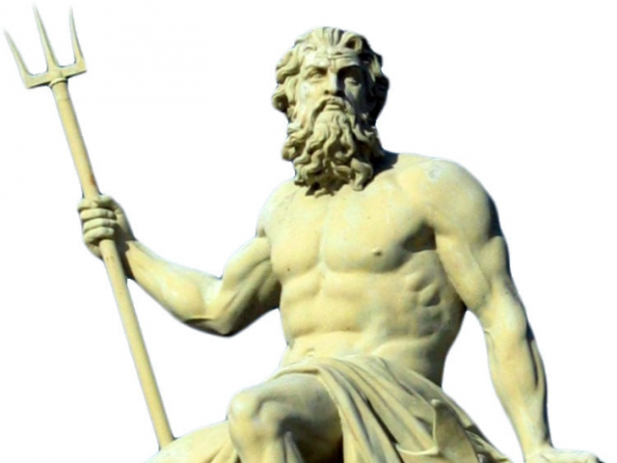
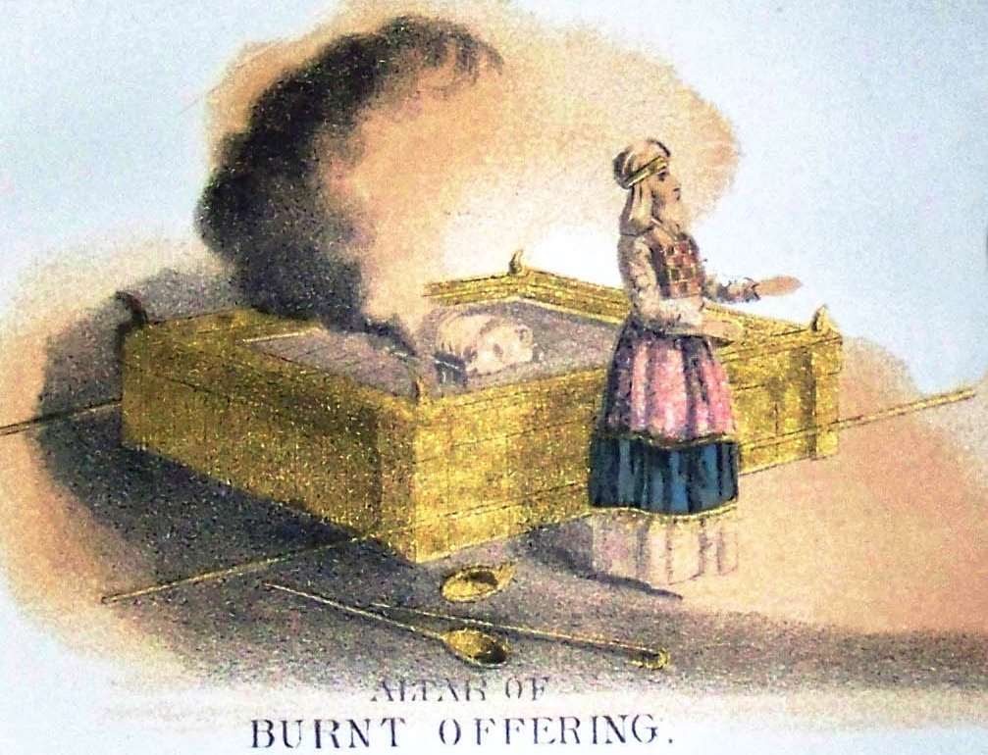
What is Meant by “Daily”???
Daily = Strong’s Concordance: 8548 tamiyd (taw-meed)- continually, continual, daily, always, alway, perpetual, continual employment 1) continuity, perpetuity, to stretch 1a) continually, continuously (as adverb) 1b) continuity (substance)
?

Slide 13
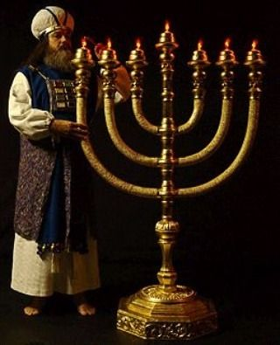
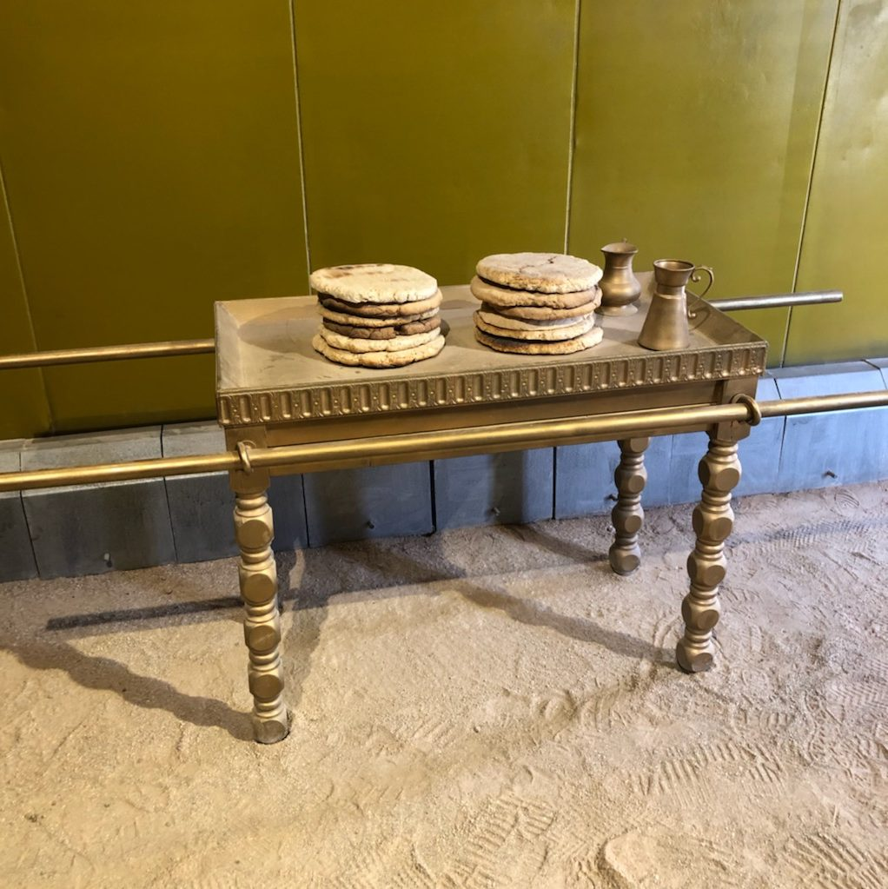
Biblical Examples of Tamiyd
Ex. 30:8 “And when Aaron lighteth the lamps at even, he shall burn incense upon it, a perpetual (tamiyd) incense before the Lord throughout your generations.”
Ex. 27:20 “And thou shalt command the children of Israel, that they bring thee pure oil olive beaten for the light, to cause the lamp to burn always. (tamiyd)”
Ex. 25:30 “And thou shalt set upon the table shewbread before me alway. (tamiyd)”
Num. 28:6 “It is a continual (tamiyd) burnt offering, which was ordained in mount Sinai for a sweet savour, a sacrifice made by fire unto the Lord.”

Slide 14
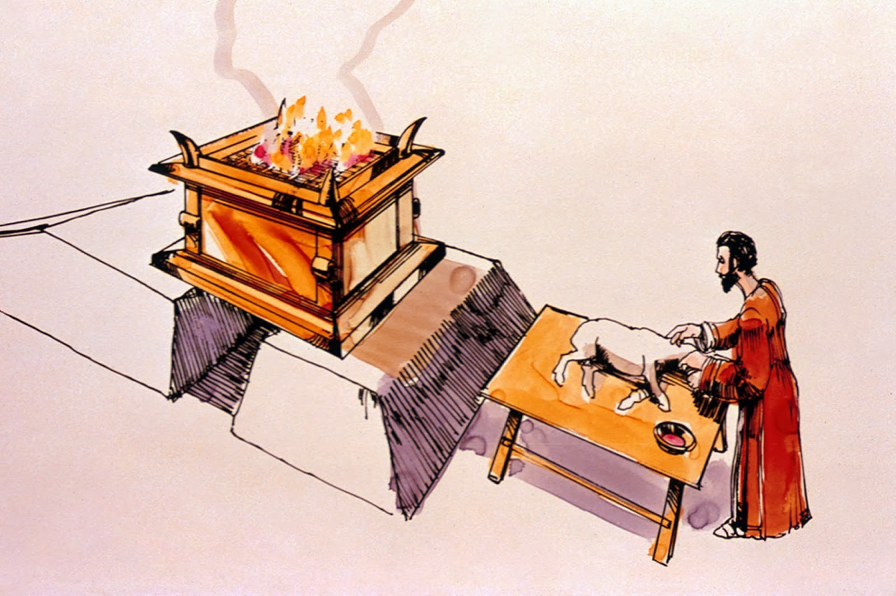
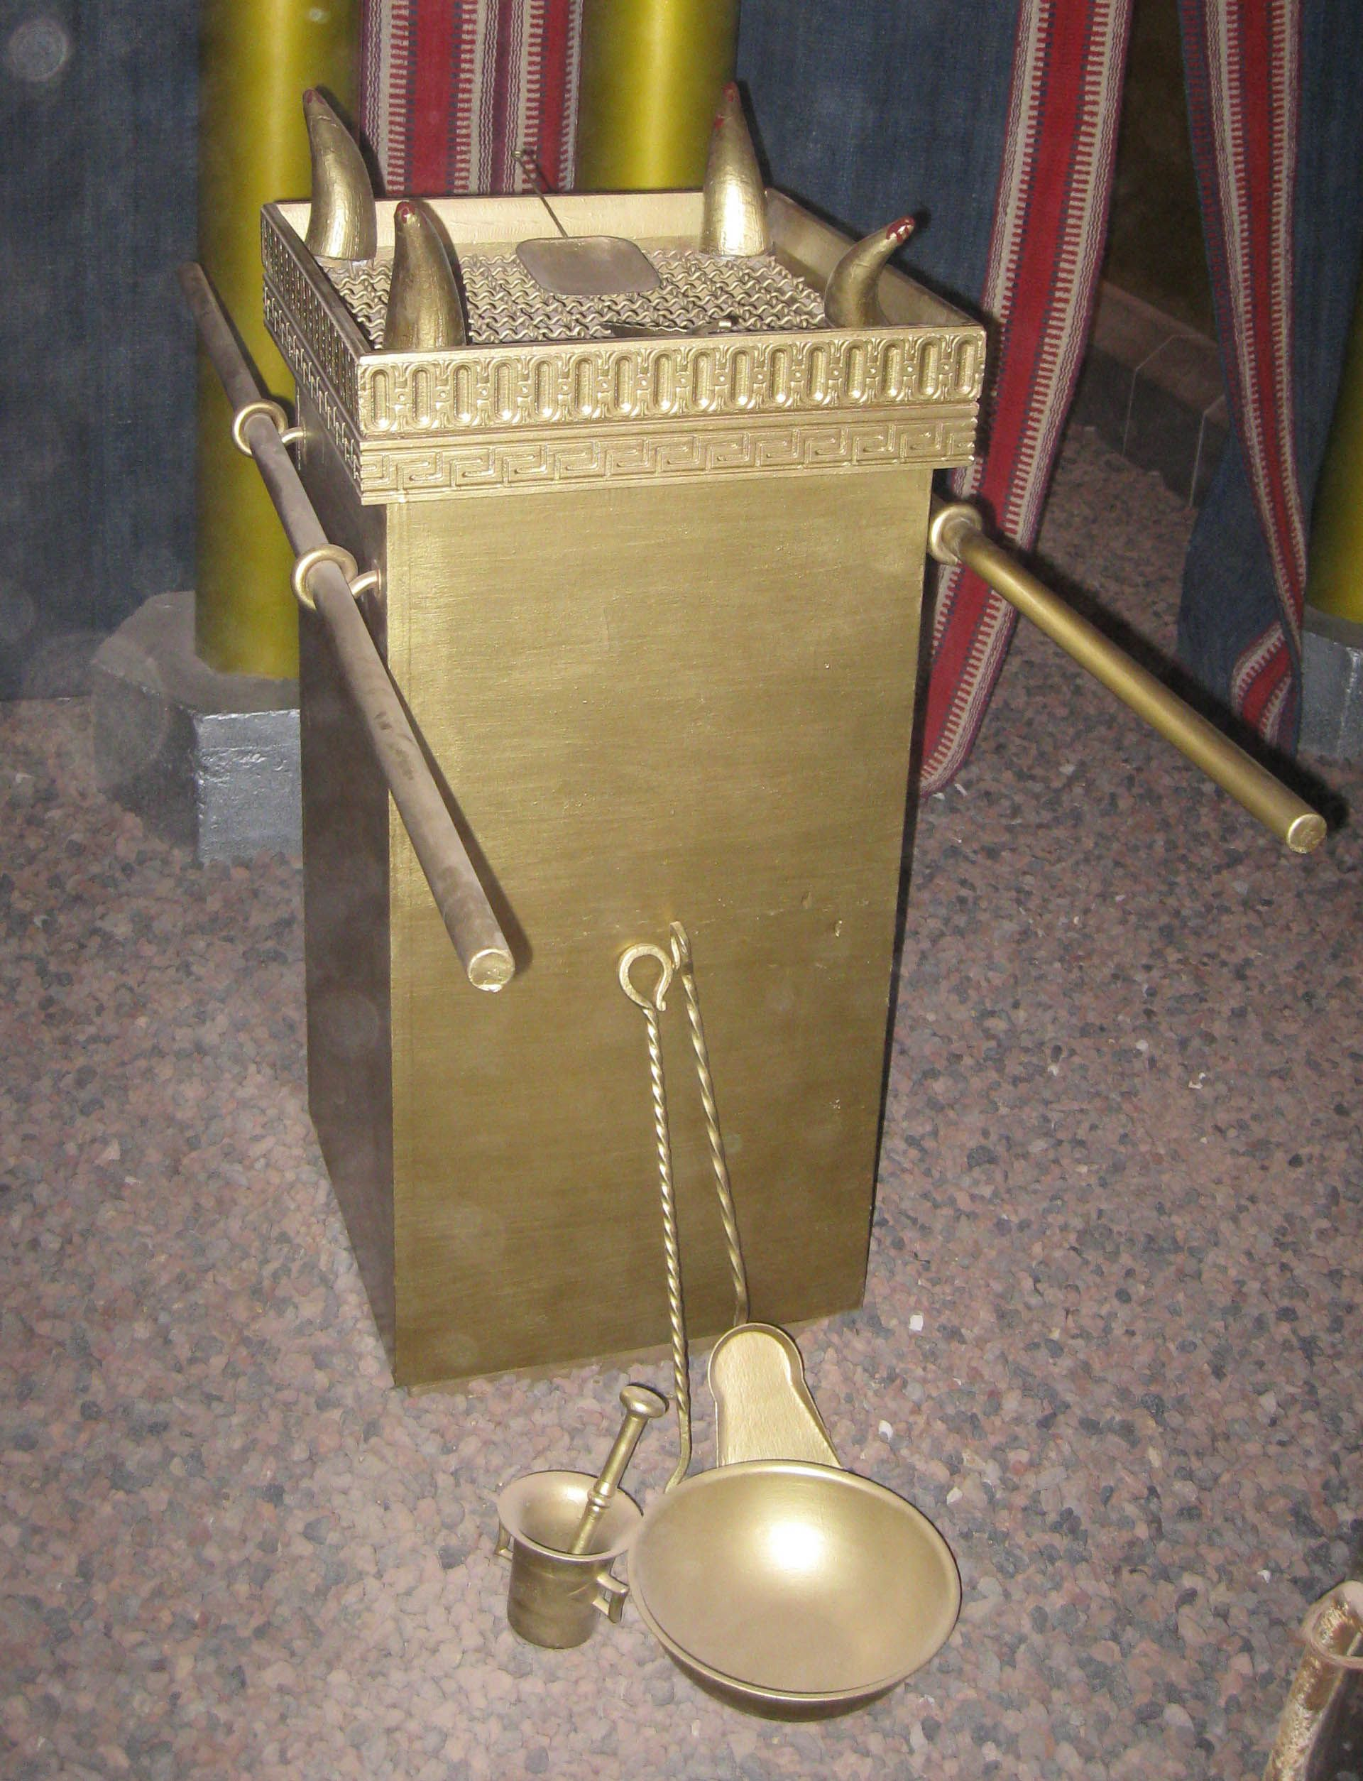
New Testament Examples of “daily/continual”
Heb. 7:3 “Without father, without mother, without descent, having neither beginning of days, nor end of life; but made like unto the Son of God; abideth a priest continually.”
Heb. 9:6 “Now when these things were thus ordained, the priests went always into the first tabernacle, accomplishing the service of God.”
Heb. 10:11 “And every priest standeth daily ministering and offering oftentimes the same sacrifices, which can never take away sins:”

Slide 15
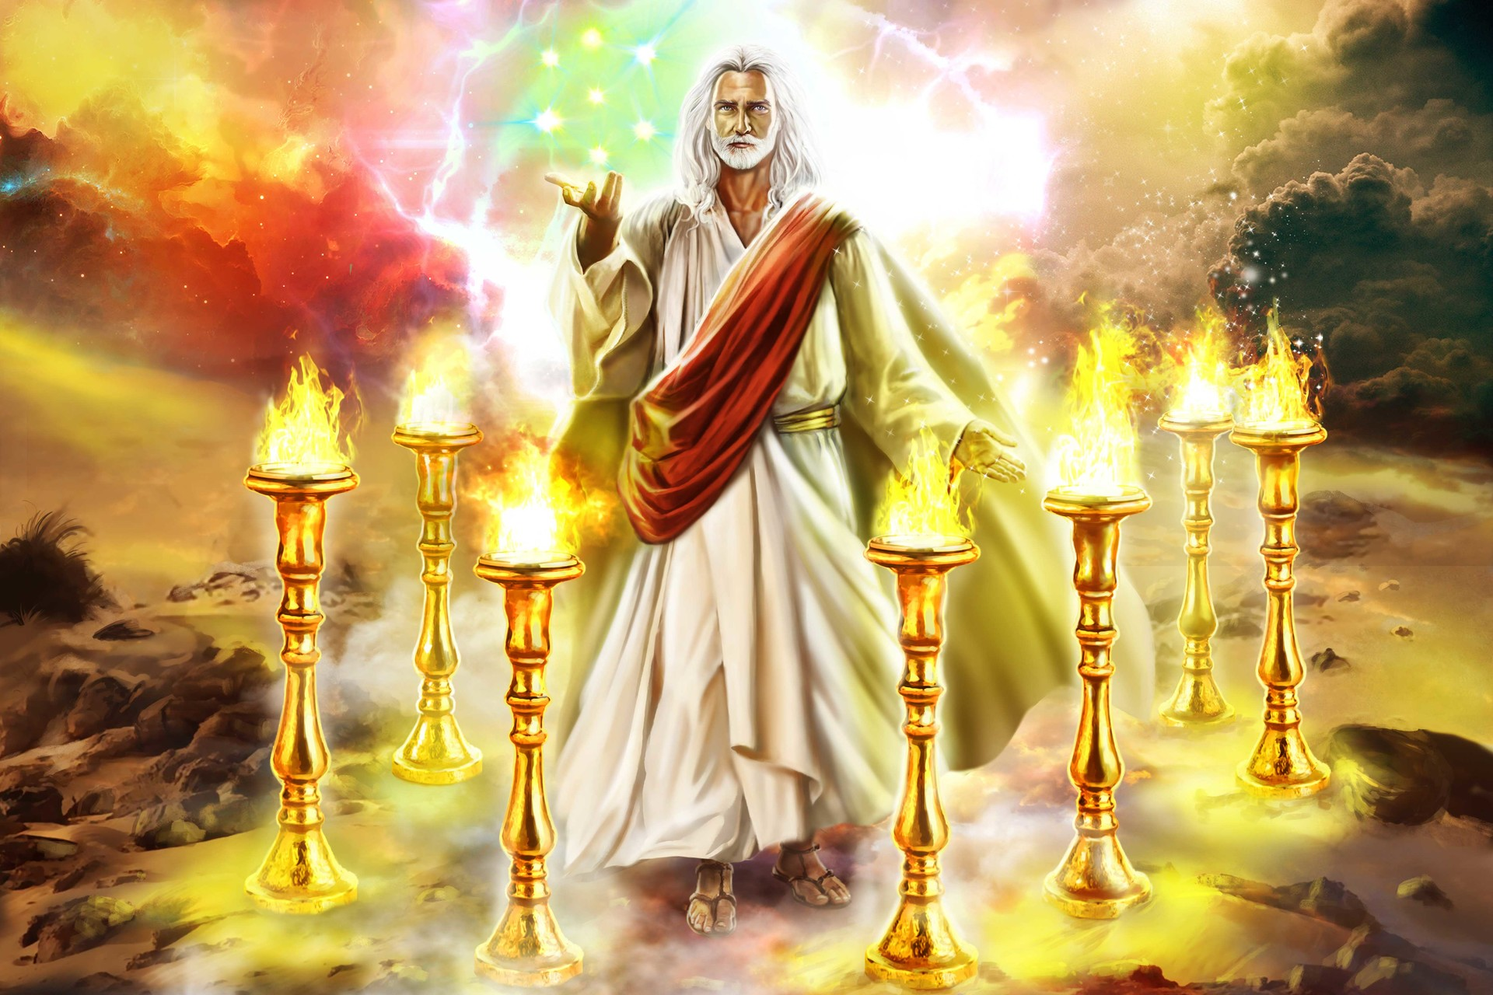
Christ is in the 1st Apartment in John’s Day!
Rev. 1:12-13 “And I turned to see the voice that spake with me. And being turned, I saw seven golden candlesticks; And in the midst of the seven candlesticks one like unto the Son of man, clothed with a garment down to the foot, and girt about the paps with a golden girdle.

Slide 16
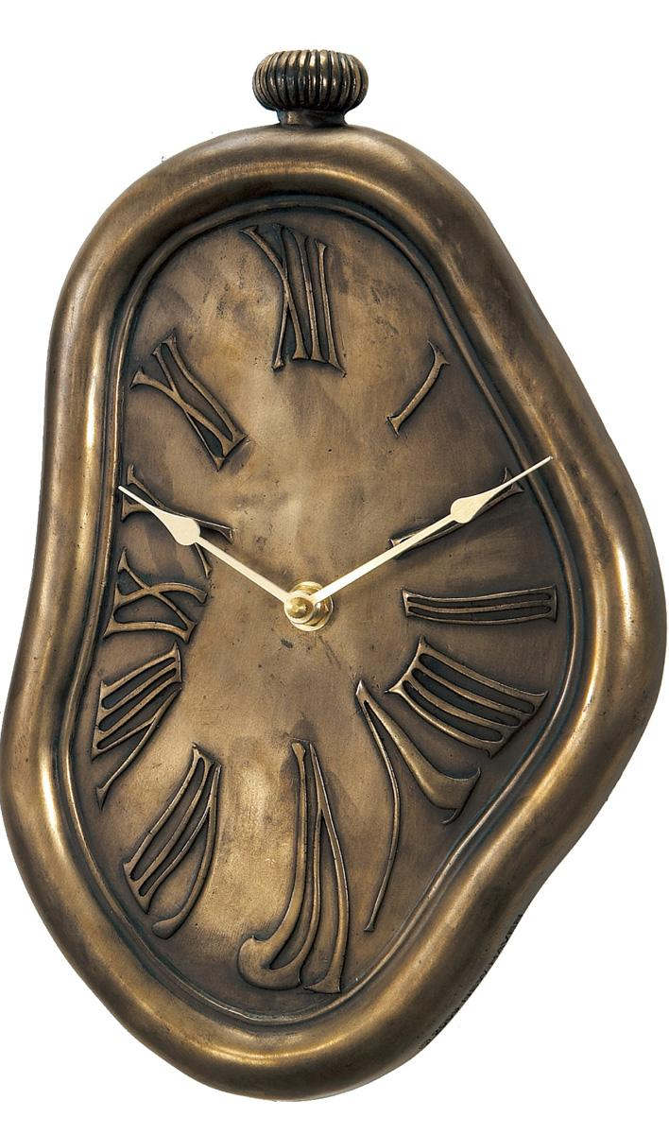
Ellen White Sheds Some Light
“Then I saw in relation to the "daily" (Daniel 8:12) that the word "sacrifice" was supplied by man's wisdom, and does not belong to the text, and that the Lord gave the correct view of it to those who gave the judgment hour cry. When union existed, before 1844, nearly all were united on the correct view of the "daily"; but in the confusion since 1844, other views have been embraced, and darkness and confusion have followed. Time has not been a test since 1844, and it will never again be a test. The Lord has shown me that the message of the third angel must go, and be proclaimed to the scattered children of the Lord, but it must not be hung on time. I saw that some were getting a false excitement, arising from preaching time; but the third angel's message is stronger than time can be. I saw that this message can stand on its own foundation and needs not time to strengthen it; and that it will go in mighty power, and do its work, and will be cut short in righteousness.” EW, p. 74-75

Slide 17
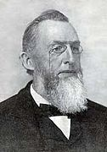
A Researcher Adds
“From nowhere in the entire Bible has anyone been able to produce even one text that says the “daily” is paganism—not one!—despite rewards offered for such evidence in my “Daily” Source Book. That’s because the Bible nowhere endorses that premise. That interpretation is alien to the Bible and the prophets, and so is its doctrine. With no Biblical support, one does not have a Biblical doctrine and should not advocate it as such. And what other authority could be claimed? When the “daily” is used in the context of the sanctuary, it is always the work of the priest in the first apartment of the sanctuary. Never was the “daily” attributed to the work of the priest in the second apartment, or to anything else in that context.”—Heidi Heiks, 508 Source Book, p. 12-13

Slide 18
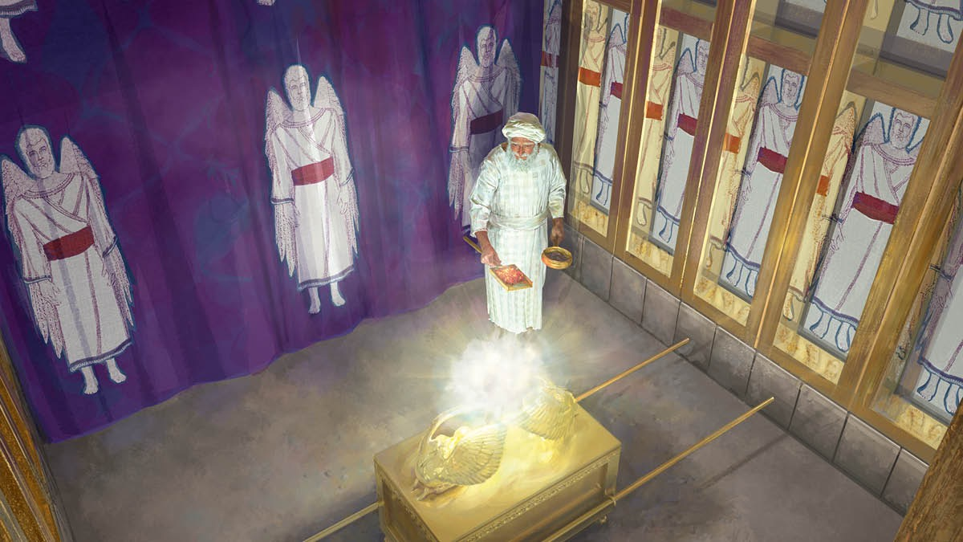
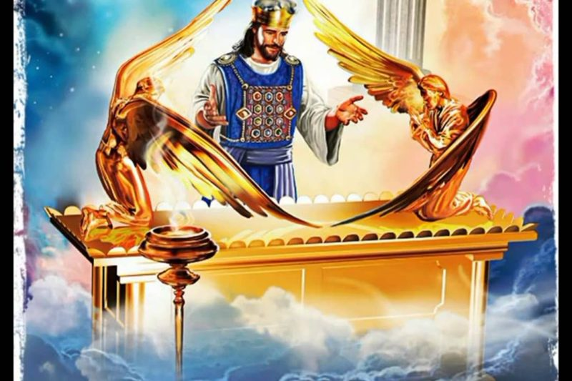
Ellen White Clarifies…
“I believe the Sanctuary, to be cleansed at the end of the 2300 days, is the New Jerusalem Temple, of which Christ is a minister. The Lord shew me in vision, more than one year ago, that Brother Crosier had the true light, on the cleansing of the Sanctuary, &c; and that it was his will, that Brother C. should write out the view which he gave us in the Day-Star, Extra, February 7, 1846. I feel fully authorized by the Lord, to recommend that Extra, to every saint. I pray that these lines may prove a blessing to you, and all the dear children who may read them.” A Word to the Little Flock, p. 7

Slide 19
What Did Crosier Say???
"Now when these things (the worldly Sanctuary with its two apartments and the furniture in each) were thus ordained, the priests went always (daily, Hebrews 7:27; 10:11) into the first tabernacle, accomplishing the service of God; but in the second went the high priest alone once every year, not without blood, which he offered for himself, and for the errors of his people." Hebrews 9:6,7. Here Paul divides the services of the Levitical priesthood into two classes - one daily in the Holy, and the other yearly in the Holy of Holies. Their stated daily services, performed in the Holy and at the brazen altar in the court before the tabernacle, consisted of a burnt-offering of two lambs, one in the morning and the other at even, with a meat [ or meal] offering which was one tenth of an ephah of flour mingled with the fourth part of an hin of beaten oil, and a drink-offering which was one-fourth of an hin of strong wine. The meat-offering was burnt with the lamb, and the drink-offering was poured in the Holy; Exodus 29:38-42; Numbers 28:3-8” —ORL Crosier, Feb. 7, 1846, The Day-Star Extra, The Sanctuary

Slide 20
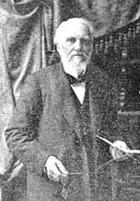
Crosier Continues
“In connection with this, they burned on the golden altar in the Holy, sweet incense, which was a very rich perfume, when they dressed and lighted the lamps every evening and morning. Exodus 34-38; 31:11; 30:7-9. The same was afterwards done at the Temple. 1 Chronicles 16:37-40; 2 Chronicles 2:4; 13:4-12; 13:3 [ see 2 Chronicles 31:3] Ezra 3:3. This did not atone for sins either individually or collectively. The daily service described was a sort of continual intercession; but the making of atonement was a special work for which special directions are given. Different words are used both in the Old Testament and New, to express the same idea as At-one-ment.”—ORL Crosier, Feb. 7, 1846, The Day-Star Extra, The Sanctuary

Slide 21
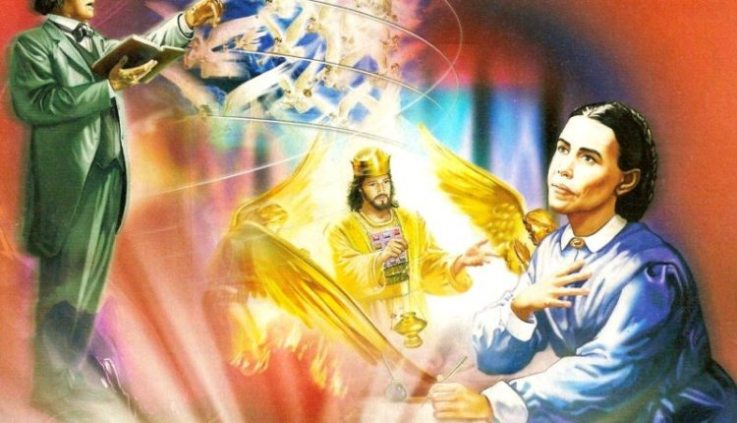
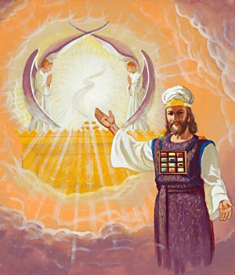
One More Section
“The atonement is the great idea of the Law, as well as the Gospel; and as the design of that of the Law was to teach us that of the Gospel, it is very important to be understood. The atonement which the priest made for the people in connection with their daily ministration was different from that made on the tenth day of the seventh month. In making the former, they went no further than in the Holy; but to make the latter they entered the Holy of Holies - the former was made for individual cases, the latter for the whole nation of Israel collectively - the former was made for the forgiveness of sins, the latter for blotting them out - the former could be made at any time, the latter only on the tenth day of the seventh month. Hence the former may be called the daily atonement and the latter the yearly, or the former the individual , and the latter the national atonement.”—ORL Crosier, Feb. 7, 1846, The Day-Star Extra, The Sanctuary

Slide 22
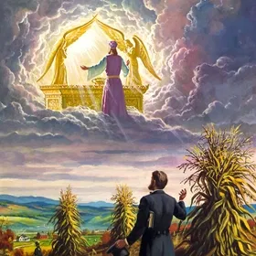
How Did the Roman Church Take Away the Daily?
Obey the Pope not the Bible (New High Priest, New Authority)
Follow the Sacraments (New Laver and Drink Offering)
Do the repetitive prayers (New Altar, New Incense)
Buy indulgences (New Substitute/Sacrifice for sin)
Pay into the church (New Tithe)
Become a monk or nun (New Candlestick)
Confess to the priests (New Intercessors)
Visit relics (New “Works”)
Pray to saints (New Mediators, New Oil)
Keep Sunday not Sabbath (New Tablets of Law)
Submit to the priesthood (New Priesthood)
Take in the “Daily” Mass (New Daily Bread/New Communion)
Believe the false Doctrines (New Faith/Doctrine)
Righteousness by works (New Man-centered Faith)
Go to purgatory (New Penalties—New Forgiveness)

Slide 23
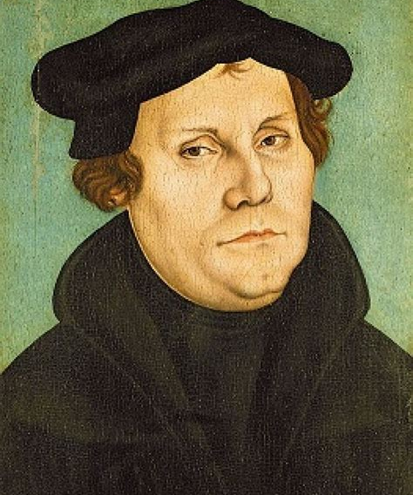
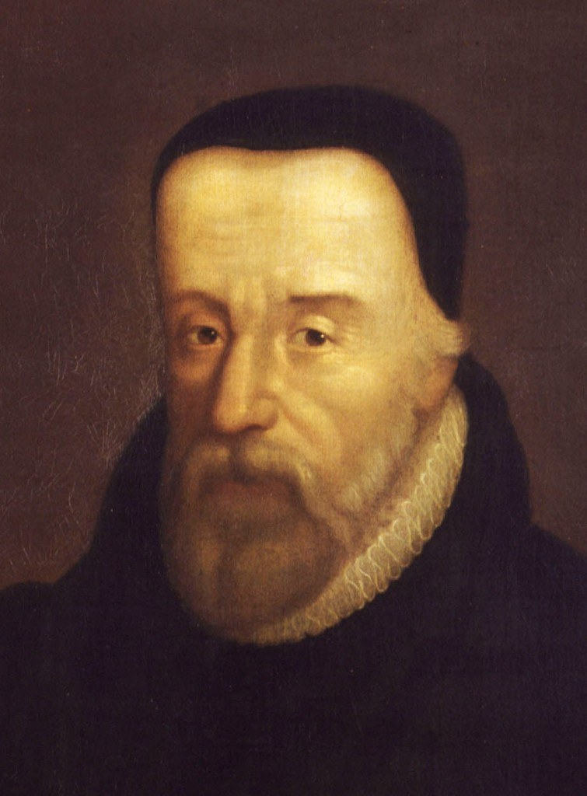
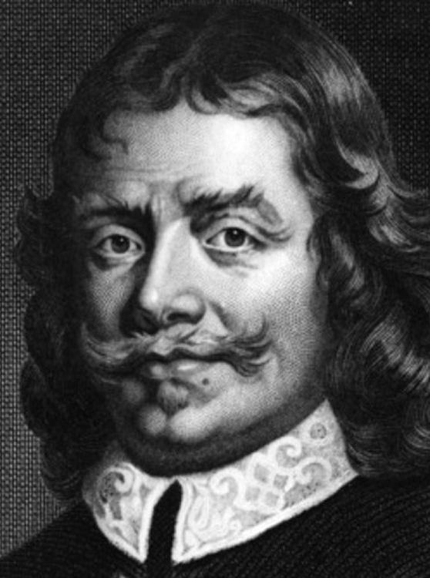
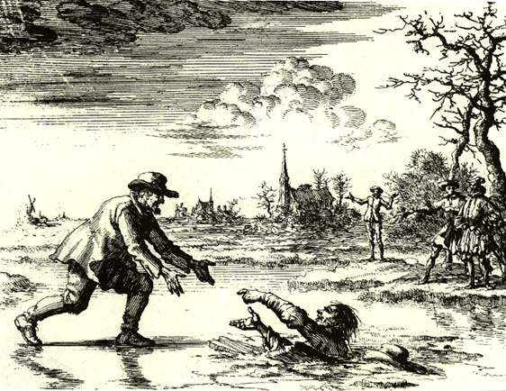
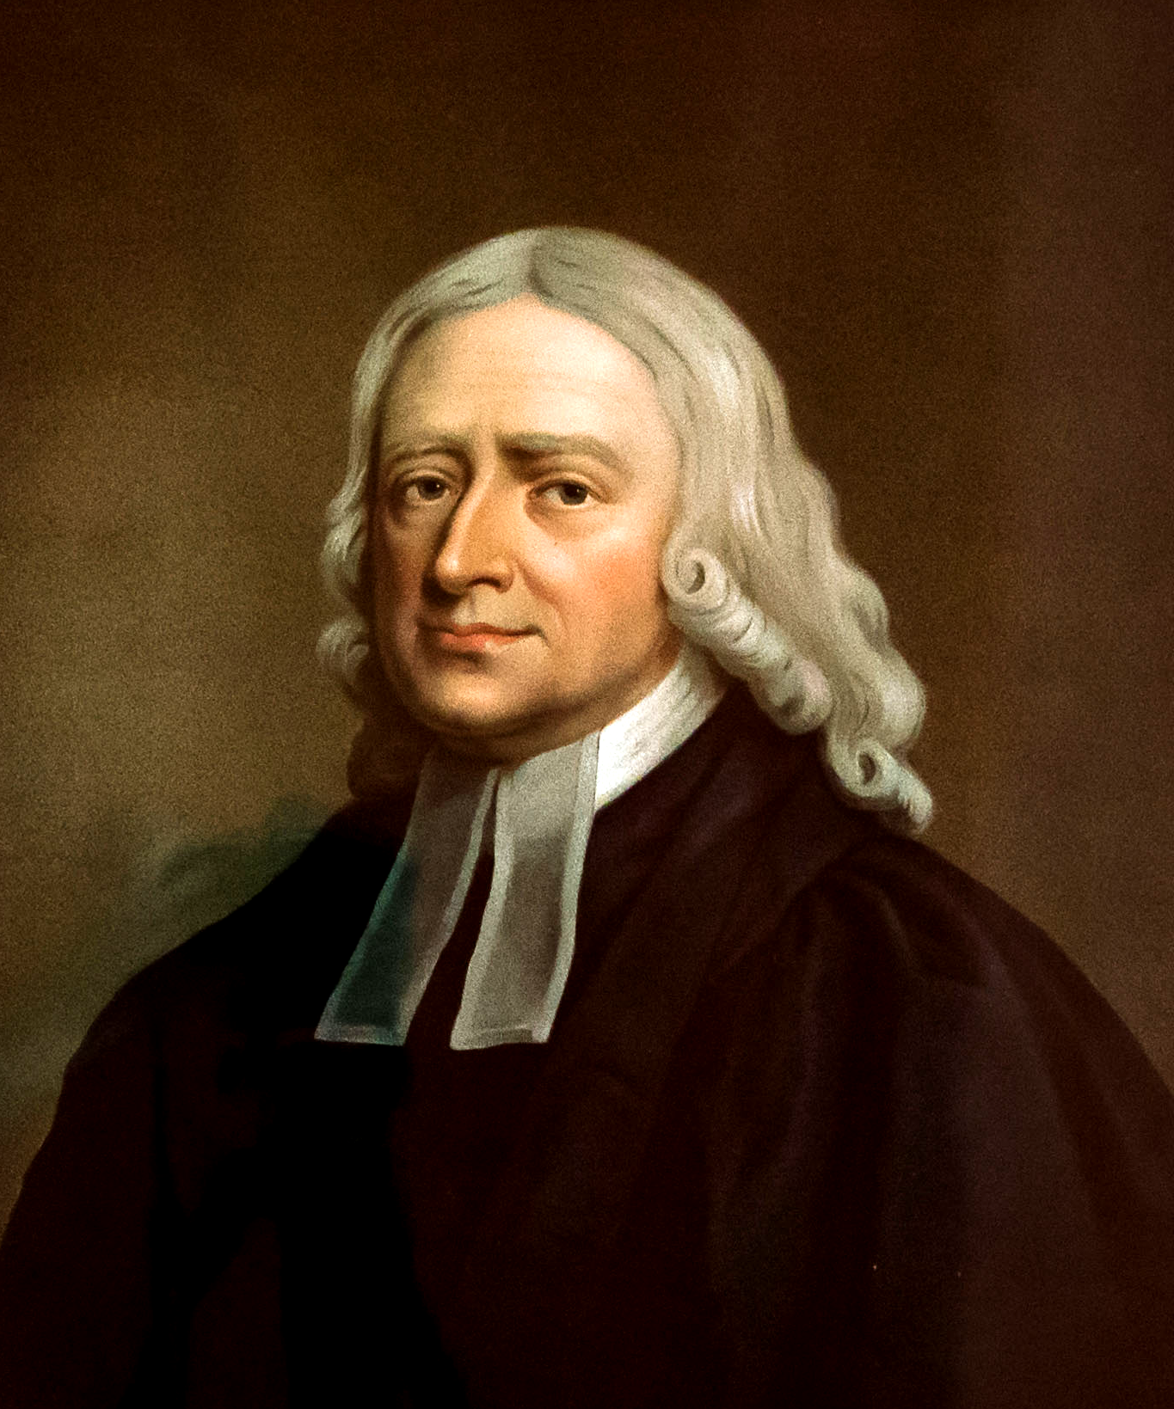
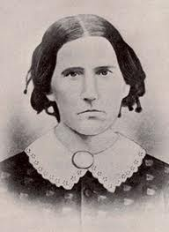
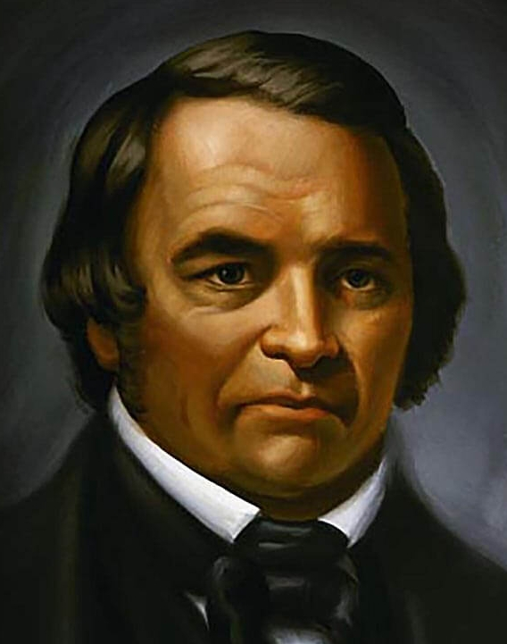
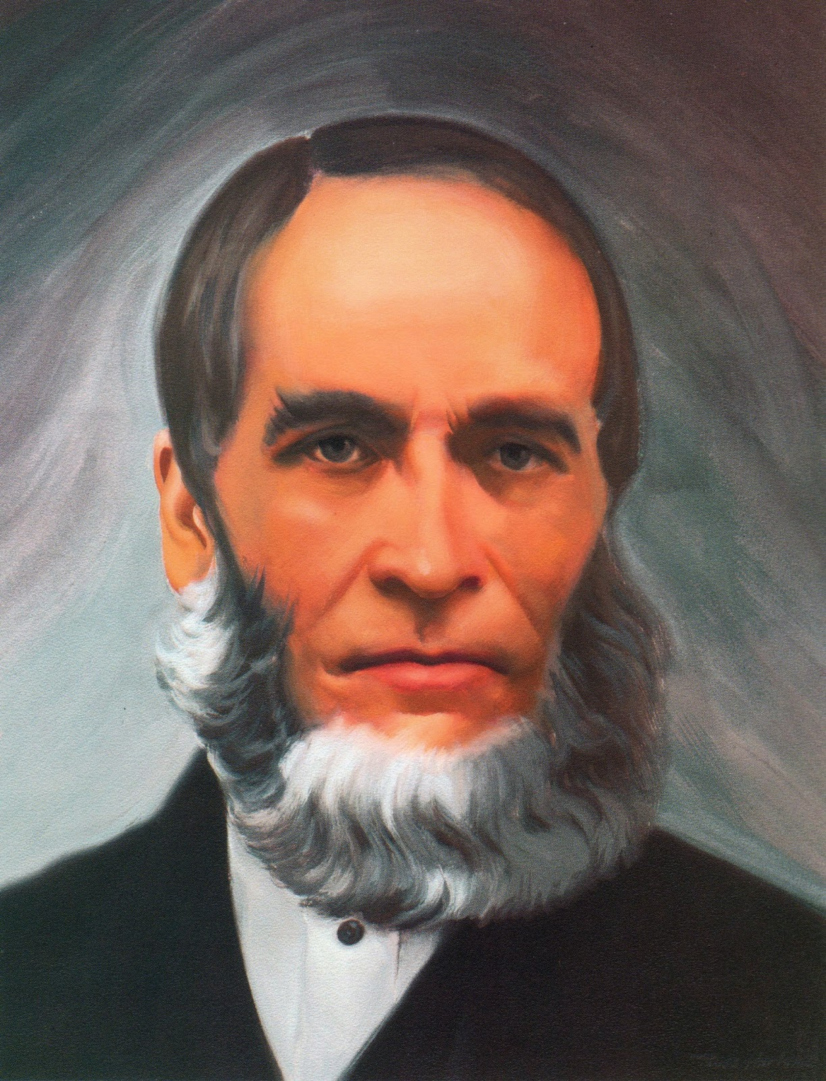
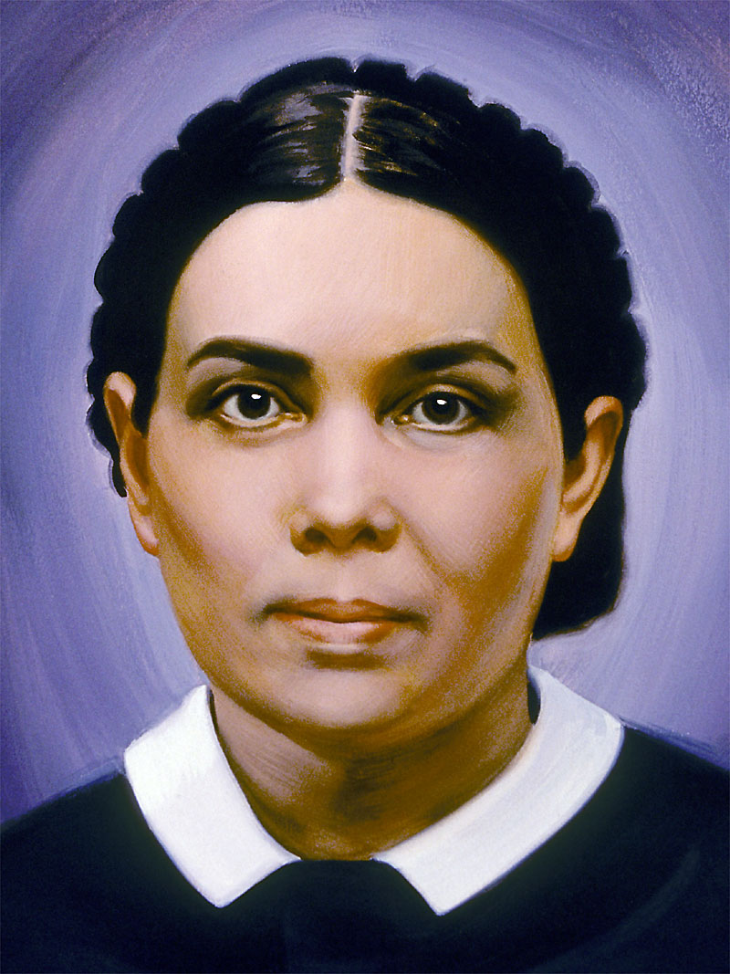
The Reformation Began Recovering the Sanctuary
The Reformation Rediscovered lost truths of the Sanctuary—effectively beginning the process of restoring the spiritual Sanctuary, culminating in the full restoration by Christ in 1844:
Justification by Faith – Altar of Burnt Offering Restored
Baptism and Communion – Laver and Drink Offering Restored
Sola Scriptura – Daily Bread/Shewbread Restored
Evangelism – Candlestick Restored
Prayer in the Spirit – Altar of Incense Restored
Righteousness by Faith – Merits of Christ/incense and oil restored
1844
7. Sabbath – Law of God Restored
8. Health Message – Manna Restored
9. Justification By Faith – Aaron’s Rod/Mercy Seat Restored
10. 3 Angel’s Messages – Judgment Hour/Day of Atonement Message Restored
11. State of the Dead – Investigative Judgment Understanding Restored

Slide 24
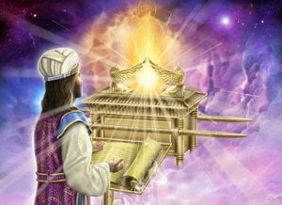
The Hour of His Judgment
Dan. 8:14 “And he said unto me, Unto two thousand and three hundred days; then shall the sanctuary be cleansed.”---ended in 1844
Lev. 16:15-16 “Then shall he kill the goat of the sin offering, that is for the people, and bring his blood within the vail, and do with that blood as he did with the blood of the bullock, and sprinkle it upon the mercy seat, and before the mercy seat: And he shall make an atonement for the holy place, because of the uncleanness of the children of Israel, and because of their transgressions in all their sins: and so shall he do for the tabernacle of the congregation, that remaineth among them in the midst of their uncleanness.”

Slide 25
