Slide 1
Revelation 22
The Heavenly Home

Slide 2
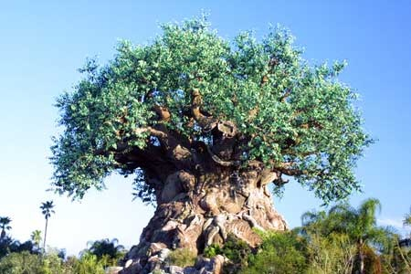
The Restored Tree
“And he shewed me a pure river of water of life, clear as crystal, proceeding out of the throne of God and of the Lamb. In the midst of the street of it, and on either side of the river, was there the tree of life, which bare twelve manner of fruits, and yielded her fruit every month: and the leaves of the tree were for the healing of the nations.“ Rev. 22:1,2 How do you depict a tree that bears 12 different kinds of fruits on one tree? Apples, mangoes, plums, peaches, pears, oranges, tangerines, pomegranates, cherries, papayas, bananas, and grapefruit. Unbelievable!!

Slide 3
How Did it get There?
“The Garden of Eden remained upon the earth long after man had become an outcast from its pleasant paths. The fallen race were long permitted to gaze upon the home of innocence, their entrance barred only by the watching angels. At the cherubim-guarded gate of Paradise the divine glory was revealed. Hither came Adam and his sons to worship God. Here they renewed their vows of obedience to that law the transgression of which had banished them from Eden. When the tide of iniquity overspread the world, and the wickedness of men determined their destruction by a flood of waters, the hand that had planted Eden withdrew it from the earth. But in the final restitution, when there shall be "a new heaven and a new earth" (Revelation 21:1), it is to be restored more gloriously adorned than at the beginning. Then they that have kept God's commandments shall breathe in immortal vigor beneath the tree of life; and through unending ages the inhabitants of sinless worlds shall behold, in that garden of delight, a sample of the perfect work of God's creation, untouched by the curse of sin--a sample of what the whole earth would have become, had man but fulfilled the Creator's glorious plan.” PP, pg. 62

Slide 4
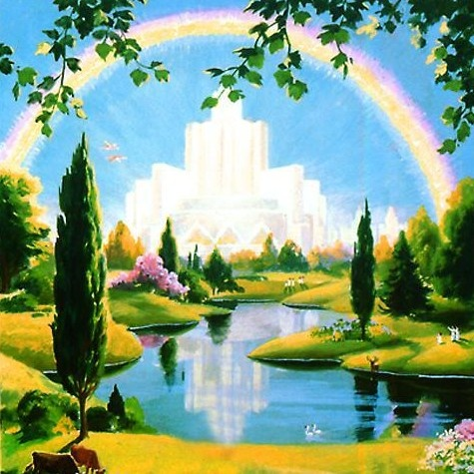
Eye Has Not Seen
“And there shall be no more curse: but the throne of God and of the Lamb shall be in it; and his servants shall serve him: And they shall see his face; and his name shall be in their foreheads. And there shall be no night there; and they need no candle, neither light of the sun; for the Lord God giveth them light: and they shall reign for ever and ever.” Revelation 22:3-5 No night and no sun?

Slide 5
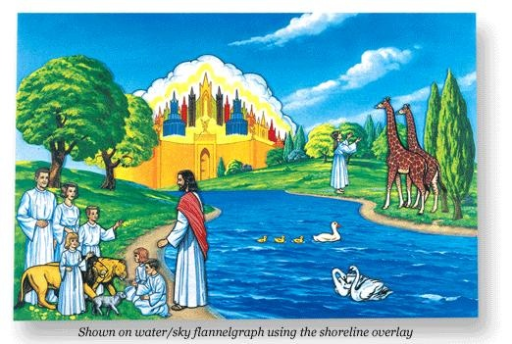
Behold……………………
Try as men do to picture heaven, it is impossible, We have no idea of the glories of that place. Even to describe it with words is futile.
“But as it is written, Eye hath not seen, nor ear heard, neither have entered into the heart of man, the things which God hath prepared for them that love him.“

Slide 6
A Blessing
“And he said unto me, These sayings are faithful and true: and the Lord God of the holy prophets sent his angel to shew unto his servants the things which must shortly be done. Behold, I come quickly: blessed is he that keepeth the sayings of the prophecy of this book.” Revelation 22:6,7
“Blessed is he that readeth, and they that hear the words of this prophecy, and keep those things which are written therein: for the time is at hand.” Revelation 1:3 A blessing is for those that study the book of Revelation. It reveals Christ as Savior, Priest, Coming King, and Judge.

Slide 7
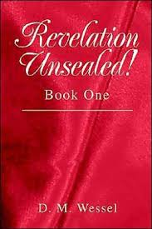
An Unsealed Book
“And I John saw these things, and heard them. And when I had heard and seen, I fell down to worship before the feet of the angel which shewed me these things. Then saith he unto me, See thou do it not: for I am thy fellow servant, and of thy brethren the prophets, and of them which keep the sayings of this book: worship God. And he saith unto me, Seal not the sayings of the prophecy of this book: for the time is at hand.” Rev. 22:8-10

Slide 8
Probation Will Soon Close!
“He that is unjust, let him be unjust still: and he which is filthy, let him be filthy still: and he that is righteous, let him be righteous still: and he that is holy, let him be holy still.” Rev. 22:11
One day soon, every person, while still alive, will have made a determination, that only Heaven can read, for or against God. When that irrevocable decision has been made, probation will shut and no other decisions for or against God will be made. There will be no more chances.

Slide 9
Sooner For Us!
“For the time is come that judgment must begin at the house of God: and if it first begin at us, what shall the end be of them that obey not the gospel of God?” 1Peter 4:17 “And the LORD said unto him, Go through the midst of the city, through the midst of Jerusalem, and set a mark upon the foreheads of the men that sigh and that cry for all the abominations that be done in the midst thereof. And to the others he said in mine hearing, Go ye after him through the city, and smite:.. but come not near any man upon whom is the mark; and begin at my sanctuary. Then they began at the ancient men which were before the house.” Ezekiel 9:4-6

Slide 10
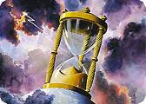
Probation Closes
Because SDA’s have been given the truth for this time. They will be judged first. Those SDA’s that choose Christ and submission to His way will receive the seal of God, the latter rain, and will give the loud cry of Rev. 18. Those SDA’s that choose rebellion will receive the mark of the beast, will be the most violent opposers of the faithful, and will suffer the plagues!

Slide 11
How it will unfold
As we draw near to the Sunday Law, the close of probation for us draws nigh. At the Sunday Law, we will make decisions for Christ and the Sabbath, or against Him, and embrace the sign of rebellion, which is Sunday. We will be sealed or marked at that time while we are still alive. What choices are we making today? Just because we keep the Sabbath doesn’t guarantee receiving the seal of God. If we choose rebellion through the week, the Sabbath is meaningless. Christ wants us to remember Him through the week and represent Him by His grace and our choices.

Slide 12
Awesome
“Satan has an accurate knowledge of the sins that he has tempted God's people to commit, and he urges his accusations against them, declaring, that by their sins they have forfeited divine protection, and claiming that he has the right to destroy them. He pronounces them just as deserving as himself of exclusion from the favor of God. "Are these," he says, "the people who are to take my place in heaven, and the place of the angels who united with me? They profess to obey the law of God; but have they kept its precepts? Have they not placed their own interests above His service? Have they not loved the things of the world? Look at the sins that have marked their lives. Behold their selfishness, their malice, their hatred of one another… Justice demands that sentence be pronounced against them……………………………………………………………………………….."

Slide 13
Concluded
……But while the followers of Christ have sinned, they have not given themselves up to be controlled by the satanic agencies. They have repented of their sins and have sought the Lord in humility and contrition, and the divine Advocate pleads in their behalf. He who has been most abused by their ingratitude, who knows their sin and also their penitence, declares: "The Lord rebuke thee, O Satan. I gave My life for these souls. They are graven upon the palms of My hands. They may have imperfections of character; they may have failed in their endeavors; but they have repented, and I have forgiven and accepted them." The assaults of Satan are strong, his delusions are subtle; but the Lord's eye is upon His people. Their affliction is great, the flames of the furnace seem about to consume them; but Jesus will bring them forth as gold tried in the fire. Their earthliness will be removed, that through them the image of Christ may be perfectly revealed.” PK, pgs. 588, 589

Slide 14
Victory!
“And, behold, I come quickly; and my reward is with me, to give every man according as his work shall be. I am Alpha and Omega, the beginning and the end, the first and the last. Blessed are they that do his commandments, that they may have right to the tree of life, and may enter in through the gates into the city. For without are dogs, and sorcerers, and whoremongers, and murderers, and idolaters, and whosoever loveth and maketh a lie.” Rev. 22:12-15
Sin forfeited man’s right to the tree of life. Victory, through faith in the power of Christ, brings the tree of life back into the grasp of God’s children. “But thanks be to God, which giveth us the victory through our Lord Jesus Christ.” 1 Corinthians 15:57

Slide 15
The Morning Star
“I Jesus have sent mine angel to testify unto you these things in the churches. I am the root and the offspring of David, and the bright and morning star.” Rev. 22:16
“And I will give him the morning star. He that hath an ear, let him hear what the Spirit saith unto the churches.” Rev. 2:28,29
“How you have fallen from heaven, morning star, son of the dawn!” Isaiah 14:12 NIV
“How art thou fallen from heaven, O Lucifer, son of the morning! how art thou cut down to the ground, which didst weaken the nations!” Isa. 14:12 KJV

Slide 16
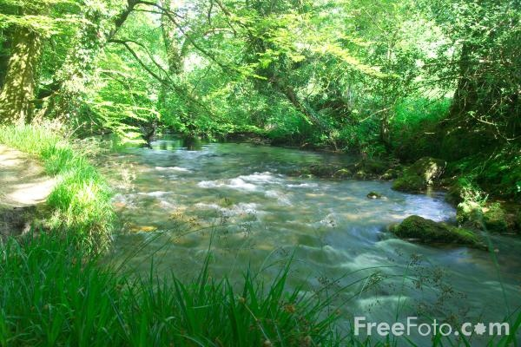
Satisfaction!!!
“And the Spirit and the bride say, Come. And let him that heareth say, Come. And let him that is athirst come. And whosoever will, let him take the water of life freely.” Rev. 22:17
“Whosoever drinketh of this water shall thirst again: But whosoever drinketh of the water that I shall give him shall never thirst; but the water that I shall give him shall be in him a well of water springing up into everlasting life.” John 4:13,14

Slide 17
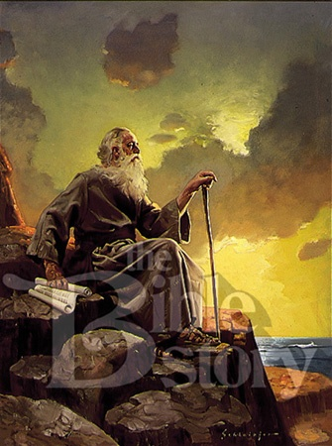
Revelation’s Importance
“For I testify unto every man that heareth the words of the prophecy of this book, If any man shall add unto these things, God shall add unto him the plagues that are written in this book: And if any man shall take away from the words of the book of this prophecy, God shall take away his part out of the book of life, and out of the holy city, and from the things which are written in this book.” Revelation 22:18,19

Slide 18
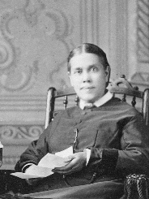
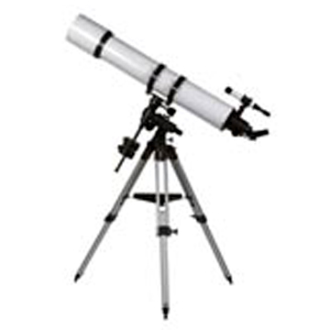
The Telescope

Slide 19
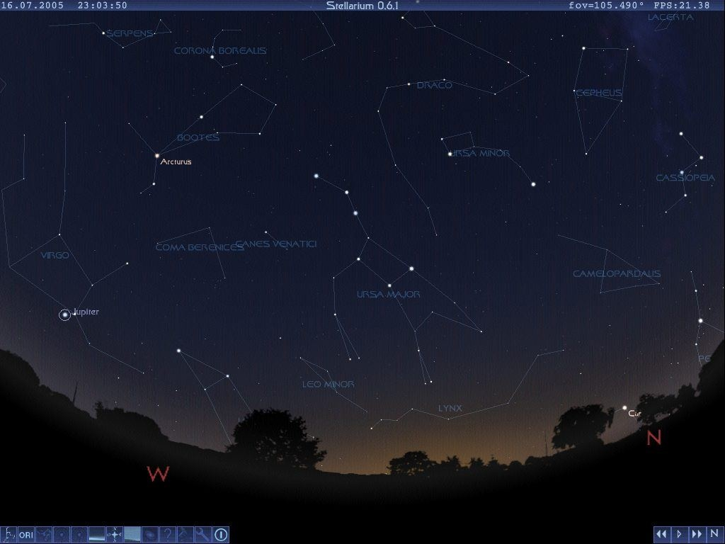
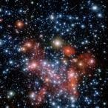
Our Choice

Slide 20
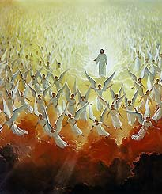
On His Way
“He which testifieth these things saith, Surely I come quickly. Amen. Even so, come, Lord Jesus. The grace of our Lord Jesus Christ be with you all. Amen.” Revelation 22: 20,21 If it was quickly 2,000 years ago, well, Christ is on His way NOW!

