Slide 1
What is the Difference Between Mormons, Jehovah’s Witnesses, and Seventh-day Adventists? pt 27

Slide 2
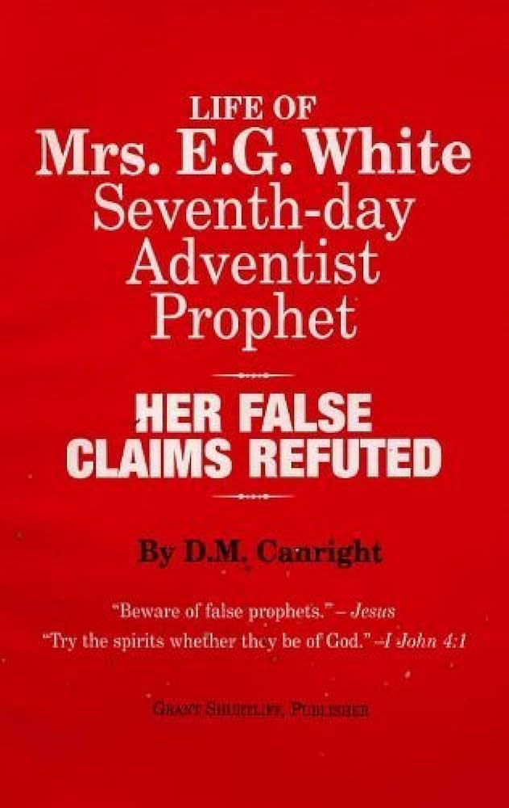
His Final Legacy….
“Canright died on May 12, 1919. Two months later, his final book, The Life of Mrs. E.G. White, was published. In it he criticised White heavily and maintained, among other charges:
that the early doctrines held in 1844 and up to 1851 failed utterly[—SHUT DOOR]
that in some cases her prophecies were wrong, and then suppressed afterwards[—FAILED PROPHECIES]
that she rebuked and controlled peoples' conduct, purportedly by spiritual knowledge, but factually by informings that often attacked an innocent party[—ELLEN WHITE CHARACTER ASSASSINATION]
that she plagiarized many of her purportedly God-inspired texts from other authors, and had to revise one of her books at an expense of $3,000[—PLAGIARISM]” DM Canright, Wikipedia

Slide 3
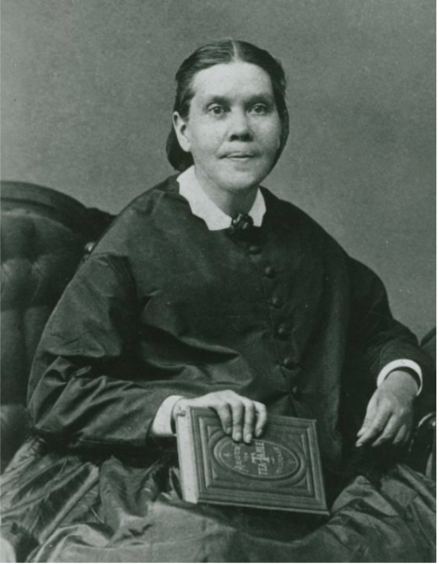
Still Standing!
-The Shut Door is a true doctrine—there’s the Open & Shut Door in the heavenly Sanctuary, & there’s the Shut Door pertaining to the parable of the Ten Virgins. The idea that all who did not participate in the 1844 movement were lost was privately (not in a prophetic public declarative sense) by Ellen White, but her visions corrected this false doctrine in her own mind and the believers
-The Plagiarism charge is a false charge. In her day, borrowing from other authors was a legitimate form of research. Plagiarism is new rule for a corrupt generation. William Tyndale did not follow it, neither did Luke, Matthew, Apostle Paul, Jude, and Jesus Christ—they all borrowed!
-The False Prophecies charge is a deceptive one. Prophecies are conditional—we see this over and over again in the Bible, why should a modern prophet’s prophecies be any different than the Bible pattern? Other prophecies were grossly misquoted, out of context, and insulting to the intelligence of the reader

Slide 4
Aha! We Got Her Now!
Ps. 40:14-16 “Let them be ashamed and confounded together that seek after my soul to destroy it; let them be driven backward and put to shame that wish me evil. Let them be desolate for a reward of their shame that say unto me, Aha, aha. Let all those that seek thee rejoice and be glad in thee: let such as love thy salvation say continually, The Lord be magnified.”
Prov. 5:10-14 “Lest strangers be filled with thy wealth; and thy labours be in the house of a stranger; And thou mourn at the last, when thy flesh and thy body are consumed, And say, How have I hated instruction, and my heart despised reproof; And have not obeyed the voice of my teachers, nor inclined mine ear to them that instructed me! I was almost in all evil in the midst of the congregation and assembly.”

Slide 5
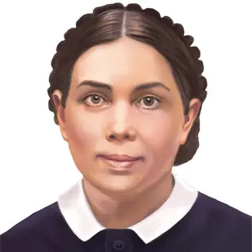
Charge 1: She Said She Was Not a Prophet!
“I said that I did not claim to be a prophetess. I have not stood before the people claiming this title, though many called me thus. I have been instructed to say, ‘I am God’s messenger, sent to bear a message of reproof to the erring and of encouragement to the meek and lowly.’”—R&H, January 26, 1905

Slide 6
Charge 1 Rebuttal: She Was Humble
“Some have stumbled over the fact that I said I did not claim to be a prophet; and they have asked, Why is this? I have had no claims to make, only that I am instructed that I am the Lord's messenger; that He called me in my youth to be His messenger, to receive His word, and to give a clear and decided message in the name of the Lord Jesus. Early in my youth I was asked several times, Are you a prophet? I have ever responded, I am the Lord's messenger. I know that many have called me a prophet, but I have made no claim to this title. My Saviour declared me to be His messenger. 'Your work,' He instructed me, 'is to bear My word. Strange things will arise, and in your youth I set you apart to bear the message to the erring ones, to carry the word before unbelievers, and with pen and voice to reprove from the Word actions that are not right. Exhort from the Word. I will make My Word open to you. It shall not be as a strange language. In the true eloquence of simplicity, with voice and pen, the messages that I give shall be heard from one who has never learned in the schools. My Spirit and My power shall be with you.’” R&H, July 26, 1906

Slide 7
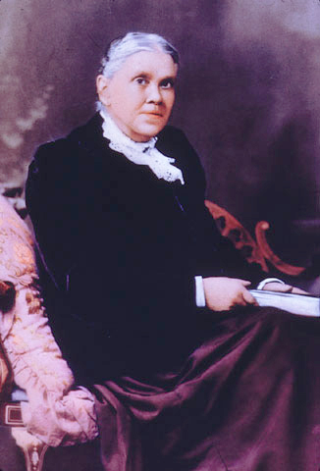
Continued…
"Why have I not claimed to be a prophet?--Because in these days many who boldly claim that they are prophets are a reproach to the cause of Christ; and because my work includes much more than the word 'prophet' signifies. . . . To claim to be a prophetess is something that I have never done. If others call me by that name, I have no controversy with them. But my work has covered so many lines that I cannot call myself other than a messenger, sent to bear a message from the Lord to His people, and to take up work in any line that He points out. When I was last in Battle Creek, I said before a large congregation that I did not claim to be a prophetess. Twice I referred to this matter, intending each time to make the statement, 'I do not claim to be a prophetess.' If I spoke otherwise than this, let all now understand that what I had in mind to say was that I do not claim the title of prophet or prophetess" R&H July 26, 1906

Slide 8
Humility… Not Making Claims… Biblical???
1 John 1:8-10 “If we say that we have no sin, we deceive ourselves, and the truth is not in us. If we confess our sins, he is faithful and just to forgive us our sins, and to cleanse us from all unrighteousness. If we say that we have not sinned, we make him a liar, and his word is not in us.”
Rom. 6:12 “Let not sin therefore reign in your mortal body, that ye should obey it in the lusts thereof.”
2 Tim. 4:7-8 “I have fought a good fight, I have finished my course, I have kept the faith: Henceforth there is laid up for me a crown of righteousness, which the Lord, the righteous judge, shall give me at that day: and not to me only, but unto all them also that love his appearing.”

Slide 9
Jesus Taught this Attitude
Matt. 6:3-4 “But when thou doest alms, let not thy left hand know what thy right hand doeth: That thine alms may be in secret: and thy Father which seeth in secret himself shall reward thee openly.”
Matt. 6:17-18 “But thou, when thou fastest, anoint thine head, and wash thy face; That thou appear not unto men to fast, but unto thy Father which is in secret: and thy Father, which seeth in secret, shall reward thee openly.”
Matt. 23:5-7, 14 “But all their works they do for to be seen of men: they make broad their phylacteries, and enlarge the borders of their garments, And love the uppermost rooms at feasts, and the chief seats in the synagogues, And greetings in the markets, and to be called of men, Rabbi, Rabbi. . . . Woe unto you, scribes and Pharisees, hypocrites! for ye devour widows' houses, and for a pretence make long prayer: therefore ye shall receive the greater damnation.”

Slide 10
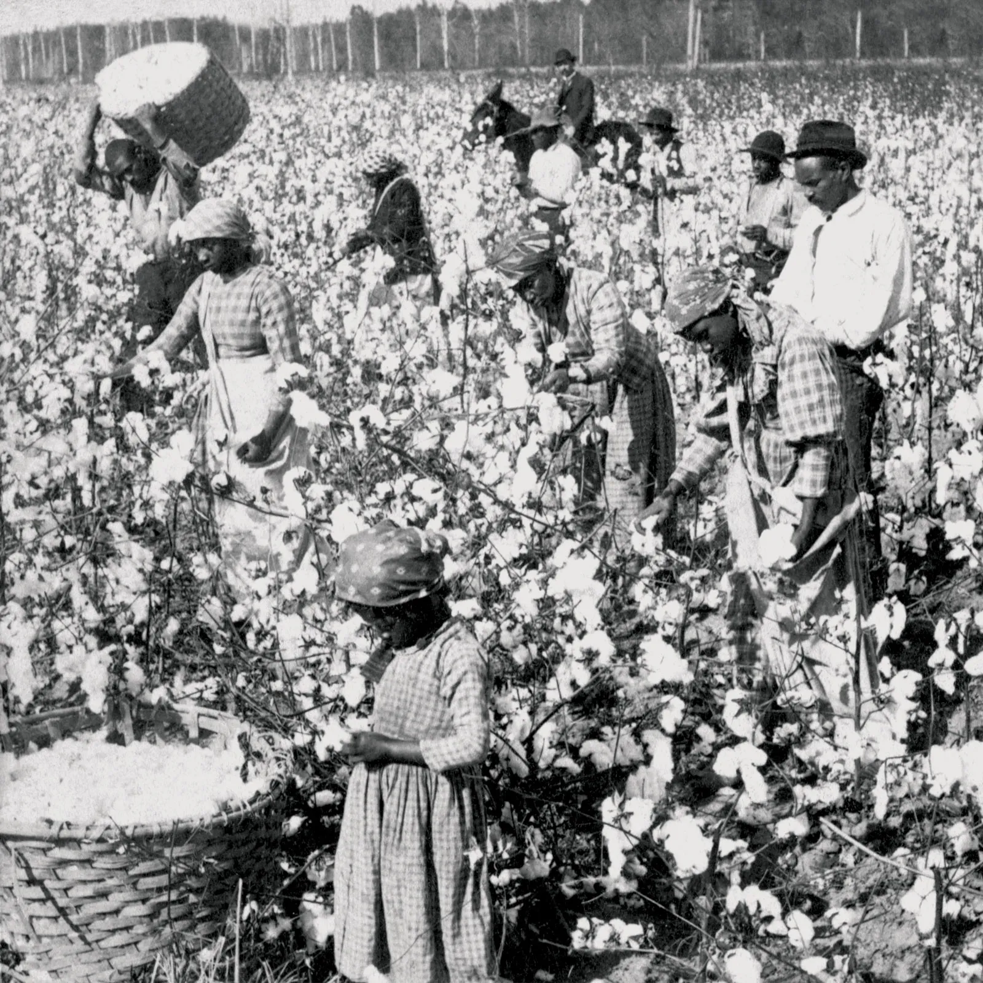
Charge 2: She’s Racist
“Where demanded by custom or where greater efficiency is to be gained, let the white believers and the colored believers assemble in separate places of worship” 9T, p. 208

Slide 11
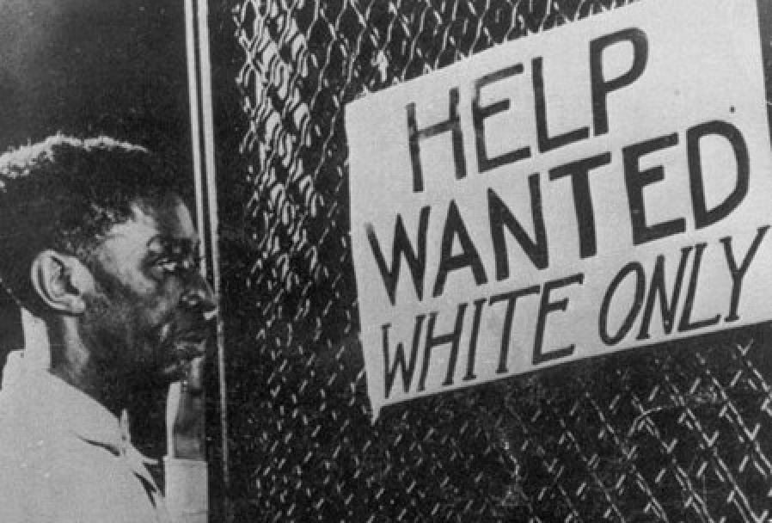
More Context
“The colored people should not urge that they be placed on an equality with white people. The relation of the two races has been a matter hard to deal with, and I fear that it will ever remain a most perplexing problem. So far as possible, everything that would stir up the race prejudice of the white people should be avoided. There is danger of closing the door so that our white laborers will not be able to work in some places in the South.” 9T, p. 214

Slide 12
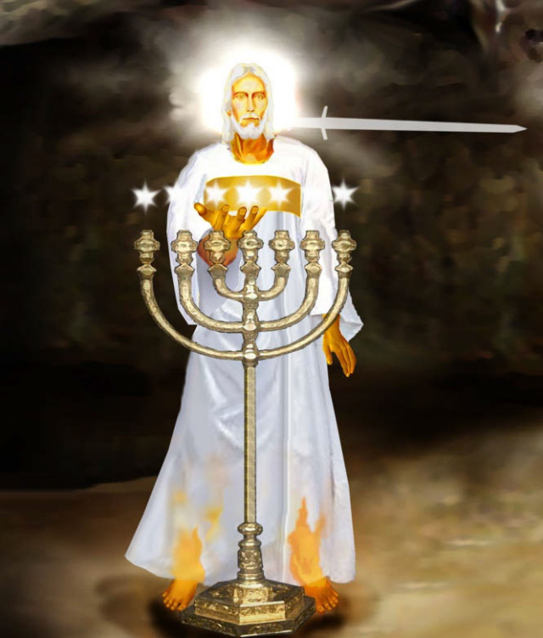
We Will All Be White???
“There is strength in the Saviour. He wants His children to banish all selfishness from the heart, that He may enter as an abiding guest, that His righteousness may go before them, and the glory of God be their rearward. ‘The Comforter, which is the Holy Ghost, Whom the Father will send in My name, He shall teach you all things, and bring all things to your remembrance.’ You are the children of God. He has adopted you, and He desires you to form characters here that will give you entrance into the heavenly family. Remembering this, you will be able to bear the trials which you meet here. In heaven there will be no color line; for all will be as white as Christ himself. Let us thank God that we can be members of the royal family.” –The Gospel Herald, March 1, 1901 (compare with Is. 1:18, ps. 51:7, matt. 28:3, Rev. 1:14, Dan. 7:9)

Slide 13
Intermarriages???
“But there is an objection to the marriage of the white race with the black. All should consider that they have no right to entail upon their offspring that which will place them at a disadvantage; they have no right to give them as a birthright a condition which would subject them to a life of humiliation. The children of these mixed marriages have a feeling of bitterness toward the parents who have given them this lifelong inheritance. For this reason, if there were no other, there should be no intermarriage between the white and the colored race.”—Manuscript 7, 1896. (2SM, p. 343)

Slide 14
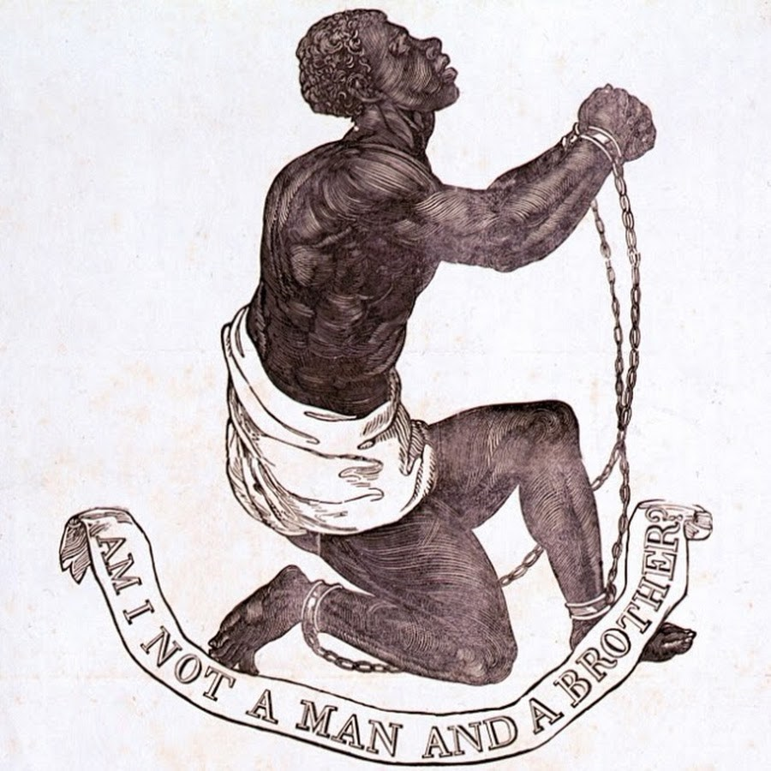
Slaves Do Not Go To Heaven???
“I saw that the slave-master would have to answer for the soul of his slave whom he has kept in ignorance; and all the sins of the slave will be visited upon the master. God cannot take the slave to heaven, who has been kept in ignorance and degradation, knowing nothing of God, or the Bible, fearing nothing but his master’s lash, and not holding so elevated a position as his master’s brute beasts. But he does the best thing for him that a compassionate God can do. He lets him be as though he had not been” Spiritual Gifts, vol. 1, p. 193 (Early Writings, p. 276).—Compare with Ez. 33

Slide 15
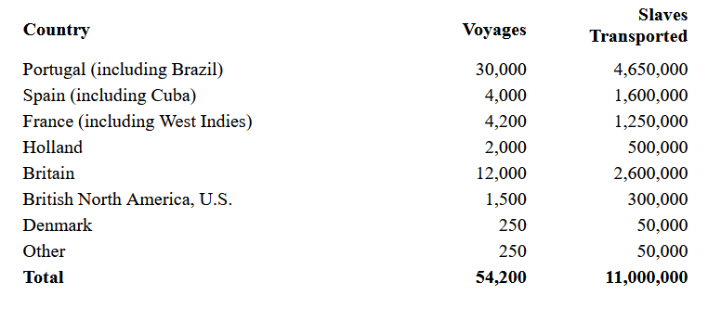
Facts about the Slave Trade: A Human Problem
1. African Slaves were largely enslaved by Muslims (created by Rome) and other warring tribes. 2. The Muslims most often enslaved infidels, with their greatest enemies being Jews first, then Christians—the Muslims sold their slaves to largely Catholic countries, including Catholic Spain, Catholic Portugal, and Catholic France. (Yes, America and England were also involved). The Muslims also had what was known as the “White Slave Trade” of Irish, Scottish, and English mostly women and children numbering 1-1.25 million, from 1530-1780 (Wikipedia, Muslim Slave Trade)
3. Mainly Spanish and Portuguese ships then transferred slaves from Africa to: the west indies, Brazil, the Caribbean Islands, South America, Florida, and English Colonies

Slide 16
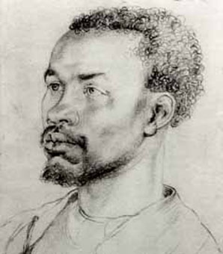
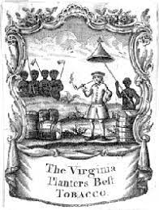
First Black “Slave-for-Life” enslaved by Black Man?
Anthony Johnson was an indentured servant from Angola, Africa. He was first enslaved by the Portuguese, then sold to the Atlantic slave trade and purchased as an indentured servant in the early 1620s. He converted to Roman Catholicism (who were extremely pro-slavery) and completed his indentured servitude contract in Virginia around 1635, where he was granted 250 acres of land. Anthony Johnson then had indentured servants of his own including 4 white and 1 black named John Casor. In 1653, John Casor sought the assistance of a white neighbor named Robert Parker, claiming that his 7 year indentured servitude contract had been fulfilled years ago and was now being held illegally. Casor signed a new indentured servitude contract with Parker, so Johnson filed a Freedom Suit against Robert Parker. After losing the first court case, Johnson appealed and won the second. Johnson insisted that the laziness of Casor, the court funds, and other losses meant that John Casor could not hope to be a profitable servant unless he was made slave-for-life, which was granted by the Virginia Courts, Later in 1661, Africans were no longer permitted to be indentured servants, but an enslaved perpetually. (see Wikipedia, Anthony Johnson (colonist) & http://www.todayifoundout.com/index.php/2013/08/the-first-legal-slave-owner-in-what-would-become-the-united-states-was-a-black-man/#google_vignette

Slide 17
Black Slavers???
“[Thomas] Pressly also shows that the percentage of free black slave owners as the total number of free black heads of families was quite high in several states, namely 43 percent in South Carolina, 40 percent in Louisiana, 26 percent in Mississippi, 25 percent in Alabama and 20 percent in Georgia. So why did these free black people own these slaves? . . . these black slave-owners, the clear majority, cleverly used the system of slavery to protect their loved ones. That's the good news. . . . These men and women, from William Stanly to Madame Ciprien Ricard, were among the largest free Negro slaveholders, and their motivations were neither benevolent nor philanthropic. . . . [Regarding Slaveowners who owned family members, we learn:] ‘ free black in Trimble County, Kentucky, ‘ … sold his own son and daughter South, one for $1,000, the other for $1,200.’ … A Maryland father sold his slave children in order to purchase his wife. A Columbus, Georgia, black woman -- Dilsey Pope -- owned her husband. ‘He offended her in some way and she sold him … ‘ Fanny Canady of Louisville, Kentucky, owned her husband Jim -- a drunken cobbler -- whom she threatened to "sell down the river." At New Bern, North Carolina, a free black wife and son purchased their slave husband-father. When the newly bought father criticized his son, the son sold him to a slave trader. The son boasted afterward that "the old man had gone to the corn fields about New Orleans where they might learn him some manners.’”—(Henry Louis Gates Jr.,”Did Black People Own Slaves?”, March 4, 2013, https://web.archive.org/web/20140123210326/http://www.theroot.com/articles/history/2013/03/black_slave_owners_did_they_exist.4.html

Slide 18
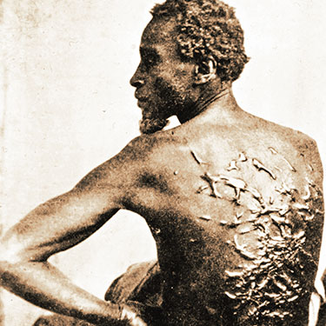
Full Picture
“There has been much perplexity as to how our laborers in the South shall deal with the "color line." It has been a question to some how far to concede to the prevailing prejudice against the colored people. The Lord has given us light concerning all such matters. There are principles laid down in His Word that should guide us in dealing with these perplexing questions. The Lord Jesus came to our world to save men and women of all nationalities. He died just as much for the colored people as for the white race. Jesus came to shed light over the whole world.” The Southern Work, p. 9

Slide 19
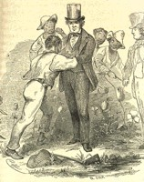
Why Segregation Had to Exist
“The gospel is to be presented to the downtrodden Negro race. But great caution will have to be shown in the efforts put forth for the uplifting of this people. Among the white people in many places there exists a strong prejudice against the Negro race. We may desire to ignore this prejudice, but we cannot do it. If we were to act as if this prejudice did not exist we could not get the light before the white people. We must meet the situation as it is and deal with it wisely and intelligently.” 9T, p. 204

Slide 20
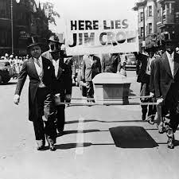
Where is the Racism?
“The colored people should not urge that they be placed on an equality with white people. The relation of the two races has been a matter hard to deal with, and I fear that it will ever remain a most perplexing problem. So far as possible, everything that would stir up the race prejudice of the white people should be avoided. There is danger of closing the door so that our white laborers will not be able to work in some places in the South.” 9T, p. 214

Slide 21
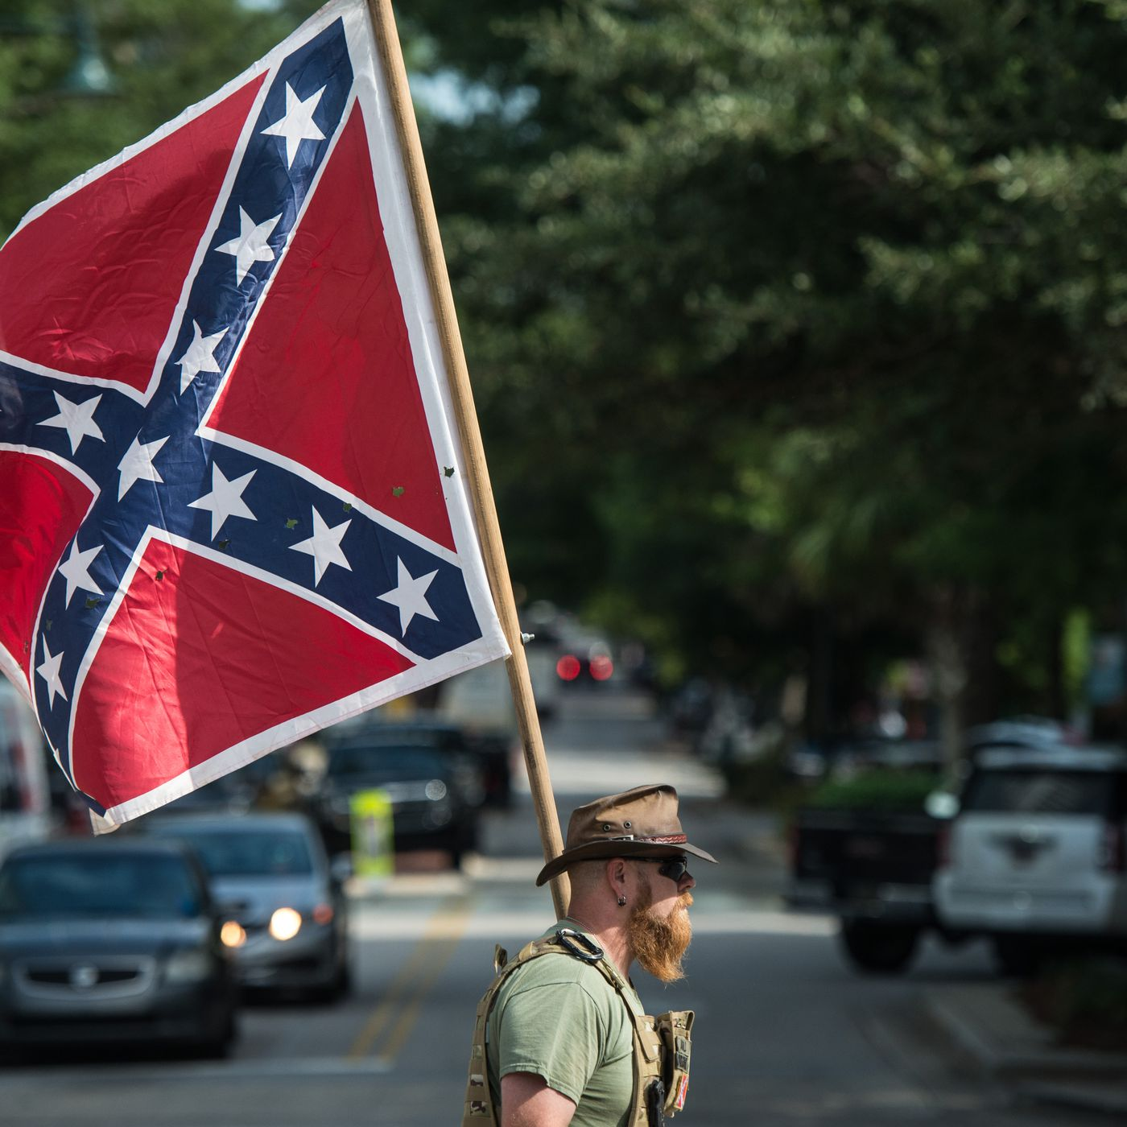
Charge 2: Rebuttal--How God Feels…
“God cares no less for the souls of the African race that might be won to serve Him than He cared for Israel. He requires far more of His people than they have given Him in missionary work among the people of the South of all classes, and especially among the colored race.” The Southern Work, p. 14

Slide 22
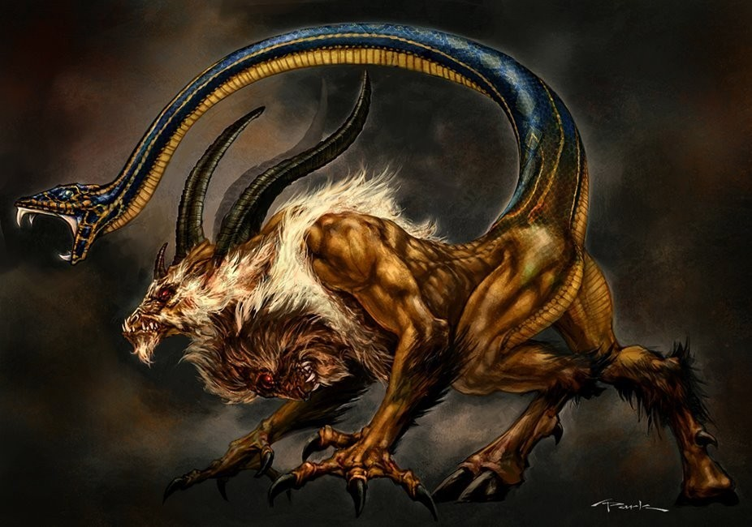
Amalgamation?
“But if there was one sin above another which called for the destruction of the race by the flood, it was the base crime of amalgamation of man and beast which defaced the image of God, and caused confusion everywhere. God purposed to destroy by a flood that powerful, long-lived race that had corrupted their ways before him.”–Spiritual Gifts, vol. 3, p. 64
“Every species of animal which God had created were preserved in the ark. The confused species which God did not create, which were the result of amalgamation, were destroyed by the Flood. Since the Flood there has been amalgamation of man and beast, as may be seen in the almost endless varieties of species of animals, and in certain races of men.”–Spiritual Gifts, vol. 3, p. 75

Slide 23
They’re Still Doing it Today???
“Scientists in China have, for the first time, used cloning techniques to create hybrid embryos that contain a mix of DNA from both humans and rabbits, according to a report in a scientific journal that has reignited the smoldering ethics debate over cloning research. More than 100 of the hybrids, made by fusing human skin cells with rabbit eggs, were allowed to develop in laboratory dishes for several days before the scientists destroyed them to retrieve so-called embryonic stem cells from their interiors. Although scientists in Massachusetts had previously mixed human cells and cow eggs in a similar attempt to make hybrid embryos as a source of stem cells, those experiments were not successful.” The Washington Post, “Cloning Yields Human-Rabbit Hybrid Embryo Rick Weiss, Aug. 14, 2003

Slide 24
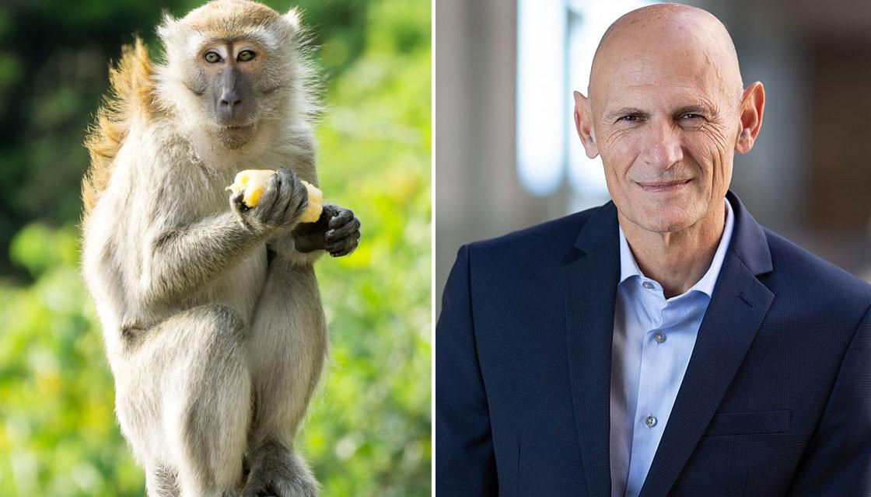
Human-Monkey Hybrids
“A team of scientists from the U.S., China, and Spain reported Thursday they have created the first embryos that were part human and part monkey and kept them alive for up to 20 days in laboratory dishes. The ethically controversial creation of chimeras — containing cells from multiple species — is part of a drive to make experimental models to help scientists better understand early development, devise new treatments for human disease, and possibly find methods to grow organs for transplant inside other animals, such as pigs or sheep” statnews.com, “International team creates first chimeric human-monkey embryos”, Usha Lee McFarling, April 15, 2021

