Slide 1
Jesus Life,pt.34 Faith or Obedience?

Slide 2

Is it Faith and Obedience or Faith without Obedience?
I hear people in Adventism all the time say, "All I have to do is accept Christ. He did it all and I just must accept that.
Is that all there is to the Christian life….just believe??
“That in the ages to come he might shew the exceeding riches of his grace in his kindness toward us through Christ Jesus. For by grace are ye saved through faith; and that not of yourselves: it is the gift of God: Not of works, lest any man should boast.” Ephesians 2:7-9

Slide 3
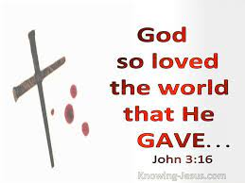
Faith is all there is!!
We love to quote Ephesians 2:7-9 and say it is all faith. But, what does the next verse say?
“For by grace are ye saved through faith; and that not of yourselves: it is the gift of God: Not of works, lest any man should boast. For we are his workmanship, created in Christ Jesus unto good works, which God hath before ordained that we should walk in them.” Ephesians 2:8-10

Slide 4
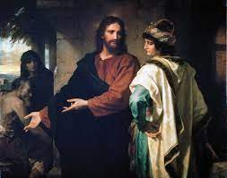
One Thing You Lack
“And, behold, one came and said unto him, Good Master, what good thing shall I do, that I may have eternal life? And he said unto him, Why callest thou me good? there is none good but one, that is, God: but if thou wilt enter into life, keep the commandments.” Matthew 19:16,17

Slide 5
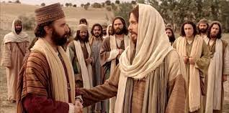
Christ told the young man that if he wanted to be saved, he had to keep the commandments of God. Christ went on to quote several of the 10 commandments that have to do with our duty to our fellow man. The rich young ruler declared that he had obeyed all of these commandments. However, there was one thing missing!

Slide 6
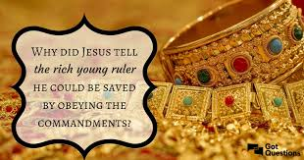
“The young man saith unto him, All these things have I kept from my youth up: what lack I yet? Jesus said unto him, If thou wilt be perfect, go and sell that thou hast, and give to the poor, and thou shalt have treasure in heaven: and come and follow me.” Matthew 19:20,21

Slide 7
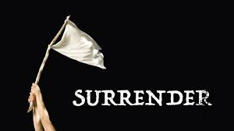
The Story Unfolds
The first four commandments point to our love for God supremely. What the rich young ruler loved more than God was his wealth. In order for him to be a follower of Jesus, he would have to give up his wealth otherwise the love of riches would over balance his love for Christ! “Christ read the ruler's heart. Only one thing he lacked, but that was a vital principle. He needed the love of God in the soul. This lack, unless supplied, would prove fatal to him; his whole nature would become corrupted. By indulgence, selfishness would strengthen. That he might receive the love of God, his supreme love of self must be surrendered.” DA, pg. 519

Slide 8
What Answer will we Give?
“Christ gave this man a test. He called upon him to choose between the heavenly treasure and worldly greatness. The heavenly treasure was assured him if he would follow Christ. But self must yield; his will must be given into Christ's control. The very holiness of God was offered to the young ruler. He had the privilege of becoming a son of God, and a coheir with Christ to the heavenly treasure. But he must take up the cross, and follow the Savior in the path of self-denial. Christ's words were verily to the ruler the invitation, “Choose you this day whom ye will serve.” Joshua 24:15. The choice was left with him. Jesus was yearning for his conversion. He had shown him the plague spot in his character, and with what deep interest He watched the issue as the young man weighed the question! If he decided to follow Christ, he must obey His words in everything. He must turn from his ambitious projects. With what earnest, anxious longing, what soul hunger, did the Savior look at the young man, hoping that he would yield to the invitation of the Spirit of God!” Desire of Ages, pgs. 519,520

Slide 9
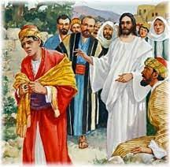
“But when the young man heard that saying, he went away sorrowful: for he had great possessions. Then said Jesus unto his disciples, Verily I say unto you, That a rich man shall hardly enter into the kingdom of heaven. And again I say unto you, It is easier for a camel to go through the eye of a needle, than for a rich man to enter into the kingdom of God.” Matthew 19:22-24

Slide 10
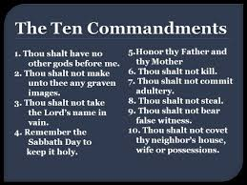
More Than just Believe!
When the rich young ruler asked about eternal life, Jesus didn’t say just accept Me, He said if you want to have eternal life then honor all 10 of God’s commandments through faith in His power! “Blessed are they that do his commandments, that they may have right to the tree of life, and may enter in through the gates into the city.” Revelation 22:14
“He that saith, I know him, and keepeth not his commandments, is a liar, and the truth is not in him. But whoso keepeth his word, in him verily is the love of God perfected: hereby know we that we are in him. He that saith he abideth in him ought himself also so to walk, even as he walked.” 1 John 2:4-6

Slide 11
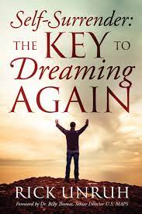
“To those who, like the young ruler, are in high positions of trust and have great possessions, it may seem too great a sacrifice to give up all in order to follow Christ. But this is the rule of conduct for all who would become His disciples. Nothing short of obedience can be accepted. Self-surrender is the substance of the teachings of Christ. Often it is presented and enjoined in language that seems authoritative, because there is no other way to save man than to cut away those things which, if entertained, will demoralize the whole being.” DA, pg. 523

Slide 12
One Other Story
“And, behold, a certain lawyer stood up, and tempted him, saying, Master, what shall I do to inherit eternal life? He said unto him, What is written in the law? how readest thou? And he answering said, Thou shalt love the Lord thy God with all thy heart, and with all thy soul, and with all thy strength, and with all thy mind; and thy neighbor as thyself.” Luke 10:25-27
Again, Christ was asked about gaining eternal life and He pointed the person back to the 10 commandments. The lawyer’s answer embodied all 10 of God’s commandments. Loving God is found in the first four commandments and loving our neighbor is found in the last six commands!!
Again, the 10 commandments are the basis on which eternal life is based. Obedience to the law by faith in Christ will lead to eternal life and disobedience to God’s commands will shut one out of the kingdom!!

Slide 13
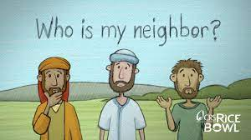
Who is My Neighbor?
“And he said unto him, Thou hast answered right: this do, and thou shalt live. But he, willing to justify himself, said unto Jesus, And who is my neighbor? And Jesus answering said, A certain man went down from Jerusalem to Jericho, and fell among thieves, which stripped him of his raiment, and wounded him, and departed, leaving him half dead. And by chance there came down a certain priest that way: and when he saw him, he passed by on the other side. And likewise a Levite, when he was at the place, came and looked on him, and passed by on the other side.” Luke 15:28-32

Slide 14

A broken and bruised world, ready to perish. We have the messages of Rev. 14 to provide healing and we refuse to give the messages. We are verily leaving the world at the curb while we pass by in our religious ways, refusing to minister to this world!!
“So it was with Israel. The principle that man can save himself by his own works lay at the foundation of every heathen religion; it had now become the principle of the Jewish religion. Satan had implanted this principle. Wherever it is held, men have no barrier against sin. The message of salvation is communicated to men through human agencies. But the Jews had sought to make a monopoly of the truth which is eternal life. They had hoarded the living manna, and it had turned to corruption. The religion which they tried to shut up to themselves became an offense. They robbed God of His glory, and defrauded the world by a counterfeit of the gospel. They had refused to surrender themselves to God for the salvation of the world, and they became agents of Satan for its destruction.” DA, pgs. 35,36

Slide 15
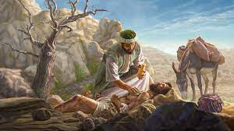
One Would Reach Out!!
“But he, willing to justify himself, said unto Jesus, And who is my neighbor? And Jesus answering said, A certain man went down from Jerusalem to Jericho, and fell among thieves, which stripped him of his raiment, and wounded him, and departed, leaving him half dead. And by chance there came down a certain priest that way: and when he saw him, he passed by on the other side. And likewise a Levite, when he was at the place, came and looked on him, and passed by on the other side. But a certain Samaritan, as he journeyed, came where he was: and when he saw him, he had compassion on him, And went to him, and bound up his wounds, pouring in oil and wine, and set him on his own beast, and brought him to an inn, and took care of him.” Luke 10:29-34

Slide 16
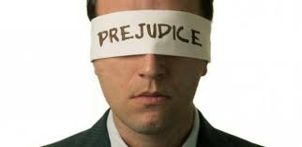
Couldn’t Even Say it!
“And on the morrow when he departed, he took out two pence, and gave them to the host, and said unto him, Take care of him; and whatsoever thou spendest more, when I come again, I will repay thee. Which now of these three, thinkest thou, was neighbor unto him that fell among the thieves? And he said, He that shewed mercy on him. Then said Jesus unto him, Go, and do thou likewise.” Luke 10:35-37

