Slide 1
Fear God

Slide 2
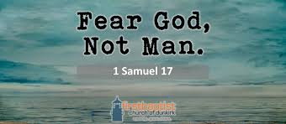
First Angel’s Message
“And I saw another angel fly in the midst of heaven, having the everlasting gospel to preach unto them that dwell on the earth, and to every nation, and kindred, and tongue, and people, Saying with a loud voice, Fear God, and give glory to him; for the hour of his judgment is come: and worship him that made heaven, and earth, and the sea, and the fountains of waters.” Revelation 14:6,7

Slide 3
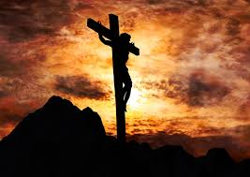
Meaning/Calvary’s Gift
Awe, respect, even a little down home fright! That is actually quite healthy; to have an awareness of God’s presence wherever we are that leads us to be afraid of evil and wickedness and to shun it with every ounce of strength in our beings!!
“By mercy and truth iniquity is purged: and by the fear of the LORD men depart from evil.” Proverbs 16:6
“The fear of the LORD is to hate evil: pride, and arrogancy, and the evil way, and the forward mouth, do I hate.” Proverbs 8:13

Slide 4
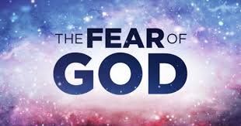
Without this, we are Blithering Idiots!!!
“The fear of the LORD is the beginning of knowledge: but fools despise wisdom and instruction.” Proverbs 1:7
The beginning of all wisdom, the foundation of all enlightenment is this fear of God!! Without this fear that leads to the shunning of all evil, we are nothing more than fools!!
“And unto man he said, Behold, the fear of the Lord, that is wisdom; and to depart from evil is understanding.” Job 28:28

Slide 5
God to be Feared!
Happy is the man that feareth alway: but he that hardeneth his heart shall fall into mischief. Proverbs 28:14.
Without the fear of God, no one can be truly happy.—Testimonies for the Church 4:435.
“God is greatly to be feared in the assembly of the saints, and to be had in reverence of all them that are about Him.” Psalm 89:7.
Those who realize the greatness and majesty of God, will take His name on their lips with holy awe. He dwelleth in light unapproachable; no man can see Him and live.—Early Writings, 122.
“Wherefore ... let us have grace, whereby we may serve God acceptably with reverence and godly fear.” Hebrews 12:28.
True reverence for God is inspired by a sense of His infinite greatness and a realization of His presence. With this sense of the Unseen, every heart should be deeply impressed.... “Holy and reverend is His name,” the psalmist declares. Angels, when they speak that name, veil their faces. With what reverence, then, should we, who are fallen and sinful, take it upon our lips!—Gospel Workers, 178.

Slide 6
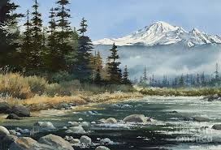
Fearing God!!
Realizing His presence wherever we are, recognizing His power, majesty, and glory, leading us to reverential fear places us in a position to see the wickedness of sin and to place it in its proper sphere of garbage and to shun it and its dominance in our lives! “And I saw another angel fly in the midst of heaven, having the everlasting gospel to preach unto them that dwell on the earth, and to every nation, and kindred, and tongue, and people, Saying with a loud voice, Fear God, and give glory to him; for the hour of his judgment is come: and worship him that made heaven, and earth, and the sea, and the fountains of waters.” Rev. 14:6,7

Slide 7
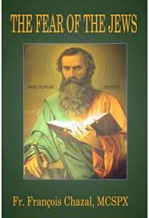
Fear of the Jews
Another kind of fear is found in the Bible. It led the Adventists of the first century to crucify Christ and it will lead Adventists today to persecute to death God’s faithful people! The Bible calls it ‘the fear of the Jews.’ We find this phrase only in the gospel of John.
“When he had said these words unto them, he abode still in Galilee. But when his brethren were gone up, then went he also up unto the feast, not openly, but as it were in secret. Then the Jews sought him at the feast, and said, Where is he? And there was much murmuring among the people concerning him: for some said, He is a good man: others said, Nay; but he deceiveth the people. Howbeit no man spake openly of him for fear of the Jews.” John 7:9-13

Slide 8
1960-Adventism
Evangelical Conferences from 1955-1957
RR Figuhr- GC President
Figuhr totally supports the controversial and wrong book called Questions on Doctrine.
Some, Andreasen and others rise up in protest!
Some of the Pacific Press employees want to write a refutation of Questions on Doctrine.
Figuhr finds out and threatens their jobs if they oppose Questions on Doctrine.
The Pacific Press employees trash the refutation and Questions on Doctrine marches on.
Even though they were doing the right thing in refuting the book, the employees ‘for fear of the Jews’ buckled. The Fear of the Jews reigns in Adventism today!!

Slide 9

1. They would chose their paycheck over the right.
2. They would save their position over the right.
3. They would save their power and influence over the right.
4. They would chose the fear of the Jews over their fearing God.

Slide 10
The Blind Man
“But the Jews did not believe concerning him, that he had been blind, and received his sight, until they called the parents of him that had received his sight. And they asked them, saying, Is this your son, who ye say was born blind? how then doth he now see? His parents answered them and said, We know that this is our son, and that he was born blind: But by what means he now seeth, we know not; or who hath opened his eyes, we know not: he is of age; ask him: he shall speak for himself. These words spake his parents, because they feared the Jews: for the Jews had agreed already, that if any man did confess that he was Christ, he should be put out of the synagogue. Therefore said his parents, He is of age; ask him. Then again called they the man that was blind, and said unto him, Give God the praise: we know that this man is a sinner. He answered and said, Whether he be a sinner or no, I know not: one thing I know, that, whereas I was blind, now I see. Then said they to him again, What did he to thee? how opened he thine eyes? He answered them, I have told you already, and ye did not hear: wherefore would ye hear it again? will ye also be his disciples?” John 9:18-27

Slide 11
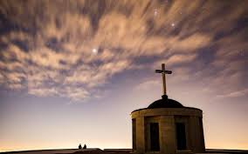
How About You?
1. They would chose their seat in the church over Christ!
2. They would bow down to leaders in order to be able to see their friends at church!
3. They would chose to hold positions in the church instead of Christ!
This is slavery! “The fear of man bringeth a snare: but whoso putteth his trust in the LORD shall be safe.” Provers 29:25

Slide 12
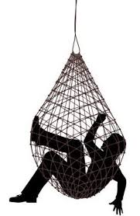
“The Pharisees and rulers looked for Him to come, hoping for an opportunity to condemn Him. They anxiously inquired, "Where is He?" but no one knew. The thought of Him was uppermost in all minds. Through fear of the priests and rulers, none dared acknowledge Him as the Messiah, but everywhere there was quiet yet earnest discussion concerning Him. Many defended Him as one sent from God, while others denounced Him as a deceiver of the people.” Desire of Ages, pgs. 451,452

Slide 13

1980, Walter Rea, EGW, and PUC
“What are the problems with Ellen White? I know of no problems, just joy and understanding!

Slide 14
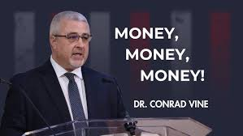
2022-2025
Interview at the GC session; St. Louis, MO 2025!!
Young man asks, “Why don’t the delegates speak up to stop these horrible things?”
Fear of the Jews!!!!

Slide 15
Why? Why?? Why???
“The Lord has a controversy with his professed people in these last days. In this controversy men in responsible positions will take a course directly opposite to that pursued by Nehemiah. They will not only ignore and despise the Sabbath themselves, but they will try to keep it from others by burying it beneath the rubbish of custom and tradition. In churches and in large gatherings in the open air, ministers will urge upon the people the necessity of keeping the first day of the week. There are calamities on sea and land: and these calamities will increase, one disaster following close upon another; and the little band of conscientious Sabbath-keepers will be pointed out as the ones who are bringing the wrath of God upon the world by their disregard of Sunday.” RH, March 18,1884

