Slide 1
TITHING
Pt. 1

Slide 2
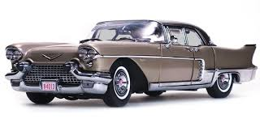
The Cadillac’s of Religion
The 1957 Cadillac Eldorado was a beauty. Top of the line, out doing any and every car in every way, this was the best of the best, the cream of the crop!! This was the car everyone wanted; it could not be outdone. It had it ALL!!!

Slide 3
The Cadillac of All Religions!
Everyone wanted to invest their money in such an undertaking. If they couldn’t afford to buy one outright, they surely would pay to support the manufacture and ultimate production of such a vehicle. The best of the best; the cream of the crop!

Slide 4

Tragedy Occurs!!!
The Cadillac was spreading all over the world. In the midst of the spreading of the awesome truth about Cadillac’s, a tragedy occurred! Leadership stopped selling and promoting Cadillac’s. They didn’t tell stockholders; they just did it! Instead of the dynamite of the Cadillac, they started selling………………….

Slide 5

Volkswagens

Slide 6
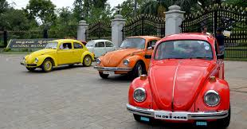
You Must Support the Volkswagen!!
People were livid! We supported you because we love the Cadillac and now, you sell Volkswagen’s! We will never support you again! “Oh, but you must. We control the storehouse and your support must come solely through this channel!!” The people were so sad; what could they do?????????????????

Slide 7
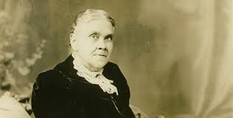
The Prophet/Messenger Paves the Way!
In Ellen White’s nearly 72 years of ministry, she faced every possible issue that could ever confront the people of God. False doctrine of every kind, dealt with every kind of character and personality; Ellen White faced it all and she has bequeathed to us a legacy and example as to what we should do in like situations. This guidance also comes in the field of giving to the cause of God.

Slide 8
Personal Accountability to God!!
“God desires to bring men into direct relation with Himself. In all His dealings with human beings He recognizes the principle of personal responsibility. He seeks to encourage a sense of personal dependence and to impress the need of personal guidance. His gifts are committed to men as individuals. Every man has been made a steward of sacred trusts; each is to discharge his trust according to the direction of the Giver; and by each an account of his stewardship must be rendered to God.” — 7 Testimonies, 176

Slide 9
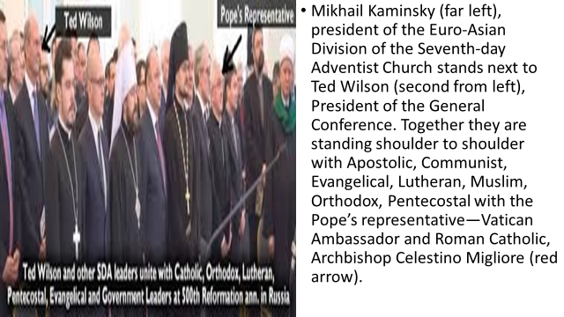
Can You Support This?

Slide 10
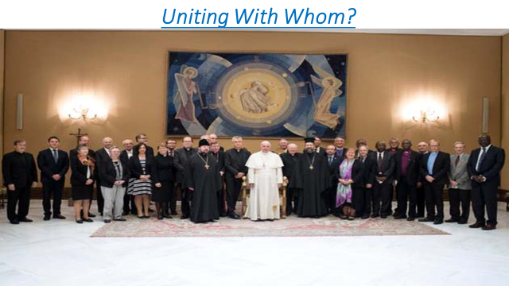
How About This?

Slide 11
Wow!
“It would be poor policy to support from the treasury of God those who really mar and injure His work, and who are constantly lowering the standard of Christianity.” — 3 Testimonies, 553
“There are fearful woes for those who preach the truth, but are not sanctified by it, and also for those who consent to receive and maintain the unsanctified to minister to them in word and doctrine.” — 1 Testimonies, 261-262

Slide 12
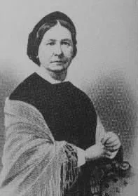
The Case of Hannah More
She was the first Seventh Day Adventist missionary to Africa, unofficially and 8 years before JN Andrews crossed the ocean to Europe. While in Africa, working for another denomination, she convinced a fellow missionary, one Dickenson of Australian descent, of the Advent truth. Their church did not take kindly to them spreading the Advent message and released them from their missionary duties. Dickenson returned to Australia and started the advent work there. This was before a party of 11 people was sent to Australia and New Zealand in 1885, to plant a church. Thus Hannah can be credited with starting the work on not one but two continents, even before she was a baptized member.

Slide 13
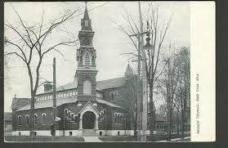
Most Adventists (if they had her name at all) knew that she was the missionary woman who visited Battle Creek during the summer of 1867 and who was not welcomed thus bringing on strong reproofs by Ellen White for their uncharitable and unfriendly attitude. Dejected, Hannah More left Battle Creek for northern Michigan and died that following winter.

Slide 14
1868! Mark it Well!!!
“There are those who can see and feel, and gladly do good to Jesus in the person of His saints. Let them have room to work. Let those who cannot do this go where they will not stand in the way of the work of God. “Especially is this applicable to those who stand at the head of the work. If they go wrong, all is wrong. The greater the responsibility, the greater the ruin in the case of unfaithfulness. If leading brethren do not faithfully perform their duty, those who are led will not do theirs . .
“If we could have had means at our command last summer and fall, Sister More would now be with us. When we learned our real circumstances, as set forth in Testimony No. 13 [1 Testimonies, 569-629], we both took the matter joyfully and said we did not want the responsibility of means. This was wrong. God wants that we should have means that we may, as in time past, help where help is needed. Satan wants to tie our hands in this respect and lead others to be careless, unfeeling, and covetous, that such cruel work may go on as in the case of Hannah More . . “When means has been pressed upon me, I have refused it, or appropriated it to such charitable objects as the Publishing Association.

Slide 15
I Shall Do My Duty!
I shall do so no more. I shall do my duty in labor as ever, but my fears of receiving means to use for the Lord are gone. This case of Sister More has fully aroused me to see the work of Satan in depriving us of means.”—1 Testimonies, 677-679. By this she meant “depriving us of means” which could be applied outside of regular denominational channels. What had happened here was that Ellen White began accepting tithe and other funds from others, to share with those who needed help or who were working for the Lord without conference backing. She used the tithe to support ministers and missionaries who needed help and were not receiving it from the church or were retired and being neglected. The other, non tithe, funds she used to help the widows, the poor, and the orphans. Hannah More is mentioned again in 2 Testimonies, 140-145, and 332:1. That lady was much on the mind of Ellen White, who was determined that, in the future, the needy and the workers who needed help might receive it.”

Slide 16
Never Again!
All this placed a burning drive within Ellen White, to make sure such a situation did not repeat itself. Carefully read 1 Testimonies, 666680. Many of us have known of similar experiences. It is for such reasons that, in later years, we find comments such as the following: “These women [Bible workers] give their whole time and are told that they receive nothing for their labors because their husbands receive wages. I tell them to go forward and all such decisions shall be reversed. “The Word says, ‘The laborer is worthy of his hire.’ When any such decision as this is made, I will in the name of the Lord, protest. I will feel it in my duty to create a fund from my tithe money, to pay these women who are accomplishing just as essential work as the ministers are doing, and this tithe I will reserve for work in the same line as that of the ministers . . “This will give you an idea of how matters are in this conference. There are seventy-five souls organized into a church, who are paying their tithe into the conference, and as a saving plan it has been deemed essential to let these poor souls labor for nothing! But this does not trouble me, for I will not allow it to go thus.”—Manuscript, dated April 22, 1898, Spalding-Magan Unpublished Testimonies, 117. As Ellen White later said in the Watson letter, she was helping those who were doing a work which should be done, which the church would not support.

Slide 17

Rubicon Moment
Ellen White came to a critical juncture in her life in 1868. Up until that time, she had always put her tithe/offerings in the conference plate. After the Hannah More experience, Ellen White stopped paying all of her tithes and offerings into the church. She would use her tithe/offering to support those who were not being supported by the church denomination, but were doing a worthy work in the cause of God. She also used means given to her by others for the same purpose! Hannah More and 1868 was a pivotal year in her life!!

Slide 18
Letter to G. F. Watson
“Some cases have been kept before me for years, and I have supplied their needs from the tithe, as God has instructed me to do, and if any person shall say to me, ‘Sister White, will you appropriate my tithe where you know it is most needed?’ I shall say, ‘Yes,’ and I will; and I have done so.”—January 22, 1905, letter to G.F. Watson. “I send this matter to you so that you shall not make a mistake . . For years there have now and then been persons who have lost confidence in the appropriation of the tithe who have placed the tithe in my hands, and said if I did not take it they would themselves appropriate it to the family of the most needy minister they could find. I have taken the money, given them a receipt for it, and told them how it was appropriated.”—— EGW letter, dated January 22, 1905 (Letter 267, 1905), to Elder G.F. Watson, president of the Colorado Conference. • But she didn’t want anyone else to directly give tithe to workers who were outside regular channels, did she? Did she not want it to go through her? Ellen White not only considered it to be a correct practice, in full harmony with Scripture, for herself to appropriate it outside of church channels,—but she commended others who also gave it to workers outside the regular lines. “I commend those sisters who have placed their tithe where it is most needed, to help to do a work that is being left undone.”—Watson Letter. “This [is a] work which the Lord has appointed to me to do and others to do.”— Watson Letter.

Slide 19
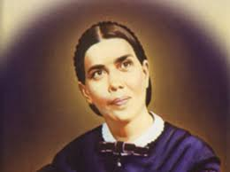
Who Was Watson?
The preceding slide had several pointed comments made to G. F. Watson. Clearly, Ellen White and Elder Watson were at odds with one another. Clearly, Ellen white was sending a warning message to this man. Who was he? Why did he and Ellen White clash over the appropriation of funds? These and other questions will be discussed in the next study of “Tithing, pt. 2”.

