Slide 1
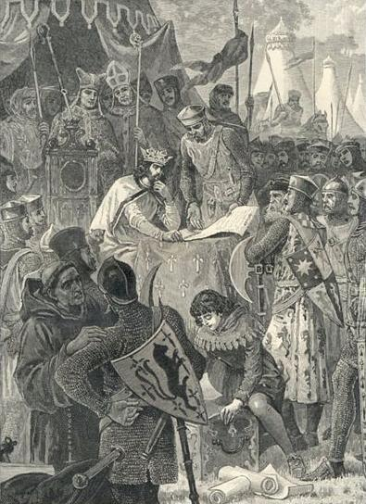
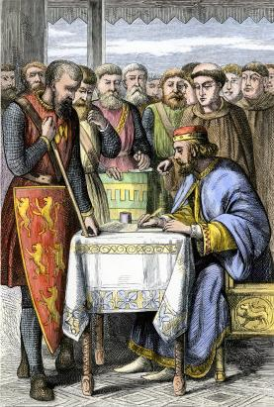

Slide 2
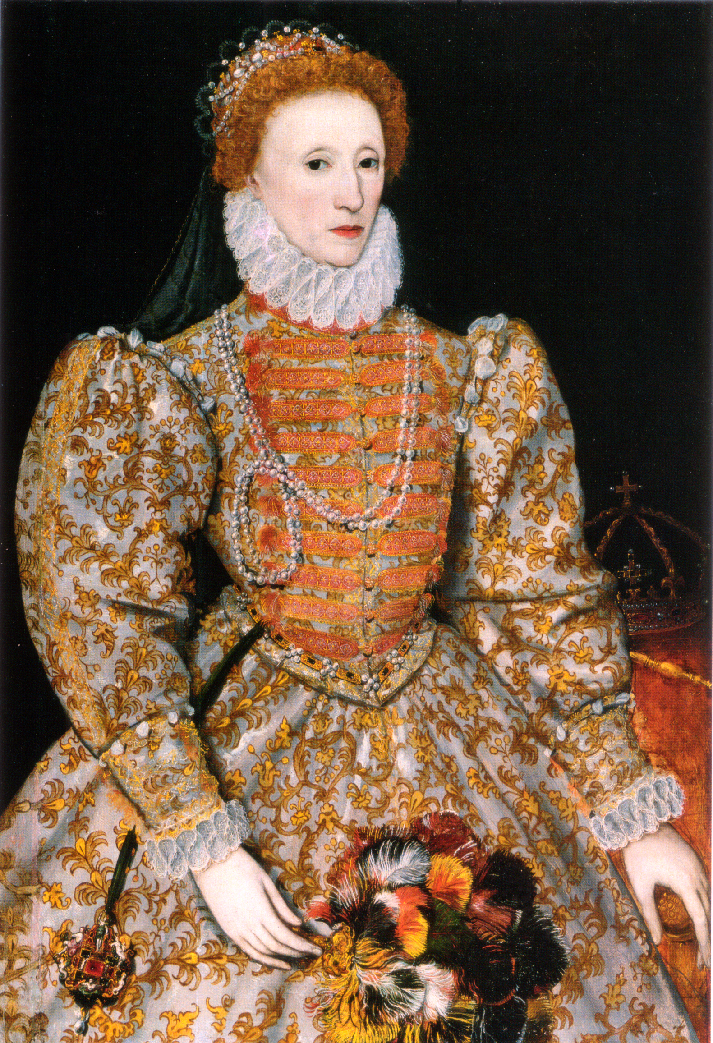
Some of the Assassination Attempts:
October 1583, John Somerville, a Catholic from Warwickshire, pistol
1584, Dr. William Parry, hid in the Queen’s garden, but backed out at the last minute
The Barge Incident-a shot intended for Elizabeth I, hits a bargeman in Thames
1571, The Ridolfi Plot, Papist Roberto Ridolfi, a Florentine Banker, uncovered by the Queen’s secret service
1583, The Throgmorton Plot, headed by Francis Throgmorton, a Catholic, thwarted by the Queen’s secret service
1586, The Babington Plot, named after Anthony Babington, an ally of Mary, Queen of Scots (Catholic Extremist involved in many of the attempts against Elizabeth I), uncovered by Elizabeth’s indispensable spymaster, Sir Francis Walsingham. This incident found a Jesuit priest named Ballard, Babington, and Mary Queen of Scots charged and executed for treason
Queen Elizabeth I of England

Slide 3
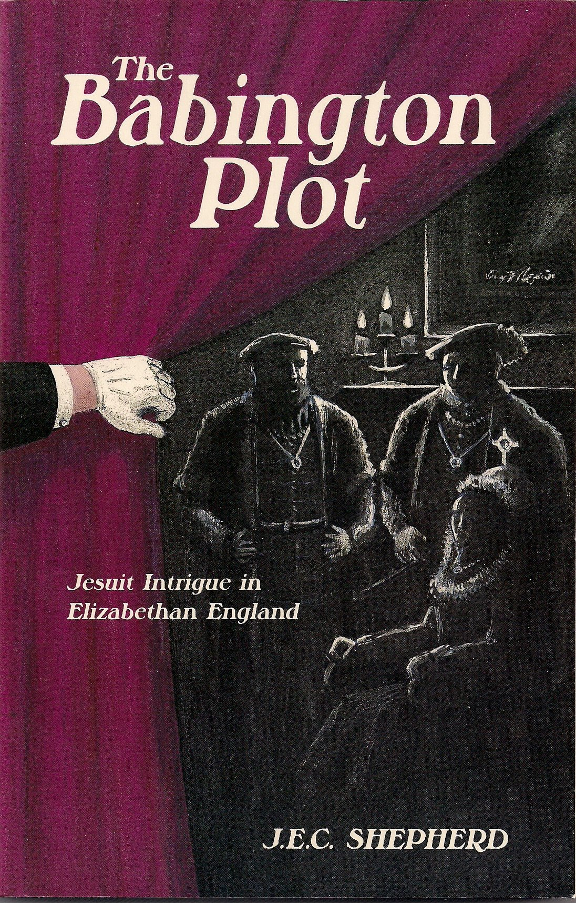
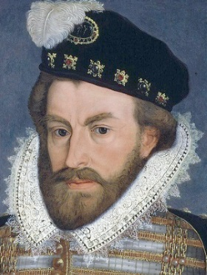
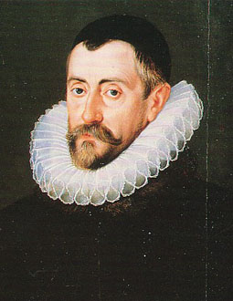
Anthony Babington
Spymaster and head of Secret Service Sir Francis Walsingham

Slide 4
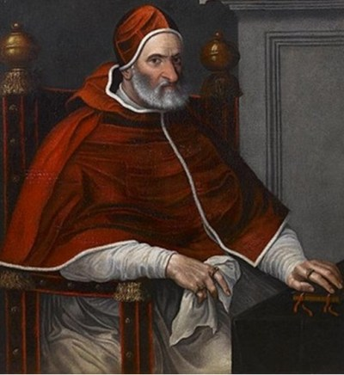
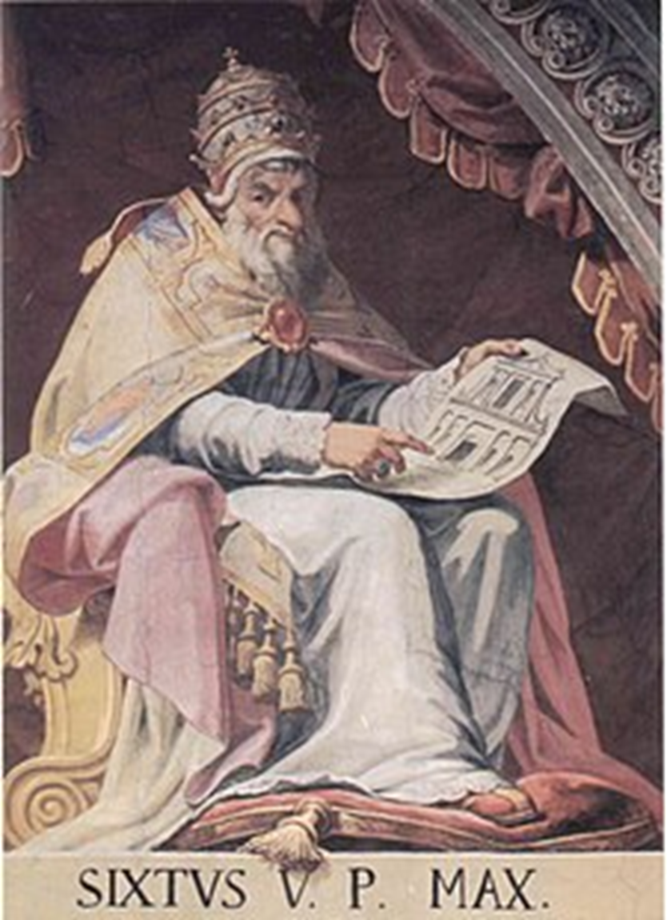
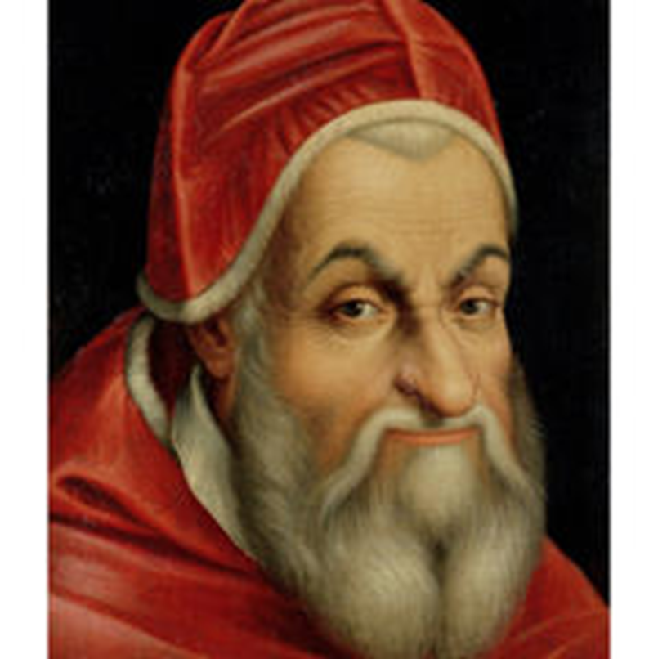
Pope Pius IV (1559-1565)

Slide 5
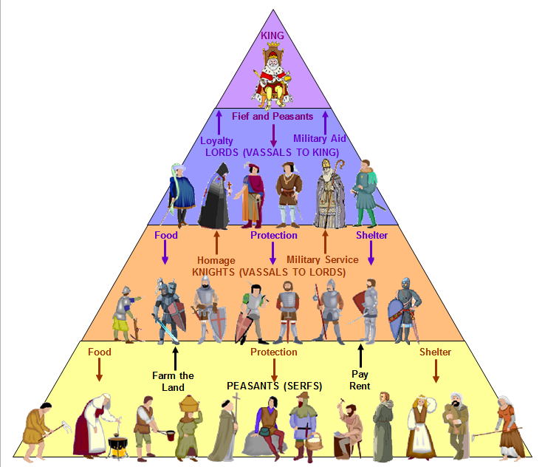

Slide 7
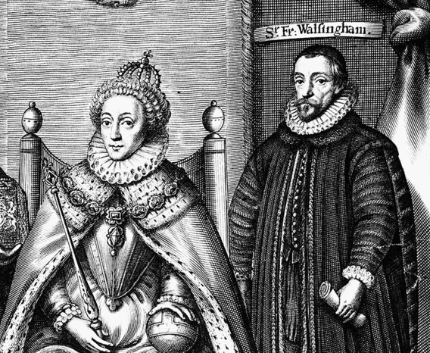

Slide 8
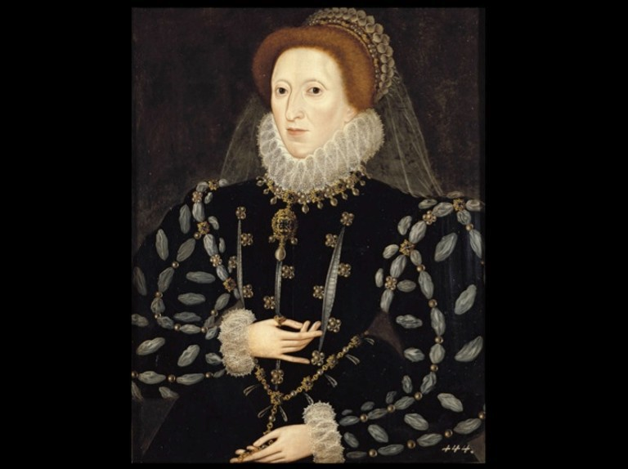
“There are more than two hundred men of all ages who, at the instigation of the Jesuits, conspire to kill me.”
Queen Elizabeth

Slide 9
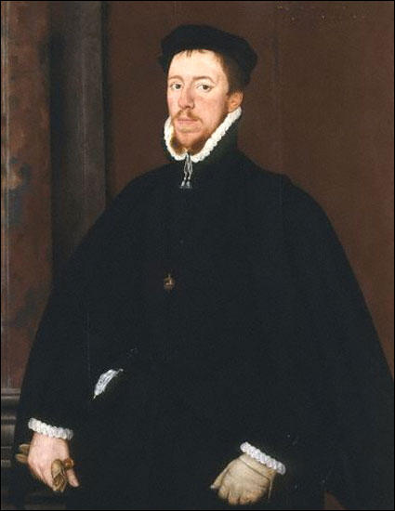
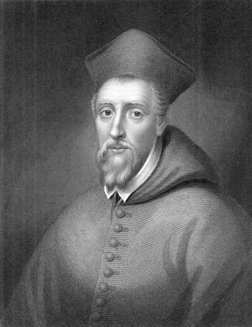
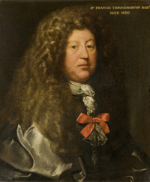
Cardinal William Allen
Roberto Ridolfi
Francis Throckmorton

Slide 10
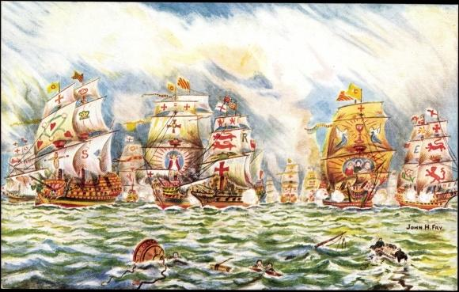
Catholic invaders thwarted by God’s grace!

Slide 11
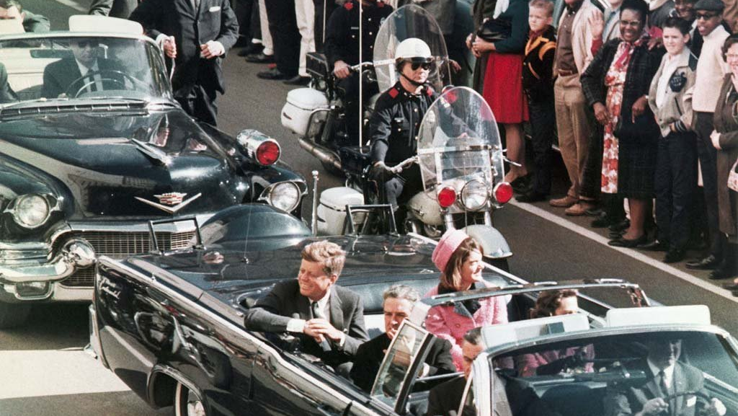

Slide 12
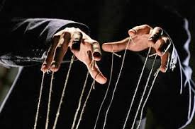

Slide 13
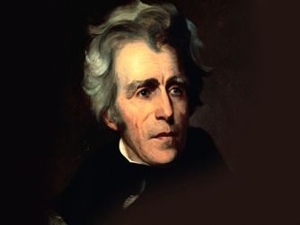
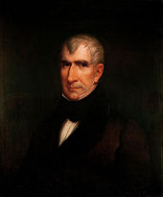
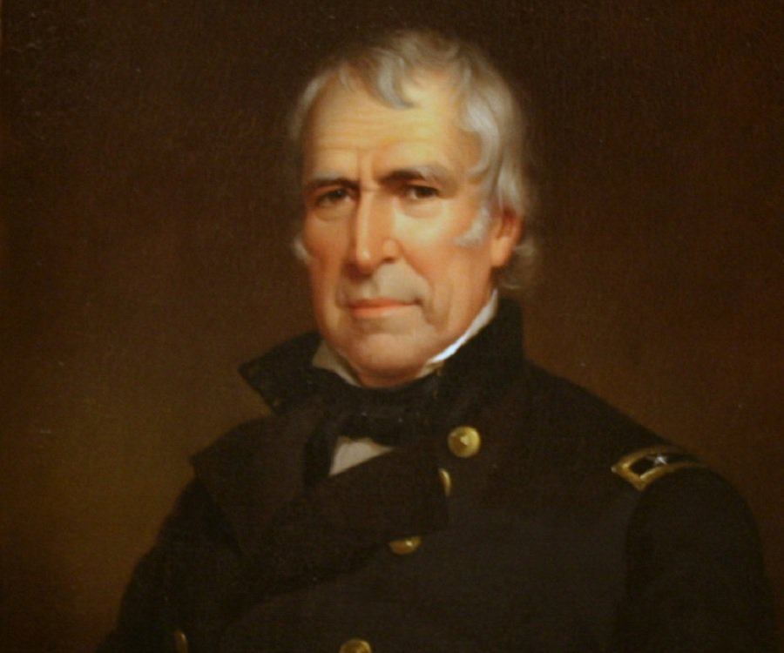
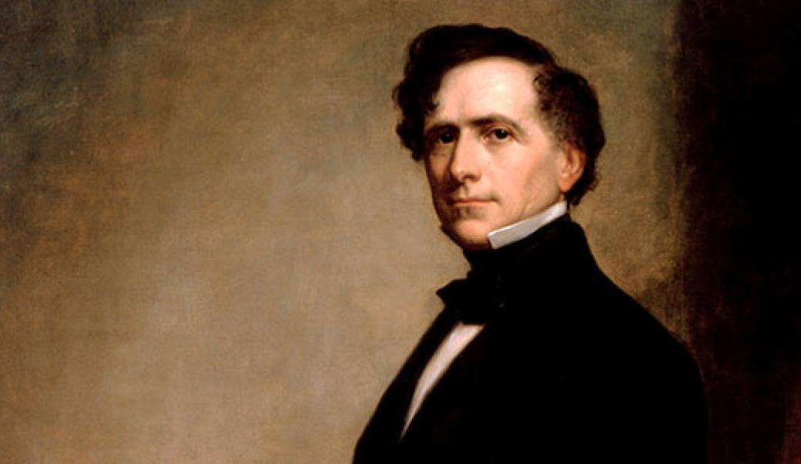
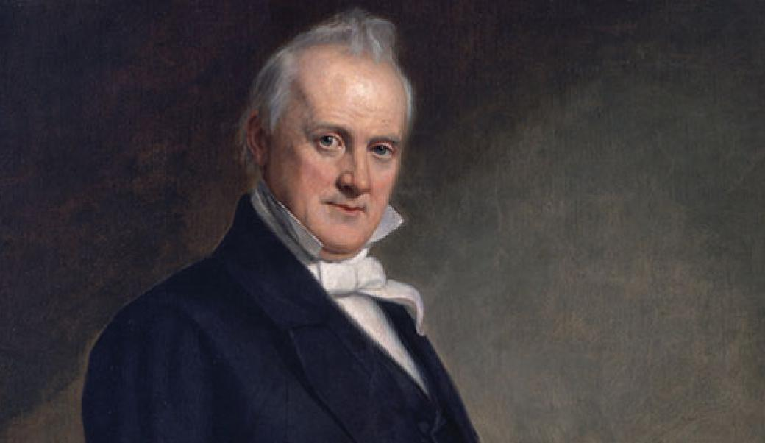
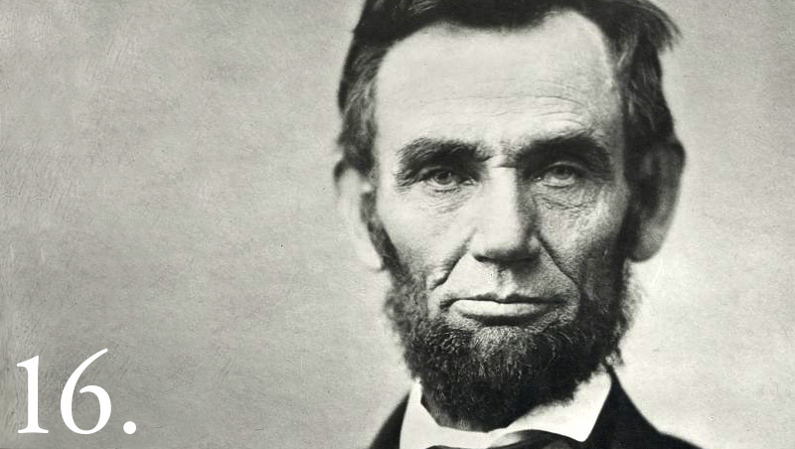
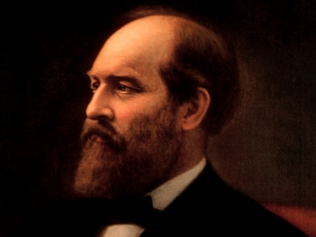
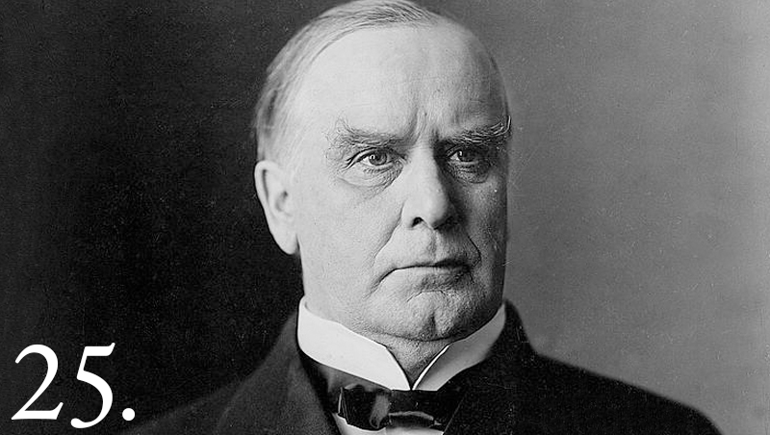
Andrew Jackson
William Henry Harrison
Zachary Taylor
Franklin Pierce
James Buchanan
Abraham Lincoln
James Garfield
William Mckinley
… AND of course John F. Kennedy in 1963. Assassination attempts by the agents of Rome against countless leaders and patriots from every generation!

Slide 14
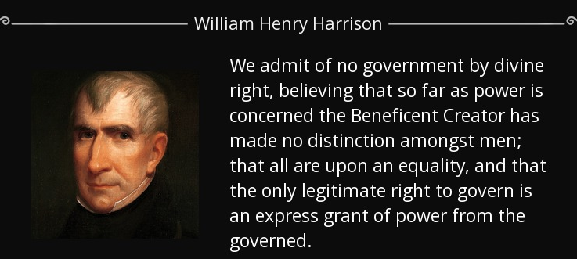

Slide 15
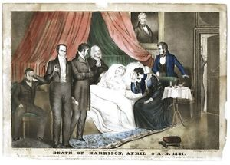
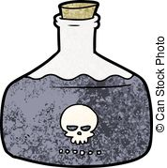

Slide 16
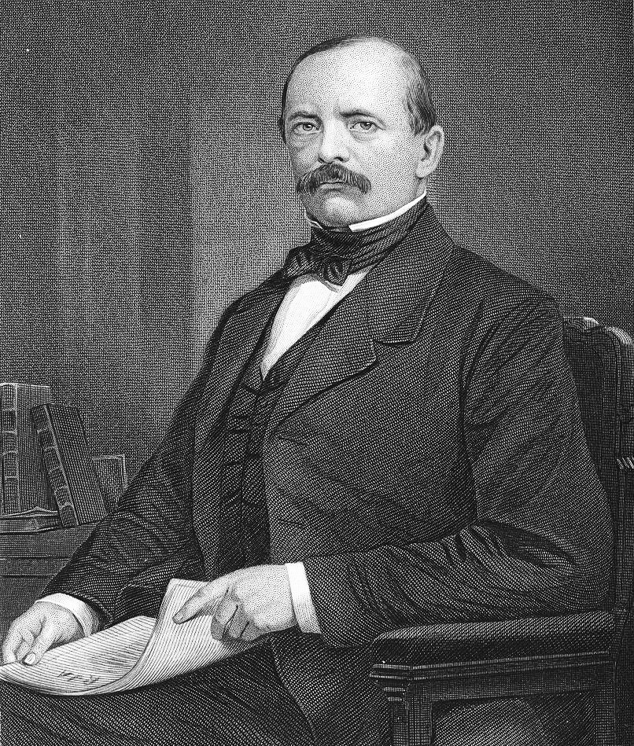
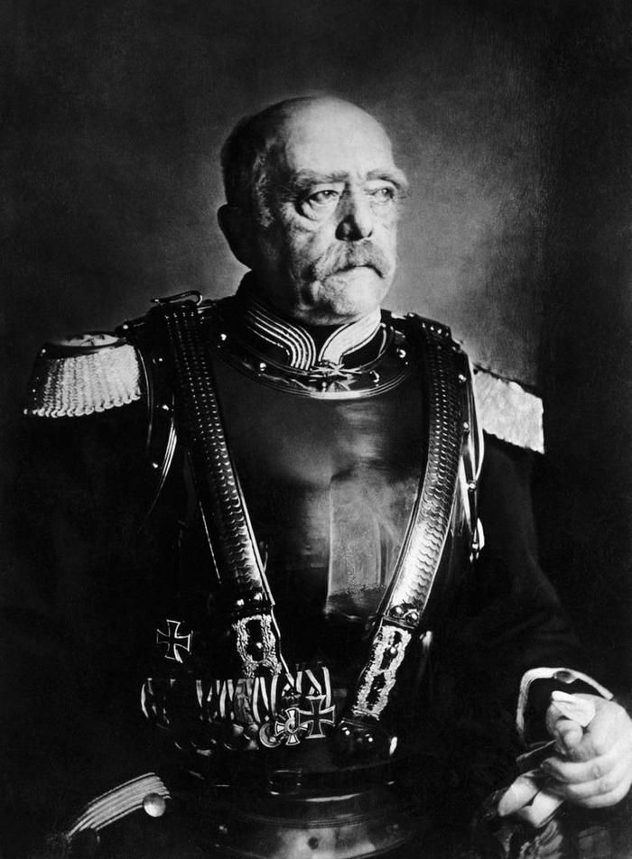
Otto von Bismark

Slide 17
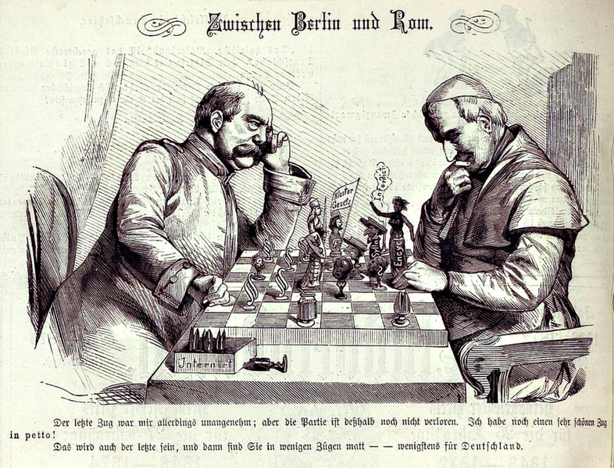

Slide 18
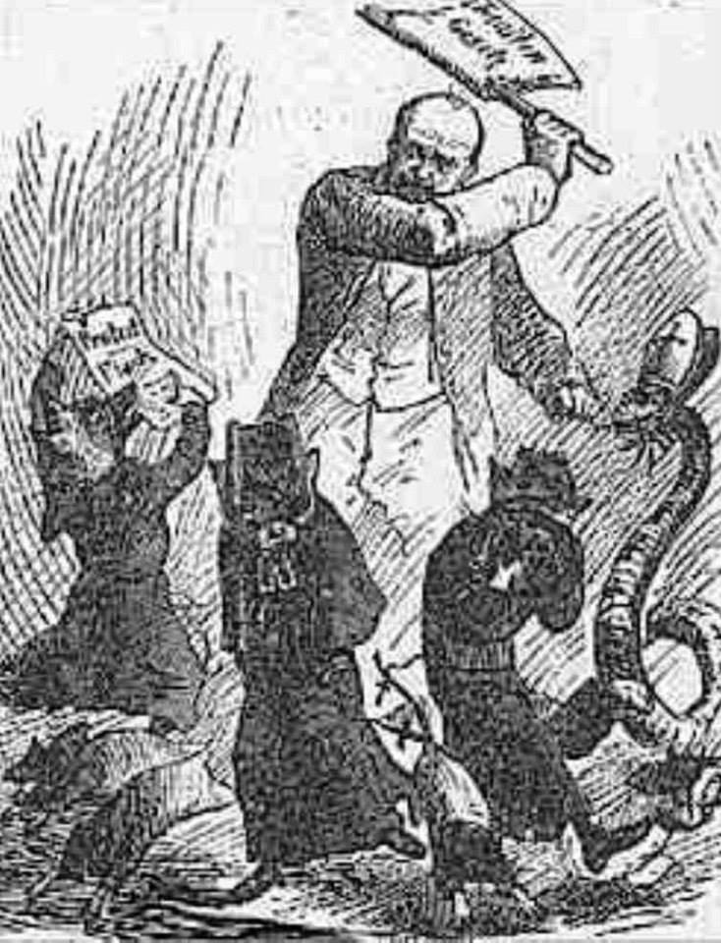

Slide 20
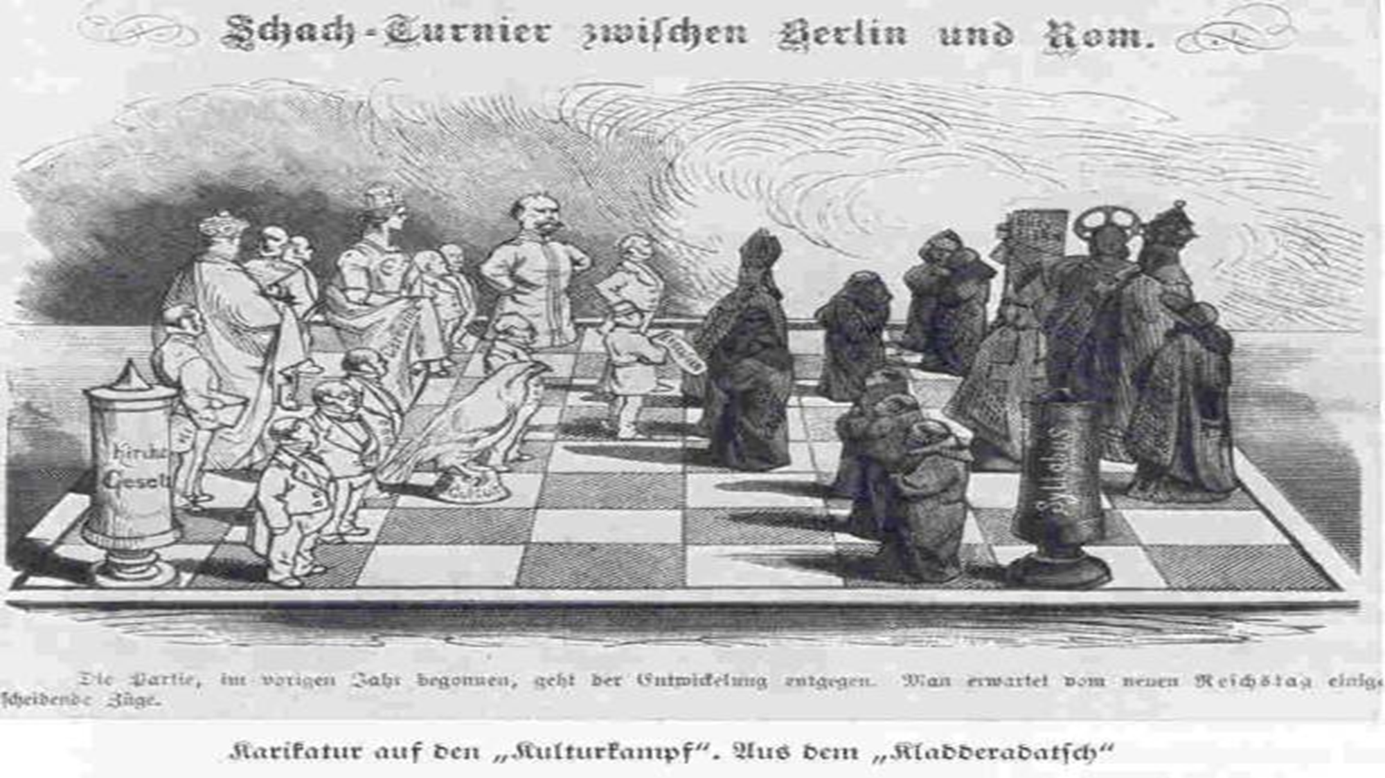
Back to Canossa!!! Just like Henry IV

Slide 21
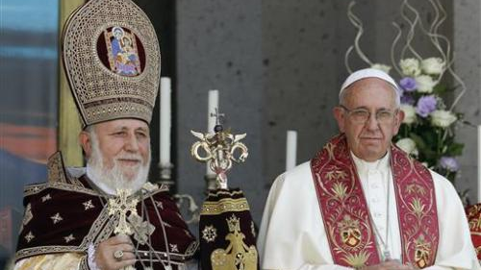

Slide 23
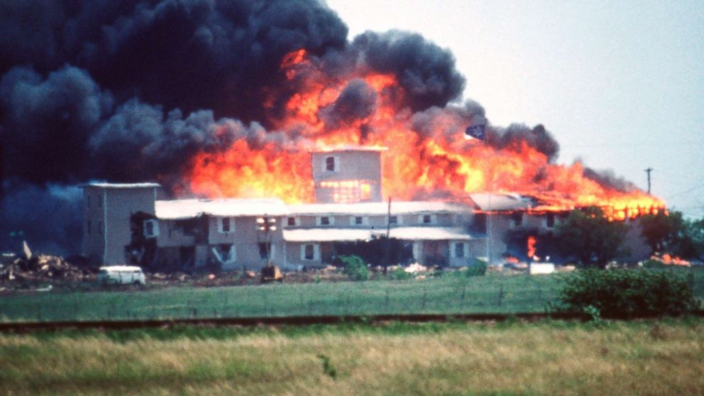

Slide 24
