Slide 1
Trends in Time
Things Don’t Change

Slide 2
“By the decree enforcing the institution of the papacy in violation of the law of God, our nation will disconnect herself fully from righteousness. When Protestantism shall stretch her hand across the gulf to grasp the hand of the Roman power, when she shall reach over the abyss to clasp hands with spiritualism, when, under the influence of this threefold union, our country shall repudiate every principle of its Constitution as a Protestant and republican government, and shall make provision for the propagation of papal falsehoods and delusions, then we may know that the time has come for the marvelous working of Satan and that the end is near.” Testimonies For The Churches – Volume 5, Testimonies, pg. 451

Slide 3
More Pointed!
"In this fearful time, just before Christ is to come the second time, God's faithful preachers will have to bear a still more pointed testimony than was borne by John the Baptist. A responsible, important work is before them; and those who speak smooth things, God will not acknowledge as His shepherds. A fearful woe is upon them" (1T 321).

Slide 4
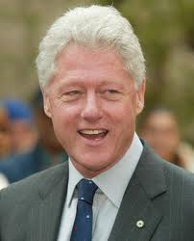
Clinton
Trained at Georgetown, the pre eminent Jesuit University in America, Clinton learned his lessons well. In his inaugural address, he quoted his mentor, Carroll Quigley who had tremendous influence over Clinton!

Slide 5
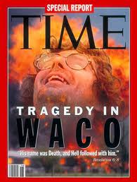
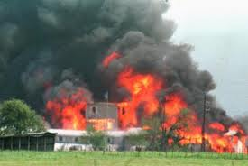
Warning to Independent Adventists

Slide 6
Wake Up!
There was another reason for Waco that Bill Clinton disclosed April 19th and 20th of 1993. This statement was made in the Rose Garden and can be found in White House press release documents.
“I want to say as I did yesterday, I am very sorry for the loss of life which occurred at the beginning and at the end of this tragedy in Waco. I hope very much that others who will be tempted to join cults and to become involved with people like David Koresh will be deterred by the horrible scenes they have seen over the last seven weeks. And I hope very much that the difficult situations which federal agents confronted there and which they will be doubtless required to confront in other contexts in the future will be somewhat better handled and better understood because of what has been learned now.” Taken from ‘Secret Terrorists, chap. 9

Slide 7
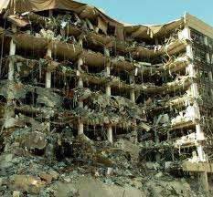
Create Fear
“The Omnibus Counter Terrorism Act of 1995 was on a slow track in Congress and the subject of a lively debate as to
whether it would violate some fundamental civil liberties,
including the right to confront one’s accuser. Now, after the Oklahoma City bombing, there are few surer legislative bets in Washington. Democrats and Republicans issued news releases Thursday calling for the bill’s quick passage. — Terror in the Heartland: Terrorism Bill Moves Very Fast, Orlando Sentinel, April 21st, 1995

Slide 8
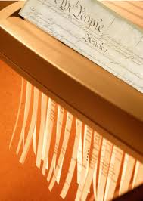
Shredding Constitution!
“President Clinton prodded Congress on Friday to move swiftly on his anti-terrorism legislation and avoid political ‘endless quibbling’ over details. ‘We must not doddle or delay. Congress must act, and act promptly.’ His 1.25 billion anti-terrorism package would expand law enforcement’s investigative and enforcement powers and toughen penalties for certain crimes. Republicans have reacted favorably to the proposals Clinton put forward on Wednesday, one week after the Oklahoma City bombing.”Clinton Urges Swift Action on Anti-terrorism Legislation, Orlando Sentinel, April
29th, 1995.

Slide 9
Clinton/Jesuit Connection
Trained at the pre eminent Jesuit University; quoting from his Jesuit mentor, Carroll Quigley in his inaugural, Clinton made it very clear through his assaults on Waco, the middle class with NAFTA, and the constitution that he would do exactly what the Jesuits wanted.
“We will rule the United States, and lay them at the feet of the Vicar of Jesus Christ [the pope], that he may put an end to their Godless system of education, and impious laws of
liberty of conscience which are an insult to God and man.” Charles Chiniquy, Fifty years in the Church of Rome, Chick
Publications, p. 282,.
“Nothing is plainer than that, if the principles of the church of Rome prevail here, our Constitution would fall. The two cannot exist together. They are in open and direct antagonism with the fundamental theory of our government and of all popular government everywhere. — Richard Thompson, The Papacy and the Civil Power, quoted in Fifty Years in the Church of Rome, p. 285

Slide 10
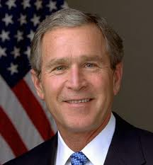
The Trend Continues
Following Clinton into office was George Bush. As for Bush’ connections, we find that he was part of the Order of Skull and Bones, having been initiated into the order in 1968. In order to become a member, one must vow blood obedience to three caricatures that represent the real deal. The three are: the head of the Masonic Order, the White Pope, and the Black Pope, the Jesuit General.
Bush sold his soul to Rome when he joined this group. All other oaths become secondary to the one he made to the order!!!

Slide 11
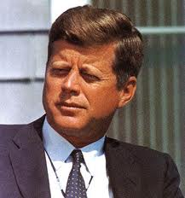
Kennedy said ‘No’, Bush said ‘Yes’
Bush made it very clear who he would be serving when he got into office in 2001.
“In 1960, John Kennedy went from Washington to Texas to
assure Protestant preachers that he would not obey the
pope. In 2001, George Bush came from Texas up to
Washington to assure a group of Catholic bishops that he
would obey the pope.” Washington Times, April 16, 2001

Slide 12
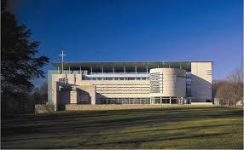
Cultural Center
From the beginning of his presidency, George Bush has been promoting the Jesuit agenda. Two months into his presidency, the President dedicated a cultural center in Washington, D.C. to the greatest enemy this Republic has ever had. “The best way to honor Pope John Paul II, truly one of the great men, is to take his teachings seriously, to listen to his words and put his words and his teachings into action here in America!”Patricia Zapoa, Catholic News Service, March 24, 2001.

Slide 13
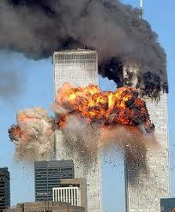

Slide 14
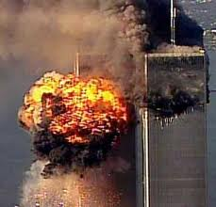
The Results
“The bill enhances the ability of federal authorities to tap
phones, share intelligence information, track Internet usage, e-mails and cell phones and protect U.S. borders. — Bush Signs Sweeping New Laws to Combat Terrorism, Reuters News Service, October 26, 2001.
“Lawmakers upset with some of the administrations antiterrorism actions will question Attorney General John Ashcroft on the matter. [Certain Congressmen] say the administration’s actions have
gone too far in infringing on civil liberties. — USA Today, November 26, 2001,.

Slide 15
Liberty Disappearing
“Long before I was ordained a priest, I knew that my church was the most implacable enemy of this republic. My professors… had been unanimous in telling me that the principles and laws of the Church of Rome were absolutely antagonistic to the principles which are the foundations stones of the Constitution of the United States of America. — Charles Chiniquy, Fifty Years in the Church of Rome, Chick Publications, p. 283
“Nothing is plainer than that, if the principles of the church of Rome prevail here, our Constitution would fall. The two cannot exist together. They are in open and direct antagonism with the fundamental theory of our government and of all popular government everywhere.” Richard Thompson, The Papacy and the Civil Power, quoted in Fifty Years in the Church of Rome, p. 285,
“If Catholics ever gain a sufficient numerical majority in this
country, religious freedom is at an end. “ The Shepherd of
the Valley, official journal of the Bishop of St. Louis,
November 23rd, 1851.

Slide 16
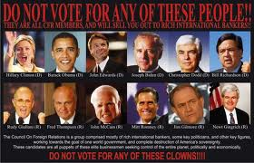
Steady Erosion
From Jesuit trained Bill Clinton to Skull and Bones member, George Bush, the papacy/Jesuits have put their men in place who will erode away freedom in this country till it is no more. These Protestant freedoms are opposite of Rome’s interests and goals. And….the beat goes on!!!!!!!!!!!!!

Slide 17
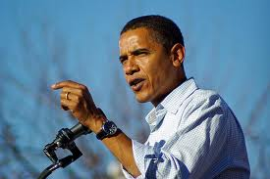
Barack Will Save Us!?! Health Care!
A retired constitutional lawyer declares, “I have concluded that this legislation really has no intention of providing affordable health care choices. Instead it is a convenient cover for the most massive transfer of power to the executive branch of government that has ever occurred., or even been contemplated. If this law or a similar one is adopted, major portions of the Constitution of the United States will effectively have been destroyed…This is not about health care; it is about seizing power and limiting rights…Three amendments out of the original ten in the Bill of Rights are effectively nullified by this Health Care Act.”

Slide 18
You Ain’t Seen Nothing Yet
“Each year, Congress authorizes the budget of the Department of Defense through a National Defense Authorization Act (NDAA). The NDAA of 2012, however, is unlike any previous ones. This year’s legislation contains highly controversial provisions that empower the Armed Forces to engage in civilian law enforcement and to selectively suspend due process and habeas corpus, as well as other rights guaranteed by the 5th and 6th Amendments to the U.S. Constitution, for terror suspects apprehended on U.S. soil…

Slide 19
Even Americans!
…This pernicious law poses one of the greatest threats to civil liberties in our nation’s history. Under Section 1021 of the NDAA, foreign nationals who are alleged to have committed or merely “suspected” of sympathizing with or providing any level of support to groups the U.S. designates as terrorist organization or an affiliate or associated force may be imprisoned without charge or trial “until the end of hostilities.” The law affirms the executive branch’s authority granted under the 2001 Authorization for Use of Military Force (AUMF) and broadens the definition and scope of “covered persons.” But because the “war on terror” is a war on a tactic, not on a state, it has no parameters or timetable. Consequently, this law can be used by authorities to detain (forever) anyone the government considers a threat to national security and stability – potentially even demonstrators and protesters exercising their First Amendment rights.” http://www.counterpunch.org/2012/01/18/why-the-ndaa-is-unconstitutional/

Slide 20
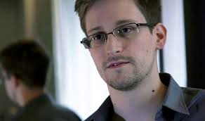
Patriot Act Today
“The bill enhances the ability of federal authorities to tap
phones, share intelligence information, track Internet usage, e-mails and cell phones and protect U.S. borders. — Bush Signs Sweeping New Laws to Combat Terrorism, Reuters News Service, October 26, 2001.
Today, ‘The NSA access is part of a previously undisclosed program called Prism, which allows officials to collect material including search history, the content of emails, file transfers and live chats, the document says.’

Slide 21
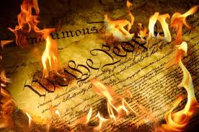
We ARE at The End!
“When Protestantism shall stretch her hand across the gulf to grasp the hand of the Roman power, when she shall reach over the abyss to clasp hands with spiritualism, when, under the influence of this threefold union, our country shall repudiate every principle of its Constitution as a Protestant and republican government, and shall make provision for the propagation of papal falsehoods and delusions, then we may know that the time has come for the marvelous working of Satan and that the end is near.” {Mar 190.2}

Slide 22
Hello!
“We are also determined to take possession of the United States; but we must proceed with the utmost secrecy. Silently and patiently, we must mass our Roman Catholics in the great cities of the United States, remembering that the vote of a poor journeyman, though he be covered with rags, has as much weight in the scale of powers as the millionaire Astor, and that if we have two votes against his one, he will become as powerless as an oyster. Let us then multiply our votes; let us call our poor but faithful Irish Catholics from every corner of the world, and gather them into the very hearts of the cities of Washington, New York, Boston, Chicago, Buffalo, Albany, Troy, Cincinnati. Under the shadows of those great cities, the Americans consider themselves a giant unconquerable race. They look upon the poor Irish Catholics with supreme contempt, as only fit to dig their canals, sweep their streets and work in their kitchens. Let no one awake those sleeping lions, today. Let us pray God that they continue to sleep a few years longer, waking only to find their votes outnumbered as we will turn them forever, out of every position of honor, power and profit!… What will those so-called giants think when not a single senator or member of Congress will be chosen, unless he has submitted to our holy father the pope! We will not only elect the president, but fill and command the armies, man the navies, and hold the keys of the public treasury!… Then, yes! then, we will rule the United States and lay them at the feet of the Vicar of Jesus Christ, that he may put an end to their godless system of education and impious laws of liberty of conscience, which are an insult to God and man!”
Charles Chiniquy, Fifty Years in the Church of Rome, Chick Publications, pp. 281,282.

