Slide 1
Ezekiel, pt. 17
Egypt-Judgment

Slide 2
Now Egypt
Ezekiel, chapters 25-28, looked at the judgments that fell on Ammon, Moab, Edom, Philistia, and Tyre. We noticed that the fall of Tyre paralleled to the fall of the papacy in Rev. 17 and 18. This also was used to reveal the fall of Lucifer in heaven and his ultimate destruction in the future. The next 4 chapters, Ezekiel chapters 29-32, deal with the judgments that fell on another local nation. This nation is Egypt and she will be our study today!

Slide 3
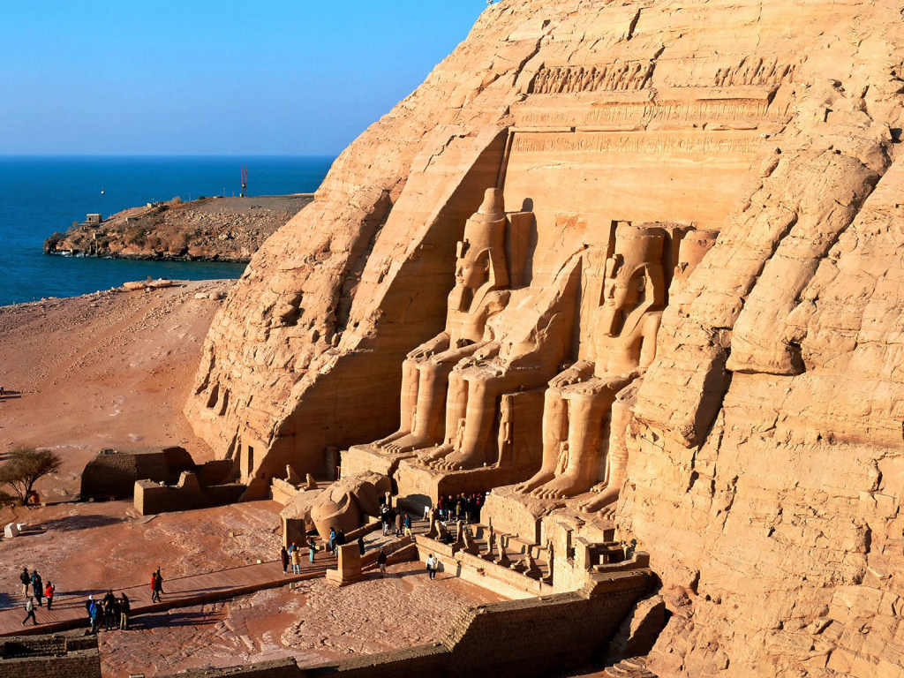
The Land of Imotep
The God of heaven loved Egypt, blessing her abundantly. Joseph , Imotep of Egyptian history, was used to save the empire and the world. Moses called on Egypt to let God’s people go!
Egypt knew of the greatness of the God heaven for centuries in her midst, but He was spurned!

Slide 4
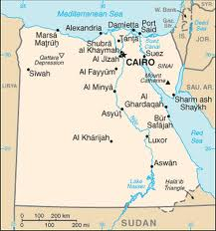
Time Frame
“In the tenth year, in the tenth month, in the twelfth day of the month, the word of the LORD came unto me, saying, Son of man, set thy face against Pharaoh king of Egypt, and prophesy against him, and against all Egypt:” Ezekiel 29:1,2

Slide 5
No Help from Egypt
Babylon had besieged Jerusalem. She was about to fall to Nebuchadnezzar. The Jews were frantically looking to Egypt for support. Egypt was a broken reed and could not deliver God’s professed people from Babylon. Ezekiel declares that Egypt would suffer too.

Slide 6
Egypt’s Problem
Speak, and say, Thus saith the Lord GOD; Behold, I am against thee, Pharaoh king of Egypt, the great dragon that lieth in the midst of his rivers, which hath said, My river is mine own, and I have made it for myself. But I will put hooks in thy jaws, and I will cause the fish of thy rivers to stick unto thy scales, and I will bring thee up out of the midst of thy rivers, and all the fish of thy rivers shall stick unto thy scales.” Ezekiel 29:3,4

Slide 7
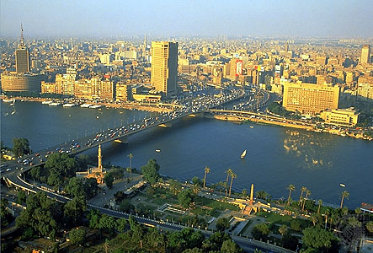
So Blessed-Going Down!
“It shall be the basest of the kingdoms; neither shall it exalt itself any more above the nations: for I will diminish them, that they shall no more rule over the nations.” Ezekiel 29:15

Slide 8
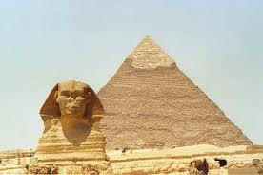
Departed Glory

Slide 9
Egypt Was god
In ancient times, Egypt was the epitome of atheism. They were god; they were creator, sustainer, provider. The existence of the only and one true God was utterly denied by the Egyptians. Not only do we see this in Ezekiel 29, but also in Exodus 5. “And afterward Moses and Aaron went in, and told Pharaoh, Thus saith the LORD God of Israel, Let my people go, that they may hold a feast unto me in the wilderness. And Pharaoh said, Who is the LORD, that I should obey his voice to let Israel go? I know not the LORD, neither will I let Israel go.” Exodus 5:1,2

Slide 10
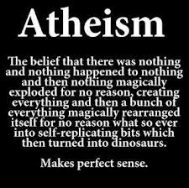
Pure Atheism
Egypt never altered this belief and they have become the epitome of atheism. This becomes deeply significant in the light of Bible prophecy in Daniel 11:40 and in Revelation 11! We will look at that momentarily.

Slide 11
Pen of Prophecy
"The great city" in whose streets the witnesses are slain, and where their dead bodies lie, is "spiritually" Egypt. Of all nations presented in Bible history, Egypt most boldly denied the existence of the living God and resisted His commands. No monarch ever ventured upon more open and highhanded rebellion against the authority of Heaven than did the king of Egypt. When the message was brought him by Moses, in the name of the Lord, Pharaoh proudly answered: "Who is Jehovah, that I should hearken unto His voice to let Israel go? I know not Jehovah, and moreover I will not let Israel go." Exodus 5:2, A.R.V. This is atheism, and the nation represented by Egypt would give voice to a similar denial of the claims of the living God and would manifest a like spirit of unbelief and defiance.” GC, pg. 269

Slide 12
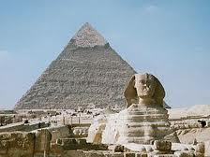
No Longer Exalted
“It shall be the basest of the kingdoms; neither shall it exalt itself any more above the nations: for I will diminish them, that they shall no more rule over the nations. And it shall be no more the confidence of the house of Israel, which bringeth their iniquity to remembrance, when they shall look after them: but they shall know that I am the Lord GOD.” Ezekiel 29:15,16

Slide 13
In Prophecy
“And at the time of the end shall the king of the south push at him: and the king of the north shall come against him like a whirlwind, with chariots, and with horsemen, and with many ships; and he shall enter into the countries, and shall overflow and pass over.” Daniel 11:40 In prophecy, the King of the north was Seleuceus/Syria-Babylon. The king of the south was Egypt. These were two of the four divisions of Alexander’s empire. These two empires battled for centuries.

Slide 14
What is the time of the end?
Daniel 12:4 “But thou, O Daniel, shut up the words, and seal the book, even to the time of the end: many shall run to and fro, and knowledge shall be increased.” The book of Daniel was sealed up until the time of the end. Great Controversy, pg. 356 “ The apostle Paul warned the church not to look for the coming of Christ in his day. "That day shall not come," he says, "except there come a falling away first, and that man of sin be revealed." 2 Thessalonians 2:3. Not till after the great apostasy, and the long period of the reign of the "man of sin," can we look for the advent of our Lord. The "man of sin," which is also styled "the mystery of iniquity," "the son of perdition," and "that wicked," represents the papacy, which, as foretold in prophecy was

Slide 15
to maintain its supremacy for 1260 years. This period ended in 1798. The coming of Christ could not take place before that time. Paul covers with his caution the whole of the Christian dispensation down to the year 1798. It is this side of that time that the message of Christ's second coming is to be proclaimed.
No such message has ever been given in past ages. Paul, as we have seen, did not preach it; he pointed his brethren into the then far-distant future for the coming of the Lord. The Reformers did not proclaim it. Martin Luther placed the judgment about three hundred years in the future from his day. But since 1798 the book of Daniel has been unsealed, knowledge of the prophecies has increased, and many have proclaimed the solemn message of the judgment near.”

Slide 16
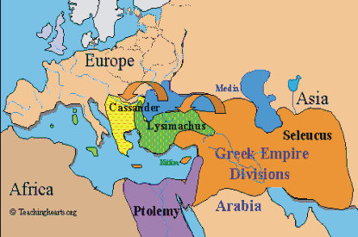
The ancient world of Alexander

Slide 17
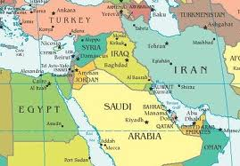
Kings of North/South

Slide 18
End time application
King of the North
The king of the north at the end represents spiritual Babylon. This same power is identified in Revelation 17. This power is the papacy.
King of the South
The king of the south represents spiritual Egypt. This same power is identified in Revelation 11 as spiritual Egypt. This represents atheistic Communism as first manifest in Russia and hence spread all over the world.

Slide 19
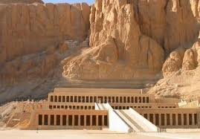
Egypt Falls
The once mighty nation of Egypt has been reduced to a 3rd world country because of her rejection of the God of heaven and her exaltation of herself. Her atheistic principles of self exaltation and the forgetting of God will bring down all modern nations and individuals that choose the same path!!!

