Slide 1
Communion

Slide 2
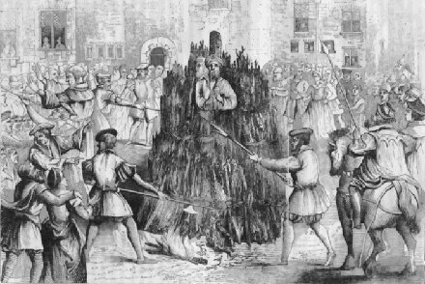
He Died over Communion

Slide 3
His Name: John Frith
“In 1532, he returned to England, and warrants for his arrest were issued by Thomas More . In October he was arrested by the local authorities before he could arrange passage to Antwerp, wearing an elaborate disguise. While imprisoned for about 8 months in the Tower of London, Frith penned his views on Communion, fully knowing that it would be used "to purchase me a most cruel death."
Frith was tried before many examiners and bishops, and produced his own writings as evidence for his views that were deemed as heresy. He was sentenced to death by fire and offered a pardon if he answered positively to two questions: Do you believe in purgatory, and do you believe in transubstantiation? He replied that neither purgatory nor transubstantiation could be proven by Holy Scriptures, and thus was condemned as a heretic and was transferred to the secular arm for his execution on June 23, 1533. He was burned at the stake on July 4, 1533 at Smithfield, London .

Slide 4
Burned at the Stake
John Frith, along with thousands of others, died because he refused to believe that the actual body of Jesus Christ is in the bread and that the blood of Jesus Christ is actually in the juice. He refused to believe that the priest could create the Creator!! For this, John Frith died by burning!!
“who through faith subdued kingdoms, wrought righteousness, obtained promises, stopped the mouths of lions, quenched the violence of fire, escaped the edge of the sword, out of weakness were made strong, waxed valiant in fight, turned to flight the armies of the aliens. Women received their dead raised to life again: and others were tortured, not accepting deliverance; that they might obtain a better resurrection:” Hebrews 11:33-35

Slide 5

What About Today?
In January, 1982, in Lima, Peru, leaders from every major religious body met and agreed on 3 things:
B-Baptism
E-Eucharist
M-Ministry

Slide 6
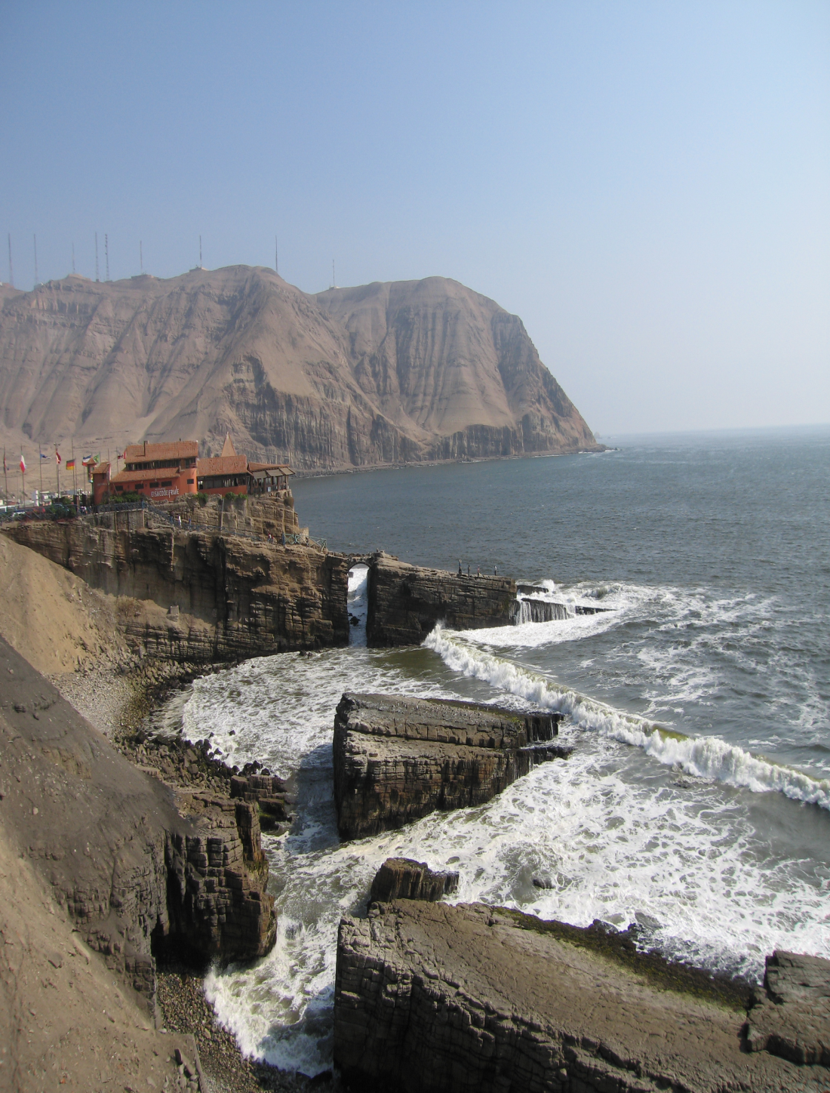
Believe Whatever You Want
To encourage all to accept equally the various concepts, whether they be trans-substantiation, con-substantiation, or the fact that the bread and wine are symbols of the broken body and spilled blood of Jesus Christ. This is what was agreed on back in 1982!

Slide 7
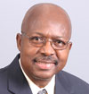
Roy Adams
With the dam broken, Associate Adventist Editor, Roy Adams could declare that “And we could go on if space permitted – to mention the WCC’s… accentuation of the Holy Spirit and the Eucharist. All of these emphases fit into the ambit of the three angels’ messages.” 5-2-1991

Slide 8
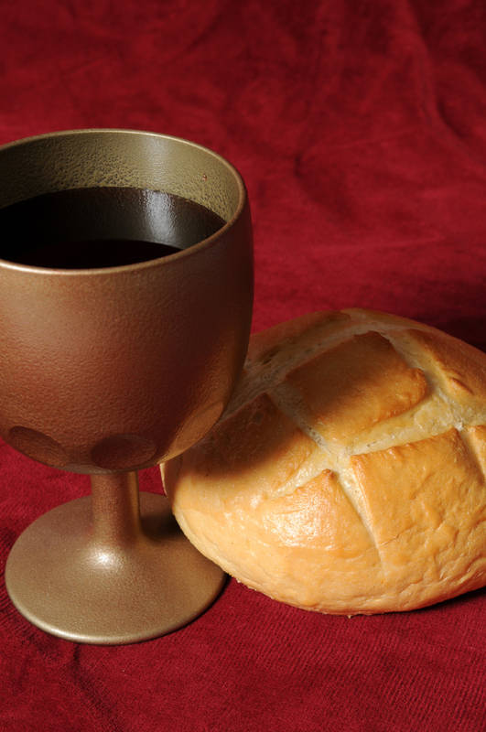
SDA’s Really Believe
The bread is symbolic of Christ’s broken body in dying for our sins. The juice is symbolic of Christ’s spilt blood for us. By participating in this service, we are truly asking for the blood of Jesus to forgive and cleanse us from all sin, and for the life of Christ to become our life!

Slide 9
More Than Us
“When believers assemble to celebrate the ordinances, there are present messengers unseen by human eyes. There may be a Judas in the company, and if so, messengers from the prince of darkness are there, for they attend all who refuse to be controlled by the Holy Spirit. Heavenly angels also are present. These unseen visitants are present on every such occasion. There may come into the company persons who are not in heart servants of truth and holiness, but who may wish to take part in the service. They should not be forbidden. There are witnesses present who were present when Jesus washed the feet of the disciples and of Judas. More than human eyes beheld the scene.
Christ by the Holy Spirit is there to set the seal to His own ordinance. He is there to convict and soften the heart. Not a look, not a thought of contrition, escapes His notice. For the repentant, brokenhearted one He is waiting. All things are ready for that soul's reception. He who washed the feet of Judas longs to wash every heart from the stain of sin.” DA, pg. 656

Slide 10
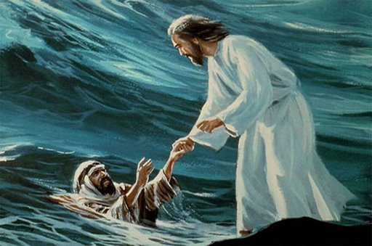
Praise the Lord!!!
“Our Lord says, Under conviction of sin, remember that I died for you. When oppressed and persecuted and afflicted for My sake and the gospel's, remember My love, so great that for you I gave My life. When your duties appear stern and severe, and your burdens too heavy to bear, remember that for your sake I endured the cross, despising the shame. When your heart shrinks from the trying ordeal, remember that your Redeemer liveth to make intercession for you.” DA, pg. 659

