Slide 1
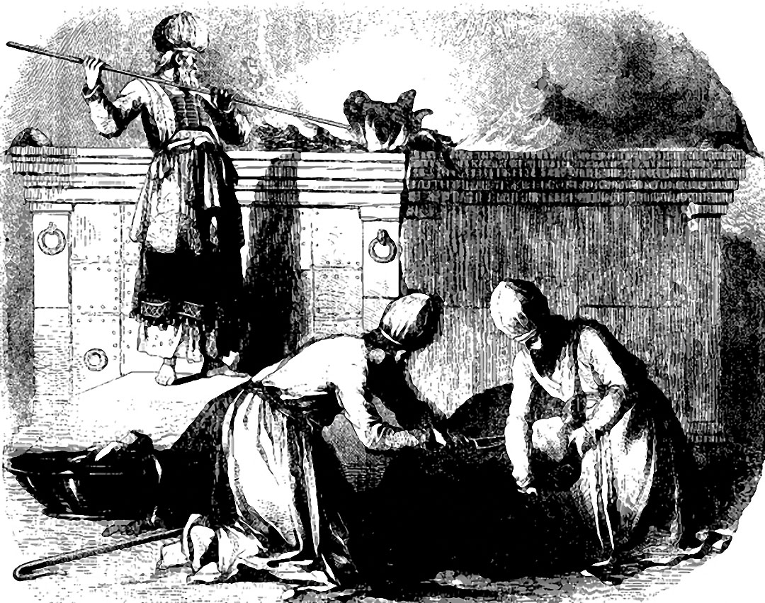
The Trespass Offering…
Hope for the Backslidden

Slide 2
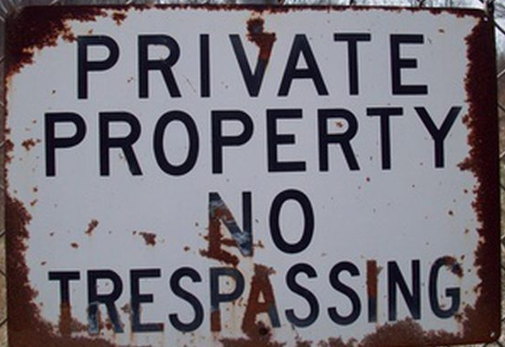
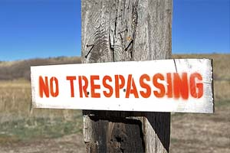
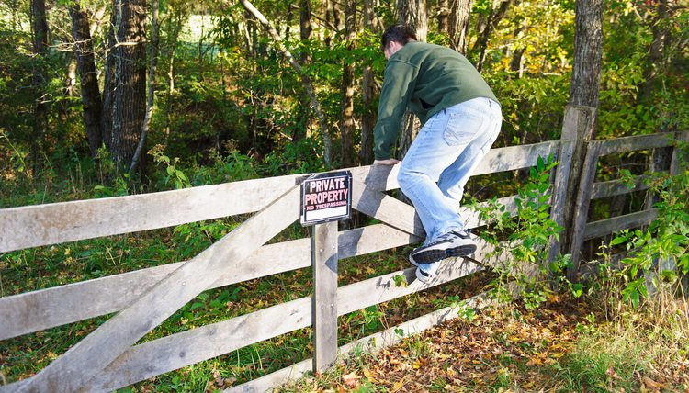
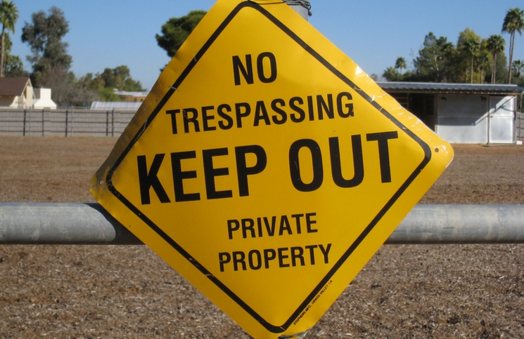
What Are Trespasses???

Slide 3
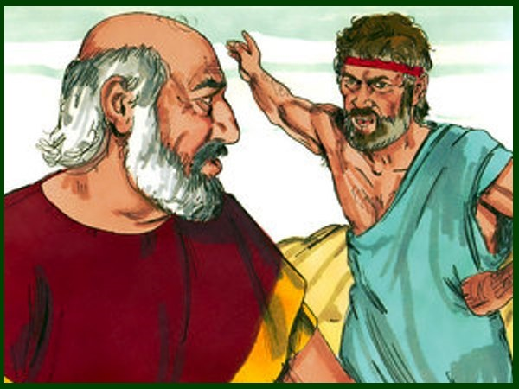
Jacob and Laban
Gen. 31:36-42 “And Jacob was wroth, and chode with
Laban: and Jacob answered and said to Laban, What
is my trespass? what is my sin, that thou hast so hotly
pursued after me? Whereas thou hast searched all
stuff, what hast thou found of all thy household stuff?
set it here before my brethren and thy brethren, that
they may judge betwixt us both. This twenty years
have I been with thee; thy ewes and thy she goats
have not cast their young, and the rams of thy flock
have I not eaten. That which was torn of beasts I brought not unto thee; I bare the loss of it; of my hand didst thou require it, whether stolen by day, or stolen by night. Thus I was; in the day the drought consumed me, and the frost by night; and my sleep departed from mine eyes. Thus have I been twenty years in thy house; I served thee fourteen years for thy two daughters, and six years for thy cattle: and thou hast changed my wages ten times. Except the God of my father, the God of Abraham, and the fear of Isaac, had been with me, surely thou hadst sent me away now empty. God hath seen mine affliction and the labour of my hands, and rebuked thee yesternight.”

Slide 4
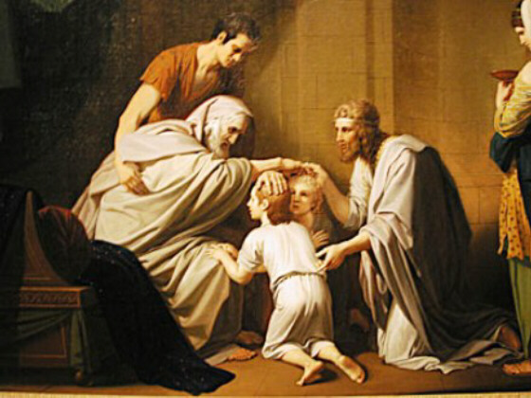
Genesis explains further…
Gen. 50:15-17 “And when Joseph's brethren saw that their father was dead, they said, Joseph will peradventure hate us, and will certainly requite us all the evil which we did unto him. And they sent a messenger unto Joseph, saying, Thy father did command before he died, saying, So shall ye say unto Joseph, Forgive, I pray thee now, the trespass of thy brethren, and their sin; for they did unto thee evil: and now, we pray thee, forgive the trespass of the servants of the God of thy father. And Joseph wept when they spake unto him.”

Slide 5
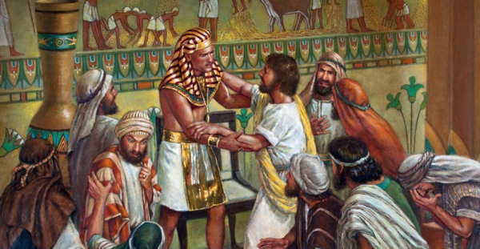
Gen. 50:18-21 “And his brethren also went and fell down before his face; and they said, Behold, we be thy servants. And Joseph said unto them, Fear not: for am I in the place of God? But as for you, ye thought evil against me; but God meant it unto good, to bring to pass, as it is this day, to save much people alive. Now therefore fear ye not: I will nourish you, and your little ones. And he comforted them, and spake kindly unto them.

Slide 6
Trespass Meaning…
Trespass (from Genesis): 6588 Pesha (peh-shah’)-transgress, transgression, sin, rebellion
Trespass offering (Leviticus): 817 asham (aw-shame)-trespass offering, guilt, offense, guiltiness, fault, compensation (for offense)
Trespass (Leviticus): 4604 ma’al (mah’-al)-trespass, transgression, trespassed, falsehood, unfaithful or treacherous act

Slide 7
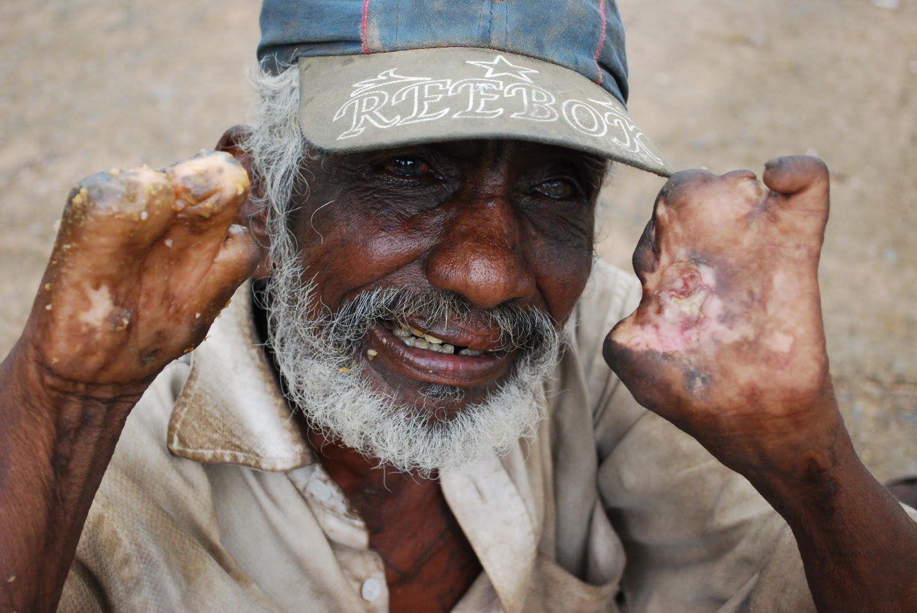
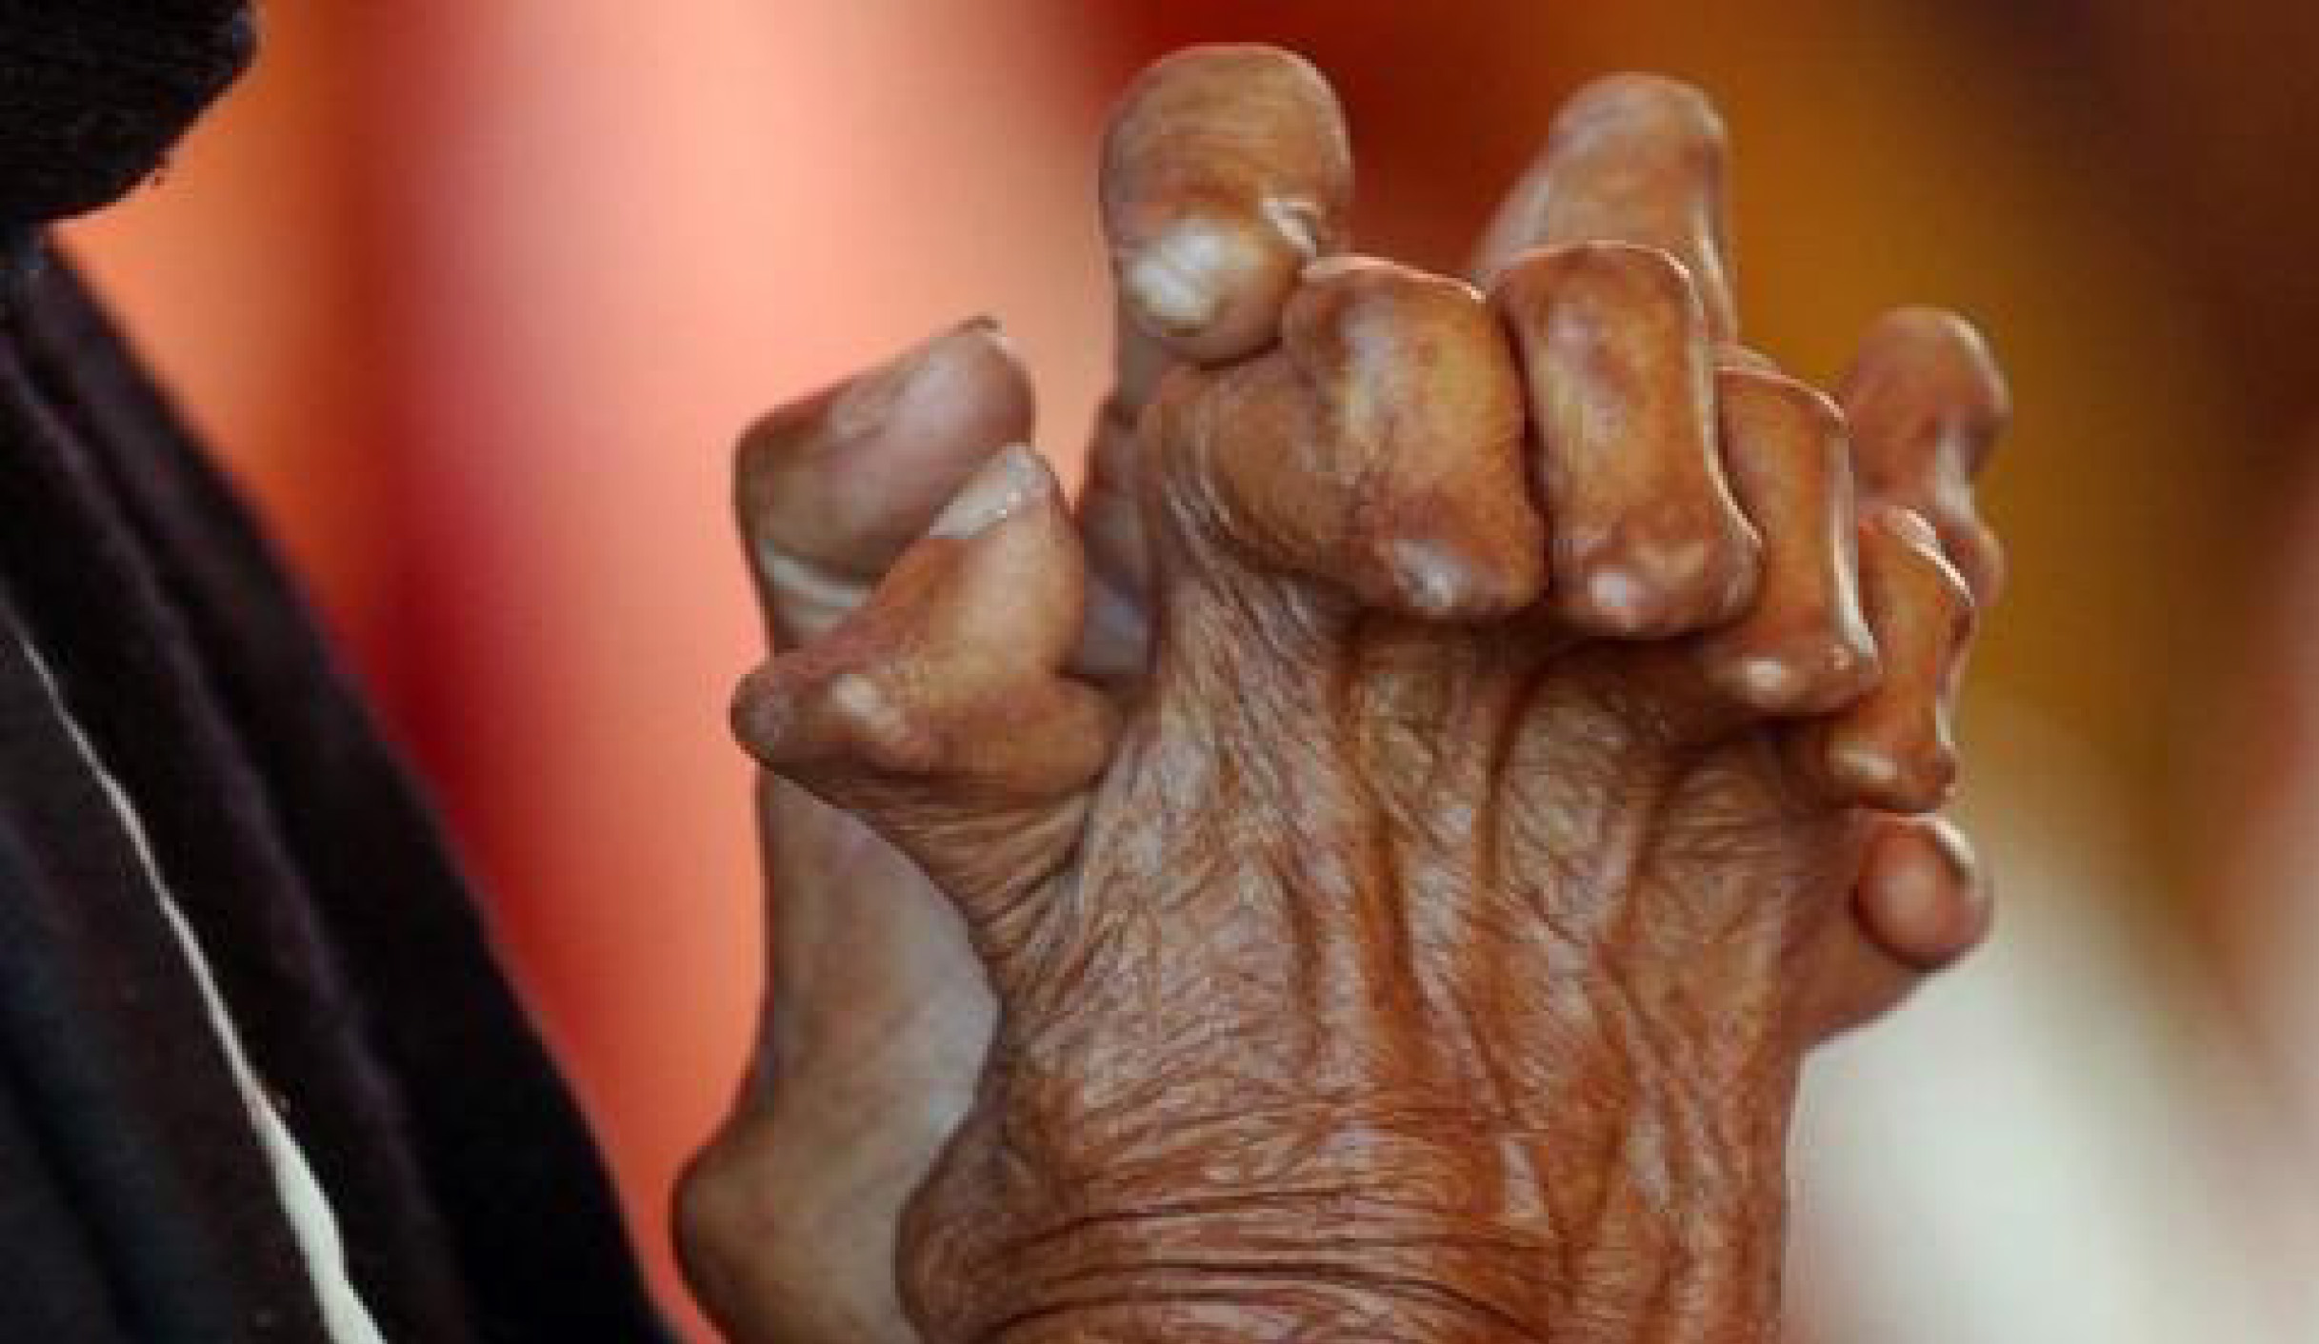
The Trespass Offering in Action!
Lev. 14:11-14 “And the priest that maketh him clean shall present the man that is to be made clean, and those things, before the Lord, at the door of the tabernacle of the congregation: And the priest shall take one he lamb, and offer him for a trespass offering, and the log of oil, and wave them for a wave offering before the Lord: And he shall slay the lamb in the place where he shall kill the sin offering and the burnt offering, in the holy place: for as the sin offering is the priest's, so is the trespass offering: it is most holy: And the priest shall take some of the blood of the trespass offering, and the priest shall put it upon the tip of the right ear of him that is to be cleansed, and upon the thumb of his right hand, and upon the great toe of his right foot”

Slide 8
Negligence, Ignorance, and Willful Transgression
Lev. 5:1-2 “And if a soul sin, and hear the voice of swearing, and is a witness, whether he hath seen or known of it; if he do not utter it, then he shall bear his iniquity. Or if a soul touch any unclean thing, whether it be a carcase of an unclean beast, or a carcase of unclean cattle, or the carcase of unclean creeping things, and if it be hidden from him; he also shall be unclean, and guilty.
2 Cor. 6:17 “And what concord hath Christ with Belial? or what part hath he that believeth with an infidel? And what agreement hath the temple of God with idols? for ye are the temple of the living God; as God hath said, I will dwell in them, and walk in them; and I will be their God, and they shall be my people. Wherefore come out from among them, and be ye separate, saith the Lord, and touch not the unclean thing; and I will receive you. And will be a Father unto you, and ye shall be my sons and daughters, saith the Lord Almighty.

Slide 9
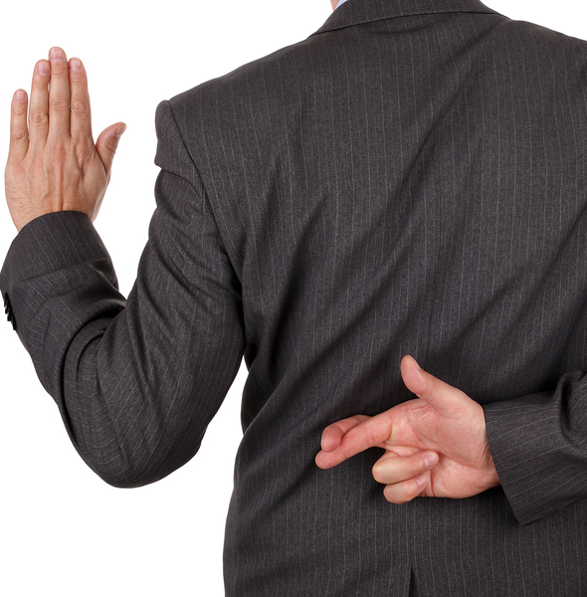
False Oaths and Evil Oaths
Lev. 5:3-5 “Or if he touch the uncleanness of man, whatsoever uncleanness it be that a man shall be defiled withal, and it be hid from him; when he knoweth of it, then he shall be guilty. Or if a soul swear, pronouncing with his lips to do evil, or to do good, whatsoever it be that a man shall pronounce with an oath, and it be hid from him; when he knoweth of it, then he shall be guilty in one of these. And it shall be, when he shall be guilty in one of these things, that he confess that he hath sinned in that thing.”

Slide 10
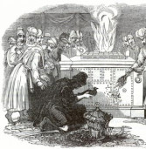
Lev. 5:6-7 And he shall bring his trespass offering unto the Lord for his sin which he hath sinned, a female from the flock, a lamb or a kid of the goats, for a sin offering; and the priest shall make an atonement for him concerning his sin. And if he be not able to bring a lamb, then he shall bring for his trespass, which he hath committed, two turtledoves, or two young pigeons, unto the Lord; one for a sin offering, and the other for a burnt offering.

Slide 11
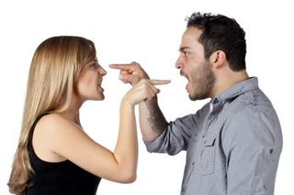
Bringing a Trespass Offering…
Let the members of every family bein to work over against their own houses. Let them humble themselves before God. It would be well to have a trespass-offering box in sight, and have all the household agree that whosoever speaks unkindly of another or utters angry words, shall drop into the trespass-offering box a certain sum of money. This would put them upon their guard against the wicked words which work injury, not only to their brethren, but to themselves. No man of himself can tame the unruly member, the tongue; but God will do the work for him who comes unto Him with contrite heart in faith and with humble supplication. By the help of God, bridle your tongues, talk less, and pray more.—R&H March 12, 1895

Slide 12
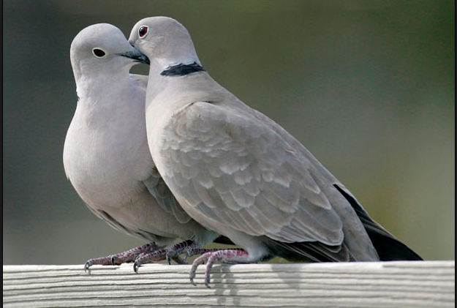
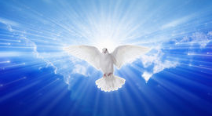
A Solemn and Gruesome Sacrifice
Lev. 5:8-10 “And he shall bring them unto the priest, who shall offer that which is for the sin offering first, and wring off his head from his neck, but shall not divide it asunder: And he shall sprinkle of the blood of the sin offering upon the side of the altar; and the rest of the blood shall be wrung out at the bottom of the altar: it is a sin offering. And he shall offer the second for a burnt offering, according to the manner: and the priest shall make an atonement for him for his sin which he hath sinned, and it shall be forgiven him.”

Slide 13
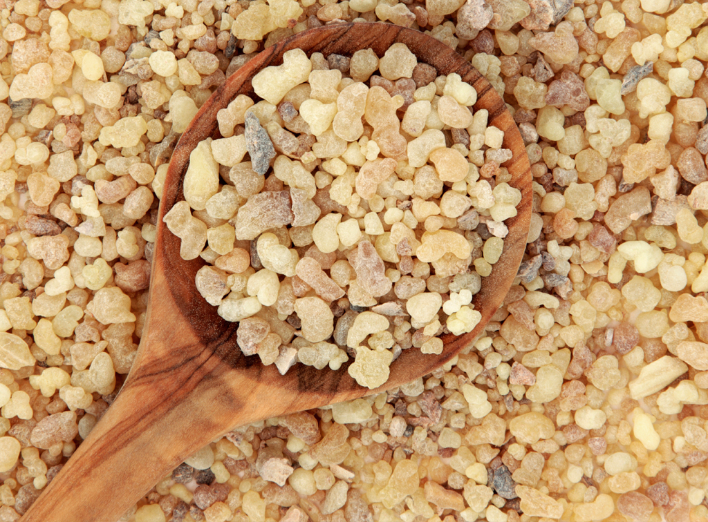
Meat Offering Provision for Trespass Offering
Lev. 5:11-13 “But if he be not able to bring two turtledoves, or two young pigeons, then he that sinned shall bring for his offering the tenth part of an ephah of fine flour for a sin offering; he shall put no oil upon it, neither shall he put any frankincense thereon: for it is a sin offering. Then shall he bring it to the priest, and the priest shall take his handful of it, even a memorial thereof, and burn it on the altar, according to the offerings made by fire unto the Lord: it is a sin offering. And the priest shall make an atonement for him as touching his sin that he hath sinned in one of these, and it shall be forgiven him: and the remnant shall be the priest's, as a meat offering.

Slide 14
The Symbol Unlocked
Ex. 29:7 Then shalt thou take the anointing oil, and pour it upon his head, and anoint him.”
Dan. 9:24 “Seventy weeks are determined upon thy people and upon thy holy city, to finish the transgression, and to make an end of sins, and to make reconciliation for iniquity, and to bring in everlasting righteousness, and to seal up the vision and prophecy, and to anoint the most Holy.”
Acts 10:38 “How God anointed Jesus of Nazareth with the Holy Ghost and with power: who went about doing good, and healing all that were oppressed of the devil; for God was with him.”

Slide 15
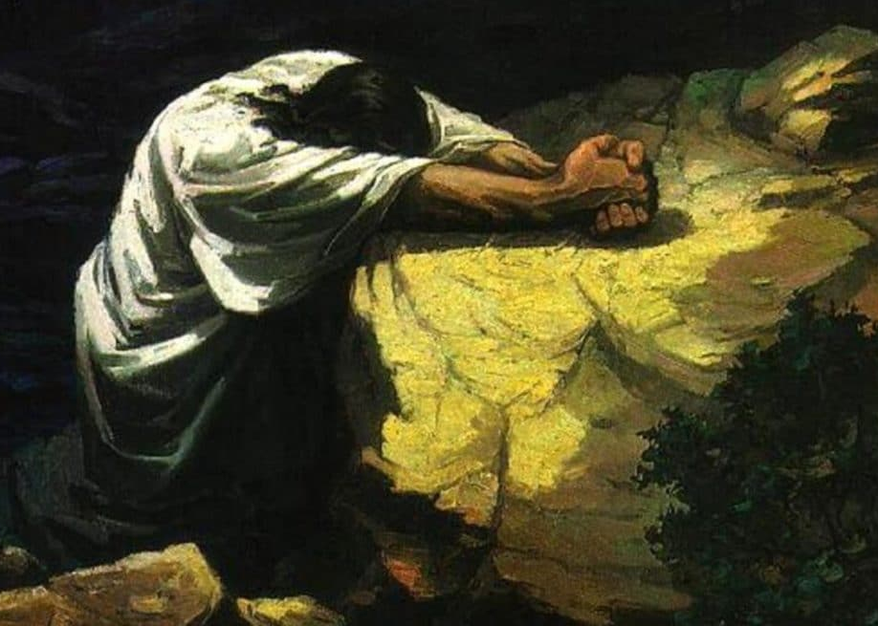
What Really Happened in Gethsemane?
Mark 14:32 And they came to a place which was named Gethsemane: and he saith to his disciples, Sit ye here, while I shall pray.
1068 Gethsamane-“an oil press”

