Slide 1
Canossa!?!?
Happening All About Us!

Slide 2
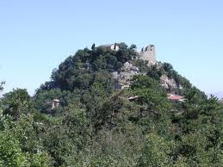
What in the World?
Some are surely wondering what Canossa is? Some may think it is related to Canola?!? Canossa is a castle in the area of Northern Italy. There were many castles in Northern Italy. It isn’t the castle that is a big deal, but it is what happened there that carries such significance for us today!

Slide 3
What Happened There?
“Another step in papal assumption was taken, when, in the eleventh century, Pope Gregory VII proclaimed the perfection of the Roman Church. Among the propositions which he put forth was one declaring that the church had never erred, nor would it ever err, according to the Scriptures. But the Scripture proofs did not accompany the assertion. The proud pontiff also claimed the power to depose emperors, and declared that no sentence which he pronounced could be reversed by anyone, but that it was his prerogative to reverse the decisions of all others.” GC. , pg. 57

Slide 4
Continued
“A striking illustration of the tyrannical character of this advocate of infallibility was given in his treatment of the German emperor, Henry IV. For presuming to disregard the pope's authority, this monarch was declared to be excommunicated and dethroned. Terrified by the desertion and threats of his own princes, who were encouraged in rebellion against him by the papal mandate, Henry felt the necessity of making his peace with Rome. In company with his wife and a faithful servant he crossed the Alps in midwinter, that he might humble himself before the pope. Upon reaching the castle whither Gregory had withdrawn, he was conducted, without his guards, into an outer court, and there, in the severe cold of winter, with uncovered head and naked feet, and in a miserable dress, he awaited the pope's permission to come into his presence.” GC, pg. 57,58

Slide 5
Concluded
“Not until he had continued three days fasting and making confession, did the pontiff condescend to grant him pardon. Even then it was only upon condition that the emperor should await the sanction of the pope before resuming the insignia or exercising the power of royalty. And Gregory, elated with his triumph, boasted that it was his duty to pull down the pride of kings. How striking the contrast between the overbearing pride of this haughty pontiff and the meekness and gentleness of Christ, who represents Himself as pleading at the door of the heart for admittance, that He may come in to bring pardon and peace, and who taught His disciples: "Whosoever will be chief among you, let him be your servant." Matthew 20:27. The advancing centuries witnessed a constant increase of error in the doctrines put forth from Rome.” GC. Pg. 58

Slide 6
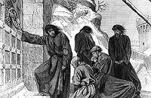
His Crime
As the Holy Roman Emperor, Henry felt that he had the right to appoint bishops or other churchmen. Pope Gregory didn’t see it the same way. He determined to bear sway over all the rulers of the earth. He forthwith declared that all warriors, barons, and citizens were no longer bound to obey the king. Henry IV headed to Canossa to make absolution!

Slide 7
The Backdrop
In 1075 Pope Gregory VII asserted in the "Dictatus Papae",^{[3][4]} a “collection of canons” (see also Canon law), one of which claimed that the deposal of an emperor was under the sole power of the pope.^{[5]} It declared that the Roman church was founded by God alone - that the papal power (the auctoritas of Pope Gelasius) was the sole universal power; in particular, a council held in the Lateran from February 24 to 28 of the same year^{[6]} decreed that the pope alone could appoint or depose churchmen or move them from see to see. By this time, Henry IV was no longer a child, and he continued to appoint his own bishops ^{[5]} and he reacted to this declaration by sending Gregory VII a letter in which he withdrew his imperial support of Gregory as pope in no uncertain terms: the letter was headed "Henry, king not through usurpation but through the holy ordination of God, to Hildebrand, at present not pope but false monk".^{[7]}

Slide 8
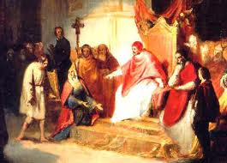
Henry Flexes his Muscles
“It called for the election of a new pope. His letter ends, "I, Henry, king by the grace of God, with all of my Bishops, say to you, come down, come down, and be damned throughout the ages."^{[7]}
The situation was made even more dire when Henry IV installed his chaplain, Tedald, a Milanese priest, as Bishop of Milan, when another priest of Milan, Atto, had already been chosen in Rome by the pope for candidacy.^{[8]} In 1076 Gregory responded by excommunicating the king, removing him from the Church and deposing him as German king.^{[9]}
Wikipedia

Slide 9
Canossa/ A Byword for Submission
Canossa has become a byword for submission. It has come to mean slave like dominance by the papacy of leaders/people in general. Canossa is the Vatican putting into operation ‘their divine right to rule kings and everyone. Canossa was invoked by Otto Von Bismarck in the 19th century’ when the papacy wanted control over Bismarck’s Prussia or Germany. After the Jesuits tried to poison him twice, von Bismarck decided to return to ‘Canossa’.

Slide 10
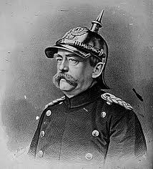
Back to Canossa
“As to the other intentions attributed to us by those who approve, as well as by the less lenient critics who censured the appointment, they have never existed. Depend upon it, in nominating a cardinal as our representative at Rome, we neither hoped to talk the pope over to our way of thinking, nor did we at all wish to signify our willingness to repeat a certain ceremony enacted centuries ago at Canossa.” 2 Poison changed his mind!!!

Slide 11
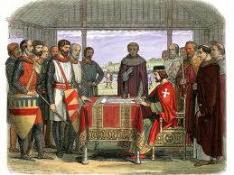
The Mighty Charter
There were some un happy campers at Runnymede in 1215. The barons were not happy with King John nor he with them. The barons got their way, John signed the Magna Carta, and the rest is history!?! What happened there is still going on today!

Slide 12
The Backdrop
When the primate of England, Hubert, died in 1205 AD, King john and the English Catholic Church argued over his successor. John appealed to Innocent III for resolution. Innocent made it worse, choosing his own primate or Archbishop of Canterbury. John was angry. Innocent placed England under interdict. No baptisms, no weddings; nothing could be done in the church because the doors were closed. Philip of France threatened to invade and John gave in to the papacy, promising anything Innocent wanted!!

Slide 13
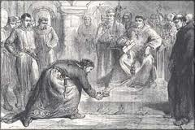
Legate kicks his crown!
John finally gave in, selling his soul and his nation into servitude to the papacy! “The 1215 charter required King John of England to proclaim certain liberties, and accept that his will was not arbitrary, for example by explicitly accepting that no "freeman" (in the sense of non-serf) could be punished except through the law of the land, a right which is still in existence today. Magna Carta was the first document forced onto an English King by a group of his subjects, the feudal barons, in an attempt to limit his powers by law and protect their privileges.” Wikipedia

Slide 14
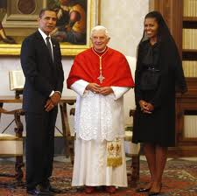
Today is the Same
“With whom the kings of the earth have committed fornication, and the inhabitants of the earth have been made drunk with the wine of her fornication.
And the woman which thou sawest is that great city, which reigneth over the kings of the earth.” Rev. 17:2,18

Slide 15
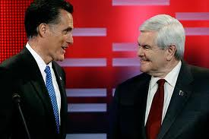
Controlled thru CFR!
All of the major frontrunners in 2008 and now, in 2012, are part of the Council on Foreign Relations. This has been true for the last 80 years. Almost every candidate, Republican or Democrat, have been a part of this secret organization. Where did it come from and who started it?

Slide 16
2008 Presidential Election
Democrat CFR Candidates:
Barack Obama
Hillary Clinton
John Edwards
Chris Dodd
Bill Richardson
Republican CFR Candidates:
Mitt Romney
Rudy Giuliani
John McCain
Fred Thompson
Newt Gingrich

Slide 17
CFR Begins
“And it was Edward M. House, under the watchful eye of Jacob Schiff, who was under the watchful eye of the HEAD of this international conspiracy {the House of Rothschild of London and Paris}, that established in 1921 what their earlier comrades established, to overthrow the governments of France and Russia. Called the Jacobin Clubs in France in the 18th century, this aristocratic revolutionary movement today in America is called THE COUNCIL ON FOREIGN RELATIONS, INC. and its offshoot is the TRILATERAL COMMISSION. The Council on Foreign Relations, Inc. is the political side of the Illuminati today. They have produced Congressmen, Senators and even Presidents, that they have used Senators and even Presidents, that they have used to pass laws that have little by little led America into becoming a Socialist country...

Slide 18
Cont.
Now when the Conspirators saw that their One World Government couldn’t be achieved using the name The League of Nations, Col. House, under the direction of Jacob Schiff, formed an aristocratic secret organization called the Council on Foreign Relations, Inc. This private Secret Society is to produce enough Congressmen, Senators, and Statesmen, etc. so the next attempt to incorporate the US into a One World Government will not fail, because of the voting power they hope to have. But reader, remember, this is not a United States Government run establishment. – William Sutton, The New Age Movement and the Illuminati 666, The Institute of Religious Knowledge, pp. 240-242.

Slide 19
The Pyramid of Evil
The Jesuits/Papacy
The Rothschilds
Jacob Schiff
Edward Mandell House
Council on Foreign Relations
Political Leaders, Media Outlets,etc.

