Slide 1
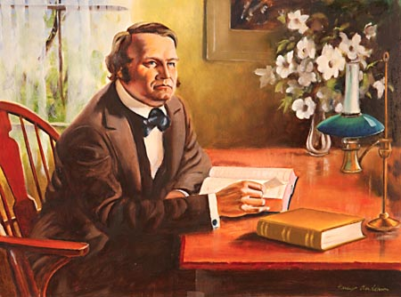
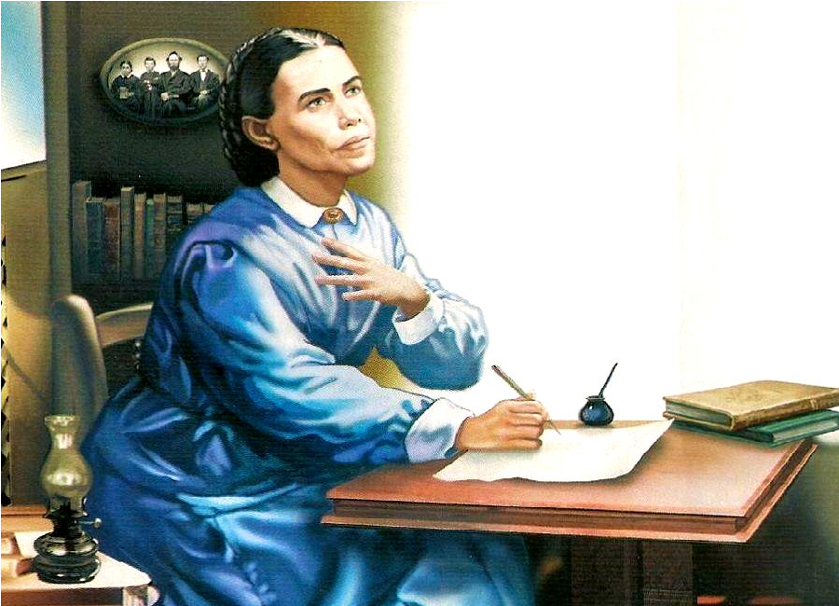
The Sanctuary pt 52: The Antitypical Trumpet Call 2

Slide 2
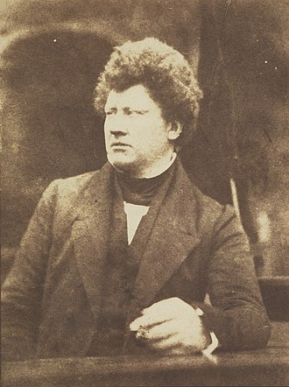
The Message of Warning Given in History
After 1798, the prophecies of Daniel started to spark an interest throughout the world, especially the time prophecies given in Daniel 8, 9, and 12. Here is just a few examples of people that began to predict the Second Coming, Judgment of God, and the End of the World:
-Johann Phillipp (1718-1792) from Germany, Christ must Return around 1847
-William Cunningham (1805-1861) D.D., President of New College, Edinburgh, England wrote a number of books on the Second Coming, which would occur in 1843
-James Frere (1779-1866) said Christ would Return between 1822-1867
-Peter Roberts (1760-1819) Anglican writer “The Manual of Prophecy” (1818), said the Lord would Return in 1843

Slide 3
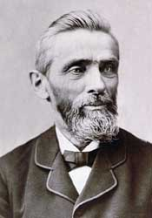
Many Shall Run To and Fro
“We here with present a list of twenty different parties who discovered the truth concerning the close of the twenty-three hundred days, not by communication with each other, but as the result of diligent searching of the Scriptures, led by the influence of the Spirit of God. Heading this list we place William Miller of the State of New York; then follow A. J. Krupp, of Philadelphia, Pa.; David McGregor, of Falmouth, Maine; Edward Irving, of England; Archibald Mason, of Scotland; W. E. Davis, of South Carolina; Joseph Wolff, who labored in various parts of Asia; Alexander Campbell, in his debate with Robert Dale Owen, in 1829; Captain A. Landers, of Liverpool, England; Leonard Heinrich Kelber, of Stuttgart, Germany; Laucunza, of Spain; Hentzepeter, of The Hague, Holland; Dr. Capadose, of Amsterdam, Holland; Rau, of Bavaria; priests of Tartary, in 1821; Bible students of Yemen, in their book called “Seera;” Hengstenberg, in another part of Germany; Russians on the Caspian Sea; Molokaners on the shores of the Baltic”—The Great Advent Movement, JN Loughborough, p. 86

Slide 4
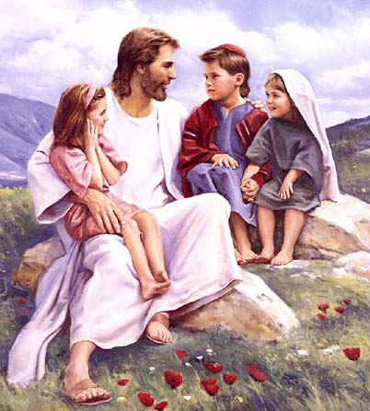
Children Preached Too?
“Sweden was one of those countries. There the Lord used little children to introduce the work. The first of this manifestation was in the summer of 1843, in Eksjo, southern Sweden. A little girl, only five years of age, who had never learned to read or sing, one day, in a most solemn manner, sang correctly a long Lutheran hymn, and then with great power proclaimed “the hour of his judgement is come,” and exhorted the family to get ready to meet the Lord; for he was soon coming. The unconverted in the family called upon God for mercy, and found pardon. This movement spread from town to town, other children proclaiming the message. The same movement among children was manifest to some extent in Norway and Germany.”—The Great Advent Movement, JN Loughborough, p. 140

Slide 5
Joseph Wolff
“During the twenty-four years from 1821 to 1845, Wolff traveled extensively: in Africa, visiting Egypt and Abyssinia; in Asia, traversing Palestine, Syria, Persia, Bokhara, and India. He also visited the United States, on the journey thither preaching on the island of Saint Helena. He arrived in New York in August, 1837; and, after speaking in that city, he preached in Philadelphia and Baltimore, and finally proceeded to Washington. Here, he says, "on a motion brought forward by the ex-President, John Quincy Adams, in one of the houses of Congress, the House unanimously granted to me the use of the Congress Hall for a lecture, which I delivered on a Saturday, honored with the presence of all the members of Congress, and also of the bishop of Virginia, and of the clergy and citizens of Washington. The same honor was granted to me by the members of the government of New Jersey and Pennsylvania, in whose presence I delivered lectures on my researches in Asia, and also on the personal reign of Jesus Christ."—Ibid., pages 398, 399. Dr. Wolff traveled in the most barbarous countries without the protection of any European authority, enduring many hardships and surrounded with countless perils. He was bastinadoed and starved, sold as a slave, and three times condemned to death. He was beset by robbers, and sometimes nearly perished from thirst. Once he was stripped of all that he possessed and left to travel hundreds of miles on foot through the mountains, the snow beating in his face and his naked feet benumbed by contact with the frozen ground. When warned against going unarmed among savage and hostile tribes, he declared himself "provided with arms"— "prayer, zeal for Christ, and confidence in His help." "I am also," he said, "provided with the love of God and my neighbor in my heart, and the Bible is in my hand.“”—GC, 360-361

Slide 6
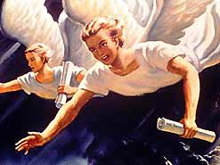
2nd Angel’s Message
And there followed another angel, saying, Babylon is fallen, is fallen, that great city, because she made all nations drink of the wine of the wrath of her fornication

Slide 7
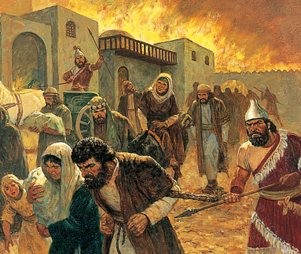
Babylon the “city”: The Captives who did not return
2 Chron. 36:20-23 “And them that had escaped from the sword carried he away to Babylon; where they were servants to him and his sons until the reign of the kingdom of Persia: To fulfil the word of the Lord by the mouth of Jeremiah, until the land had enjoyed her sabbaths: for as long as she lay desolate she kept sabbath, to fulfil threescore and ten years. Now in the first year of Cyrus king of Persia, that the word of the Lord spoken by the mouth of Jeremiah might be accomplished, the Lord stirred up the spirit of Cyrus king of Persia, that he made a proclamation throughout all his kingdom, and put it also in writing, saying, Thus saith Cyrus king of Persia, All the kingdoms of the earth hath the Lord God of heaven given me; and he hath charged me to build him an house in Jerusalem, which is in Judah. Who is there among you of all his people? The Lord his God be with him, and let him go up.

Slide 8
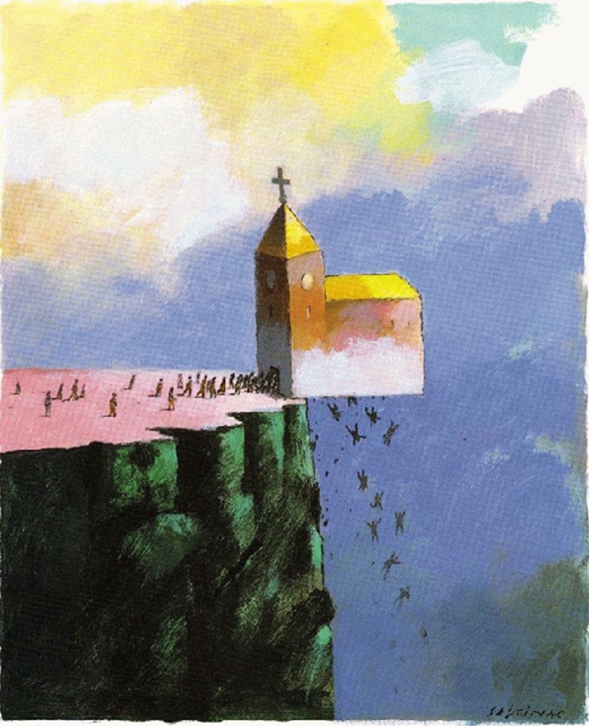
Who is Babylon Fallen?
"It is our individual duty to walk humbly with God. We are not to seek any strange, new message. We are not to think that the chosen ones of God who are trying to walk in the light, compose Babylon. The fallen denominational churches are Babylon. Babylon has been fostering poisonous doctrines, the wine of error. This wine of error is made up of false doctrines, such as the natural immortality of the soul, the eternal torment of the wicked, the denial of the pre-existence of Christ prior to his birth in Bethlehem, and advocating and exalting the first day of the week above God's holy, sanctified day. These and kindred errors are presented to the world by the various, churches, and thus the Scriptures are fulfilled that say, 'For all nations have drunk of the wine of the wrath of her fornication.' It is a wrath which is created by false doctrines, and when kings and presidents drink this wine of the wrath of her fornication, they are stirred with anger against those who will not come into harmony with the false and Satanic heresies which exalt the false Sabbath, and lead men to trample under foot God's memorial.” (R&H, September 12, 1893)

Slide 9
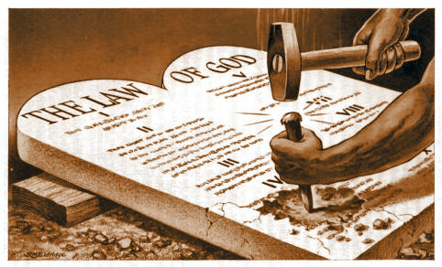
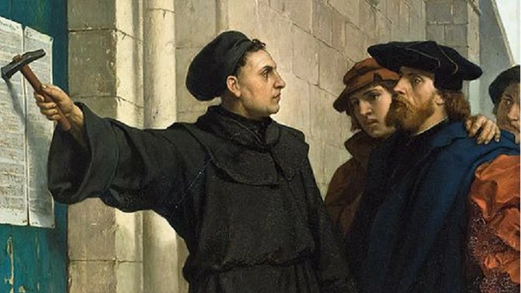
Another Statement
“Babylon is said to be “the mother of harlots.” By her daughters must be symbolized churches that cling to her doctrines and traditions, and follow her example of sacrificing the truth and the approval of God, in order to form an unlawful alliance with the world. The message of Revelation 14 announcing the fall of Babylon, must apply to religious bodies that were once pure and have become corrupt. Since this message follows the warning of the Judgment, it must be given in the last days, therefore it cannot refer to the Romish Church, for that church has been in a fallen condition for many centuries. Furthermore, in the eighteenth chapter of the Revelation, in a message which is yet future, the people of God are called upon to come out of Babylon. According to this scripture, many of God's people must still be in Babylon. And in what religious bodies are the greater part of the followers of Christ now to be found? Without doubt, in the various churches professing the Protestant faith” (GC, p. 382-383)

Slide 10
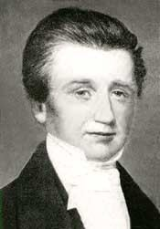
Charles Fitch Gives the 2nd Angel’s Message
“Our dear brother Storrs say that the Great Head of the Church designed that we should come out of Babylon, and not wait for Babylon to thrust us out. I believe he is right, and I am therefore determined to come out. . . . I now wish to say through your paper to the world, that I do from this time regard myself, and hereby proclaim myself to all men, as fee and independent of all ecclesiastical domination, as a member of no sect, and a subscriber of no creed. At the same time, I receive the Bible as the word of the living and true God, and am looking for the immediate coming to the Lord Jesus Christ to whom I must give account.” Charles Fitch, Midnight Cry, Letter, Mar. 14, 1844

Slide 11
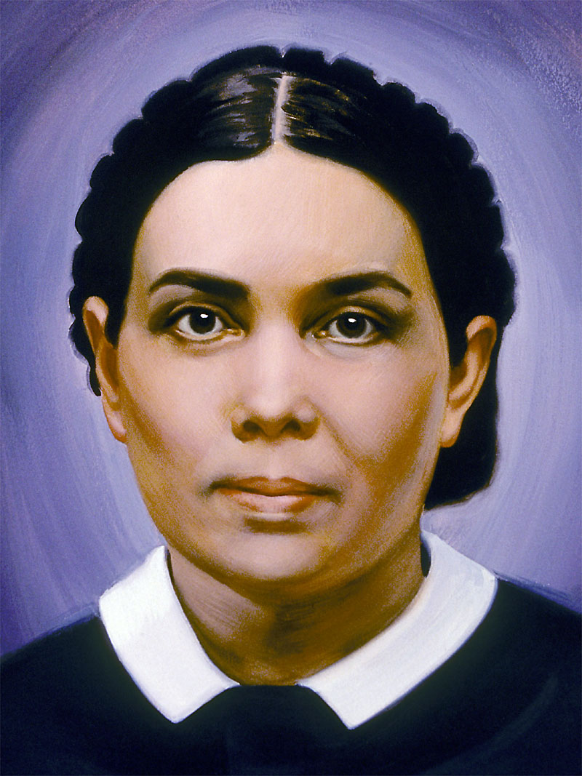
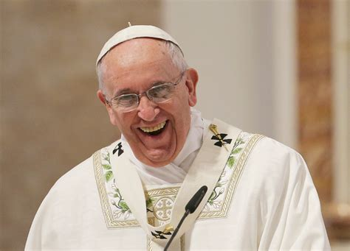
Ellen White Explains
“As the churches refused to receive the first angel's message, they rejected the light from heaven and fell from the favor of God. They trusted to their own strength, and by opposing the first message placed themselves where they could not see the light of the second angel's message. But the beloved of God, who were oppressed, accepted the message, "Babylon is fallen," and left the churches” EW, p. 237
“I saw that God has honest children among the nominal Adventists and the fallen churches, and before the plagues shall be poured out, ministers and people will be called out from these churches and will gladly receive the truth. Satan knows this; and before the loud cry of the third angel is given, he raises an excitement in these religious bodies, that those who have rejected the truth may think that God is with them. He hopes to deceive the honest and lead them to think that God is still working for the churches. But the light will shine, and all who are honest will leave the fallen churches, and take their stand with the remnant.”—EW, p. 261

Slide 12
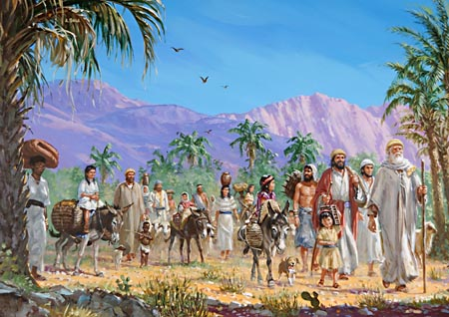
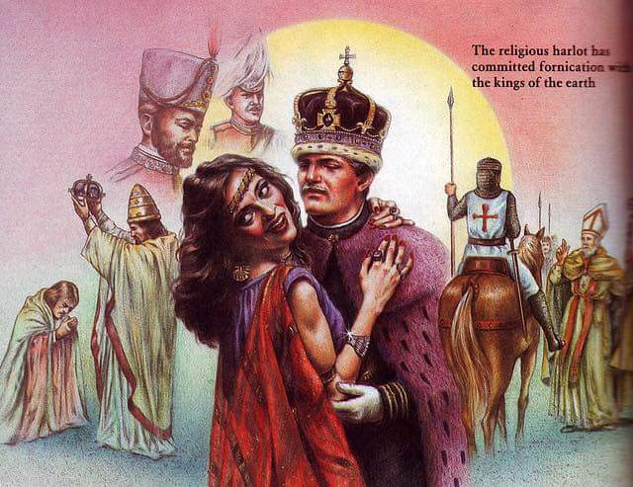
The Last Warning…
“And the third angel followed them, saying with a loud voice, If any man worship the beast and his image, and receive his mark in his forehead, or in his hand, The same shall drink of the wine of the wrath of God, which is poured out without mixture into the cup of his indignation; and he shall be tormented with fire and brimstone in the presence of the holy angels, and in the presence of the Lamb: And the smoke of their torment ascendeth up for ever and ever: and they have no rest day nor night, who worship the beast and his image, and whosoever receiveth the mark of his name. Here is the patience of the saints: here are they that keep the commandments of God, and the faith of Jesus.”

Slide 13
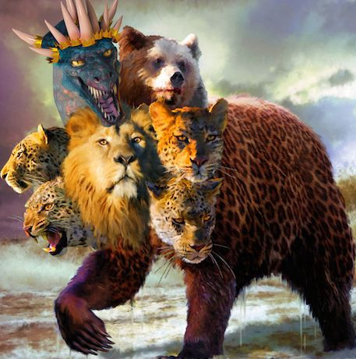
Who’s The Beast? And What is Her Mark?
“Of course the Catholic Church claims that the change was her act. And the act is a mark of her ecclesiastical power and authority in religious matters.” (C.F. Thomas, Chancellor of Cardinal Gibbons, in answer to a letter regarding the change of the Sabbath, November 11, 1895)
“Sunday is our mark of authority . . . The church is above the Bible, and this transference of Sabbath observance is proof of that fact.” (Catholic Record, Sept. 1, 1923, Ontario)

Slide 14
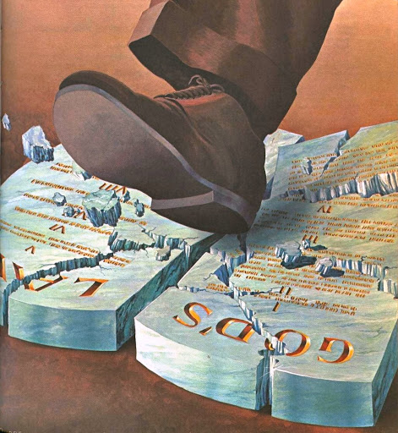
A Couple More Powerful Quotes…
“Perhaps the boldest thing, the most revolutionary change the Church ever did, happened in the first century. The holy day, the Sabbath, was changed from Saturday to Sunday. ‘The day of the Lord’ was chosen, not from any direction noted in the Scriptures, but from the Church’s sense of its power . . . People who think that the Scriptures should be the sole authority, should logically become 7th Day Adventists, and keep Saturday holy” (St. Catherine Church Sentinel, Algonac, Michigan, May 21, 1995)
"It is not yet too late for Protestants to redeem themselves. Will they do it?... will they indeed take the written word only, the Scripture alone, as their sole authority and their sole standard? Or will they still hold the indefensible, self contradictory, and suicidal doctrine and practice of following the authority of the Catholic church and wear the sign of her authority? Will they keep the Sabbath of the Lord, the seventh day, according to Scripture? Or will they keep the Sunday according to the tradition of the Catholic church." (Canon and Tradition, page 31)

Slide 15
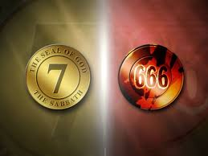

Slide 16
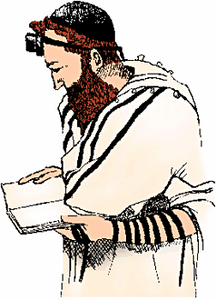
In the Forehead or in the Hand
Deut. 6:1-8 “Now these are the commandments, the statutes, and the judgments, which the Lord your God commanded to teach you, that ye might do them in the land whither ye go to possess it: That thou mightest fear the Lord thy God, to keep all his statutes and his commandments, which I command thee, thou, and thy son, and thy son's son, all the days of thy life; and that thy days may be prolonged. Hear therefore, O Israel, and observe to do it; that it may be well with thee, and that ye may increase mightily, as the Lord God of thy fathers hath promised thee, in the land that floweth with milk and honey. Hear, O Israel: The Lord our God is one Lord: And thou shalt love the Lord thy God with all thine heart, and with all thy soul, and with all thy might. And these words, which I command thee this day, shall be in thine heart: And thou shalt teach them diligently unto thy children, and shalt talk of them when thou sittest in thine house, and when thou walkest by the way, and when thou liest down, and when thou risest up. And thou shalt bind them for a sign upon thine hand, and they shall be as frontlets between thine eyes.”

Slide 17
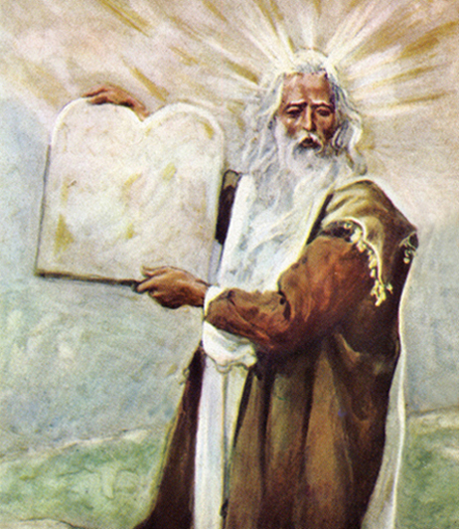
The Patience of the Saints
Rev. 14:12 “Here is the patience of the saints: here are they that keep the commandments of God, and the faith of Jesus”
Is. 58:12 “And they that shall be of thee shall build the old waste places: thou shalt raise up the foundations of many generations; and thou shalt be called, The repairer of the breach, The restorer of paths to dwell in.”
Jer. 6:16 “Thus saith the Lord, Stand ye in the ways, and see, and ask for the old paths, where is the good way, and walk therein, and ye shall find rest for your souls. But they said, We will not walk therein.”

Slide 18
It’s The Final Message of Warning!
“Will the churches heed the Laodicean message? Will they repent, or will they, notwithstanding that the most solemn message of truth--the third angel's message--is being proclaimed to the world, go on in sin? This is the last message of mercy, the last warning to a fallen world. If the church of God becomes lukewarm, it does not stand in favor with God any more than do the churches that are represented as having fallen and become the habitation of devils, and the hold of every foul spirit, and the cage of every unclean and hateful bird.” Manuscript Releases, Vol. 19, p. 176

Slide 19
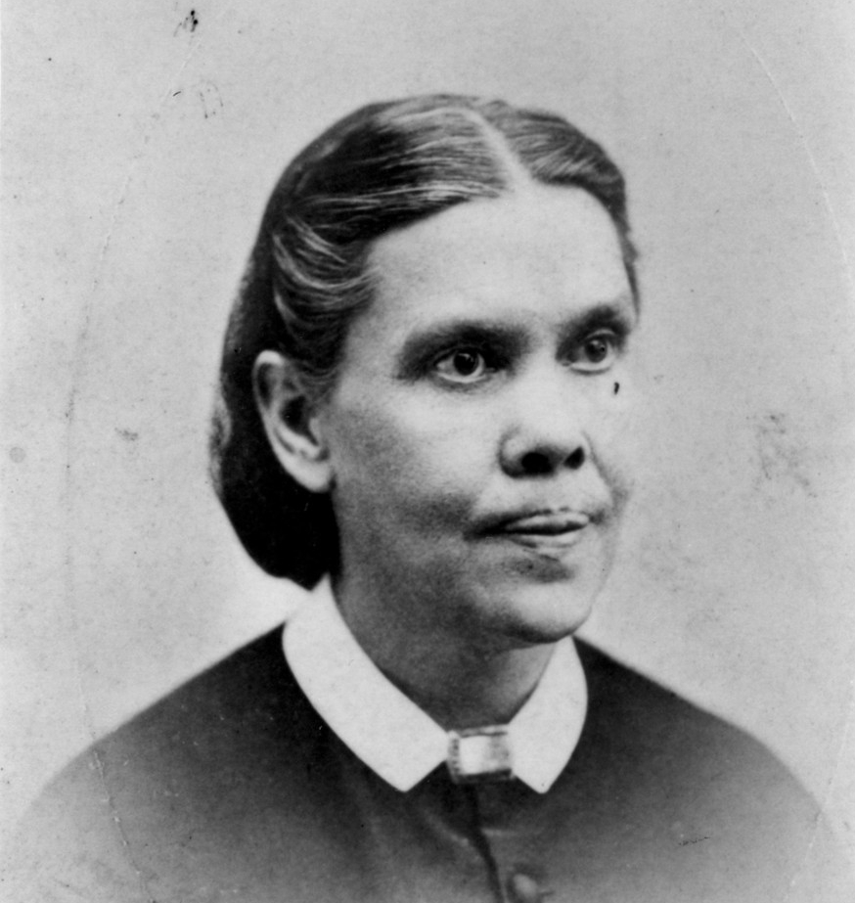
Faith of Jesus=Righteousness By Faith!
“The third angel’s message is the proclamation of the commandments of God and the faith of Jesus Christ. The commandments of God have been proclaimed, but the faith of Jesus Christ has not been proclaimed by Seventh-day Adventists as of equal importance, the law and the gospel going hand in hand. I cannot find language to express this subject in its fullness. ‘The faith of Jesus.’ It is talked of, but not understood. What constitutes the faith of Jesus, that belongs to the third angel’s message? Jesus becoming our sin-bearer that He might become our sin-pardoning Saviour. He was treated as we deserve to be treated. He came to our world and took our sins that we might take His righteousness. And faith in the ability of Christ to save us amply and fully and entirely is the faith of Jesus.” (3 Selected Messages, p. 172)

Slide 20
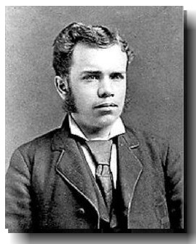
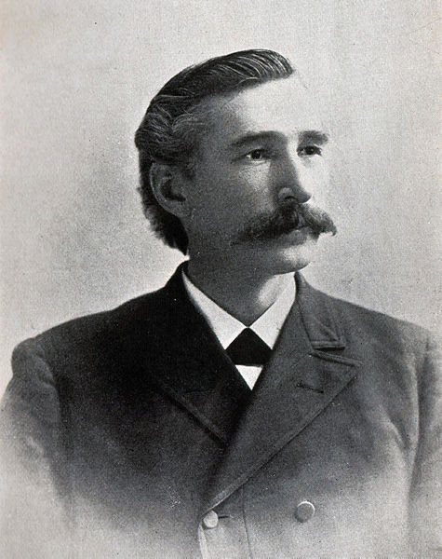
AT Jones and EJ Waggoner: The Faith of Jesus!
“The Lord in His great mercy sent a most precious message to His people through Elders Waggoner and Jones. This message was to bring more prominently before the world the uplifted Saviour, the sacrifice for the sins of the whole world. It presented justification through faith in the Surety; it invited the people to receive the righteousness of Christ, which is made manifest in obedience to all the commandments of God. Many had lost sight of Jesus. They needed to have their eyes directed to His divine person, His merits, and His changeless love for the human family. All power is given into His hands, that He may dispense rich gifts unto men, imparting the priceless gift of His own righteousness to the helpless human agent. This is the message that God commanded to be given to the world. It is the third angel’s message, which is to be proclaimed with a loud voice, and attended with the outpouring of His Spirit in a large measure.” TM, p. 91-92

Slide 21
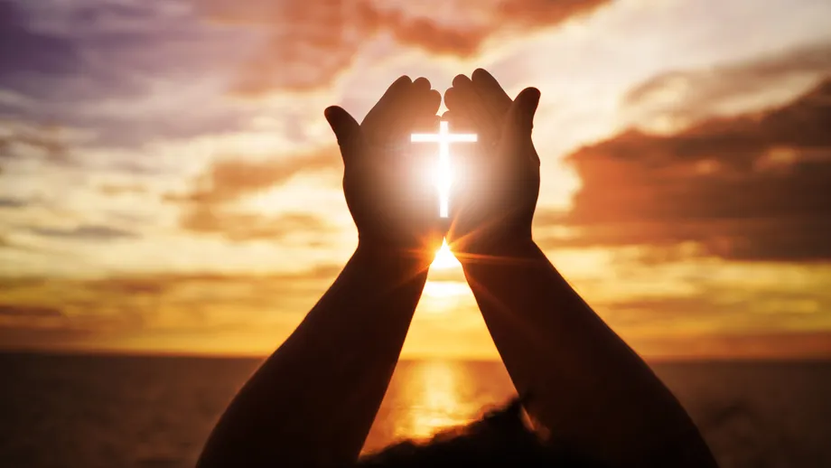
Can’t Be Clearer!
“Several have written to me, inquiring if the message of justification by faith is the third angel’s message, and I have answered, ‘It is the third angel’s message, in verity’”—R&H, Aug. 1, 1890
“The message of Christ’s righteousness is to sound from one end of the earth to the other to prepare the way of the Lord. This is the glory of God, which closes the work of the third angel.”—6T, p. 19

