Slide 1
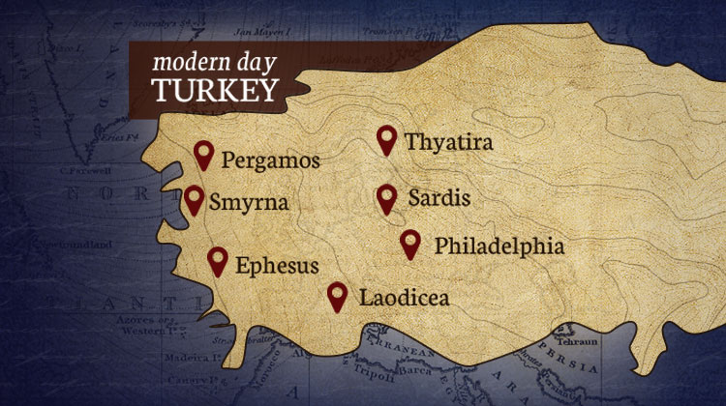
The Seven Churches pt 2: Ephesus

Slide 2
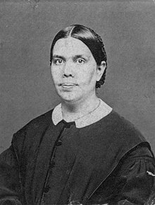
Prophetic Setup…
“Of the church of Ephesus, which the Lord Jesus used as a symbol of the entire Christian church in the apostolic age [34AD-100AD], the faithful and true Witness declared [Rev. 2:2-3 quoted]” AA, p. 578

Slide 3
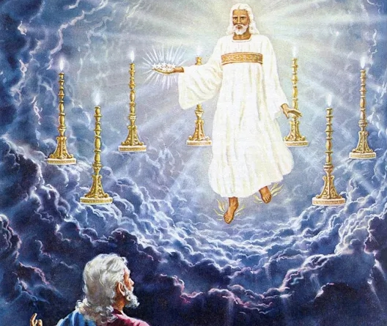
The Seven Churches Prophecy
Rev. 1:19-20 “Write the things which thou hast seen, and the things which are, and the things which shall be hereafter; The mystery of the seven stars which thou sawest in my right hand, and the seven golden candlesticks. The seven stars are the angels of the seven churches: and the seven candlesticks which thou sawest are the seven churches.”

Slide 4
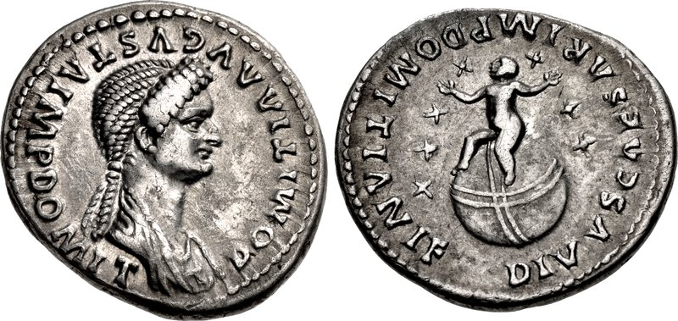
Domitian Holds the 7 Stars????

Slide 5
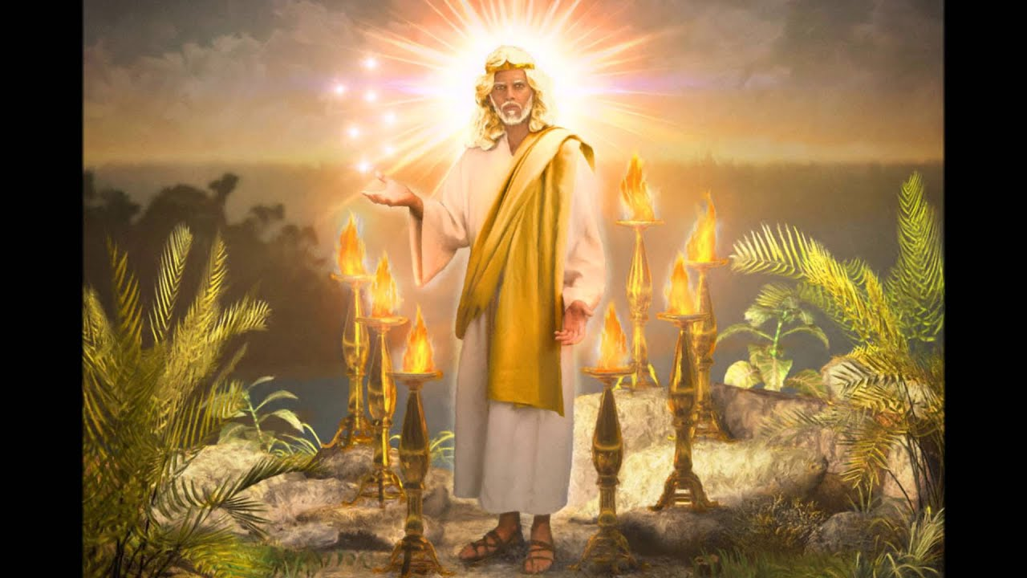

Slide 6
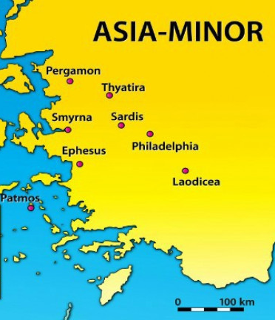
What We Will Study and How….
The Seven Churches in the Context of the Literal Seven Churches—How the messages relate to that specific Church
The Seven Churches in the Context of a time Prophecy—How the messages relate prophetically to chronological periods of Church history
The Seven Churches in the Context of Personal counsel—How the messages relate to all Christians in all periods of earth’s history

Slide 7
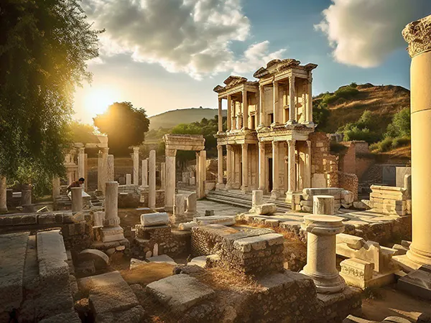
A Few Facts About Ephesus…
The Name Ephesus means “Desirable”—a fitting description of the strong church in Ephesus both literally and prophetically…
Ephesus was home to one of the 7 Wonders of the Ancient World→ The Temple to Artemis/Diana “Goddess” of the hunt, goddess of nature, fertility, Virgin goddess, The moon→ It was in the Council of Ephesus in 431AD that Mary was given the title “Mother of God” made popular by Cyril of Alexandria instead of “Mother of Christ” posited by Nestorius
High honors for “Imperial Cult” or Emperor worship, having a Temple of Augustus and Temple of Domitian (81AD-96AD)

Slide 8
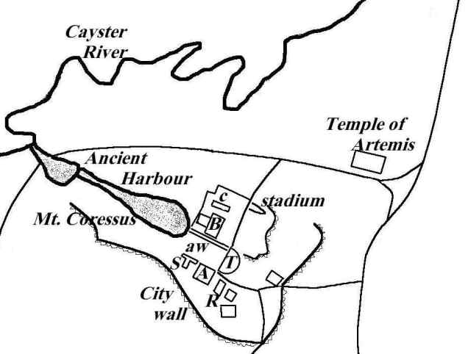
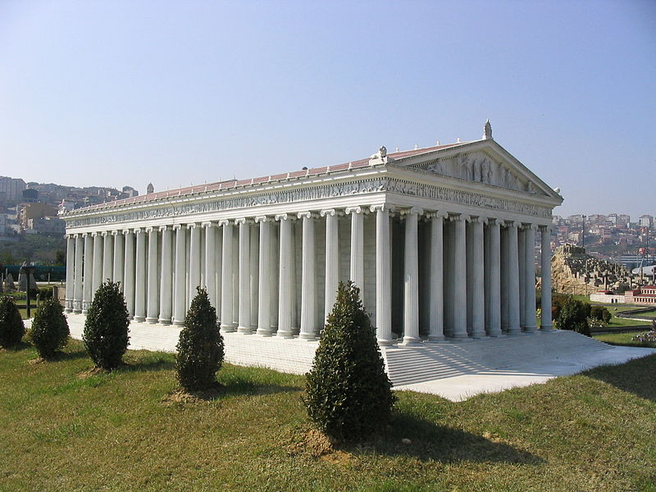

Slide 9
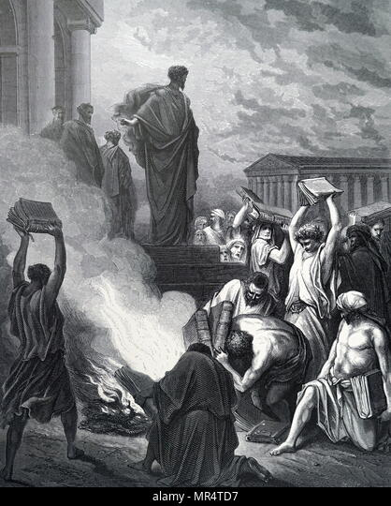
Ephesus: Fellowship with Demons
1 Cor. 10:20 “But I say, that the things which the Gentiles sacrifice, they sacrifice to devils, and not to God: and I would not that ye should have fellowship with devils.”
Acts 19:17-19 “And this was known to all the Jews and Greeks also dwelling at Ephesus; and fear fell on them all, and the name of the Lord Jesus was magnified. And many that believed came, and confessed, and shewed their deeds. Many of them also which used curious arts brought their books together, and burned them before all men: and they counted the price of them, and found it fifty thousand pieces of silver.”

Slide 10

Facts Continued…
4. Major Trading Port City until the harbor receded in the 4th Century, the capital of the Roman Province of Asia
5. Center for learning (major library across from a major brothel), Slave Trade, Witchcraft
6. Had 2 Agoras or marketplaces, one upper and one lower—where before entering one must burn a pinch of incense in obeisance to the Emperor
7. The Temple of Diana was outside of the city because of its tree shrine or sacred tree, known as a “tree of life” due to its for healing powers
8. Its theater seated up to 35,000 people
9. The Temple had an asylum area known as the Temenos (Paradise in Persian) which was a safe space for criminals—expanded by Marc Antony, receded by Augustus, expanded by Domitian

Slide 11
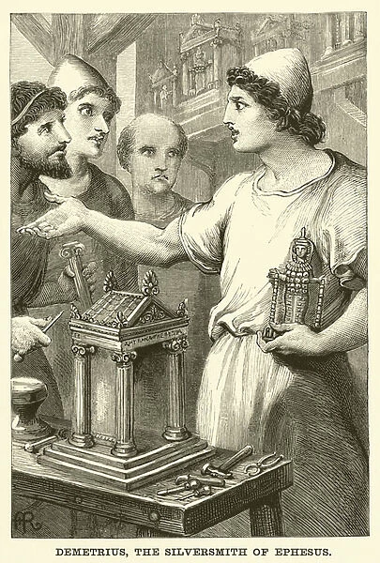
Ancient Sanctuary City
“Not only was the temple of Diana a place of worship, and a treasure-house, but it was also a museum in which the best statuary and most beautiful paintings were preserved. Among the paintings was one by the famous Apelles, a native of Ephesus, representing Alexander the Great hurling a thunderbolt. It was also a sanctuary for the criminal, a kind of city of refuge, for none might be arrested for any crime whatever when within a bowshot of its walls. There sprang up, therefore, about the temple a village in which the thieves and murderers and other criminals made their homes. Not only did the temple bring vast numbers of pilgrims to the city, as does the Kaaba at Mecca at the present time, but it employed hosts of people apart from the priests and priestesses; among them were the large number of artisans who manufactured images of the goddess Diana, or shrines to sell to the visiting strangers” https://www.internationalstandardbible.com/E/ephesus.html

Slide 12

The Letter to Ephesus…
Rev. 2:1-7 “Unto the angel of the church of Ephesus write; These things saith he that holdeth the seven stars in his right hand, who walketh in the midst of the seven golden candlesticks; I know thy works, and thy labour, and thy patience, and how thou canst not bear them which are evil: and thou hast tried them which say they are apostles, and are not, and hast found them liars [called out sin and false teachers]: And hast borne, and hast patience, and for my name's sake hast laboured, and hast not fainted [hard workers for the faith]. Nevertheless I have somewhat against thee, because thou hast left thy first love [Relationship Broken]. Remember therefore from whence thou art fallen, and repent, and do the first works; or else I will come unto thee quickly, and will remove thy candlestick out of his place, except thou repent. But this thou hast, that thou hatest the deeds of the Nicolaitanes, which I also hate. He that hath an ear, let him hear what the Spirit saith unto the churches; To him that overcometh will I give to eat of the tree of life, which is in the midst of the paradise of God.”

Slide 13
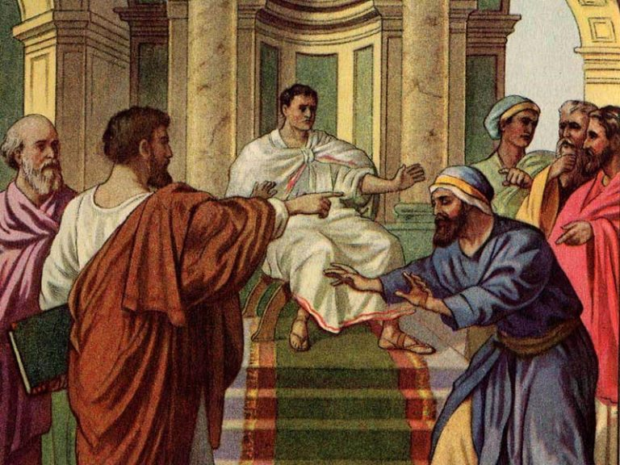
False Apostles in the 1st Church Age:
Simon Magus (Acts 8)
Ananias and Saphira (Acts 5)
Paul Called out False Christians by name who were teaching false doctrines (1 Tim. 1:20; 2 Tim. 2:17; 2 Tim. 4:14)
The Judaizers of Galatians
The Judaizers of 2 Corinthians 11
False Brethren (Gal. 2:4)
False Prophet Elymas Barjesus (Acts 13)

Slide 14
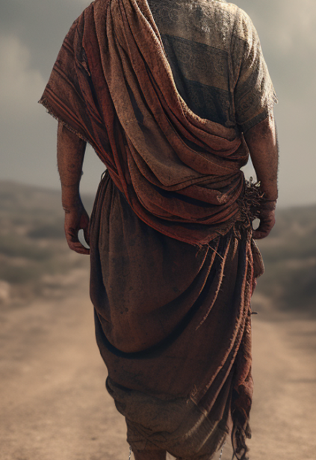
The Work of the Apostolic Age
“By the cooperation of the divine Spirit, the apostles did a work that shook the world. To every nation was the gospel carried in a single generation.” AA, 593
Col. 1:23 “If ye continue in the faith grounded and settled, and be not moved away from the hope of the gospel, which ye have heard, and which was preached to every creature which is under heaven; whereof I Paul am made a minister”
2 Cor. 4:7-10 “But we have this treasure in earthen vessels, that the excellency of the power may be of God, and not of us. We are troubled on every side, yet not distressed; we are perplexed, but not in despair;
⁹ Persecuted, but not forsaken; cast down, but not destroyed; Always bearing about in the body the dying of the Lord Jesus, that the life also of Jesus might be made manifest in our body.

Slide 15
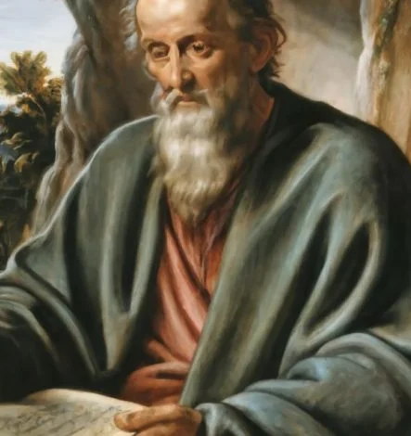
Back to Primitive Godliness… Like the Apostles???!!!
“The power of godliness has well-nigh departed from many of the churches. Picnics, church theatricals, church fairs, fine houses, personal display, have banished thoughts of God. Lands and goods and worldly occupations engross the mind, and things of eternal interest receive hardly a passing notice. Notwithstanding the widespread declension of faith and piety, there are true followers of Christ in these churches. Before the final visitation of God's judgments upon the earth there will be among the people of the Lord such a revival of primitive godliness as has not been witnessed since apostolic times. The Spirit and power of God will be poured out upon His children. At that time many will separate themselves from those churches in which the love of this world has supplanted love for God and His word” GC, 463-464

Slide 16
Ephesus: Not a Perfect Church…
Rev. 2:4 “Nevertheless I have somewhat against thee, because thou hast left thy first love”
“Let my brethren be very careful how they present the subject of faith and works before the people, lest minds become confused. The people need to be urged to diligence in good works. They should be shown how to be successful, how to be purified, and their offerings may be fragrant before God. It is by virtue of the blood of Christ. Messages of a decided character must be borne to the people. Men must go forth reproving, rebuking every manner of evil. If there is given to the angel of any church a commission like unto that given to the angel of the church of Ephesus, let the message be heard through human agents rebuking carelessness, backsliding, and sin, that the people may be brought to repentance and confession of sin. Never seek to cover sin; for in the message of rebuke, Christ is to be proclaimed as the first and the last, He who is all in all to the soul. His power awaits the demand of those who would overcome. The reprover is to animate his hearers so that they shall strive for the mastery. He is to encourage them to struggle for deliverance from every sinful practice, to be free from every corrupt habit, even if his denial of self is like taking the right eye, or separating the right arm from the body. No concession or compromise is to be made to evil habits or sinful practices” 1SM, 379-380

Slide 17
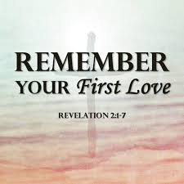
How it looked during the Church Age…
“Early in the history of the church the mystery of iniquity foretold by the apostle Paul began its baleful work; and as the false teachers concerning whom Peter had warned the believers, urged their heresies, many were ensnared by false doctrines. Some faltered under trial and were tempted to give up the faith. At the time when John was given this revelation, many had lost their first love of gospel truth. But in His mercy God did not leave the church to continue in a backslidden state. In a message of infinite tenderness He revealed His love for them and His desire that they should make sure work for eternity. “Remember,” He pleaded, “from whence thou art fallen, and repent, and do the first works.” [Rev. 2:5]” AA, 587

Slide 18
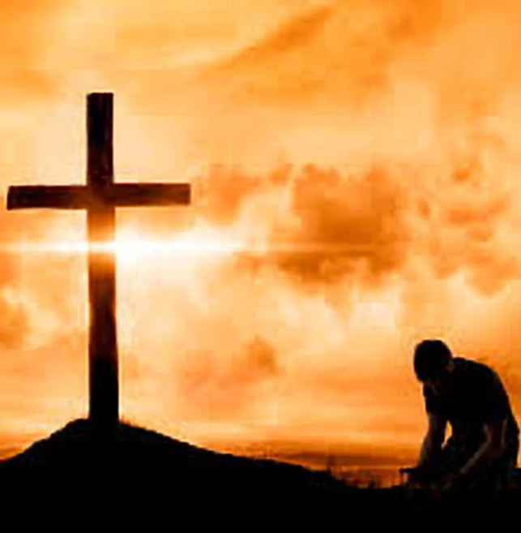
Personal Counsel on Your First Love
“The Ephesian church met with great opposition, and some of the early Christians suffered persecution; and yet some of these very ones turned from the truths that had united them with Christ's followers, and adopted, in their stead, the specious errors devised by Satan. This change is represented as a spiritual fall. “Remember therefore from whence thou art fallen, and repent, and do the first works”—as outlined in the preceding verses. The believers did not sense their spiritual fall. They knew not that a change had taken place in their hearts and that they would have to repent because of the noncontinuance of their first works. But God in His mercy called for repentance, for a return to their first love and to the works that are always the result of true, Christlike love” Sermons and Talks, Vol. II, p. 278

Slide 19
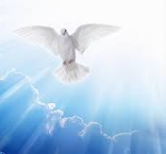
Your Lamps Will Flicker and Grow Dim!
“Brethren, your own lamps will surely flicker and grow dim until they go out in darkness unless you make decided efforts to reform. “Remember therefore from whence thou art fallen, and repent, and do the first works.” The opportunity now presented may be short. If this season of grace and repentance passes unimproved, the warning is given: “I will come unto thee quickly, and will remove thy candlestick out of his place.” These words are uttered by the lips of the long-suffering, forbearing One. They are a solemn warning to churches and individuals that the Watcher who never slumbers is measuring their course of action. It is only by reason of His marvelous patience that they are not cut down as cumberers of the ground. But His Spirit will not always strive. His patience will wait but little longer.” 5T, 612

Slide 20

The Nicolaitans
“But the doctrine is now largely taught that the Gospel of Christ has made the Law of God of no effect; that by “believing” we are released from the necessity of being doers of the word. But this is the doctrine of the Nicolaitans, which Christ so unsparingly condemned . . . Those who are teaching this doctrine today have much to say in regard to faith and the righteousness of Christ; but they pervert the truth, and make it serve the cause of error. They declare that we have only to believe on Jesus Christ, and that faith is all-sufficient; that the righteousness of Christ is to be the sinner's credentials; that this imputed righteousness fulfils the law for us, and that we are under no obligation to obey the law of God. This class claim that Christ came to save sinners, and that he has saved them. “I am saved,” they will repeat over and over again. But are they saved while transgressing the law of Jehovah?—No; for the garments of Christ's righteousness are not a cloak for iniquity.” ST, Feb. 25, 1897

Slide 21

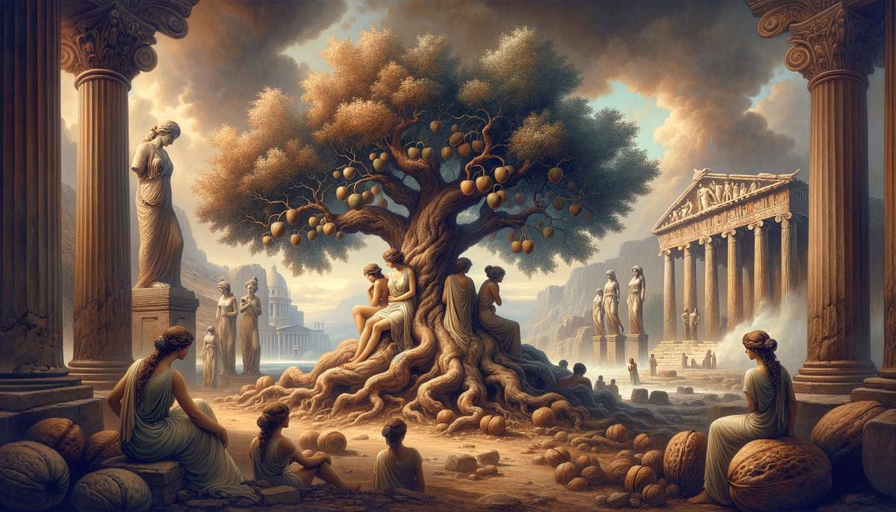
The Tree of Life Available Now…
VS
“So with all the promises of God's word. In them He is speaking to us individually, speaking as directly as if we could listen to His voice. It is in these promises that Christ communicates to us His grace and power. They are leaves from that tree which is “for the healing of the nations.” Revelation 22:2. Received, assimilated, they are to be the strength of the character, the inspiration and sustenance of the life. Nothing else can have such healing power. Nothing besides can impart the courage and faith which give vital energy to the whole being.” Ministry of Healing, p. 122

