Slide 1

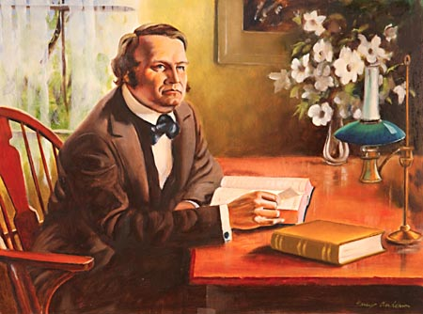
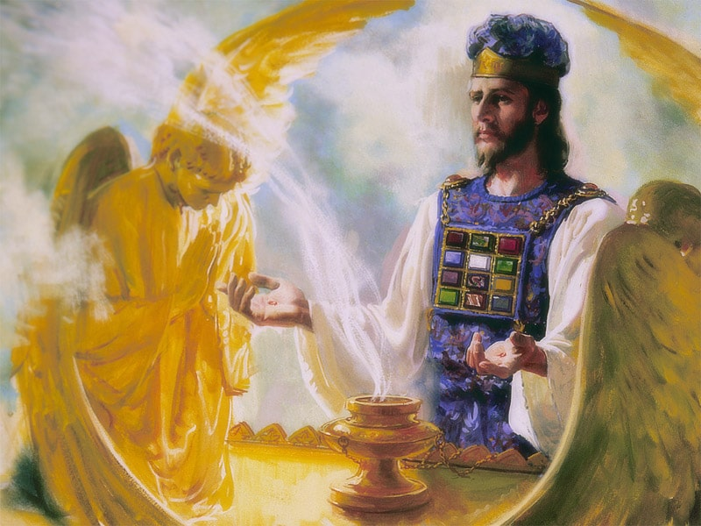
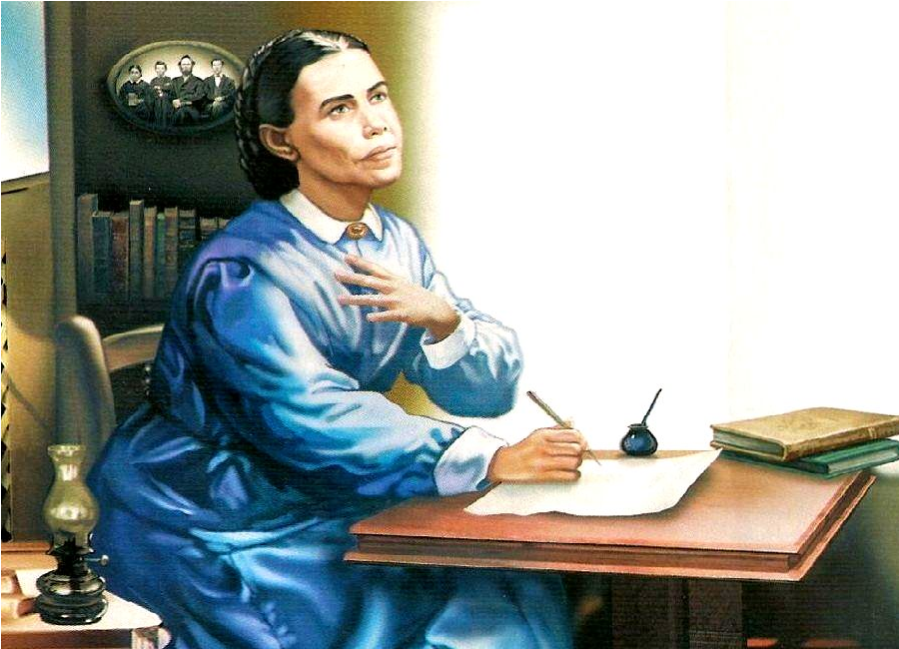
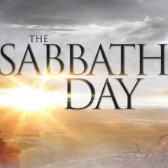
The 2300 Days

Slide 2


4th Beast
Progression of Rome through time…
Little Horn
Daniel 7
Progression of Rome through time…
Little Horn
Little Horn
Daniel 8

Slide 3
Caesar Pope
Pontifex Maximus
Senate
Rules From Rome
Self-styled god on earth
Head of state and religion
Persecutes God’s people
Attacks Christ
Succeeds in persecutions
Stays in the Lateran Palace
Roman Pantheon (12 gods)
Sun Worship
Pontifex Maximus
Curia of Cardinals
Rules From Rome
Self-styled god on earth
Head of state and religion
Persecutes God’s people
Attacks Christ (spiritually)
Succeeds in persecutions
Stays in the Lateran Palace
Roman Pantheon renamed Christian Apostles
Sun Worship (Sunday)

Slide 4
Caesar Pope
Nero (64-68 AD) because of the Great Fire of Rome
Domitian (81 AD) Once brought to the tribunal, Christians must be killed if unwilling to renounce their religion
Trajan (108 AD)
Marcus Aurelius (162 AD)
Severus (192-232 AD)
Maximus (235 AD)
Decius (249-251 AD) Empire-wide
Valerian (257 AD)
Aurelian (274 AD)
Diocletian (284-305 AD) Empire-wide
St. Bartholomew’s Day Massacre 1572 (ends in 70,000 killed in France)
Irish Massacre 1641 (300,000 killed)
30 Years War 1618-1648 (12 million)
The Great Massacre of 1655 Waldenses (1,700 most brutal)
Inquisitions, Crusades, various dates (50 million)
Age of Exploration Conquistadors (15 million American Natives)
Wars with Waldenses and Albigenses (1 million)
Nazi Germany (11 million-not including WWII victims)

Slide 5
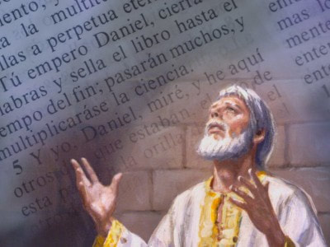
Daniel Drops Out After He Realizes its 2300 years not days
Dan. 8:26-27 “And the vision of the evening [6153] and the morning [1242] which was told is true: wherefore shut thou up the vision; for it shall be for many days. And I Daniel fainted, and was sick certain days; afterward I rose up, and did the king's business; and I was astonished at the vision, but none understood it.”

Slide 6
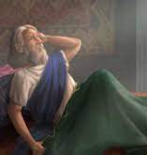
Evening-Mornings?
6153: ereb (eh’-reb)- even, evening, night, mingled, people, eventide, eveningtide 1) evening, night, sunset 1a) evening, sunset 1b) night
1242: boqer (bo’-ker)- morning, morrow, day, days, early 1) morning, break of day 1a) morning 1) end of night 2) of coming of daylight 3) of coming of sunrise 4) of beginning of day 5) of bright joy after night of distress (fig.) morrow, next day, next morning
Dan. 8:26-27 “And the vision of the evening and the morning (6153, 1242) which was told is true: wherefore shut thou up the vision; for it shall be for many days. And I Daniel fainted, and was sick certain days; afterward I rose up, and did the king's business; and I was astonished at the vision, but none understood it.”

Slide 7
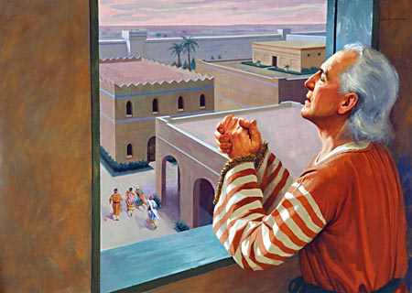
Daniel 9 Picks it Back Up
Dan. 9:1-2, “In the first year of Darius the son of Ahasuerus, of the seed of the Medes, which was made king over the realm of the Chaldeans; In the first year of his reign I Daniel understood by books the number of the years, whereof the word of the Lord came to Jeremiah the prophet, that he would accomplish seventy years in the desolations of Jerusalem. . . . Now therefore, O our God, hear the prayer of thy servant, and his supplications, and cause thy face to shine upon thy sanctuary that is desolate, for the Lord's sake.

Slide 8
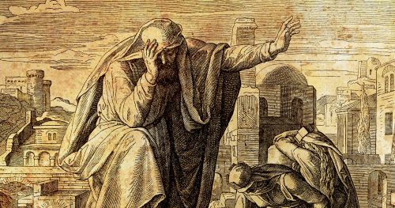
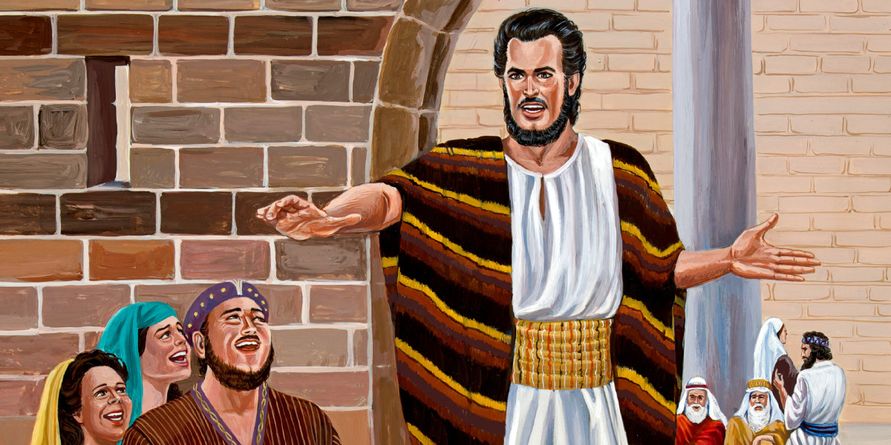
Jeremiah’s Prophecy on the Sanctuary
Jer. 25:11 “And this whole land shall be a desolation, and an astonishment; and these nations shall serve the king of Babylon seventy years.”
Jer. 29:10-13 “For thus saith the Lord, That after seventy years be accomplished at Babylon I will visit you, and perform my good word toward you, in causing you to return to this place. For I know the thoughts that I think toward you, saith the Lord, thoughts of peace, and not of evil, to give you an expected end. Then shall ye call upon me, and ye shall go and pray unto me, and I will hearken unto you. And ye shall seek me, and find me, when ye shall search for me with all your heart.”

Slide 9
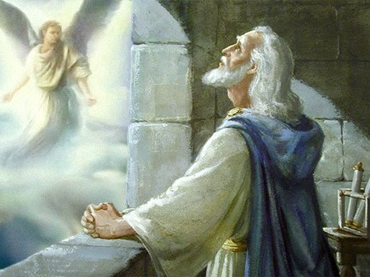
Back to Daniel 9
Daniel 9:22-23 “And he informed me, and talked with me, and said, O Daniel, I am now come forth to give thee skill and understanding. At the beginning of thy supplications the commandment came forth, and I am come to shew thee; for thou art greatly beloved: therefore understand the matter, and consider the vision.”

Slide 10
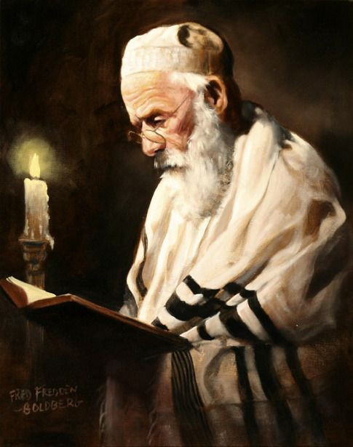
“Cursed” Scripture???
"May the curse of heaven fall upon those who calculate the date of the advent of the Messiah, and thus create political and social unrest among the people.“--Sanhedrin, 97b., Louis Newman and Samuel Spitz, The Talmudic anthology: tales and teachings of the rabbis (Behrman House, 1945): 277.

Slide 11
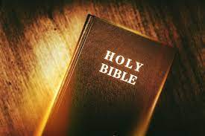
The Scholars or the Holy Spirit??
2 Tim. 3:15-17 “And that from a child thou hast known the holy scriptures, which are able to make thee wise unto salvation through faith which is in Christ Jesus. All scripture is given by inspiration of God, and is profitable for doctrine, for reproof, for correction, for instruction in righteousness: That the man of God may be perfect, thoroughly furnished unto all good works.”

Slide 12
The 70 Weeks
Daniel 9:24-27 “Seventy weeks are determined upon thy people and upon thy holy city [70 weeks=490 years], to finish the transgression, and to make an end of sins, and to make reconciliation for iniquity, and to bring in everlasting righteousness, and to seal up the vision and prophecy, and to anoint the most Holy. Know therefore and understand, that from the going forth of the commandment to restore and to build Jerusalem unto the Messiah the Prince shall be seven weeks [7 weeks=49years], and threescore and two weeks [62 weeks=434 years]: the street shall be built again, and the wall, even in troublous times. And after threescore and two weeks [after the 49 years of rebuilding+the 434 years=483 years] shall Messiah be cut off, but not for himself: and the people of the prince that shall come shall destroy the city and the sanctuary; and the end thereof shall be with a flood, and unto the end of the war desolations are determined. And he shall confirm the covenant with many for one week [7days=7 years]: and in the midst of the week he shall cause the sacrifice and the oblation to cease, and for the overspreading of abominations he shall make it desolate, even until the consummation, and that determined shall be poured upon the desolate.”

Slide 13
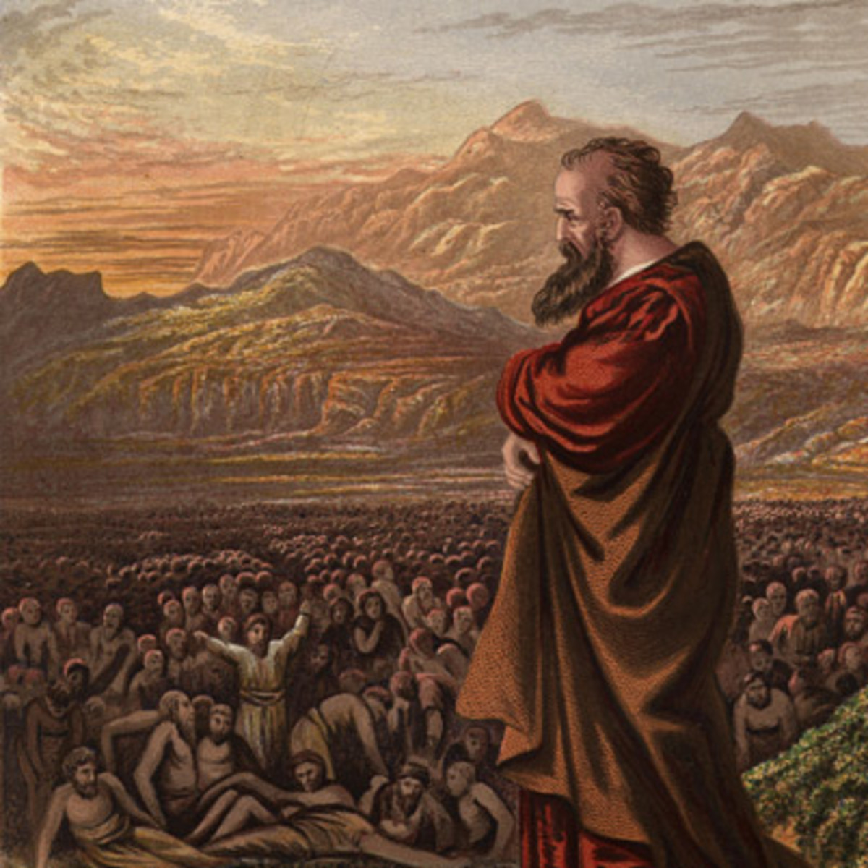
Day for a Year
Num. 14:34 “After the number of the days in which ye searched the land, even forty days, each day for a year, shall ye bear your iniquities, even forty years, and ye shall know my breach of promise.”
Ez. 4:6 “And when thou hast accomplished them, lie again on thy right side, and thou shalt bear the iniquity of the house of Judah forty days: I have appointed thee each day for a year.”

Slide 14
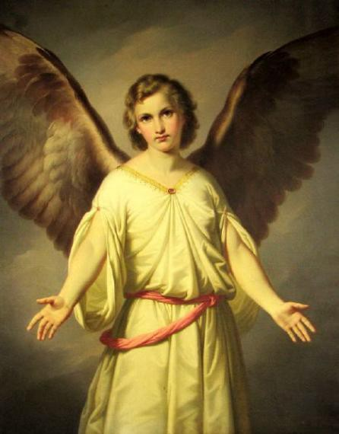
Breaking it Down…
“Seventy weeks are determined upon thy people and upon thy holy city [70 weeks=490 years], to finish the transgression, and to make an end of sins, and to make reconciliation for iniquity, and to bring in everlasting righteousness, and to seal up the vision and prophecy, and to anoint the most Holy.”

Slide 15
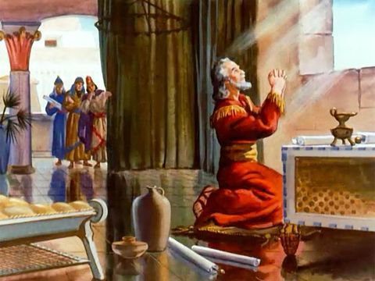
Determined…
Determined: 2852 chathak (khaw-thak)- determined 1) to divide, determine 1a) to be determined, be decreed, be settled, be marked out

Slide 16
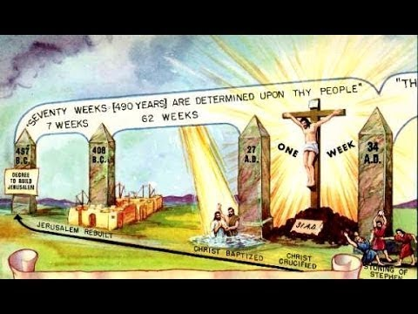

Ellen White Confirms What We Already Know!
“The angel had been sent to Daniel for the express purpose of explaining to him the point which he had failed to understand in the vision of the eighth chapter, the statement relative to time—"unto two thousand and three hundred days; then shall the sanctuary be cleansed." After bidding Daniel "understand the matter, and consider the vision," the very first words of the angel are: "Seventy weeks are determined upon thy people and upon thy Holy City." The word here translated "determined" literally signifies "cut off." Seventy weeks, representing 490 years, are declared by the angel to be cut off, as specially pertaining to the Jews. But from what were they cut off? As the 2300 days was the only period of time mentioned in chapter 8, it must be the period from which the seventy weeks were cut off; the seventy weeks must therefore be a part of the 2300 days, and the two periods must begin together. The seventy weeks were declared by the angel to date from the going forth of the commandment to restore and build Jerusalem. If the date of this commandment could be found, then the starting point for the great period of the 2300 days would be ascertained.”—GC, 326

Slide 17

Jesus Finished the Transgression and Made and End of Sin
Heb. 9:15 “And for this cause he is the mediator of the new testament, that by means of death, for the redemption of the transgressions that were under the first testament, they which are called might receive the promise of eternal inheritance.”
John 1:29 “The next day John seeth Jesus coming unto him, and saith, Behold the Lamb of God, which taketh away the sin of the world.”

Slide 18

Bring in Everlasting Righteousness
Romans 3:20-24 “Therefore by the deeds of the law there shall no flesh be justified in his sight: for by the law is the knowledge of sin. But now the righteousness of God without the law is manifested, being witnessed by the law and the prophets; Even the righteousness of God which is by faith of Jesus Christ unto all and upon all them that believe: for there is no difference: For all have sinned, and come short of the glory of God; Being justified freely by his grace through the redemption that is in Christ Jesus:”

Slide 19
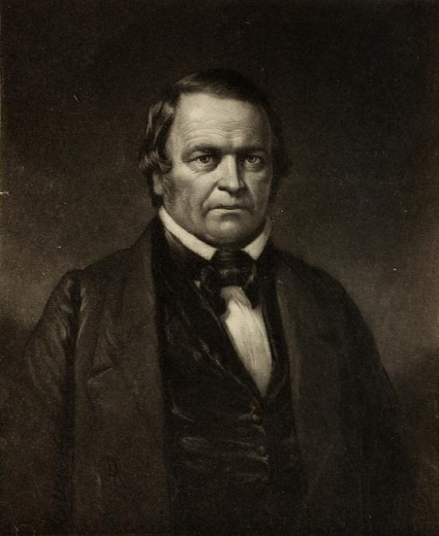
Back to the Time Prophecy
“Who would give the command? . . . I answer, It must be a king who had power over the Jews to release and restore them. It must of necessity be a king over the Medes and Persians, or it would not be in agreement with the vision in the 8th chapter of Daniel; for he is expressly told by Gabriel that the ram he saw, and which was the first thing he did see in the vision, were the kings of the Medes and Persia. And now this same angel Gabriel has come the second time, and tells Daniel, plainly and distinctly, that he has come to make him ‘understand the vision.’ What vision? The one Daniel had in the beginning, in the 8th chapter. See Daniel 9:21-23”—William Miller, Evidence From Scripture and History of the Second Coming of Christ about the Year 1843, p. 65-66

Slide 20
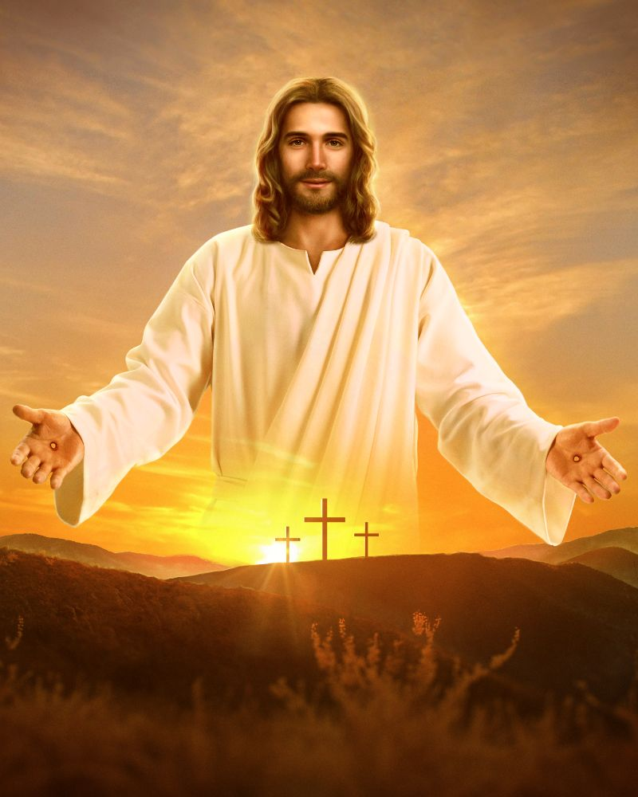
Time Period Breakdown
In Daniel 9:24-27, Gabriel is explaining to Daniel that his people (the Jewish Nation) has 70 “Weeks” or 490 years of allotted probationary time to do God’s will before He moves on to another “nation”—the Messiah will appear in this time period.
Once the Decree to Restore and Rebuild Jerusalem occurs, the time starts. It will take 7 “Weeks” or 49 years to Rebuild the wall and city in troublous times.
After the first 49 years has passed, an additional 62 “Weeks” or 434 years will pass, and at some point AFTER that time, the Messiah shall be “cut off” or killed

Slide 21
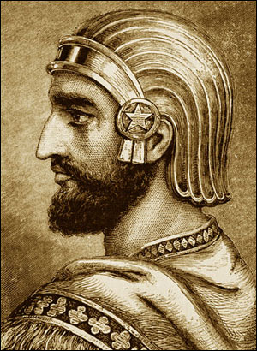
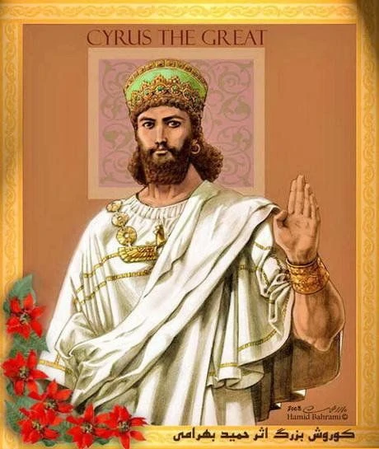
The Decree to Restore and Rebuild Jerusalem
Bible Option 1: Cyrus’ Decree in 536 BC-
Ezra 1:1-4 “Now in the first year of Cyrus king of Persia, that the word of the Lord by the mouth of Jeremiah might be fulfilled, the Lord stirred up the spirit of Cyrus king of Persia, that he made a proclamation throughout all his kingdom, and put it also in writing, saying, Thus saith Cyrus king of Persia, The Lord God of heaven hath given me all the kingdoms of the earth; and he hath charged me to build him an house at Jerusalem, which is in Judah. Who is there among you of all his people? his God be with him, and let him go up to Jerusalem, which is in Judah, and build the house of the Lord God of Israel, (he is the God,) which is in Jerusalem. And whosoever remaineth in any place where he sojourneth, let the men of his place help him with silver, and with gold, and with goods, and with beasts, beside the freewill offering for the house of God that is in Jerusalem.”
Does This Decree Restore and Rebuild Jerusalem?
Answer: NO—Just Rebuild

Slide 22
The Decree to Restore and Rebuild Jerusalem
Bible Option 2: Darius’ Decree in 519 BC-
Ezra 6:1-12 “Then Darius the king made a decree, and search was made in the house of the rolls, where the treasures were laid up in Babylon. And there was found at Achmetha, in the palace that is in the province of the Medes, a roll, and therein was a record thus written: In the first year of Cyrus the king the same Cyrus the king made a decree concerning the house of God at Jerusalem, Let the house be builded, the place where they offered sacrifices, and let the foundations thereof be strongly laid; the height thereof threescore cubits, and the breadth thereof threescore cubits; With three rows of great stones, and a row of new timber: and let the expenses be given out of the king's house: And also let the golden and silver vessels of the house of God, which Nebuchadnezzar took forth out of the temple which is at Jerusalem, and brought unto Babylon, be restored, and brought again unto the temple which is at Jerusalem, every one to his place, and place them in the house of God. Now therefore, Tatnai, governor beyond the river, Shetharboznai, and your companions the Apharsachites, which are beyond the river, be ye far from thence: Let the work of this house of God alone; let the governor of the Jews and the elders of the Jews build this house of God in his place. Moreover I make a decree what ye shall do to the elders of these Jews for the building of this house of God: that of the king's goods, even of the tribute beyond the river, forthwith expenses be given unto these men, that they be not hindered. And that which they have need of, both young bullocks, and rams, and lambs, for the burnt offerings of the God of heaven, wheat, salt, wine, and oil, according to the appointment of the priests which are at Jerusalem, let it be given them day by day without fail: That they may offer sacrifices of sweet savours unto the God of heaven, and pray for the life of the king, and of his sons. Also I have made a decree, that whosoever shall alter this word, let timber be pulled down from his house, and being set up, let him be hanged thereon; and let his house be made a dunghill for this. And the God that hath caused his name to dwell there destroy all kings and people, that shall put to their hand to alter and to destroy this house of God which is at Jerusalem. I Darius have made a decree; let it be done with speed.”
Does This Decree Restore and Rebuild Jerusalem? Answer: Somewhat—Not full restoration

Slide 23
Bible Option 3: Artaxerxes’ Decree in 457 BC-
Ezra 7:8,12-26 “And he came to Jerusalem in the fifth month, which was in the seventh year of the king. . . . Artaxerxes, king of kings, unto Ezra the priest, a scribe of the law of the God of heaven, perfect peace, and at such a time. I make a decree, that all they of the people of Israel, and of his priests and Levites, in my realm, which are minded of their own freewill to go up to Jerusalem, go with thee. Forasmuch as thou art sent of the king, and of his seven counsellors, to enquire concerning Judah and Jerusalem, according to the law of thy God which is in thine hand; And to carry the silver and gold, which the king and his counsellors have freely offered unto the God of Israel, whose habitation is in Jerusalem, And all the silver and gold that thou canst find in all the province of Babylon, with the freewill offering of the people, and of the priests, offering willingly for the house of their God which is in Jerusalem: That thou mayest buy speedily with this money bullocks, rams, lambs, with their meat offerings and their drink offerings, and offer them upon the altar of the house of your God which is in Jerusalem. And whatsoever shall seem good to thee, and to thy brethren, to do with the rest of the silver and the gold, that do after the will of your God. The vessels also that are given thee for the service of the house of thy God, those deliver thou before the God of Jerusalem. And whatsoever more shall be needful for the house of thy God, which thou shalt have occasion to bestow, bestow it out of the king's treasure house. And I, even I Artaxerxes the king, do make a decree to all the treasurers which are beyond the river, that whatsoever Ezra the priest, the scribe of the law of the God of heaven, shall require of you, it be done speedily, Unto an hundred talents of silver, and to an hundred measures of wheat, and to an hundred baths of wine, and to an hundred baths of oil, and salt without prescribing how much. Whatsoever is commanded by the God of heaven, let it be diligently done for the house of the God of heaven: for why should there be wrath against the realm of the king and his sons? Also we certify you, that touching any of the priests and Levites, singers, porters, Nethinims, or ministers of this house of God, it shall not be lawful to impose toll, tribute, or custom, upon them. And thou, Ezra, after the wisdom of thy God, that is in thine hand, set magistrates and judges, which may judge all the people that are beyond the river, all such as know the laws of thy God; and teach ye them that know them not. And whosoever will not do the law of thy God, and the law of the king, let judgment be executed speedily upon him, whether it be unto death, or to banishment, or to confiscation of goods, or to imprisonment.”

Slide 24
Does This Decree Restore and Rebuild Jerusalem?
Answer: Yes, Jerusalem is Rebuilt, Sanctuary reestablished with tax immunities to clergy, civil authority and autonomy granted, immunity to tribute.

Slide 25
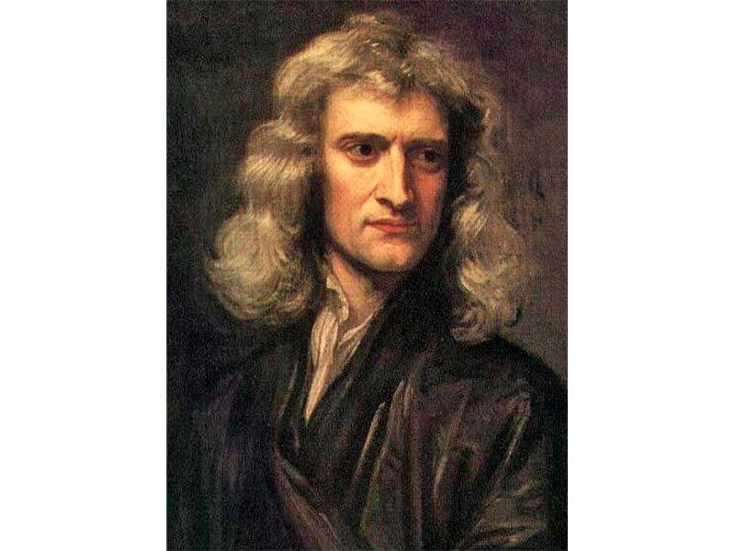
How Can We Be Sure About the Start Date?
“Now the dispersed Jews became a body politick; and this was in the seventh year of Artazerzes Longimanus, when Ezra returned with a body of Jews from captivity, and revived the Jewish worship; and by the King’s commission created Magistrates in all the land, to judge and govern the people according to the laws of God and the King, Ezra vii. 25. There were but two returns from captivity, Zerubbabel’s and Ezra’s; in Zerubbabel’s they had only commission to build the Temple, in Ezra’s they first became a polity or city by a government of their own. Now the years of Artaxerxes began about two or three months after the summer solstice, and his seventh year fell in with the third year of the eightieth Olympiad; and the latter part thereof, wherein Ezra went up to Jerusalem, was in the year of the Julian Period 4257 [457 BC]”—Isaac Newton, Observations Upon the Prophecies of Daniel and The Apocalypse of St. John, p. 82

Slide 26
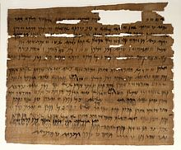
Other Ancient Texts Confirm
In the Ancient Dating Systems, we find that the 7th Year of Artaxerxes to be 457 BC to be confirmed by:
The Canon of Ptolemy—lists kings and astronomical observations
Greek Olympiad Dates
Babylonian Tablets (see Richard A. Parker and Waldo H. Dubberstein Babylonian Chronology: 626 B.C.-AD. 75)
Elephantine papyri from Egypt—contains the identification of the reign of Artaxerxes in 464 BC

Slide 27
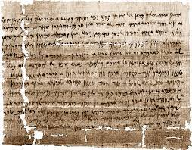
The Elephantine Papyri
“Xerxes, the predecessor of Artaxerxes, was murdered sometime between December 17, 465 B.C., and January 3, 464 B.C. The tablet bearing the latest known date from his reign is dated to month 9 (which corresponds to December) of his twenty-first year of reign. And the Elephantine papyri from Egypt contain the first known date identified with Artaxerxes' reign the equivalent of our January 3, 464 B.C. . . . With this information we can construct a time line for the early years of Artaxerxes and thus arrive at the all-important seventh year of his reign. We calculate that year according to the Jewish fall-to-fall calendar the calendar Ezra was using when he referred to Artaxerxes' decree . . . . shows that Artaxerxes' seventh year began in 458 B.C. and extended into 457 B.C., and that the dates Scripture records in connection with this decree--those for Ezra's departure for Jerusalem and for his arrival there--fall well within 457 B.C.”—L.P. Tolhurst, April 1988, Ministry Magazine

Slide 28
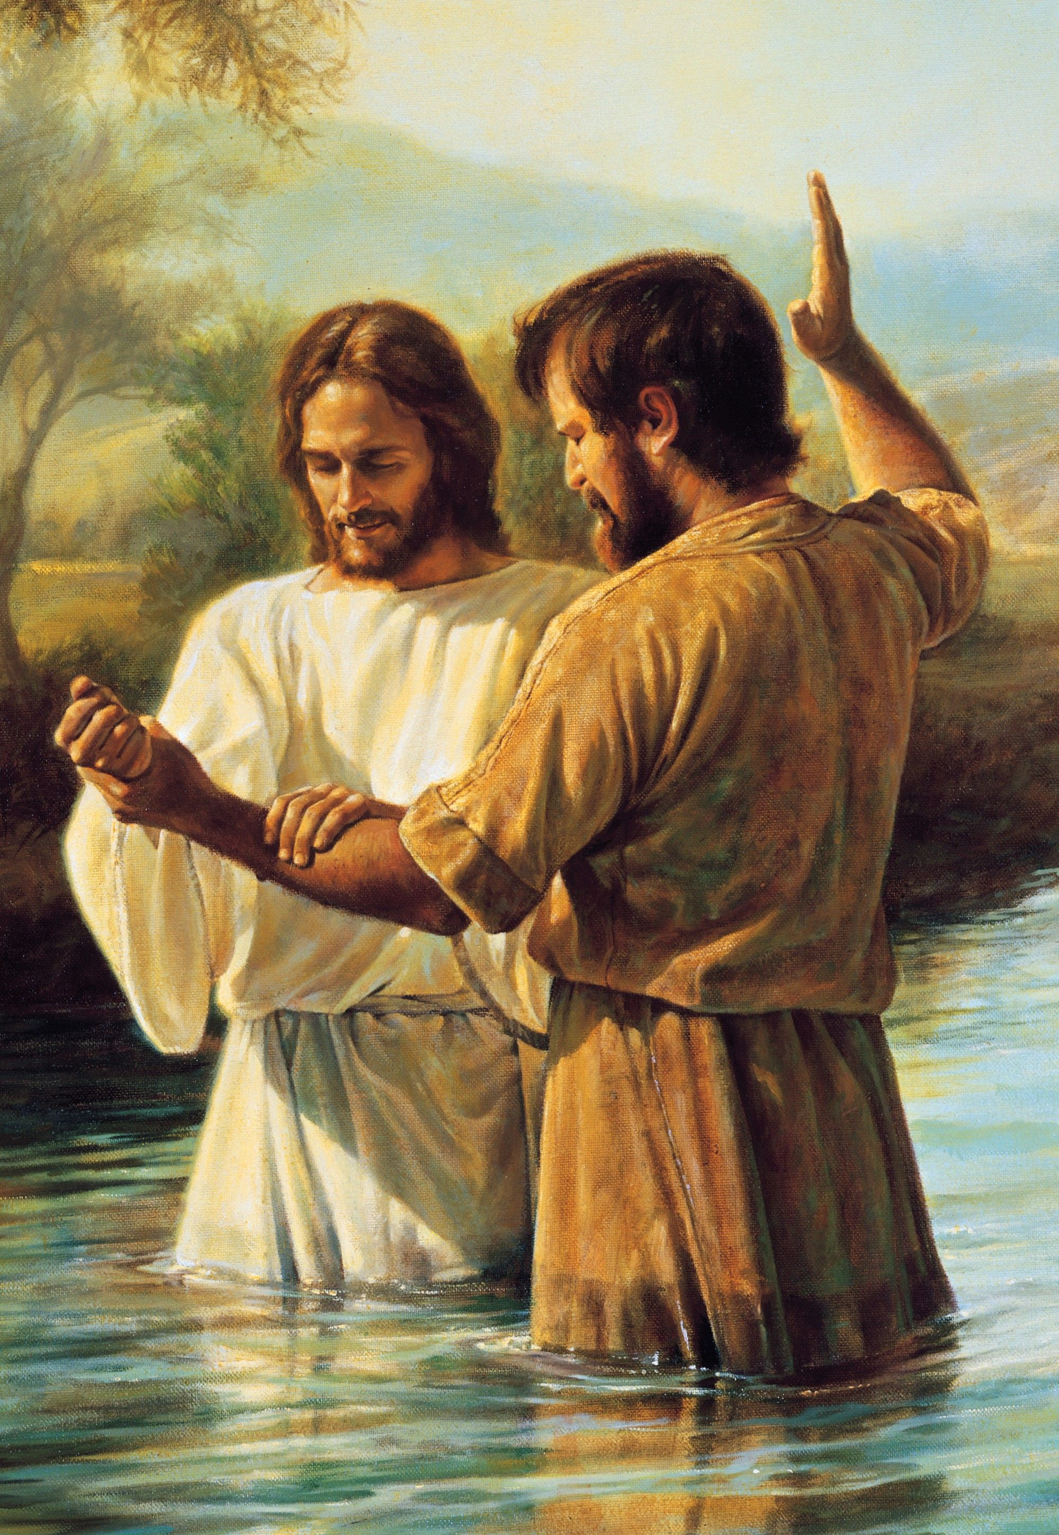
Was the Messiah Identified at the Time Appointed???
457 BC + 483 (7+62 Weeks) = 27 AD
Luke 3:1-3 “Now in the fifteenth year of the reign of Tiberius Caesar, Pontius Pilate being governor of Judaea, and Herod being tetrarch of Galilee, and his brother Philip tetrarch of Ituraea and of the region of Trachonitis, and Lysanias the tetrarch of Abilene, Annas and Caiaphas being the high priests, the word of God came unto John the son of Zacharias in the wilderness. And he came into all the country about Jordan, preaching the baptism of repentance for the remission of sins”

Slide 29
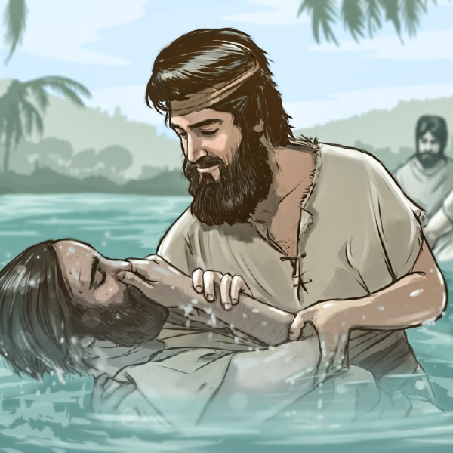
ANNOINT THE MOST HOLY
Matt. 3:13-17 “Then cometh Jesus from Galilee to Jordan unto John, to be baptized of him. But John forbad him, saying, I have need to be baptized of thee, and comest thou to me? And Jesus answering said unto him, Suffer it to be so now: for thus it becometh us to fulfil all righteousness. Then he suffered him. And Jesus, when he was baptized, went up straightway out of the water: and, lo, the heavens were opened unto him, and he saw the Spirit of God descending like a dove, and lighting upon him: And lo a voice from heaven, saying, This is my beloved Son, in whom I am well pleased.

Slide 30

Acts Confirms the Anointing
Acts 10:37-39 “That word, I say, ye know, which was published throughout all Judaea, and began from Galilee, after the baptism which John preached; How God anointed Jesus of Nazareth with the Holy Ghost and with power: who went about doing good, and healing all that were oppressed of the devil; for God was with him. And we are witnesses of all things which he did both in the land of the Jews, and in Jerusalem; whom they slew and hanged on a tree”

Slide 31
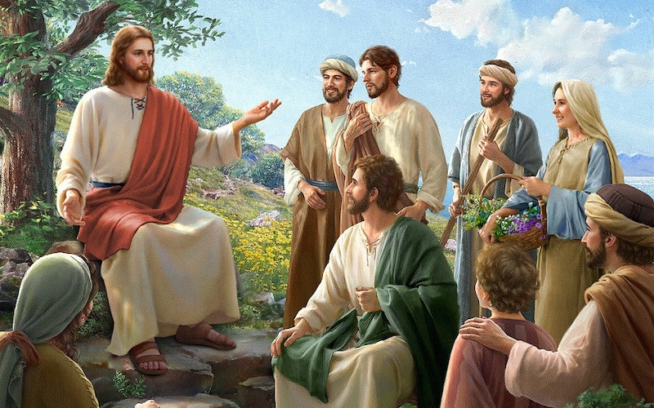
“The Time is Fulfilled”
Mark 1:13-15 “And he was there in the wilderness forty days, tempted of Satan; and was with the wild beasts; and the angels ministered unto him. Now after that John was put in prison, Jesus came into Galilee, preaching the gospel of the kingdom of God, And saying, The time is fulfilled, and the kingdom of God is at hand: repent ye, and believe the gospel.”

Slide 32
Mrs. White Confirms What We Just Proved Again
“The burden of Christ's preaching was, "The time is fulfilled, and the kingdom of God is at hand; repent ye, and believe the gospel." Thus the gospel message, as given by the Saviour Himself, was based on the prophecies. The "time" which He declared to be fulfilled was the period made known by the angel Gabriel to Daniel. "Seventy weeks," said the angel, "are determined upon thy people and upon thy holy city, to finish the transgression, and to make an end of sins, and to make reconciliation for iniquity, and to bring in everlasting righteousness, and to seal up the vision and prophecy, and to anoint the most holy." Daniel 9:24. A day in prophecy stands for a year. See Numbers 14:34; Ezekiel 4:6. The seventy weeks, or four hundred and ninety days, represent four hundred and ninety years. A starting point for this period is given: "Know therefore and understand, that from the going forth of the commandment to restore and to build Jerusalem unto the Messiah the Prince shall be seven weeks, and threescore and two weeks," sixty-nine weeks, or four hundred and eighty-three years. Daniel 9:25. The commandment to restore and build Jerusalem, as completed by the decree of Artaxerxes Longimanus (see Ezra 6:14; 7:1, 9, margin), went into effect in the autumn of B. C. 457. From this time four hundred and eighty-three years extend to the autumn of A. D. 27. According to the prophecy, this period was to reach to the Messiah, the Anointed One. In A. D. 27, Jesus at His baptism received the anointing of the Holy Spirit, and soon afterward began His ministry. Then the message was proclaimed. "The time is fulfilled.“—DA, 233

Slide 33

The Talmudic Curse Explained…. Careful With “Jewish Calendars”!!!
"Rabbis Akiva and Ben Halafta also slashed out 160 years from the Persian/Jewish calendar to nullify the “named one’s” [Jesus] fulfillment of Daniel’s 490-year prophecy. . . That’s right, 160 years of real time was ripped out and thrown away!" (see The Forbidden Secret, Jonathan Gray, p. 29; The Da Vinci Code Hoax, Chapters 17-18,20-21, 27; Who’s Playing Jesus Games? Chapters 12-15; The Sorcerers’ Secret, Chapters 4-6).

Slide 34
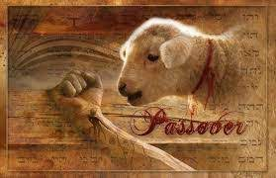
Confirm the Covenant for 1 Week But Cut Off in the Midst
Last Week: 27 AD + 7 = 34 AD
Event One: Jesus cut off in the midst of the Week:
According to the allotted probationary time for the nation of Israel: the Messiah, or Jesus Christ was to confirm the Covenant for 1 week/7 years, and to be “cut off” in the midst (halfway) in that week. Meaning Jesus must have died 3-1/2 years into His ministry. AKA 31 AD… Do We have evidence of this?

Slide 35
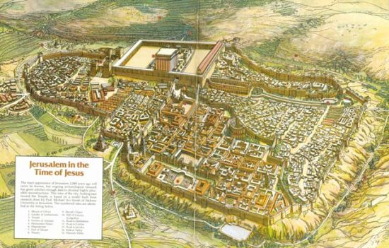
Passovers For Christ in Chronology
Jesus Baptized-27AD
First Passover (spring)-28AD (John 2:13, 23)=6 months of ministry
Second Passover-29AD (John 5:1)=1-1/2 years
Third Passover-30AD (John 6:4)=2-1/2 years
Final Passover-31AD=3-1/2 years

Slide 36

How He “Confirmed the Covenant”
“As the Bible presents two laws, one changeless and eternal, the other provisional and temporary, so there are two covenants. The covenant of grace was first made with man in Eden, when after the Fall there was given a divine promise that the seed of the woman should bruise the serpent's head. To all men this covenant offered pardon and the assisting grace of God for future obedience through faith in Christ. It also promised them eternal life on condition of fidelity to God's law. Thus the patriarchs received the hope of salvation.”—PP, 370

Slide 37
“This same covenant was renewed to Abraham in the promise, "In thy seed shall all the nations of the earth be blessed." Genesis 22:18. This promise pointed to Christ. So Abraham understood it (see Galatians 3:8, 16), and he trusted in Christ for the forgiveness of sins. It was this faith that was accounted unto him for righteousness. The covenant with Abraham also maintained the authority of God's law. The Lord appeared unto Abraham, and said, "I am the Almighty God; walk before Me, and be thou perfect." Genesis 17:1. The testimony of God concerning His faithful servant was, "Abraham obeyed My voice, and kept My charge, My commandments, My statutes, and My laws." Genesis 26:5. And the Lord declared to him, "I will establish My covenant between Me and thee and thy seed after thee in their generations, for an everlasting covenant, to be a God unto thee and to thy seed after thee." Genesis 17:7. Though this covenant was made with Adam and renewed to Abraham, it could not be ratified until the death of Christ. It [p. 371] had existed by the promise of God since the first intimation of redemption had been given; it had been accepted by faith; yet when ratified by Christ, it is called a new covenant. The law of God was the basis of this covenant, which was simply an arrangement for bringing men again into harmony with the divine will, placing them where they could obey God's law.”—PP 370,371

Slide 38

Confirm the Covenant for 1 Week But Cut Off in the Midst
Last Week: 27 AD + 7 = 34 AD
Event Two: Probation ends for Israel:
Amazing Love and Grace, Mercy, and Patience!!! God still gave the nation of Israel 3-1/2 more years to get their act together! Now, we can expect another event which signifies a clear connection with Christ’s death, message, and ministry. A Message of Judgment is what we expect in 34 AD. But Where do we see this event?

Slide 39
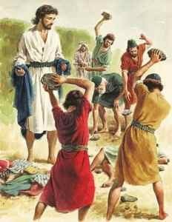
What Happened in 34 AD???
“The seventy weeks, or 490 years, especially allotted to the Jews, ended, as we have seen, in A.D. 34. At that time, through the action of the Jewish Sanhedrin, the nation sealed its rejection of the gospel by the martyrdom of Stephen and the persecution of the followers of Christ. Then the message of salvation, no longer restricted to the chosen people, was given to the world. The disciples, forced by persecution to flee from Jerusalem, "went everywhere preaching the word." "Philip went down to the city of Samaria, and preached Christ unto them." Peter, divinely guided, opened the gospel to the centurion of Caesarea, the God-fearing Cornelius; and the ardent Paul, won to the faith of Christ, was commissioned to carry the glad tidings "far hence unto the Gentiles." Acts 8:4, 5; 22:21.”—GC, 328

Slide 40
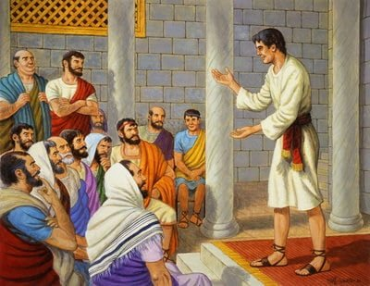
Stephen’s Message of Judgment to Israel
Acts 7:42-44 “Then God turned, and gave them up to worship the host of heaven; as it is written in the book of the prophets, O ye house of Israel, have ye offered to me slain beasts and sacrifices by the space of forty years in the wilderness? Yea, ye took up the tabernacle of Moloch, and the star of your god Remphan, figures which ye made to worship them: and I will carry you away beyond Babylon. Our fathers had the tabernacle of witness in the wilderness, as he had appointed, speaking unto Moses, that he should make it according to the fashion that he had seen.”

Slide 41
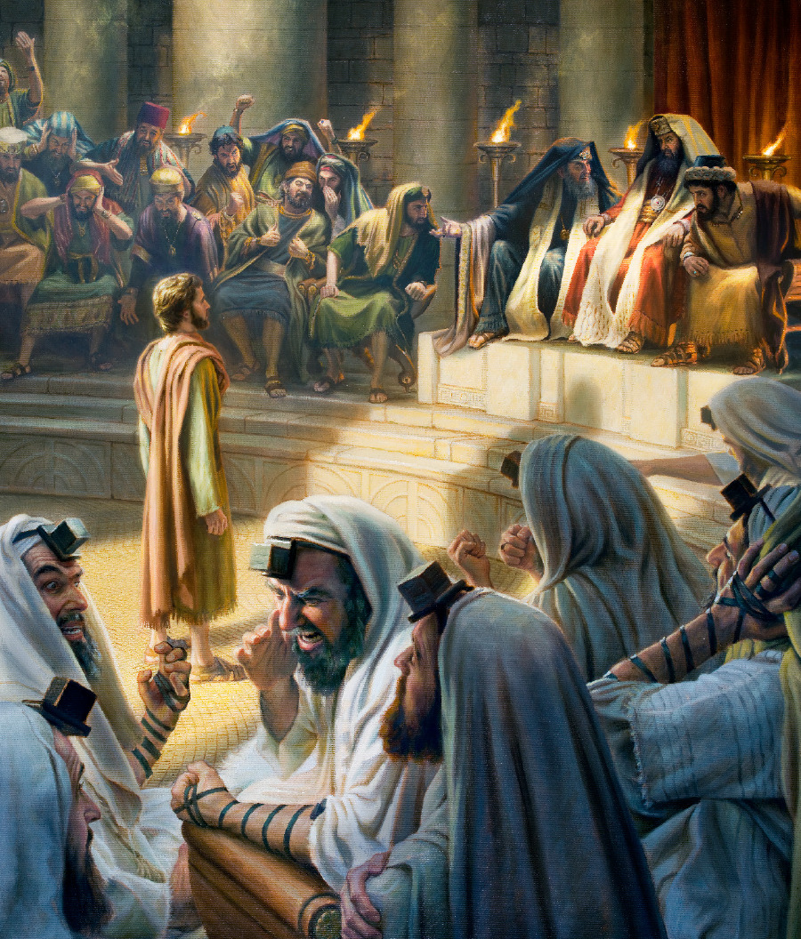
Acts 7:51-54 “Ye stiffnecked and uncircumcised in heart and ears, ye do always resist the Holy Ghost: as your fathers did, so do ye. Which of the prophets have not your fathers persecuted? and they have slain them which shewed before of the coming of the Just One; of whom ye have been now the betrayers and murderers: Who have received the law by the disposition of angels, and have not kept it. When they heard these things, they were cut to the heart, and they gnashed on him with their teeth.”

Slide 42
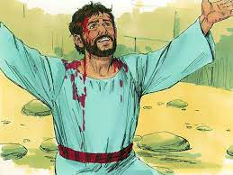
Acts 7:55-60 “But he, being full of the Holy Ghost, looked up stedfastly into heaven, and saw the glory of God, and Jesus standing on the right hand of God, And said, Behold, I see the heavens opened, and the Son of man standing on the right hand of God. Then they cried out with a loud voice, and stopped their ears, and ran upon him with one accord, And cast him out of the city, and stoned him: and the witnesses laid down their clothes at a young man's feet, whose name was Saul. And they stoned Stephen, calling upon God, and saying, Lord Jesus, receive my spirit. And he kneeled down, and cried with a loud voice, Lord, lay not this sin to their charge. And when he had said this, he fell asleep.”

Slide 43
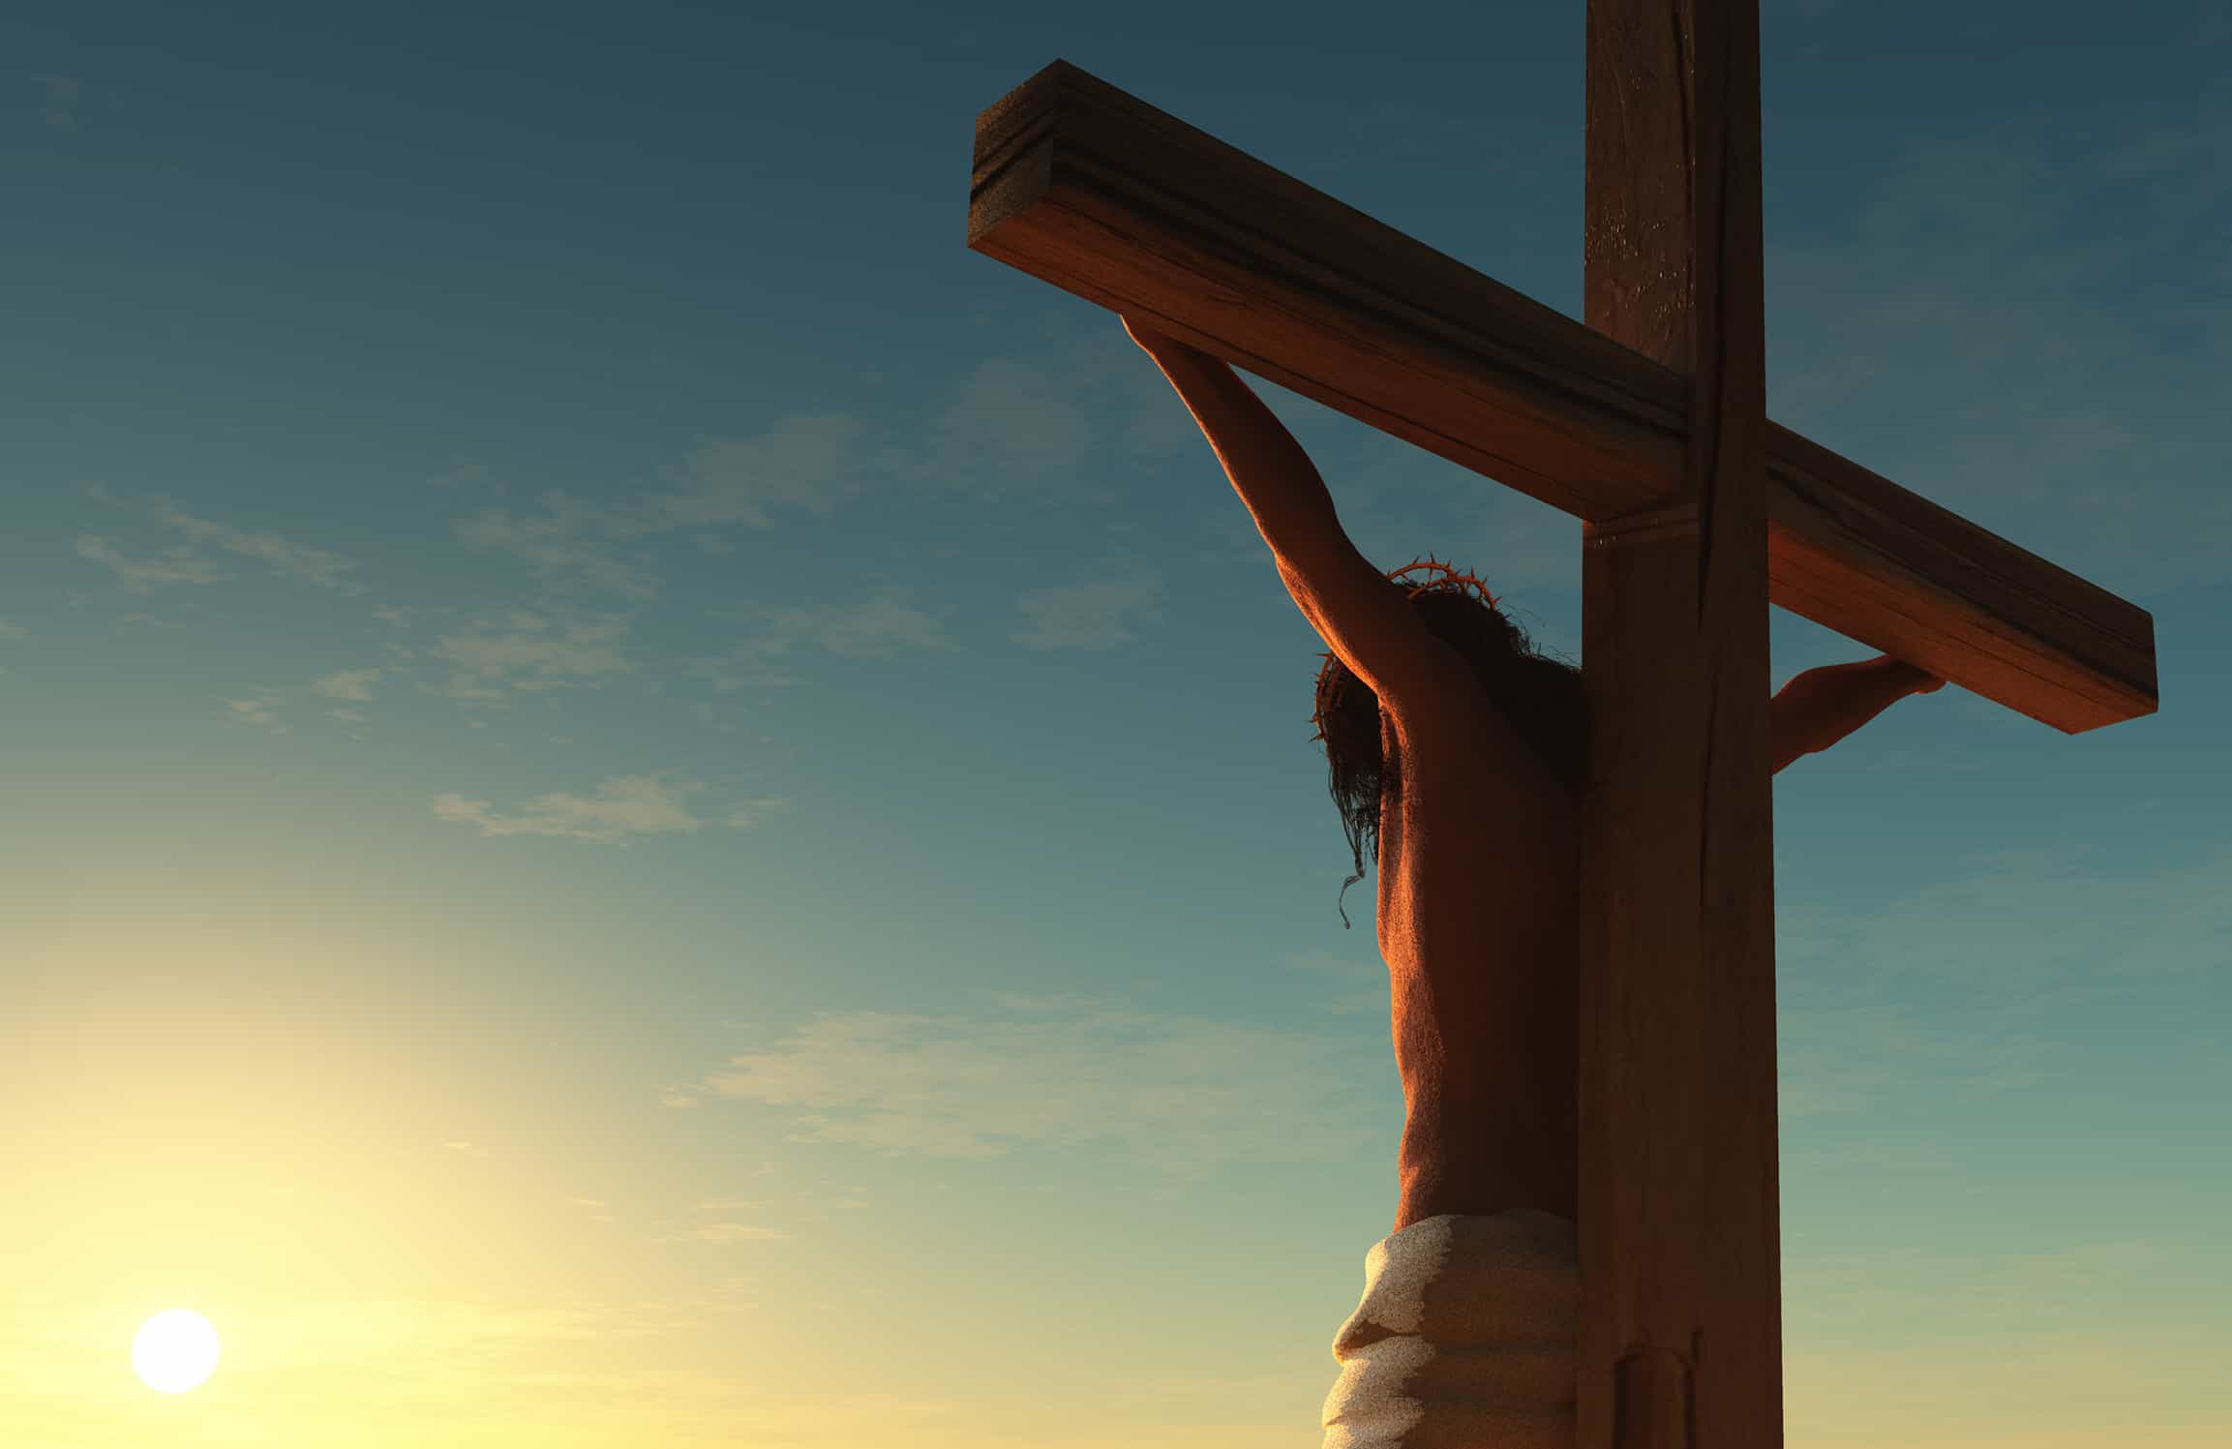
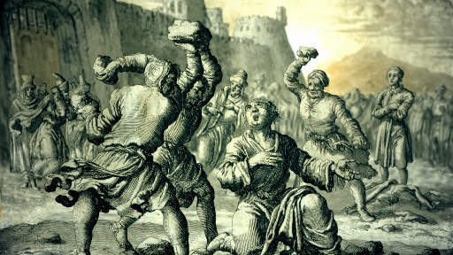
Stephen and Christ Similarities
Both Stephen and Christ gave a message of Judgment to the Sanhedrin, unmingled with any hope of restoration (See. Matt. 21-23)
Both Stephen and Christ were prophets with a special message
Both attempted to correct and confirm the Covenant
Both were brought out of the city and murdered
Both prayed God that their persecutors would be pardoned
Both died innocent for their teachings
Both prayed that God would receive their spirit

Slide 44
Now Let’s Calculate using this logic for the 2300 Days….
457 BC + 2300 = 1844

Slide 45
Explain the time of the end and the Reformation, restoring the Sanctuary
Elijah and the restoration of the altar
Explain the Millerite movement and the 2300 days as the only ones who understood the significance of this passage
Walk through the events and the errors, highlight the importance of the sanctuary throughout
Loughborough’s account, etc.

Slide 46
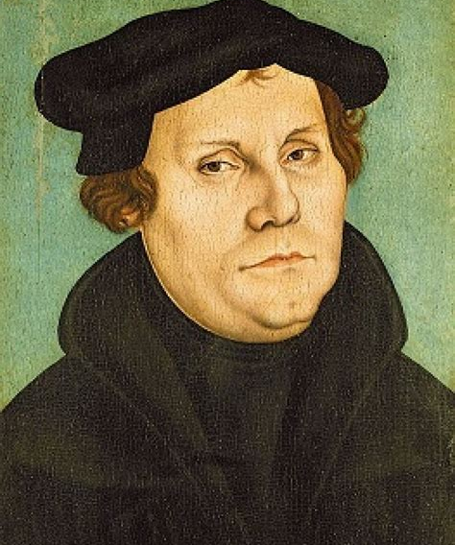
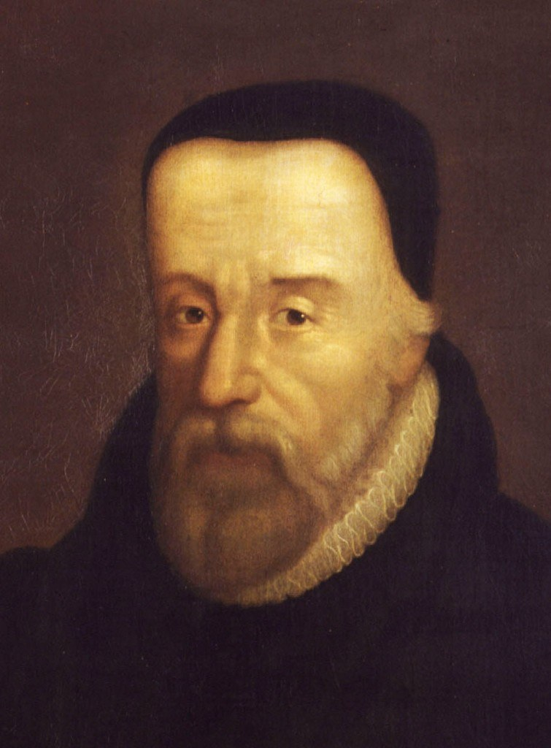
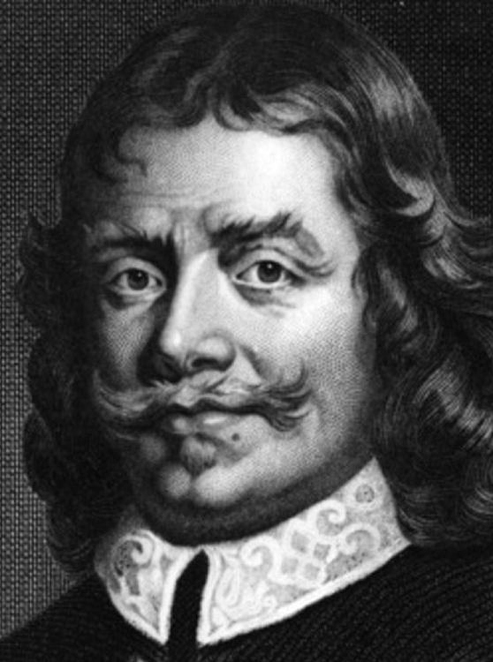
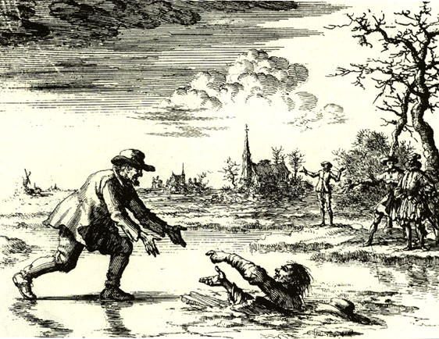
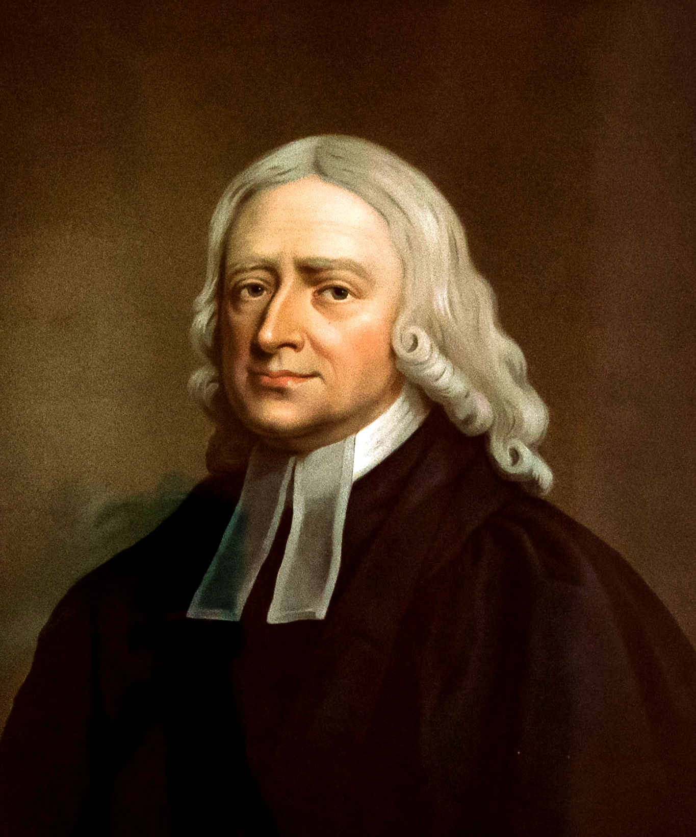
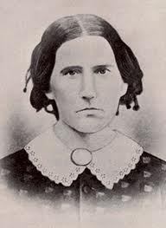
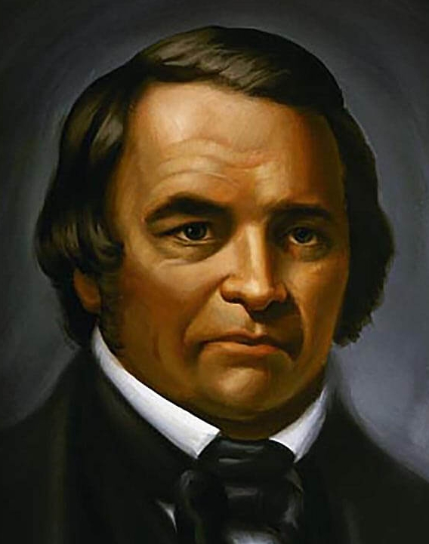
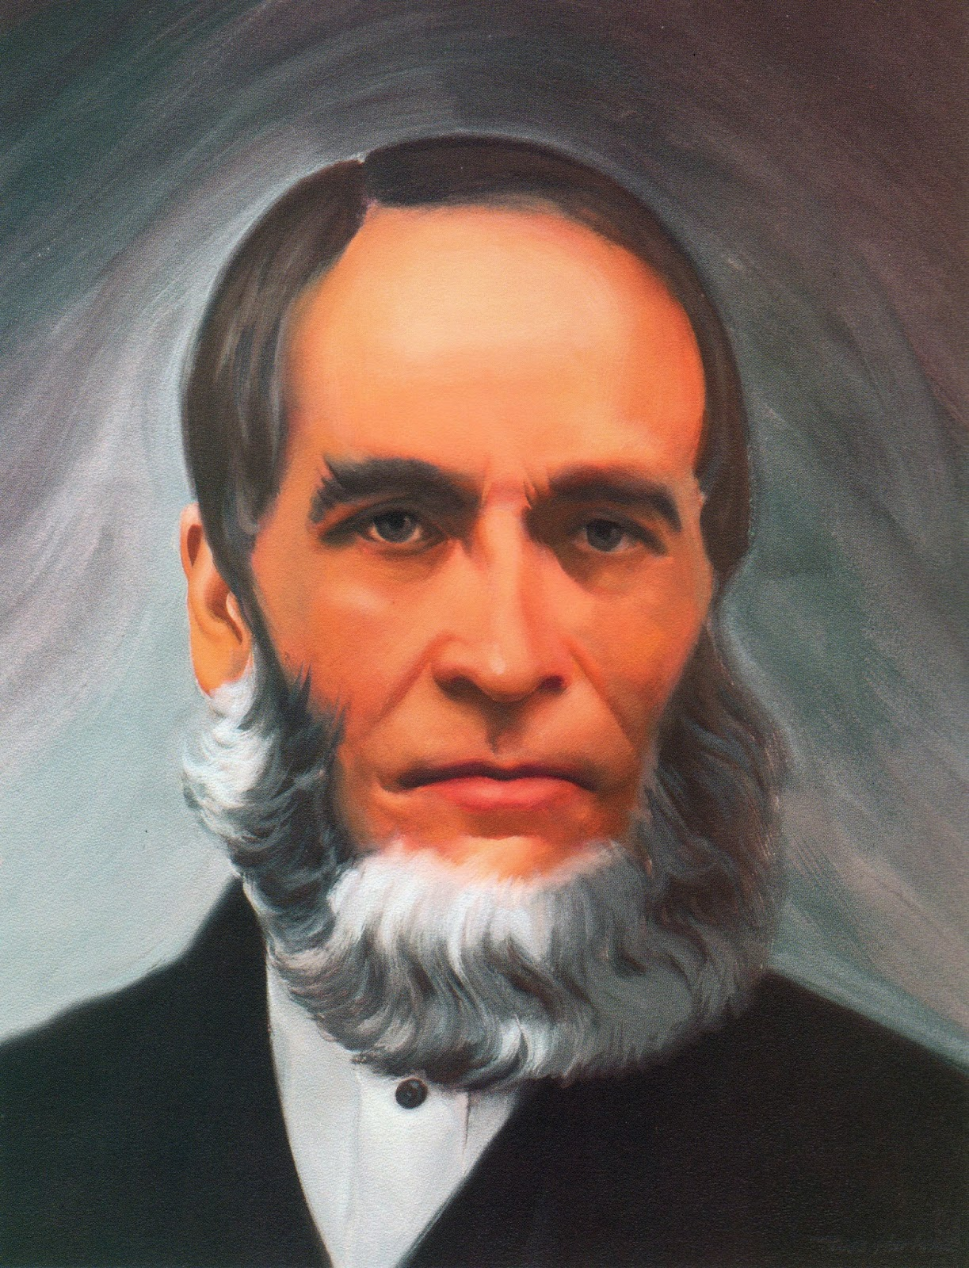
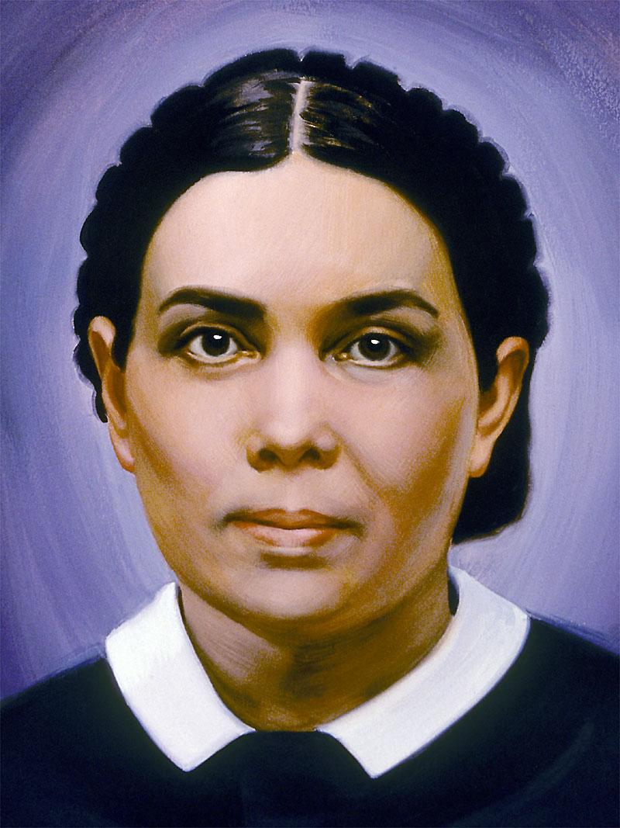

The Reformation Began Recovering the Sanctuary
The Reformation Rediscovered lost truths of the Sanctuary—effectively beginning the process of restoring the spiritual Sanctuary, culminating in the full restoration by Christ in 1844:
Justification by Faith – Altar of Burnt Offering Restored
Baptism and Communion – Laver and Drink Offering Restored
Sola Scriptura – Daily Bread/Shewbread Restored
Evangelism – Candlestick Restored
Prayer in the Spirit – Altar of Incense Restored
Righteousness by Faith – Merits of Christ/incense and oil restored
1844
7. Sabbath – Law of God Restored
8. Health Message – Manna Restored
9. Justification By Faith – Aaron’s Rod/Mercy Seat Restored
10. 3 Angel’s Messages – Judgment Hour/Day of Atonement Message Restored
11. State of the Dead – Investigative Judgment Understanding Restored

