Slide 1
Prophecy Arise, pt. 14
What Lies Ahead!

Slide 2
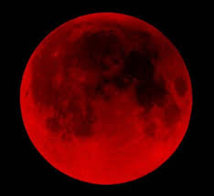
Are Blood Moons the catalyst?
A few moons ago, Jonathan Kahn, a Jewish convert to Christianity, and John Hagee, a well known evangelical declared that blood moons would trigger in the final events of earth's history. Their dumb predictions fell flat on their face! What will trigger earth’s final events?

Slide 3
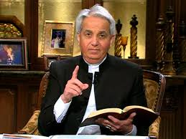
Benny Hinn and the Charismatic Movement???
Some think Benny Hinn and the charismatic movement are the sign of the last days! He performs ‘miracles’ in plain site! Surely, this is the trigger for Earth’s Final Hours? Think again, friend of mine!

Slide 4
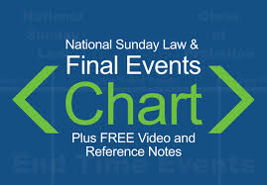

Slide 5
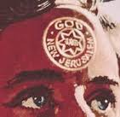
National Sunday Law!
The National Sunday Law, beginning in America, will trigger the final events of earth’s history. This will be the catalyst for:
1. the sealing/marking of God’s professed people.
2. the outpouring of the Latter Rain.
3. The Loud Cry of Revelation 18.

Slide 6
Great Test!
“The Lord has shown me clearly that the image of the beast will be formed before probation closes; for it is to be the great test for the people of God, by which their eternal destiny will be decided…(Rev. 13:11-17 quoted)
“This is the test that the people of God must have before they are sealed. All who prove their loyalty to God by observing His law, and refusing to accept a spurious sabbath, will rank under the banner of the Lord God Jehovah, and will receive the seal of the living God. Those who yield the truth of heavenly origin and accept the Sunday sabbath, will receive the mark of the beast.” (Letter 11, 1890) quoted in 7A Bible Commentary, pg. 976

Slide 7
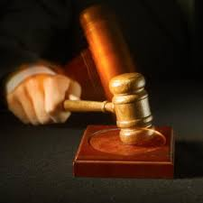
Happens to Adventists First!
“For the time is come that judgment must begin at the house of God: and if it first begin at us, what shall the end be of them that obey not the gospel of God?” 1 Peter 4:17
“And the LORD said unto him, Go through the midst of the city, through the midst of Jerusalem, and set a mark upon the foreheads of the men that sigh and that cry for all the abominations that be done in the midst thereof. And to the others he said in mine hearing, Go ye after him through the city, and smite: let not your eye spare, neither have ye pity: Slay utterly old and young, both maids, and little children, and women: but come not near any man upon whom is the mark; and begin at my sanctuary. Then they began at the ancient men which were before the house.” Ezekiel 9:4-6

Slide 8
Ready for What?
“As the storm approaches, a large class who have professed faith in the third angel's message, but have not been sanctified through obedience to the truth, abandon their position and join the ranks of the opposition. By uniting with the world and partaking of its spirit, they have come to view matters in nearly the same light; and when the test is brought, they are prepared to choose the easy, popular side. Men of talent and pleasing address, who once rejoiced in the truth, employ their powers to deceive and mislead souls. They become the most bitter enemies of their former brethren. When Sabbath keepers are brought before the courts to answer for their faith, these apostates are the most efficient agents of Satan to misrepresent and accuse them, and by false reports and insinuations to stir up the rulers against them.
In this time of persecution the faith of the Lord's servants will be tried. They have faithfully given the warning, looking to God and to His word alone. God's Spirit, moving upon their hearts, has constrained them to speak.” GC, pg. 608

Slide 9
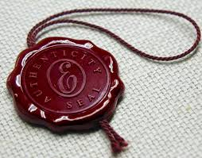
Seals what is There!
When the Latter Rain comes, at the time of the NSL, It does not change anyone. The Holy Spirit seals what is there for eternity! If there is impurity, we remain impure forever. If we are experiencing victory, then we will have victory forever!

Slide 10
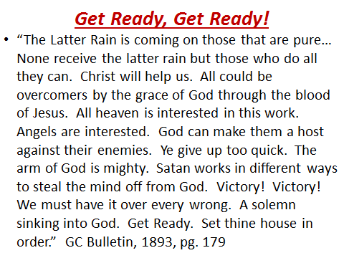

Slide 11
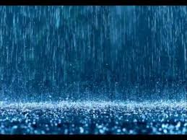
“And after these things I saw another angel come down from heaven, having great power; and the earth was lightened with his glory. And he cried mightily with a strong voice, saying, Babylon the great is fallen, is fallen, and is become the habitation of devils, and the hold of every foul spirit, and a cage of every unclean and hateful bird.” Rev. 18:1,2
“Be glad then, ye children of Zion, and rejoice in the LORD your God: for he hath given you the former rain moderately, and he will cause to come down for you the rain, the former rain, and the latter rain in the first month.” Joel 2:23

Slide 12
Little Time of Trouble
The Little Time of trouble begins at the NSL. Those who are sealed give the loud cry of Rev. 18. Those Adventists who receive the mark of the beast will become the most evil of persecutors. It will be during this time that all the world will hear the 3 angel’s messages in the power of the latter rain. Once everyone has heard the message, then probation will clsoe on the inhabitants of earth.

Slide 13
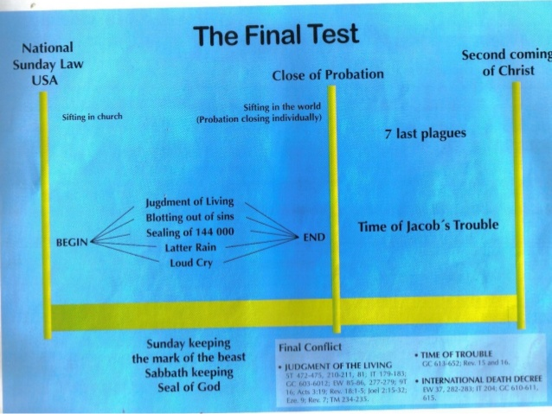
“The Sabbath will be the great test of loyalty, for it is the point of truth especially controverted. When the final test shall be brought to bear upon men, then the line of distinction will be drawn between those who serve God and those who serve Him not. While the observance of the false sabbath in compliance with the law of the state, contrary to the fourth commandment, will be an avowal of allegiance to a power that is in opposition to God, the keeping of the true Sabbath, in obedience to God's law, is an evidence of loyalty to the Creator. While one class, by accepting the sign of submission to earthly powers, receive the mark of the beast, the other choosing the token of allegiance to divine authority, receive the seal of God.” GC, pg. 605

Slide 14
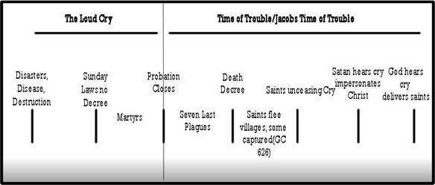

Slide 15
All Cases Decided!
"At that time shall Michael stand up, the great Prince which standeth for the children of thy people: and there shall be a time of trouble, such as never was since there was a nation even to that same time: and at that time thy people shall be delivered, everyone that shall be found written in the book." Daniel 12:1.
When the third angel's message closes, mercy no longer pleads for the guilty inhabitants of the earth. The people of God have accomplished their work. They have received "the latter rain," "the refreshing from the presence of the Lord," and they are prepared for the trying hour before them. Angels are hastening to and fro in heaven. An angel returning from the earth announces that his work is done; the final test has been brought upon the world, and all who have proved themselves loyal to the divine precepts have received "the seal of the living God.”

Slide 16
It is Over
…Then Jesus ceases His intercession in the sanctuary above. He lifts His hands and with a loud voice says, "It is done;" and all the angelic host lay off their crowns as He makes the solemn announcement: "He that is unjust, let him be unjust still: and he which is filthy, let him be filthy still: and he that is righteous, let him be righteous still: and he that is holy, let him be holy still." Revelation 22:11. Every case has been decided for life or death. Christ has made the atonement for His people and blotted out their sins. The number of His subjects is made up; "the kingdom and dominion, and the greatness of the kingdom under the whole heaven," is about to be given to the heirs of salvation, and Jesus is to reign as King of kings and Lord of lords.” GC, pgs. 613, 614

Slide 17
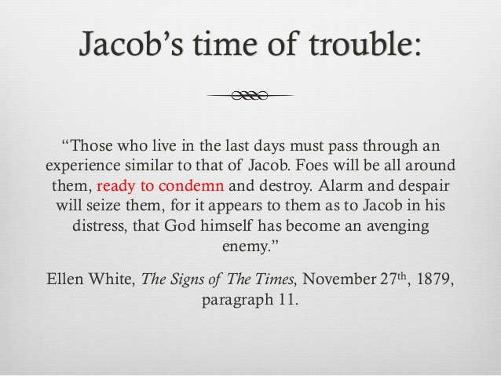
Probation Closes on the World!
“He that is unjust, let him be unjust still: and he which is filthy, let him be filthy still: and he that is righteous, let him be righteous still: and he that is holy, let him be holy still.” Rev. 22:12

Slide 18
Jacob’s Trouble
During this time, the 7 last plagues will be poured out. (Rev. 16)
Christ will have left the Most Holy
Place, preparing to return.
God’s children will stand before Him without a mediator. Since they are bathed in the Latter Rain of the Holy Spirit, they can stand during this time.
At the end of the plagues, Christ returns.

Slide 19
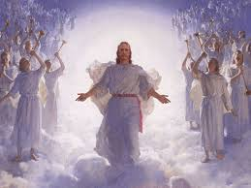
Advent!
“For the Lord himself shall descend from heaven with a shout, with the voice of the archangel, and with the trump of God: and the dead in Christ shall rise first: Then we which are alive and remain shall be caught up together with them in the clouds, to meet the Lord in the air: and so shall we ever be with the Lord.” 1 Thess. 4:16,17

