Slide 1
Ezekiel, pt. 1
Hope Beyond Fading Dreams

Slide 2
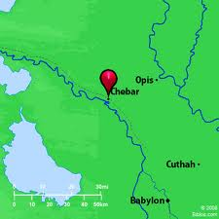
His Biography
”Now it came to pass in the thirtieth year, in the fourth month, in the fifth day of the month, as I was among the captives by the river of Chebar, that the heavens were opened, and I saw visions of God. In the fifth day of the month, which was the fifth year of king Jehoiachin's captivity, The word of the LORD came expressly unto Ezekiel the priest, the son of Buzi, in the land of the Chaldeans by the river Chebar; and the hand of the LORD was there upon him.” Ezekiel 1:1-3

Slide 3
Things didn’t Go as Planned
Ezekiel was trained for the priesthood. His goal, his dream, was to serve God and be a blessing to His people. Ezekiel had not planned to end up in Babylon. Nebuchadnezzar had invaded Judah twice already; once in 605 BC, and once in 597 BC and a third invasion would also come. Ezekiel had been taken under the second captivity in 597. He received his first vision in 592 BC. Things had not gone as planned.

Slide 4
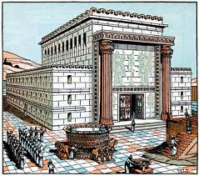
A bunch of Insteads
His dream had been to minister in Solomon’s temple. Instead, a few short years away and Solomon’s temple would be annihilated. He had wanted to serve God in Judah. Instead, he found himself a captive slave in Babylon. He thought his education was over. Instead, he had to learn a new language, in a new land, new customs. His world was crashing around him!

Slide 5
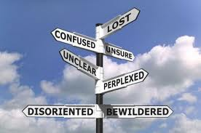
Not So Sure Now!
Everything that was sure; his life goals, his plans for the future, his eventual place in Judah’s history; everything seemed rock solid. Then, like a whirlwind, like a nightmare, it toppled around him like a house of cards! The world he had hoped for was now a deep, dark, hole!! Where could he turn now? Was there anything left? Was there anyone he could trust? Was there nothing in this world that could bring him hope? Strength? Stability?

Slide 6
He Wasn’t the first, nor the Last
“It was under circumstances of difficulty and discouragement that Isaiah, while yet a young man, was called to the prophetic mission. Disaster was threatening his country. By their transgression of God's law the people of Judah had forfeited His protection, and the Assyrian forces were about to come against the kingdom of Judah. But the danger from their enemies was not the greatest trouble. It was the perversity of the people that brought upon the Lord's servant the deepest depression. By their apostasy and rebellion they were inviting the judgments of God...

Slide 7
Concluded
…The youthful prophet had been called to bear to them a message of warning, and he knew that he would meet with obstinate resistance. He trembled as he viewed himself and thought of the stubbornness and unbelief of the people for whom he was to labour. His task seemed to him almost hopeless. Should he in despair relinquish his mission and leave Israel undisturbed to their idolatry? Were the gods of Nineveh to rule the earth in defiance of the God of heaven? Such thoughts as these were crowding upon his mind as he stood under the portico of the holy temple. .. Ezekiel, the mourning exile prophet, in the land of the Chaldeans, was given a vision teaching the same lesson of faith in the mighty God of Israel.” 5 Testimonies, pgs. 749-751

Slide 8
What Ezekiel Saw
”And I looked, and, behold, a whirlwind came out of the north, a great cloud, and a fire infolding itself, and a brightness was about it, and out of the midst thereof as the colour of amber, out of the midst of the fire. Also out of the midst thereof came the likeness of four living creatures. And this was their appearance; they had the likeness of a man. And every one had four faces, and every one had four wings. And their feet were straight feet; and the sole of their feet was like the sole of a calf's foot: and they sparkled like the colour of burnished brass. And they had the hands of a man under their wings on their four sides; and they four had their faces and their wings.” Ezekiel 1:4-8

Slide 9
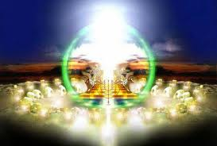
Fire and Creatures
“ For our God is a consuming fire.” Heb. 12:29
Th
Ezekiel 10:15/ Creatures
“And the cherubims were lifted up. This is the living creature that I saw by the river of Chebar.”
Ezekiel beheld the glory/majesty of God surrounded by cherubim. He had a vision of the nerve center of the universe-the Heavenly Sanctuary’s inner Holy of Holies!

Slide 10
In the Temple
”And thou shalt put into the ark the testimony which I shall give thee. And thou shalt make a mercy seat of pure gold: two cubits and a half shall be the length thereof, and a cubit and a half the breadth thereof. And thou shalt make two cherubims of gold, of beaten work shalt thou make them, in the two ends of the mercy seat. And make one cherub on the one end, and the other cherub on the other end: even of the mercy seat shall ye make the cherubims on the two ends thereof. And the cherubims shall stretch forth their wings on high, covering the mercy seat with their wings, and their faces shall look one to another; toward the mercy seat shall the faces of the cherubims be.” Ex. 25:16-20

Slide 11
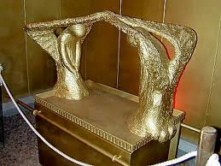
Lucifer once Resided There
“Thou hast been in Eden the garden of God; every precious stone was thy covering, the sardius, topaz, and the diamond, the beryl, the onyx, and the jasper, the sapphire, the emerald, and the carbuncle, and gold: the workmanship of thy tabrets and of thy pipes was prepared in thee in the day that thou wast created. Thou art the anointed cherub that covereth; and I have set thee so: thou wast upon the holy mountain of God; thou hast walked up and down in the midst of the stones of fire. Thou wast perfect in thy ways from the day that thou wast created, till iniquity was found in thee.” Ezek. 28:13-15

Slide 12
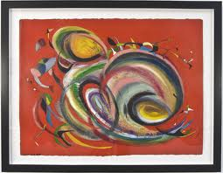
Their Work
“ Now as I beheld the living creatures, behold one wheel upon the earth by the living creatures, with his four faces. The appearance of the wheels and their work was like unto the colour of a beryl: and they four had one likeness: and their appearance and their work was as it were a wheel in the middle of a wheel.” Ezek. 1:15,16

Slide 13
Wheels in Wheels
“There were wheels within wheels in an arrangement so complicated that at first sight they appeared to Ezekiel to be all in confusion. But when they moved, it was with beautiful exactness and in perfect harmony. Heavenly beings were impelling these wheels, and, above all, upon the glorious sapphire throne, was the Eternal One; while round about the throne was the encircling rainbow, emblem of grace and love. Overpowered by the terrible glory of the scene, Ezekiel fell upon his face, when a voice bade him arise and hear the word of the Lord. Then there was given him a message of warning for Israel…The wheel like complications that appeared to the prophet to be involved in such confusion were under the guidance of an infinite hand. The Spirit of God, revealed to him as moving and directing these wheels, brought harmony out of confusion; so the whole world was under His control. Myriads of glorified beings were ready at His word to overrule the power and policy of evil men, and bring good to His faithful ones.” 5 Testimonies, 752,753

Slide 14
John and Isaiah Saw this Too
…In the visions given to Isaiah, to Ezekiel, and to John we see how closely heaven is connected with the events taking place upon the earth and how great is the care of God for those who are loyal to Him…The program of coming events is in the hands of the Lord. The Majesty of heaven has the destiny of nations, as well as the concerns of His church, in His own charge. We permit ourselves to feel altogether too much care, trouble, and perplexity in the Lord's work. Finite men are not left to carry the burden of responsibility. ..The tireless vigilance of the heavenly messengers, and their unceasing employment in their ministry in connection with the beings of earth, show us how God's hand is guiding the wheel within a wheel. The divine Instructor is saying to every actor in His work, as He said to Cyrus of old: "I girded thee, though thou hast not known Me." In Ezekiel's vision God had His hand beneath the wings of the cherubim. This is to teach His servants that it is divine power that gives them success. He will work with them if they will put away iniquity and become pure in heart and life.” 5 Testimonies 753, 754

Slide 15
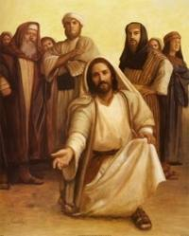
The Mysterious Hand
“And they had the hands of a man under their wings on their four sides; and they four had their faces and their wings.” Ezekiel 1:8
The hands of Calvary give stability, comfort, and support to the work. Without Him, it would collapse!

Slide 16
The Authority
“And above the firmament that was over their heads was the likeness of a throne, as the appearance of a sapphire stone: and upon the likeness of the throne was the likeness as the appearance of a man above upon it. And I saw as the colour of amber, as the appearance of fire round about within it, from the appearance of his loins even upward, and from the appearance of his loins even downward, I saw as it were the appearance of fire, and it had brightness round about. As the appearance of the bow that is in the cloud in the day of rain, so was the appearance of the brightness round about. This was the appearance of the likeness of the glory of the LORD. And when I saw it, I fell upon my face, and I heard a voice of one that spake.” Ezekiel 1:26-28

Slide 17
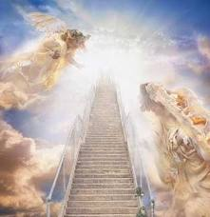
The Absolute
“Thy throne, O God, is for ever and ever: the sceptre of thy kingdom is a right sceptre.” Ps. 45:6
“Thy throne is established of old: thou art from everlasting.” Ps. 93:2

Slide 18
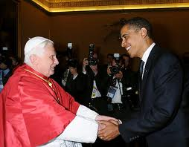
Don’t Forget!!!
Babylon thinks she is in charge! America/Obama think they are running the show!
Rulers rise and fall. Nations as well control for a time. Above and beyond, the King of Kings rules the universe!

