Slide 1
Will the Real Enemy Please Stand Up?

Slide 2
Four-fold Warning
“And Jesus answered and said unto them, Take heed that no man deceive you.” “For many shall come in my name, saying, I am Christ; and shall deceive many.” “And many false prophets shall rise, and shall deceive many.” “For there shall arise false Christs, and false prophets, and shall shew great signs and wonders; insomuch that, if it were possible, they shall deceive the very elect.” Matthew 24:4,5,11,24

Slide 3
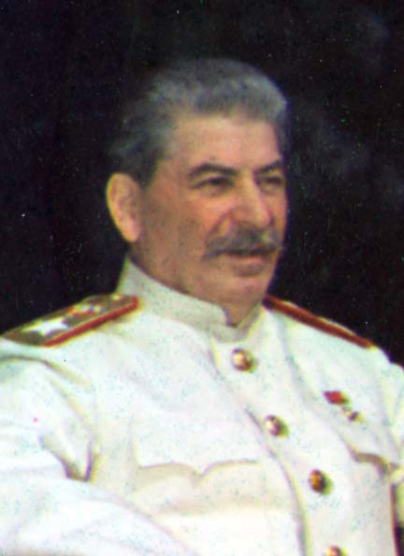
After World War II

Slide 4
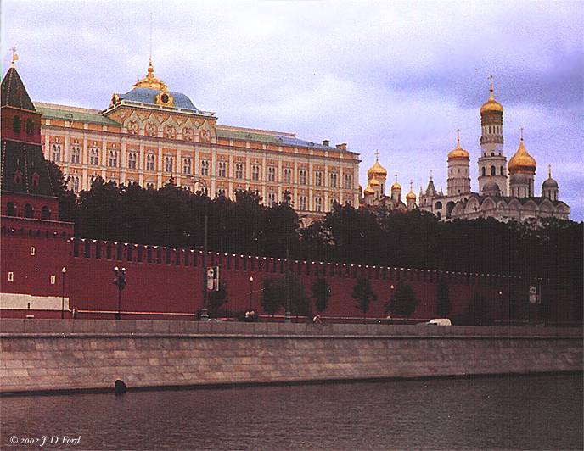
Cold War

Slide 5
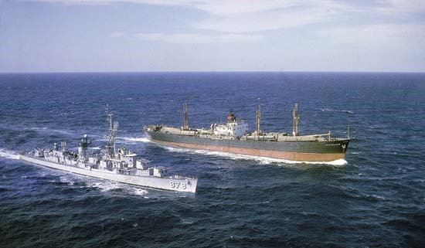
Cuban Missile Crisis

Slide 6
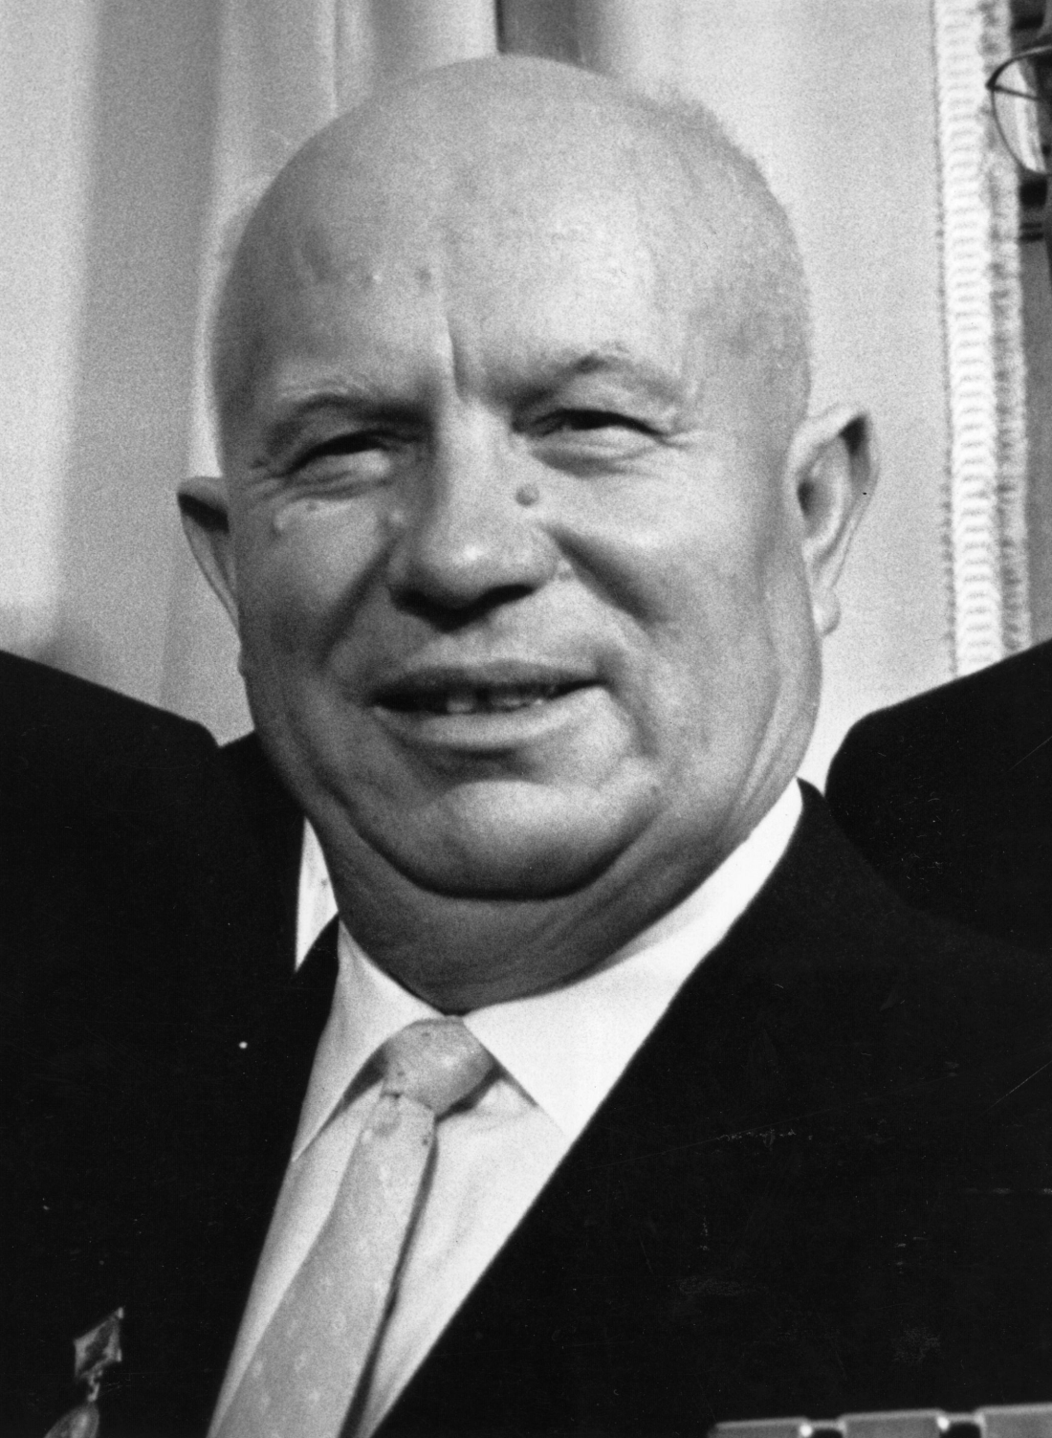
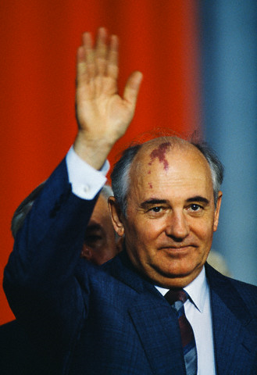
The Evil Empire

Slide 7
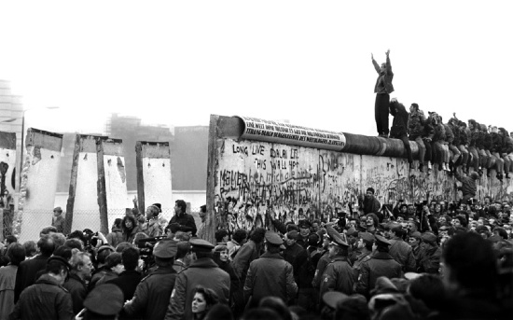
A Wall Falls- 1989

Slide 8
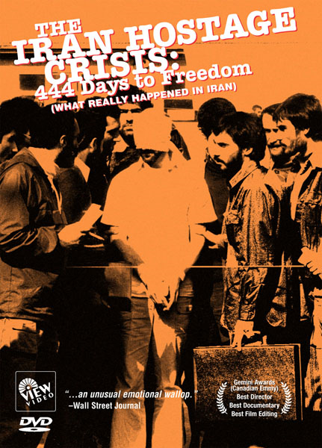

Slide 9
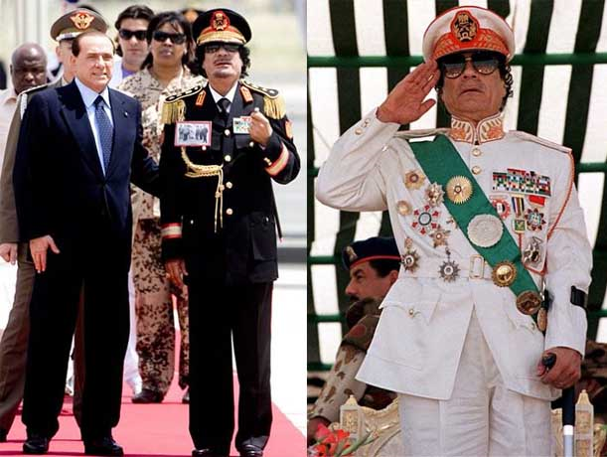
Islam

Slide 10
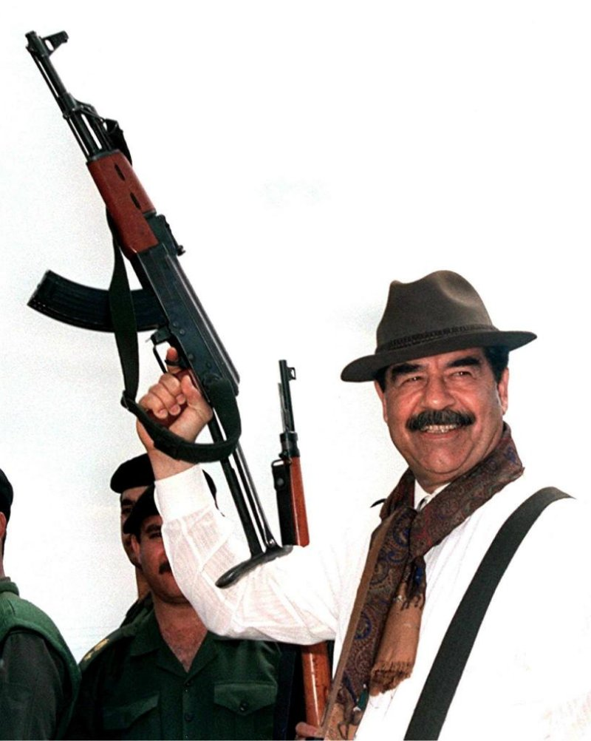
Islam

Slide 11
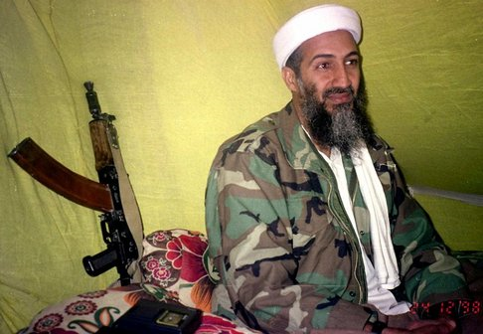
Islam

Slide 12
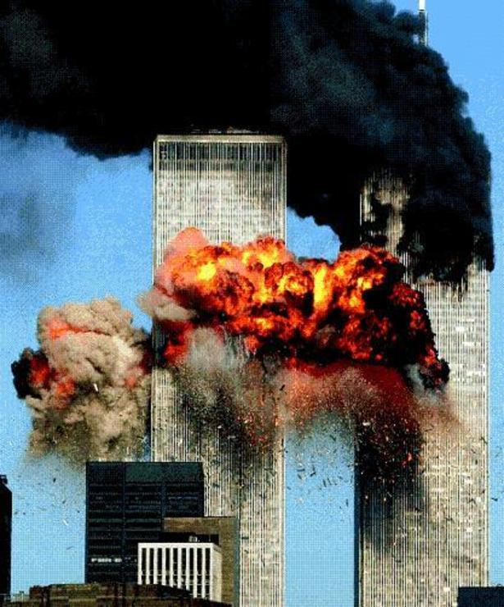
ISLAM-REALLY?!????

Slide 13
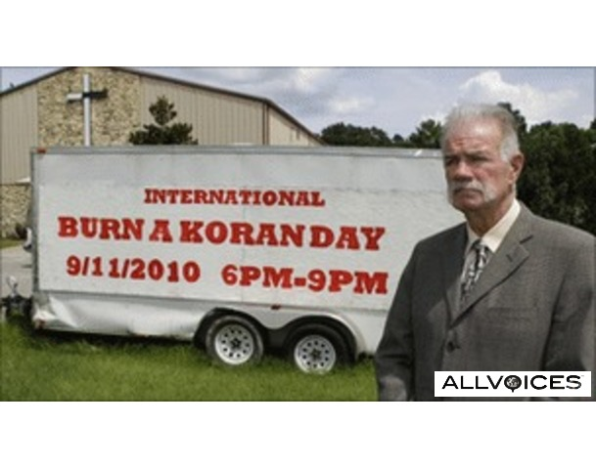
Protesting Islam

Slide 14
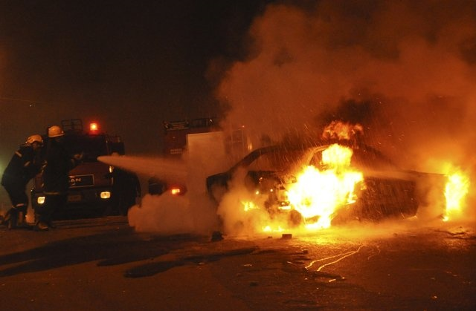
Bombing in Alexandria, Egypt January 1, 2011

Slide 16
IN ADVENTISM-Bacchiochi
“In the light of this symbolic interpretation of the three and half year as the time of the domination and persecution of the Antichrist during which God's people will be protected, this identifying mark of the Little Horn applies equally well to the Papacy and Islam. Both powers have attempted to wear out the saints of the Most High, but during the times of persecution many believers have been empowered and protected by God.
The preceding analysis of the identifying marks of the prophetic Antichrist, represented in Daniel 7 by the imagery of the Little Horn and in Revelation 13 by the symbol of a Beast, has shown that both the Papacy and Islam fulfill the qualifying marks of this prophetic power.” End time Issues, #86 Disgusting!

Slide 17
9-11 Was it Really Islam?
So many unanswered questions still remain many years later and most will probably never be answered.
1. Why were the planes allowed to go so far off track from their original flight plan without being intercepted?
2. Why did the President of the United States, George Bush, after knowing of the terror attack on the first building of the World Trade Center, continue to laugh and joke with the children in Sarasota, FL even though Americans were burning and jumping to their deaths?
3. Why are we told that the airplanes, gasoline, and subsequent heat caused the buildings to fall when that just couldn’t be? Does someone have something to hide?
For a student of Bible prophecy, the events of September 11, 2001, and its aftermath are deeply instructive for us today.
1. 9-11 was used to pass the Patriot Act which seriously gutted Constitutionally liberty. Could something like this happen again?
2. Could another attack occur to create a climate whereby Sunday laws could appear absolutely necessary to a scared populous?

Slide 18
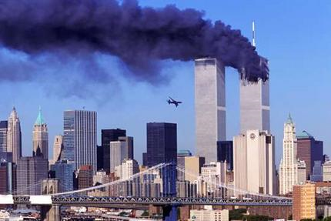
Never Should Have Happened
“In light of standard procedures for dealing with hijacked airplanes, however, not one of these planes should have reached its target, let alone all three of them…Skeptics about the official account believe that the attempt to crash an airliner into the WTC could not have been successful under normal circumstances. The basic problem, they argue, is that there are standard procedures for situations such as this and that, if they had been followed, Flight 11 would have been intercepted by fighter jets within 10 minutes of any sign that it may have been hijacked. Had the plane then failed to obey the standard signal to follow the fighter jets to an airport to land, it would have been shot down. This would have occurred by 8:24, or 8:30 at the latest, so that the question of whether to shoot down a commercial airliner over the heart of New York City would not have arisen.” David Ray Griffin’s book, The New Pearl Harbor, pgs. 3,4

Slide 19
Who Had the Authority?
“Standard Operating Procedures (SOP) were completely and inexplicably dropped on 11th September — something that had never occurred before. The question then remains as to who was responsible for ensuring that routine emergency response rules were not adhered to. Bykov and Israel have little doubt about who that was, saying: The sabotage of routine protective systems, controlled by strict hierarchies, would never have been contemplated let alone attempted absent the involvement of the supreme US military command. This includes at least US President George Bush, US Secretary of Defense Donald Rumsfeld and the then-Acting Head of the Joint Chiefs of Staff, Air Force General Richard B. Myers.” Anatoli Kornukov, Pravda Online, September 13, 2001 (http://english.pravda.ru),
Ahmed, 164, 167.
Israel and Bykov, "Guilty for 9-11," quoted in Ahmed, 169.

Slide 20
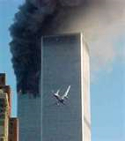
Does She Deserve an Answer?
Kristen Breitweiser, whose husband died in the WTC, said on Phil Donahue's television show: “I don't understand how a plane could hit our Defense Department... an hour after the first plane hit the first tower. I don't understand how that is possible. I'm a reasonable person. But when you look at the fact that we spend a half trillion dollars on national defense and you're telling me that a plane is able to hit our Pentagon...an hour after the first tower is hit? There are procedures and protocols in place in this nation that are to be followed when transponders are disconnected, and they were not followed on September 11th.”

Slide 21
The Three Men
George Bush- member of Skull and Bones Society. Vowed obedience to the papacy and Black Pope in his initiation.
Donald Rumsfeld-member of the council on Foreign Relations. Front organization behind which the Jesuit Order has controlled the American press and political parties for the last 70 YEARS!
Richard B. Myers-member of the Council on Foreign Relations. CFR is a front for the insidious operations of the Jesuit Order. “The most powerful clique in these elitist groups have one objective in common – they want to bring about the surrender of the sovereignty of the national independence of the United States. A second clique of international members in the CFR comprises the Wall Street international bankers and their key agents. Primarily, they want the world-banking monopoly from whatever power ends up in the control of global government.” Chester Ward

Slide 22
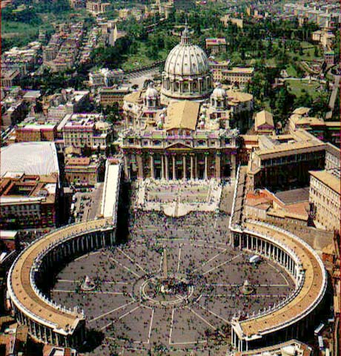
Employees of the Whore!

Slide 23
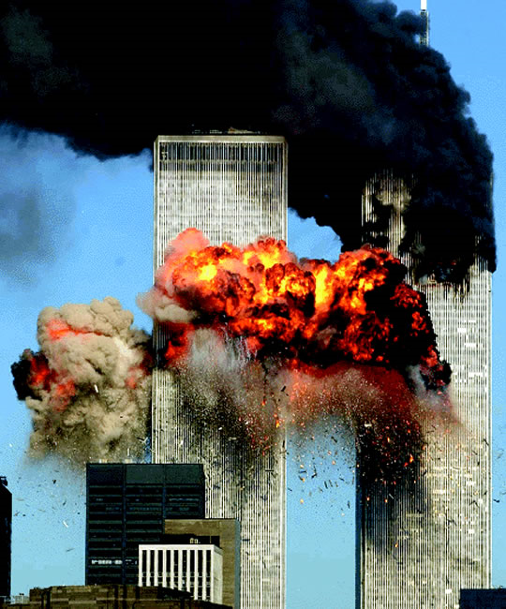
Culprits in Crime
These three men, Bush, Rumsfeld, and Myers were the only ones who could have given the order to let the planes do their deeds of destruction. These men were American leaders, working for the Vatican, and perpetrating the MURDERS of thousands of American citizens who trusted them! Are we AWAKE?

Slide 24
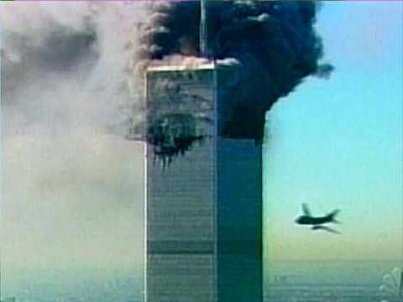
The Bible Affirms
“Come hither; I will show unto thee the judgment of the great whore that sitteth upon many waters; with whom the kings of the earth have committed fornication, and the inhabitants of the earth have been made drunk with the wine of her fornication…And the woman which thou sawest is that great city, which reigneth over the kings of the earth.
” Rev. 17:1,2,18
“ And in her was found the blood of prophets, and of saints, and of all that were slain upon the earth.” Rev. 18:24

Slide 25
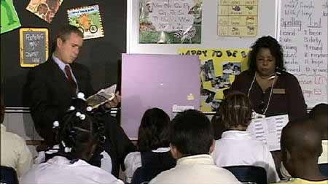
Working for Rome! How Else Do You Explain This?

Slide 26
“Critics find this incredible. If the hijackings were unanticipated occurrences, as claimed, with one of the hijacked airplanes having already completed its terrorist mission, the country was suffering the worst terrorist attack of its history. And yet the Commander in Chief, rather than making sure that his military was prepared to shoot down all hijacked planes, sticks to his planned schedule. At approximately 8:48 AM...,the first pictures of the burning World Trade Center were broadcast on live television.... By that time, the Federal Aviation Administration (FAA), the North American Aerospace Defense Command (NORAD), the National Military Command Center, the Pentagon, the White House, the Secret Service, and Canada's Strategic Command all knew that three commercial airplanes had been hijacked. They knew that one plane had been flown deliberately into the World Trade Center's North Tower; a second plane was wildly off course and also heading toward Manhattan.... So why, at 9:03 AM—fifteen minutes after it was clear the United States was under terrorist attack—did President Bush sit down with a classroom of second-graders and begin a 20-minute preplanned photo op?” P.58,9

Slide 27
Why and How?
“Intelligence agencies monitor the stock market, critics point out, to watch for clues of impending catastrophes. And the days just before September 11 saw an extremely high volume of "put options" purchased for the stock of Morgan Stanley Dean Witter, which occupied 22 stories of the World Trade Center, and for United and American Airlines, the two airlines used in the attacks. For these two airlines, and only these two, "the level of these trades was up by 1,200 percent in the three days prior to the World Trade Center attacks."To buy a put option is to bet that the price of shares is going to go down, and in this case the bet was highly profitable. As the San Francisco Chronicle explained: "When the stock prices...dropped...in response to the terrorist attacks, the options multiplied a hundredfold in value, making millions of dollars in profit." If a single group of speculators purchased most of the thousands of put options for those three stocks, this group would have made over $10 million. This unusual set of purchases raises suspicions that the investors had advance knowledge of the strikes.”
Griffin, The New Pearl Harbor, pg. 71,72

Slide 28
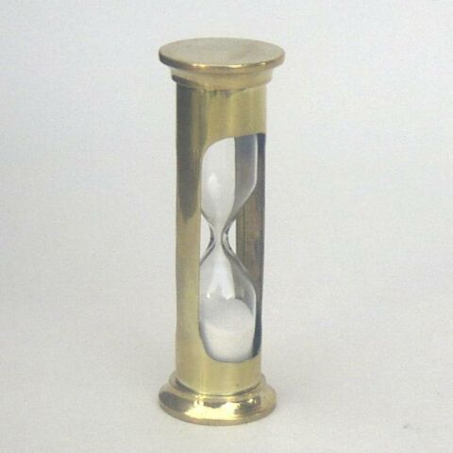
Aftermath of 9-11
There has been an onslaught of media articles and statements suggesting the giving up of certain civil liberties just as the Jesuit agenda requires. On October 26, 2001, George Bush signed the misnamed USA Patriot Act of 2001, which was proposed five days after the tragedy. Just six weeks after the World Trade Center was destroyed, this bill was passed. This is truly amazing. It is virtually impossible for a bill to be conceived, written, debated, and passed this quickly. You see, they already had the bill written before the tragedy occurred. The bill enhances the ability of federal authorities to tap phones, share intelligence information, track Internet usage, e-mails and cell phones and protect U.S. borders. — Bush Signs Sweeping New Laws to Combat Terrorism, Reuters News Service, October 26, 2001.

Slide 29
Go Back to Sleep!
Lawmakers upset with some of the administrations anti-terrorism actions will question Attorney General John Ashcroft on the matter.
[Certain Congressmen] say the administration’s actions have gone too far in infringing on civil liberties. — USA Today, November 26, 2001, (emphasis supplied).
In the same paper, on the same day, there’s a cartoon of two children, decorating a Christmas tree. One sings, “He sees you when you are sleeping, He knows when you are awake, He knows if you have been bad or good….” The other child says, “Enough about Attorney General Ashcroft already!”

Slide 30
A Voice From the Past
“And he exerciseth all the power of the first beast before him, and causeth the earth and them which dwell therein to worship the first beast, whose deadly wound was healed.” Rev. 13:12
Down at the end of time, a world power would compel the world to honor the Sunday tradition of Rome. How they would do it remained for the people at the end to decipher. God has given us warning after warning. Are we listening?

Slide 31
A Voice in our Midst
“Fearful is the issue to which the world is to be brought. The powers of earth, uniting to war against the commandments of God, will decree that "all, both small and great, rich and poor, free and bond" (Revelation 13:16), shall conform to the customs of the church by the observance of the false sabbath. All who refuse compliance will be visited with civil penalties, and it will finally be declared that they are deserving of death. On the other hand, the law of God enjoining the Creator's rest day demands obedience and threatens wrath against all who transgress its precepts. With the issue thus clearly brought before him, whoever shall trample upon God's law to obey a human enactment receives the mark of the beast; he accepts the sign of allegiance to the power which he chooses to obey instead of God. The warning from heaven is: "If any man worship the beast and his image, and receive his mark in his forehead, or in his hand, the same shall drink of the wine of the wrath of God, which is poured out without mixture into the cup of His indignation." Revelation 14:9, 10. GC. Pg. 604,5

