Slide 1
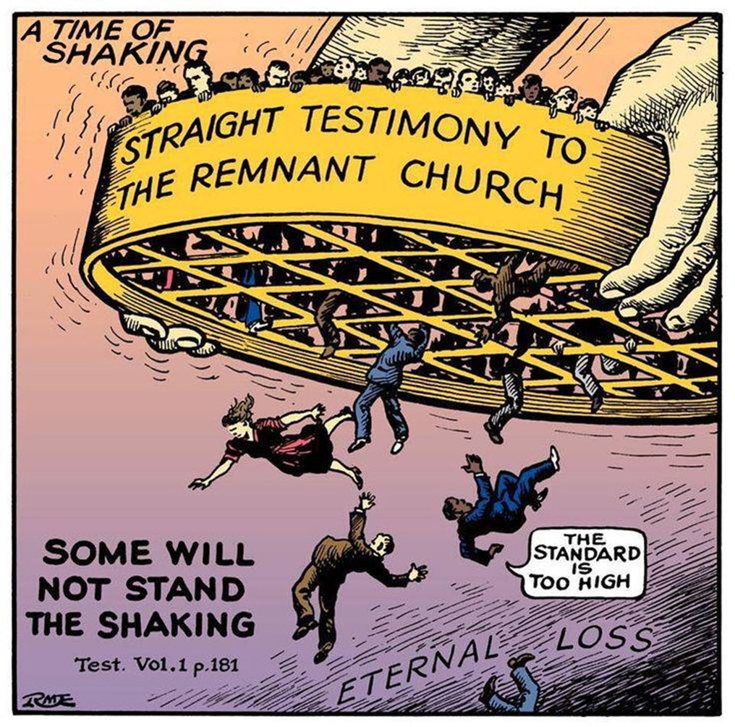

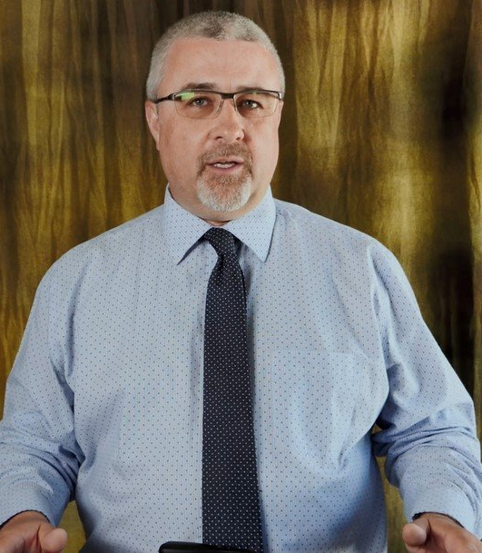
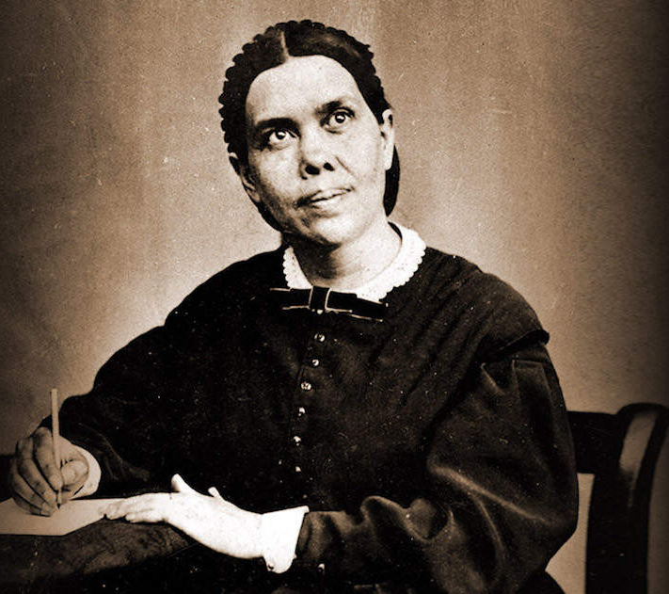
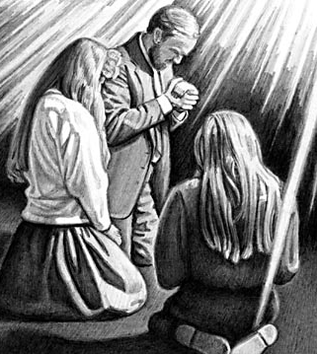
Stephen Bohr Vs Conrad Vine and the Truth
VS

Slide 2
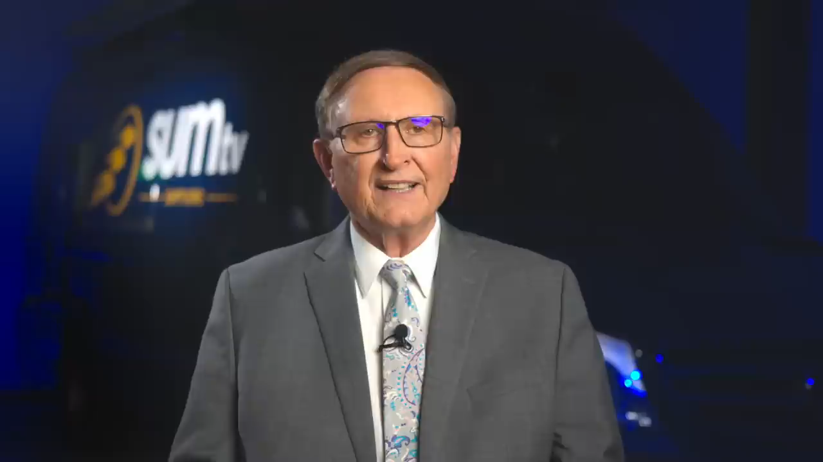
Stephen Bohr Trashes The Truth!
Official Statement || Pastor Stephen Bohr
Secrets Unsealed, 08/30/2024

Slide 3

Today We are Going to Answer:
Who/What Constitutes the True Church of God on earth?
Who is Shaken out during the Shaking time?
Who Remains Unshaken? And How do I ensure I’m in that class?

Slide 4
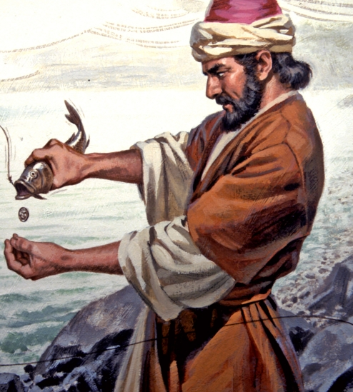
1. Who is God’s True Church on earth?
1 Pet. 2:1-5 “Wherefore laying aside all malice, and all guile, and hypocrisies, and envies, and all evil speakings, As newborn babes, desire the sincere milk of the word, that ye may grow thereby: If so be ye have tasted that the Lord is gracious. To whom coming, as unto a living stone, disallowed indeed of men, but chosen of God, and precious, Ye also, as lively stones, are built up a spiritual house, an holy priesthood, to offer up spiritual sacrifices, acceptable to God by Jesus Christ.

Slide 5
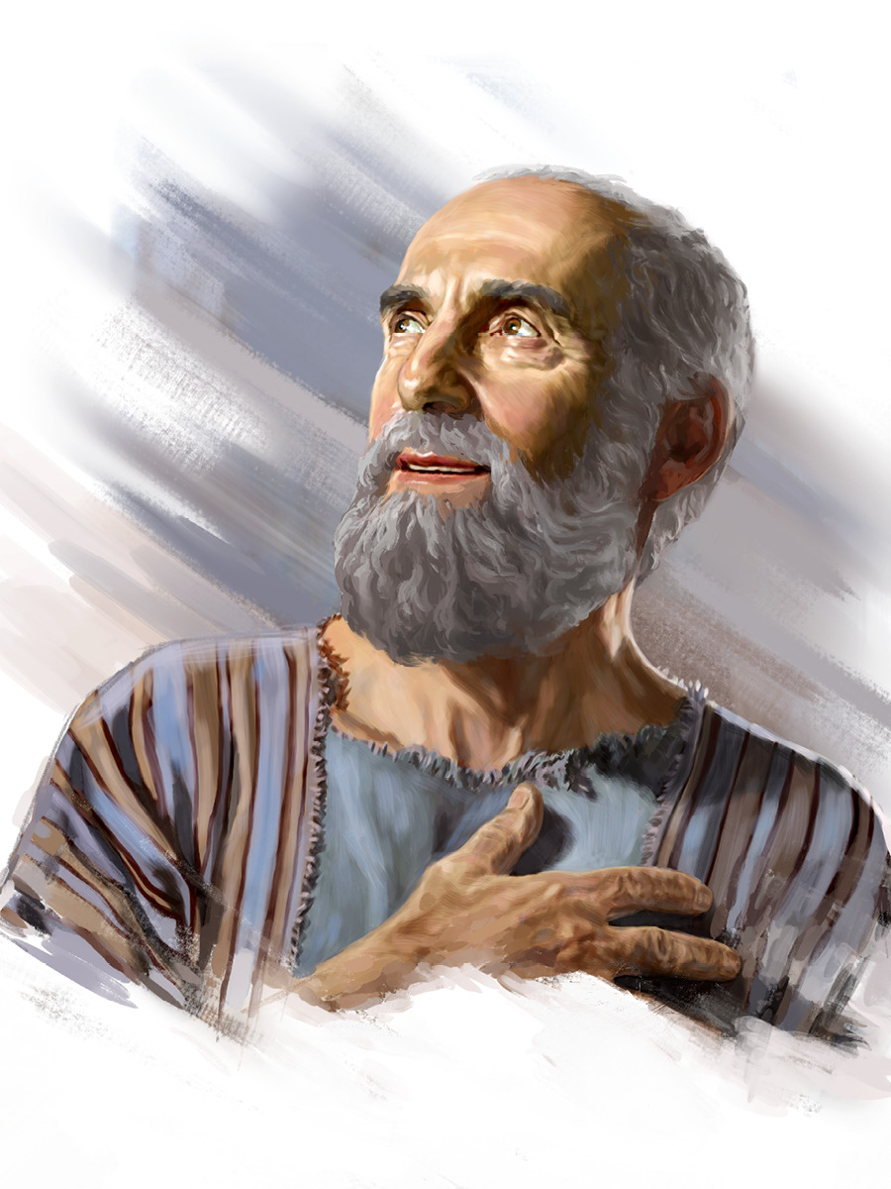
Apostle Paul Agrees…
1 Cor. 3:13-17 “Every man's work shall be made manifest: for the day shall declare it, because it shall be revealed by fire; and the fire shall try every man's work of what sort it is. If any man's work abide which he hath built thereupon, he shall receive a reward. If any man's work shall be burned, he shall suffer loss: but he himself shall be saved; yet so as by fire. Know ye not that ye are the temple of God, and that the Spirit of God dwelleth in you? If any man defile the temple of God, him shall God destroy; for the temple of God is holy, which temple ye are.”

Slide 6
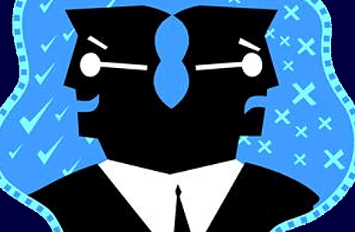

The Flesh VS the Spirit
Rom. 8:5-11 “For they that are after the flesh do mind the things of the flesh; but they that are after the Spirit the things of the Spirit. For to be carnally minded is death; but to be spiritually minded is life and peace. Because the carnal mind is enmity against God: for it is not subject to the law of God, neither indeed can be. So then they that are in the flesh cannot please God. But ye are not in the flesh, but in the Spirit, if so be that the Spirit of God dwell in you. Now if any man have not the Spirit of Christ, he is none of his. And if Christ be in you, the body is dead because of sin; but the Spirit is life because of righteousness. But if the Spirit of him that raised up Jesus from the dead dwell in you, he that raised up Christ from the dead shall also quicken your mortal bodies by his Spirit that dwelleth in you.”

Slide 7
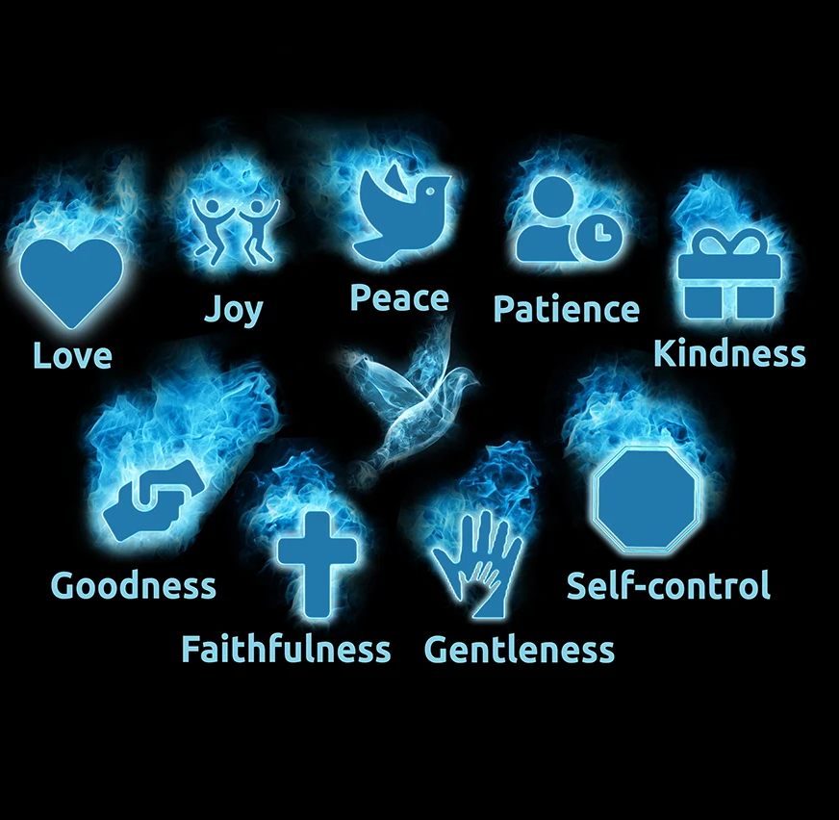
Fruits of the Spirit
Galatians 5:22-25 “But the fruit of the Spirit is love, joy, peace, longsuffering, gentleness, goodness, faith, Meekness, temperance: against such there is no law. And they that are Christ's have crucified the flesh with the affections and lusts. If we live in the Spirit, let us also walk in the Spirit.”
Eph. 5:9 “For the fruit of the Spirit is in all goodness and righteousness and truth”

Slide 8
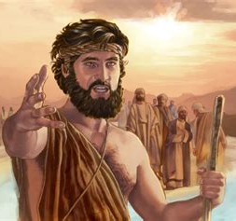
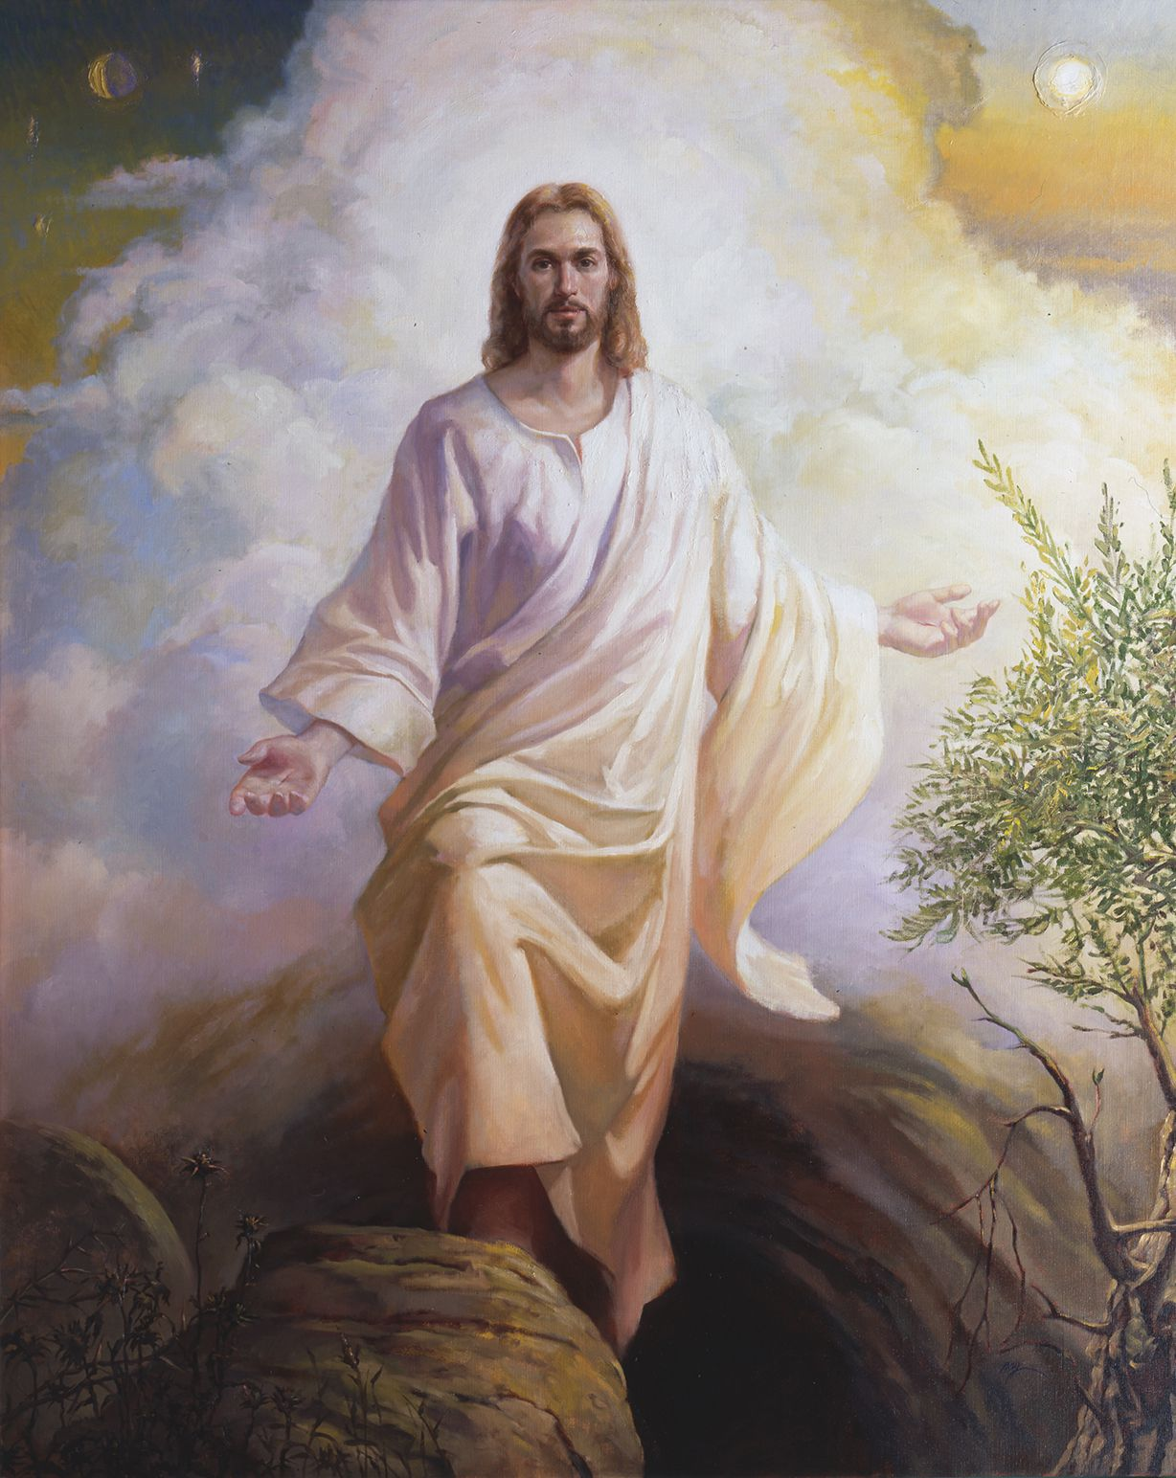
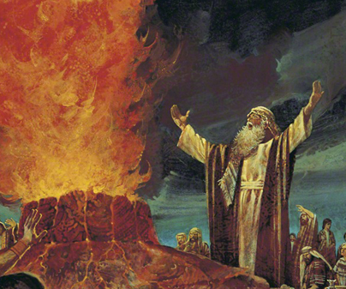
What is the True Church According to SOP?
“The church is God's fortress, His city of refuge, which He holds in a revolted world. Any betrayal of the church is treachery to Him who has bought mankind with the blood of His only-begotten Son. From the beginning, faithful souls have constituted the church on earth. In every age the Lord has had His watchmen, who have borne a faithful testimony to the generation in which they lived. These sentinels gave the message of warning; and when they were called to lay off their armor, others took up the work. God brought these witnesses into covenant relation with Himself, uniting the church on earth with the church in heaven. He has sent forth His angels to minister to His church, and the gates of hell have not been able to prevail against His people.” Acts of the Apostles, p. 11

Slide 9
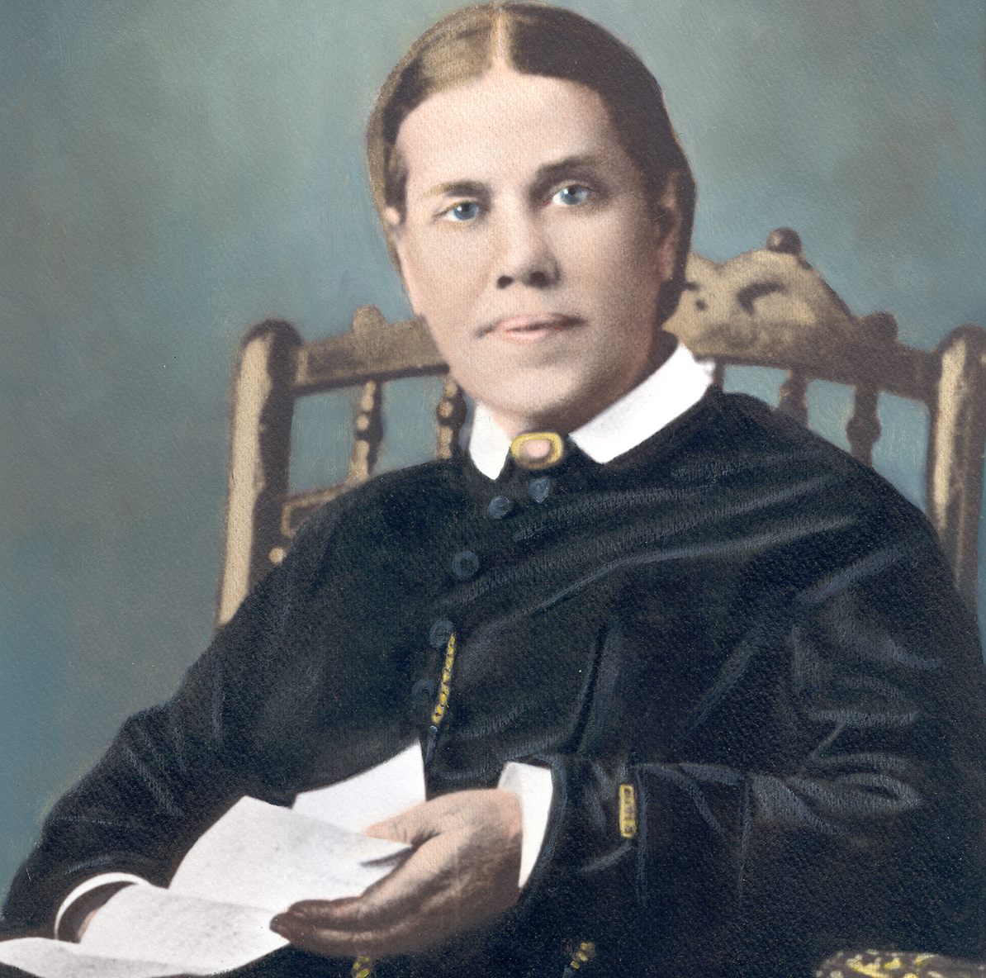
Who’s the Church? Who’s Doing the Work?
“God has a church on earth who are lifting up the downtrodden law, and presenting to the world the Lamb of God that taketh away the sins of the world.” TM, p. 50
“God is leading out a people. He has a chosen people, a church on the earth, whom He has made the depositories of His law. He has committed to them sacred trust and eternal truth to be given to the world.” 2 SM, p. 66

Slide 10
How Do We Make Sense of it All?
“The Lord does not set limits about His workers in some lines as men are wont to set. In their work, Brethren Megan and Sutherland have been hindered unnecessarily. Means have been withheld from them because in the organization and management of the Madison school, it was not placed under the control of the Conference. But the reasons why this school was not owned and controlled by the Conference has not been duly considered . . . The Lord does not require that the educational work at Madison shall be changed all about before it can receive hearty support of our people. The work that has been done there is approved of God, and He forbids that this line of work shall be broken up. The Lord will continue to bless and sustain the workers so long as they follow His counsel.”—EGW, June 18, 1907; Series B, No. 11, p. 32.
“God has a church upon the earth who are His chosen people, who keep His commandments. He is leading, not stray offshoots, not one here and one there, but a people. The truth is a sanctifying power; but the church militant is not the church triumphant. There are tares among the wheat.” TM, p. 61

Slide 11

2. The Shaking…
“I asked the meaning of the shaking I had seen and was shown that it would be caused by the straight testimony called forth by the counsel of the True Witness to the Laodiceans. This will have its effect upon the heart of the receiver, and will lead him to exalt the standard and pour forth the straight truth. Some will not bear this straight testimony. They will rise up against it, and this is what will cause a shaking among God's people. I saw that the testimony of the True Witness has not been half heeded. The solemn testimony upon which the destiny of the church hangs has been lightly esteemed, if not entirely disregarded. This testimony must work deep repentance; all who truly receive it will obey it and be purified.” EW, p. 270

Slide 12

Who Leaves?
“In the absence of the persecution there have drifted into our ranks men who appear sound and their Christianity unquestionable, but who, if persecution should arise, would go out from us. In the crisis they would see force in specious reasons that have had an influence on their minds. Satan has prepared various snares to meet varied minds. When the law of God is made void, the church will be sifted by fiery trials, and a larger proportion than we now anticipate will give heed to seducing spirits and doctrines of devils. Instead of being strengthened when brought into strait places, many prove that they are not living branches of the true Vine, they bear no fruit, and the husbandman taketh them away” Letter 3, 1890

Slide 13

“Oh, what a day is before us! What sifting will there be among those who claim to be the children of God! The unjust will be found among the just. Those who have great light and who have not walked in it will have darkness corresponding to the light they have despised . . . The enemy is diligently working to see whom he can add to the ranks of apostasy; but the Lord is soon coming, and erelong every case will be decided for eternity. Those whose works correspond with the light graciously given them will be numbered on the Lord's side. We are waiting and watching for the grand and awful scene which will close up this earth's history. But we are not simply to be waiting; we are to be vigilantly working with reference to this solemn event. The living church of God will be waiting, watching, and working.” TM, 163

Slide 14

“The work which the church has failed to do in a time of peace and prosperity she will have to do in a terrible crisis under most discouraging, forbidding circumstances. The warnings that worldly conformity has silenced or withheld must be given under the fiercest opposition from enemies of the faith. And at that time the superficial, conservative class, whose influence has steadily retarded the progress of the work, will renounce the faith.”--5T 463; see also LDE, Ch. 12, The Shaking, p. 174

Slide 15

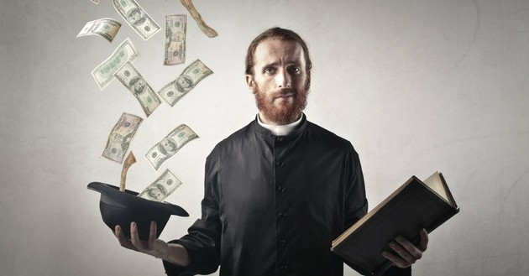
“The time is not far distant when the test will come to every soul. The observance of the false sabbath will be urged upon us. The contest will be between the commandments of God and the commandments of men. Those who have yielded step by step to worldly demands and conformed to worldly customs will then yield to the powers that be, rather than subject themselves to derision, insult, threatened imprisonment, and death. At that time the gold will be separated from the dross. True godliness will be clearly distinguished from the appearance and tinsel of it. Many a star that we have admired for its brilliance will then go out in darkness. Those who have assumed the ornaments of the sanctuary, but are not clothed with Christ's righteousness, will then appear in the shame of their own nakedness” PK, 188

Slide 16
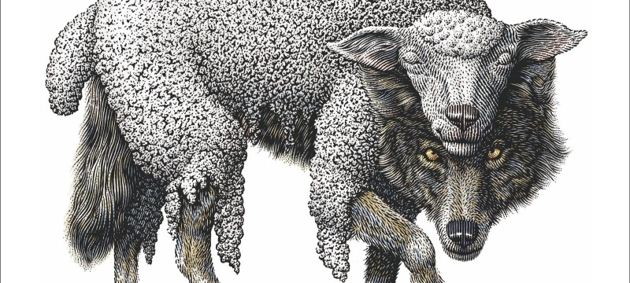
“As the storm approaches, a large class who have professed faith in the third angel's message, but have not been sanctified through obedience to the truth, abandon their position and join the ranks of the opposition. By uniting with the world and partaking of its spirit, they have come to view matters in nearly the same light; and when the test is brought, they are prepared to choose the easy, popular side. Men of talent and pleasing address, who once rejoiced in the truth, employ their powers to deceive and mislead souls. They become the most bitter enemies of their former brethren. When Sabbathkeepers are brought before the courts to answer for their faith, these apostates are the most efficient agents of Satan to misrepresent and accuse them, and by false reports and insinuations to stir up the rulers against them.” GC, p. 608

Slide 17
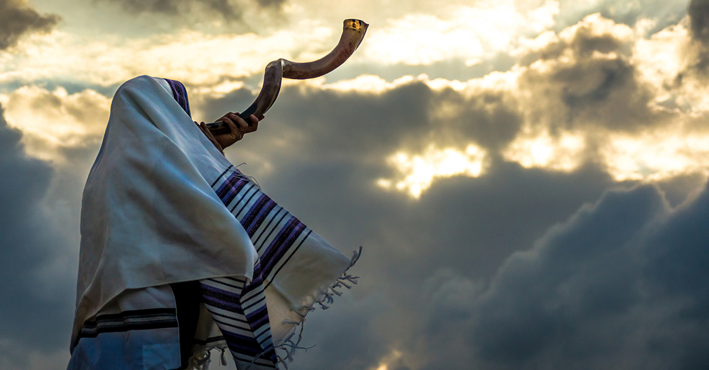
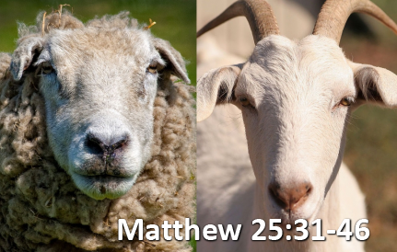
Our Job…
Is. 58:1 “Cry aloud, spare not, lift up thy voice like a trumpet, and shew my people their transgression, and the house of Jacob their sins.”
Ez. 9:4-5 “And the Lord said unto him, Go through the midst of the city, through the midst of Jerusalem, and set a mark upon the foreheads of the men that sigh and that cry for all the abominations that be done in the midst thereof. And to the others he said in mine hearing, Go ye after him through the city, and smite: let not your eye spare, neither have ye pity”

Slide 18
The “Reformation”
“The enemy of souls has sought to bring in the supposition that a great reformation was to take place among Seventh-day Adventists, and that this reformation would consist in giving up the doctrines which stand as the pillars of our faith, and engaging in a process of reorganization. Were this reformation to take place, what would result? The principles of truth that God in His wisdom has given to the remnant church, would be discarded. Our religion would be changed. The fundamental principles that have sustained the work for the last fifty years would be accounted as error. A new organization would be established. Books of a new order would be written. A system of intellectual philosophy would be introduced. The founders of this system would go into the cities, and do a wonderful work. The Sabbath of course, would be lightly regarded, as also the God who created it. Nothing would be allowed to stand in the way of the new movement. The leaders would teach that virtue is better than vice, but God being removed, they would place their dependence on human power, which, without God, is worthless. Their foundation would be built on the sand, and storm and tempest would sweep away the structure. Who has authority to begin such a movement? We have our Bibles. We have our experience, attested to by the miraculous working of the Holy Spirit. We have a truth that admits of no compromise. Shall we not repudiate everything that is not in harmony with this truth?” 1 SM, 204-205

Slide 19
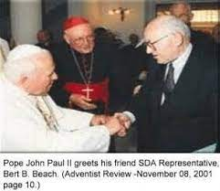
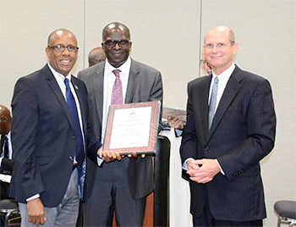
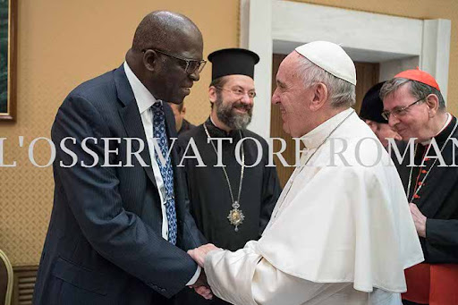
3.Warned to Leave “Nominal” Adventist Churches
“I saw that God has honest children among the nominal Adventists and the fallen churches, and before the plagues shall be poured out, ministers and people will be called out from these churches and will gladly receive the truth. Satan knows this; and before the loud cry of the third angel is given, he raises an excitement in these religious bodies, that those who have rejected the truth may think that God is with them. He hopes to deceive the honest and lead them to think that God is still working for the churches. But the light will shine, and all who are honest will leave the fallen churches, and take their stand with the remnant.” EW, 261

Slide 20

What Can We Do to Make Sure We Are Not Shaken Out?
“Christians should be preparing for what is soon to break upon the world as an overwhelming surprise, and this preparation they should make by diligently studying the Word of God and striving to conform their lives to its precepts.” Maranatha, p. 68
“The greatest want of the world is the want of men,—men who will not be bought or sold; men who in their inmost souls are true and honest; men who do not fear to call sin by its right name; men whose conscience is as true to duty as the needle to the pole; men who will stand for the right though the heavens fall. But such a character is not the result of accident; it is not due to special favors or endowments of Providence. A noble character is the result of self-discipline, of the subjection of the lower to the higher nature--the surrender of self for the service of love to God and man.” Education, p. 57.

Slide 21
Who Will Make It?
“I saw some, with strong faith and agonizing cries, pleading with God. Their countenances were pale and marked with deep anxiety, expressive of their internal struggle. Firmness and great earnestness was expressed in their countenances; large drops of perspiration fell from their foreheads. Now and then their faces would light up with the marks of God’s approbation, and again the same solemn, earnest, anxious look would settle upon them. Evil angels crowded around, pressing darkness upon them to shut out Jesus from their view, that their eyes might be drawn to the darkness that surrounded them, and thus they be led to distrust God and murmur against Him. Their only safety was in keeping their eyes directed upward. Angels of God had charge over His people, and as the poisonous atmosphere of evil angels was pressed around these anxious ones, the heavenly angels were continually wafting their wings over them to scatter the thick darkness. As the praying ones continued their earnest cries, at times a ray of light from Jesus came to them, to encourage their hearts and light up their countenances. Some, I saw, did not participate in this work of agonizing and pleading. They seemed indifferent and careless. They were not resisting the darkness around them, and it shut them in like a thick cloud. The angels of God left these and went to the aid of the earnest, praying ones. I saw angels of God hasten to the assistance of all who were struggling with all their power to resist the evil angels and trying to help themselves by calling upon God with perseverance. But His angels left those who made no effort to help themselves, and I lost sight of them.” EW, 269-270

