Slide 1
Jesus Vs. Jan Paulien, pt. 27

Slide 2
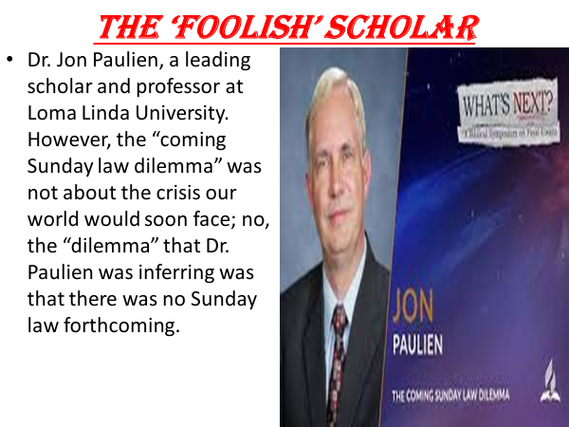

Slide 3
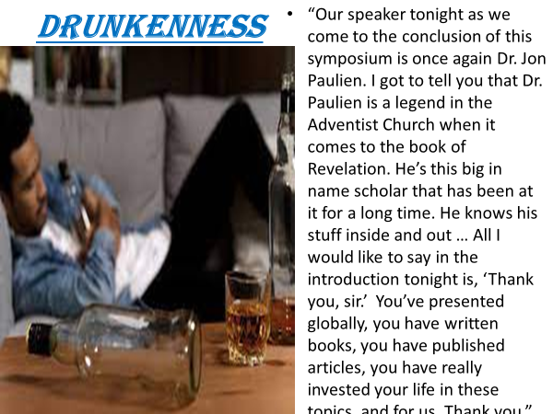

Slide 4
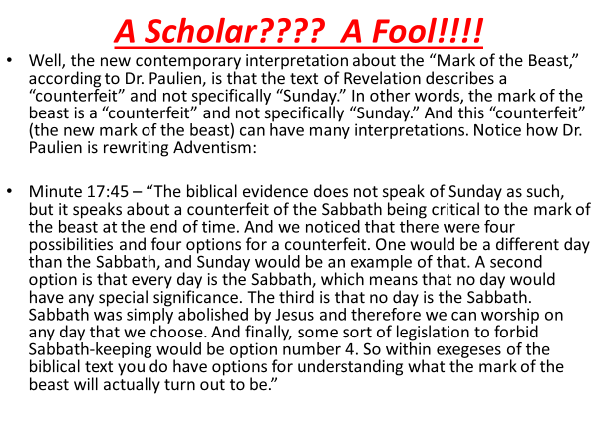

Slide 5

Pile of Garbage!!
Options as to what the mark of the beast is?
The Sabbath is abolished and thus, it will not be part of end time events!!
Friends, it is dangerous to listen to a scholar! Beware of intelligent people who do not know what they are talking about!!
Ellen White would see things different today if she were alive now! Scary stuff!

Slide 6
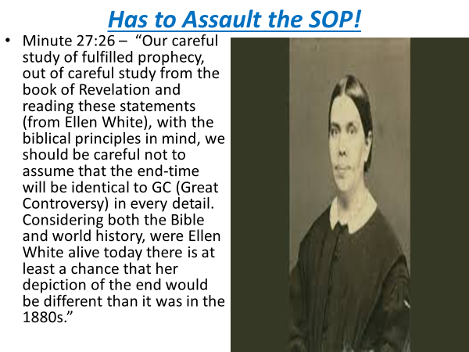

Slide 7
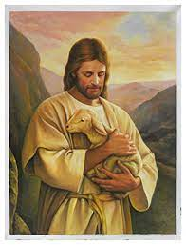
Paulien is WRONG!
Revelation, Ellen White, and Jesus Himself totally disagree with Jan Paulien. The 3 sources of Inspiration all taught there would be a Sunday Law and they all totally disagree with Jan Paulien. This guy has not studied Revelation, Ellen White or Jesus at all or he wouldn’t make such foolish statements as that!!!

Slide 8
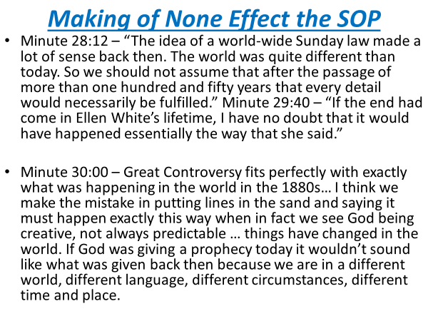

Slide 9
End time’s Big Issue!
Rev. 13:12,15 “And he exerciseth all the power of the first beast before him, and causeth the earth and them which dwell therein to worship the first beast, whose deadly wound was healed…. And he had power to give life unto the image of the beast, that the image of the beast should both speak, and cause that as many as would not worship the image of the beast should be killed.”
Rev. 14:7,9 “Saying with a loud voice, Fear God, and give glory to him; for the hour of his judgment is come: and worship him that made heaven, and earth, and the sea, and the fountains of waters…. And the third angel followed them, saying with a loud voice, If any man worship the beast and his image, and receive his mark in his forehead, or in his hand,…”

Slide 10

The Final Issue is over WORSHIP
A look through the Old Testament, especially in Daniel 3, where the word worship is used more than any other place in Scripture, it is crystal clear that true worship involves obedience to God’s 10 commandments through faith in Jesus Christ and false worship is honoring man made traditions in direct opposition to the 10 commandments! Jesus says the identical thing in Matthew 15:2-9!

Slide 11
Jesus Already Told Us!
“Then came to Jesus scribes and Pharisees, which were of Jerusalem, saying, Why do thy disciples transgress the tradition of the elders? for they wash not their hands when they eat bread. But he answered and said unto them, Why do ye also transgress the commandment of God by your tradition? For God commanded, saying, Honour thy father and mother: and, He that curseth father or mother, let him die the death. But ye say, Whosoever shall say to his father or his mother, It is a gift, by whatsoever thou mightest be profited by me; And honour not his father or his mother, he shall be free. Thus have ye made the commandment of God of none effect by your tradition. Ye hypocrites, well did Esaias prophesy of you, saying, This people draweth nigh unto me with their mouth, and honoureth me with their lips; but their heart is far from me. But in vain they do worship me, teaching for doctrines the commandments of men.” Matthew 15:9

Slide 12
Traditions VS. 10 Commandments
“They set aside the fifth commandment as of no consequence, but were very exact in carrying out the traditions of the elders. They taught the people that the devotion of their property to the temple was a duty more sacred than even the support of their parents; and that, however great the necessity, it was sacrilege to impart to father or mother any part of what had been thus consecrated. An undutiful child had only to pronounce the word “Corban” over his property, thus devoting it to God, and he could retain it for his own use during his lifetime, and after his death it was to be appropriated to the temple service. Thus he was at liberty, both in life and in death, to dishonor and defraud his parents, under cover of a pretended devotion to God.” DA, pg. 396

Slide 13
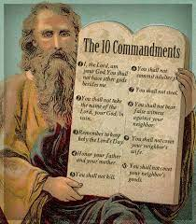
Thus, Jan Paulien, the great issue in Revelation 13 and 14, is over the commandments of God versus the traditions of men. Since, the first beast, the papacy is the one espousing false worship; then the papacy is exalting a tradition that originates with them and is directly contrary to the 10 commandments. Has the papacy adopted a tradition that is directly contrary to the 10 commandments? Clearly she has.

Slide 14
Well?
“The observance of Sunday by the Protestants is an homage they pay, in spite of themselves, to the authority of the [Catholic] church.” — Monsignor Louis Segur, Plain Talk About the Protestantism of Today (1868), p. 213.
“If Protestants would follow the Bible, they should worship God on the Sabbath Day [Saturday]. In keeping the Sunday they are following a law of the Catholic church.” — Albert Smith, Chancellor of the Archdiocese of Baltimore, replying for the Cardinal in a letter of February 10, 1920.

Slide 15
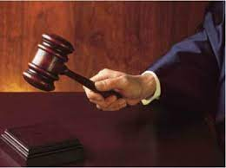
Done Deal
“The dignitaries of church and state will unite to bribe, persuade, or compel all classes to honor the Sunday. The lack of divine authority will be supplied by oppressive enactments. Political corruption is destroying love of justice and regard for truth; and even in free America, rulers and legislators, in order to secure public favor, will yield to the popular demand for a law enforcing Sunday observance. Liberty of conscience, which has cost so great a sacrifice, will no longer be respected. In the soon-coming conflict we shall see exemplified the prophet's words: “The dragon was wroth with the woman, and went to make war with the remnant of her seed, which keep the commandments of God, and have the testimony of Jesus Christ.” Revelation 12:17. GC, pg. 592

Slide 16
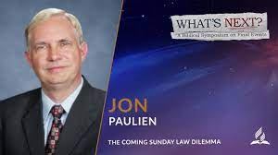
No Dilemma at All, except…
Jesus said it in Matthew 15!
Revelation foretold it 20 centuries ago!
Ellen White confirmed what was already in the Bible!
A dilemma you say!! Only for a pretender! Only for someone masquerading as a Seventh Day Adventist!! For an honest hearted Christian who accepts the Bible, there is no dilemma at all!
The court sets!!

