Slide 1
Revelation, chapter 4
‘Visions of the Sky Sanctuary’

Slide 2
Activity in the Heavens
“After this I looked, and, behold, a door was opened in heaven: and the first voice which I heard was as it were of a trumpet talking with me; which said, Come up hither, and I will shew thee things which must be hereafter. And immediately I was in the spirit: and, behold, a throne was set in heaven, and one sat on the throne. And he that sat was to look upon like a jasper and a sardine stone: and there was a rainbow round about the throne, in sight like unto an emerald.” Revelation 4:1-3

Slide 3
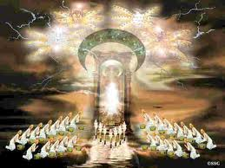
Seated on the Throne
“And the four beasts had each of them six wings about him; and they were full of eyes within: and they rest not day and night, saying, Holy, holy, holy, Lord God Almighty, which was, and is, and is to come.” Rev. 4:8 The Father is seated on the throne. (Rev. 1:8)

Slide 4
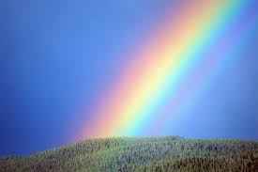
Rainbow
“The revelator declares, “Behold, a throne was set in heaven, and one sat on the throne.... There was a rainbow round about the throne, in sight like unto an emerald.” Revelation 4:2, 3. When man by his great wickedness invites the divine judgments, the Saviour, interceding with the Father in his behalf, points to the bow in the clouds, to the rainbow around the throne and above His own head, as a token of the mercy of God toward the repentant sinner.” PP, pg. 107

Slide 5
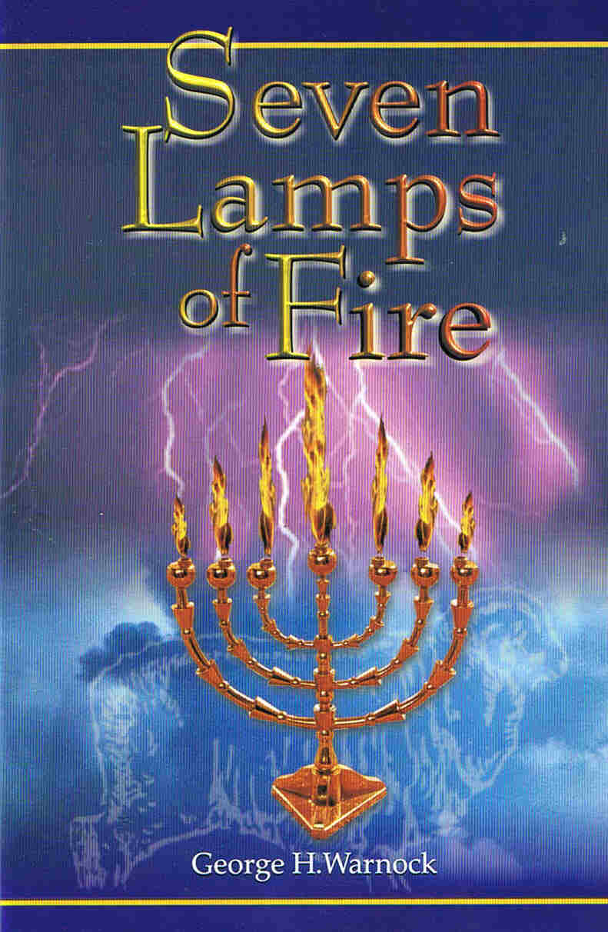
7 Lamps of Fire
“And out of the throne proceeded lightnings and thunderings and voices: and there were seven lamps of fire burning before the throne, which are the seven Spirits of God.” Rev. 4:5

Slide 6
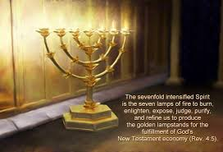
Sky Sanctuary
“The holy places of the sanctuary in heaven are represented by the two apartments in the sanctuary on earth. As in vision the apostle John was granted a view of the temple of God in heaven, he beheld there "seven lamps of fire burning before the throne." Revelation 4:5. He saw an angel "having a golden censer; and there was given unto him much incense, that he should offer it with the prayers of all saints upon the golden altar which was before the throne." Revelation 8:3. Here the prophet was permitted to behold the first apartment.” GC, pg. 414

Slide 7
The Spirit’s Power
“From the two olive trees the golden oil was emptied through the golden pipes into the bowl of the candlestick, and thence into the golden lamps that gave light to the sanctuary. So from the holy ones that stand in God’s presence His Spirit is imparted to the human instrumentalities who are consecrated to His service.” COL, pg. 408

Slide 8
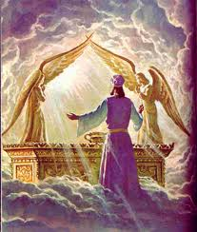
And………..the Son
“And I beheld, and, lo, in the midst of the throne and of the four beasts, and in the midst of the elders, stood a Lamb as it had been slain, having seven horns and seven eyes, which are the seven Spirits of God sent forth into all the earth.” Rev. 5:6

Slide 9
Who Else?
“And round about the throne were four and twenty seats: and upon the seats I saw four and twenty elders sitting, clothed in white raiment; and they had on their heads crowns of gold.” Rev. 4:4
These 24 elders are wearing white raiment and crowns of gold.
White raiment is the righteousness of Christ that is given to enable a human being to help them overcome. (Rev. 3:5, 19:7,8)
Crowns of gold are given to the victor. ( James 1:12, 2 Tim. 4:8, 1 Cor. 9:25)

Slide 10
The SOP!
According to the Spirit of Prophecy, the 24 elders are powerful angels to whom God as delegated the responsibility of being representatives of the worlds that never sinned. Notice the following statements: “This roll was written within and without. John says: "I wept much, because no man was found worthy to open and to read the book, neither to look thereon" [verse 4]. The vision as presented to John made its impression upon his mind. The destiny of every nation was contained in that book. John was distressed at the utter inability of any human being or angelic intelligence to read the words, or even to look thereon. His soul was wrought up to such a point of agony and suspense that one of the strong angels had compassion on him, and laying his hand on him assuringly, said, "Weep not: behold, the Lion of the tribe of Judah, the Root of David, hath prevailed to open the book, and to loose the seven seals thereof" [verse 5].” Manuscript Releases, volume 12, pp. 296, 297
In its original Biblical context the words of verse 5 are spoken by one of the twenty-four elders but
Ellen White identifies the elder as ‘one of the strong angels.’

Slide 11
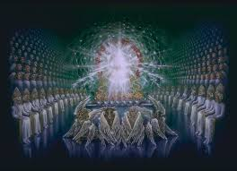
Strange?????
“And before the throne there was a sea of glass like unto crystal: and in the midst of the throne, and round about the throne, were four beasts full of eyes before and behind. And the first beast was like a lion, and the second beast like a calf, and the third beast had a face as a man, and the fourth beast was like a flying eagle. And the four beasts had each of them six wings about him; and they were full of eyes within: and they rest not day and night, saying, Holy, holy, holy, Lord God Almighty, which was, and is, and is to come.” Rev. 4:6-8

Slide 12
Beasts Around God’s Throne?
A beast in Bible prophecy is a……………world power/nation. What are world powers/nations doing around God’s throne? Very poor translation! The Greek word is zone which means a living creature. The Greek word in Rev. 13 for beast is therion. These four living creatures are identical to the living creatures Ezekiel saw in Ezekiel 1: 5-10 and 10:15. Ezekiel declared that the living creatures ‘And the cherubims were lifted up. This is the living creature that I saw by the river of Chebar.’ Ezekiel and John saw the cherubim that are near to God’s throne.

Slide 13
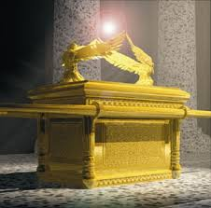
“Also out of the midst thereof came the likeness of four living creatures. And this was their appearance; they had the likeness of a man. And every one had four faces, and every one had four wings. And their feet were straight feet; and the sole of their feet was like the sole of a calf's foot: and they sparkled like the colour of burnished brass.” Eze. 1:5-7
“And the cherubim's were lifted up. This is the living creature that I saw by the river of Chebar.” Eze. 10:15

Slide 14
John and Isaiah Saw this Too
…In the visions given to Isaiah, to Ezekiel, and to John we see how closely heaven is connected with the events taking place upon the earth and how great is the care of God for those who are loyal to Him…The program of coming events is in the hands of the Lord. The Majesty of heaven has the destiny of nations, as well as the concerns of His church, in His own charge. We permit ourselves to feel altogether too much care, trouble, and perplexity in the Lord's work. Finite men are not left to carry the burden of responsibility. ..The tireless vigilance of the heavenly messengers, and their unceasing employment in their ministry in connection with the beings of earth, show us how God's hand is guiding the wheel within a wheel. The divine Instructor is saying to every actor in His work, as He said to Cyrus of old: "I girded thee, though thou hast not known Me." In Ezekiel's vision God had His hand beneath the wings of the cherubim. This is to teach His servants that it is divine power that gives them success. He will work with them if they will put away iniquity and become pure in heart and life.” 5 Testimonies 753, 754

Slide 15
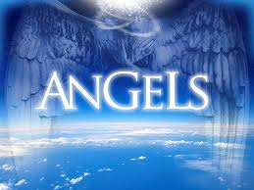
One More Group
“And I beheld, and I heard the voice of many angels round about the throne and the beasts and the elders: and the number of them was ten thousand times ten thousand, and thousands of thousands;” Rev. 5:11

Slide 16
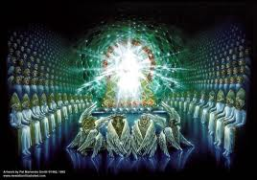
Summary So Far
John looks into the very nerve center of the universe. He beholds:
1. The Father on the throne.
2. The Son in the midst of the throne.
3. The Holy Spirit near the throne.
4. Strong angels seated near the throne.
5. Cherubim around the throne.
6. Myriads of angels looking on.

Slide 17
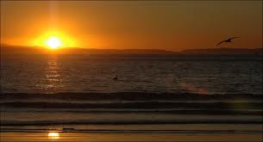
Creator
“And when those beasts give glory and honour and thanks to him that sat on the throne, who liveth for ever and ever, The four and twenty elders fall down before him that sat on the throne, and worship him that liveth for ever and ever, and cast their crowns before the throne, saying, Thou art worthy, O Lord, to receive glory and honour and power: for thou hast created all things, and for thy pleasure they are and were created.” Rev. 4:9-11

Slide 18
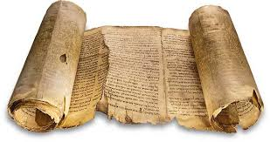
The Mysterious Book Sealed
“And I saw in the right hand of him that sat on the throne a book written within and on the backside, sealed with seven seals. And I saw a strong angel proclaiming with a loud voice, Who is worthy to open the book, and to loose the seals thereof?” Rev. 5:1,2

