Slide 1
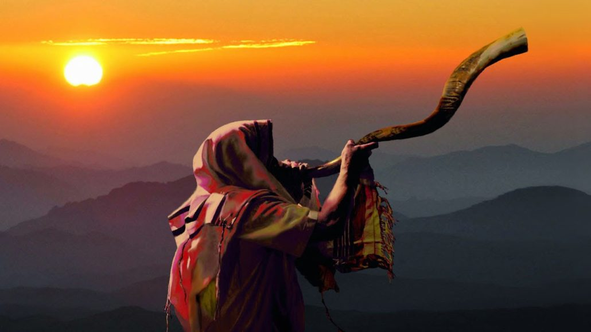
The Sanctuary pt 49: The Feast of Trumpets

Slide 2
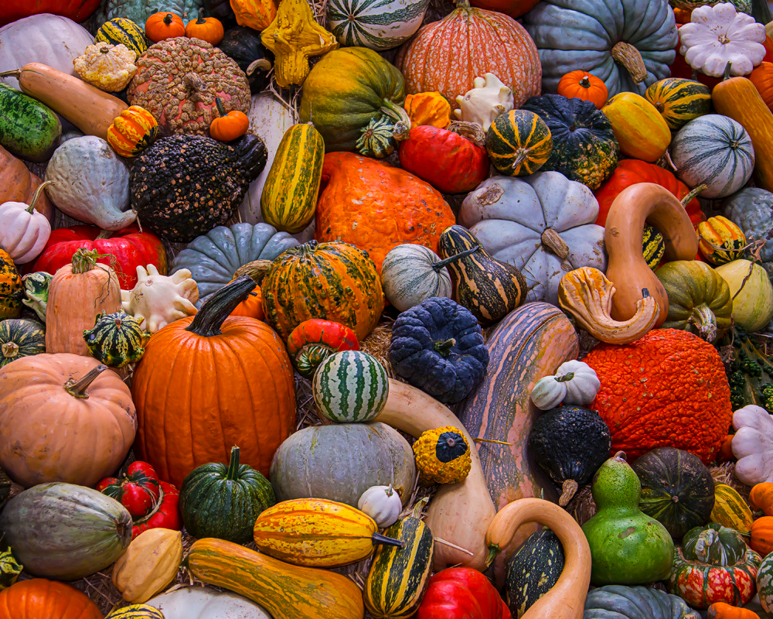
Difference Between the Spring and the Fall Feasts
Spring: The Spring Feasts in prophecy surrounded the 1st Coming of the Son of God, each element highlighted the ministry, death, burial, resurrection of Christ and the beginning of His ministration in the Sanctuary above (the “Daily”)—these feasts revolve around the literal and spiritual harvest time
Fall: The Fall Feasts in prophecy surround the 2nd Coming of the Son of God, each element highlights the ministry, Judgment, and Return of Christ and the closing of His ministration in the Sanctuary above (the “Yearly”)—these feasts revolve around the literal and spiritual harvest time

Slide 3
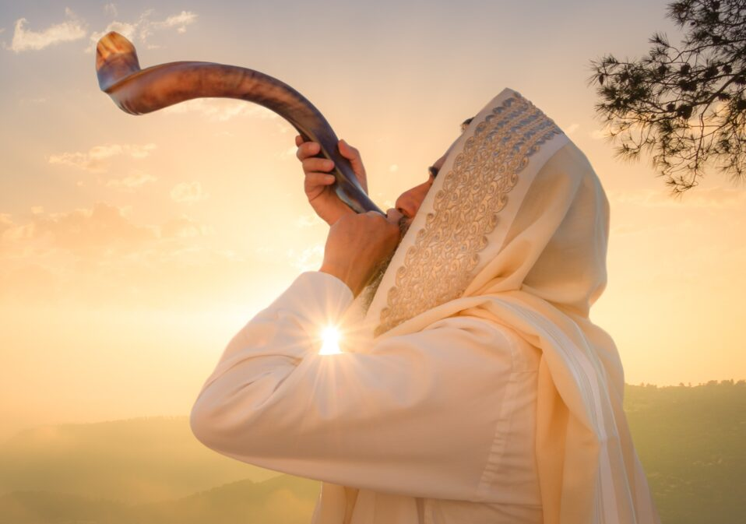
What We will Study Today:
What Happened during this feast
What it meant for ancient Israel and What it means for us today
It’s prophetic fulfillment

Slide 5
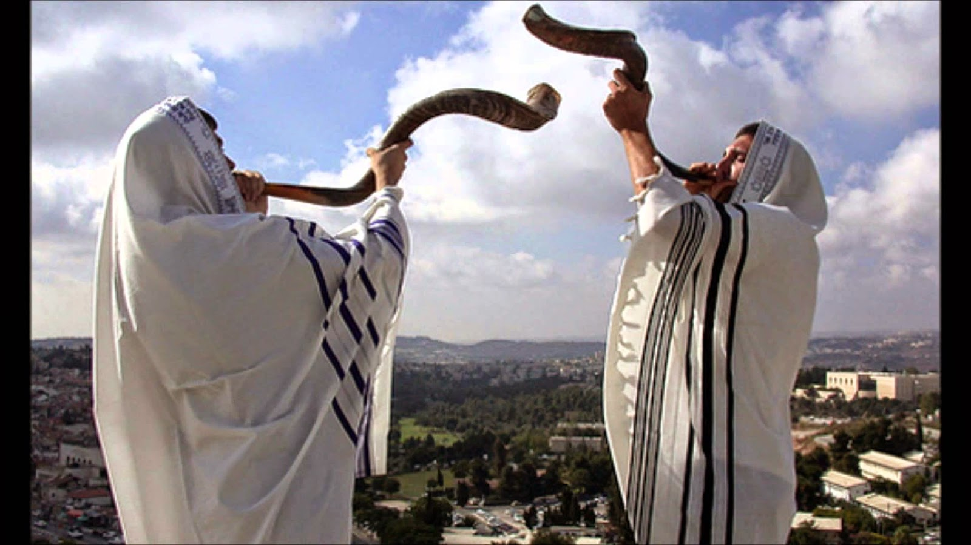
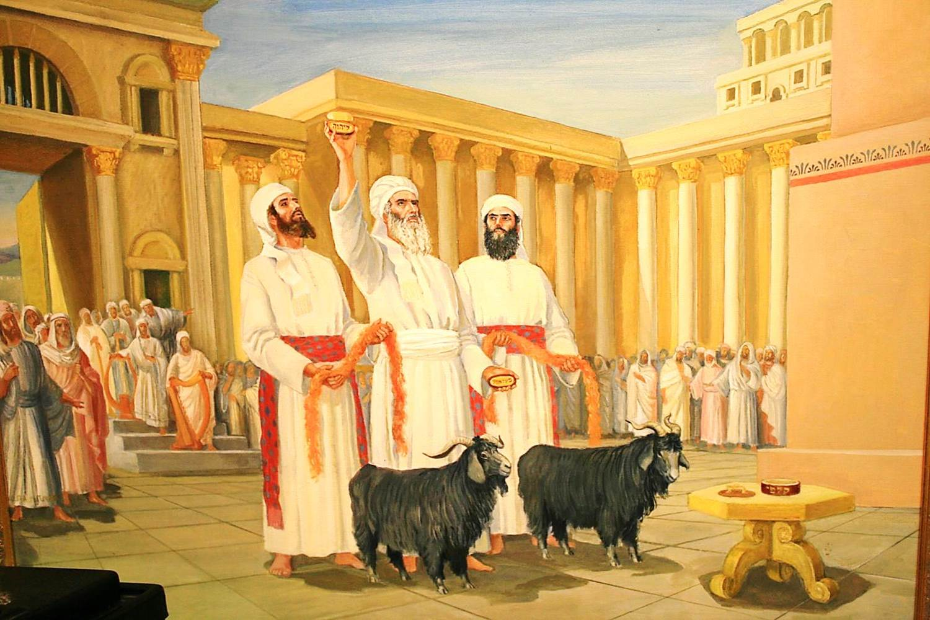
1st Mention: Leviticus 23
Lev. 23:23-27 “And the Lord spake unto Moses, saying, Speak unto the children of Israel, saying, In the seventh month, in the first day of the month, shall ye have a sabbath, a memorial of blowing of trumpets, an holy convocation. Ye shall do no servile work therein: but ye shall offer an offering made by fire unto the Lord. And the Lord spake unto Moses, saying, Also on the tenth day of this seventh month there shall be a day of atonement: it shall be an holy convocation unto you; and ye shall afflict your souls, and offer an offering made by fire unto the Lord.

Slide 6
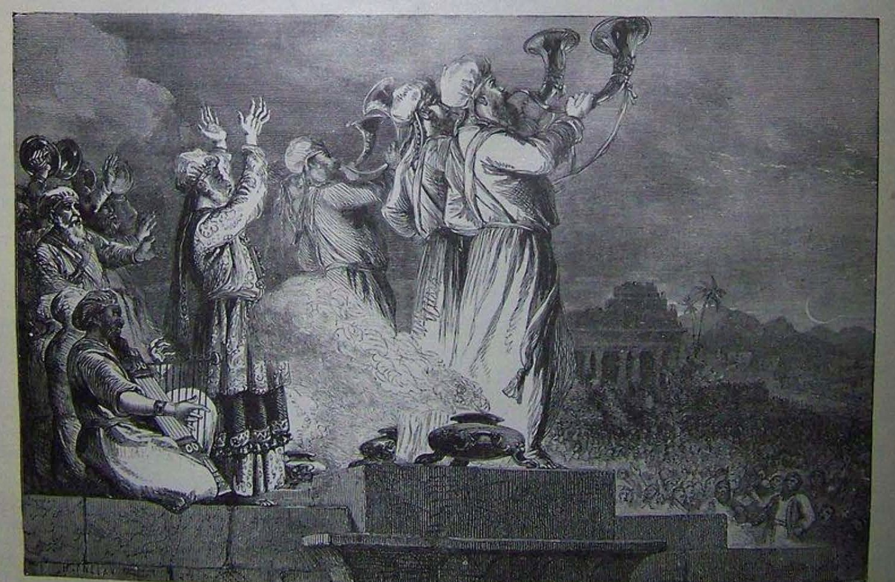
Offerings Made at ALL Feasts
Lev. 23:37-38 “These are the feasts of the Lord, which ye shall proclaim to be holy convocations, to offer an offering made by fire unto the Lord, a burnt offering, and a meat offering, a sacrifice, and drink offerings, every thing upon his day: Beside the sabbaths of the Lord, and beside your gifts, and beside all your vows, and beside all your freewill offerings, which ye give unto the Lord.”

Slide 7
The Trumpet Blast to Day of Atonement
Num. 29:1-7 “And in the seventh month, on the first day of the month, ye shall have an holy convocation; ye shall do no servile work: it is a day of blowing the trumpets unto you. And ye shall offer a burnt offering for a sweet savour unto the Lord; one young bullock, one ram, and seven lambs of the first year without blemish: And their meat offering shall be of flour mingled with oil, three tenth deals for a bullock, and two tenth deals for a ram, And one tenth deal for one lamb, throughout the seven lambs: And one kid of the goats for a sin offering, to make an atonement for you: Beside the burnt offering of the month, and his meat offering, and the daily burnt offering, and his meat offering, and their drink offerings, according unto their manner, for a sweet savour, a sacrifice made by fire unto the Lord. And ye shall have on the tenth day of this seventh month an holy convocation; and ye shall afflict your souls: ye shall not do any work therein”

Slide 8
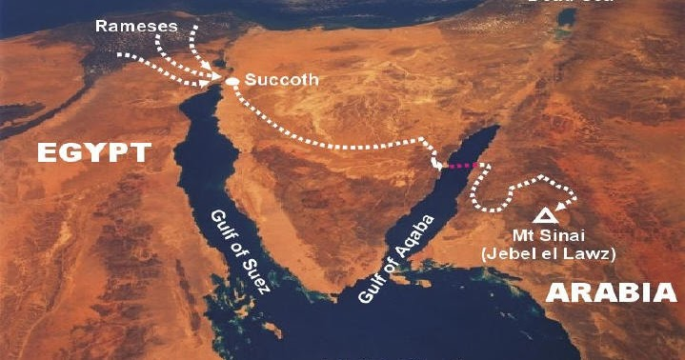
God’s Trumpet Call to Israel in Ancient Times
Ex. 19:12-14 “And thou shalt set bounds unto the people round about, saying, Take heed to yourselves, that ye go not up into the mount, or touch the border of it: whosoever toucheth the mount shall be surely put to death: There shall not an hand touch it, but he shall surely be stoned, or shot through; whether it be beast or man, it shall not live: when the trumpet soundeth long, they shall come up to the mount. And Moses went down from the mount unto the people, and sanctified the people; and they washed their clothes.”

Slide 9
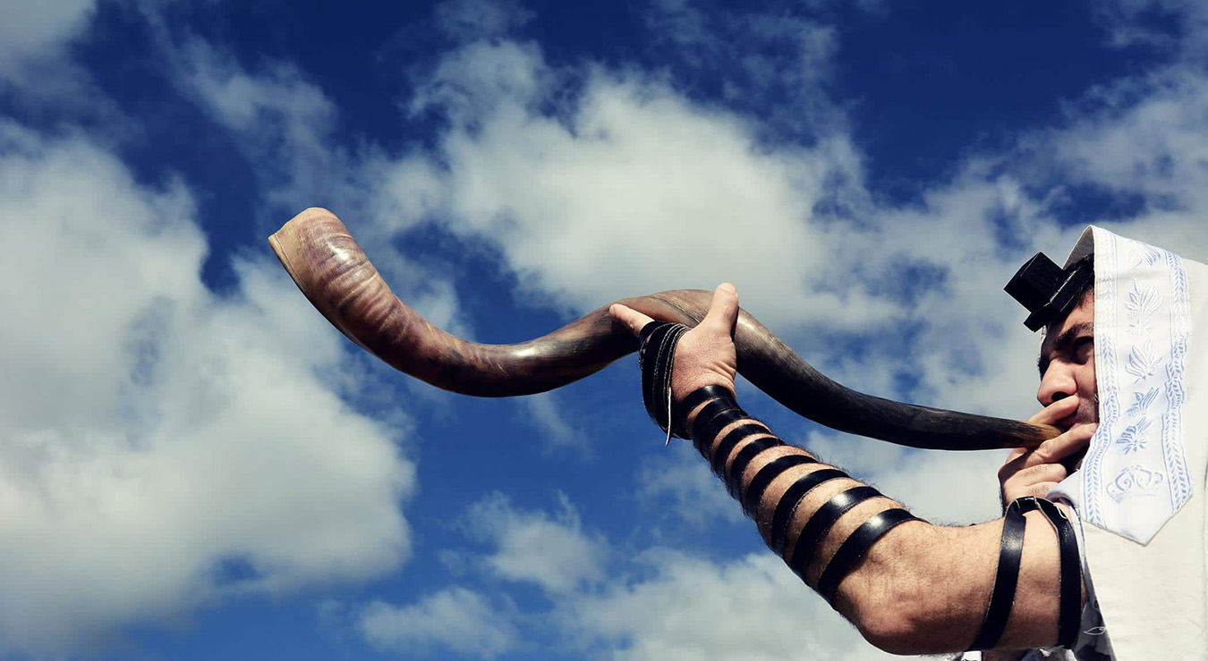
Trumpets….
“The sound of the trumpet summoned Israel to meet with God. The voice of the archangel and the trump of God shall summon, from the whole earth, both the living and the dead to the presence of their Judge.”—PP, 339

Slide 10
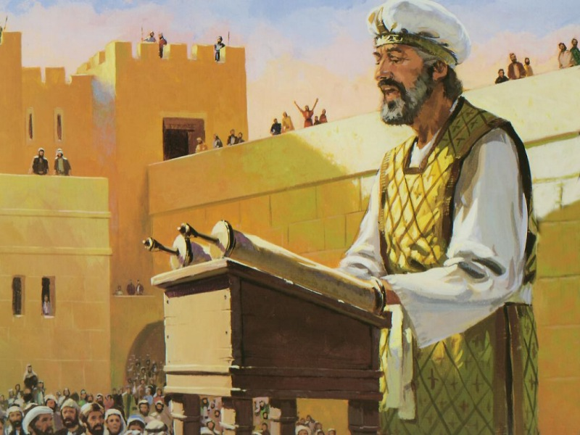
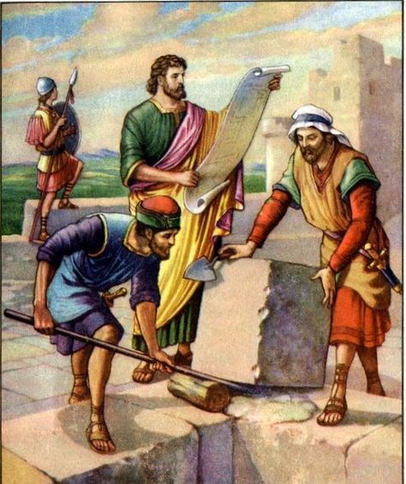
Nehemiah and Ezra Keep the Feast of Trumpets
Neh. 8:1-3 “And all the people gathered themselves together as one man into the street that was before the water gate; and they spake unto Ezra the scribe to bring the book of the law of Moses, which the Lord had commanded to Israel. And Ezra the priest brought the law before the congregation both of men and women, and all that could hear with understanding, upon the first day of the seventh month. And he read therein before the street that was before the water gate from the morning until midday, before the men and the women, and those that could understand; and the ears of all the people were attentive unto the book of the law.”

Slide 11
A Day of Mourning???
“It was the time of the Feast of Trumpets. Many were gathered at Jerusalem. The scene was one of mournful interest. The wall of Jerusalem had been rebuilt and the gates set up, but a large part of the city was still in ruins. On a platform of wood, erected in one of the broadest streets, and surrounded on every hand by the sad reminders of Judah's departed glory, stood Ezra, now an aged man. At his right and left were gathered his brother Levites. Looking down from the platform, their eyes swept over a sea of heads. From all the surrounding country the children of the covenant had assembled. "And Ezra blessed the Lord, the great God. And all the people answered, Amen: . . . and they bowed their heads, and worshiped the Lord with their faces to the ground.“ Yet even here was evidence of the sin of Israel. Through the intermarriage of the people with other nations, the Hebrew language had become corrupted, and great care was necessary on the part of the speakers to explain the law in the language of the people, that it might be understood by all. Certain of the priests and Levites united with Ezra in explaining the principles of the law. "They read in the book in the law of God distinctly, and gave the sense, and caused them to understand the reading.“—PK, p. 661-662

Slide 12
The Forgotten Law of God is the Focus!!!
"And the ears of all the people were attentive unto the book of the law." They listened, intent and reverent, to the words of the Most High. As the law was explained, they were convinced of their guilt, and they mourned because of their transgressions. But this day was a festival, a day of rejoicing, a holy convocation, a day which the Lord had commanded the people to keep with joy and gladness; and in view of this they were bidden to restrain their grief and to rejoice because of God's great mercy toward them. "This day is holy unto the Lord your God," Nehemiah said. "Mourn not, nor weep. . . . Go your way, eat the fat, and drink the sweet, and send portions unto them for whom nothing is prepared: for this day is holy unto our Lord: neither be ye sorry; for the joy of the Lord is your strength.“ The earlier part of the day was devoted to religious exercises, and the people spent the remainder of the time in gratefully recounting the blessings of God and in enjoying the bounties that He had provided. Portions were also sent to the poor, who had nothing to prepare. There was great rejoicing because the words of the law had been read and understood” PK, p. 662-663

Slide 13
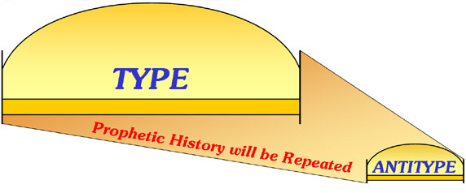
Recount of the Ancient and Personal Meanings
The Feast of Trumpets was a preliminary preparation feast for the Day of Atonement. It was a time of rejoicing for the fall harvest. It began exactly 10 days before the Day of Atonement, and it consisted of the preparatory work of final sanctification. In other words, the Law of God was read, the people were exhorted to repent for their transgressions and prepare to “meet thy God”—the Antitypical fulfillment of this feast day must/will have the same elements—a time of rejoicing, focus on repentance and Law of God, and preparation to “meet thy God”

Slide 14
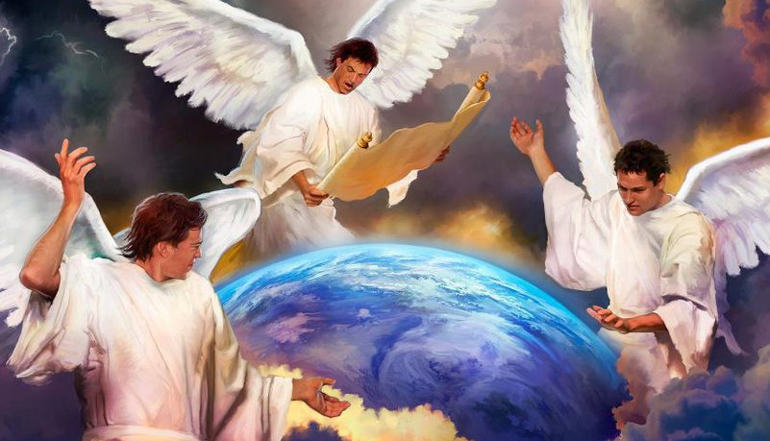
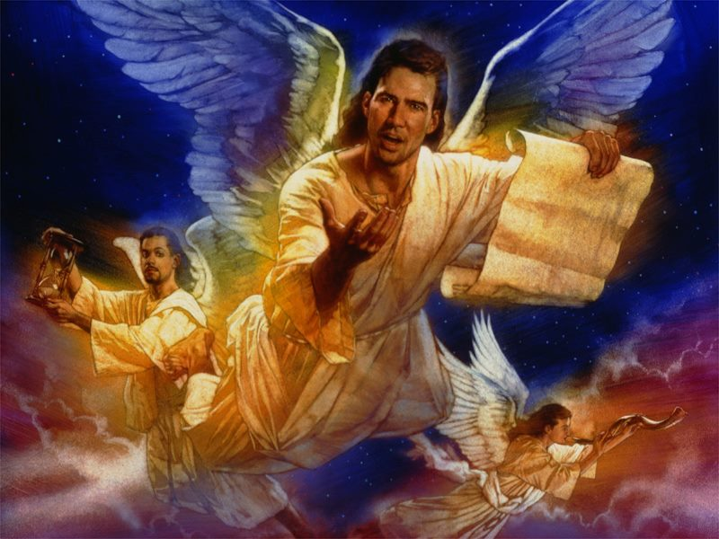
What is the Antitype of the Feast of Trumpets???
Rev. 14:6-7 “And I saw another angel fly in the midst of heaven, having the everlasting gospel to preach unto them that dwell on the earth, and to every nation, and kindred, and tongue, and people, Saying with a loud voice, Fear God, and give glory to him; for the hour of his judgment is come: and worship him that made heaven, and earth, and the sea, and the fountains of waters.”

Slide 15
The Great Controversy Explains!
“An upright, honest-hearted farmer, who had been led to doubt the divine authority of the Scriptures, yet who sincerely desired to know the truth, was the man specially chosen of God to lead out in the proclamation of Christ's second coming. Like many other reformers, William Miller had in early life battled with poverty and had thus learned the great lessons of energy and self-denial . . . Endeavoring to lay aside all preconceived opinions, and dispensing with commentaries, he compared scripture with scripture by the aid of the marginal references and the concordance. He pursued his study in a regular and methodical manner; beginning with Genesis, and reading verse by verse, he proceeded no faster than the meaning of the several passages so unfolded as to leave him free from all embarrassment. When he found anything obscure, it was his custom to compare it with every other text which seemed to have any reference to the matter under consideration. Every word was permitted to have its proper bearing upon the subject of the text, and if his view of it harmonized with every collateral passage, it ceased to be a difficulty. Thus whenever he met with a passage hard to be understood he found an explanation in some other portion of the Scriptures. As he studied with earnest prayer for divine enlightenment, that which had before appeared dark to his understanding was made clear. He experienced the truth of the psalmist's words: "The entrance of Thy words giveth light; it giveth understanding unto the simple." Psalm 119:130. With intense interest he studied the books of Daniel and the Revelation, employing the same principles of interpretation as in the other scriptures, and found, to his great joy, that the prophetic symbols could be understood. He saw that the prophecies, so far as they had been fulfilled, had been fulfilled literally; that all the various figures, metaphors, parables, similitudes, etc., were either explained in their immediate connection, or the terms in which they were expressed were defined in other scriptures, and when thus explained, were to be literally understood”—GC, p. 317, 320

Slide 16
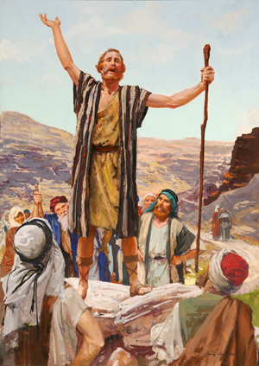
First Angel’s Message in History
“All heaven watched with the deepest interest the reception of the first angel's message. But many who professed to love Jesus, and who shed tears as they read the story of the cross, derided the good news of His coming. Instead of receiving the message with gladness, they declared it to be a delusion. They hated those who loved His appearing and shut them out of the churches. Those who rejected the first message could not be benefited by the second; neither were they benefited by the midnight cry, which was to prepare them to enter with Jesus by faith into the most holy place of the heavenly sanctuary. And by rejecting the two former messages, they have so darkened their understanding that they can see no light in the third angel's message, which shows the way into the most holy place” EW, 260-261

Slide 17
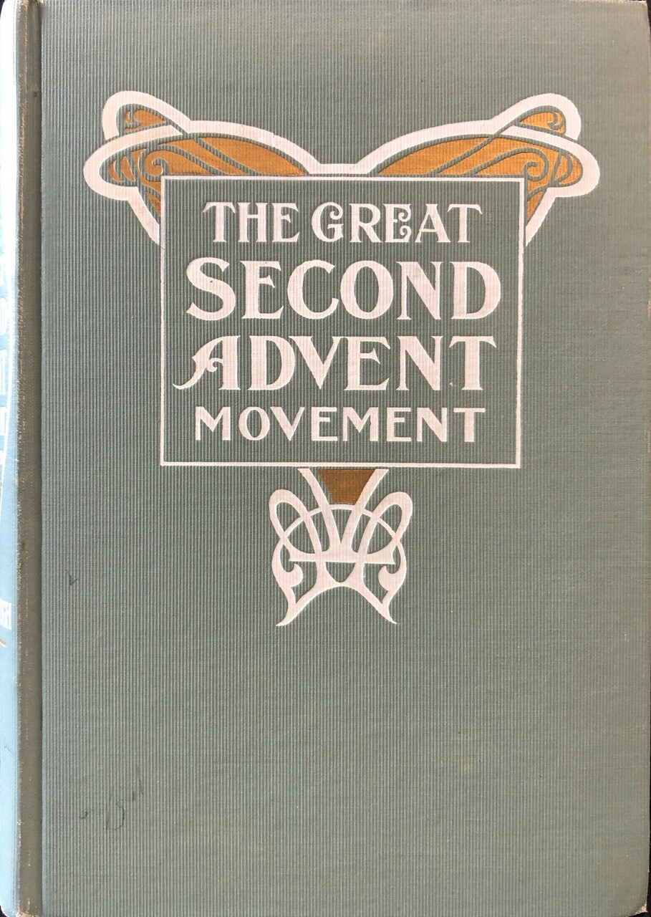
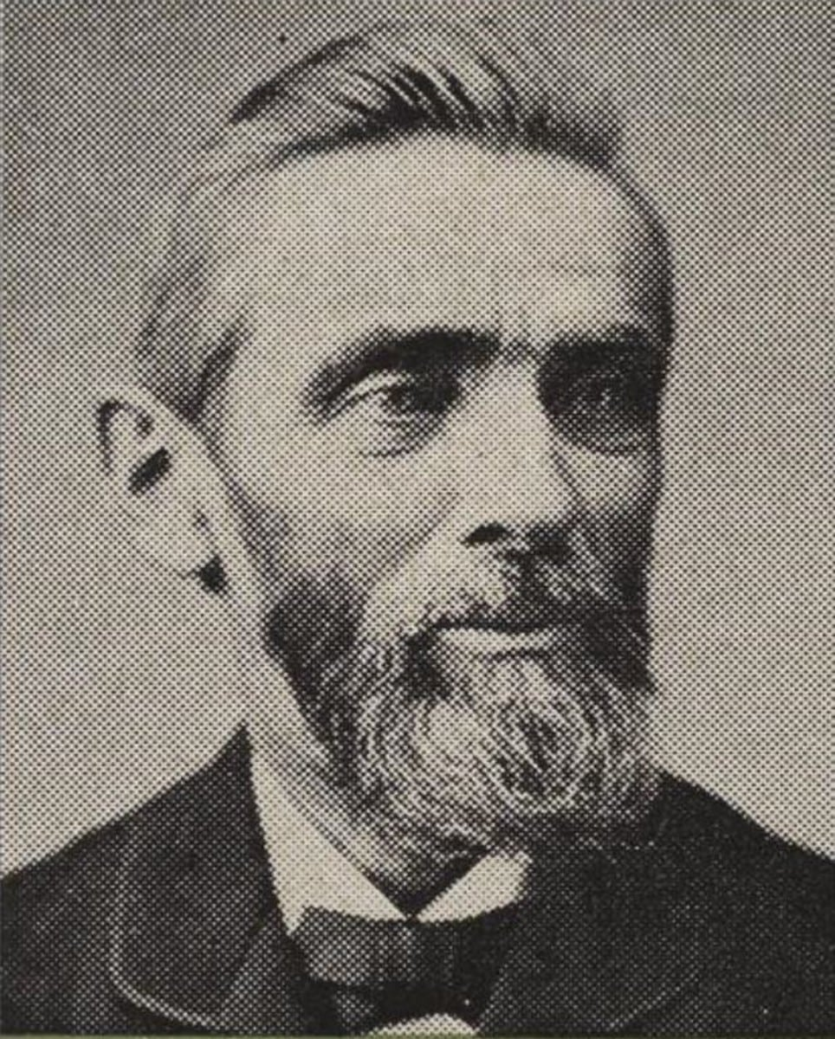
The Worldwide Message Proclaimed!
“To meet the growing interest, large tents were used, and grove meetings here held in summer season. Some of the largest church buildings and public halls were used in the winter, and all were packed to their utmost capacity with interested listeners. Instead of Elder Miller now standing, as had previous in 1840, ‘almost alone’ in declaring the message, about three hundred joined him in publicly proclaiming the termination of the twenty-three-hundred-day period, and in giving the cry ‘There shall be time no longer,’ and ‘The hour of his judgment is come.’ This we see how, when the Lord’s time came for the message to make its world-wide advancement, his word was fulfilled, and the millions were moved, with a desire to hear the call. What was true of the movement in America was true in other countries. From the year 1840, instead of a few individuals scattering their publications, scores sprang, as it were, to the front to proclaim the cry. In England there were seven hundred ministers of the Church of England alone proclaiming the message, to say nought of the scores of others engaged in the same work. In more than a score of the different leading nations of the earth a message going with that zeal which the looker-on to say, ‘This people are terribly in earnest.’”—Loughborough, The Great Second Advent Movement, p. 188

Slide 18
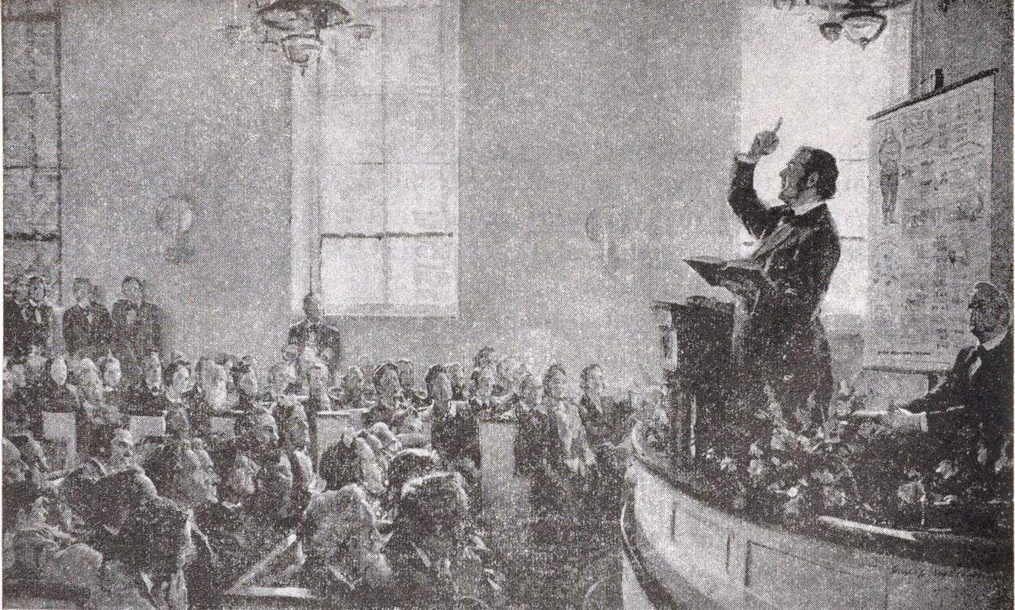
A Message Meant For Rejoicing!
Rev. 10:9-11 “And I went unto the angel, and said unto him, Give me the little book. And he said unto me, Take it, and eat it up; and it shall make thy belly bitter, but it shall be in thy mouth sweet as honey. And I took the little book out of the angel's hand, and ate it up; and it was in my mouth sweet as honey: and as soon as I had eaten it, my belly was bitter. And he said unto me, Thou must prophesy again before many peoples, and nations, and tongues, and kings.”

Slide 19
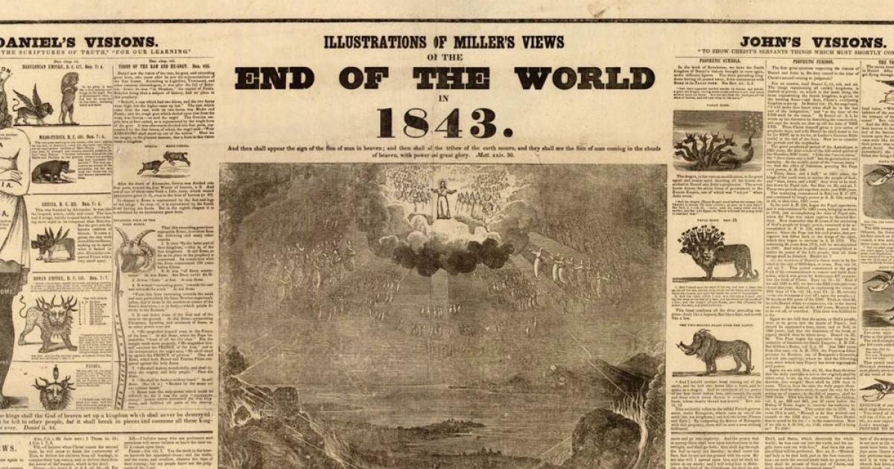
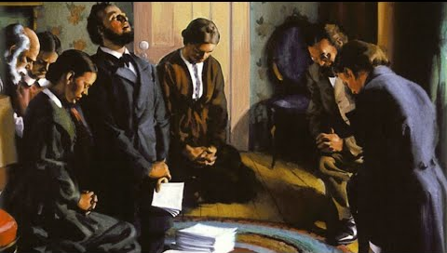
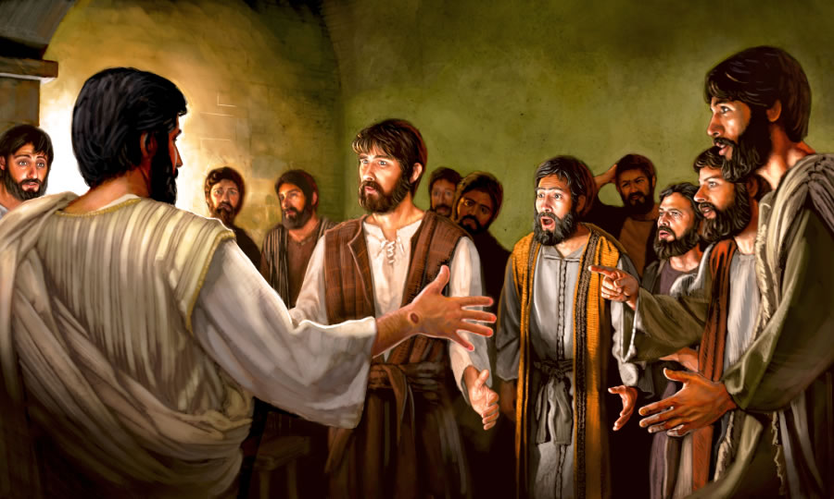
The Second Great Disappointment
“Both the prophecy of Daniel 8:14, "Unto two thousand and three hundred days; then shall the sanctuary be cleansed," and the first angel's message, "Fear God, and give glory to Him; for the hour of His judgment is come," pointed to Christ's ministration in the most holy place, to the investigative judgment, and not to the coming of Christ for the redemption of His people and the destruction of the wicked. The mistake had not been in the reckoning of the prophetic periods, but in the event to take place at the end of the 2300 days. Through this error the believers had suffered disappointment, yet all that was foretold by the prophecy, and all that they had any Scripture warrant to expect, had been accomplished. At the very time when they were lamenting the failure of their hopes, the event had taken place which was foretold by the message, and which must be fulfilled before the Lord could appear to give reward to His servants.”—GC, p. 424

Slide 20
The Power of the Message
“To William Miller and his colaborers it was given to preach the warning in America. This country became the center of the great advent movement. It was here that the prophecy of the first angel's message had its most direct fulfillment. The writings of Miller and his associates were carried to distant lands. Wherever missionaries had penetrated in all the world, were sent the glad tidings of Christ's speedy return. Far and wide spread the message of the everlasting gospel: "Fear God, and give glory to Him; for the hour of His judgment is come.“ The testimony of the prophecies which seemed to point to the coming of Christ in the spring of 1844 took deep hold of the minds of the people. As the message went from state to state, there was everywhere awakened widespread interest. Many were convinced that the arguments from the prophetic periods were correct, and, sacrificing their pride of opinion, they joyfully received the truth. Some ministers laid aside their sectarian views and feelings, left their salaries and their churches, and united in proclaiming the coming of Jesus. There were comparatively few ministers, however, who would accept this message; therefore it was largely committed to humble laymen. Farmers left their fields, mechanics their tools, traders their merchandise, professional men their positions; and yet the number of workers was small in comparison with the work to be accomplished. The condition of an ungodly church and a world lying in wickedness, burdened the souls of the true watchmen, and they willingly endured toil, privation, and suffering, that they might call men to repentance unto salvation. Though opposed by Satan, the work went steadily forward, and the advent truth was accepted by many thousands”—GC, p. 368

Slide 21
The Acceptance of the Sabbath
“As we trace the story of the beginning of Sabbathkeeping among the early Adventists, we go to a little church in the township of Washington in the heart of New Hampshire, the state that adjoins Maine on the east and whose western boundary is within sixty miles of the New York state line. Here the members of an independent Christian church in 1843 heard and accepted the preaching of the Advent message. It was an earnest group. Into their midst came a Seventh Day Baptist, Rachel Oakes, who distributed tracts setting forth the binding claims of the fourth commandment. Some in 1844 saw and accepted this Bible truth. One of their number, William Farnsworth, in a Sunday morning service, stood to his feet and declared that he intended to keep God’s Sabbath of the fourth commandment. A dozen others joined him, taking their stand firmly on all of God’s commandments. They were the first Seventh-day Adventists. The minister who cared for this church group, Frederick Wheeler, soon accepted the seventh-day Sabbath and was the first Adventist minister to do so. Another of the Advent preachers, T. M. Preble, who lived in the same state, accepted the Sabbath truth and in February, 1845, published an article in the Hope of Israel, one of the Adventist journals, setting forth the binding claims of the fourth commandment. Joseph Bates, a prominent Adventist minister residing in Fairhaven, Massachusetts, read the Preble article and accepted the Seventh-day Sabbath. Shortly thereafter, Elder Bates journeyed to Washington, New Hampshire, to study this new-found truth with the Sabbathkeeping Adventists residing there. When he returned to his home, he was fully convinced of the Sabbath truth. Bates in time determined to publish a tract setting forth the binding claims of the fourth commandment. His 48-page Sabbath pamphlet was published in August, 1846. A copy of it came to the hands of James and Ellen White at about the time of their marriage in late August. From the scriptural evidence therein presented, they accepted, and began to keep the seventh-day Sabbath. Of this Ellen White later wrote: “In the autumn of 1846 we began to observe the Bible Sabbath, and to teach and defend it” Early Writings, preface, p. xix-xxi

Slide 22
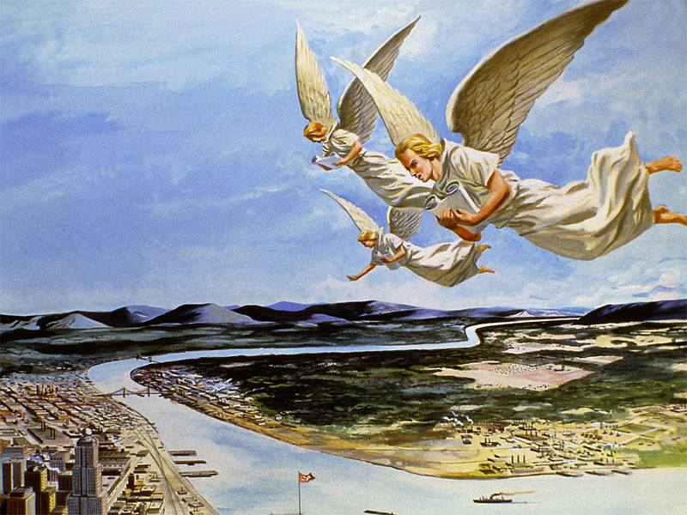
Are the Elements There????
In Ezra’s day there was:
A time of rejoicing
Focus on Repentance and Law of God
Preparation for the Day of Atonement/Meeting the LORD
In William Miller’s day there was:
A message that was sweet to those who loved Jesus (Rev. 10)
Focus on Repentance and Law of God
Message was about Second Coming!

Slide 23
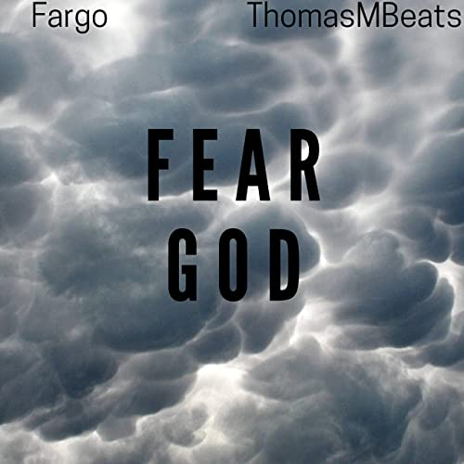
Are These Messages in the 1st Angel’s Message!?
Strong’s Concordance: phobeo (fob-eh’-o)- fear, be afraid, be afraid of, reverence, 1) to put to flight by terrifying (to scare away), 1a) to put to flight, to flee, 1b) to fear, be afraid, 1) to be struck with fear, to be seized with alarm of those started by strange occurrences, of those struck with amazement, 2) to fear, to be afraid of one, 3) to fear (i.e. hesitate) to do something (for fear of harm), 1c) to reverence, venerate, to treat with deference or reverential obedience

Slide 24
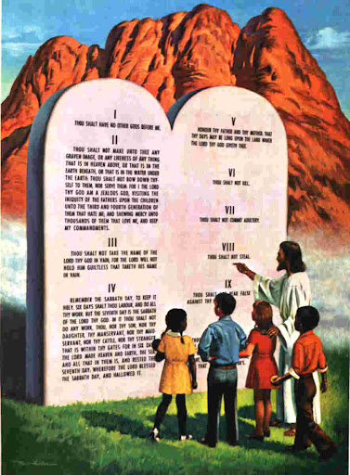
Fear God=Keep the Commandments
Deut. 5:29 “O that there were such an heart in them, that they would fear me, and keep all my commandments always, that it might be well with them, and with their children for ever!”
Prov. 8:13 “The fear of the Lord is to hate evil: pride, and arrogancy, and the evil way, and the froward mouth, do I hate.”
Job 28:28 “And unto man he said, Behold, the fear of the Lord, that is wisdom; and to depart from evil is understanding.”

Slide 25
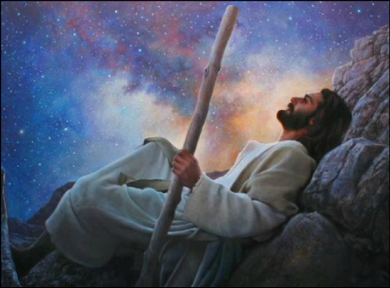
Worship the Creator
Rev. 14:7 “and worship him that made heaven, and earth, and the sea, and the fountains of waters”
Gen. 2:1-3 “Thus the heavens and the earth were finished, and all the host of them. And on the seventh day God ended his work which he had made; and he rested on the seventh day from all his work which he had made. And God blessed the seventh day, and sanctified it: because that in it he had rested from all his work which God created and made.”

Slide 26
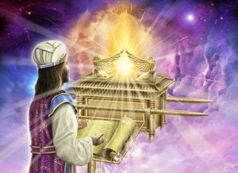
The Hour of His Judgment
Dan. 8:14 “And he said unto me, Unto two thousand and three hundred days; then shall the sanctuary be cleansed.”---ended in 1844
Lev. 16:15-16 “Then shall he kill the goat of the sin offering, that is for the people, and bring his blood within the vail, and do with that blood as he did with the blood of the bullock, and sprinkle it upon the mercy seat, and before the mercy seat: And he shall make an atonement for the holy place, because of the uncleanness of the children of Israel, and because of their transgressions in all their sins: and so shall he do for the tabernacle of the congregation, that remaineth among them in the midst of their uncleanness.”

Slide 27
Are the Elements There????
In Ezra’s day there was:
A time of rejoicing
Focus on Repentance and Law of God
Preparation for the Day of Atonement/Meeting the LORD
In William Miller’s day there was:
A message that was sweet to those who loved Jesus (Rev. 10)
Focus on Repentance and Law of God
Message was about Second Coming!
In the First Angel’s Message there are:
A message of rejoicing “the everlasting gospel”
Focus on Repentance and Law of God—Fear God!
Prepare to “Meet thy God”

Slide 28
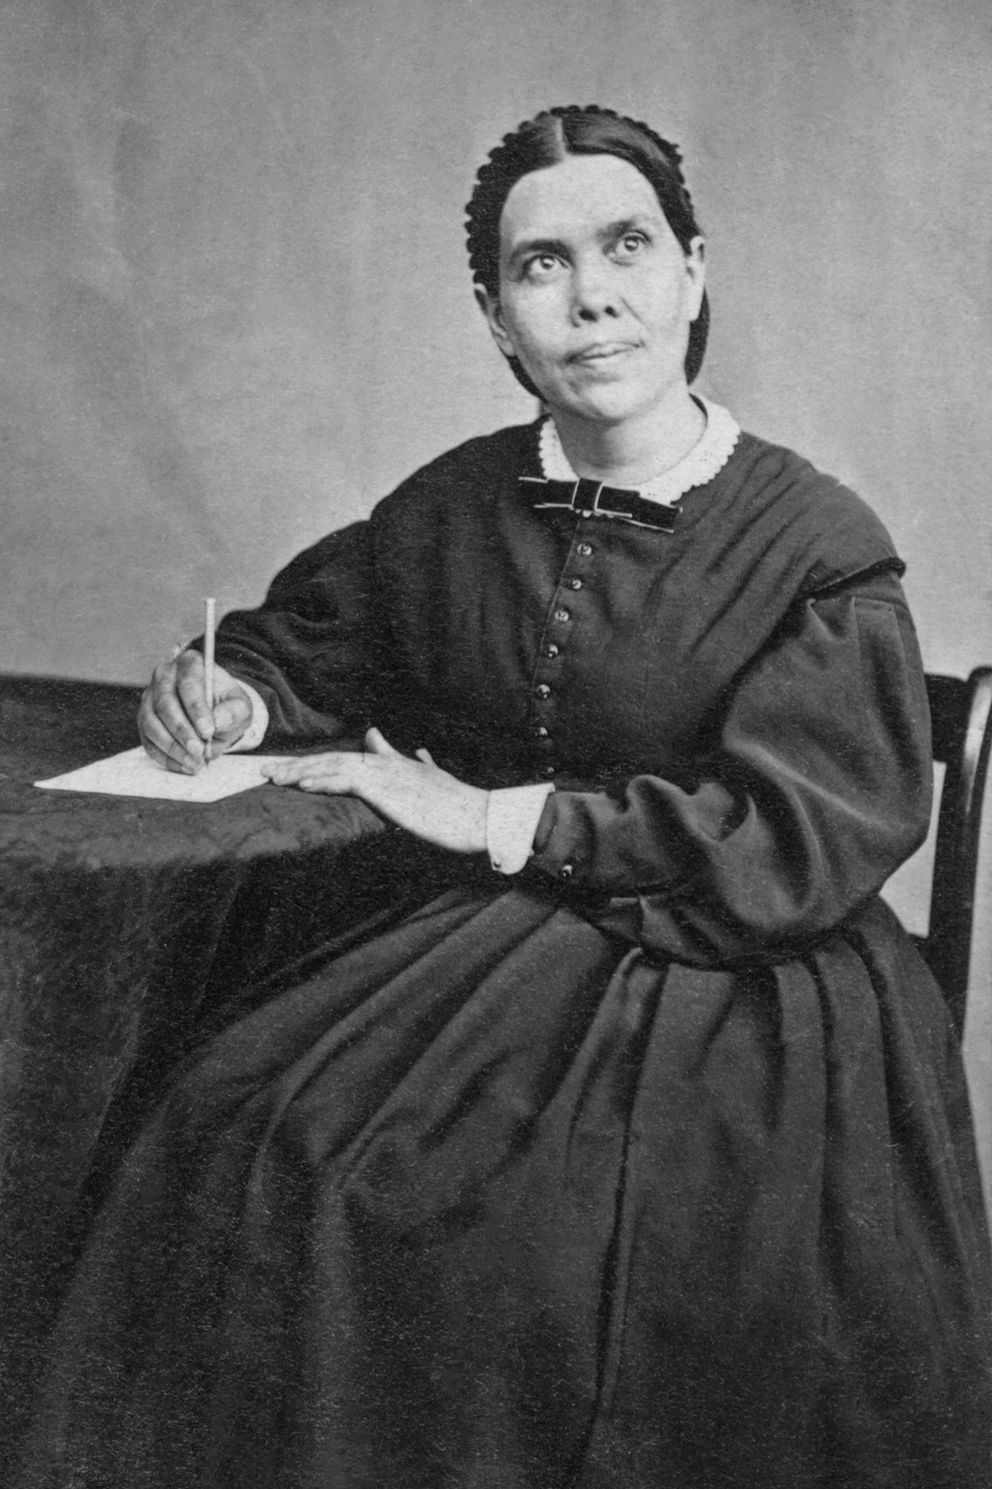
What A Work Has Been Entrusted to Us!
“In a special sense Seventh-day Adventists have been set in the world as watchmen and light bearers. To them has been entrusted the last warning for a perishing world. On them is shining wonderful light from the word of God. They have been given a work of the most solemn import--the proclamation of the first, second, and third angels' messages. There is no other work of so great importance. They are to allow nothing else to absorb their attention. The most solemn truths ever entrusted to mortals have been given us to proclaim to the world. The proclamation of these truths is to be our work. The world is to be warned, and God's people are to be true to the trust committed to them. They are not to engage in speculation, neither are they to enter into business enterprises with unbelievers; for this would hinder them in their God-given work.”—9T, p. 19

Slide 29
