Slide 1
Jesus Life, pt. 36 ‘Iniquity Abounds’

Slide 2

Signs of the Times!!
“And many false prophets shall rise, and shall deceive many. And because iniquity shall abound, the love of many shall wax cold. But he that shall endure unto the end, the same shall be saved. And this gospel of the kingdom shall be preached in all the world for a witness unto all nations; and then shall the end come. When ye therefore shall see the abomination of desolation, spoken of by Daniel the prophet, stand in the holy place, (whoso readeth, let him understand:)…” Matthew 24:11-15

Slide 3
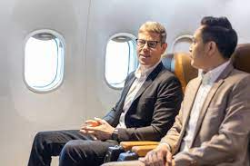
A Story from the Adventist Mecca..
Flying home from meetings in Loma Linda, sitting next to a man, chatting with him, learning of his job as a handy man, trying to make an honest living, wanting so desperately to get out of the Loma Linda area. Why? , I asked. To hear his answer left me so ashamed!!!!

Slide 4

No Compassion for our Neighbor
Walking into church, putting money into the till and patting ourselves on the shoulder for being so giving when we ripped off the people who did work for us because we got him down!!
Shame on us!!

Slide 5
All Time Favorite Stories
“Then came Peter to him, and said, Lord, how oft shall my brother sin against me, and I forgive him? till seven times? Jesus saith unto him, I say not unto thee, Until seven times: but, Until seventy times seven. Therefore is the kingdom of heaven likened unto a certain king, which would take account of his servants. And when he had begun to reckon, one was brought unto him, which owed him ten thousand talents. But forasmuch as he had not to pay, his lord commanded him to be sold, and his wife, and children, and all that he had, and payment to be made. The servant therefore fell down, and worshipped him, saying, Lord, have patience with me, and I will pay thee all. Then the lord of that servant was moved with compassion, and loosed him, and forgave him the debt.” Matthew 18:21-27

Slide 6

King’s Servant
The king’s servant owed the king roughly $15,000,000 dollars in our money. Impossible to pay. His financial mismanagement would cost him everything he had. His job, his family, his life, all thrown away by his indulgences. He had absolutely no chance in this scenario. His only hope was in the mercy of the benevolent King! ‘then the Lord of that servant was moved with compassion, and loosed him, and forgave him the debt.’

Slide 7
Never Become Weary!
“Peter had come to Christ with the question, “How oft shall my brother sin against me, and I forgive him? till seven times?” The rabbis limited the exercise of forgiveness to three offenses. Peter, carrying out, as he supposed, the teaching of Christ, thought to extend it to seven, the number signifying perfection. But Christ taught that we are never to become weary of forgiving. Not “Until seven times,” He said, “but, Until seventy times seven.” Then He showed the true ground upon which forgiveness is to be granted and the danger of cherishing an unforgiving spirit.” COL pg. 243

Slide 8
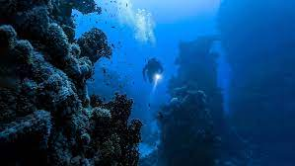
Depths of the Sea
“Who is a God like unto thee, that pardoneth iniquity, and passeth by the transgression of the remnant of his heritage? he retaineth not his anger for ever, because he delighteth in mercy. He will turn again, he will have compassion upon us; he will subdue our iniquities; and thou wilt cast all their sins into the depths of the sea.” Micah 7:18,19

Slide 9
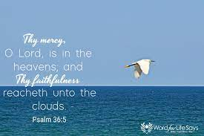
“The pardon granted by this king represents a divine forgiveness of all sin. Christ is represented by the king, who, moved with compassion, forgave the debt of his servant. Man was under the condemnation of the broken law. He could not save himself, and for this reason Christ came to this world, clothed His divinity with humanity, and gave His life, the just for the unjust. He gave Himself for our sins, and to every soul He freely offers the blood-bought pardon. “With the Lord there is mercy, and with Him is plenteous redemption.” Psalm 130:7. Here is the ground upon which we should exercise compassion toward our fellow sinners.” COL pg. 244,245

Slide 10
Owed 15.00 Dollars
“But the same servant went out, and found one of his fellow servants, which owed him an hundred pence: and he laid hands on him, and took him by the throat, saying, Pay me that thou owest. And his fellow servant fell down at his feet, and besought him, saying, Have patience with me, and I will pay thee all. And he would not: but went and cast him into prison, till he should pay the debt. So when his fellow servants saw what was done, they were very sorry, and came and told unto their lord all that was done.” Matthew 18:28-31

Slide 11
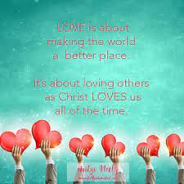
Love Others
The forgiven man was owed 15.00 in comparison to what he owed mere pennies! After having been forgiven so much, this hard hearted man showed he really didn’t appreciate the gift he was given. He proved it by his harsh treatment of his fellow man. “We love him, because he first loved us.
“If a man say, I love God, and hateth his brother, he is a liar: for he that loveth not his brother whom he hath seen, how can he love God whom he hath not seen? And this commandment have we from him, That he who loveth God love his brother also.” 1 John 4:19-21

Slide 12

Walk on Me!!
Lady in Kenya with her daughter…………..
Young man in Zambia……..

Slide 13
“How many are today manifesting the same spirit. When the debtor pleaded with his lord for mercy, he had no true sense of the greatness of his debt. He did not realize his helplessness. He hoped to deliver himself. “Have patience with me,” he said, “and I will pay thee all.” So there are many who hope by their own works to merit God's favor. They do not realize their helplessness. They do not accept the grace of God as a free gift, but are trying to build themselves up in self-righteousness. Their own hearts are not broken and humbled on account of sin, and they are exacting and unforgiving toward others. Their own sins against God, compared with their brother's sins against them, are as ten thousand talents to one hundred pence—nearly one million to one; yet they dare to be unforgiving.” COL pg. 245

Slide 14
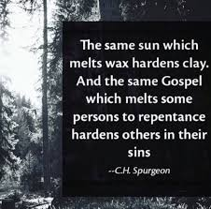
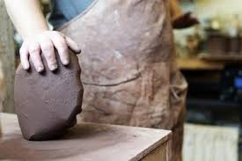
What Will it Be?

Slide 15
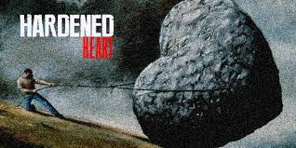
False Christs, abomination…
“And many false prophets shall rise, and shall deceive many. And because iniquity shall abound, the love of many shall wax cold. But he that shall endure unto the end, the same shall be saved. And this gospel of the kingdom shall be preached in all the world for a witness unto all nations; and then shall the end come. When ye therefore shall see the abomination of desolation, spoken of by Daniel the prophet, stand in the holy place, (whoso readeth, let him understand:)” Matthew 24:11-15

