Slide 1
The ‘Carnal’ sabbath
By The Letter

Slide 2
The Accusation
“After this there was a feast of the Jews; and Jesus went up to Jerusalem. Now there is at Jerusalem by the sheep market a pool, which is called in the Hebrew tongue Bethesda, having five porches. In these lay a great multitude of impotent folk, of blind, halt, withered, waiting for the moving of the water. For an angel went down at a certain season into the pool, and troubled the water: whosoever then first after the troubling of the water stepped in was made whole of whatsoever disease he had. And a certain man was there, which had an infirmity thirty and eight years. When Jesus saw him lie, and knew that he had been now a long time in that case, he saith unto him, Wilt thou be made whole? The impotent man answered him, Sir, I have no man, when the water is troubled, to put me into the pool: but while I am coming, another steppeth down before me. Jesus saith unto him, Rise, take up thy bed, and walk. And immediately the man was made whole, and took up his bed, and walked: and on the same day was the sabbath. The Jews therefore said unto him that was cured, It is the sabbath day: it is not lawful for thee to carry thy bed.” John 5:1-10

Slide 3
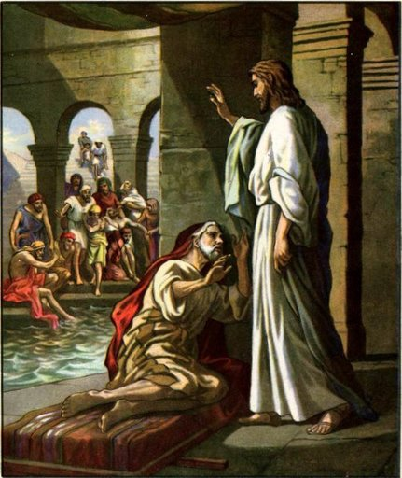
The Letter
The SDA’s in Christ’s day condemned a man for carrying his bed on the sabbath day. According to the letter of the law, as far as outward acts were concerned, this man was violating the sabbath and they let him know it!

Slide 4
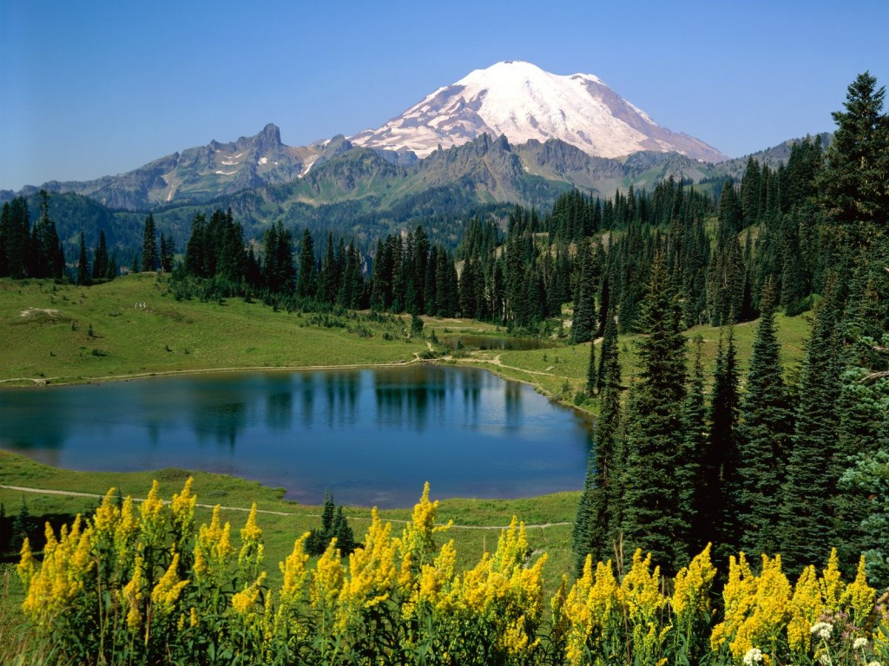
The Assault
“He answered them, He that made me whole, the same said unto me, Take up thy bed, and walk. Then asked they him, What man is that which said unto thee, Take up thy bed, and walk? And he that was healed wist not who it was: for Jesus had conveyed himself away, a multitude being in that place. Afterward Jesus findeth him in the temple, and said unto him, Behold, thou art made whole: sin no more, lest a worse thing come unto thee. The man departed, and told the Jews that it was Jesus, which had made him whole. And therefore did the Jews persecute Jesus, and sought to slay him, because he had done these things on the sabbath day.” John 5:11-16

Slide 5
The Sabbath Breaker
“These rulers knew well that only One had shown Himself able to perform this miracle; but they wished for direct proof that it was Jesus, that they might condemn Him as a Sabbath-breaker. In their judgment He had not only broken the law in healing the sick man on the Sabbath, but had committed sacrilege in bidding him bear away his bed. The Jews had so perverted the law that they made it a yoke of bondage. Their meaningless requirements had become a byword among other nations. Especially was the Sabbath hedged in by all manner of senseless restrictions. It was not to them a delight, the holy of the Lord, and honorable. The scribes and Pharisees had made its observance an intolerable burden. A Jew was not allowed to kindle a fire nor even to light a candle on the Sabbath. As a consequence the people were dependent upon the Gentiles for many services which their rules forbade them to do for themselves. They did not reflect that if these acts were sinful, those who employed others to perform them were as guilty as if they had done the work themselves. They thought that salvation was restricted to the Jews, and that the condition of all others, being already hopeless, could be made no worse. But God has given no commandments which cannot be obeyed by all. His laws sanction no unreasonable or selfish restrictions. “ DA, pg. 204

Slide 6

Is There Something Wrong with this picture?
Is there something awry here? Christ, the Creator of the worlds and of the Sabbath, is being condemned for breaking the Sabbath. Is it possible that the SDA’s of Christ’s day didn’t understand the Sabbath? Is it possible to keep the carnal Sabbath, by the letter of the law, and reject the Sabbath of Christ?

Slide 7

The Sabbath Breaker
Who was really breaking the Sabbath? Was it the SDA, who was keeping the letter of the law, but who had anger, envy, jealousy, and strife in their mind? Or, was it Christ who was keeping the letter of the law and the spirit of the law in submission to His Father?

Slide 8
The sabbath or the Sabbath?
1. Is it possible to be keeping the carnal sabbath, or the sabbath by the letter, but be rejecting the Sabbath because we are harboring anger, lust, and impatience toward others?
2. Can we be keeping the carnal sabbath and be rejecting the Sabbath of God at the same time?
3. The SDA’s of the 1st century were keeping the carnal sabbath and rejecting the Sabbath of God at the same time. Well?

Slide 9
The Distortion
“And he bearing his cross went forth into a place called the place of a skull, which is called in the Hebrew Golgotha: Where they crucified him, and two other with him, on either side one, and Jesus in the midst. And Pilate wrote a title, and put it on the cross. And the writing was, JESUS OF NAZARETH THE KING OF THE JEWS. This title then read many of the Jews: for the place where Jesus was crucified was nigh to the city: and it was written in Hebrew, and Greek, and Latin. Then said the chief priests of the Jews to Pilate, Write not, The King of the Jews; but that he said, I am King of the Jews. Pilate answered, What I have written I have written. Then the soldiers, when they had crucified Jesus, took his garments, and made four parts, to every soldier a part; and also his coat: now the coat was without seam, woven from the top throughout. They said therefore among themselves, Let us not rend it, but cast lots for it, whose it shall be: that the scripture might be fulfilled, which saith, They parted my raiment among them, and for my vesture they did cast lots. These things therefore the soldiers did. Now there stood by the cross of Jesus his mother, and his mother's sister, Mary the wife of Cleophas, and Mary Magdalene. When Jesus therefore saw his mother, and the disciple standing by, whom he loved, he saith unto his mother, Woman, behold thy son! Then saith he to the disciple, Behold thy mother! And from that hour that disciple took her unto his own home. After this, Jesus knowing that all things were now accomplished, that the scripture might be fulfilled, saith, I thirst. Now there was set a vessel full of vinegar: and they filled a spunge with vinegar, and put it upon hyssop, and put it to his mouth. When Jesus therefore had received the vinegar, he said, It is finished: and he bowed his head, and gave up the ghost. The Jews therefore, because it was the preparation, that the bodies should not remain upon the cross on the sabbath day, (for that sabbath day was an high day,) besought Pilate that their legs might be broken, and that they might be taken away.” John 19:17-31

Slide 10
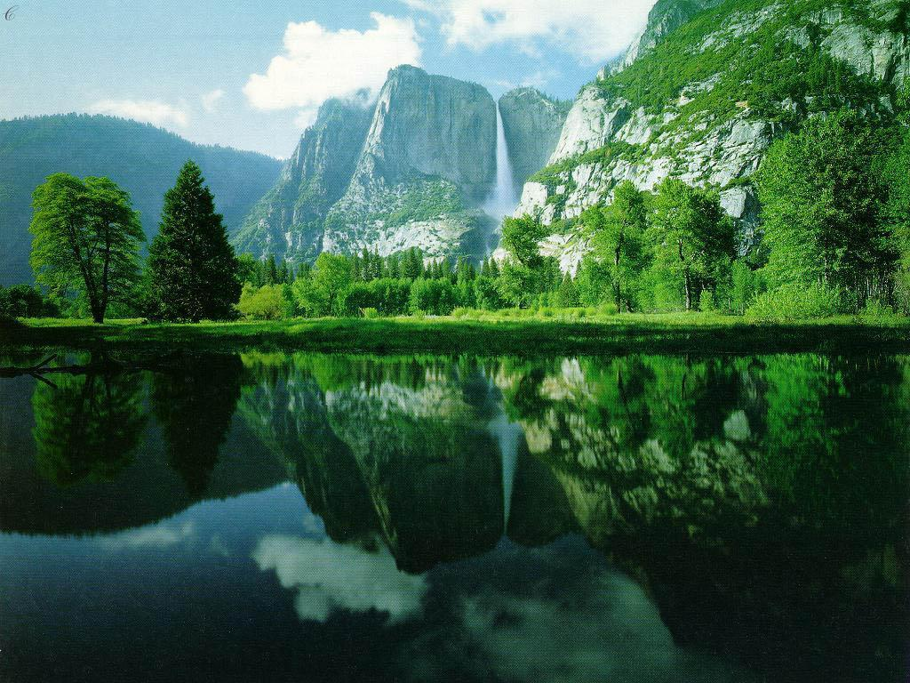
The Shock
1. Did John laugh as he recounted the reason the SDA’s did not want Christ to remain on the cross after He died?
2. They didn’t want to dishonor the sabbath.
3. Besides, it was a feast day as well, making it a high sabbath, which made it doubly important.
4. After crucifying Christ on Friday, what did the Jews do the next day?
5. Was there a misunderstanding?

Slide 11
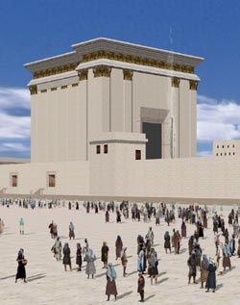
The Usual
“On the Sabbath the courts of the temple were filled with worshipers. The high priest from Golgotha was there, splendidly robed in his sacerdotal garments. White-turbaned priests, full of activity, performed their duties…The trumpets and musical instruments and the voices of the singers were as loud and clear as usual. But a sense of strangeness pervaded everything.” DA, pg. 774

Slide 12

The sabbath or the Sabbath?
They had sundown worship Friday evening.
They sang the same songs.
They read from the same Sabbath School lessons.
They ate fellowship lunch like always.
They had sundown worship to close the Sabbath as well.
With the blood of the Son of God on their hands, did they keep the Sabbath of God or the sabbath of the carnal heart?

Slide 13
No More Significance
“As the Jews departed from God, and failed to make the righteousness of Christ their own by faith, the Sabbath lost its significance to them. Satan was seeking to exalt himself and to draw men away from Christ, and he worked to pervert the Sabbath, because it is the sign of the power of Christ. The Jewish leaders accomplished the will of Satan by surrounding God's rest day with burdensome requirements. In the days of Christ the Sabbath had become so perverted that its observance reflected the character of selfish and arbitrary men rather than the character of the loving heavenly Father. The rabbis virtually represented God as giving laws which it was impossible for men to obey. They led the people to look upon God as a tyrant, and to think that the observance of the Sabbath, as He required it, made men hard-hearted and cruel. It was the work of Christ to clear away these misconceptions.” DA, pg. 283,284

Slide 14
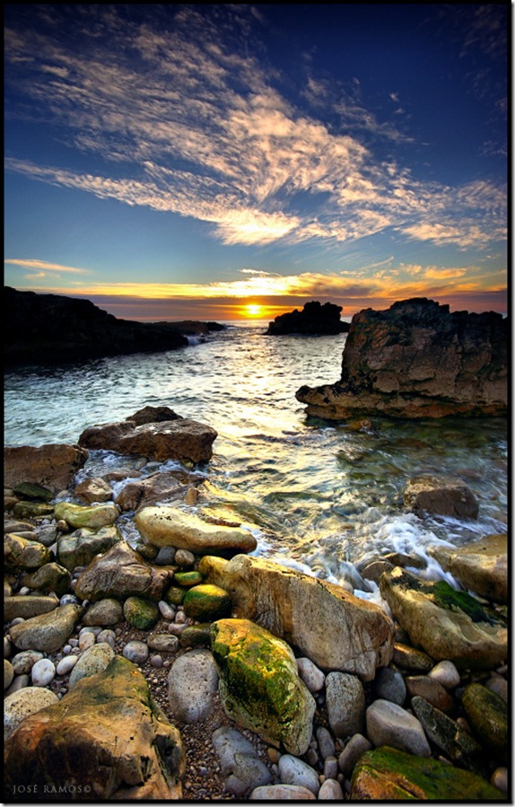
The Missing Link
“And the LORD spake unto Moses, saying, Speak thou also unto the children of Israel, saying, Verily my sabbaths ye shall keep: for it is a sign between me and you throughout your generations; that ye may know that I am the LORD that doth sanctify you.” Exodus 31:12,13

Slide 15
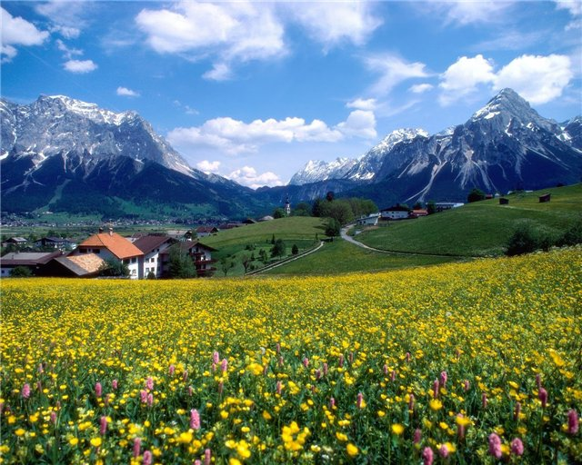
The Sign
“Moreover also I gave them my sabbaths, to be a sign between me and them, that they might know that I am the LORD that sanctify them.” Ezekiel 20:12
The sabbath was to be a sign of sanctification; it had become the sign for world engrossed people to think they could LIVE INDEPENDENT OF God and still be saved! What a lie!

Slide 16
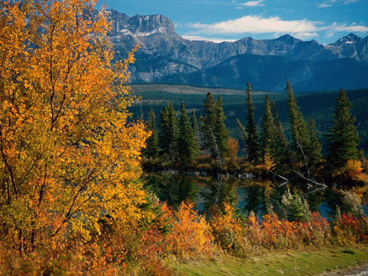
The Misunderstanding
“For he is not a Jew, which is one outwardly; neither is that circumcision, which is outward in the flesh: But he is a Jew, which is one inwardly; and circumcision is that of the heart, in the spirit, and not in the letter; whose praise is not of men, but of God.” Romans 2:28,29

Slide 17
The Seal of God or the Mark of Selfishness?
We can be keeping the 7th day Sabbath, thinking we have the seal of God, but unless Christ is the Lord of our lives, then the Sabbath is not the seal at all, but rather the mark of selfishness and self righteousness.
“And grieve not the holy Spirit of God, whereby ye are sealed unto the day of redemption. Let all bitterness, and wrath, and anger, and clamour, and evil speaking, be put away from you, with all malice: And be ye kind one to another, tenderhearted, forgiving one another, even as God for Christ's sake hath forgiven you.” Ephesians 4:30-32
The Holy Spirit seals us when we are surrendered to Christ Jesus. He doesn’t seal us while we are clinging to evil and cruelty. When we hold to the Sabbath without Christ in our lives, then it ceases to be the Seal of God to us!

Slide 18
“It [the Sabbath] belongs to Christ. . . . Since He made all things, He made the Sabbath. By Him it was set apart as a memorial of the work of creation. It points to Him as both the Creator and the Sanctifier. It declares that He who created all things in heaven and in earth, and by whom all things hold together, is the head of the church, and that by His power we are reconciled to God. For, speaking of Israel, He said, "I gave them my sabbaths, to be a sign between me and them, that they might know that I am the Lord that sanctify them"--make them holy. Then the Sabbath is a sign of Christ's power to make us holy. And it is given to all whom Christ makes holy. As a sign of His sanctifying power, the Sabbath is given to all who through Christ become a part of the Israel of God. To all who receive the Sabbath as a sign of Christ's creative and redeeming power, it will be a delight. Seeing Christ in it, they delight themselves in Him. The Sabbath points them to the works of creation as an evidence of His mighty power in redemption. While it calls to mind the lost peace of Eden, it tells of peace restored through the Saviour. And every object in nature repeats His invitation, "Come unto me, all ye that labour and are heavy laden, and I will give you rest." Matt. 11:28. The Sabbath is a golden clasp that unites God and His people.” Mar 244

Slide 19
Why God said Remember!
“Remember the sabbath day, to keep it holy. Six days shalt thou labour, and do all thy work: But the seventh day is the sabbath of the LORD thy God: in it thou shalt not do any work, thou, nor thy son, nor thy daughter, thy manservant, nor thy maidservant, nor thy cattle, nor thy stranger that is within thy gates: For in six days the LORD made heaven and earth, the sea, and all that in them is, and rested the seventh day: wherefore the LORD blessed the sabbath day, and hallowed it.” Exodus 20:8-11
Typically, we say that the Lord told us to remember the Sabbath because it is the one unique commandment that He knew everyone would forget. If we look around, we can see that all of God’s commands have been forgotten. Why did God want us to remember especially the Sabbath?

Slide 20

The Sign of Victory
The Lord wants us to remember the Sabbath every day. The Sabbath reminds us who we are and who God is. If we remember the Sabbath everyday, then, when tempted to do wrong, we will remember our Creator and ask Him to help us turn away from sin because we don’t want to hurt Him.
“The only defense against evil is the indwelling of Christ in the heart through faith in His righteousness.” DA, pg. 324
The Sabbath remains the reminder that everyday we rest in the power of Christ to help us overcome sin.

