Slide 1
Prophecy Arise, pt. 13
Beasts, Messages, and Power!

Slide 2
Beasts of Prophecy!
“And I stood upon the sand of the sea, and saw a beast rise up out of the sea, having seven heads and ten horns, and upon his horns ten crowns, and upon his heads the name of blasphemy. And the beast which I saw was like unto a leopard, and his feet were as the feet of a bear, and his mouth as the mouth of a lion: and the dragon gave him his power, and his seat, and great authority. And I saw one of his heads as it were wounded to death; and his deadly wound was healed: and all the world wondered after the beast. And they worshipped the dragon which gave power unto the beast: and they worshipped the beast, saying, Who is like unto the beast? who is able to make war with him? And there was given unto him a mouth speaking great things and blasphemies; and power was given unto him to continue forty and two months. And he opened his mouth in blasphemy against God, to blaspheme his name, and his tabernacle, and them that dwell in heaven. And it was given unto him to make war with the saints, and to overcome them: and power was given him over all kindreds, and tongues, and nations.” Rev. 13:1-7

Slide 3
Beast, Number 1
1. Beast=“These great beasts, which are four, are four kings, which shall arise out of the earth…The fourth beast shall be the fourth kingdom upon earth, which shall be diverse from all kingdoms, and shall devour the whole earth, and shall tread it down, and break it in pieces.” Daniel 7:17,23 Beast=World Power
2. Blasphemy=“When Jesus saw their faith, he said unto the sick of the palsy, Son, thy sins be forgiven thee. But there were certain of the scribes sitting there, and reasoning in their hearts, Why doth this man thus speak blasphemies? who can forgive sins but God only?.... Mk. 2:5-7 “The Jews answered him, saying, For a good work we stone thee not; but for blasphemy; and because that thou, being a man, makest thyself God.” Jn. 10:30-33

Slide 4
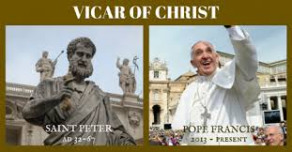
“The pope is the supreme judge of the law of the land.... He is the vicegerent of Christ, who is not only a Priest forever, but also King of kings and Lord of lords. — La Civilta Cattolica, March 18, 1871, quoted in Leonard Woolsey Bacon, An Inside View of the Vatican Council, American Tract Society, p. 229.

Slide 5
Worship or Else!
3. Worship the beast= “Why do thy disciples transgress the tradition of the elders? for they wash not their hands when they eat bread. But he answered and said unto them, Why do ye also transgress the commandment of God by your tradition? For God commanded, saying, Honour thy father and mother: and, He that curseth father or mother, let him die the death. But ye say, Whosoever shall say to his father or his mother, It is a gift, by whatsoever thou mightest be profited by me; And honour not his father or his mother, he shall be free. Thus have ye made the commandment of God of none effect by your tradition. Ye hypocrites, well did Esaias prophesy of you, saying, This people draweth nigh unto me with their mouth, and honoureth me with their lips; but their heart is far from me. But in vain they do worship me, teaching for doctrines the commandments of men.” Matthew 15:2-9
True Worship= honoring God’s commandments False Worship= honoring man made tradition

Slide 6
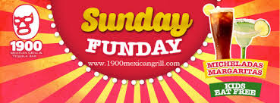
Sunday Tradition
“Protestants... accept Sunday rather than Saturday as the day for public worship after the Catholic Church made the change.... But the Protestant mind does not seem to realize that...in observing the Sunday, they are accepting the authority of the spokesman for the church, the Pope. — Our Sunday Visitor, February 5, 1950.
“It is well to remind the Presbyterians, Baptists, Methodists, and all other Christians, that the Bible does not support them anywhere in their observance of Sunday. Sunday is an institution of the Roman Catholic Church, and those who observe the day observe a commandment of the Catholic Church. — Priest Brady, in an address, reported in the Elizabeth, N.J. “News,” March 18, 1903.

Slide 7
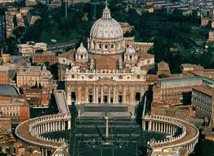
All Fulfilled in Papacy!
1. world power
2. blasphemy
3. almost perished in 1798
4. exalts Sunday tradition
5. reigned in Dark Ages for 1260 years
6. persecutor of God’s people

Slide 8
Another Beast
“And I beheld another beast coming up out of the earth; and he had two horns like a lamb, and he spake as a dragon. And he exerciseth all the power of the first beast before him, and causeth the earth and them which dwell therein to worship the first beast, whose deadly wound was healed. And he doeth great wonders, so that he maketh fire come down from heaven on the earth in the sight of men, And deceiveth them that dwell on the earth by the means of those miracles which he had power to do in the sight of the beast; saying to them that dwell on the earth, that they should make an image to the beast, which had the wound by a sword, and did live. And he had power to give life unto the image of the beast, that the image of the beast should both speak, and cause that as many as would not worship the image of the beast should be killed. And he causeth all, both small and great, rich and poor, free and bond, to receive a mark in their right hand, or in their foreheads: And that no man might buy or sell, save he that had the mark, or the name of the beast, or the number of his name.” Rev. 13:11-18

Slide 9
Characteristics
1. Starts off with Christ-like govt.; ends up behaving like the devil.
2. Encourages the world to honor the Sunday tradition.
3. Deceives the world thru miracle working power.
4. An Image develops in this nation.
5. Persecutes those who refuse to follow her.

Slide 10
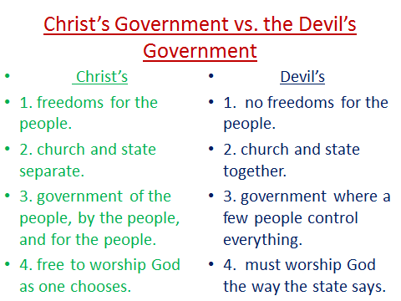

Slide 11
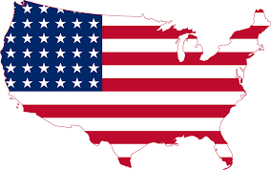
The USA
America strikingly fulfills this 2ND beast power in Rev. 13:11-18. America repudiates her constitution and enforces the Sunday tradition of the papal power! America uses deceptive power to bring almost everyone to obey. She sets up an image….

Slide 12
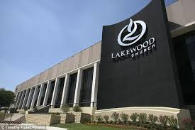
An image
The image of the beast is…..
1. An exact replica of the papal power in the Dark Ages.
2. It is religious/church that uses the government to enforce her beliefs; namely, Sunday!
3. The image is Apostate Protestant churches!

Slide 13
3 Messages of Love/Warning
“And I saw another angel fly in the midst of heaven, having the everlasting gospel to preach unto them that dwell on the earth, and to every nation, and kindred, and tongue, and people, Saying with a loud voice, Fear God, and give glory to him; for the hour of his judgment is come: and worship him that made heaven, and earth, and the sea, and the fountains of waters. And there followed another angel, saying, Babylon is fallen, is fallen, that great city, because she made all nations drink of the wine of the wrath of her fornication. And the third angel followed them, saying with a loud voice, If any man worship the beast and his image, and receive his mark in his forehead, or in his hand, The same shall drink of the wine of the wrath of God, which is poured out without mixture into the cup of his indignation; and he shall be tormented with fire and brimstone in the presence of the holy angels, and in the presence of the Lamb: And the smoke of their torment ascendeth up for ever and ever: and they have no rest day nor night, who worship the beast and his image, and whosoever receiveth the mark of his name. Here is the patience of the saints: here are they that keep the commandments of God, and the faith of Jesus.” Rev. 14:6-12

Slide 14
Focus of these messages
1. Christ alone is to be honored. He alone can forgive and empower for victory.
2. The 10 Commandments are the standard in the judgment. The 7th day Sabbath is binding upon men!
3. The message of health and soundness of mind are critical at this time.
4. Babylon/the image/Apostate Protestants are condemned for rejecting Christ and His commandments.
5. The papal power and apostate protestants are condemned for exalting their mark of authority in religious affairs, namely Sunday.

Slide 15
The Mark of the Beast!
“Of course the Catholic Church claims that the change [from Saturday to Sunday] was her act. And the act is a MARK of her ecclesiastical power and authority in religious matters. — C. F. Thomas, Chancellor of Cardinal Gibbons.
“Sunday is our MARK of authority.... The church is above the Bible, and this transference of Sabbath observance is proof of that fact. — Catholic Record, September 1, 1923 (Ontario).

Slide 16
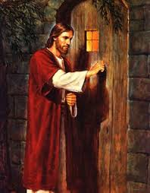
Christ’s Call
1. Christ calls us to faith in His power to obey His commandments.
2. Christ calls us to healthy living and a clear mind.
3. Christ calls us to set aside the Sabbath for fellowship with Him and others.
4. Christ calls us to rebuke apostasy in the churches of today.

Slide 17
Christ's Final Call
“And after these things I saw another angel come down from heaven, having great power; and the earth was lightened with his glory. And he cried mightily with a strong voice, saying, Babylon the great is fallen, is fallen, and is become the habitation of devils, and the hold of every foul spirit, and a cage of every unclean and hateful bird. For all nations have drunk of the wine of the wrath of her fornication, and the kings of the earth have committed fornication with her, and the merchants of the earth are waxed rich through the abundance of her delicacies. And I heard another voice from heaven, saying, Come out of her, my people, that ye be not partakers of her sins, and that ye receive not of her plagues. For her sins have reached unto heaven, and God hath remembered her iniquities. Reward her even as she rewarded you, and double unto her double according to her works: in the cup which she hath filled fill to her double. How much she hath glorified herself, and lived deliciously, so much torment and sorrow give her: for she saith in her heart, I sit a queen, and am no widow, and shall see no sorrow.” Rev. 18:1-7

Slide 18
Babylon in a Free Fall
1. The Lord will soon pour out power on His children like this world has never seen!
2. Babylon, as Apostate Protestantism in Rev. 14:8; Babylon, as the papacy in Rev. 17, is teetering on the brink of collapse. God calls His faithful children out of those churches.
3. God wants no one to suffer of the plagues that will befall her.
4. Apostate Protestant and Catholic Sunday traditionalists will suffer the wrath of God!

Slide 19
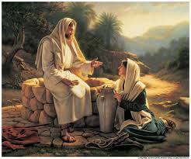
Christ’s Invitation Today
“Jesus answered and said unto her, Whosoever drinketh of this water shall thirst again: But whosoever drinketh of the water that I shall give him shall never thirst; but the water that I shall give him shall be in him a well of water springing up into everlasting life.” John 4:13,14

