Slide 1
What is the Difference Between Mormons, Jehovah’s Witnesses, and Seventh-day Adventists? pt 3

Slide 2
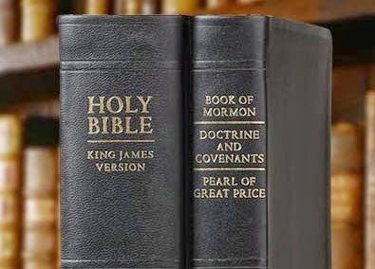
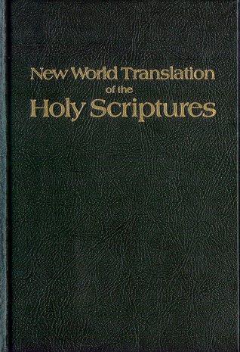
What We Will Study….
Origins of the Religion
Their Authorities and/or Authoritative Texts
Their Doctrinal Differences
Their Message to the World

Slide 3
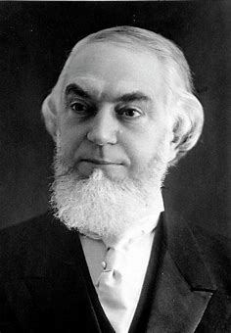
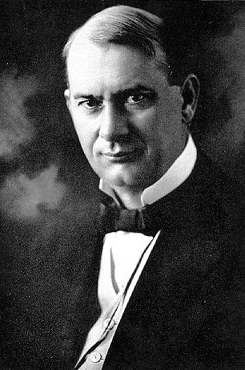
Overview…
The Jehovah’s Witnesses were originally founded by Charles Taze Russell, but were not called “Jehovah’s Witnesses” until 1931 under Joseph Rutherford’s leadership as the President of the Watch Tower Society.
“Jehovah’s Witnesses is a millenarian restorationist Christian denomination with nontrinitarian beliefs distinct from mainstream Christianity. The group reports a worldwide membership of approximately 8.5 million adherents involved in evangelism and an annual Memorial attendance of over 19.7 million. Jehovah's Witnesses are directed by the Governing Body of Jehovah's Witnesses, a group of elders in Warwick, New York, United States, which establishes all doctrines based on its interpretations of the Bible. They believe that the destruction of the present world system at Armageddon is imminent, and that the establishment of God's kingdom over the earth is the only solution for all problems faced by humanity. The group emerged from the Bible Student movement founded in the late 1870s by Charles Taze Russell, who also co-founded Zion's Watch Tower Tract Society in 1881 to organize and print the movement's publications.”—Wikipedia, Jehovah’s Witnesses

Slide 4
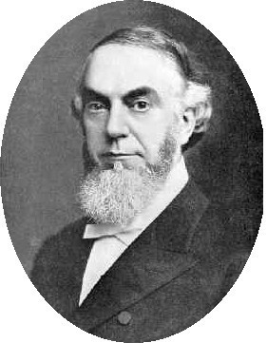
The Founder’s Conversion Story
“At age sixteen, a discussion with a childhood friend on faults perceived in Christianity (such as contradictions in creeds, along with medieval traditions) led Russell to question his faith. He investigated various other religions, but concluded that they did not provide the answers he was seeking. In 1870, at age eighteen, he attended a presentation by Adventist minister Jonas Wendell. Russell later said that, although he had not entirely agreed with Wendell's arguments, the presentation had inspired him with a renewed zeal and belief that the Bible is the word of God.” Wikipedia, Charles Taze Russell, retrieved on April 24, 2023

Slide 5
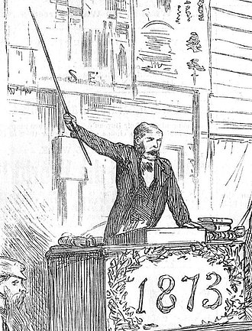
Who Was Jonas Wendell???
“Jonas Wendell . . . was a zealous Adventist preacher following in the spirit of William Miller. Following the "Great Disappointment" Wendell experienced periods of weak faith, as did many Adventists. He eventually recovered his faith after renewing his study of Bible chronology (historic and prophetic) and began to preach extensively throughout Ohio, Pennsylvania, the Virginias, and New England. By the late 1860s he had been studying the chronology of the Bible, and was encouraged by conclusions showing Christ's return would occur in either 1868 or 1873/4. In 1870 Wendell published his views in the booklet entitled The Present Truth, or Meat in Due Season concluding that the Second Advent was sure to occur in 1873.” Wikipedia, Jonas Wendell

Slide 7
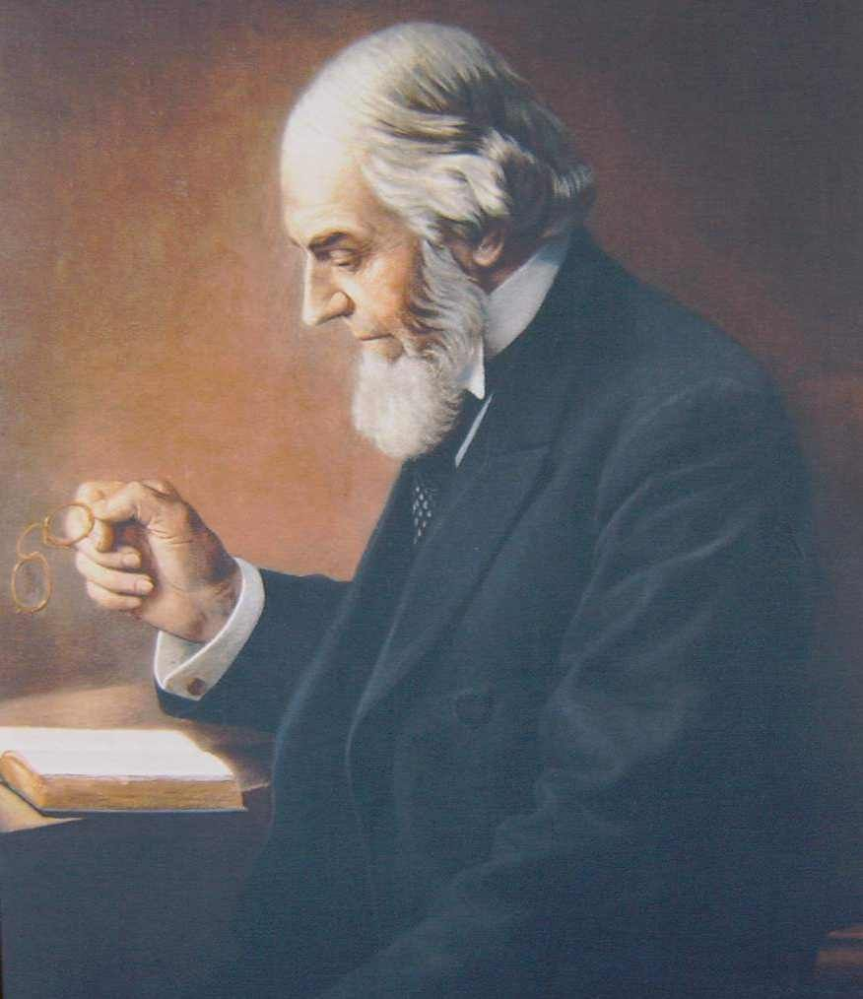
What did Charles Believe and Teach?
“In 1870, Charles Taze Russell and others formed a group in Pittsburgh, Pennsylvania, to study the Bible. During the course of his ministry, Russell disputed many beliefs of mainstream Christianity including immortality of the soul, hellfire, predestination, the fleshly return of Jesus Christ, the Trinity, and the burning up of the world. In 1876, Russell met Nelson H. Barbour. Later that year they jointly produced the book Three Worlds, which combined restitutionist views with end time prophecy. The book taught that God's dealings with humanity were divided dispensationally, each ending with a "harvest," that Christ had returned as an invisible spirit being in 1874 inaugurating the "harvest of the Gospel age", and that 1914 would mark the end of a 2,520-year period called "the Gentile Times“”-studied under George Stetson and George Storrs—Wikipedia, Jehovah’s Witnesses, retrieved on April 24, 2023

Slide 8
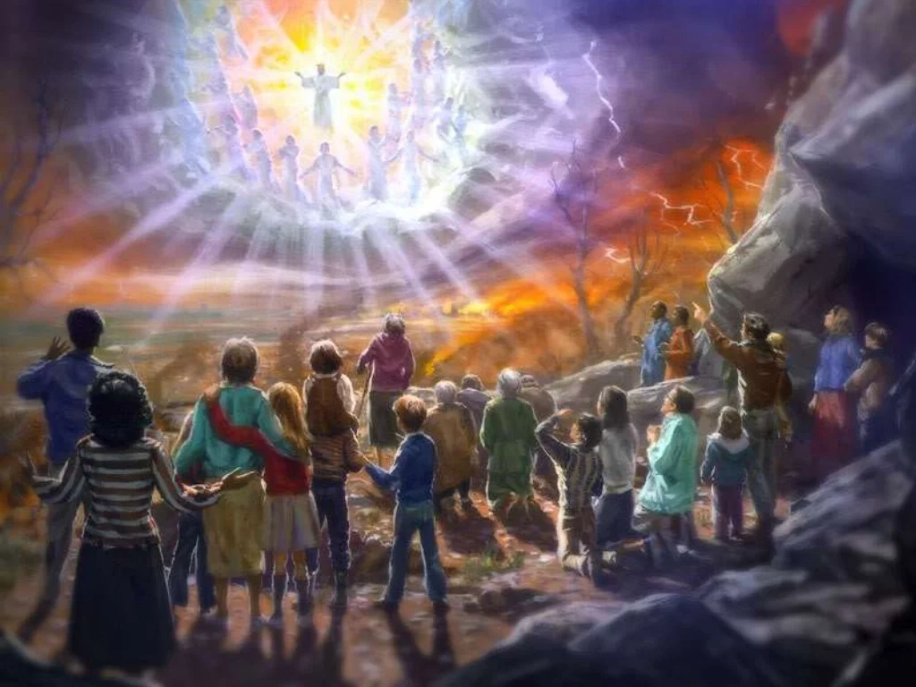
Not an Invisible Event Russell!
Matt. 24:23-27 “Then if any man shall say unto you, Lo, here is Christ, or there; believe it not. For there shall arise false Christs, and false prophets, and shall shew great signs and wonders; insomuch that, if it were possible, they shall deceive the very elect. Behold, I have told you before. Wherefore if they shall say unto you, Behold, he is in the desert; go not forth: behold, he is in the secret chambers; believe it not. For as the lightning cometh out of the east, and shineth even unto the west; so shall also the coming of the Son of man be.”

Slide 9
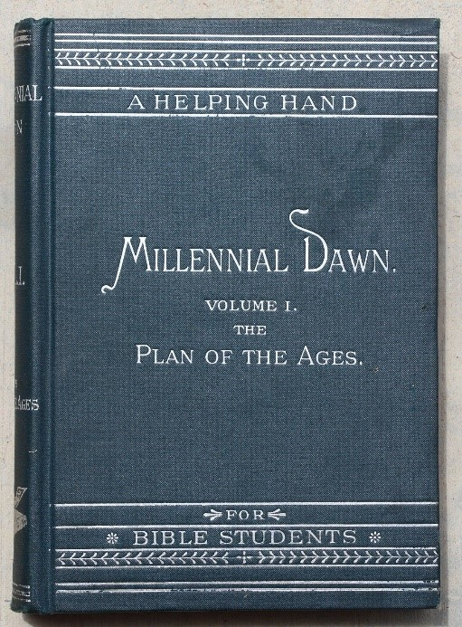
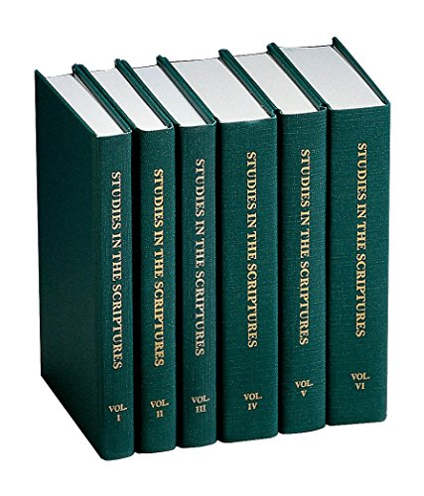
Great Success
Overland Monthly, January 1910 p. 130: "As a writer, Mr. Russell's books have enjoyed a larger circulation than any English work ... Of his work entitled 'Studies in the Scriptures,' the average output is two thousand three hundred copies for each working day. We regret the records of 1909 are not yet complete, but in 1908 seven hundred and twenty-eight thousand, four hundred and seventy-four volumes were sold. Since publication, three million five hundred and thirty-four thousand volumes have been circulated. Last year, in addition to these there were three hundred and eight million pages of his tracts circulated. In all literature the Bible is about the only book that has had a larger circulation ... In the literature of the world, the order would probably be as follows: The Bible, the Chinese Almanac, the 'Studies in the Scriptures,' 'Don Quixote,' 'Uncle Tom's Cabin' and Hubbard's 'Message to Garcia.'"

Slide 10
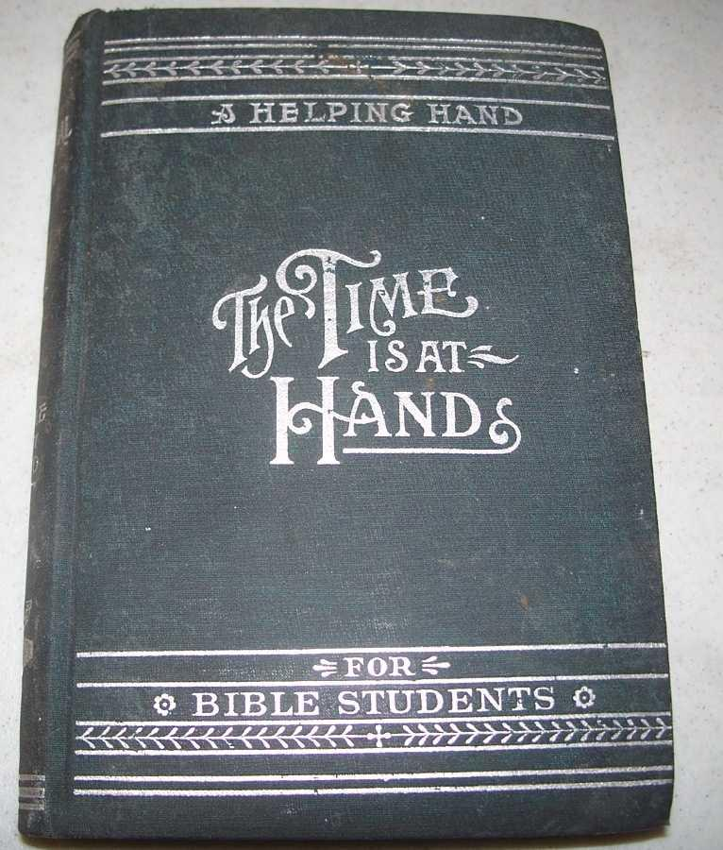
Time-Setting: End of the World in 1914
“Be not surprised, then, when in subsequent chapters we present proofs that the setting up of the Kingdom of God is already begun, that it is pointed out in prophecy as due to begin the exercise of power in A. D. 1878, and that the “battle of the great day of God Almighty'' (Rev. 16:14.), which will end in A.D. 1914 with the complete overthrow of earth's present rulership, is already commenced. The gathering of the armies is plainly visible from the standpoint of God's Word.” Russell, The Time is at Hand (Millenial Dawn/Studies in the Scriptures vol. 2), p. 101

Slide 11
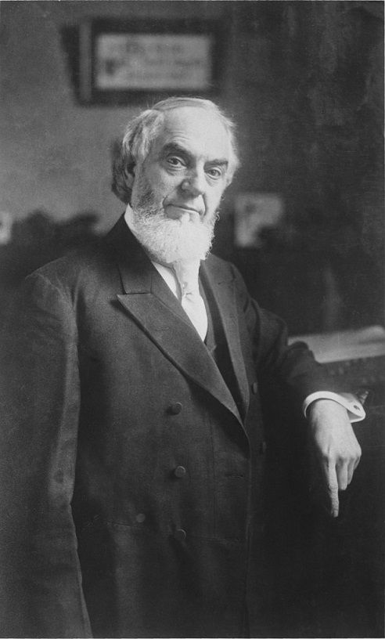
Why 1914? 2520 is the Basis!
“The Bible evidence is clear and strong that the "Times of the Gentiles'' is a period of 2520 years, from the year B.C. 606 to and including A. D. 1914. This lease of universal dominion to Gentile governments, as we have already seen, began with Nebuchadnezzar—not when his reign began, but when the typical kingdom of the Lord passed away, and the dominion of the whole world was left in the hands of the Gentiles.” Charles Taze Russell, Thy Kingdom Come (Ibid.), p. 79

Slide 12
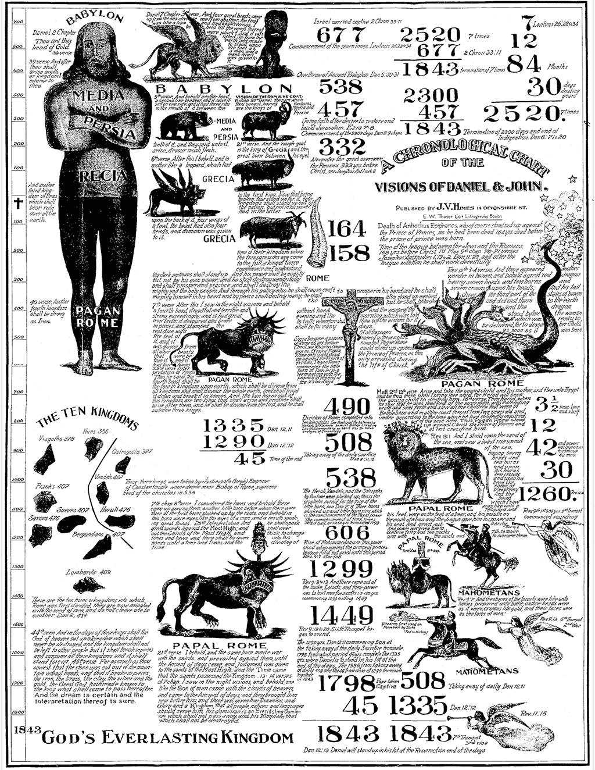
Time vs Time:
Daniel 7:25 “and they shall be given into his hand until a time [5742], times [5742 in the plural], and the dividing of time [5732].” (see also Dan. 4:32) iddan (id-dawn’)-time, time (of duration), a year
Leviticus 26:28 “I, even I, will chastise you seven times [7651] for your sins ” sheba’ (sheh’-bah) or masculine shib’ah (shib-aw)-seven, seventh, seventeen, sevenfold

Slide 13
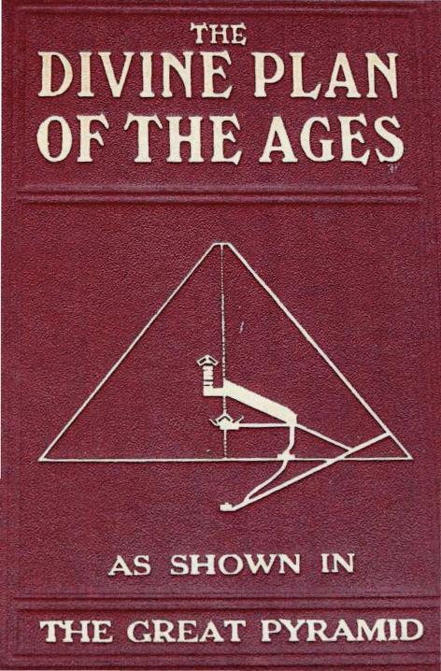
Pyramidology….?
“This threefold ending is in full accord with what we have found taught in the Scriptures: that the ‘harvest, the end of the age,’ was reached in October, 1874, and that the ‘call’ proper ended in October, 1881 . . . the Scriptures do not, so far as we have yet seen, indicate; but this date, 1910, indicated by the Pyramid, seems to harmonize well with the dates furnished by the Bible. It is but four years before the full close of the time of trouble which ends the Gentile times; and when we remember the Lord’s words—that the overcomers shall be accounted worthy to escape the severest of the trouble coming upon the world, we may well accept as correct the testimony of the Great Pyramid, that the last members of the ‘body’ or ‘bride’ of Christ will have been tested and accepted and will have passed beyond the vail before the close of A.D. 1910. Is not this a most remarkable agreement between this stone ‘Witness’ and the Bible?” Russell, (1891) Thy Kingdom Come, p. 363-364

Slide 14
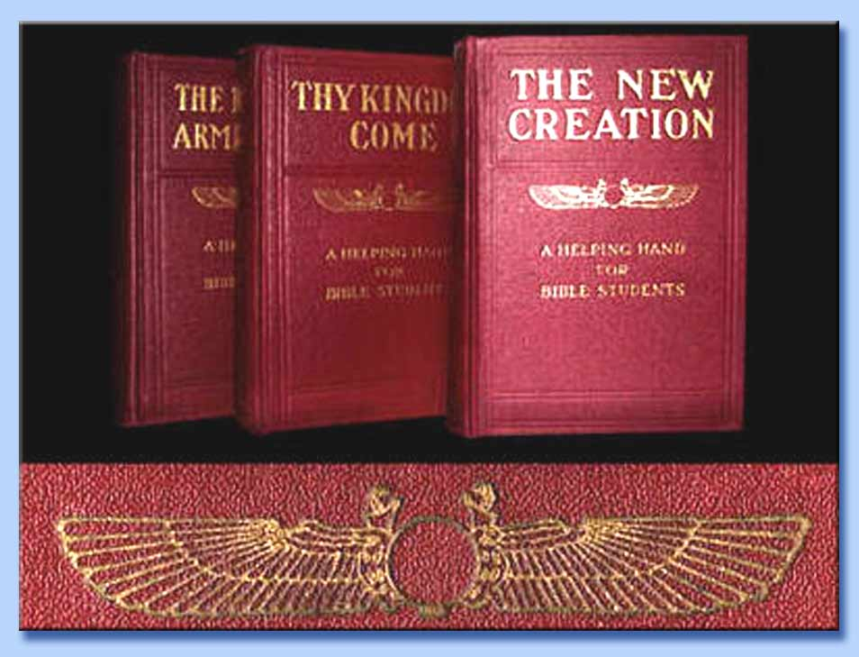

Slide 15
Astrology…?
“We seriously question all the claims of Astrology; yet the following—from whatever source the suggestions come, even though of the adversary himself—seem remarkably true to our expectations based upon the Word of the Lord. For this reason alone we present them here,—as follows:—’Saturn is the representative of the great motive power that has dominated the mind of man up to the present time. The great organizations of Capital, attracting now so much attention, are in reality the last great struggle of this Saturn-god to save his throne. . . . Jupiter, representing law, religion, and morality, has been perforce subservient to Saturn’s greater and more potent force. . . . Jupiter must also transfer his allegiance from the grasping Saturn to the newly discovered factor that stands for universal brotherhood; namely, Uranus. When Uranus and Jupiter meet in the humane sign of Aquarius in 1914 the long-promised era will have made a fair start in the work of setting man free to work out his own salvation”—Watchtower, May 1, 1903, Vol. XXIV, no. 9, “An Astrologer’s Outlook”

Slide 16
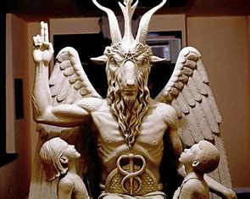
Satan is a Source of Truth???
“We should learn to love and value truth for its own sake; to respect and honor it by owning and acknowledging it wherever we find it and by whomsoever presented. A truth presented by Satan himself is just as true as a truth stated by God. . . . Accept truth wherever you find it, no matter what it contradicts, and rely for ability to afterwards harmonize it with others upon ‘the Spirit of Truth which shall guide you into all truth,’ as Jesus promised. . . . Be not content with one flower of truth. Had one been sufficient there would have been no more. Gather ever, seek for more. Weaved them together as a garland”—Watchtower, July 1879 “What is Truth?”

Slide 17
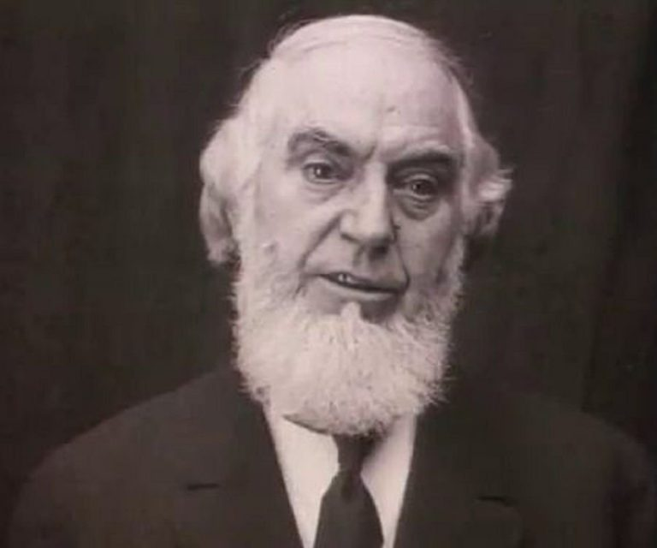
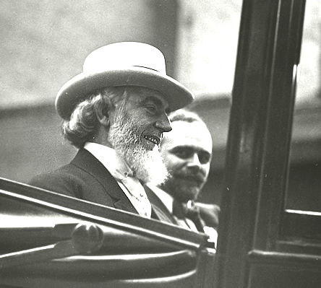
The Restoration of the Nation of Israel
“In 1910 Pastor Russell received a letter from a committee of Jewish leaders: "Dear Sir: Your Sympathetic interest in the Jewish people for years past has not escaped our notice. Your denunciation of the atrocities perpetrated against our race in the name of Christianity has added to our conviction that you are a sincere friend," wrote the committee members. "Your discourse on “Jerusalem and Jewish Hopes” has struck a responsive chord in the hearts of many of our people. Still we doubted for a time if any Christian minister could really be interested in a Jew as a Jew and merely from a hope of proselyting him…You may well understand how surprised we are to find a Christian minister acknowledging that there are prophecies of the Bible still fulfilled, which belong to the Jew and not to the Christian… These things, Pastor Russell, have led to the formation of a Jewish Mass Meeting Committee, which by this letter, request you to give a public discourse," they concluded.”-- HAARETZ.com, Before Herzl, There Was Pastor Russell: A Neglected Chapter of Zionism, Philippe Bohstrom, Aug. 22, 2018

Slide 18
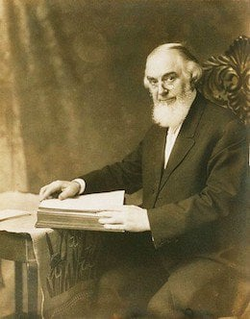
No Gospel Preached to the Jews!?
“The pastor acceded and on October 9, 1910 gave a talk titled “Zionism in Prophecy” before an audience of about 4,000 Jews at the Hippodrome, New York's largest and finest auditorium at the time. As The New York American reported on that day, “The unusual spectacle of 4,000 Hebrews enthusiastically applauding a Gentile preacher, after having listened to a sermon he addressed to them concerning their own religion…where Pastor Russell, the famous head of the Brooklyn Tabernacle conducted a most unusual service. It was not long before all reserve, and all possible doubt of Pastor Russell’s entire sincerity and friendliness were worn away. Then the mention of the name of a great leader [Herzl] who, the speaker declared, had been raised by God for the cause -- brought a burst of applause.“ Russell held similar mass meetings in Chicago, Philadelphia, St. Louis, Kansas City and Cincinnati. In England he addressed 4,600 Jews in London's Royal Albert Hall, following which he appeared in Glasgow and Manchester, then gave talks in other European cities with large Jewish populations, including Vienna, Berlin, Krakow and Budapest.” HAARETZ.com, Before Herzl, There Was Pastor Russell: A Neglected Chapter of Zionism, Philippe Bohstrom, Aug. 22, 2018

Slide 19
Does the Bible Agree???
-John 20:30-31 “And many other signs truly did Jesus in the presence of his disciples, which are not written in this book: But these are written, that ye might believe that Jesus is the Christ, the Son of God; and that believing ye might have life through his name.”
-Acts 4:10-12 “Be it known unto you all, and to all the people of Israel, that by the name of Jesus Christ of Nazareth, whom ye crucified, whom God raised from the dead, even by him doth this man stand here before you whole. This is the stone which was set at nought of you builders, which is become the head of the corner. Neither is there salvation in any other: for there is none other name under heaven given among men, whereby we must be saved.”
-Acts 8:37-38 “And Philip said, If thou believest with all thine heart, thou mayest. And he answered and said, I believe that Jesus Christ is the Son of God. And he commanded the chariot to stand still: and they went down both into the water, both Philip and the eunuch; and he baptized him.”
-Acts 16:29-31 “Then he called for a light, and sprang in, and came trembling, and fell down before Paul and Silas, And brought them out, and said, Sirs, what must I do to be saved? And they said, Believe on the Lord Jesus Christ, and thou shalt be saved, and thy house.”
-Rom. 10:9 “That if thou shalt confess with thy mouth the Lord Jesus, and shalt believe in thine heart that God hath raised him from the dead, thou shalt be saved.”

Slide 20
Masonic Ties?
“We must demand that the Society of Jesus be expelled from the American Empire, while earnestly praying for individual Jesuits that they would leave the Company and tell their story. Laws must be passed that no one may hold public office who has given an oath of allegiance to a foreign Monarch—especially the Pope! This would include the Knights of Malta and the Knights of Columbus. Laws must be passed that no member of a secret society can hold public office. This would include all Freemasons, as their doctrines are secret, their lodges have no windows (just like the Kingdom Halls of the Masonically-controlled Jehovah’s Witnesses who deny the deity of Jesus Christ) and their highest leaders are loyal to the Jesuit General.” Eric Jon Phelps, Vatican Assassins, 3rd Ed., p. 1693

Slide 21
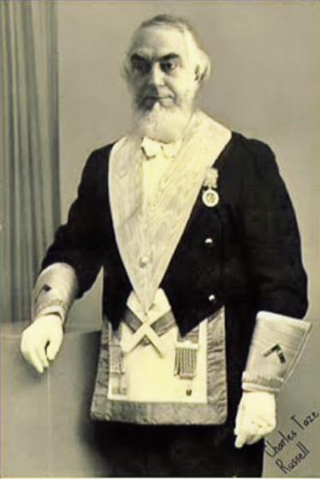
The Masonic Question….
Pieces of Evidence so Far:
According to the book “Bloodlines of the Illuminati” by Fritz Springmeier, the “Russell” Family is one of the major families in history who are tied to the Illuminati and extremely successful. The Skull and Bones Society was started by a man named William Russell, and organized under the “Russell Trust”—it is unclear if there is any relation..
Charles T. Russell is promoting Time-Setting Armageddon theories, of which the prophecy happens to begin in 1914, which was the start of World War I, which is based on the erroneous and unbiblical teaching of the 2520
Charles T. Russel’s does not try to get Jews to accept the Gospel, but to reestablish a nation, which God will use to rule the earth—Zionism

Slide 22
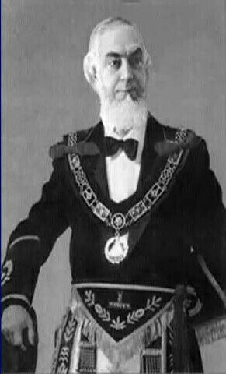
Charles Knows the Masonic Handshakes?
“Many Masons shake hands with me and give me what I know is their grip; they don't know me from a Mason. Something I do seems to be the same as Masons do, I don't know what it is; but they often give me all kinds of grips and I give them back, then I tell them I don't know anything about it except just a few grips that have come to me naturally” June, 1913, Masonic Hall in San Francisco (see Wayback Machine (archive.org), Pastor Russell’s Convention Tours, CR 362)

Slide 23
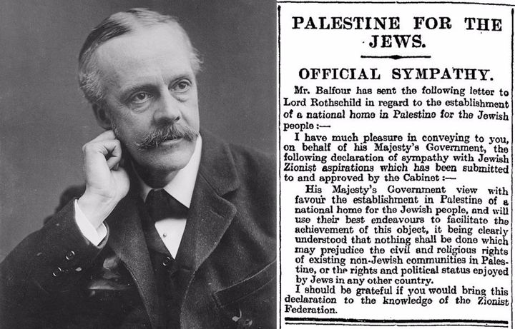
1914: World War I and then the Nation of Israel
World War I began with the assassination of Austrian Royalty in the person of the Archduke Franz Ferdinand by the Serbian Gavrilo Princip. In a domino effect, many countries into the war in opposing factions. America entered the war in 1916 after the terrorist attack of the sinking of the Lusitania German Uboats. It is estimated that 20 million people died in the war, and over 40 million military and civilian casualties. The war ended with the signing of the Treaty of Versailles which was extremely antagonistic to Germany. After the war, the world saw the creation of the “League of Nations” which was the first attempt of a united world government alliance, which failed and would later be replaced by the United Nations. Great Britain was entrusted with the temporary rule of Palestine, which allowed for Jewish resettlement in Israel. The Balfour Declaration was given in 1917, declared the necessity of restoring the nation of Israel “On November 2, Balfour sent a letter to Lionel Walter Rothschild—scion of the Rothschild family, a prominent Zionist and a friend of Chaim Weizmann—stating that: “His Majesty’s Government view with favor the establishment in Palestine of a national home for the Jewish people”—History.com, the Balfour Declaration, August 21, 2018

Slide 24
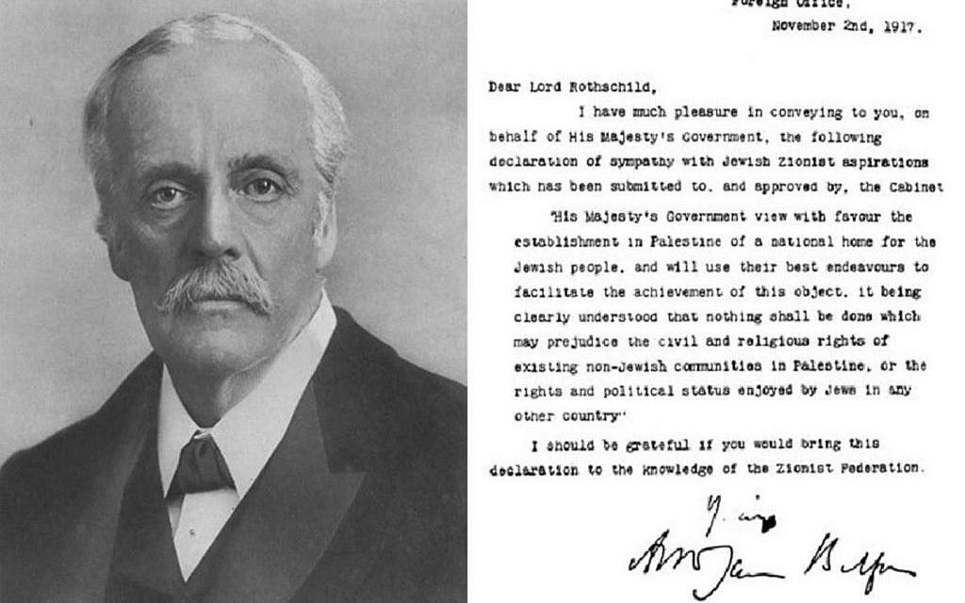

Slide 25
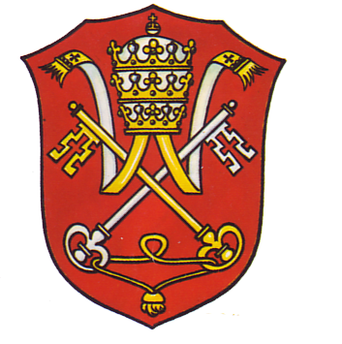
Who are the Rothschilds???
“Aware that the Rothschilds are an important Jewish family, I looked them up in Encyclopedia ]udaica and discovered that they bear the title “Guardians of the Vatican Treasury.” The Vatican Treasury, of course, holds the imperial wealth of Rome. Imperial wealth grows in proportion to its victories in war – as the Jesuit empowerment Regimini militantis ecclesiae implies, the Church-at-War is more necessary than the Church-at-Peace. According to H. Russell Robinson’ s illustrated Armour of Imperial Rome, Caesarean soldiers protected themselves in battle with shields painted red. Since the soldiery is the State’s most valuable resource (the Council of Trent admitted this in preferring the Jesuits to all other religious orders), it is easy to understand why the red shield was identified with the very life of the Church. Hence, the appropriateness of the name Rothschild, German for “red shield.” The appointment of Rothschild gave the black papacy absolute financial privacy and secrecy. Who would ever search a family of orthodox Jews for the key to the wealth of the Roman Catholic Church? I believe this appointment explains why the House of Rothschild is famous for helping nations go to war.” F. Tauper Saussy, Rulers of Evil, p. 160-161

Slide 26
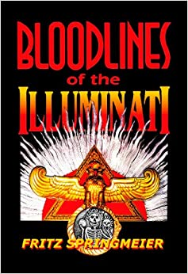
Bloodlines of the Illuminati
“It has been said all roads lead to Rome. For this book, it could be said all paths of investigation lead to the Rothschilds. Charles T. Russell, in a 1891 letter to Baron (Lord) Rothschild, mailed from Palestine, outlined possible courses of action that could be taken to establish the Jews in Palestine. Russell’s letters praised the Rothschild’s money which established Jewish colonies in Palestine. Russell writes Rothschild, “What is needed here, therefore, next to water and cleanliness, is a good government which will protect the poor from the ravenous and the wealthy. Banking institutions on sound bases, and doing business honorably, are also greatly needed" Russell continues, "May the God of Jacob direct you, my dear Sir, and all interested with you in the deliverance and prosperity of Israel, and blessed will they be who, to any extent, yield themselves as his servants in fulfilling his will as predicted.“ Fritz Springmeier, Bloodlines of the Illuminati, ch. Financial Wizards and Wealthy p. 116 (PDF)

Slide 27
Where is Russell Getting His Theology From?
“In the decades that followed it became apparent that, in order to achieve their goal of world domination, they would have to instigate a series of world wars which would result in the leveling of the old world order in preparation for the construction of the New World Order. This plan was outlined in graphic detail by Albert Pike, the Sovereign Grand Commander of the Ancient and Accepted Scottish Rite of Freemasonry, and the top Illuminist in America, in a letter to Giuseppe Mazzini dated August 15, 1871. Pike stated that the first world war was to be fomented in order to destroy Czarist Russia—and to place that vast land under the direct control of Illuminati agents. Russia was then to be used as a 'bogey man' to further the aims of the Illuminati worldwide. World War II was to be fomented through manipulation of the differences that existed between the German Nationalists and the Political Zionists. This was to result in an expansion of Russian influence and the establishment of a state of Israel in Palestine [May, 1948]. The Third World War was planned to result from the differences stirred up by Illuminati agents between the Zionists and the Arabs. The conflict was planned to spread worldwide. The Illuminati, said the letter, planned to "unleash the Nihilists and Atheists" and "provoke a formidable social cataclysm which in all its horror will show clearly to the nations the effect of absolute atheism, origin of savagery and of the most bloody turmoil. Then everywhere, the citizens, obliged to defend themselves against the world minority of revolutionaries, will exterminate those destroyers of civilization, and the multitude, disillusioned with Christianity, whose deistic spirits will from that moment be without compass [direction], anxious for an ideal, but without knowing where to render its adoration, will receive the true light through the universal manifestation of the pure doctrine of Lucifer, brought finally out in the public view, a manifestation which will result from the general reactionary movement which will follow the destruction of Christianity and atheism, both conquered and exterminated at the same time." Des Griffin, Descent Into Slavery, p. 38-39

Slide 28
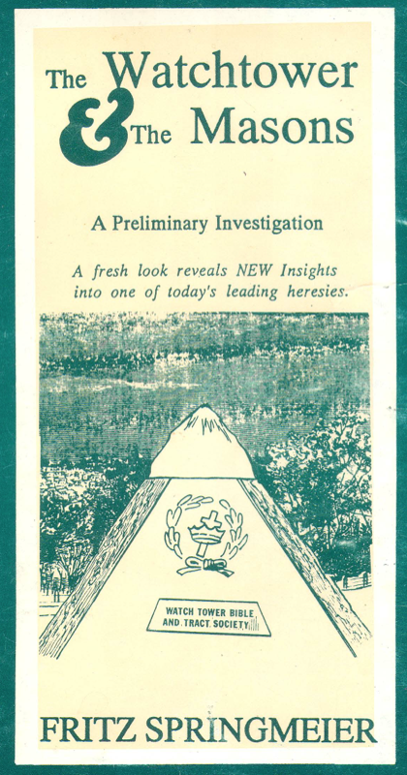
Russell Tapped Into the Illuminati Plan???
Evidence:
1. Charles T. Russell was preaching false doctrines, and using them to set prophetic times, which correlated to actual events which were controlled by Rome
2. Charles T. Russell “knew” “naturally” Masonic handshakes and used them
3. Charles T. Russell promoted the Illuminati plan to reestablish the Nation of Israel—based again on false doctrines
4. Charles T. Russell was in direct contact with the Rothschilds family (aka Rome) and planned how to reestablish Israel for the Jews
5. Charles T. Russell was obsessed with Pagan mystic practices and symbols like Pyramidology, astrology, and winged disks

Slide 29
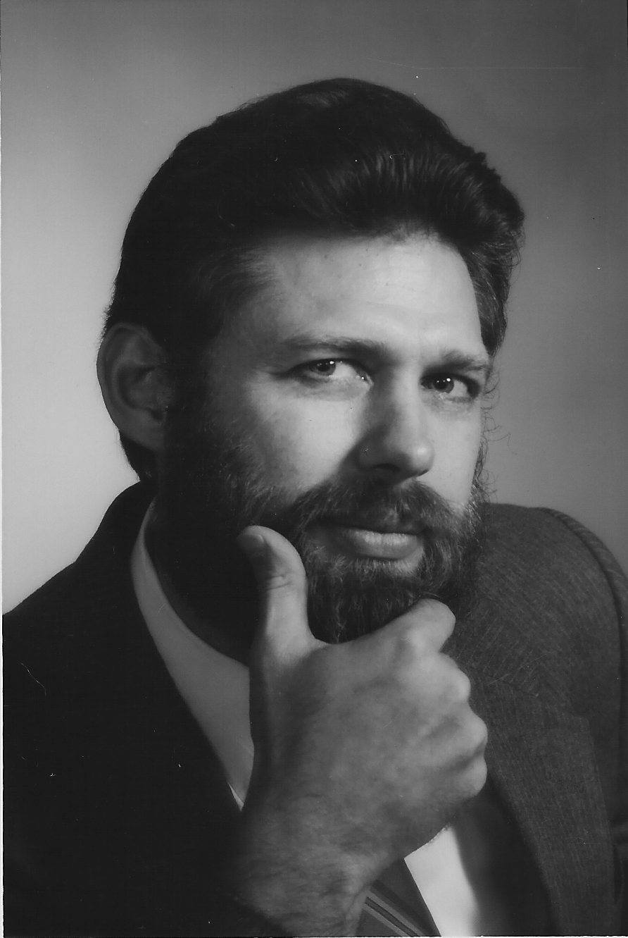
Fritz Springmeier Says Russell was a Satanist?
One of the strangest things for this Author was to continue running into evidence that seems to indicate Charles Taze Russell, the man who started the Jehovah’s Witnesses’ Watchtower Society, was secretly an important Satanist. Lest the reader devalue the evidence, permit this author to state that the evidence came in first before I came up with my theory that Russell was an important Satanist, and not vice-versa. Some of the outstanding clues are:
a.) C.T. Russell was definitely a Mason, yet he puts up some great smokescreens in his writing concerning his membership.
b.) C.T. Russell’s Bethel staff became concerned about his occultic activities and required him to take an oath forswearing any further occultic activities.
c.) In my previous book The Watchtower and the Masons, I study 35 parallel beliefs that Russell had with Masonry. I spent a page per parallel. These 35 are not in any way inclusive, Russell had many other identical ideas to what the Masonic lodges propogate.” Fritz Springmeier, Bloodlines of the Illuminati, p. 166 (PDF)

Slide 30
Satanic Assessment Continued…
d.) Various items from magic were part of Russell’s religious beliefs including healing handkerchiefs, phrenology, the Winged-Sun-Disk, Enochian Magical planes, etc.
e.) Russell’s family’s possible Illuminati links, and his wife’s possible connections with a family line of Satanists.
f.) Russell’s apparent secret Rosicrucian membership with the Quakertown, PA group of Rosicrucians, as revealed by the pyramid he ordered erected, his use of the Winged-Sun-Disk. and his cremation three days after his death.
g.) Russell owned a cemetary in Pittsburgh. Leading Satanists try to own cemetaries for several reasons. First, it facilitates the disposal of human sacrifices which are buried in pieces below the fresh holes dug for someone else’s burial. When the casket is placed in the hole, it would be rare for anyone to dig below the casket level ever again. Second, magic power is associated with cemetaries. The spiritual power of the dead is pulled up by making a circle of light over them then within the circle a naked Satanist lays. Third, specific bones are sought such as the skulls and left hands. Left hands are preserved in order to hold candles for certain ceremonies.
h.) Contacts from various places today indicate that the modern Watchtower Society is working with the New World Order. This implies that at some point the Society began cooperating with the New World Order. Russell seems to be the likeliest starting point.” Ibid.

Slide 31
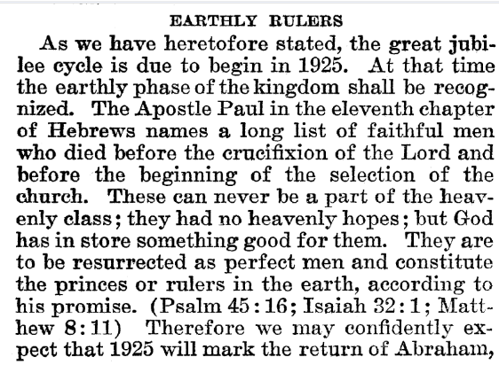
Rutherford Predicts Return of Abraham
Joseph F. Rutherford, (1920): Millions Now Living Will Never Die! p. 89-90

Slide 32
Time-setting Again! 1975
"Choosing the Best Way of Life". The Watchtower. March 15, 1980. pp. 17–18. With the appearance of the book Life Everlasting—in Freedom of the Sons of God, ... considerable expectation was aroused regarding the year 1975. ... there were other statements published that implied that such realization of hopes by that year was more of a probability than a mere possibility. It is to be regretted that these latter statements apparently overshadowed the cautionary ones and contributed to a buildup of the expectation already initiated. ... persons having to do with the publication of the information ... contributed to the buildup of hopes centered on that date.
"What will the 1970's Bring?". Awake!. Watch Tower Society. October 8, 1968. p. 14. Does this mean that the above evidence positively points to 1975 as the complete end of this system of things? Since the Bible does not specifically state this, no man can say... If the 1970s should see intervention by Jehovah God to bring an end to a corrupt world drifting toward ultimate disintegration, that should surely not surprise us.
"How Are You Using Your Life?". Our Kingdom Ministry. May 1, 1974. p. 63. Reports are heard of brothers selling their homes and property and planning to finish out the rest of their days in this old system in the pioneer service. Certainly, this is a fine way to spend the short time remaining before the wicked world's end.

Slide 33
Decline of the Watch Tower After Death
Chicago Daily Tribune October 30, 1949 pg 18: "Pastor Russell died in 1916. In the 33 years since, the methods of this sect have deviated completely from those of Pastor Russell and his manner of teaching."

Slide 34
The Legacy:
Joseph Smith Claimed to have seen the Father in 1820—an impossibility because no man has seen the Father, and Joseph was practicing forms of witchcraft, which made him in touch with demons not heavenly beings
Joseph Smith receives the “golden plates” while he is using magic and breaking the law, of which he stands trial in 1826—he defrauds Josiah Stowell and later Ohioans
Joseph Smith claims revelations that do not come true (Salem treasure), makes plans that God cannot bring to pass (Ohio Bank), loses almost every military engagement (no spiritual backing)
Joseph Smith is a practicer of Freemasonry, a Satanic organization, and destroys the lives of his followers by taking young brides, forcing the men to go on mission and sell all—all the while publicly condemning polygamy.
Joseph Smith dies in 1844, the year of the 2300 year prophecy of the Millerites, by an angry mob with seemingly no divine assistance from God
Brigham Young has ties to Rome, and the Jesuit de’Smet, begins practicing polygamy openly, taking 50+ wives
Problems arise between the Federal Government and the Mormons of several occasions, even causing the necessity of the Army to be marched into Utah
The Mormons deceive and murder 120 emigrants in Utah, polygamy is given up in 1890 by “divine revelation”, and Utah becomes a state in 1896

Slide 35
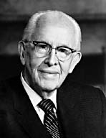
An Important Statement From an LDS Prophet
Prophet Ezra Taft: “the Book of Mormon is the keystone of our religion. This was the Prophet Joseph Smith’s statement. He testified that “the Book of Mormon was the most correct of any book on earth, and the keystone of our religion” (Introduction to the Book of Mormon). A keystone is the central stone in an arch. It holds all the other stones in place, and if removed, the arch crumbles.” (October 1986 General Conference)

