Slide 1
Daniel 8, pt.2
The Puzzle is Coming Together

Slide 2
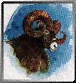
The Ram Power
“ And I saw in a vision; and it came to pass, when I saw, that I was at Shushan in the palace, which is in the province of Elam; and I saw in a vision, and I was by the river of Ulai. Then I lifted up mine eyes, and saw, and, behold, there stood before the river a ram which had two horns: and the two horns were high; but one was higher than the other, and the higher came up last. I saw the ram pushing westward, and northward, and southward; so that no beasts might stand before him, neither was there any that could deliver out of his hand; but he did according to his will, and became great.” Daniel 8:2-4
“The ram which thou sawest having two horns are the kings of Media and Persia.” verse 20

Slide 3
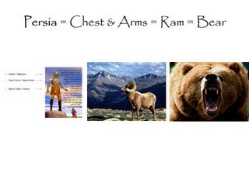
Parallels
The ram of Daniel 8 has two horns and one is higher than the other. This is identical to the bear of Daniel 7 that is lopsided. These two animals are the same as the chest of arms and silver in Daniel 2. They all represent Media and Persia.

Slide 4
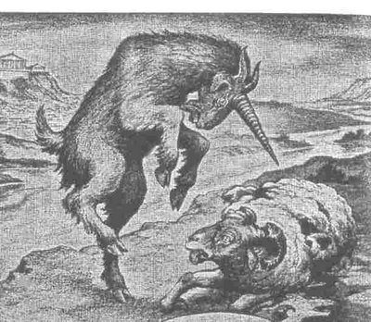
The He Goat lets him have it
“And as I was considering, behold, an he goat came from the west on the face of the whole earth, and touched not the ground: and the goat had a notable horn between his eyes. And he came to the ram that had two horns, which I had there seen standing before the river, and ran unto him in the fury of his power. And I saw him come close unto the ram, and he was moved with choler against him, and smote the ram, and brake his two horns: and there was no power in the ram to stand before him, but he cast him down to the ground, and stamped upon him: and there was none that could deliver the ram out of his hand. Therefore the he goat waxed very great: and when he was strong, the great horn was broken; and for it came up four notable ones toward the four winds of heaven.” Daniel 8:5-8

Slide 5
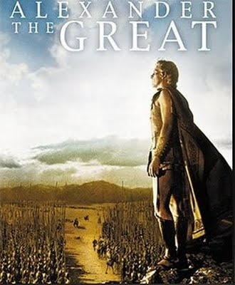
The He Goats Identity
“And the rough goat is the king of Grecia: and the great horn that is between his eyes is the first king. Now that being broken, whereas four stood up for it, four kingdoms shall stand up out of the nation, but not in his power.” Daniel 8:21,22
History records the destruction of the Medes and Persians at the hands of Alexander and Greece.

Slide 6
Parallels
Daniel 2,7, and 8 are following very distinct and clear patterns. Each covers similar ground with some small variations. Daniel2 covers the kingdoms, but brings in the Second Coming of Christ.
Daniel 7 covers the kingdoms, but brings in the role of the papacy and the judgment taking place in heaven after 1798.
Thus far, Daniel 8 covers kingdoms and will add its own little ‘twists’ as we proceed.

Slide 7
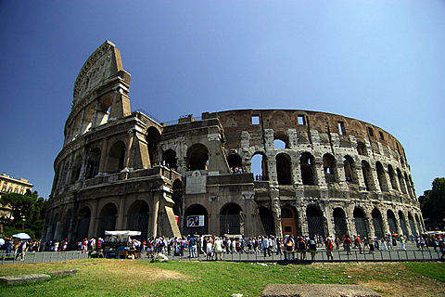
The Little Horn of Daniel 8
“And out of one of them came forth a little horn, which waxed exceeding great, toward the south, and toward the east, and toward the pleasant land. And it waxed great, even to the host of heaven; and it cast down some of the host and of the stars to the ground, and stamped upon them. Yea, he magnified himself even to the prince of the host, and by him the daily sacrifice was taken away, and the place of his sanctuary was cast down. And an host was given him against the daily sacrifice by reason of transgression, and it cast down the truth to the ground; and it practised, and prospered.” Daniel 8:9-12

Slide 8
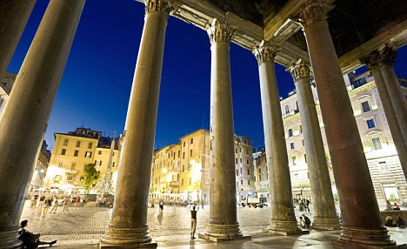
Pagan Rome
The little horn defeats the kingdom of Greece. By 168 B.C., Pagan Rome began to topple the Western part of the Greek Empire. For the next century and a half, this dismantling continued until the fall of the Greek kingdom of Ptolemy in 30 B.C. brought a final end to the Greek Empire.

Slide 9
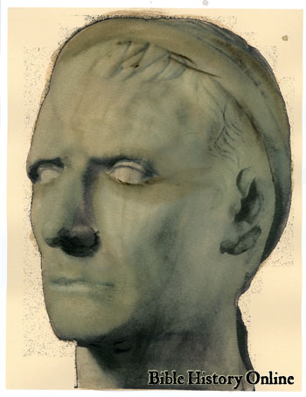
Why the Little Horn is not Antiochus Epiphanes
Antiochus was one leader of the Seleucid Kingdom, a division of Alexander’s Empire of Greece. He reigned from 175-164 B.C. This reign was only in the Seleucid part of the kingdom. The prophecy says that the little horn came from the west and that it waxed exceeding great; this did not happen to Antiochus. Antiochus did not exceed the power of the Greek kingdom; he was part of it!
The little horn of Daniel 8 is Pagan Rome and something else……………………………………………..

Slide 10
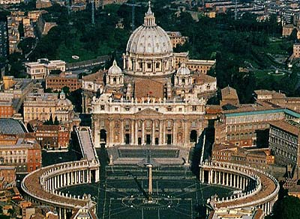
Papal Rome
In Daniel chapter 7, the non-descript beast and the little horn were used to denote pagan and papal Rome. In Daniel chapter 8, only the one symbol is used. The reason is because the characteristics of pagan and papal Rome are identical. Watch as we look at the characteristics………………………..

Slide 11
Pagan/Papal Rome look-a-likes
1. persecuted the people of God. (v. 10)
2. magnified himself against Christ. (v.11)
3. the daily and the sanctuary were assaulted by the little horn. (v. 11)
4. the truth was trampled. (v. 12)
Both were persecutors of God’s people and both attacked Christ. Both attacked the sanctuary and both trampled on the truth of God.

Slide 12
The Truth is Trampled
Pagan Rome attacked God’s law by the worship of the sun and their rejection of the 7th day Sabbath. They also were most cruel toward their fellow man.
Papal Rome attacked God’s law by setting up Sunday worship and by expunging the 2nd commandment from God’s law.
“Thy righteousness is an everlasting righteousness, and thy law is the truth.” Psalm 119:142
“Thou art near, O LORD; and all thy commandments are truth.” Psalm 119:151

Slide 13
Heaven’s Response to Rome’s Challenge
“Then I heard one saint speaking, and another saint said unto that certain saint which spake, How long shall be the vision concerning the daily sacrifice, and the transgression of desolation, to give both the sanctuary and the host to be trodden under foot? And he said unto me, Unto two thousand and three hundred days; then shall the sanctuary be cleansed.”

Slide 14
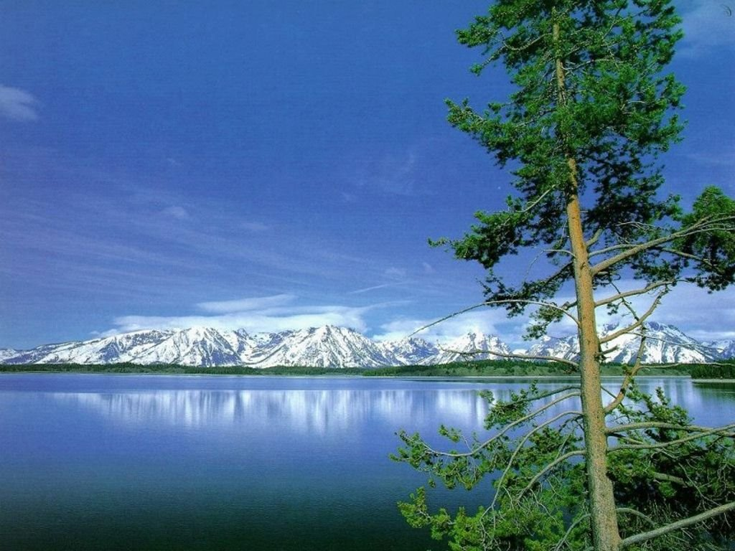
Centuries of Conflict
For centuries, pagan and papal Rome assaulted:
1. God’s people
2. Christ
3. the sanctuary
4. the law of God
Heavenly beings asked ‘For how long will this be allowed?’

Slide 15
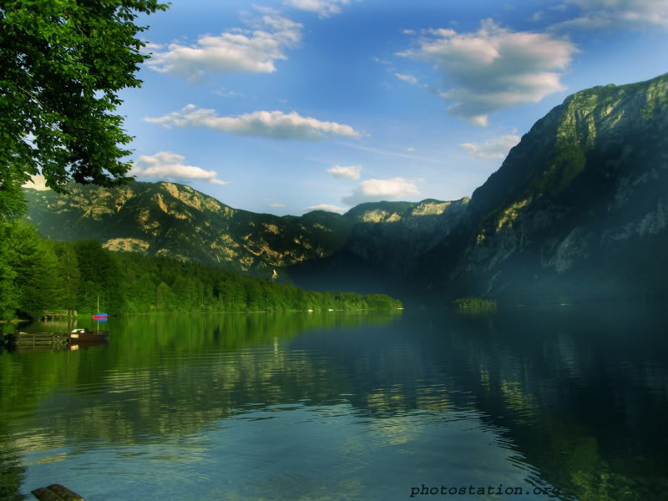
2,300 days
Does the answer fit the question? Many ‘scholars’ say no. Many say that the word for cleansed is not the right translation and that this has nothing to do with the cleansing of the heavenly sanctuary. The word for cleansed is tsadaq. It means ‘to restore to its rightful place’. On what day in the Jewish year was everything restored to its rightful state? Everything was made right on the Day of Atonement.

Slide 16
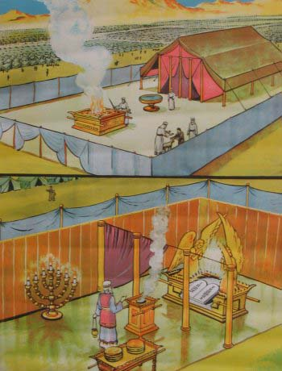
Synonymous Terms
It is amazing that there are three terms used to describe one day in the Jewish calendar. On the 7th month and the 10th day, there was:
1. the day of atonement
2. the day of judgment
3. the cleansing of the sanctuary.
Leviticus 16 and Leviticus 23:26-32 interchange the terms.

Slide 17
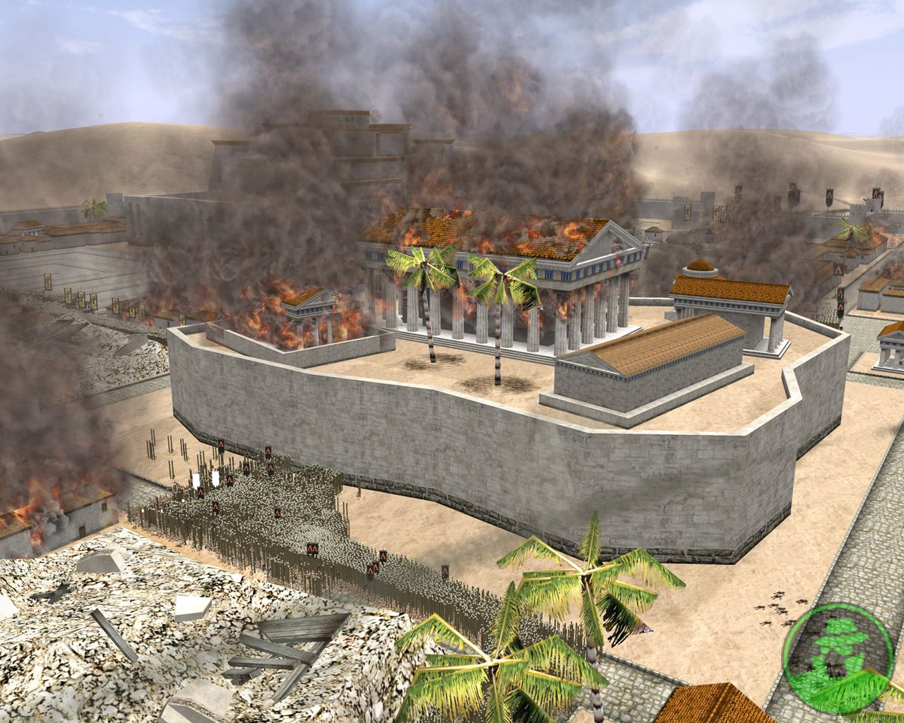
Does it Fit?
What does the Jewish Day of Atonement have to do with the assaults of pagan and papal Rome on the
1. people of God ?
2. Christ?
3. the sanctuary?
4. the law of God?

Slide 18
The Rightful State
At the end of this 2,300 year period, there would be a restoration of the truth of the sanctuary in heaven and Christ’s work in the heavenly sanctuary. There would be a vindication of the people of God in this end-time judgment. The law of God would be exalted at this time and restored.
Daniel 8:14 involves a group of people that would restore these great truths that had been trampled on for so long. A people would exalt these truths to all the world.

Slide 19
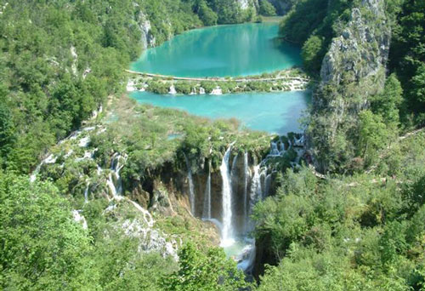
2,300 years
From Daniel 7, we were left with the clue that the judgment takes place after 1798. Now, we are told that 2,300 years would elapse before judgment or the cleansing of the sanctuary would take place. We are given no starting date for this time. In fact, this was the part of the chapter Daniel didn’t understand even the 2,300 years.

Slide 20
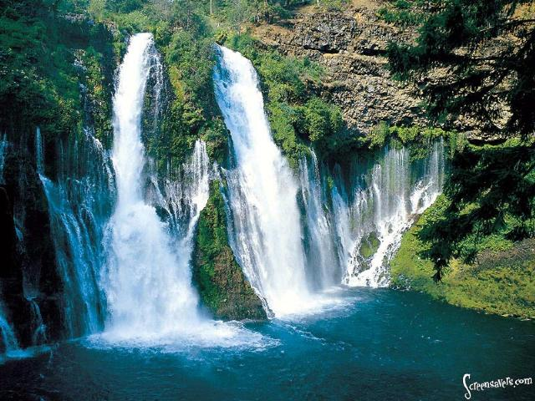
He Didn’t Understand it!
“And the vision of the evening and the morning which was told is true: wherefore shut thou up the vision; for it shall be for many days. And I Daniel fainted, and was sick certain days; afterward I rose up, and did the king's business; and I was astonished at the vision, but none understood it.” Dan. 8:26,27

Slide 21
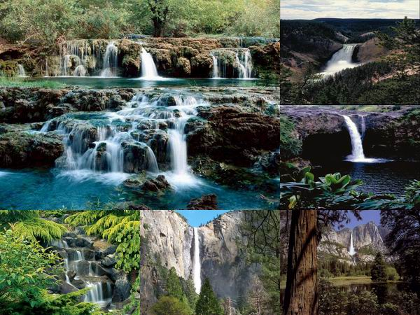
The plot thickens
Daniel understood:
1. the ram-Media/Persia
2. the he goat-Greece
3. The little horn-Pagan and Papal Rome
The only part that wasn’t clear was the part of the vision that related to time, even the 2,300 years, but Gabriel was told to “make this man to understand the vision.” verse 16

Slide 22

In Summation
We know:
The judgment takes place after 1798.
There is a time prophecy of 2,300 years connected to the judgment.
We should see Gabriel again, and when we do, he should explain the 2,300 year prophecy.

