Slide 1
Judges, pt. 3 “Prophetess”

Slide 2
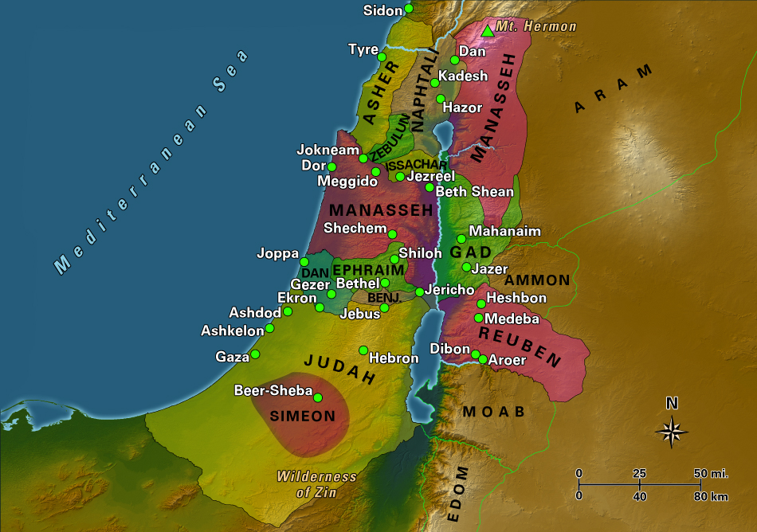
“And the children of Israel again did evil in the sight of the LORD, when Ehud was dead. And the LORD sold them into the hand of Jabin king of Canaan, that reigned in Hazor; the captain of whose host was Sisera, which dwelt in Harosheth of the Gentiles. And the children of Israel cried unto the LORD: for he had nine hundred chariots of iron; and twenty years he mightily oppressed the children of Israel.” Judges 4:1-3

Slide 3
They Did it Again!
“Deborah the prophet governed Israel during the reign of Jabin, a Canaanite king who was very cruel to the children of Israel. Life in the villages was harsh. The people were plundered and fled to the fortified cities for protection. Then the Lord raised up Deborah, who was like a loving mother to Israel. God sent a message through her to Barak that he should prepare to meet Sisera, Jabin's general, in battle. Barak refused to go unless Deborah went with him. She agreed, but warned him that because of his lack of faith in the words of the Lord, the honor of killing Sisera would go to a woman, not to Barak. The Israelites, having again separated themselves from God by idolatry, were grievously oppressed by [their] enemies. The property and even the lives of the people were in constant danger. Hence the villages and lonely dwellings were deserted, and the people congregated in the walled cities. The highroads were unoccupied, and the people went from place to place by unfrequented byways. At the places for drawing water, many were robbed and even murdered, and to add to their distress, the Israelites were unarmed. Among forty thousand men, not a sword or a spear could be found. For twenty years, the Israelites groaned under the yoke of the oppressor; then they turned from their idolatry, and with humiliation and repentance cried unto the Lord for deliverance.” Daughters of God, pgs. 36,37

Slide 4
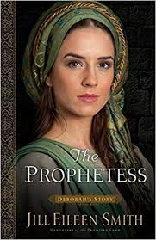
Deliverer, Judge, Prophetess
“There was dwelling in Israel a woman illustrious for her piety, and through her the Lord chose to deliver His people. Her name was Deborah. She was known as a prophetess, and in the absence of the usual magistrates, the people had sought to her for counsel and justice. The Lord communicated to Deborah His purpose to destroy the enemies of Israel, and bade her send for a man named Barak, of the tribe of Naphtali, and make known to him the instructions which she had received.” Daughters of God, pg. 37

Slide 5
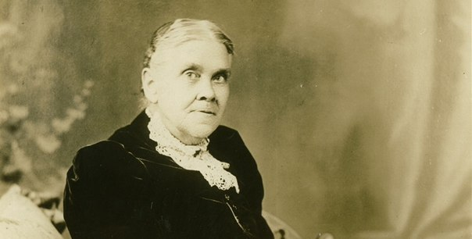
What Do You Know?
In a time of crisis in the history of God’s people, the Lord raised up a prophetess, judge, deliverer. Would He ever consider to do it again? And what would be the only hope for God’s people in this time of crisis? Would the people of God listen to the instructions of the prophetess? Would they embrace her heart and carry the torch to victory? Some would and would carry the torch to victory; others would not and would be found out making big time money and enjoying leisure while the battle raged!

Slide 6
The Insanity of it All:Weakest of Weak
"The vision was repeated the second time, and in addition he was told that if he still refused to relate what had been shown him, the burden would be taken from him, and be given to one of the weakest of the Lord's Children, one who would faithfully relate what God would reveal. Then a third vision was given, and he was told that he was released, and the burden was laid upon one of the weakest of the weak, who would do the Lord's bidding." —Loughborough, The Great Second Advent Movement, p. 182.
“Because the foolishness of God is wiser than men; and the weakness of God is stronger than men. For ye see your calling, brethren, how that not many wise men after the flesh, not many mighty, not many noble, are called: But God hath chosen the foolish things of the world to confound the wise; and God hath chosen the weak things of the world to confound the things which are mighty; And base things of the world, and things which are despised, hath God chosen, yea, and things which are not, to bring to nought things that are: That no flesh should glory in his presence.” 1 Corinthians 1:25-29

Slide 7
Instructions!
“And Deborah, a prophetess, the wife of Lapidoth, she judged Israel at that time. And she dwelt under the palm tree of Deborah between Ramah and Bethel in mount Ephraim: and the children of Israel came up to her for judgment. And she sent and called Barak the son of Abinoam out of Kedeshnaphtali, and said unto him, Hath not the LORD God of Israel commanded, saying, Go and draw toward mount Tabor, and take with thee ten thousand men of the children of Naphtali and of the children of Zebulun? And I will draw unto thee to the river Kishon Sisera, the captain of Jabin's army, with his chariots and his multitude; and I will deliver him into thine hand.” Judges 4:4-7

Slide 8
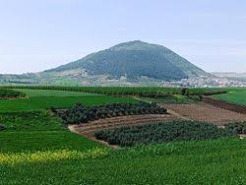
Mt. Tabor
The battle plan would be for Barak and his men to gather on Mt. Tabor. Then, as the armies of Sisera came up the mountain, the Israelites would come charging down, thus maximizing the army’s appearance and causing it to appear to be a huge army when in reality, it was not that big! The Lord caused a fear to come on Sisera and his mighty host and they fled from before the Israelites!

Slide 9
Another Battle, Another Time
“The murderers of Huss did not stand quietly by and witness the triumph of his cause. The pope and the emperor united to crush out the movement, and the armies of Sigismund were hurled upon Bohemia. But a deliverer was raised up. Ziska, who soon after the opening of the war became totally blind, yet who was one of the ablest generals of his age, was the leader of the Bohemians. Trusting in the help of God and the righteousness of their cause, that people withstood the mightiest armies that could be brought against them. Again and again the emperor, raising fresh armies, invaded Bohemia, only to be ignominiously repulsed. The Hussites were raised above the fear of death, and nothing could stand against them. A few years after the opening of the war, the brave Ziska died; but his place was filled by Procopius, who was an equally brave and skillful general, and in some respects a more able leader. The enemies of the Bohemians, knowing that the blind warrior was dead, deemed the opportunity favorable for recovering all that they had lost….

Slide 10
Victory
… In all the papal countries of Europe, men, money, and munitions of war were raised. Multitudes flocked to the papal standard, assured that at last an end would be made of the Hussite heretics. Confident of victory, the vast force entered Bohemia. The people rallied to repel them. The two armies approached each other until only a river lay between them. “The crusaders were in greatly superior force, but instead of dashing across the stream, and closing in battle with the Hussites whom they had come so far to meet, they stood gazing in silence at those warriors.”—Wylie, b. 3, ch. 17. Then suddenly a mysterious terror fell upon the host. Without striking a blow, that mighty force broke and scattered as if dispelled by an unseen power. Great numbers were slaughtered by the Hussite army, which pursued the fugitives, and an immense booty fell into the hands of the victors, so that the war, instead of impoverishing, enriched the Bohemians.” GC, pgs. 115,116

Slide 11
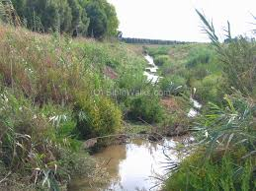
Kishon Brook
The bed runs along the bottom of a trench some 20 ft. deep through the plain. It is easily crossed at the fords by those who know how to avoid the localities of the springs. In time of heavy rains the trench is swiftly filled, and the soft soil of the plain goes to mud. Remembering this, it is easy to understand the disaster that overwhelmed the heavily armed cavalry and chariots of Sisera.

Slide 12
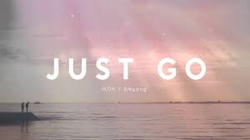
But How? Just Go!
Deborah gave no battle plans. She did not lay out the objectives or the wherewithal for there accomplishment. This was not Operation: Desert Storm or Operation: Desert Fox! It wasn’t even Operation: Brook Kishon! It was simply GO! By going down the mountain with your men and showing a willingness to face the enemy, this shows faith strong enough to abolish Jabin, Sisera, and his iron chariots!!!

Slide 13
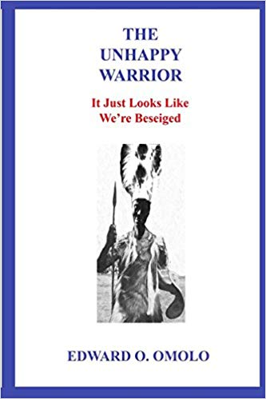
The Warrior Was Not Satisfied
“And Barak said unto her, If thou wilt go with me, then I will go: but if thou wilt not go with me, then I will not go. And she said, I will surely go with thee: notwithstanding the journey that thou takest shall not be for thine honour; for the LORD shall sell Sisera into the hand of a woman. And Deborah arose, and went with Barak to Kedesh.” Judges 4:8,9

Slide 14
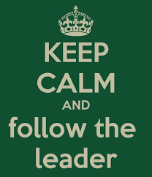
Follow the Prophetess!
“And Sisera gathered together all his chariots, even nine hundred chariots of iron, and all the people that were with him, from Harosheth of the Gentiles unto the river of Kishon. And Deborah said unto Barak, Up; for this is the day in which the LORD hath delivered Sisera into thine hand: is not the LORD gone out before thee? So Barak went down from mount Tabor, and ten thousand men after him. And the LORD discomfited Sisera, and all his chariots, and all his host, with the edge of the sword before Barak; so that Sisera lighted down off his chariot, and fled away on his feet.” Judges 4:13-15

Slide 15
Yahweh Sabaoth!
“The Lord communicated to Deborah His purpose to destroy the enemies of Israel, and bade her send for a man named Barak, of the tribe of Naphtali, and make known to him the instructions which she had received. She accordingly sent for Barak, and directed him to assemble ten thousand men of the tribes of Naphtali and Zebulun, and make war upon the armies of King Jabin. Barak knew the scattered, disheartened, and unarmed condition of the Hebrews, and the strength and skill of their enemies. Although he had been designated by the Lord Himself as the one chosen to deliver Israel, and had received the assurance that God would go with him and subdue their enemies, yet he was timid and distrustful. He accepted the message from Deborah as the word of God, but he had little confidence in Israel, and feared that they would not obey his call. He refused to engage in such a doubtful undertaking unless Deborah would accompany him, and thus support his efforts by her influence and counsel. Deborah consented, but assured him that because of his lack of faith, the victory gained should not bring honor to him; for Sisera would be betrayed into the hands of a woman....The Israelites had established themselves in a strong position in the mountains, to await a favorable opportunity for an attack. Encouraged by Deborah's assurance that the very day had come for signal victory, Barak led his army down into the open plain, and boldly made a charge upon the enemy. The God of battle fought for Israel, and neither skill in warfare, nor superiority of numbers and equipment, could withstand them. The hosts of Sisera were panic-stricken; in their terror they sought only how they might escape. Vast numbers were slain, and the strength of the invading army was utterly destroyed. The Israelites acted with courage and promptness; but God alone could have discomfited the enemy, and the victory could be ascribed to Him alone.” Daughters of God, pgs. 37,38

Slide 16
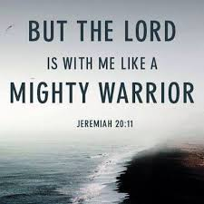
God of Battle!!!
“Lift up your heads, O ye gates; and be ye lift up, ye everlasting doors; and the King of glory shall come in. Who is this King of glory? The LORD strong and mighty, the LORD mighty in battle. Lift up your heads, O ye gates; even lift them up, ye everlasting doors; and the King of glory shall come in. Who is this King of glory? The LORD of hosts, he is the King of glory. Selah.” Ps. 24:7-10
Did we in our own strength confide,
Our striving would be losing;
Were not the right Man on our side,
The Man of God's own choosing.
Dost ask who that may be?
Christ Jesus, it is he;
Lord Sabaoth is his name,
From age to age the same,
And He must win the battle.

Slide 17

He Will do it Again!
“And after these things I saw another angel come down from heaven, having great power; and the earth was lightened with his glory. And he cried mightily with a strong voice, saying, Babylon the great is fallen, is fallen, and is become the habitation of devils, and the hold of every foul spirit, and a cage of every unclean and hateful bird. For all nations have drunk of the wine of the wrath of her fornication, and the kings of the earth have committed fornication with her, and the merchants of the earth are waxed rich through the abundance of her delicacies. And I heard another voice from heaven, saying, Come out of her, my people, that ye be not partakers of her sins, and that ye receive not of her plagues.” Rev. 18:1-4

Slide 18
