Slide 1
Japanese Invasion, pt. 2
Payback

Slide 2
Edict Undone
The Edict of 1639 remained in effect for over 200 years. Roman Catholicism and Spanish and Portuguese traders, were forbidden to show up at Japanese ports. Japan wanted nothing to do with foreign, ‘Christian’, religions. However, the papacy would not give up. She would resort to other means, other powers, to do her bidding. Hence, in 1853, the United States and Commodore Matthew Perry did Rome’s dirty work, opening up Japan to Rome all over again!

Slide 3
History Stinks!
On July 8, 1853, Commodore Matthew Perry of the United States Navy, commanding a squadron of two steamers and two sailing vessels, sailed into Tôkyô harbor aboard the frigate Susquehanna. Perry, on behalf of the U.S. government, forced Japan to enter into trade with the United States and demanded a treaty permitting trade and the opening of Japanese ports to U.S. merchant ships. This was the era when all Western powers were seeking to open new markets for their manufactured goods abroad, as well as new countries to supply raw materials for industry. It was clear that Commodore Perry could impose his demands by force. The Japanese had no navy with which to defend themselves, and thus they had to agree to the demands.
Perry's small squadron itself was not enough to force the massive changes that then took place in Japan, but the Japanese knew that his ships were just the beginning of Western interest in their islands. Russia, Britain, France, and Holland all followed Perry's example and used their fleets to force Japan to sign treaties that promised regular relations and trade.

Slide 4
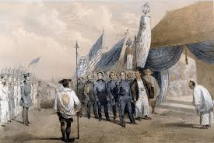
Trouble Arrives!
With the arrival of Perry in 1853, this meant the opening up of Japan to Western influence and the golden opportunity for Rome to infiltrate Japanese shores and to infect her with the poison of Romanism and to bring PAYBACK!

Slide 5
Assassination of Komei!
Emperor Kōmei did not care much for anything foreign, and he opposed opening Japan to Western powers, even as the shogun continued to accept foreign demands… By the time of Emperor Kōmei's death in 1867, the government was faced with bankruptcy and near collapse. In addition, Japan was surrounded by colonial powers, with substantial investments in Japanese trade, who stood poised to gain considerable influence. Precipitated by the signing of the unequal trade treaties with the Western powers, such as the Treaty of Kanagawa and the Harris Treaty, which were signed without Imperial sanction and in spite of the Emperor's refusal to approve it, he twice expressed his will to resign from his position in protest… Emperor Kōmei generally agreed with anti-Western sentiments, and, breaking with centuries of imperial tradition, began to take an active role in matters of state: as opportunities arose, he fulminated against the treaties and attempted to interfere in the shogunal succession. His efforts culminated in 1863 with his "Order to expel barbarians“… In January 1867 the emperor was diagnosed with smallpox. This caused surprise because it was said that Kōmei had never been ill before. On 30 January 1867 he suffered a fatally violent bout of vomiting and diarrhea. He had purple spots on his face caused by smallpox. It is widely thought that he was assassinated, probably by radicals from Choshu, as he drew closer to the Shogun in mutually seeking to define a way forward for Japan under increasingly challenging circumstances. There are no indications that anyone that he came into contact with before contracting the disease had been infected, so it is thought that a handkerchief or the like contaminated with the virus was transferred to him through some conduit in the court. He was murdered by Rome!

Slide 6
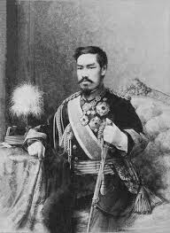
Meiji Takes Over as Puppet of Rome!
The Results?
1. The ban on Christianity was finally lifted in 1873. As a result, Catholic/Jesuit infiltrators overran the country.
2. Power was consolidated in one man-Meiji, who feared for his life from his Jesuit controllers!!!

Slide 7
Catholics Protected!
“The Order, in control of the Japanese Emperor Hirohito and his warlord, Tojo, used the Imperial Army to persecute Protestants but bless the Catholic missionaries. The Jesuits declared in their review ‘America’ in January of 1944: “ . . . the American and English citizens arrested in the Pacific Islands, and in particular all the Protestant missionaries, were interned there in concentration camps which were in no way inferior to those of Germany. But . . . the 7,500 Catholic missionaries remained free, they received help
and were officially protected by the Japanese military authorities.” The Vatican Against Europe, pg. 226

Slide 8
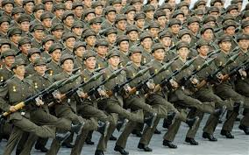
Meiji Attacks Rome’s Old Enemies!
During Meiji’s regime, he attacked two of the Jesuits old enemies, China in 1895 and Russia in 1905. China had expelled the Jesuits in 1716 and again in 1783. Russia had driven the Jesuits out of Russia in 1820. Japan was being used to do Rome’s dirty work, but payback would come! Meiji was controlled by Rome from 1868 to 1912!

Slide 9
Trouble Begins to Brew!
In the Far East the Jesuits had a score to settle with Japan. Remembering that the shogun Iyeyasu had formally expelled the Jesuits in 1614, the Order had been barred from reentry for over two hundred and fifty years. So the Jesuits forced the shogun to resign, obtained control over Emperor Meiji, were formally readmitted in 1865 and ultimately orchestrated a war with the United States. We read in 1924: …………

Slide 10
“The next step in the Vatican ’s Great Scheme is to make war between this country and Japan after the latter country has been placed under full dominance of the Jesuits. The priests, monks and nuns of the Roman Church have been pouring into Japan from all over the world now for many years with that purpose in view. The writer was told by a Christian Japanese minister in charge of a Protestant mission in Los Angeles in reply to the question as to why the Jesuits, who had been barred for years from Japan had now been permitted to enter. He answered that the Roman Church had gotten into his country under the guise of Mohammedanism, and that after it was well entrenched threw off its disguise, and his country learned to its astonishment that it was to the Roman Church and its monastic orders it had opened its doors…” Suppressed Truth About the Assassination of Lincoln, Burke McCarty, pg. 12

Slide 11
The Time Had Arrived!
“President Roosevelt’s responsibility for goading the Japanese into war by sending a war ultimatum on November 26, 1941, demanding that the Japanese withdraw all troops from Indo-china, and China (Manchuria) is an historic fact, although a closely-guarded secret. FDR’s war ultimatum was deliberately withheld from Congress until after Pearl Harbor... all agreed that the ultimatum left Japan no alternative but war... The Japanese would have done almost anything to avoid war with America... Prince Kenoye, the prime minister, who was very peacefully inclined, repeatedly requested to come to Washington or Honolulu to meet with President Roosevelt. He was willing to agree to our terms to keep out of war on a modus Vivendi but…

Slide 12
“…FDR refused to talk with the Japanese prime minister simply because he was determined to get into war with Japan, and through that, with Germany. The American ambassador in Tokyo, Joseph Grew, knew how much the Japanese wanted to maintain peaceful relations and urged such a conference. But FDR and his fellow ardent interventionists used ruses, dodges and tricks to involve us in a totally unnecessary war.” Hamilton Fish, FDR- The Other Side of the Coin, Vantage Press, pp. 132-134.

Slide 13
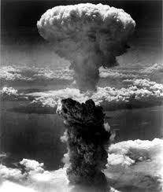
A Price to be Paid!
Every effort on the part of the Japanese to avoid war was fruitless. Roosevelt and his Jesuit cronies would hear of no peaceful resolutions. Japan would receive payback for her ousting of the Jesuits way back in the 1600’s!

Slide 14
Blockade Provocation!
“By 1941, the Japanese and American governments, controlled by the Jesuits, were ready for war. Twenty-five years of anti-Jap agitation was ready to yield its bitter fruit. On December 7, 1941 the Japanese attacked Pearl Harbor crippling the majority of the American Fleet — except the carriers. According to a Japanese Baptist Missionary, the late Daniel Fuji, he told the author the attack was provoked by a blockade of Japan called “the A, B, C, D line.” The American, British, Canadian and Dutch fleets blocked Japanese shipping, cutting off its oil, which, in International

Slide 15
Law, was an act of war! So, the Japanese attacked, as FDR knew they were coming and did nothing, giving Congress a legitimate reason to declare war. We read:
“Roosevelt now knew that Japan planned on attacking the United States, but still he did nothing about warning the American forces at Pearl Harbor . . . Admiral Husband Kimmel, the commander of the naval forces at Pearl Harbor, clearly places the blame for Pearl Harbor’s unpreparedness on President Roosevelt. He has written: ‘We were unready at Pearl Harbor because President Roosevelt’s plans required that no word be sent to alert the fleet in Hawaii.’ The Unseen Hand, pgs. 282,283

Slide 16
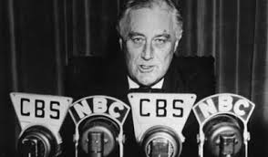
Bloody Puppet!
This bloody puppet of the Jesuits, FDR, had to have an excuse for bringing America into the war. He goaded the Japanese into attacking Pearl Harbor. He knew they would in retaliation and did nothing to protect American interests or lives! He was a bold faced liar!

Slide 17
No War!?
Fish believed that Roosevelt’s deception of the American people was an immoral and infamous act. This shrewd and astute politician covered his tracks by shouting from the housetops and denouncing the attack on Pearl Harbor as a day of infamy, blaming it entirely on the Japanese. While Roosevelt was trying to bring America into war with Japan, he was telling Americans, “While I am talking to you mothers and fathers, I give you one more assurance. I have said this before, and I shall say it again and again: Your boys are not going to be sent into any foreign wars.” -- ibid. p. 29.

Slide 18
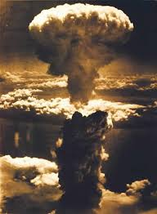
Payback Had Come!
Driving the Jesuits out of Japan in the 16th and 17th centuries would have its consequences. The 26 Catholic infiltrators were justly killed for insurrection against the Japanese government. The papal power calls them martyr’s, dying for their faith. What blasphemy!

Slide 19
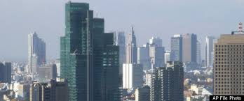
Japan Today
Japan is virtually identical to America. It is a commercial and industrial power. While it carries a façade of democracy, it moves constantly toward a more centralized government. Centralized power is so much easier to control and this is Rome’s perfect govt!

