Slide 1
What is the Difference Between Mormons, Jehovah’s Witnesses, and Seventh-day Adventists? pt 2

Slide 2
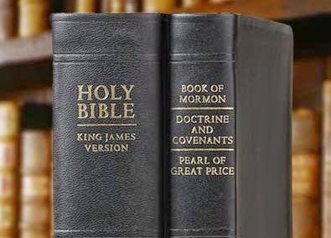
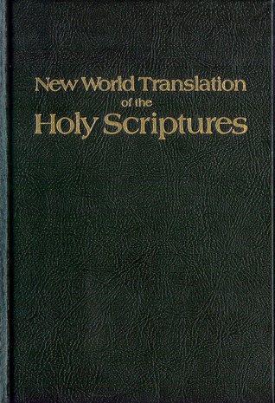
What We Will Study….
Origins of the Religion
Their Authorities and/or Authoritative Texts
Their Doctrinal Differences
Their Message to the World

Slide 3
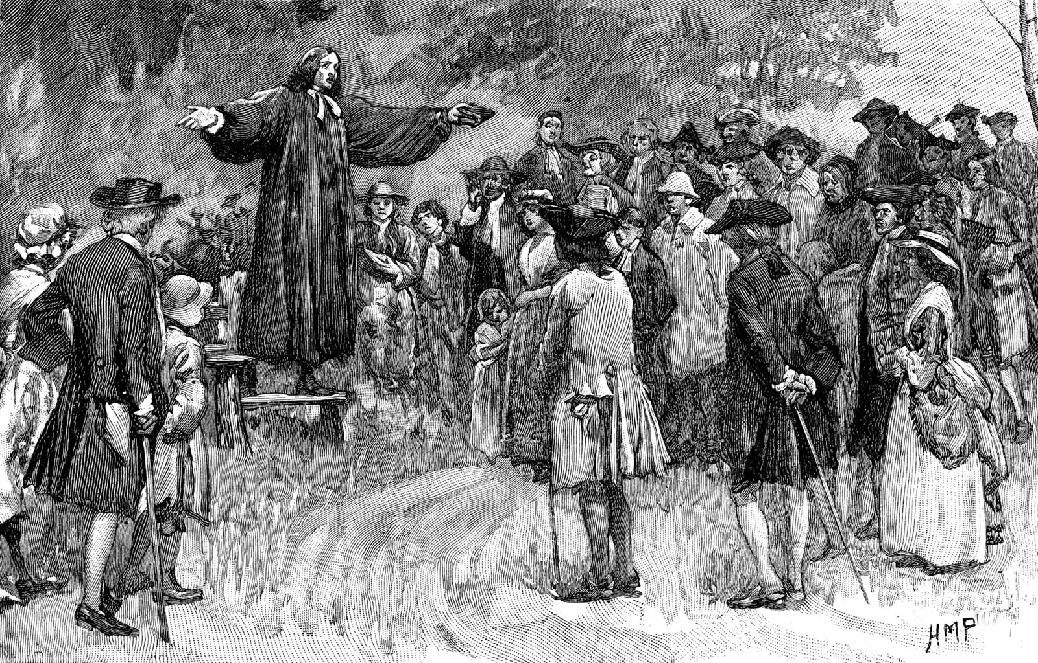
The Backdrop: The Great Awakening
“The Great Awakening came to an end sometime during the 1740s. In the 1790s, another religious revival, which became known as the Second Great Awakening, began in New England. This movement is typically regarded as less emotionally charged than the First Great Awakening. It led to the founding of several colleges, seminaries and mission societies. A Third Great Awakening was said to span from the late 1850s to the early 20th century. Some scholars, however, disagree that this movement was ever a significant event.” History.com, Great Awakening, Sept. 2019

Slide 4
The Warlock of New York
Joseph Smith is a confirmed “treasure digger” and “diviner” according to Mormon sources:
“In frontier America, seer stones or “peep stones” were commonly used by lost object finders, people engaged in the widespread practice of lost treasure digging, and sometimes by people seeking to uncover the kind of truths we might call a private or police detective for today. It is unclear how much of this kind of activity Joseph Smith was involved in, except for water divining and treasure digging, which are widely attested.” (BYU Studies Quarterly, Vol.55, No.1, 2016)

Slide 5
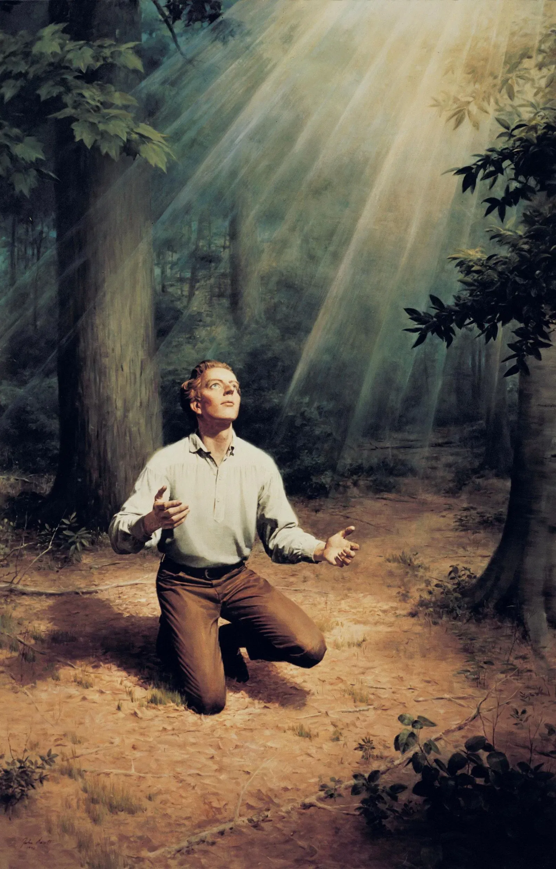
In League With Whom?
1 Cor. 10:20 “But I say, that the things which the Gentiles sacrifice, they sacrifice to devils, and not to God: and I would not that ye should have fellowship with devils.”

Slide 6
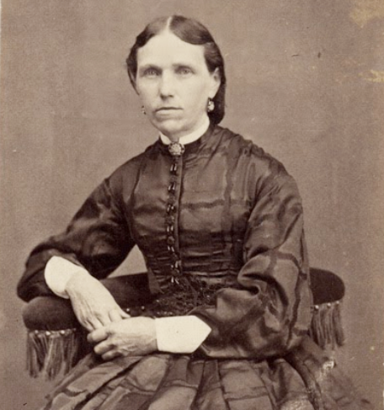
Polygamy: True or Fairy Tale?
“In the year 1842, President Joseph Smith sought an interview with me, and said: “I have a message for you. I have been commanded of God to take another wife, and you are the woman.” My astonishment knew no bounds. This announcement was indeed a thunderbolt to me. He asked me if I believed him to be a prophet of God. “Most assuredly I do,” I replied. He fully explained to me the principle of plural or celestial marriage. He said this principle was again to be restored for the benefit of the human family, that it would prove an everlasting blessing to my father’s house, and form a chain that could never be broken, worlds without end. “What have you to say?” he asked. “Nothing.” How could I speak, or what could I say? He said, “If you will pray sincerely for light and understanding in relation thereto, you shall receive a testimony of the correctness of this principle. I thought I prayed sincerely, but was so unwilling to consider the matter favorably that I fear I did not ask in faith for light. Gross darkness instead of light took possession of my mind. (Lucy Walker’s Journal, quoted in: Lyman Omer Littlefield, Reminiscences of Latter-day Saints: Giving an Account of Much Individual Suffering Endured for Religious Conscience, p. 46-48)

Slide 7
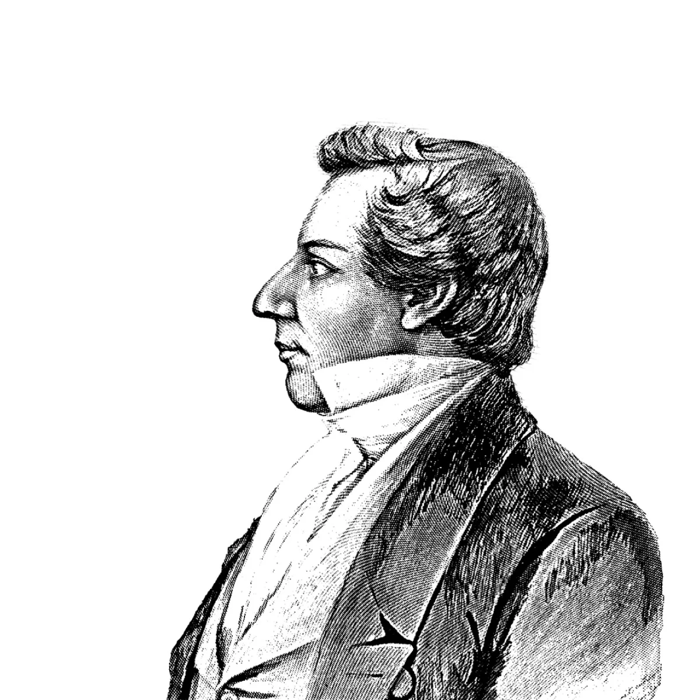
Lucy Walker: In the Pit of Despair!
“I was tempted and tortured beyond endurance until life was not desirable. Oh that the grave would kindly receive me, that I might find rest on the bosom of my dear mother. Why should I be chosen from among thy daughters, Father, I am only a child in years and experience, no mother to counsel [she died in January, 1842]; no father near to tell me what to do in this trying hour [he was on a mission to a warmer climate to help his health]. Oh, let this bitter cup pass. And thus I prayed in the agony of my soul. The Prophet discerned my sorrow. He saw how unhappy I was, and sought an opportunity of again speaking to me on this subject, and said: “Although I cannot, under existing circumstances, acknowledge you as my wife, the time is near when we will go beyond the Rocky Mountains and then you will be acknowledged and honored as my wife.”5 He also said, “This principle will yet be believed in and practiced by the righteous. I have no flattering words to offer. It is a command of God to you. I will give you until tomorrow to decide this matter. If you reject this message the gate will be closed forever against you. . . The first day of May, 1843, I consented to become the Prophet’s wife, and was sealed to him for time and all eternity, at his own house by Elder William Clayton.” (Ibid., p. 46-48)

Slide 8
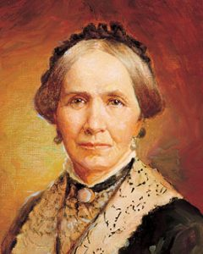
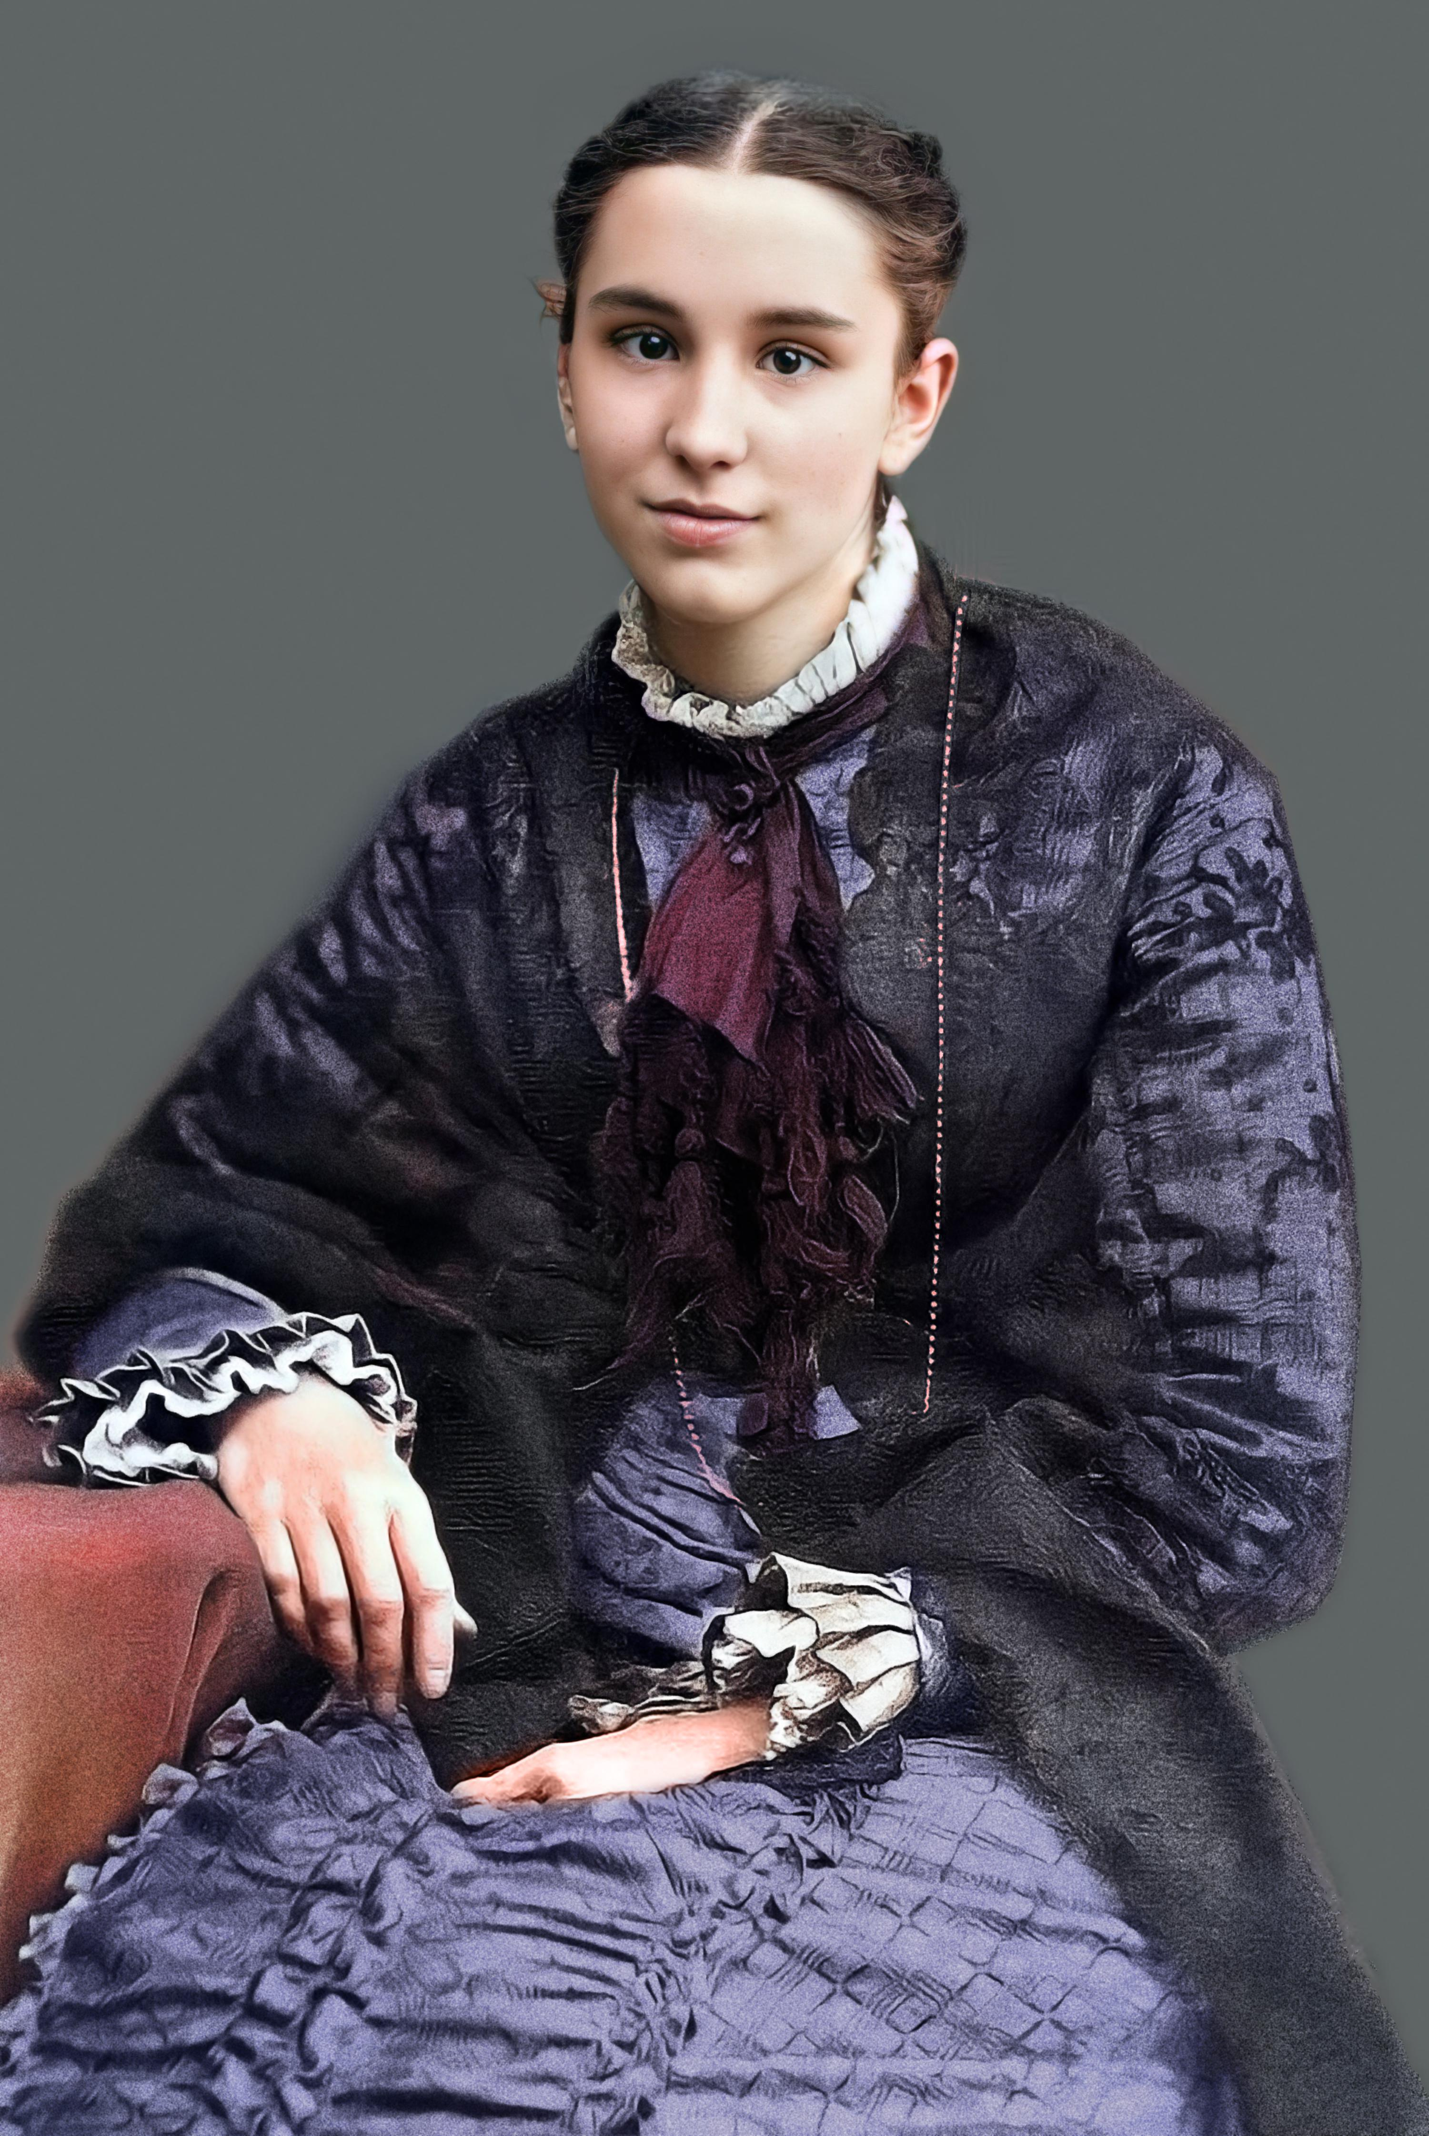
Other Stories….
“The youngest [wife] was Helen Mar Kimball, daughter of Joseph’s close friends Heber C. and Vilate Murray Kimball, who was sealed to Joseph several months before her 15th birthday. Marriage at such an age, inappropriate by today’s standards, was legal in that era, and some women married in their mid-teens.” (churchofjesuschrist.org, Gospel Essays, Plural Marriage in Kirtland and Nauvoo)
-Joseph Smith also married a woman who was 7 months pregnant: Zina Huntington Jacobs, several sister pairs: Emily and Eliza Partridge, and a mother-daughter pair

Slide 9
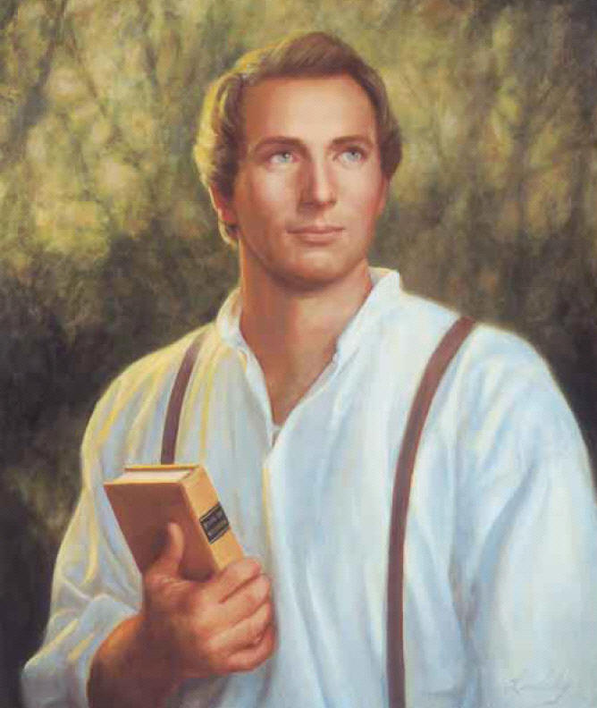
The 2nd Muhammad?
“With their backing [the Danites], this powerful force gave “The Prophet” the courage to flex his muscles. He became fierce with pride and boldness. He actually said: ‘If the people will let us alone, we will preach the gospel in peace. But if they come upon us to molest us, we will establish our religion with the sword. We will trample down our enemies and make it one gore of blood . . . From the Rocky Mountains to the Atlantic Ocean. I will be to this generation a 2nd Muhammad, whose motto in treating for peace was ‘the Al-Qur’an or the sword’ So shall it eventually be with us—’Joseph Smith or the sword!’ (see History of the Church, Vol. 3, p. 167)” Jack Chick, The Enchanter, p. 23

Slide 10
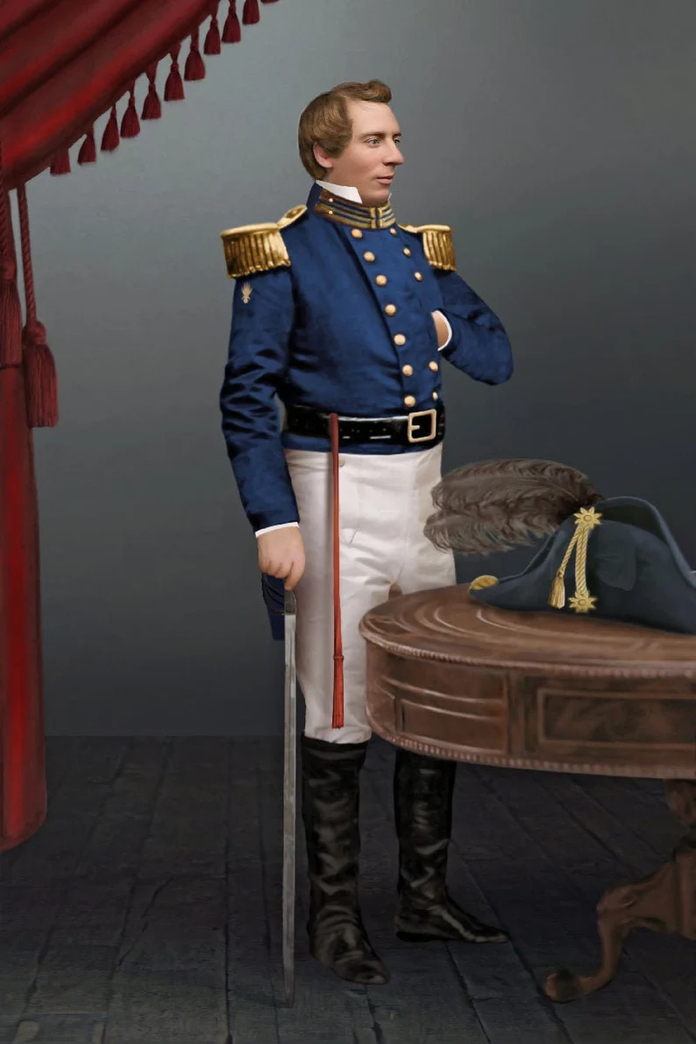
New Doctrines for Nauvoo
It was in Nauvoo that new doctrines were introduced, starting in 1840, with “Baptism for the dead”, the Nauvoo Temple, in May 1842 Smith created the “first anointing” or endowment, which was a ceremony designed to prepare Christians to be kings and queens, priests and priestesses in heaven. It highly resembled the Freemason rite of “at sight” which he had recently took 2 months prior in the Nauvoo Masonic Lodge. “At sight” is when a non-Mason is initiated into Freemasonry and immediately promoted to Master Mason by the power of a Grand Master. Moreover, Zion was no longer to be built in a specific place but all of North and South America was to be the New Zion, with each local church representing a tent “stake” in that region (see Bushman, 2005, 350-410)

Slide 11
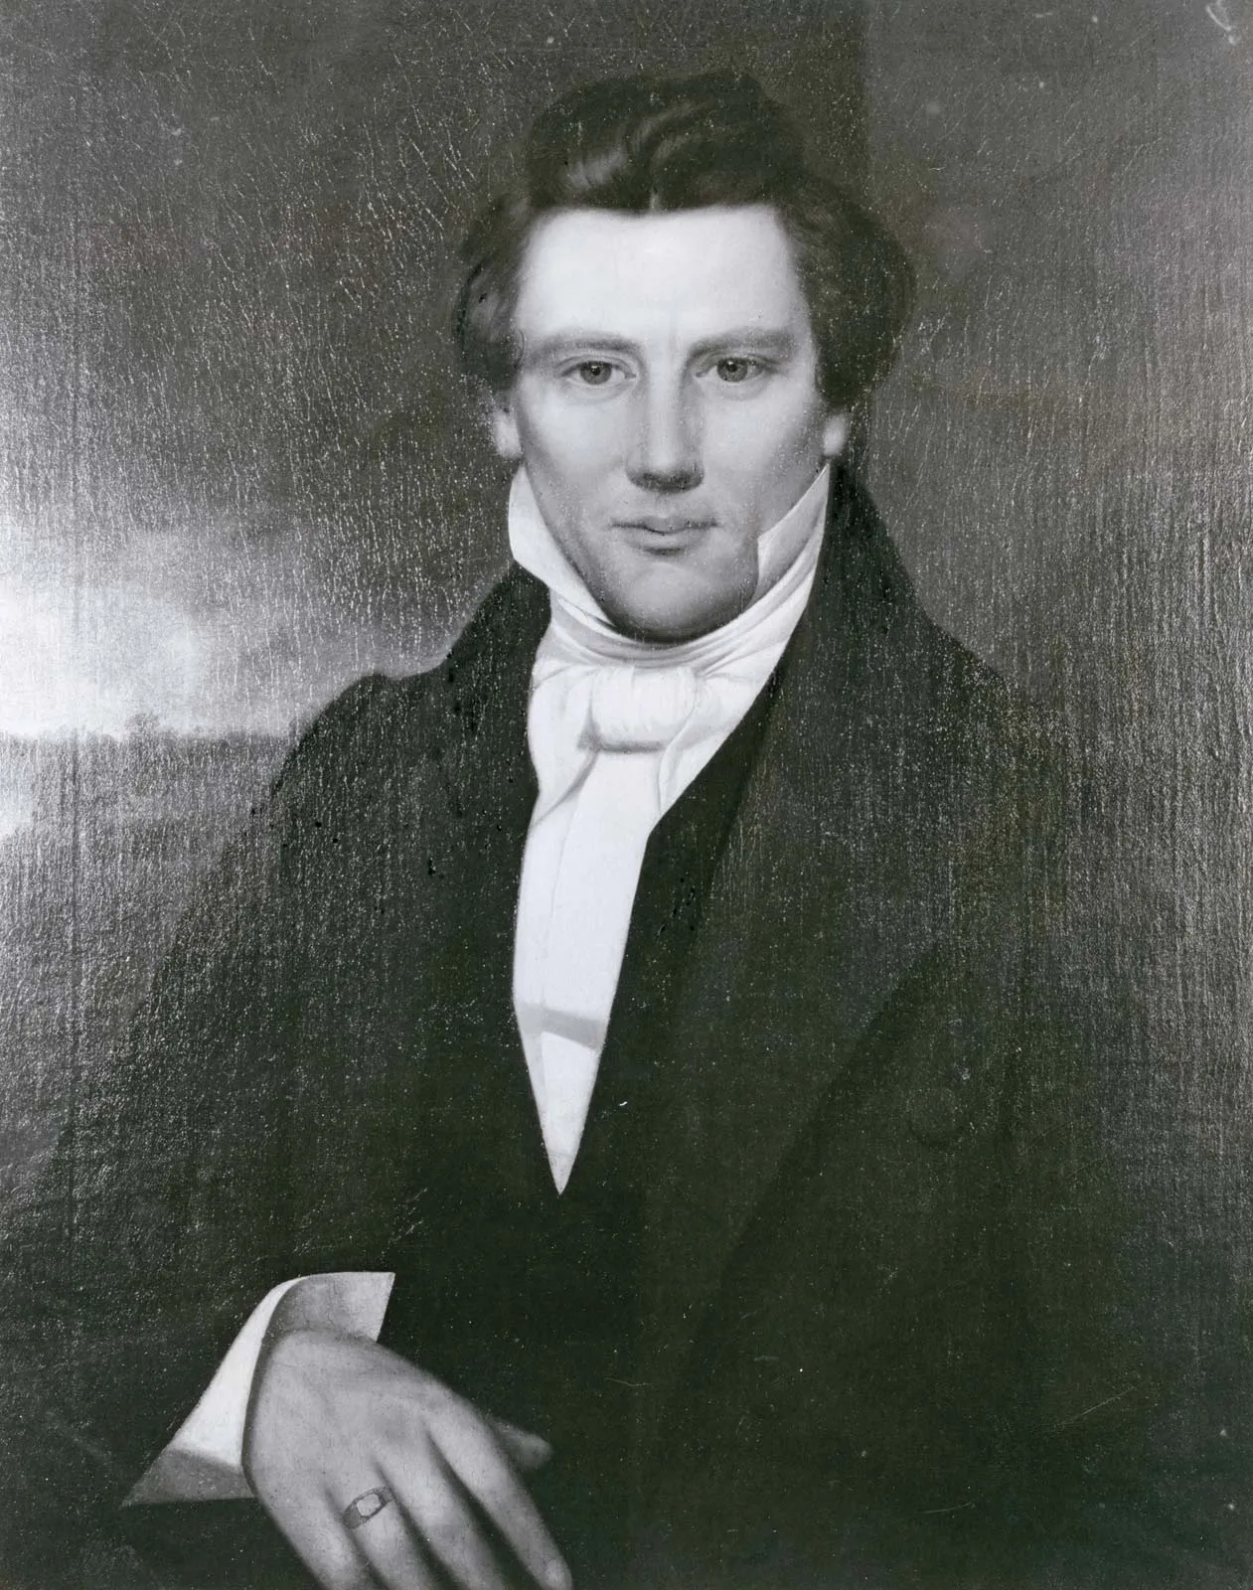
Freemasonry and Protestantism??
Eph. 5:11 “And have no fellowship with the unfruitful works of darkness, but rather reprove them.”
2 Cor. 6:14-17 “Be ye not unequally yoked together with unbelievers: for what fellowship hath righteousness with unrighteousness? and what communion hath light with darkness? And what concord hath Christ with Belial? or what part hath he that believeth with an infidel? And what agreement hath the temple of God with idols? for ye are the temple of the living God; as God hath said, I will dwell in them, and walk in them; and I will be their God, and they shall be my people. Wherefore come out from among them, and be ye separate, saith the Lord, and touch not the unclean thing; and I will receive you.”

Slide 12
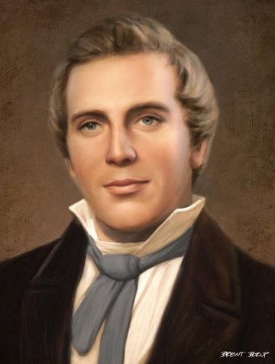
More Insanity
In Summer 1842, he revealed plans to establish Theocratic rule over the earth, setting us God’s Millennial Kingdom. He also married many additional wives during this time, called “plural marriage”. In the beginning, he kept the doctrine secret, except to John Bennett, who called it spiritual wifery. However, when polygamy rumors went abroad, Smith forced Bennett to resign as mayor of Nauvoo, which made Bennett his open enemy. Eventually, Mormon hatred became prevalent again, and an assassination attempt against Missouri Governor Boggs, led to the order to extradite Smith, which failed, but later old charges of treason which were never resolved rekindled the extradition order. Smith was handed over by Illinois Governor Thomas Ford in 1843 but intercepted by Mormons before he could get back to Missouri (see Bushman, 2005, p. 400-508)

Slide 13
Smith for President
In 1843, Smith petitioned Congress to make Illinois a territory with the right to call out federal troops to its defense, which was denied. Smith then petitioned Presidential candidates for commitments to protect the Mormons, but when he received negative comments back, he announced his independent bid to run for President of the United States! He suspended proselytizing and sent Mormons as political missionaries. By 1844, a rift between Smith and his two powerful followers William Law and Robert Foster occurred when it was discovered that Smith had allegedly attempted to seduce their wives and add them to his plural marriage companions. He promptly excommunicated them on April 18, 1844 (see Ostling, Richard; Ostling, Joan K. (1999). Mormon America: The Power and the Promise, p. 14)

Slide 14
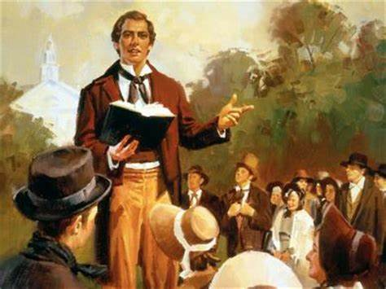
Joseph Strikes Back!
“Scandal broke out! It was Joseph Smith against the men whose wives he had abused. (He called those men “Apostates”). In an explosive sermon he bragged: ‘I’m the only man that has been able to keep a whole Church together since the days of Adam! I boast that no man ever did such as I. The followers of Jesus ran away from Him . . . But the Latter Day Saints never ran away from me . . . Yet!’ (see History of the Church, Vol. 6 p. 408-409)” Jack Chick, The Enchanter, p. 27

Slide 15
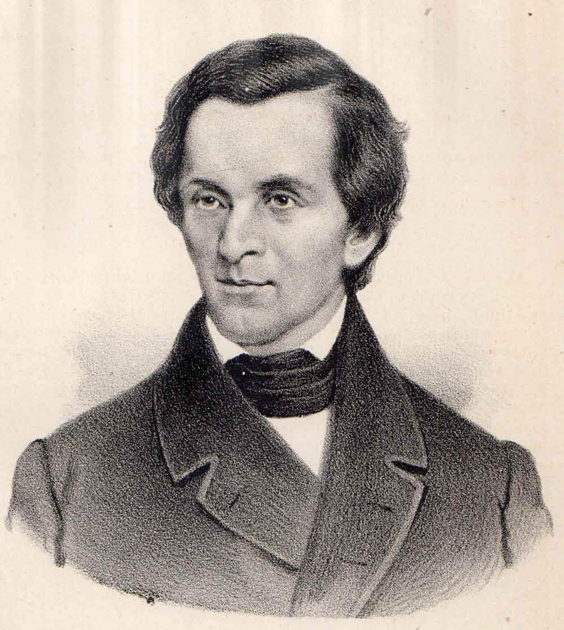
The End…
By June of 1844, The Dissenters published the Nauvoo Expositor calling for reforms within the church but also requesting political assistance from non-Mormons in the area to repeal the Nauvoo Charter, making void the political stranglehold that Mormons had in Nauvoo. The Nauvoo Legion (the autonomous militia of Nauvoo) was ordered at the direction of Smith to destroy the press, making freedom of the press effectively illegal in Nauvoo. This act, brought a call to arms from a critic of Joseph Smith, and as a result the Nauvoo Legion was mobilized and martial law declared in Nauvoo. This caused the state militia under Governor Thomas Ford to force Smith and the Nauvoo council to surrender, which after initially fleeing they eventually did (see Ostling, Richard; Ostling, Joan K. (1999). Mormon America: The Power and the Promise, p. 16)

Slide 16
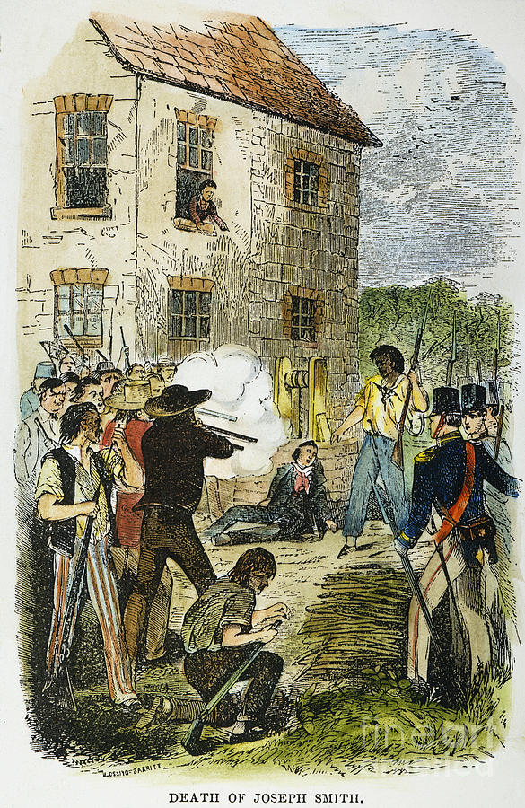
By the Sword…
On June 25th 1844, Joseph Smith, his brother Hyrum, and other willing followers were in custody of Carthage, Illinois. On June 27, 1844 a mob with blackened faces stormed Carthage Jail, and shot Hyrum in the face, and shot Joseph Smith as he fell out of a window, where he was shot more once he hit the ground before the mob dispersed. He was screaming ‘Oh Lord, my God!’ before he hit the ground. 5 men were charged with his murder but all were acquitted due to identification factors. At that point, Brigham Young became the new Mormon leader, expanding LDS doctrines, and making new settlements in Salt Lake Valley in Utah. Other groups who did not agree with Young as the appointment splintered into smaller Mormon groups, some went with Sidney Rigdon and James J Strang, others went to Texas with Lyman Wight (see Bushman 2005, p. 500-600

Slide 17
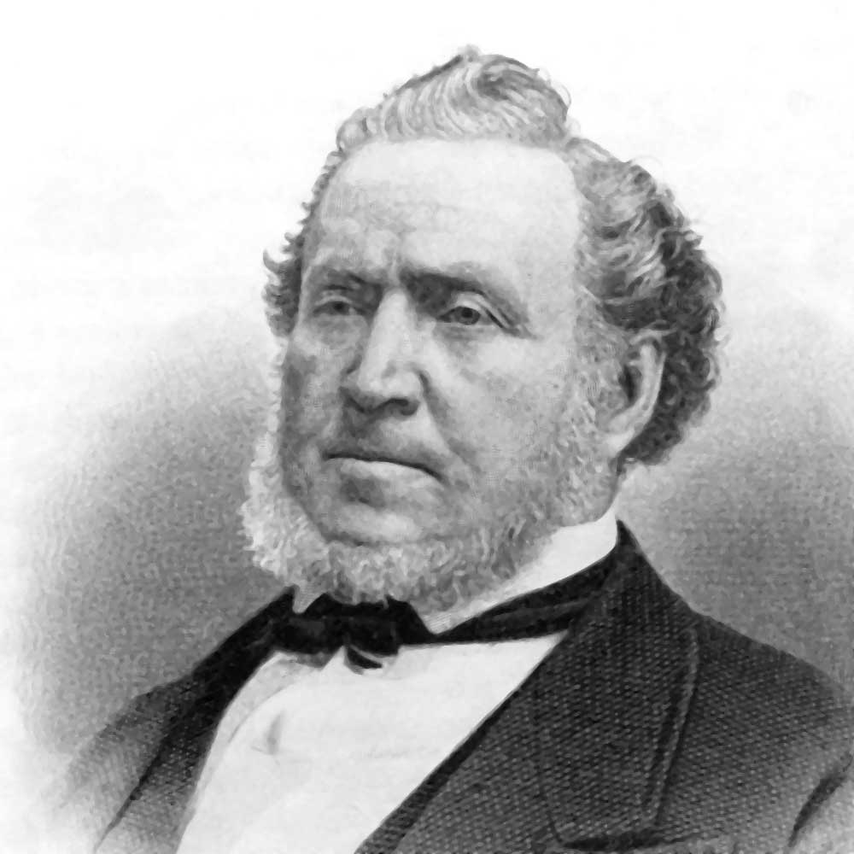
Brigham Young, the New Leader…
“In 1846 at Council Bluffs, while moving 10,000 of his followers West, Young met with one of the Order's most powerful American Jesuits, Pierre-Jean De Smet. . . . The Jesuit directed Young to move his "Saints" to the Great Valley of the Salt Lake; Young obeyed, and upon arrival organized his new nation of "Deseret" along the lines of the Order's socialist Paraguayan Reductions. In 1857 Masonic President James Buchanan, controlled by the Jesuits since his early 1857 arsenic poisoning, began a political agitation over the governorship of Utah, igniting the bloodless "Utah War.“ . . . That same year Young ordered Bishop John D. Lee to lead a force composed of Mormons and Paiute Indians to murder nearly 130 "heretic" Protestant emigrants at Mountain Meadows- pursuant to the Order's wicked Council of Trent and bloody Jesuit Oath. In the Spring of 1858 Masonic President Buchanan arranged for a free pardon if the Mormons would submit to Federal authority. The chief negotiator between both parties was the Jesuit, Pierre-Jean De Smet! Jesuit Coadjutor Brigham Young died in 1877, and will one day answer to the Lord Jesus Christ!” (Vatican Assassins, Eric Jon Phelps, p. 319

Slide 18
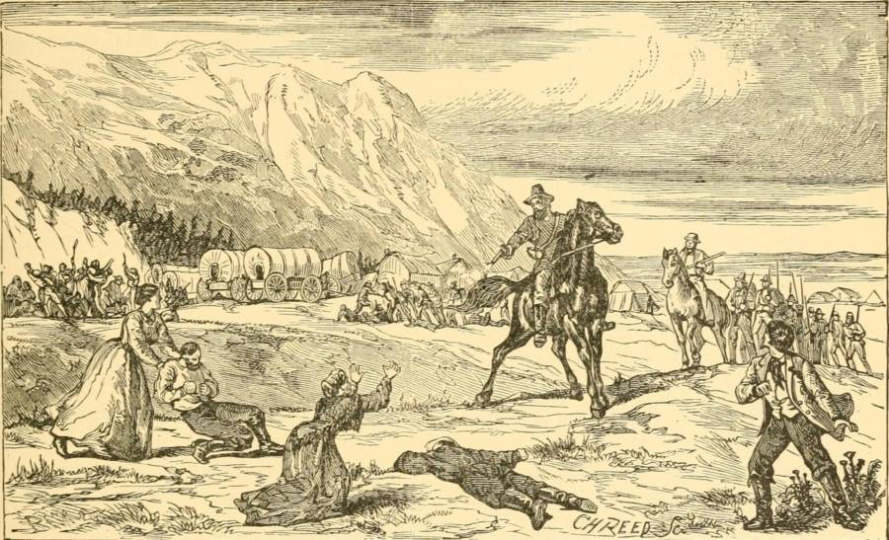
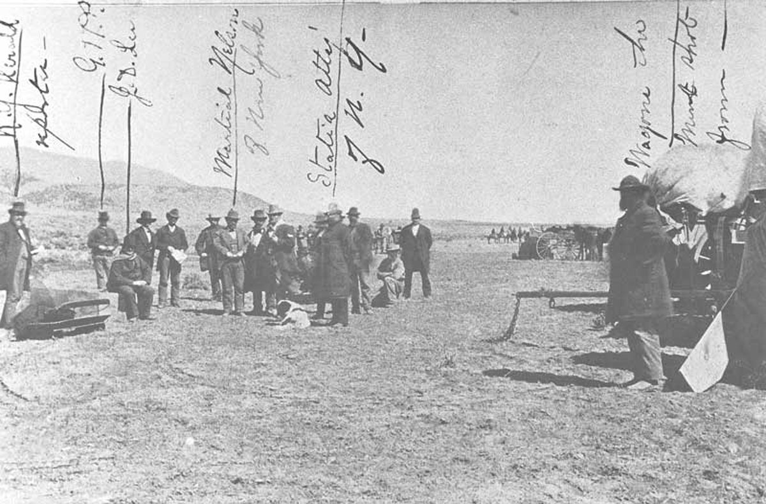
Massacre of Pioneers…
“Angered by the emigrants’ abuse and fired by a zealous passion against the growing tide of invading gentiles, a group of LDS guerillas from around Cedar City decided to take revenge. Cooperating with a group of Paiutes who had already attacked the train on their own initiative, the guerillas initially pretended to be protectors. The guerillas persuaded the emigrants that they had convinced the Paitues to let them go if they would surrender their arms and allow the Latter-day Saints to escort the wagon train through the territory. But as the train again moved forward under the LDS escort, a guerilla leader gave a pre-arranged signal. The Latter-day Saints opened fire on the unarmed male emigrants, while the Paiutes reportedly murdered the women.” (History.com, This Day in History: September 11, 1857, 120 Emigrants Murdered at the Mountains Meadow Massacre)

Slide 19
The Legacy:
Joseph Smith Claimed to have seen the Father in 1820—an impossibility because no man has seen the Father, and Joseph was practicing forms of witchcraft, which made him in touch with demons not heavenly beings
Joseph Smith receives the “golden plates” while he is using magic and breaking the law, of which he stands trial in 1826—he defrauds Josiah Stowell and later Ohioans
Joseph Smith claims revelations that do not come true (Salem treasure), makes plans that God cannot bring to pass (Ohio Bank), loses almost every military engagement (no spiritual backing)
Joseph Smith is a practicer of Freemasonry, a Satanic organization, and destroys the lives of his followers by taking young brides, forcing the men to go on mission and sell all—all the while publicly condemning polygamy.
Joseph Smith dies in 1844, the year of the 2300 year prophecy of the Millerites, by an angry mob with seemingly no divine assistance from God
Brigham Young has ties to Rome, and the Jesuit de’Smet, begins practicing polygamy openly, taking 50+ wives
Problems arise between the Federal Government and the Mormons of several occasions, even causing the necessity of the Army to be marched into Utah
The Mormons deceive and murder 120 emigrants in Utah, polygamy is given up in 1890 by “divine revelation”, and Utah becomes a state in 1896

Slide 20
Very Successful
Overland Monthly, January 1910 p. 130: "As a writer, Mr. Russell's books have enjoyed a larger circulation than any English work ... Of his work entitled 'Studies in the Scriptures,' the average output is two thousand three hundred copies for each working day. We regret the records of 1909 are not yet complete, but in 1908 seven hundred and twenty-eight thousand, four hundred and seventy-four volumes were sold. Since publication, three million five hundred and thirty-four thousand volumes have been circulated. Last year, in addition to these there were three hundred and eight million pages of his tracts circulated. In all literature the Bible is about the only book that has had a larger circulation ... In the literature of the world, the order would probably be as follows: The Bible, the Chinese Almanac, the 'Studies in the Scriptures,' 'Don Quixote,' 'Uncle Tom's Cabin' and Hubbard's 'Message to Garcia.'"

Slide 21
End of the World in 1914
Be not surprised, then, when in subsequent chapters we present proofs that the setting up of the Kingdom of God is already begun, that it is pointed out in prophecy as due to begin the exercise of power in A. D. 1878, and that the < < battle of the great day of God Almighty'' (Rev. 16:14.), which will end in A. D. 1914 with the complete overthrow of earth's present rulership, is already commenced. The gathering of the armies is plainly visible from the standpoint of God's Word.” Russell, The Time is at Hand, p. 101

Slide 22
2520 is the Basis!
The Bible evidence is clear and strong that the "Times of the Gentiles'' is a period of 2520 years, from the year B. C. 606 to and including A. D. 1914. This lease of universal dominion to Gentile governments, as we have already seen, began with Nebuchadnezzar—not when his reign began, but when the typical kingdom of the Lord passed away, and the dominion of the whole world was left in the hands of the Gentiles.

Slide 23
No Gospel Preached to the Jews!?
In 1910 Pastor Russell received a letter from a committee of Jewish leaders:
"Dear Sir: Your Sympathetic interest in the Jewish people for years past has not escaped our notice. Your denunciation of the atrocities perpetrated against our race in the name of Christianity has added to our conviction that you are a sincere friend," wrote the committee members.
"Your discourse on “Jerusalem and Jewish Hopes” has struck a responsive chord in the hearts of many of our people. Still we doubted for a time if any Christian minister could really be interested in a Jew as a Jew and merely from a hope of proselyting him…You may well understand how surprised we are to find a Christian minister acknowledging that there are prophecies of the Bible still fulfilled, which belong to the Jew and not to the Christian…
"These things, Pastor Russell, have led to the formation of a Jewish Mass Meeting Committee, which by this letter, request you to give a public discourse," they concluded.
The pastor acceded and on October 9, 1910 gave a talk titled “Zionism in Prophecy” before an audience of about 4,000 Jews at the Hippodrome, New York's largest and finest auditorium at the time.
As The New York American reported on that day, “The unusual spectacle of 4,000 Hebrews enthusiastically applauding a Gentile preacher, after having listened to a sermon he addressed to them concerning their own religion…where Pastor Russell, the famous head of the Brooklyn Tabernacle conducted a most unusual service. It was not long before all reserve, and all possible doubt of Pastor Russell’s entire sincerity and friendliness were worn away. Then the mention of the name of a great leader [Herzl] who, the speaker declared, had been raised by God for the cause -- brought a burst of applause."
Russell held similar mass meetings in Chicago, Philadelphia, St. Louis, Kansas City and Cincinnati. In England he addressed 4,600 Jews in London's Royal Albert Hall, following which he appeared in Glasgow and Manchester, then gave talks in other European cities with large Jewish populations, including Vienna, Berlin, Krakow and Budapest.” HAARETZ.com, Before Herzl, There Was Pastor Russell: A Neglected Chapter of Zionism, Philippe Bohstrom, Aug. 22, 2018

Slide 24
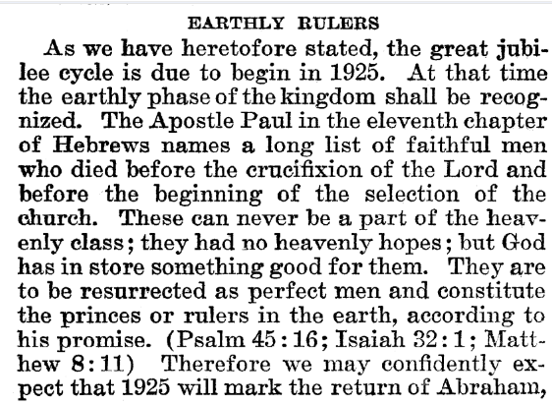
Rutherford Predicts Return of Abraham
Joseph F. Rutherford, (1920): Millions Now Living Will Never Die! p. 89-90

Slide 25
Time-setting Again! 1975
"Choosing the Best Way of Life". The Watchtower. March 15, 1980. pp. 17–18. With the appearance of the book Life Everlasting—in Freedom of the Sons of God, ... considerable expectation was aroused regarding the year 1975. ... there were other statements published that implied that such realization of hopes by that year was more of a probability than a mere possibility. It is to be regretted that these latter statements apparently overshadowed the cautionary ones and contributed to a buildup of the expectation already initiated. ... persons having to do with the publication of the information ... contributed to the buildup of hopes centered on that date.
"What will the 1970's Bring?". Awake!. Watch Tower Society. October 8, 1968. p. 14. Does this mean that the above evidence positively points to 1975 as the complete end of this system of things? Since the Bible does not specifically state this, no man can say... If the 1970s should see intervention by Jehovah God to bring an end to a corrupt world drifting toward ultimate disintegration, that should surely not surprise us.
"How Are You Using Your Life?". Our Kingdom Ministry. May 1, 1974. p. 63. Reports are heard of brothers selling their homes and property and planning to finish out the rest of their days in this old system in the pioneer service. Certainly, this is a fine way to spend the short time remaining before the wicked world's end.

Slide 26
Decline of the Watch Tower After Death
Chicago Daily Tribune October 30, 1949 pg 18: "Pastor Russell died in 1916. In the 33 years since, the methods of this sect have deviated completely from those of Pastor Russell and his manner of teaching."

Slide 28
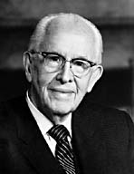
An Important Statement From an LDS Prophet
Prophet Ezra Taft: “the Book of Mormon is the keystone of our religion. This was the Prophet Joseph Smith’s statement. He testified that “the Book of Mormon was the most correct of any book on earth, and the keystone of our religion” (Introduction to the Book of Mormon). A keystone is the central stone in an arch. It holds all the other stones in place, and if removed, the arch crumbles.” (October 1986 General Conference)

