Slide 1
Final Scenes, pt. 13
On Trial Before Annas

Slide 2
A Thoughtful Hour
“It would be well for us to spend a thoughtful hour each day in contemplation of the life of Christ. We should take it point by point, and let the imagination grasp each scene, especially the closing ones. As we thus dwell upon His great sacrifice for us, our confidence in Him will be more constant, our love will be quickened, and we shall be more deeply imbued with His spirit. If we would be saved at last, we must learn the lesson of penitence and humiliation at the foot of the cross.” Desire of Ages, pg. 83

Slide 3
The Backdrop
It is now early Friday morning of the 6th day of the week. Christ has tasted of death for every child of humanity. “But we see Jesus, who was made a little lower than the angels for the suffering of death, crowned with glory and honour; that he by the grace of God should taste death for every man.” Heb. 2:9
From this point on to the cross, Christ will be bearing our sin. “Christ's agony did not cease, but His depression and discouragement left Him. The storm had in nowise abated, but He who was its object was strengthened to meet its fury. He came forth calm and serene. A heavenly peace rested upon His bloodstained face. He had borne that which no human being could ever bear; for He had tasted the sufferings of death for every man.” DA, pg. 694

Slide 4
Heaven Suffers
“But God suffered with His Son. Angels beheld the Saviour's agony. They saw their Lord enclosed by legions of satanic forces, His nature weighed down with a shuddering, mysterious dread. There was silence in heaven. No harp was touched. Could mortals have viewed the amazement of the angelic host as in silent grief they watched the Father separating His beams of light, love, and glory from His beloved Son, they would better understand how offensive in His sight is sin.” DA, pg. 693

Slide 5
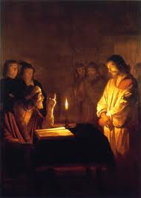
Now a Criminal
“Annas was the head of the officiating priestly family, and in deference to his age he was recognized by the people as high priest. His counsel was sought and carried out as the voice of God. He must first see Jesus a captive to priestly power. He must be present at the examination of the prisoner, for fear that the less-experienced Caiaphas might fail of securing the object for which they were working. His artifice, cunning, and subtlety must be used on this occasion; for, at all events, Christ's condemnation must be secured.” DA, pg. 698

Slide 6
Trying to Overthrow the Romans!?
“Christ was to be tried formally before the Sanhedrin; but before Annas He was subjected to a preliminary trial. Under the Roman rule the Sanhedrin could not execute the sentence of death. They could only examine a prisoner, and pass judgment, to be ratified by the Roman authorities. It was therefore necessary to bring against Christ charges that would be regarded as criminal by the Romans. An accusation must also be found which would condemn Him in the eyes of the Jews. Not a few among the priests and rulers had been convicted by Christ's teaching, and only fear of excommunication prevented them from confessing Him. … The trial must be so conducted as to unite the members of the Sanhedrin against Christ. There were two charges which the priests desired to maintain. If Jesus could be proved a blasphemer, He would be condemned by the Jews. If convicted of sedition, it would secure His condemnation by the Romans. The second charge Annas tried first to establish. He questioned Jesus concerning His disciples and His doctrines, hoping the prisoner would say something that would give him material upon which to work. He thought to draw out some statement to prove that He was seeking to establish a secret society, with the purpose of setting up a new kingdom. Then the priests could deliver Him to the Romans as a disturber of the peace and a creator of insurrection.” DA, pgs. 698,699

Slide 7
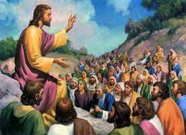
Secret Society
In order to secure Christ’s condemnation before the Romans, it had to be shown that Christ was trying to establish a secret government. This was the goal of Annas in his questioning of Christ.
“ The high priest then asked Jesus of his disciples, and of his doctrine. Jesus answered him, I spake openly to the world; I ever taught in the synagogue, and in the temple, whither the Jews always resort; and in secret have I said nothing. Why askest thou me? ask them which heard me, what I have said unto them: behold, they know what I said.” Jn. 18:19-21

Slide 8
Christ tried by ADVENTISM!
“As the storm approaches, a large class who have professed faith in the third angel's message, but have not been sanctified through obedience to the truth, abandon their position and join the ranks of the opposition. By uniting with the world and partaking of its spirit, they have come to view matters in nearly the same light; and when the test is brought, they are prepared to choose the easy, popular side. Men of talent and pleasing address, who once rejoiced in the truth, employ their powers to deceive and mislead souls. They become the most bitter enemies of their former brethren. When Sabbath keepers are brought before the courts to answer for their faith, these apostates are the most efficient agents of Satan to misrepresent and accuse them, and by false reports and insinuations to stir up the rulers against them.” GC., pg. 608

Slide 9
Where it All Ends
“The Lord has a controversy with his professed people in these last days. In this controversy men in responsible positions will take a course directly opposite to that pursued by Nehemiah. They will not only ignore and despise the Sabbath themselves, but they will try to keep it from others by burying it beneath the rubbish of custom and tradition. In churches and in large gatherings in the open air, ministers will urge upon the people the necessity of keeping the first day of the week. There are calamities on sea and land: and these calamities will increase, one disaster following close upon another; and the little band of conscientious Sabbath-keepers will be pointed out as the ones who are bringing the wrath of God upon the world by their disregard of Sunday.” RH, March 18,1884

Slide 10
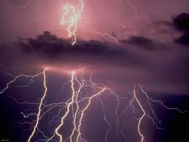
Christ Struck
“Annas was silenced by the decision of the answer. Fearing that Christ would say something regarding his course of action that he would prefer to keep covered up, he said nothing more to Him at this time. One of his officers, filled with wrath as he saw Annas silenced, struck Jesus on the face, saying, "Answerest Thou the high priest so?"
Christ calmly replied, "If I have spoken evil, bear witness of the evil: but if well, why smitest thou Me?" He spoke no burning words of retaliation. His calm answer came from a heart sinless, patient, and gentle, that would not be provoked.” DA., pg. 700

Slide 11
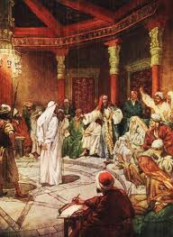
Adventism’s Voice of God!
“The Saviour contrasted His own manner of work with the methods of His accusers. For months they had hunted Him, striving to entrap Him and bring Him before a secret tribunal, where they might obtain by perjury what it was impossible to gain by fair means… The midnight seizure by a mob, the mockery and abuse before He was condemned, or even accused, was their manner of work, not His… Their own rules declared that every man should be treated as innocent until proved guilty...” DA, pg. 699

Slide 12
Christ’s Greatest Temptation
This would not be a temptation to any of us to lift a mountain because none of us could. When the soldier struck Christ, His greatest temptation was to force everyone in the room, who were acting like devils, to bow down to Christ and confess that He was God in human form. He didn’t do that because He had taken on Himself human nature and would do nothing that we couldn’t do in like situations!

Slide 13
“Christ suffered keenly under abuse and insult. At the hands of the beings whom He had created, and for whom He was making an infinite sacrifice, He received every indignity. And He suffered in proportion to the perfection of His holiness and His hatred of sin. His trial by men who acted as fiends was to Him a perpetual sacrifice. To be surrounded by human beings under the control of Satan was revolting to Him. And He knew that in a moment, by the flashing forth of His divine power, He could lay His cruel tormentors in the dust. This made the trial the harder to bear.
The Jews were looking for a Messiah to be revealed in outward show. They expected Him, by one flash of overmastering will, to change the current of men's thoughts, and force from them an acknowledgment of His supremacy. Thus, they believed, He was to secure His own exaltation, and gratify their ambitious hopes. Thus when Christ was treated with contempt, there came to Him a strong temptation to manifest His divine character. By a word, by a look, He could compel His persecutors to confess that He was Lord above kings and rulers, priests and temple. But it was His difficult task to keep to the position He had chosen as one with humanity.” DA, pg. 702

Slide 14
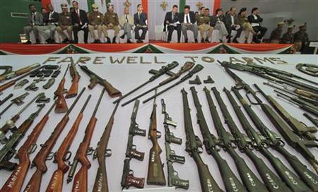
Christ Refused to Fight
Like in the garden when Peter cut off the servant’s ear, Christ did not fight. He had told Peter then, “Then said Jesus unto Peter, Put up thy sword into the sheath: the cup which my Father hath given me, shall I not drink it?” Jn. 18:11 Christ knew it was time for Him to die. May God give us wisdom to know when our hour has come!!!

Slide 15
Put it Away!
“The disciples had thought that their Master would not suffer Himself to be taken. For the same power that had caused the mob to fall as dead men could keep them helpless, until Jesus and His companions should escape. They were disappointed and indignant as they saw the cords brought forward to bind the hands of Him whom they loved. Peter in his anger rashly drew his sword and tried to defend his Master, but he only cut off an ear of the high priest's servant. When Jesus saw what was done, He released His hands, though held firmly by the Roman soldiers, and saying, "Suffer ye thus far," He touched the wounded ear, and it was instantly made whole. He then said to Peter, "Put up again thy sword into his place: for all they that take the sword shall perish with the sword. Thinkest thou that I cannot now pray to My Father, and He shall presently give Me more than twelve legions of angels?"--a legion in place of each one of the disciples. Oh, why, the disciples thought, does He not save Himself and us? Answering their unspoken thought, He added, "But how then shall the scriptures be fulfilled, that thus it must be?" "The cup which My Father hath given Me, shall I not drink it?“ DA, pg. 696

Slide 16
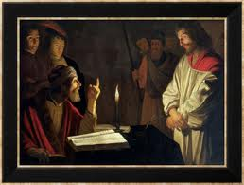
Annas Failed
“Now Annas had sent him bound unto Caiaphas the high priest.” Jn. 18:24
As the voice of God, Annas tried to condemn the Son of God. Shocking. He tried to pin on Christ secrecy, insurrection, and subtlety. It all failed. Christ had nothing to hide. He had done everything openly, having rendered to Caesar what was his and to God what was His. Annas had signally failed, so now Christ would be sent to Caiaphas. Ancient Adventism met Adventism’s finest and it wasn’t pretty!!!

Slide 17
Caiaphas
“The contrast between Jesus and the high priest as they talked together was marked. The proud dignitary of the temple was clothed in rich and costly garments. Upon his head was a glittering tiara. His bearing was majestic, his hair and his long flowing beard were silvered by age. His appearance awed the beholders. Before this august personage stood the Majesty of heaven, without adornment or display. His garments were travel stained; His face was pale, and expressed a patient sadness; yet written there were dignity and benevolence that contrasted strangely with the proud, self-confident, and angry air of the high priest.” DA, pg. 594

