Slide 1
The Departing
Ezekiel. Pt. 6

Slide 2
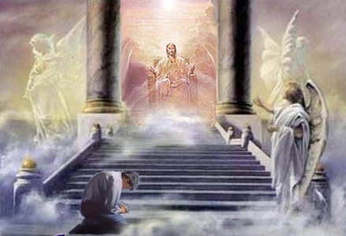
Repetition
Ezekiel 10 is pretty much a repeat of Ezekiel 1. Ezekiel saw a vision of Heaven’s throne. He beheld the glory of Christ, the cherubim under His command, and their constant watch care over the events of earth. This vision encouraged Ezekiel, knowing that, no matter what happens, God is in control and is trustworthy!

Slide 3
Christ is at the Helm
”Then I looked, and, behold, in the firmament that was above the head of the cherubims there appeared over them as it were a sapphire stone, as the appearance of the likeness of a throne…And one cherub stretched forth his hand from between the cherubims unto the fire that was between the cherubims, and took thereof, and put it into the hands of him that was clothed with linen: who took it, and went out. And there appeared in the cherubims the form of a man's hand under their wings. And when I looked, behold the four wheels by the cherubims, one wheel by one cherub, and another wheel by another cherub: and the appearance of the wheels was as the colour of a beryl stone. And as for their appearances, they four had one likeness, as if a wheel had been in the midst of a wheel. When they went, they went upon their four sides; they turned not as they went, but to the place whither the head looked they followed it; they turned not as they went.” Ezek. 10:1, 7-11

Slide 4
Wheels in Wheels
“There were wheels within wheels in an arrangement so complicated that at first sight they appeared to Ezekiel to be all in confusion. But when they moved, it was with beautiful exactness and in perfect harmony. Heavenly beings were impelling these wheels, and, above all, upon the glorious sapphire throne, was the Eternal One; while round about the throne was the encircling rainbow, emblem of grace and love. Overpowered by the terrible glory of the scene, Ezekiel fell upon his face, when a voice bade him arise and hear the word of the Lord. Then there was given him a message of warning for Israel…The wheel like complications that appeared to the prophet to be involved in such confusion were under the guidance of an infinite hand. The Spirit of God, revealed to him as moving and directing these wheels, brought harmony out of confusion; so the whole world was under His control. Myriads of glorified beings were ready at His word to overrule the power and policy of evil men, and bring good to His faithful ones.” 5 Testimonies, 752,753

Slide 5
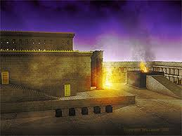
A BIG DIFFERENCE
While Ezek 1 and 10 are very similar, the two chapters have a huge difference and Ezek 11 fills in the details. Heaven has put forth great efforts to redeem Judah and Israel. Christ gave them Solomon’s temple, the prophets, His law, health message, and educational guidance. Even Heaven’s resources to redeem can be exhausted!!

Slide 6
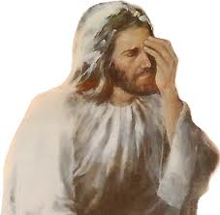
Glory Starts Moving
“Then the glory of the LORD went up from the cherub, and stood over the threshold of the house; and the house was filled with the cloud, and the court was full of the brightness of the LORD'S glory.” Ezek. 10:4

Slide 7
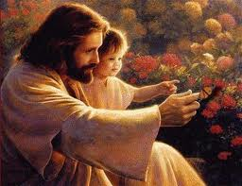
How Many Opportunities?
“Then the glory of the LORD departed from off the threshold of the house, and stood over the cherubims. And the cherubims lifted up their wings, and mounted up from the earth in my sight: when they went out, the wheels also were beside them, and every one stood at the door of the east gate of the LORD'S house; and the glory of the God of Israel was over them above.” Ezek. 10:18,19

Slide 8
Gone!!!!!!!!
“And the glory of the LORD went up from the midst of the city, and stood upon the mountain which is on the east side of the city.” Ezek. 11:23

Slide 9
Closed!!
“Though rewarded with evil for good, and hatred for His love (Psalm 109:5), He had steadfastly pursued His mission of mercy. Never were those repelled that sought His grace. A homeless wanderer, reproach and penury His daily lot, He lived to minister to the needs and lighten the woes of men, to plead with them to accept the gift of life. The waves of mercy, beaten back by those stubborn hearts, returned in a stronger tide of pitying, inexpressible love. But Israel had turned from her best Friend and only Helper. The pleadings of His love had been despised, His counsels spurned, His warnings ridiculed. The hour of hope and pardon was fast passing; the cup of God's long-deferred wrath was almost full. The cloud that had been gathering through ages of apostasy and rebellion, now black with woe, was about to burst upon a guilty people; and He who alone could save them from their impending fate had been slighted, abused, rejected, and was soon to be crucified. When Christ should hang upon the cross of Calvary, Israel's day as a nation favored and blessed of God would be ended. ” GC, pgs. 20,21

Slide 10
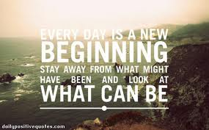
John Greenleaf Whittier
“God pity them both! and pity us all, Who vainly the dreams of youth recall; For of all sad words of tongue or pen, The saddest are these: ‘It might have been!’

Slide 11
We Are SAFE
“ Moreover the spirit lifted me up, and brought me unto the east gate of the LORD'S house, which looketh eastward: and behold at the door of the gate five and twenty men; among whom I saw Jaazaniah the son of Azur, and Pelatiah the son of Benaiah, princes of the people. Then said he unto me, Son of man, these are the men that devise mischief, and give wicked counsel in this city: Which say, It is not near; let us build houses: this city is the caldron, and we be the flesh. Therefore prophesy against them, prophesy, O son of man. And the Spirit of the LORD fell upon me, and said unto me, Speak; Thus saith the LORD; Thus have ye said, O house of Israel: for I know the things that come into your mind, every one of them. Ye have multiplied your slain in this city, and ye have filled the streets thereof with the slain.” Ezek. 11:1-6

Slide 12
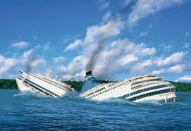
Stay With the Ship!
Ezekiel had said, “Judgment is coming on Jerusalem.” These men said, “Don’t worry; everything is fine.” They encouraged the people with the fact that Jerusalem was God’s city; nothing could happen to her!

Slide 13
Institutional Salvation
”Thus saith the LORD of hosts, the God of Israel, Amend your ways and your doings, and I will cause you to dwell in this place. Trust ye not in lying words, saying, The temple of the LORD, The temple of the LORD, The temple of the LORD, are these. For if ye thoroughly amend your ways and your doings; if ye thoroughly execute judgment between a man and his neighbour; If ye oppress not the stranger, the fatherless, and the widow, and shed not innocent blood in this place, neither walk after other gods to your hurt: Then will I cause you to dwell in this place, in the land that I gave to your fathers, for ever and ever. Behold, ye trust in lying words, that cannot profit.” Jer. 7:3-8

Slide 14
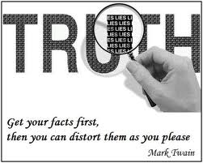
Balderdash
1. We are God’s people
2. We have a great hospital system.
3. We have a worldwide educational system.
4. We are 17,00,000 strong.
5. We perform so much good community service around the world.

Slide 15
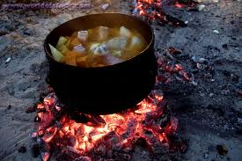
No Fire Here
“Not by its name, but by its fruit, is the value of a tree determined. If the fruit is worthless, the name cannot save the tree from destruction. John declared to the Jews that their standing before God was to be decided by their character and life. Profession was worthless. If their life and character were not in harmony with God's law, they were not His people.” DA., pg. 107

Slide 16
“To a people in whose hearts His law is written, the favor of God is assured. They are one with Him. But the Jews had separated themselves from God. Because of their sins they were suffering under His judgments. This was the cause of their bondage to a heathen nation. Their minds were darkened by transgression, and because in times past the Lord had shown them so great favor, they excused their sins. They flattered themselves that they were better than other men, and entitled to His blessings.” DA, pg. 106

Slide 17
Trouble for Fakes
And I will bring you out of the midst thereof, and deliver you into the hands of strangers, and will execute judgments among you. Ye shall fall by the sword; I will judge you in the border of Israel; and ye shall know that I am the LORD. This city shall not be your caldron, neither shall ye be the flesh in the midst thereof; but I will judge you in the border of Israel: And ye shall know that I am the LORD: for ye have not walked in my statutes, neither executed my judgments, but have done after the manners of the heathen that are round about you. And it came to pass, when I prophesied, that Pelatiah the son of Benaiah died. Then fell I down upon my face, and cried with a loud voice, and said, Ah Lord GOD! wilt thou make a full end of the remnant of Israel?” Ezek. 11:9-13

Slide 18
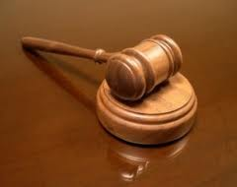
Judgment
Peletiah was a pre eminent figure in ancient Adventism. For his apostasy, he was struck down. For his selfishness, greedy, and cruelty, he was cut off. Like Ananias of old, he learned too late that ‘It is a fearful thing to fall into the hands of the living God.’ Heb. 10:31

Slide 19
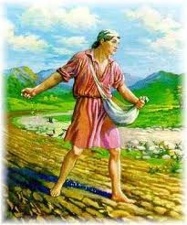
Watch Out!
“ Be not deceived; God is not mocked: for whatsoever a man soweth, that shall he also reap. For he that soweth to his flesh shall of the flesh reap corruption; but he that soweth to the Spirit shall of the Spirit reap life everlasting. And let us not be weary in well doing: for in due season we shall reap, if we faint not.” Galatians 6:7,8

Slide 20
New Covenant Hope
“Therefore say, Thus saith the Lord GOD; I will even gather you from the people, and assemble you out of the countries where ye have been scattered, and I will give you the land of Israel. And they shall come thither, and they shall take away all the detestable things thereof and all the abominations thereof from thence. And I will give them one heart, and I will put a new spirit within you; and I will take the stony heart out of their flesh, and will give them an heart of flesh: That they may walk in my statutes, and keep mine ordinances, and do them: and they shall be my people, and I will be their God.” Ezekiel 11:17-20

