Slide 1
The Boy who would be King
Born out of Time

Slide 2
“The Mistake”
1. The boy should have never been born.
2. His dad had been told that he would die. His dad had prayed that he might live a little longer and his dad was given 15 years.
3. His dad had no heir to the throne.
4. Three years after his dad had been told he would live 15 more years, the boy was born.
5. The boy was named after a famous patriarch’s son.

Slide 3
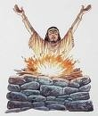
The Boy’s ancestors
The boy’s ancestor’s were all kings. The boy’s grandpa he never knew, but his grandpa was a wicked king/man. Grandpa influenced many to turn from the one true God. Grandpa had burned children to the gods of stone.

Slide 4
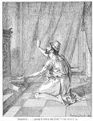
The Boy’s Dad
Dad prayed to the God of heaven. One time, God dramatically delivered Dad and the city from evil invaders. 185,000 enemy soldiers died in one night. Dad prayed and God gave him 15 years of life. Dad tried to teach me about God, but……………

Slide 5
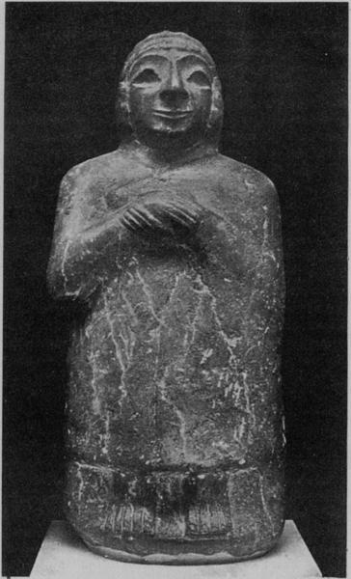
The Boy is King
Dad died when the boy was 12 years old. While older counselors aided in the affairs of the nation, the boy could now do as he pleased. He wasn’t use to anyone telling him what to do but his Dad, and now, Dad was dead. In his grief, or new found freedom, or kingly authority, he ran wild, and took Judah with him.

Slide 6
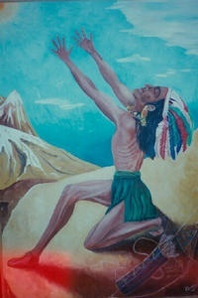
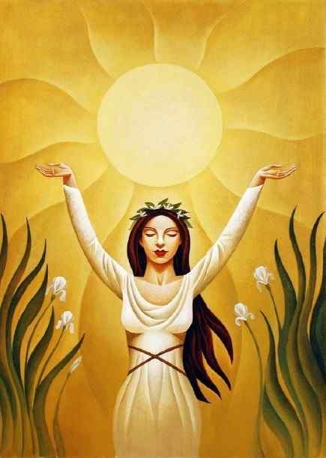
Images, Groves, and Orgies

Slide 7
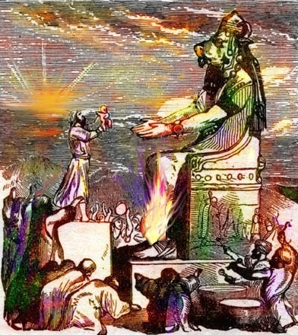
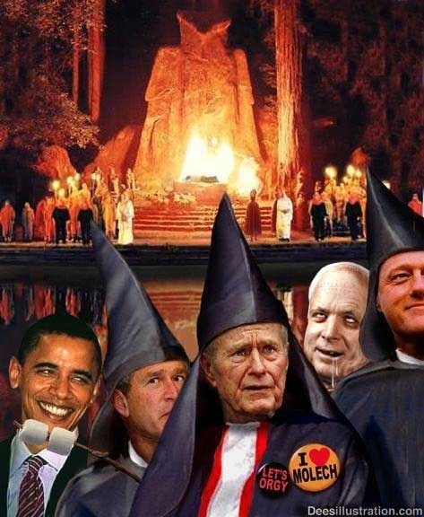
Slavery to Sin

Slide 8
The Boy Was a Horrible King and Dad
“For he built again the high places which Hezekiah his father had broken down, and he reared up altars for Baalim, and made groves, and worshipped all the host of heaven, and served them. Also he built altars in the house of the LORD, whereof the LORD had said, In Jerusalem shall my name be for ever. And he built altars for all the host of heaven in the two courts of the house of the LORD. And he caused his children to pass through the fire in the valley of the son of Hinnom:…

Slide 9
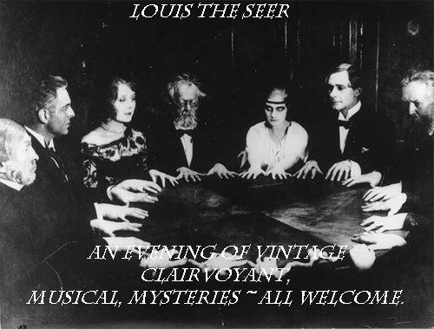
Witch Worship
also he observed times, and used enchantments, and used witchcraft, and dealt with a familiar spirit, and with wizards: he wrought much evil in the sight of the LORD, to provoke him to anger. And he set a carved image, the idol which he had made, in the house of God, of which God had said to David and to Solomon his son, In this house, and in Jerusalem, which I have chosen before all the tribes of Israel, will I put my name for ever:’ 2Chronicles 33:3-7

Slide 10
Isaiah was Cut in Half
“Moreover Manasseh shed innocent blood very much, till he had filled Jerusalem from one end to another; beside his sin wherewith he made Judah to sin, in doing that which was evil in the sight of the LORD.” 2Kings 21:16
“Their testimony in behalf of truth and righteousness aroused the anger of Manasseh and his associates in authority, who endeavored to establish themselves in evil-doing by silencing every voice of disapproval. "Manasseh shed innocent blood very much, till he had filled Jerusalem from one end to another." 2 Kings 21:16. One of the first to fall was Isaiah, who for over half a century had stood Judah as the appointed messenger of Jehovah. "Others had trial of cruel mockings and scourgings, yea, moreover of bonds and imprisonment: they were stoned, they were sawn asunder,…” PK, pg.381,382

Slide 11
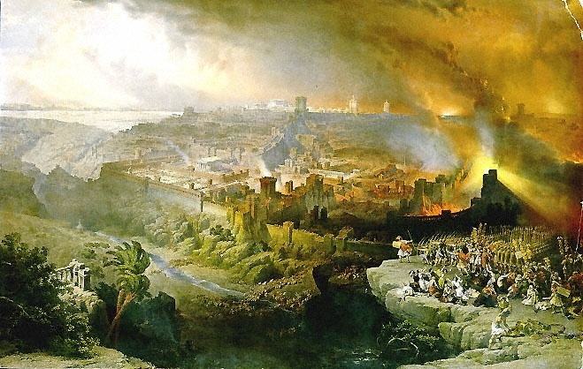
It Got So Bad……
“Because Manasseh king of Judah hath done these abominations, and hath done wickedly above all that the Amorites did, which were before him, and hath made Judah also to sin with his idols: Behold, I am bringing such evil upon Jerusalem and Judah, that whosoever heareth of it, both his ears shall tingle…

Slide 12
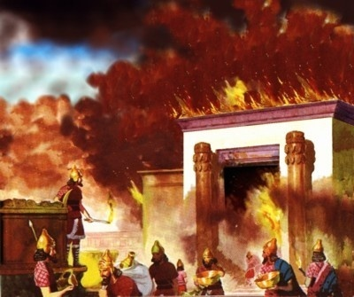
Jerusalem’s Captivity
And I will stretch over Jerusalem the line of Samaria, and the plummet of the house of Ahab: and I will wipe Jerusalem as a man wipeth a dish, wiping it, and turning it upside down. And I will forsake the remnant of mine inheritance, and deliver them into the hand of their enemies; and they shall become a prey and a spoil to all their enemies;” 2Kings 21:12-14

Slide 13
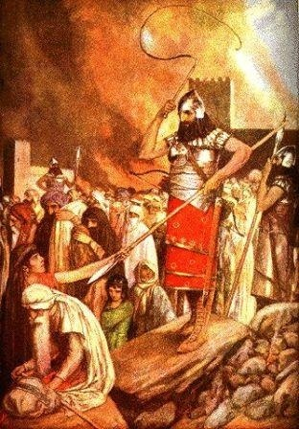
Babylonian Captivity Came Because of Manasseh
Jeremiah 15:1-4 “Then said the LORD unto me, Though Moses and Samuel stood before me, yet my mind could not be toward this people: cast them out of my sight, and let them go forth. And it shall come to pass, if they say unto thee, Whither shall we go forth? then thou shalt tell them, Thus saith the LORD; Such as are for death, to death; and such as are for the sword, to the sword; and such as are for the famine, to the famine; and such as are for the captivity, to the captivity. And I will appoint over them four kinds, saith the LORD: the sword to slay, and the dogs to tear, and the fowls of the heaven, and the beasts of the earth, to devour and destroy. And I will cause them to be removed into all kingdoms of the earth, because of Manasseh the son of Hezekiah king of Judah, for that which he did in Jerusalem.“

Slide 14
Again!
“And the LORD sent against him bands of the Chaldees, and bands of the Syrians, and bands of the Moabites, and bands of the children of Ammon, and sent them against Judah to destroy it, according to the word of the LORD, which he spake by his servants the prophets.
3: Surely at the commandment of the LORD came this upon Judah, to remove them out of his sight, for the sins of Manasseh, according to all that he did;
4: And also for the innocent blood that he shed: for he filled Jerusalem with innocent blood; which the LORD would not pardon.” 2Kings 24:2-4

Slide 15
Manasseh Goes to Babylon
“And the LORD spake to Manasseh, and to his people: but they would not hearken. Wherefore the LORD brought upon them the captains of the host of the king of Assyria, which took Manasseh among the thorns, and bound him with fetters, and carried him to Babylon.” 2Chronicles 33:10,11 One would think that this was the end for Manasseh. He had caused such apostasy, such grief, such irreversible evil and wickedness……………………...

Slide 16
God Still Cared
“And when he was in affliction, he besought the LORD his God, and humbled himself greatly before the God of his fathers,
And prayed unto him: and he was intreated of him, and heard his supplication,…” 2Chronicles 33:11,12
Manasseh turned to the God of Hezekiah. He saw what sin had done to him, to others, and had no peace. He confessed his sins, begged for Heaven’s forgiveness for his foolishness, and asked for a new life.

Slide 17
In Heaven’s Eyes
A fervent prayer rose up to heaven, a fragile soul is losing ground. Sorting through this earthly babble, heaven heard the sound. This was a life with no distinction, no successes, only tries. Yet gazing down on this unlovely one, there was love in heaven`s eyes.
In heaven`s eyes, there are no losers, in heaven`s eyes no hopeless cause
Only people like you with feelings like me amazed by the grace we can find In heaven`s eyes
A restless child, a wayward father, a lonely traveler in the rain; When life goes on and no one bothers, heaven feels the pain. Looking down, He sees each heart ache, knows each sorrow, hears each cry. And looking up, we see compassion`s fire ablaze in heaven`s eyes.
In heaven`s eyes, there are no losers, in heaven`s eyes there is no hopeless cause
Only people like you with feelings like me amazed by the grace we can find
In heaven`s eyes.

Slide 18
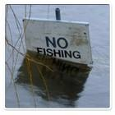
No Fishing Allowed
“Who is a God like unto thee, that pardoneth iniquity, and passeth by the transgression of the remnant of his heritage? he retaineth not his anger for ever, because he delighteth in mercy. He will turn again, he will have compassion upon us; he will subdue our iniquities; and thou wilt cast all their sins into the depths of the sea.” Micah 7:18,19

Slide 19
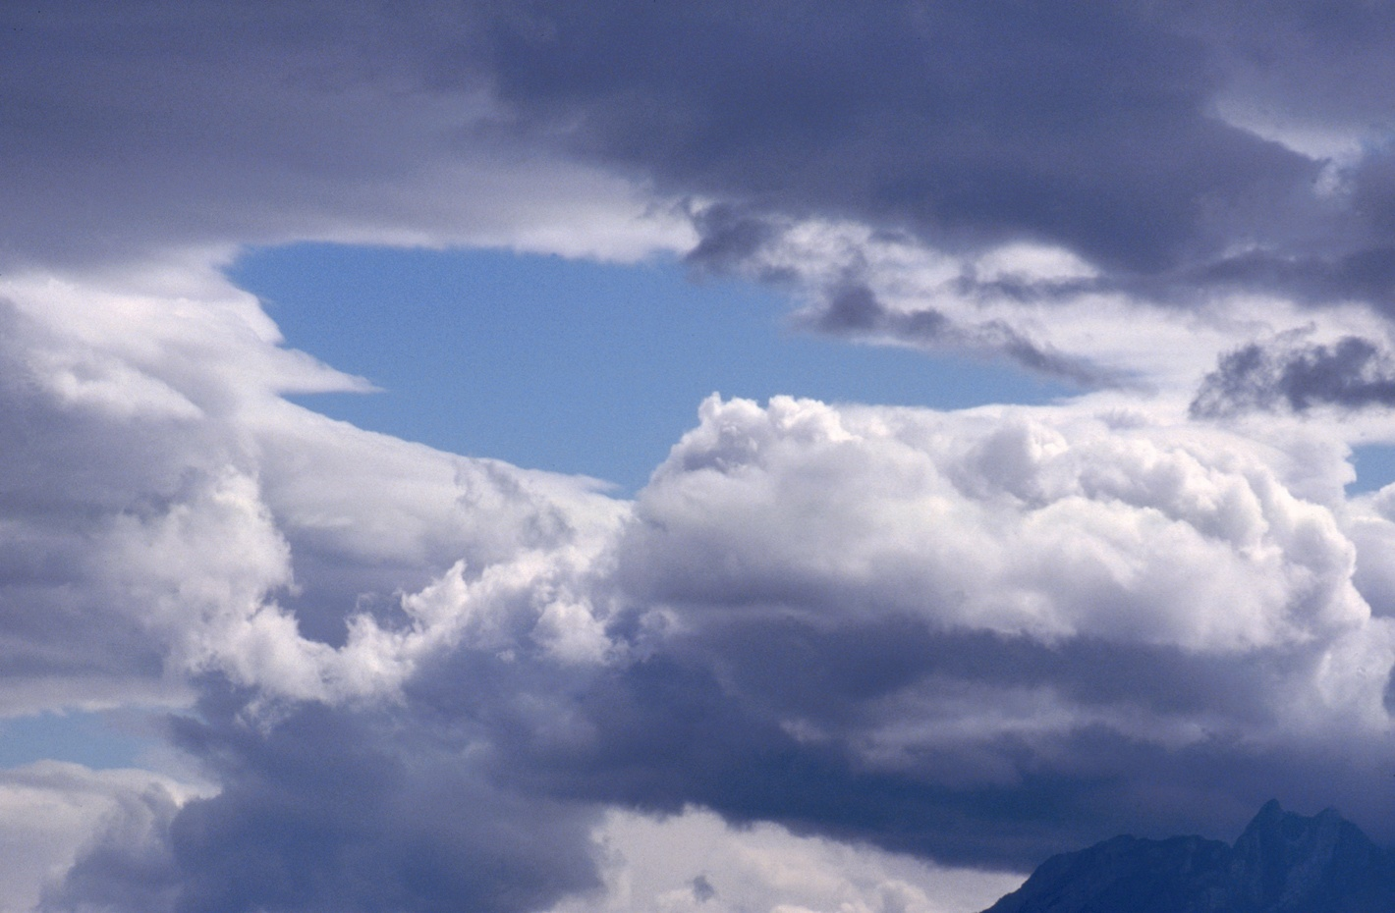
As Thick as Clouds
“Remember these, O Jacob and Israel; for thou art my servant: I have formed thee; thou art my servant: O Israel, thou shalt not be forgotten of me. I have blotted out, as a thick cloud, thy transgressions, and, as a cloud, thy sins: return unto me; for I have redeemed thee.”

Slide 20
Confession and Repentance
“If we confess our sins, he is faithful and just to forgive us our sins, and to cleanse us from all unrighteousness.
10: If we say that we have not sinned, we make him a liar, and his word is not in us.” 1John 1:9
“Create in me a clean heart, O God; and renew a right spirit within me. Cast me not away from thy presence; and take not thy holy spirit from me.
Restore unto me the joy of thy salvation; and uphold me with thy free spirit. “ Psalm 51:10-12

Slide 21
True Repentance
“The prayer of David after his fall, illustrates the nature of true sorrow for sin. His repentance was sincere and deep. There was no effort to palliate his guilt; no desire to escape the judgment threatened, inspired his prayer. David saw the enormity of his transgression; he saw the defilement of his soul; he loathed his sin. It was not for pardon only that he prayed, but for purity of heart. He longed for the joy of holiness--to be restored to harmony and communion with God. This was the language of his soul: "Blessed is he whose transgression is forgiven, whose sin is covered. Blessed is the man unto whom the Lord imputeth not iniquity, And in whose spirit there is no guile." Psalm 32:1, 2. "Have mercy upon me, O God, according to Thy loving-kindness: According unto the multitude of Thy tender mercies blot out my transgressions. . . Purge me with hyssop and I shall be clean: wash me, and I shall be whiter than snow. . . Create in me a clean heart, O God; And renew a right spirit within me. Cast me not away from Thy presence; And take not Thy Holy Spirit from me. Restore unto me the joy of Thy salvation; And uphold me with Thy free spirit.” SC, 24,25

Slide 22
Manasseh Restored
“And prayed unto him: and he was intreated of him, and heard his supplication, and brought him again to Jerusalem into his kingdom. Then Manasseh knew that the LORD he was God. Now after this he built a wall without the city of David, on the west side of Gihon, in the valley, even to the entering in at the fish gate, and compassed about Ophel, and raised it up a very great height, and put captains of war in all the fenced cities of Judah. And he took away the strange gods, and the idol out of the house of the LORD, and all the altars that he had built in the mount of the house of the LORD, and in Jerusalem, and cast them out of the city. And he repaired the altar of the LORD, and sacrificed thereon peace offerings and thank offerings, and commanded Judah to serve the LORD God of Israel.” 2Chronicles 33:12-16

Slide 23
Forgiven, Restored, but………
Forgiveness and restoration is freely offered to us. Consequences for past wrongs remain with us. A child that breaks the family vase of many generations is forgiven and restored by mommy, but that doesn’t fix the vase.
Consequences for sin are set in motion when we commit a wrong act/acts. Those consequences are a continual reminder of what sin does. These reminders are there that we might abhor evil and shun it like the plague. “For I acknowledge my transgressions: and my sin is ever before me.” Ps. 51:3

Slide 24
David’s true Repentance
The Consequences
Amnon, Absalom, Bathsheba’s first baby, and Adonijah all died as a result of David’s sin, but it led him to see the heinousness of sin, and the need for continued humility before God.
“For whom the Lord loveth he chasteneth, and scourgeth every son whom he receiveth. If ye endure chastening, God dealeth with you as with sons; for what son is he whom the father chasteneth not? But if ye be without chastisement, whereof all are partakers, then are ye bastards, and not sons. Furthermore we have had fathers of our flesh which corrected us, and we gave them reverence: shall we not much rather be in subjection unto the Father of spirits, and live? For they verily for a few days chastened us after their own pleasure; but he for our profit, that we might be partakers of his holiness. Now no chastening for the present seemeth to be joyous, but grievous: nevertheless afterward it yieldeth the peaceable fruit of righteousness unto them which are exercised thereby.” Hebrews 12:6-11

Slide 25
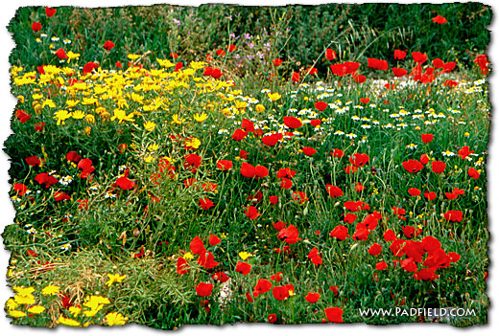
Forgiveness and Restoration
“He hath made every thing beautiful in his time:” Eccl. 3:11
“And why take ye thought for raiment? Consider the lilies of the field, how they grow; they toil not, neither do they spin: And yet I say unto you, That even Solomon in all his glory was not arrayed like one of these.” Matthew 6:28,29

