Slide 1
Final Scenes, pt.3
A Tree Without Fruit and a Building that Needed to be Cleaned

Slide 2
A Thoughtful Hour
“It would be well for us to spend a thoughtful hour each day in contemplation of the life of Christ. We should take it point by point, and let the imagination grasp each scene, especially the closing ones. As we thus dwell upon His great sacrifice for us, our confidence in Him will be more constant, our love will be quickened, and we shall be more deeply imbued with His spirit. If we would be saved at last, we must learn the lesson of penitence and humiliation at the foot of the cross.” Desire of Ages, pg. 83

Slide 3
The Chronology
Christ spent His last Sabbath alive on earth at the home of Simon of Bethany. It was here that Mary of Magdala/Bethany anointed the feet of Jesus.
Following this event, on the first day of the week, Christ began the short 1.5 mile trek from Bethany to Jerusalem. It was during this trip that Christ rode on a donkey in what is known as the ‘Triumphal Entry’. It was a time of great rejoicing as everyone thought Jesus was going to Jerusalem to be crowned king. The ride ended sorrowfully as Christ wept over the impenitent city of Jerusalem.

Slide 4
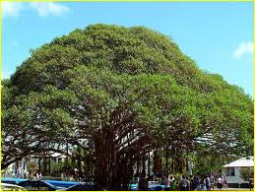
The Next Day--Monday
“And Jesus entered into Jerusalem, and into the temple: and when he had looked round about upon all things, and now the eventide was come, he went out unto Bethany with the twelve. And on the morrow, when they were come from Bethany, he was hungry: And seeing a fig tree afar off having leaves, he came, if haply he might find any thing thereon: and when he came to it, he found nothing but leaves; for the time of figs was not yet. And Jesus answered and said unto it, No man eat fruit of thee hereafter for ever. And his disciples heard it.” Mark 11:11-14

Slide 5
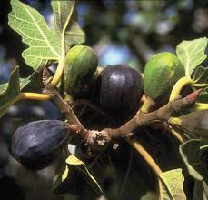
Looking for Fruit
“But in the orchard to which Jesus came, one tree appeared to be in advance of all the others. It was already covered with leaves. It is the nature of the fig tree that before the leaves open, the growing fruit appears. Therefore this tree in full leaf gave promise of well-developed fruit. But its appearance was deceptive. Upon searching its branches, from the lowest bough to the topmost twig, Jesus found "nothing but leaves." It was a mass of pretentious foliage, nothing more.” DA, pg. 581

Slide 6
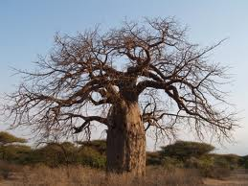
Christ Cursed the Worthless Tree
“The cursing of the fig tree was an acted parable. That barren tree, flaunting its pretentious foliage in the very face of Christ, was a symbol of the Jewish nation. The Saviour desired to make plain to His disciples the cause and the certainty of Israel's doom. For this purpose He invested the tree with moral qualities, and made it the expositor of divine truth. The Jews stood forth distinct from all other nations, professing allegiance to God.” DA, pgs. 582,583

Slide 7
So Much Effort Wasted!
“He spake also this parable; A certain man had a fig tree planted in his vineyard; and he came and sought fruit thereon, and found none. Then said he unto the dresser of his vineyard, Behold, these three years I come seeking fruit on this fig tree, and find none: cut it down; why cumbereth it the ground? And he answering said unto him, Lord, let it alone this year also, till I shall dig about it, and dung it: And if it bear fruit, well: and if not, then after that thou shalt cut it down.”

Slide 8
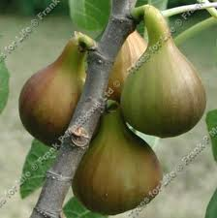
Parable Explained
Things looked very bad for that particular fig tree. It looked hopeless for it. 3 years of labor had been lavished on it; 6 months by John and 2 and a half by Christ. When asked if it wasn’t ready for the tree to be destroyed, the answer was to give it another year of tender care; the final year of Christ’s ministry. The sum of John and Jesus’ work of ministry was 4 years; the same amount granted the tree in the parable of Luke 13!!

Slide 9
Rejection of Care
“Jesus had come to the fig tree hungry, to find food. So He had come to Israel, hungering to find in them the fruits of righteousness. He had lavished on them His gifts, that they might bear fruit for the blessing of the world. Every opportunity and privilege had been granted them, and in return He sought their sympathy and co-operation in His work of grace. He longed to see in them self-sacrifice and compassion, zeal for God, and a deep yearning of soul for the salvation of their fellow men. Had they kept the law of God, they would have done the same unselfish work that Christ did. But love to God and man was eclipsed by pride and self-sufficiency. They brought ruin upon themselves by refusing to minister to others. The treasures of truth which God had committed to them, they did not give to the world. In the barren tree they might read both their sin and its punishment. Withered beneath the Saviour's curse, standing forth sere and blasted, dried up by the roots, the fig tree showed what the Jewish people would be when the grace of God was removed from them.” DA, pg. 583

Slide 10
Glad it only applied TO ?????
“The warning is for all time. Christ's act in cursing the tree which His own power had created stands as a warning to all churches and to all Christians. No one can live the law of God without ministering to others. But there are many who do not live out Christ's merciful, unselfish life. Some who think themselves excellent Christians do not understand what constitutes service for God. They plan and study to please themselves. They act only in reference to self. Time is of value to them only as they can gather for themselves. In all the affairs of life this is their object. Not for others but for themselves do they minister. God created them to live in a world where unselfish service must be performed. He designed them to help their fellow men in every possible way. But self is so large that they cannot see anything else. They are not in touch with humanity. Those who thus live for self are like the fig tree, which made every pretension but was fruitless. They observe the forms of worship, but without repentance or faith. In profession they honor the law of God, but obedience is lacking. They say, but do not. In the sentence pronounced on the fig tree Christ demonstrates how hateful in His eyes is this vain pretense. He declares that the open sinner is less guilty than is he who professes to serve God, but who bears no fruit to His glory.” DA, pg.586

Slide 11
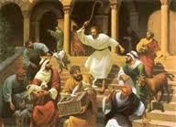
Trees to Dirty Buildings
“And they come to Jerusalem: and Jesus went into the temple, and began to cast out them that sold and bought in the temple, and overthrew the tables of the moneychangers, and the seats of them that sold doves; And would not suffer that any man should carry any vessel through the temple. And he taught, saying unto them, Is it not written, My house shall be called of all nations the house of prayer? but ye have made it a den of thieves.” Mark 11:15-17

Slide 12
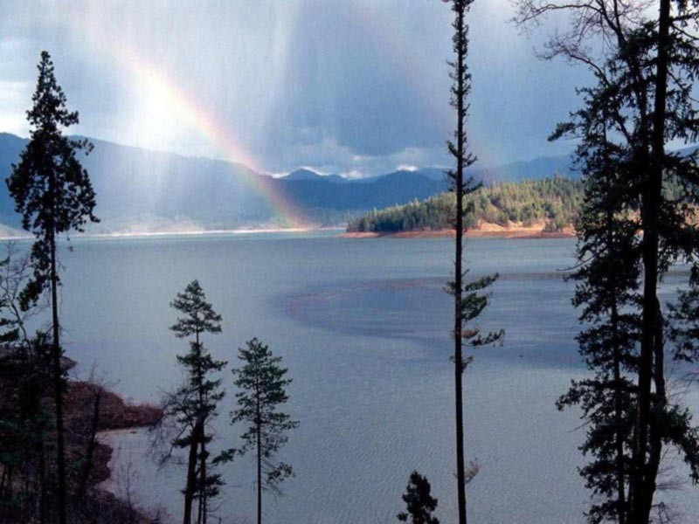
Christ the Peace Giver
Throughout Jesus life on earth, He had brought a message of God’s love and kindness to man. Now, He curses a fig tree and knocks over the tables of the money changers. He demands sacred in the temple worship of God. Something seems to be changing in the ministry of Christ?

Slide 13
Inconsistency?!?
“Christ's act in cursing the fig tree had astonished the disciples. It seemed to them unlike His ways and works. Often they had heard Him declare that He came not to condemn the world, but that the world through Him might be saved. They remembered His words, "The Son of man is not come to destroy men's lives, but to save them." Luke 9:56. His wonderful works had been done to restore, never to destroy. The disciples had known Him only as the Restorer, the Healer. This act stood alone. What was its purpose? they questioned.
God "delighteth in mercy." "As I live, saith the Lord God, I have no pleasure in the death of the wicked." Micah 7:18; Ezek. 33:11. To Him the work of destruction and the denunciation of judgment is a "strange work." Isa. 28:21. But it is in mercy and love that He lifts the veil from the future, and reveals to men the results of a course of sin.” DA, pg. 582

Slide 14
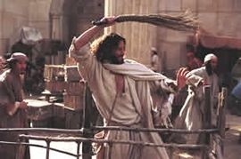
Upset!
”The priests and rulers had hardened their hearts through selfishness and avarice. The very symbols pointing to the Lamb of God they had made a means of getting gain. Thus in the eyes of the people the sacredness of the sacrificial service had been in a great measure destroyed. The indignation of Jesus was stirred; He knew that His blood, so soon to be shed for the sins of the world, would be as little appreciated by the priests and elders as was the blood of beasts which they kept incessantly flowing.” DA, pg. 590

Slide 15
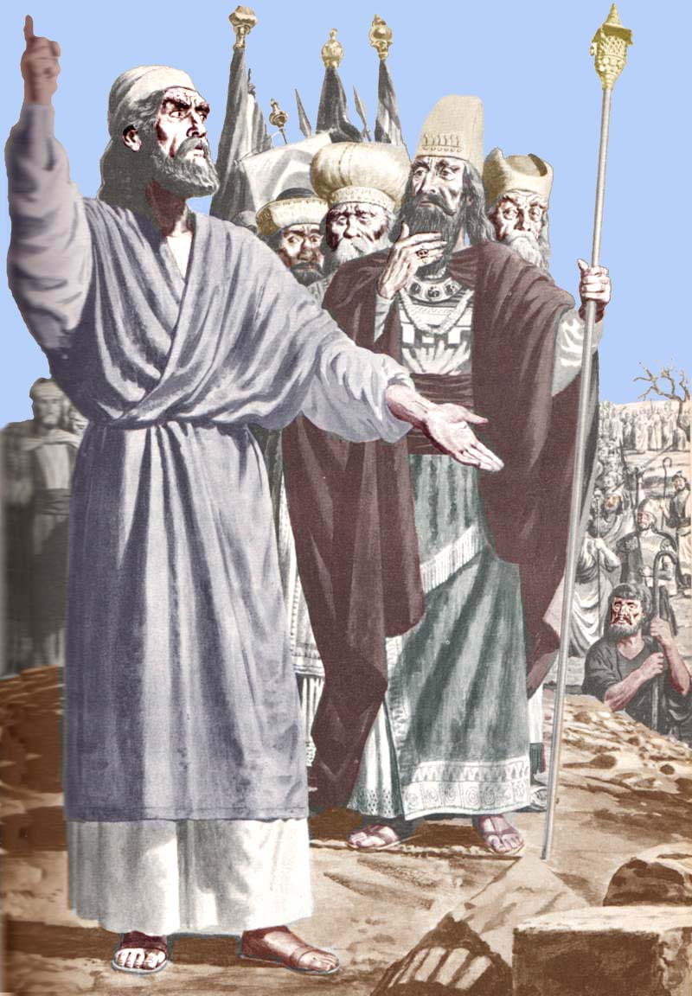
A Voice of Stern Rebuke
The worship of the true God was being trampled in the dust. The purpose of the temple was utterly desecrated in the minds of the people. The temple was turned into a traffic fro money making. Someone needed to say something. Would anyone dare?

Slide 16
Politically Incorrect!
“In the closing work of God in the earth, the standard of His law will be again exalted. False religion may prevail, iniquity may abound, the love of many may wax cold, the cross of Calvary may be lost sight of, and darkness, like the pall of death, may spread over the world; the whole force of the popular current may be turned against the truth; plot after plot may be formed to overthrow the people of God; but in the hour of greatest peril the God of Elijah will raise up human instrumentalities to bear a message that will not be silenced. In the populous cities of the land, and in the places where men have gone to the greatest lengths in speaking against the Most High, the voice of stern rebuke will be heard. Boldly will men of God's appointment denounce the union of the church with the world. Earnestly will they call upon men and women to turn from the observance of a man-made institution to the observance of the true Sabbath. ” PK, pg. 186,187

Slide 17
The temple Cleansed
“In the cleansing of the temple, Jesus was announcing His mission as the Messiah, and entering upon His work. That temple, erected for the abode of the divine Presence, was designed to be an object lesson for Israel and for the world. From eternal ages it was God's purpose that every created being, from the bright and holy seraph to man, should be a temple for the indwelling of the Creator. Because of sin, humanity ceased to be a temple for God. Darkened and defiled by evil, the heart of man no longer revealed the glory of the Divine One. But by the incarnation of the Son of God, the purpose of Heaven is fulfilled. God dwells in humanity, and through saving grace the heart of man becomes again His temple. God designed that the temple at Jerusalem should be a continual witness to the high destiny open to every soul. But the Jews had not understood the significance of the building they regarded with so much pride. They did not yield themselves as holy temples for the Divine Spirit.” DA, pg. 161

Slide 18
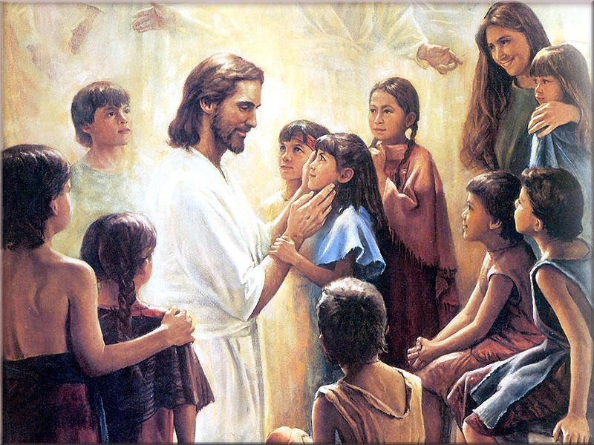
The Children Remained
“As the priests and temple officials witnessed this great work, what a revelation to them were the sounds that fell on their ears! The people were relating the story of the pain they had suffered, of their disappointed hopes, of painful days and sleepless nights. When the last spark of hope seemed to be dead, Christ had healed them. The burden was so heavy, one said; but I have found a helper. He is the Christ of God, and I will devote my life to His service. Parents said to their children, He has saved your life; lift up your voice and praise Him. The voices of children and youth, fathers and mothers, friends and spectators, blended in thanksgiving and praise. Hope and gladness filled their hearts.” DA, pg. 163

Slide 19
There Would Be a Consequence
Consequences always come for plain speaking. So then, do we stop speaking plainly or do we say with Lincoln, “Man must not care how or when he dies; as long as he dies at the post of honor and duty.”
“And the scribes and chief priests heard it, and sought how they might destroy him: for they feared him, because all the people was astonished at his doctrine.” Mk. 11:18

Slide 20
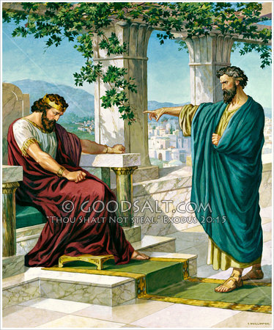
What Say Ye?
Will we be politically correct or true to God?
Will we dare to tell the truth, in love, to souls perishing in darkness or warn them and suffer the results?
“And if it seem evil unto you to serve the LORD, choose you this day whom ye will serve;…” Joshua 24:15

