Slide 1
Romans, pt. 20
chapter 11

Slide 2
Review of Chapter 10
1. Paul would have cursed himself if only the Jews/Adventists would be saved.
2. Christ is the only true means to righteousness and that only thru faith in His power.
3. We must embrace His word to overcome sin.
4. In Paul’s gospel, faith/belief is a living principle that changes one’s life.
5. Jew and Gentile both were to have opportunity to hear the gospel.

Slide 3

God’s Fairness
“I say then, Hath God cast away his people? God forbid. For I also am an Israelite, of the seed of Abraham, of the tribe of Benjamin. God hath not cast away his people which he foreknew. Wot ye not what the scripture saith of Elias? how he maketh intercession to God against Israel saying, Lord, they have killed thy prophets, and digged down thine altars; and I am left alone, and they seek my life. But what saith the answer of God unto him? I have reserved to myself seven thousand men, who have not bowed the knee to the image of Baal.” Romans 11:1-4

Slide 4

All have Opportunity
God casts no one away; especially those upon whom He has lavished such care. “and him that cometh to me I will in no wise cast out.” Jn. 6:37
God hardens no one; people, by their choices harden their own hearts and this caused Israel’s fall and failure.
“And I will harden Pharaoh's heart, and multiply my signs and
my wonders in the land of Egypt. But Pharaoh shall not hearken unto you,” Exodus 7:3,4

Slide 5
Hardening of a heart
“The Pharisees to whom Jesus spoke this warning did not themselves believe the charge they brought against Him. There was not one of those dignitaries but had felt drawn toward the Saviour. They had heard the Spirit's voice in their own hearts declaring Him to be the Anointed of Israel, and urging them to confess themselves His disciples. In the light of His presence they had realized their unholiness, and had longed for a righteousness which they could not create. But after their rejection of Him it would be too humiliating to receive Him as the Messiah. Having set their feet in the path of unbelief, they were too proud to confess their error. And in order to avoid acknowledging the truth, they tried with desperate violence to dispute the Saviour's teaching. The evidence of His power and mercy exasperated them. They could not prevent the Saviour from working miracles, they could not silence His teaching; but they did everything in their power to misrepresent Him and to falsify His words. Still the convicting Spirit of God followed them, and they had to build up many barriers in order to withstand its power. The mightiest agency that can be brought to bear upon the human heart was striving with them, but they would not yield.
It is not God that blinds the eyes of men or hardens their hearts. He sends them light to correct their errors, and to lead them in safe paths; it is by the rejection of this light that the eyes are blinded and the heart hardened. Often the process is gradual, and almost imperceptible. Light comes to the soul through God's word, through His servants, or by the direct agency of His Spirit; but when one ray of light is disregarded, there is a partial benumbing of the spiritual perceptions, and the second revealing of light is less clearly discerned. So the darkness increases, until it is night in the soul. Thus it had been with these Jewish leaders. They were convinced that a divine power attended Christ, but in order to resist the truth, they attributed the work of the Holy Spirit to Satan. In doing this they deliberately chose deception; they yielded themselves to Satan, and henceforth they were controlled by his power. “ DA, pgs. 322,323

Slide 6
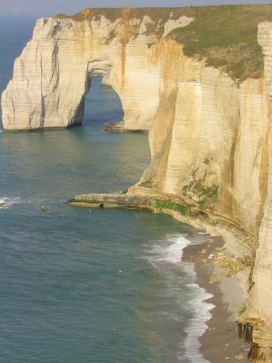
Heaven’s Impartiality
God sends light to all. By how we respond to that light is the determining factor in the salvation of our souls. He meticulously and fairly judges everyone based on all the evidence. “For we must all appear before the judgment seat of Christ; that every one may receive the things done in his body, according to that he hath done, whether it be good or bad.” 2 Corinthians 5:10
“For the grace of God that bringeth salvation hath appeared to all men,” Titus 2:11

Slide 7

By Grace that Works
“Even so then at this present time also there is a remnant according to the election of grace. And if by grace, then is it no more of works: otherwise grace is no more grace. But if it be of works, then it is no more grace: otherwise work is no more work.” Romans 11:5,6

Slide 8
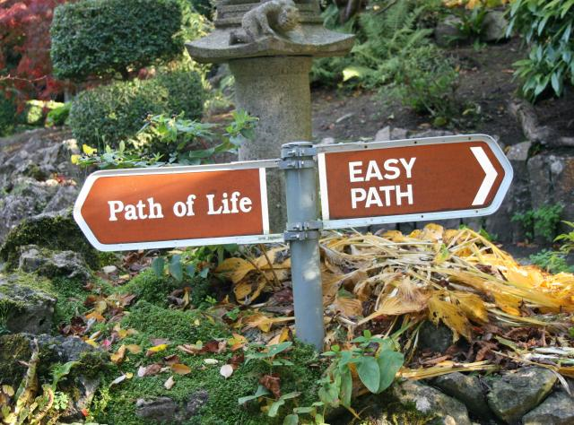
Choose you this Day
To be among the remnant of God involves choices on a daily basis, either for or against God.
“And if it seem evil unto you to serve the LORD, choose you this day whom ye will serve; whether the gods which your fathers served that were on the other side of the flood, or the gods of the Amorites, in whose land ye dwell: but as for me and my house, we will serve the LORD.” Joshua 24:15
“But seek ye first the kingdom of God, and his righteousness; and all these things shall be added unto you.” Matthew 6:33

Slide 9

What Choice are WE Making?
We can choose the grace of God to empower us to do right or we can choose to do what we want and be lost.
“For by grace are ye saved through faith; and that not of yourselves: it is the gift of God: Not of works, lest any man should boast. For we are his workmanship, created in Christ Jesus unto good works, which God hath before ordained that we should walk in them.” Eph. 2:8-10

Slide 10

Rejected the Walking Stick!
“What then? Israel hath not obtained that which he seeketh for; but the election hath obtained it, and the rest were blinded. (According as it is written, God hath given them the spirit of slumber, eyes that they should not see, and ears that they should not hear;) unto this day. And David saith, Let their table be made a snare, and a trap, and a stumblingblock, and a recompence unto them: Let their eyes be darkened, that they may not see, and bow down their back alway.” Romans 11:7-10

Slide 11
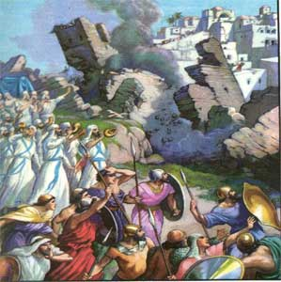
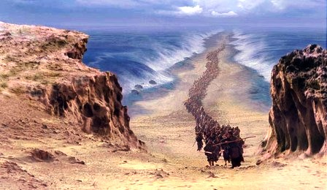
How Many Evidences?

Slide 12
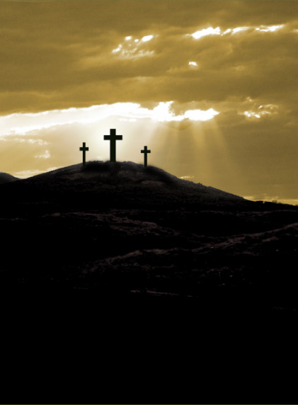
What More?

Slide 13
Well?
“There were many in Christ's day, as there are today, over whom the control of Satan for the time seemed broken; through the grace of God they were set free from the evil spirits that had held dominion over the soul. They rejoiced in the love of God; but, like the stony-ground hearers of the parable, they did not abide in His love. They did not surrender themselves to God daily, that Christ might dwell in the heart; and when the evil spirit returned, with "seven other spirits more wicked than himself," they were wholly dominated by the power of evil. When the soul surrenders itself to Christ, a new power takes possession of the new heart. A change is wrought which man can never accomplish for himself. It is a supernatural work, bringing a supernatural element into human nature. The soul that is yielded to Christ becomes His own fortress, which He holds in a revolted world, and He intends that no authority shall be known in it but His own. A soul thus kept in possession by the heavenly agencies is impregnable to the assaults of Satan. But unless we do yield ourselves to the control of Christ, we shall be dominated by the wicked one. We must inevitably be under the control of the one or the other of the two great powers that are contending for the supremacy of the world. It is not necessary for us deliberately to choose the service of the kingdom of darkness in order to come under its dominion. We have only to neglect to ally ourselves with the kingdom of light. If we do not co-operate with the heavenly agencies, Satan will take possession of the heart, and will make it his abiding place. The only defense against evil is the indwelling of Christ in the heart through faith in His righteousness.” DA, pgs. 323,324

Slide 14

Stumbling
“I say then, Have they stumbled that they should fall? God forbid: but rather through their fall salvation is come unto the Gentiles, for to provoke them to jealousy. Now if the fall of them be the riches of the world, and the diminishing of them the riches of the Gentiles; how much more their fullness? For I speak to you Gentiles, inasmuch as I am the apostle of the Gentiles, I magnify mine office: If by any means I may provoke to emulation them which are my flesh, and might save some of them. For if the casting away of them be the reconciling of the world, what shall the receiving of them be, but life from the dead? “
Romans 11:11-15

Slide 15
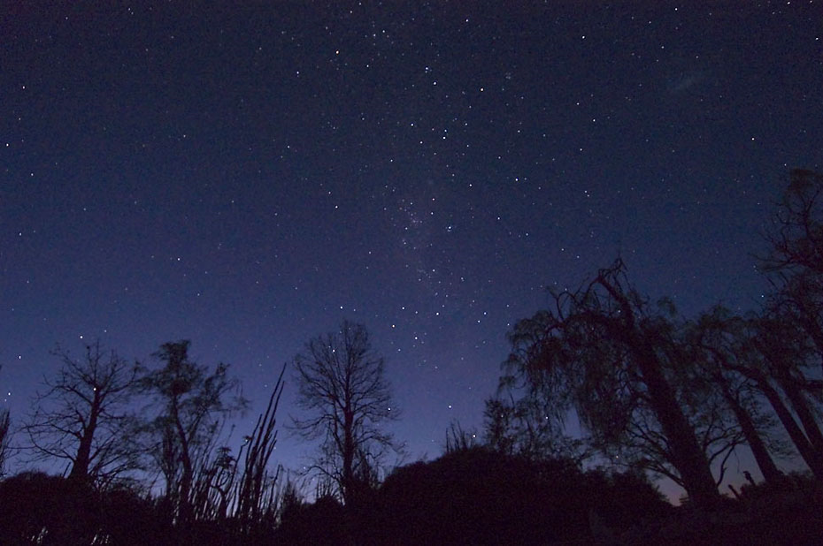
Not the Light, but the Night of the World
Never was it God’s intention that the message of salvation should go only to the Jews. God called Abraham and his descendents to be the representatives of God in the earth and to call all men to repentance. The Jews failed miserably to carry out God’s plan, just as SDA’s have done today.
“They did not become the light of the world, but shut themselves away from the world in order to escape temptation to idolatry. In the instruction given through Moses, God had placed restrictions upon their association with idolaters; but this teaching had been misinterpreted. It was intended to prevent them from conforming to the practices of the heathen. But it was used to build up a wall of separation between Israel and all other nations. The Jews looked upon Jerusalem as their heaven, and they were actually jealous lest the Lord should show mercy to the Gentiles. “ DA, pg. 29

Slide 16
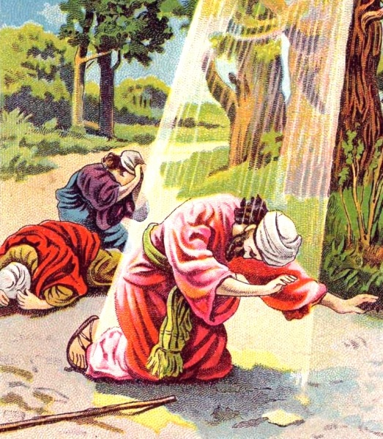
God Made Sure
Through the conversion of Saul of Tarsus, God had raised one who would carry the truth to the Gentiles.
“But the Lord said unto him, Go thy way: for he is a chosen vessel unto me, to bear my name before the Gentiles, and kings, and the children of Israel: For I will shew him how great things he must suffer for my name's sake.” Acts 9:15,16
So successful and earnest was Paul that he could say, “be not moved away from the hope of the gospel, which ye have heard, and which was preached to every creature which is under heaven; whereof I Paul am made a minister;” Col. 1:23

Slide 17
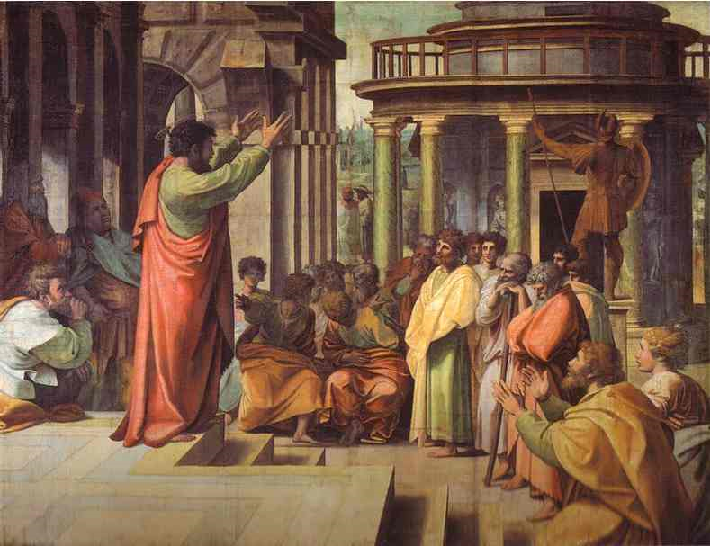
Go and preach
“And I said, Who art thou, Lord? And he said, I am Jesus whom thou persecutest. But rise, and stand upon thy feet: for I have appeared unto thee for this purpose, to make thee a minister and a witness both of these things which thou hast seen, and of those things in the which I will appear unto thee; Delivering thee from the people, and from the Gentiles, unto whom now I send thee, To open their eyes, and to turn them from darkness to light, and from the power of Satan unto God, that they may receive forgiveness of sins, and inheritance among them which are sanctified by faith that is in me.” Acts 26:15-18

Slide 18
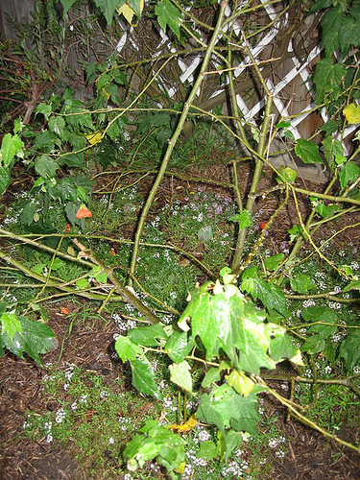
Broken Branches
“For if the firstfruit be holy, the lump is also holy: and if the root be holy, so are the branches. And if some of the branches be broken off, and thou, being a wild olive tree, wert graffed in among them, and with them partakest of the root and fatness of the olive tree; Boast not against the branches. But if thou boast, thou bearest not the root, but the root thee. Thou wilt say then, The branches were broken off, that I might be graffed in. Well; because of unbelief they were broken off, and thou standest by faith. Be not highminded, but fear: For if God spared not the natural branches, take heed lest he also spare not thee.” Romans 11:16-21

Slide 19
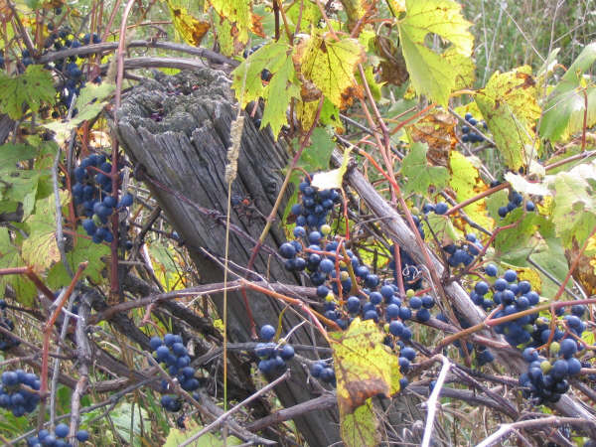
Wild Grapes
The Jews had been broken off because of their rebelliousness.
“he looked that it should bring forth grapes, and it brought forth wild grapes. And now, O inhabitants of Jerusalem, and men of Judah, judge, I pray you, betwixt me and my vineyard. What could have been done more to my vineyard, that I have not done in it? wherefore, when I looked that it should bring forth grapes, brought it forth wild grapes? And now go to; I will tell you what I will do to my vineyard: I will take away the hedge thereof, and it shall be eaten up; and break down the wall thereof, and it shall be trodden down: And I will lay it waste: it shall not be pruned, nor digged; but there shall come up briers and thorns: I will also command the clouds that they rain no rain upon it. For the vineyard of the LORD of hosts is the house of Israel, and the men of Judah his pleasant plant: and he looked for judgment, but behold oppression; for righteousness, but behold a cry.” Isaiah 5:2-7

Slide 20
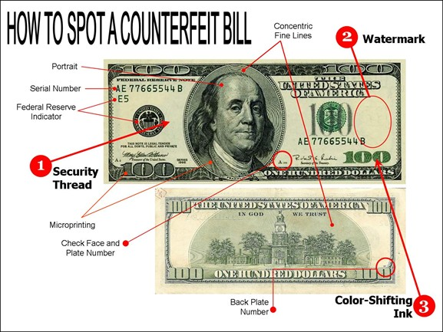
A Counterfeit
“The Jews stood forth distinct from all other nations, professing allegiance to God. They had been specially favored by Him, and they laid claim to righteousness above every other people. But they were corrupted by the love of the world and the greed of gain. They boasted of their knowledge, but they were ignorant of the requirements of God, and were full of hypocrisy. Like the barren tree, they spread their pretentious branches aloft, luxuriant in appearance, and beautiful to the eye, but they yielded "nothing but leaves." The Jewish religion, with its magnificent temple, its sacred altars, its mitered priests and impressive ceremonies, was indeed fair in outward appearance, but humility, love, and benevolence were lacking. “ DA, pgs. 582,583

Slide 21
Gentiles Beware
BEWARE!
The Gentiles were grafted into the parent stock. They had been blessed with the high and sacred privileges of the gospel. If they too were rebellious and refused to bring forth the fruits thereof, then they would be cut off just as the Jews were.
“ Now all these things happened unto them for ensamples: and they are written for our admonition, upon whom the ends of the world are come. Wherefore let him that thinketh he standeth take heed lest he fall.” 1 Corinthians 10:11,12

