Slide 1
The Book of Romans, pt. 7
Romans 4:1-13

Slide 2
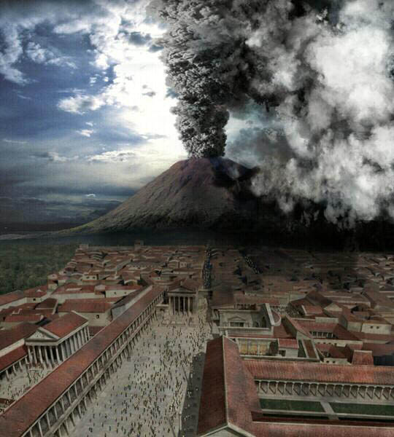
Romans 3:21-31 Review
1. Forgiveness comes through faith in Christ alone.
2. Righteousness in our lives comes through faith in Jesus Christ alone.
3. Boasting over good deeds has no place in the life of a Christian.
4. The law and the gospel go hand in hand.

Slide 3
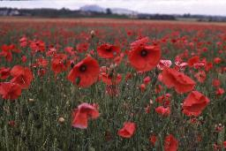
Romans 4:1-3
“What shall we say then that Abraham our father, as pertaining to the flesh, hath found? For if Abraham were justified by works, he hath whereof to glory; but not before God. For what saith the scripture? Abraham believed God, and it was counted unto him for righteousness.” Romans 4:1-3

Slide 4
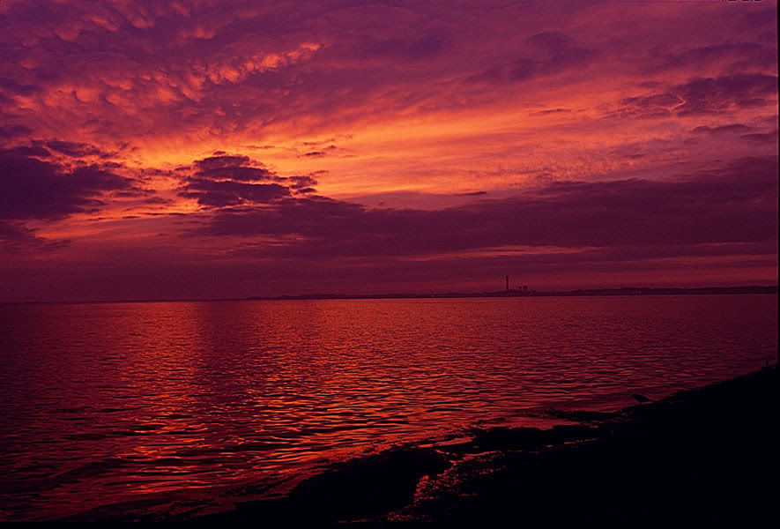
Abraham
To illustrate his point on faith and righteousness, Paul cites the experience of Abraham to exemplify his position. How was Abraham justified? Was it by works? Or, was it thru faith?

Slide 5
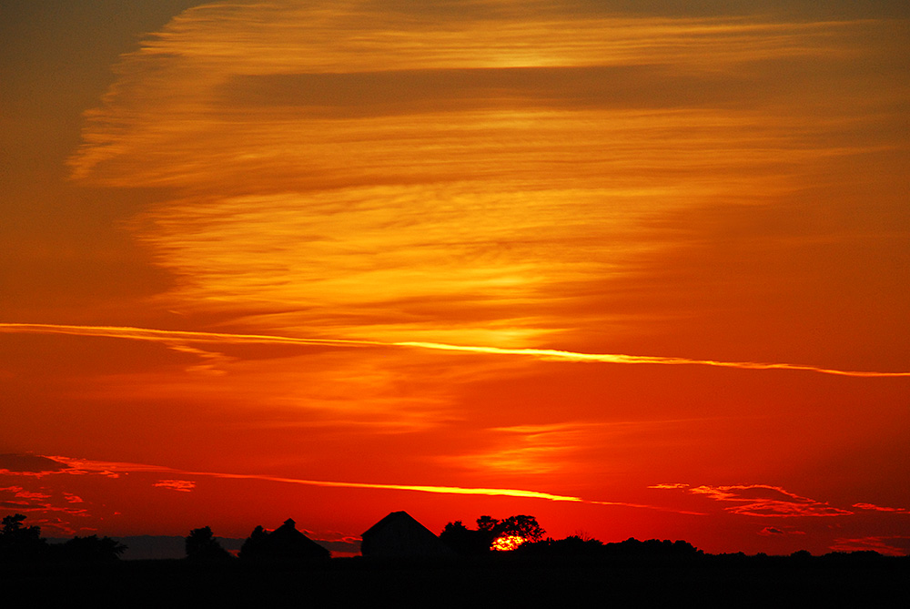
Affirmation
Paul cites Genesis 15:6 that “And he believed in the LORD; and he counted it to him for righteousness.” This was Paul’s proof that for Abraham righteousness came by faith. In spite of apparent odds to the contrary, Abraham believed that God could and would provide a son for him.

Slide 6
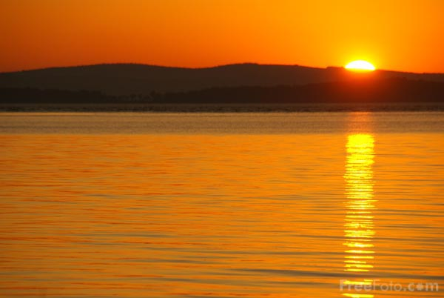
Contradiction?!?
Many years later, James came along and apparently contradicted Paul or ‘balanced’ him. Notice “Thou believest that there is one God; thou doest well: the devils also believe, and tremble. But wilt thou know, O vain man, that faith without works is dead? Was not Abraham our father justified by works, when he had offered Isaac his son upon the altar? Seest thou how faith wrought with his works, and by works was faith made perfect? And the scripture was fulfilled which saith, Abraham believed God, and it was imputed unto him for righteousness: and he was called the Friend of God. Ye see then how that by works a man is justified, and not by faith only.” James 2:19-24

Slide 7
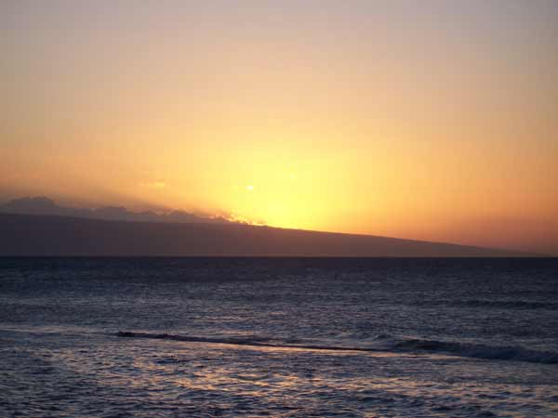
Paul and James-the Same
The same Spirit, that inspired them both, is not contradicting Himself. Paul’s point is that forgiveness and righteousness come thru faith in Jesus Christ. James’ point is that true faith is manifest in works of righteousness.

Slide 8

Same Coin-Opposite Side
We are forgiven by faith in Jesus Christ. We are empowered to do right thru faith in Jesus Christ. This is Paul’s focus. Once we have been forgiven and have experienced God’s goodness and power, we will reveal our connection to Heaven by works of righteousness. This is James’ focus.

Slide 9
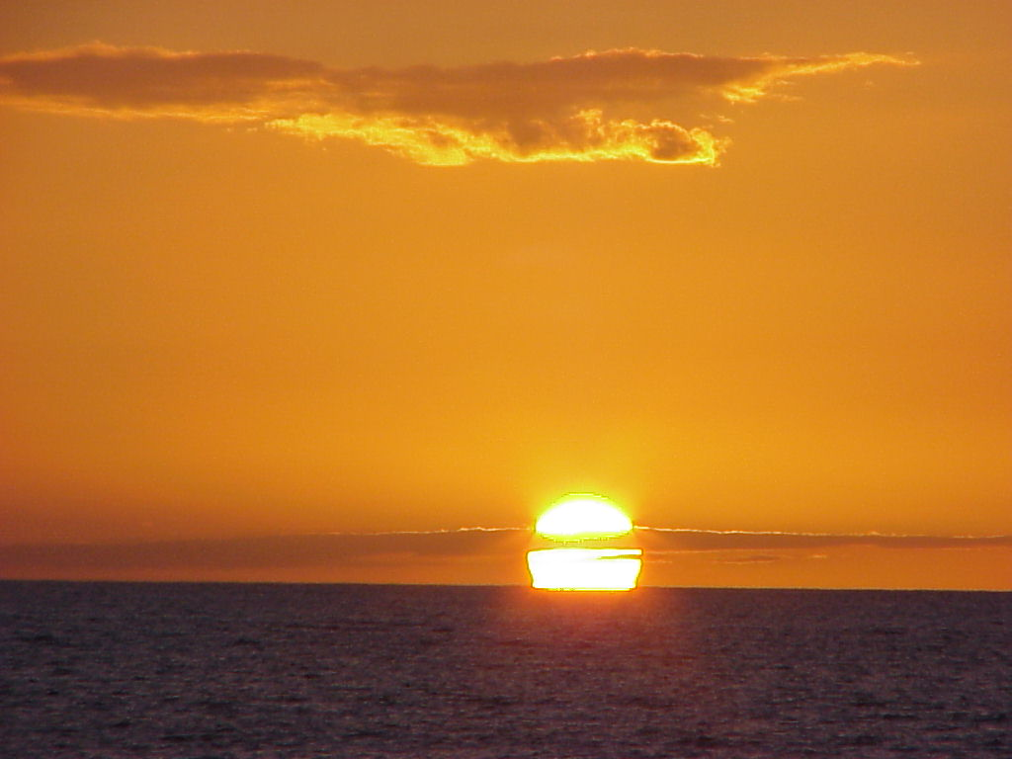
Romans 4:4-8
“Now to him that worketh is the reward not reckoned of grace, but of debt. But to him that worketh not, but believeth on him that justifieth the ungodly, his faith is counted for righteousness.
Even as David also describeth the blessedness of the man, unto whom God imputeth righteousness without works, Saying, Blessed are they whose iniquities are forgiven, and whose sins are covered. Blessed is the man to whom the Lord will not impute sin.”

Slide 10
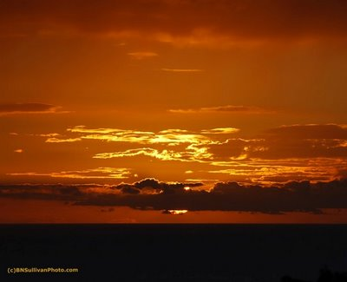
How Can I be Saved?
If I’m trying to earn God’s forgiveness by my works, then I will continually fall short because I can never meet the requirements of God. I will always owe a debt to Heaven. On the other hand, I can look by faith to Christ and His merits can satisfy my debt. I can accept His righteousness in my place and receive forgiveness.

Slide 11

Our Good Works Stink
My good deeds or being a good guy aren’t going to cut it. “But we are all as an unclean thing, and all our righteous nesses are as filthy rags; and we all do fade as a leaf; and our iniquities, like the wind, have taken us away.” Isaiah 64:6

Slide 12
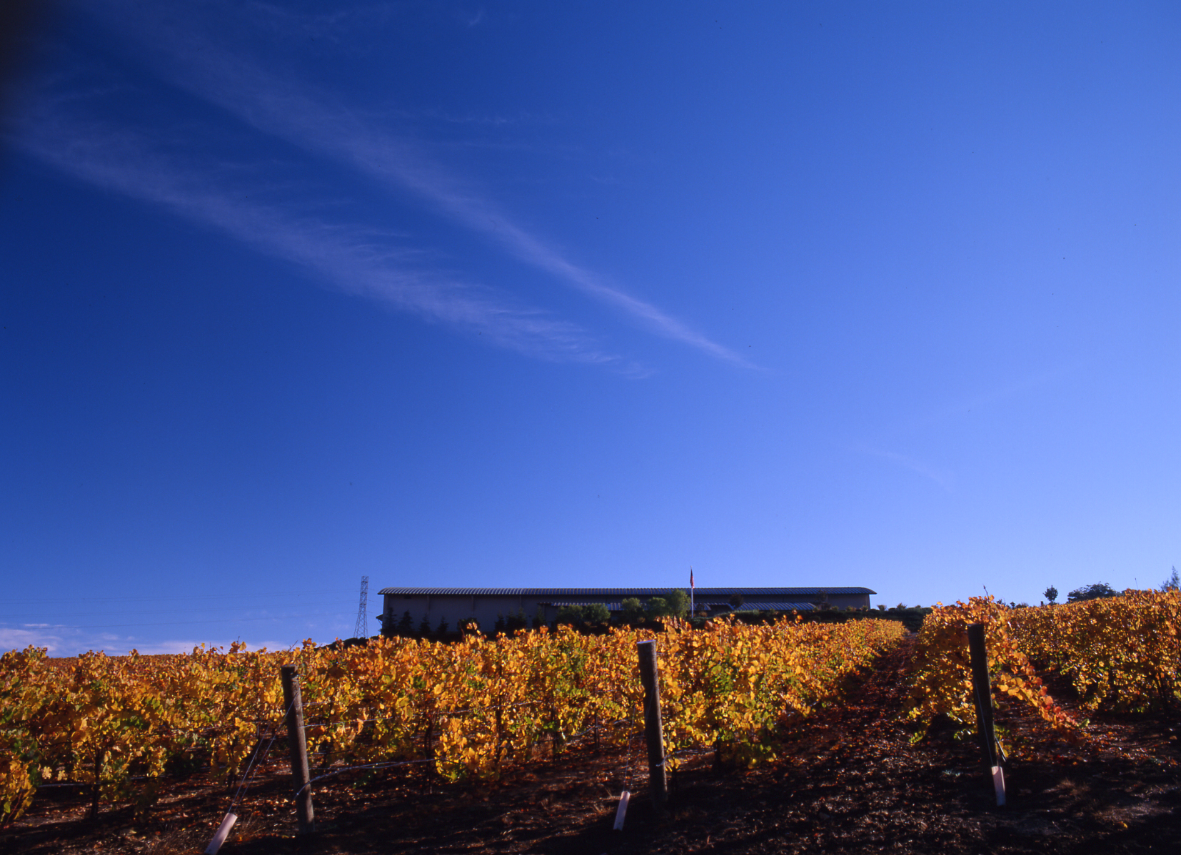
In Christ Alone
David’s joy was not found in what he did, but was found in Whom he trusted. He trusted that Christ could forgive even him. “Have mercy upon me, O God, according to thy lovingkindness: according unto the multitude of thy tender mercies blot out my transgressions. Wash me throughly from mine iniquity, and cleanse me from my sin.
For I acknowledge my transgressions: and my sin is ever before me.” Psalm 51:1-3

Slide 13
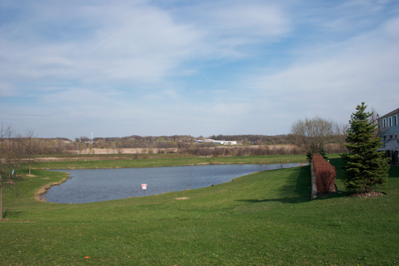
What does He want?
“Wherewith shall I come before the LORD, and bow myself before the high God? shall I come before him with burnt offerings, with calves of a year old? Will the LORD be pleased with thousands of rams, or with ten thousands of rivers of oil? shall I give my firstborn for my transgression, the fruit of my body for the sin of my soul?” Micah 6:6,7

Slide 14
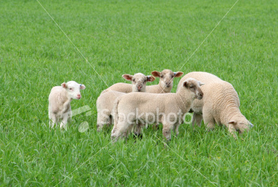
David’s Answer
“For thou desirest not sacrifice; else would I give it: thou delightest not in burnt offering. The sacrifices of God are a broken spirit: a broken and a contrite heart, O God, thou wilt not despise.” Psalm 51:16,17

Slide 15
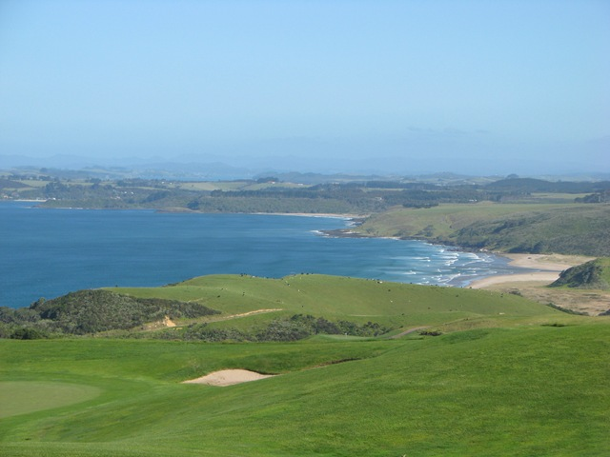
Romans 4:9-13
“Cometh this blessedness then upon the circumcision only, or upon the uncircumcision also? for we say that faith was reckoned to Abraham for righteousness. How was it then reckoned? when he was in circumcision, or in uncircumcision? Not in circumcision, but in uncircumcision. And he received the sign of circumcision, a seal of the righteousness of the faith which he had yet being uncircumcised: that he might be the father of all them that believe, though they be not circumcised; that righteousness might be imputed unto them also: And the father of circumcision to them who are not of the circumcision only, but who also walk in the steps of that faith of our father Abraham, which he had being yet uncircumcised. For the promise, that he should be the heir of the world, was not to Abraham, or to his seed, through the law, but through the righteousness of faith.”

Slide 16
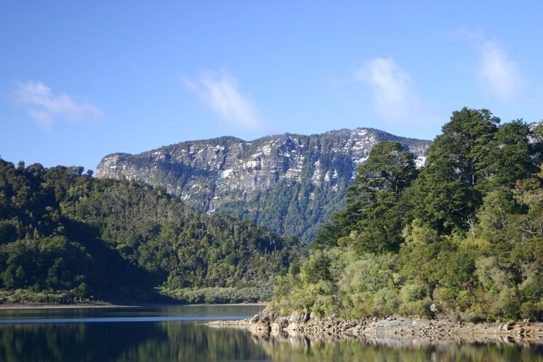
Who can have this experience?
Is the message and precious experience of Christ’s forgiveness and righteousness in the life only for those who are circumcised? Is this experience only for Sabbath keepers? Or can others experience this too?

Slide 17
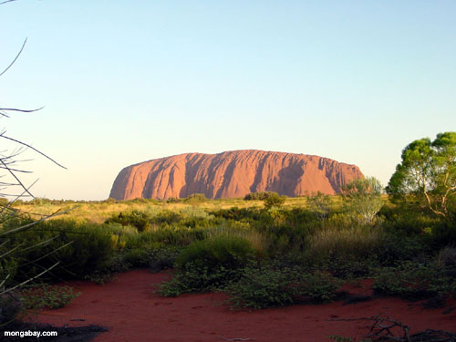
Paul’s Consistency
“Even as Abraham believed God, and it was accounted to him for righteousness. Know ye therefore that they which are of faith, the same are the children of Abraham. And the scripture, foreseeing that God would justify the heathen through faith, preached before the gospel unto Abraham, saying, In thee shall all nations be blessed. So then they which be of faith are blessed with faithful Abraham.” Galatians 3:6-9

Slide 18
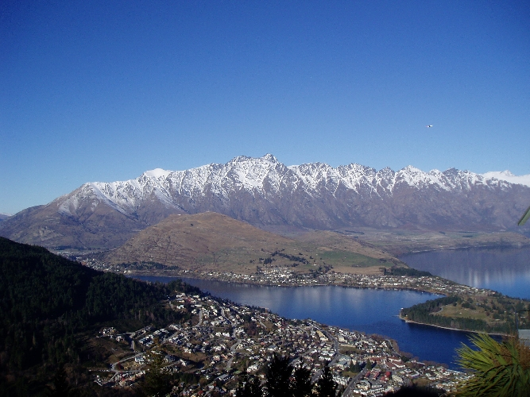
Abraham’s experience
Was Abraham forgiven and trusting in Christ’s righteousness after he was circumcised or was he trusting in Christ prior to circumcision? He had this glorious experience before he was circumcised!

Slide 19

Circumcision inside out
Circumcision simply represented the outward sign of the inward experience that he already had. Circumcision represented the cutting away of sin and evil from the life thru faith in the righteousness of Christ. Abraham had this experience before he was circumcised.

Slide 20
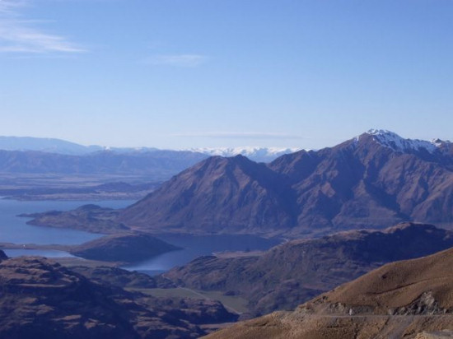
Don’t put the cart before the horse
Our grave danger is to think that some outward act of obedience gains God’s approval of me. WRONG! We are not accepted before God because of anything WE DO! We are accepted before God because we have faith in Jesus Christ!

Slide 21
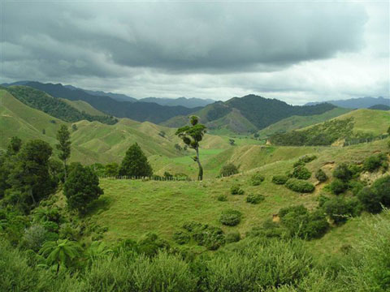
Through the Law
“For the promise, that he should be the heir of the world, was not to Abraham, or to his seed, through the law, but through the righteousness of faith.” Romans 4:13 What does Paul mean “through the law”? In the context, he obviously means that outward acts of obedience do not gain God’s acceptance; they simply reveal the genuineness of the faith professed!

