Slide 1
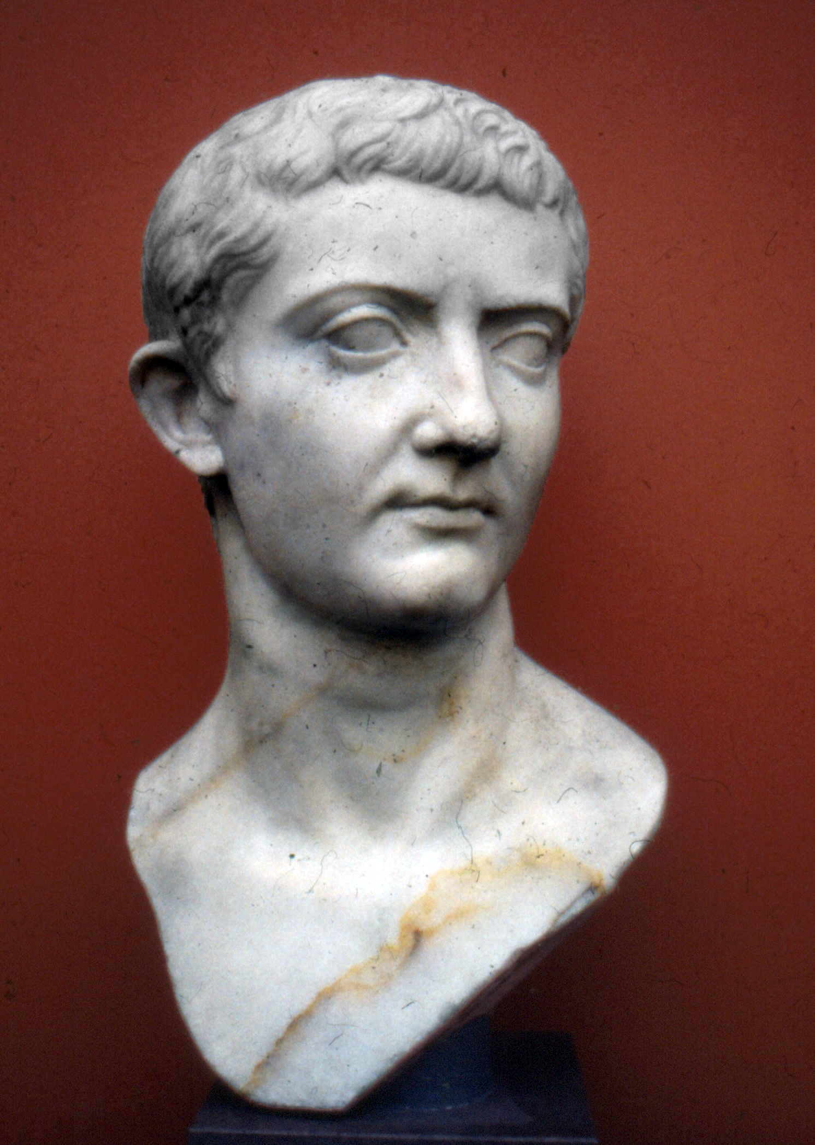
Tyranny, Sex, Violence, Depravity
“According to some Roman writers, such as Suetonius, although Caligula started out as a beneficent ruler, he became cruel, depraved, and vicious after he suffered from a serious illness (or perhaps was poisoned) in CE 37, shortly after he took the throne. He revived the treason trials of his father and predecessor Tiberius, opened a brothel in the palace, raped whomever he wished and then reported her performance to her husband, committed incest, and killed for greed. In addition to all that, he thought he should be treated as a god.”—www.thoughtco.com, “Top 5 Worst Roman Emperors”

Slide 2
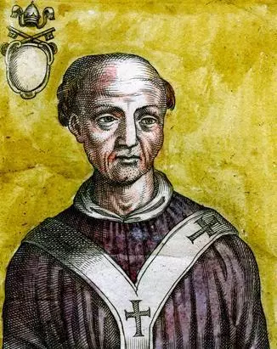
Pope John XII 950s
“In his relationship with the Church, John seems to have been urged toward a course of deliberate sacrilege that went far beyond the casual enjoyment of sensual pleasures. It was as though the dark element in his nature goaded him on to test the utmost extents of his power, a Christian Caligula whose crimes were rendered peculiarly horrific by the office he held. Later, the charge was specifically made against him that he turned the Lateran into a brothel; that he and his gang violated female pilgrims in the very basilica of St Peter . . . His sexual hunger was insatiable”—Bad Popes, p. 43

Slide 3
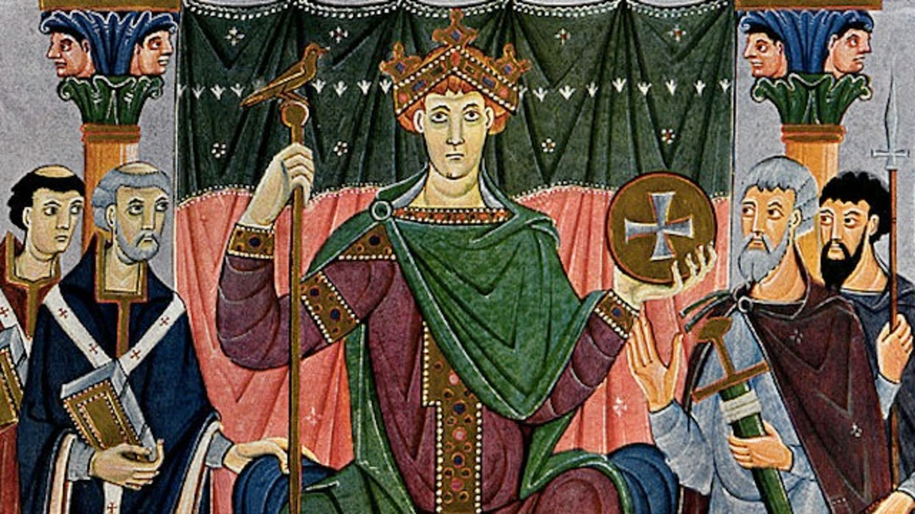
For, from the time that the Bishop of Rome had gotten to be acknowledged for bishop universal, by pretence of succession to St. Peter, their whole hierarchy, or kingdom of darkness, may be compared not unfitly to the kingdom of fairies; that is, to the old wives' fables in England concerning ghosts and spirits, and the feats they play in the night. And if a man consider the original of this great ecclesiastical dominion, he will easily perceive that the papacy is no other than the ghost of the deceased Roman Empire, sitting crowned upon the grave thereof: for so did the papacy start up on a sudden out of the ruins of that heathen power.”—Thomas Hobbes, Leviathan, ch. 47

Slide 4
The Spirit of Prophecy Shows how this Happened….
“In vain were Satan's efforts to destroy the church of Christ by violence. The great controversy in which the disciples of Jesus yielded up their lives did not cease when these faithful standard-bearers fell at their post. By defeat they conquered. God's workmen were slain, but His work went steadily forward. The gospel continued to spread and the number of its adherents to increase. It penetrated into regions that were inaccessible even to the eagles of Rome. Said a Christian, expostulating with the heathen rulers who were urging forward the persecution: You may ‘kill us, torture us, condemn us. . . . Your injustice is the proof that we are innocent . . . . Nor does your cruelty . . . avail you.’ It was but a stronger invitation to bring others to their persuasion. ‘The oftener we are mown down by you, the more in number we grow; the blood of Christians is seed.’—Tertullian, Apology, paragraph 50”—Great Controversy, p. 41-42

Slide 5
“Little by little, at first in stealth and silence, and then more openly as it increased in strength and gained control of the minds of men, "the mystery of iniquity" carried forward its deceptive and blasphemous work. Almost imperceptibly the customs of heathenism found their way into the Christian church. The spirit of compromise and conformity was restrained for a time by the fierce persecutions which the church endured under paganism. But as persecution ceased, and Christianity entered the courts and palaces of kings, she laid aside the humble simplicity of Christ and His apostles for the pomp and pride of pagan priests and rulers; and in place of the requirements of God, she substituted human theories and traditions. The nominal conversion of Constantine, in the early part of the fourth century, caused great rejoicing; and the world, cloaked with a form of righteousness, walked into the church. Now the work of corruption rapidly progressed. Paganism, while appearing to be vanquished, became the conqueror. Her spirit controlled the church. Her doctrines, ceremonies, and superstitions were incorporated into the faith and worship of the professed followers of Christ.”—GC, p. 49-50.

Slide 6
Absorbing Paganism
“From the beginning Roman religion was polytheistic. From an initial array of gods and spirits, Rome added to this collection to include both Greek gods as well as a number of foreign cults. As the empire expanded, the Romans refrained from imposing their own religious beliefs upon those they conquered; however, this inclusion must not be misinterpreted as tolerance - this can be seen with their early reaction to the Jewish and Christian population. . . . As the empire expanded across the Balkans, Asia Minor and into Egypt, Roman religion absorbed many of the gods and cults of conquered nations, but the primary influence would always remain Greece.”—Ancient History Encyclopedia, “Roman Religion, https://www.ancient.eu/Roman_Religion/

Slide 7
Pagan Outfits
“Ancient Philistines priest”

Slide 8
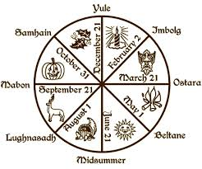
Symbols
“Shamash sun disc”
“solar wheel”

