Slide 1
What is the Difference Between Mormons, Jehovah’s Witnesses, and Seventh-day Adventists? pt 26

Slide 2
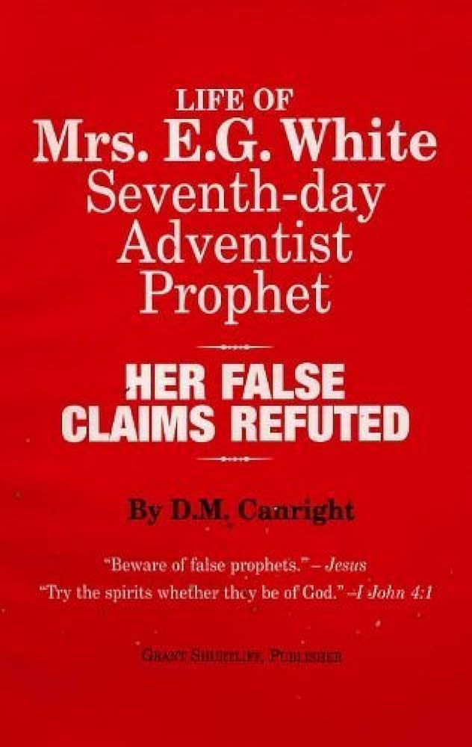
His Final Legacy….
“Canright died on May 12, 1919. Two months later, his final book, The Life of Mrs. E.G. White, was published. In it he criticised White heavily and maintained, among other charges:
that the early doctrines held in 1844 and up to 1851 failed utterly[—SHUT DOOR]
that in some cases her prophecies were wrong, and then suppressed afterwards[—FAILED PROPHECIES]
that she rebuked and controlled peoples' conduct, purportedly by spiritual knowledge, but factually by informings that often attacked an innocent party[—ELLEN WHITE CHARACTER ASSASSINATION]
that she plagiarized many of her purportedly God-inspired texts from other authors, and had to revise one of her books at an expense of $3,000[—PLAGIARISM]” DM Canright, Wikipedia

Slide 3
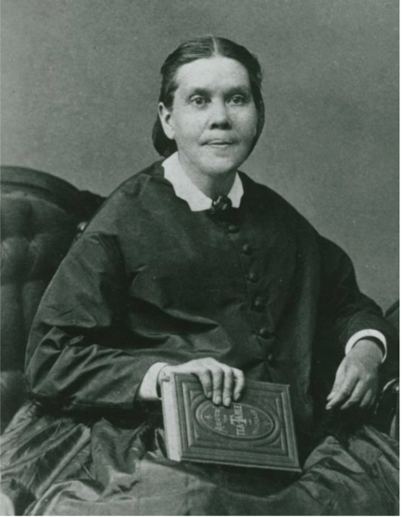
Still Standing!
The major charges against the prophetic gift of Ellen White are the Shut Door Controversy and the Plagiarism charge. As we have seen, both of these claims hold no water at all. Like a fungus, when exposed to the rays of the noonday sun, it withers, dies and loses all force. The more light, the less weight of the argument. The Goliaths are slain—Ahab and Jezebel gone. Now all that are left are small fish. We will deal with the next largest gainsay, which is that Ellen White made false predictions, which if true, makes her ministry a violation of Deuteronomy 18:22: “When a prophet speaketh in the name of the Lord, if the thing follow not, nor come to pass, that is the thing which the Lord hath not spoken, but the prophet hath spoken it presumptuously: thou shalt not be afraid of him.”

Slide 4
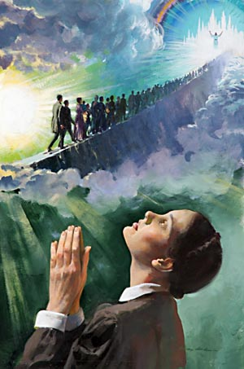
False Prophecy About the Second Coming?
“Said the angel: ‘Some food for worms, [SISTER CLARISSA M. BONFOEY, WHO FELL ASLEEP IN JESUS ONLY THREE DAYS AFTER THIS VISION WAS GIVEN, WAS PRESENT IN USUAL HEALTH, AND WAS DEEPLY IMPRESSED THAT SHE WAS ONE WHO WOULD GO INTO THE GRAVE, AND STATED HER CONVICTIONS TO OTHERS.] some subjects of the seven last plagues, some will be alive and remain upon the earth to be translated at the coming of Jesus.’ Solemn words were these, spoken by the angel. I asked the angel why so few were interested in their eternal welfare, so few preparing for their last change. Said he: "Earth attracts them, its treasures seem of worth to them." They find enough to engross the mind, and have no time to prepare for heaven. Satan is ever ready to plunge them deeper and deeper into difficulty; as soon as one perplexity and trouble is off the mind, he begets within them an unholy desire for more of the things of earth; and thus their time passes, and, when it is too late, they see that they have gained nothing substantial. They have grasped at shadows and lost eternal life. Such will have no excuse.” 1T, p. 131-132 (May 27, 1856)

Slide 5
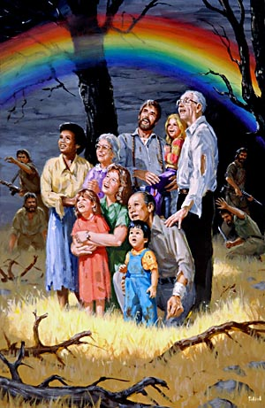
Conditional Prophecy??? Conditional on What?
“The angels of God in their messages to men represent time as very short. Thus it has always been presented to me. It is true that time has continued longer than we expected in the early days of this message. Our Saviour did not appear as soon as we hoped. But has the word of the Lord failed? Never! It should be remembered that the promises and threatenings of God are alike conditional.” 1SM, p. 67
Matt. 24:14 “And this gospel of the kingdom shall be preached in all the world for a witness unto all nations; and then shall the end come.”

Slide 6
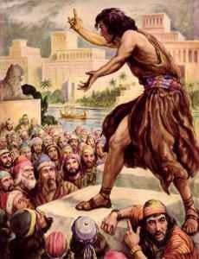
Bible: Conditional Prophecies
Jonah 4:4-6, 10 “And Jonah began to enter into the city a day's journey, and he cried, and said, Yet forty days, and Nineveh shall be overthrown. So the people of Nineveh believed God, and proclaimed a fast, and put on sackcloth, from the greatest of them even to the least of them. For word came unto the king of Nineveh, and he arose from his throne, and he laid his robe from him, and covered him with sackcloth, and sat in ashes. . . . And God saw their works, that they turned from their evil way; and God repented of the evil, that he had said that he would do unto them; and he did it not.

Slide 7
God Explains Conditional Prophecies Via Jeremiah
Jer. 18:7-10 “At what instant I shall speak concerning a nation, and concerning a kingdom, to pluck up, and to pull down, and to destroy it; If that nation, against whom I have pronounced, turn from their evil, I will repent of the evil that I thought to do unto them. And at what instant I shall speak concerning a nation, and concerning a kingdom, to build and to plant it; If it do evil in my sight, that it obey not my voice, then I will repent of the good, wherewith I said I would benefit them.”

Slide 8
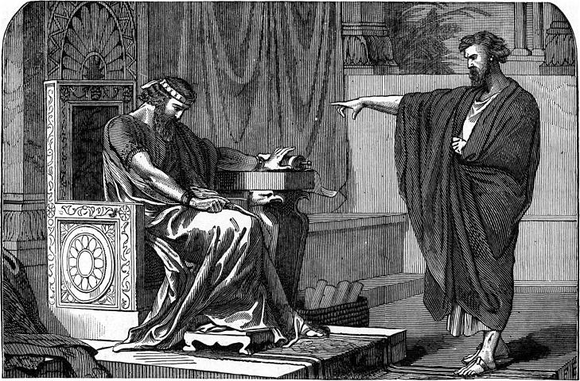
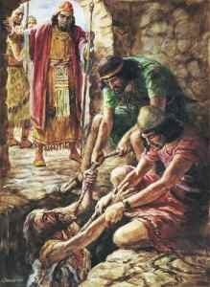
Conditional Prophecy With No “Escape Clause”
Jer. 4:5-7 “Declare ye in Judah, and publish in Jerusalem; and say, Blow ye the trumpet in the land: cry, gather together, and say, Assemble yourselves, and let us go into the defenced cities. Set up the standard toward Zion: retire, stay not: for I will bring evil from the north, and a great destruction. The lion is come up from his thicket, and the destroyer of the Gentiles is on his way; he is gone forth from his place to make thy land desolate; and thy cities shall be laid waste, without an inhabitant.”
Jer. 38:17-18 “Then said Jeremiah unto Zedekiah, Thus saith the Lord, the God of hosts, the God of Israel; If thou wilt assuredly go forth unto the king of Babylon's princes, then thy soul shall live, and this city shall not be burned with fire; and thou shalt live, and thine house: But if thou wilt not go forth to the king of Babylon's princes, then shall this city be given into the hand of the Chaldeans, and they shall burn it with fire, and thou shalt not escape out of their hand.”

Slide 9
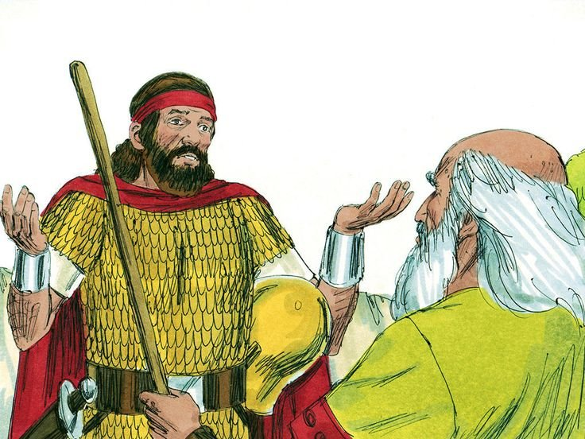
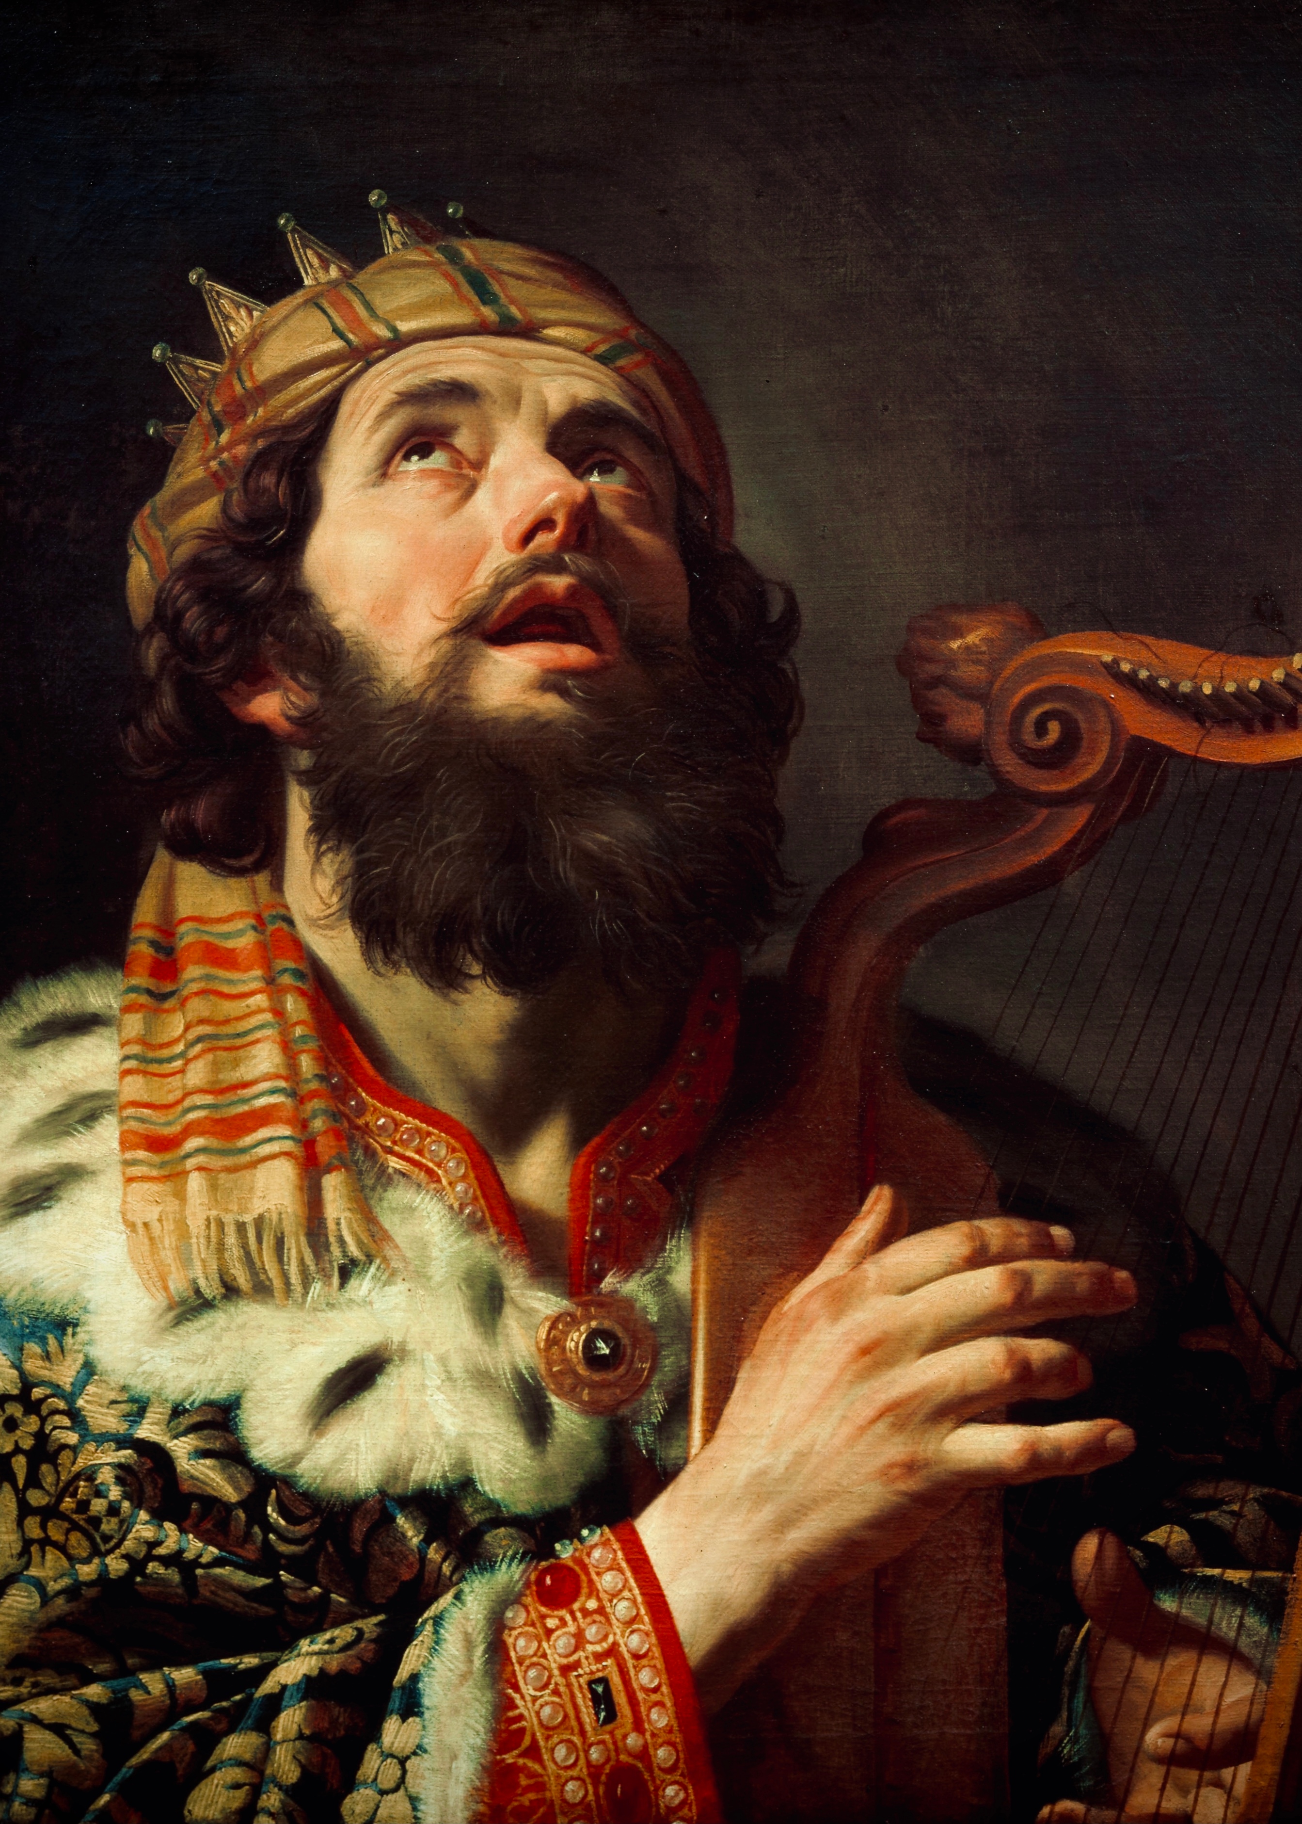
Other Examples…
1 Sam. 13;4-14: Saul loses the Kingdom for offering a burnt offering, by 1 Sam. 15:2-28 it is renewed because Saul refuses to destroy utterly the Amalekites and spares sheep and Agag.
David given rest from his enemies: 2 Sam. 7:10-11 “Moreover I will appoint a place for my people Israel, and will plant them, that they may dwell in a place of their own, and move no more; neither shall the children of wickedness afflict them any more, as beforetime, And as since the time that I commanded judges to be over my people Israel, and have caused thee to rest from all thine enemies. Also the Lord telleth thee that he will make thee an house.”
Condition (Obedience) Broken: 2 Sam. 12:16 “Now therefore the sword shall never depart from thine house; because thou hast despised me, and hast taken the wife of Uriah the Hittite to be thy wife.”

Slide 10
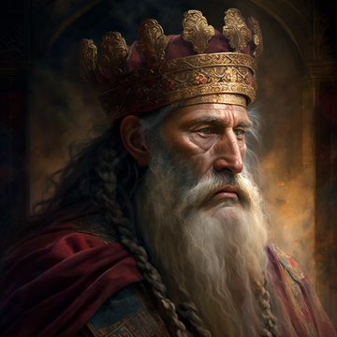
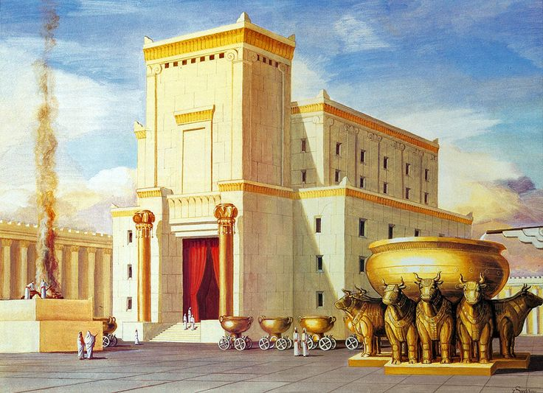
Positive Condition Broken
2 Sam. 7:12-15 “And when thy days be fulfilled, and thou shalt sleep with thy fathers, I will set up thy seed after thee, which shall proceed out of thy bowels, and I will establish his kingdom. He shall build an house for my name, and I will stablish the throne of his kingdom for ever. I will be his father, and he shall be my son. If he commit iniquity, I will chasten him with the rod of men, and with the stripes of the children of men: But my mercy shall not depart away from him, as I took it from Saul, whom I put away before thee.”
1 Kings 11:11 “Wherefore the Lord said unto Solomon, Forasmuch as this is done of thee, and thou hast not kept my covenant and my statutes, which I have commanded thee, I will surely rend the kingdom from thee, and will give it to thy servant.”

Slide 11
Still More Conditional Prophecies
Rehoboam forsakes God and Shishak King of Egypt attacks Judah, a prophet rebukes Rehoboam (2 Chron. 12:1-5), Rehoboam repents and humbles himself and God delivers Judah from Shishak (2 Chron. 12:6-7)
Evil King Ahab is told he will die (1 Kings 21:21-22), Ahab repents and humbles himself and God tells Elisha that the judgments will fall on his sons (1 Kings 21:27-29)
Hezekiah is told he will die (1 Kings 20:1) Hezekiah begs God for more time and God grants more life (1 Kings 20:5)
Josiah is told he will die in peace after reading about the Judgments that must fall on the nation for disobeying God (2 Kings 22:20) but Josiah rashly decides to stick his nose in the War between Egypt and Babylon and ends up dying in battle (2 Chron. 35:19-24)
Zedekiah is told he would die in peace by Jeremiah (Jer. 34:4-5): “Yet hear the word of the Lord, O Zedekiah king of Judah; Thus saith the Lord of thee, Thou shalt not die by the sword: But thou shalt die in peace: and with the burnings of thy fathers, the former kings which were before thee, so shall they burn odours for thee; and they will lament thee, saying, Ah lord! for I have pronounced the word, saith the Lord.” But Zedekiah continues in disobedience and has his children killed before his eyes, before they are removed, and dies in prison (Jer. 52:10-11)
David pleads with God over his unborn child (2 Sam. 12:14) but this prophecy is NOT overturned (2 Sam. 12:22)
Jesus pleads with the Father in Gethsemane 3 times for another way (Mark 14:36) but to no avail

Slide 12
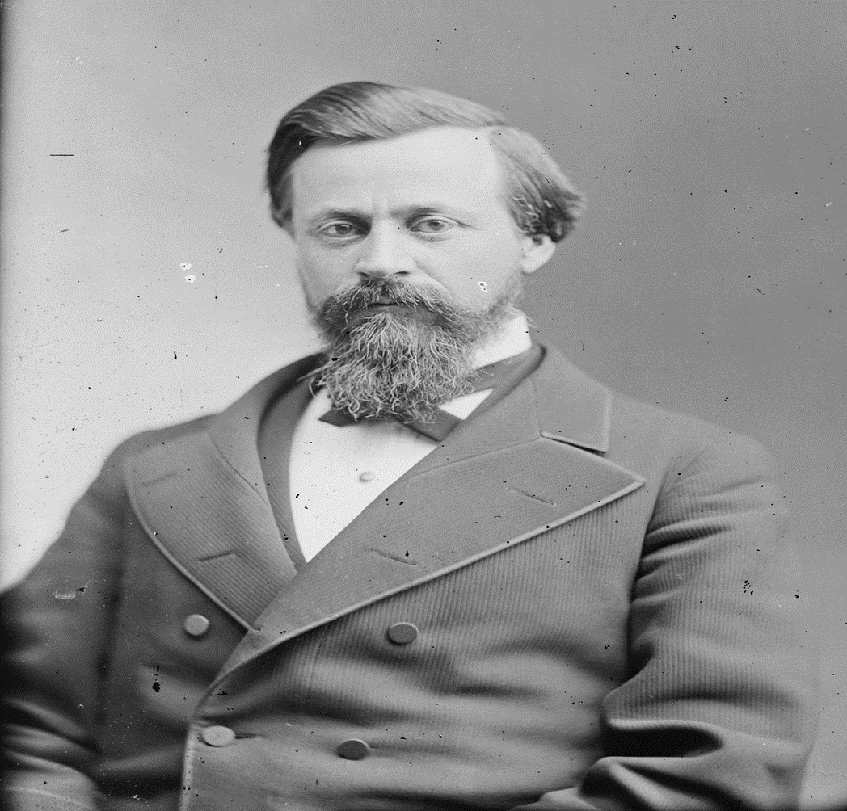
Almost Did Happen!!!!
“It is well known to most of our readers that United States Senator Henry W. Blair, from New Hampshire, introduced in the Fiftieth Congress, May 21, 1888, what has been commonly known as the " Blair Sunday-Rest bill," which was read twice, and referred to the Committee on Education and Labor. It was quite fully discussed pro and con. before the committee, with decided favors shown to those who favored the bill, by Mr. Blair, the author of the bill, who was also the chairman of the committee. Many millions of signatures to petitions for and against the bill came before Congress.” American Sentinel, Dec. 1889

Slide 13
AT Jones before Congress
THE NATIONAL SUNDAY LAW ARGUMENT OF ALONZO T. JONES Before the United States Senate Committee on Education and Labor: at WASHINGTON, D. C., DEC. 13, 1888
AT Jones “There are three particular lines in which I wish to conduct the argument: First, the (page 11) principles upon which we stand; second, the historical view; and, third, the practical aspect of the question. The principle upon which we stand is that civil government is civil, and has nothing to do in the matter of legislation, with religious observances in any way. The basis of this is found in the words of Jesus Christ in Matt. 22:21. When the Pharisees asked whether it was lawful to give tribute to Caesar or not, he replied: "Render therefore unto Caesar the things which are Caesar's; and unto God the things that are God's." In this the Saviour certainly separated that which pertains to Caesar from that which pertains to God. We are not to render to Caesar that which pertains to God; we are not to render to God by Caesar that which is God's.
Senator Blair. -- May not the thing due to Caesar be due to God also?
AT Jones -- No, sir. If that be so, then the Saviour did entangle himself in his talk, the very thing which they wanted him to do. The record says that they sought "how they might entangle him in his talk." Having drawn the distinction which he has, between that which belongs to Caesar and that which belongs to God, if it be true that the same things belong to both, then he did entangle himself in his talk; and where is the force in his words which command us to render to Caesar that which belongs to Caesar, and to God the things that are God's?”

Slide 14
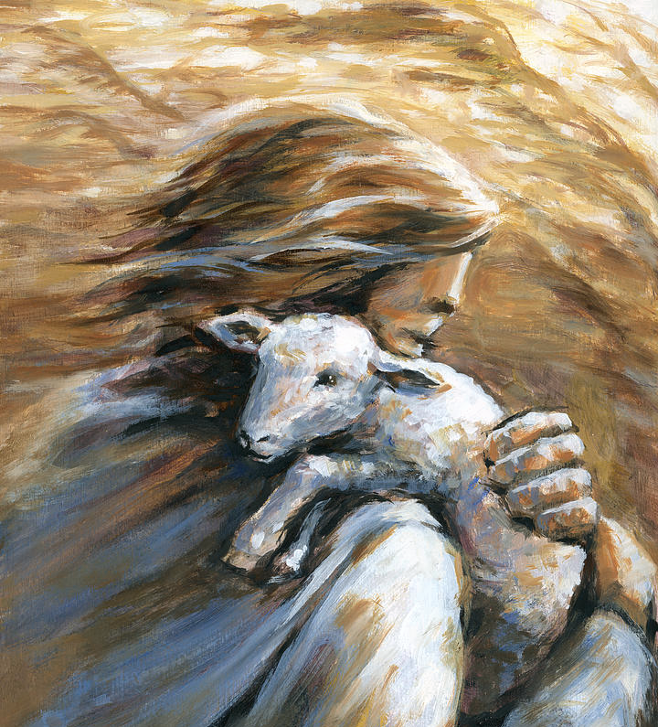
Why Christ Delays…
“The long night of gloom is trying; but the morning is deferred in mercy, because if the Master should come, so many would be found unready. God's unwillingness to have His people perish has been the reason for so long delay” 2T, p. 194 (Given in 1863).
Matt. 24:14 “And this gospel of the kingdom shall be preached in all the world for a witness unto all nations; and then shall the end come.”

Slide 15
Ellen White Acknowledges Second Coming Prophecies are Conditional
“God had committed to His people a work to be accomplished on earth. The third angel's message was to be given, the minds of believers were to be directed to the heavenly sanctuary, where Christ had entered to make atonement for His people. The Sabbath reform was to be carried forward. The breach in the law of God must be made up. The message must be proclaimed with a loud voice, that all the inhabitants of earth might receive the warning. The people of God must purify their souls through obedience to the truth, and be prepared to stand without fault before Him at His coming. Had Adventists, after the great disappointment in 1844, held fast their faith, and followed on unitedly in the opening providence of God, receiving the message of the third angel and in the power of the Holy Spirit proclaiming it to the world, they would have seen the salvation of God, the Lord would have wrought mightily with their efforts, the work would have been completed, and Christ would have come ere this to receive His people to their reward. But in the period of doubt and uncertainty that followed the disappointment, many of the advent believers yielded their faith. Dissensions and divisions came in. The majority opposed with voice and pen the few who, following in the providence of God, received the Sabbath reform and began to proclaim the third angel's message.” 1SM, p. 67-68

Slide 16
“Many who should have devoted their time and talents to the one purpose of sounding warning to the world, were absorbed in opposing the Sabbath truth, and in turn, the labor of its advocates was necessarily spent in answering these opponents and defending the truth. Thus the work was hindered, and the world was left in darkness. Had the whole Adventist body united upon the commandments of God and the faith of Jesus, how widely different would have been our history! It was not the will of God that the coming of Christ should be thus delayed. God did not design that His people, Israel, should wander forty years in the wilderness. He promised to lead them directly to the land of Canaan, and establish them there a holy, healthy, happy people. But those to whom it was first preached, ‘went not in because of unbelief’ (Heb. 3:19). Their hearts were filled with murmuring, rebellion, and hatred, and He could not fulfill His covenant with them. For forty years did unbelief, murmuring, and rebellion shut out ancient Israel from the land of Canaan. The same sins have delayed the entrance of modern Israel into the heavenly Canaan. In neither case were the promises of God at fault. It is the unbelief, the worldliness, unconsecration, and strife among the Lord's professed people that have kept us in this world of sin and sorrow so many years” 1SM, p. 68-69 (Stated in 1883)

Slide 17
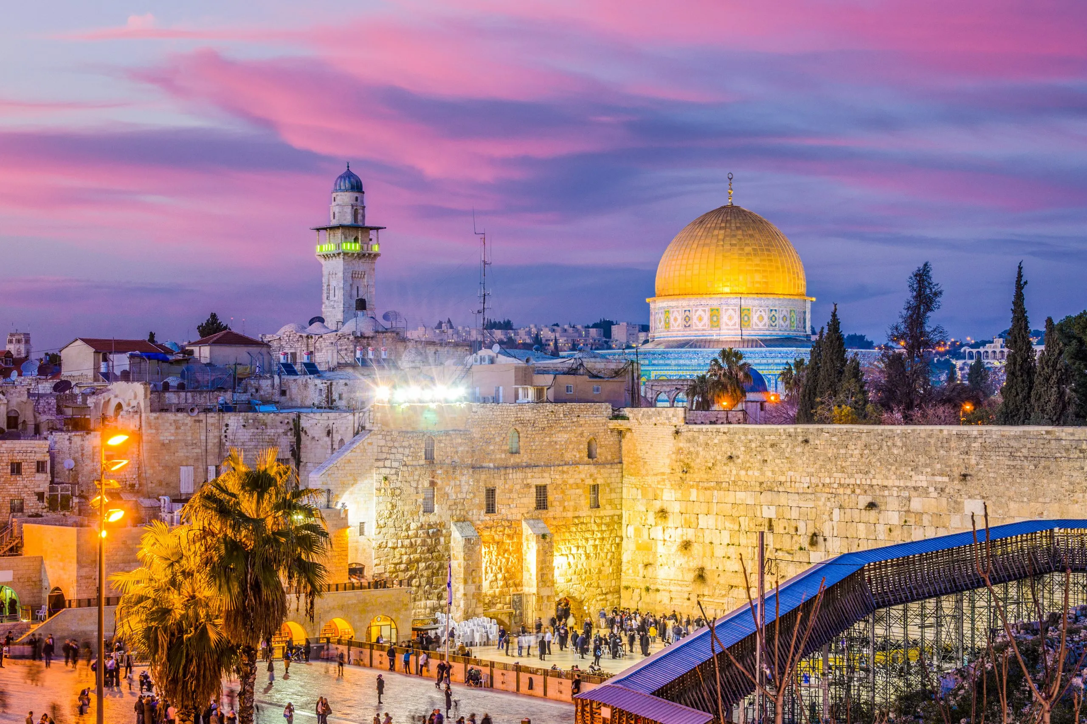
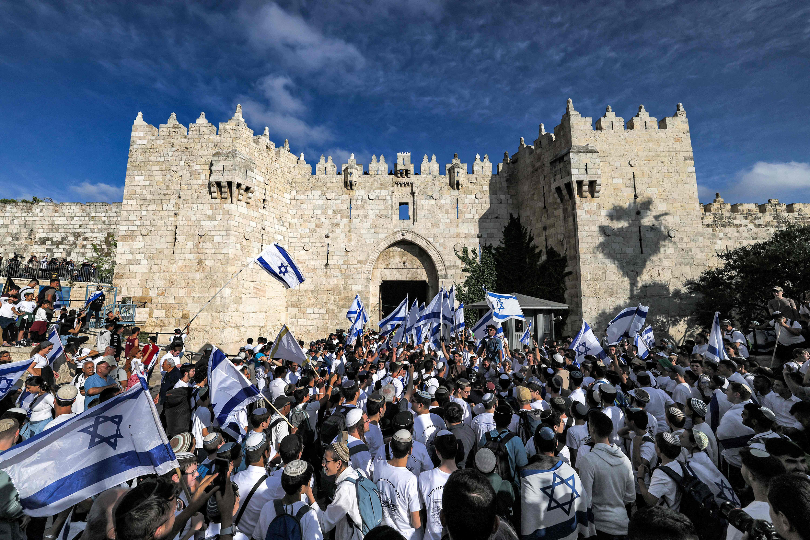
Old Jerusalem Will Not Be Built Again?
“I also saw that Old Jerusalem never would be built up; and that Satan was doing his utmost to lead the minds of the children of the Lord into these things now, in the gathering time, to keep them from throwing their whole interest into the present work of the Lord, and to cause them to neglect the necessary preparation for the day of the Lord.” EW, p. 75-76

Slide 18
Full Context: NOT Talking About Buildings
“The Lord has shown me that the message of the third angel must go, and be proclaimed to the scattered children of the Lord, but it must not be hung on time. I saw that some were getting a false excitement, arising from preaching time; but the third angel's message is stronger than time can be. I saw that this message can stand on its own foundation and needs not time to strengthen it; and that it will go in mighty power, and do its work, and will be cut short in righteousness. Then I was pointed to some who are in the great error of believing that it is their duty to go to Old Jerusalem, and think they have a work to do there before the Lord comes. Such a view is calculated to take the mind and interest from the present work of the Lord, under the message of the third angel; for those who think that they are yet to go to Jerusalem will have their minds there, and their means will be withheld from the cause of present truth to get themselves and others there. I saw that such a mission would accomplish no real good, that it would take a long while to make a very few of the Jews believe even in the first advent of Christ, much more to believe in His second advent. I saw that Satan had greatly deceived some in this thing and that souls all around them in this land could be helped by them and led to keep the commandments of God, but they were leaving them to perish. I also saw that Old Jerusalem never would be built up; and that Satan was doing his utmost to lead the minds of the children of the Lord into these things now, in the gathering time, to keep [76] them from throwing their whole interest into the present work of the Lord, and to cause them to neglect the necessary preparation for the day of the Lord.” EW, p. 75-76

Slide 19
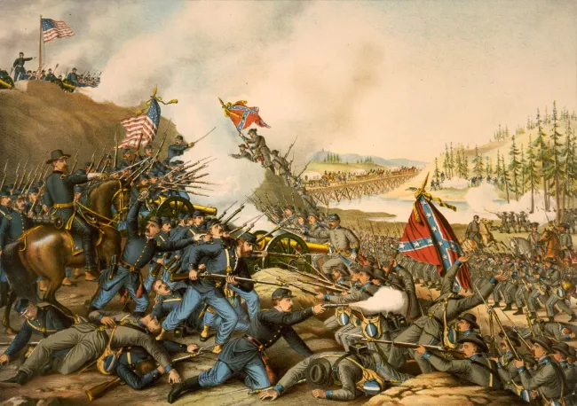
England to Attack Union During Civil War?
“This nation will yet be humbled into the dust. . . . When England does declare war, all nations will have an interest of their own to serve, and there will be general war” 1T, p. 259 (Canright, Life of Mrs. E.G. White, p. 238)

Slide 20
Full Context: Notice the “If”
“I was shown that if the object of this war had been to exterminate slavery, then, if desired, England would have helped the North. But England fully understands the existing feelings in the Government, and that the war is not to do away slavery, but merely to preserve the Union; and it is not for her interest to have it preserved. Our Government has been very proud and independent. The people of this nation have exalted themselves to heaven, and have looked down upon monarchical governments, and triumphed in their boasted liberty, while the institution of slavery, that was a thousand times worse than the tyranny exercised by monarchial governments, was suffered to exist and was cherished. In this land of light a system is cherished which allows one portion of the human family to enslave another portion, degrading millions of human beings to the level of the brute creation. The equal of this sin is not to be found in heathen lands. Said the angel: “Hear, O heavens, the cry of the oppressed, and reward the oppressors double according to their deeds.” This nation will yet be humbled into the dust. England is studying whether it is best to take advantage of the present weak condition of our nation, and venture to make war upon her. She is weighing the matter, and North and the South trying to sound other nations. She fears, if she should commence war abroad, that she would be weak at home, and that other nations would take advantage of her weakness. Other nations are making quiet yet active preparations for war, and are hoping that England will make war with our nation, for then they would improve the opportunity to be revenged on her for the advantage she has taken of them in the past and the injustice done them. A portion of the queen’s subjects are waiting a favorable opportunity to break their yoke; but if England thinks it will pay, she will not hesitate a moment to improve her opportunities to exercise her power and humble our nation. When England does declare war, all nations will have an interest of their own to serve, and there will be general war, general confusion. England is acquainted with the diversity of feeling among those who are seeking to quell the rebellion. She well knows the perplexed condition of our Government; she has looked with astonishment at the prosecution of this war—the slow, inefficient moves, the inactivity of our armies, and the ruinous expenses of our nation. The weakness of our Government is fully open before other nations, and they now conclude that it is because it was not a monarchial government, and they admire their own government, and look down, some with pity, others with contempt, upon our nation, which they have regarded as the most powerful upon the globe. EW, p. 258-260

Slide 21
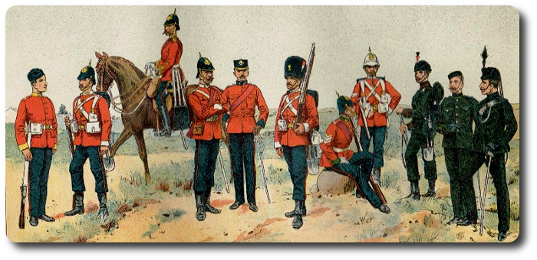
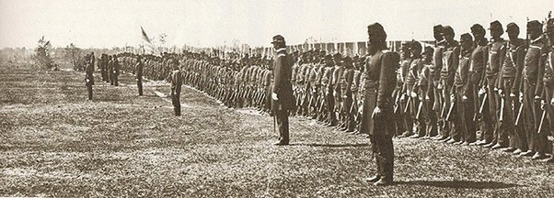
Almost A World War!
“The Trent Affair threatened to directly involve Canada in the Civil War. In international waters near Cuba, on 8 November 1861, a Union ship stopped Trent, a British merchant ship and mail packet. Two Confederate officials were taken from Trent and arrested. Britain pledged to declare war on the United States unless the men were released and Lincoln apologized. Meanwhile, Britain sent thousands of soldiers to Canada and the Maritimes to prepare for the war that it predicted would begin with Americans marching north. Lincoln was advised to invade Canada, but said he would fight only one war at a time. He did not apologize, but the men were freed and the crisis subsided” Canadian Encyclopedia, American Civil War, https://www.thecanadianencyclopedia.ca/en/article/american-civil-war

Slide 22
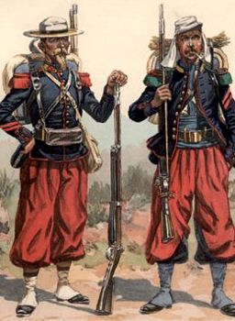
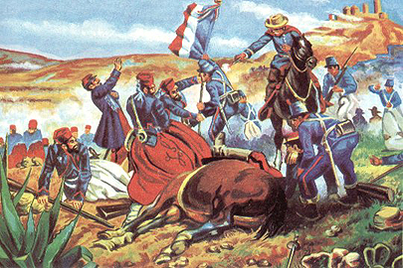
England to the North? France to the South?
“In 1862, French Emperor Napoleon III maneuvered to establish a French client state in Mexico, and eventually installed Maximilian of Habsburg, Archduke of Austria, as Emperor of Mexico. Stiff Mexican resistance caused Napoleon III to order French withdrawal in 1867, a decision strongly encouraged by a United States recovered from its Civil War weakness in foreign affairs. Earlier, during the Civil War, U.S. Secretary of State William Henry Seward followed a more cautious policy that attempted to keep relations with France harmonious and prevent French willingness to assist the Confederacy. Consequently, Maximilian’s government rebuffed Confederate diplomatic overtures.” Office of the Historian, https://history.state.gov/milestones/1861-1865/french-intervention

Slide 23
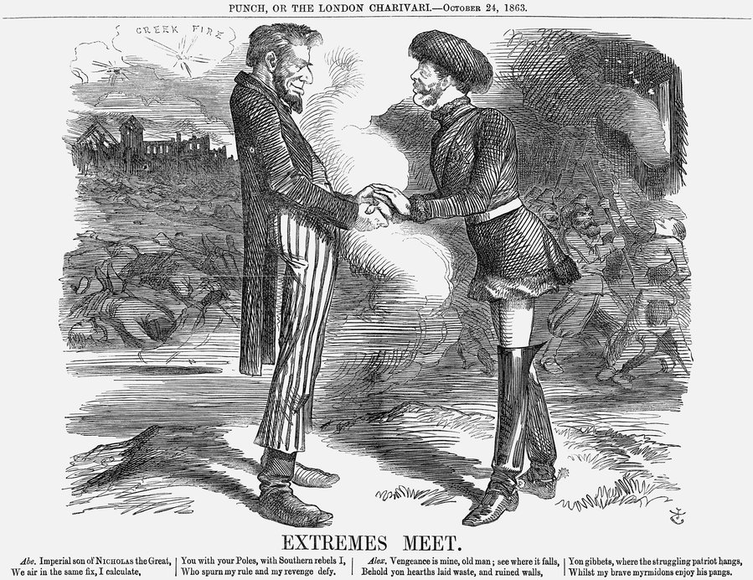
Russia with the Union?
“During the American Civil War, Russia supported the Union, largely because it believed that the U.S. served as a counterbalance to its geopolitical rival, the United Kingdom. In 1863, the Russian Navy's Baltic and Pacific fleets wintered in the American ports of New York and San Francisco, respectively. The Alexander Nevsky and the other vessels of the Atlantic squadron stayed in American waters for seven months (September 1863 to June 1864)” Wikipedia, Russian Empire-United States Relations

