Slide 1
The SAnctuary
The Role of Jesus Christ

Slide 2
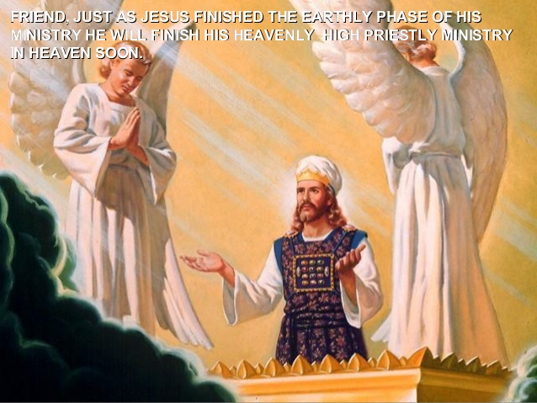
Why study the Sanctuary?
Thy way, O God, is in the sanctuary: who is so great a God as our God?—Psalm 77:13
Unto two thousand and three hundred days; then shall the sanctuary be cleansed—Daniel 8:14
“The correct understanding of the ministration in the heavenly sanctuary is the foundation of our faith”
E.W., Evangelism, 221.
“The intercession of Christ in man’s behalf in the sanctuary above is as essential to the plan of salvation as was His death upon the cross.”
Ellen White, The Great Controversy, pg. 489.

Slide 3
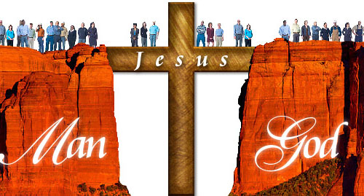
The Role(?) of Christ
Isaiah 59:1,2 “Behold, the LORD’S hand is not shortened, that is cannot save;
neither his ear heavy, that it cannot hear: But your iniquities have separated
between you and your God, and your sins have hid his face from you, that
he will not hear.
Isaiah 59:16 “And he [God] saw that there was no man, and wondered that there
was no intercessor: therefore his arm brought salvation unto him; and his
righteousness, it sustained him.”

Slide 4
Christ Our High Priest
Hebrews 9:11, 12 “Christ being come an high priest of good things to come, by a
greater and more perfect tabernacle, not made with hands, that is to say, not of
this building; Neither by the blood of goats and calves, but by his own blood he
entered in once into the holy place, having obtained eternal redemption for us.”
Hebrews 5:8-10 “Though he were a Son, yet leaned he obedience by the things
which he suffered; And being made perfect, he became the author of eternal
salvation unto all them that obey him; Called of God an high priest after the order
of Melchisedec.”
1. High priest in a heavenly tabernacle (NOT ON EARTH)
2. Entered the Sanctuary by His Own Blood
3. Called of God
4. Author of eternal salvation to ALL those that obey him
5. Not after the Levitical priesthood, but a higher order

Slide 5
What was the High Priest’s Responsibilities?
Leviticus 6:1-7 “And the Lord spake unto Moses, saying, “If a soul sin, and commit
a trespass against the Lord, and lie unto his neighbor in that which was delivered
him to keep, or in fellowship, or in a thing taken away by violence, or hath deceived
His neighbor; or have found that which was lost, and lieth concerning it, and
sweareth falsely; in any of all these that a man doeth, sinning therein: Then it shall
be, because he hath sinned, and is guilty, that he shall restore that which he took
violently away, or the thing which he hath deceitfully gotten, or that which was
delivered him to keep, or the lost thing which he found, or all that about which he
hath sworn falsely; he shall even restore restore it in the principal, and shall add the
fifth part more thereto, and give it unto him to whom it appertaineth, in the day of his
trespass offering unto the Lord, a ram without blemish out of the flock, with thy
estimation, for a trespass offering, unto the priest: And the priest shall make an
atonement for him before the Lord: and it shall be forgiven him for any thing of all
that hath done in trespassing therein.”
The Priest makes Atonement for the Repentant Sinner

Slide 6
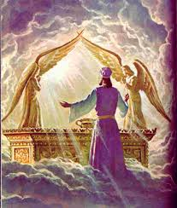
Christ Atones for Us….
“Every man’s work passes in review before
God and is registered for faithfulness or unfathfulness. Opposite each name in the book of heaven is entered with terrible exactness every work, every selfish act, every unfulfilled duty, every secret sin, with every artful, dissembling. Heaven sent warnings of reproof neglected, wasted moments, unimproved opportunities, the influence exerted for good or for evil, with its far reaching results. All are chronicled by the recording angel, for the law of God is the standard by which the character and lives of men will be tested in the judgment, says the wise man. ‘For God shall bring every work into judgment’ Ecc. 12:13,14”
E.W. GC, p. 482

Slide 7
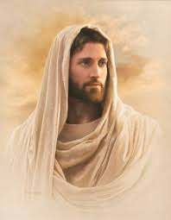
What a Savior!
However, Christ is unique and superior to
other priests, He is the High Priest, the One that may enter the Holy of Holies, and He
may enter because of His own blood which He offered on our behalf
The main difference is that today, we do not
need a sin offering, because Christ has fulfilled that requirement. Now all we need to do is confess and repent, truly repent, and ask for forgiveness and it is ours!!
I came not to call the righteous, but sinners to repentance—Luke 5:32

Slide 8
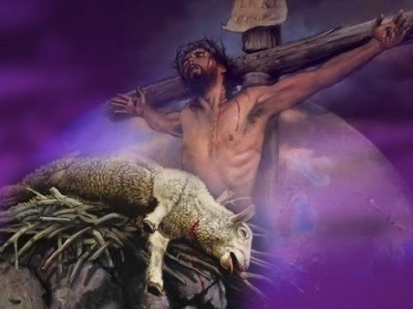
Christ Our Sacrifice, our Lamb
John 1:29 “Behold the Lamb of God which taketh away the sin of the world
1 Cor. 5:7 Purge out therefore the old leaven, that ye may be a new lump, as ye are unleavened. For even Christ our passover is sacrificed for us
1 Peter 1:18,19 Forasmuch as ye know that ye were not redeemed with corruptible things, as silver and gold, from your vain conversation received by tradition from your fathers;
But with the precious blood of Christ, as of a lamb without blemish and without spot:

Slide 9
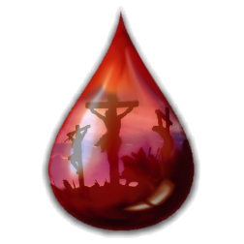
What Does a Lamb Do?
“the Lord hath laid on him the iniquity of us all…
he is brought as a lamb to the slaughter”
Isaiah 53:6,7
If any one of the common people sin through ignorance, while he doeth somewhat against any of the commandments of the Lord concerning things which ought not to be done, and be guilty; he shall bring his offering, a kid of the goats, a female without blemish, for his sin which he hath sinned. And he shall lay his hand upon the sin offering, and slay the sin offering in the place of the burnt offering —Lev. 4:27-29
Jesus is the sin offering, the penalty paid if full
Jesus is our substitute, taking our place in death
The life is in the blood (Lev. 17:11), Jesus gave His life while we were yet in our sins

Slide 10
Embrace the Cross!
The spotless son of God hung upon the cross. His flesh, lacerated with stripes. Those hands, so often reached out in blessing, nailed to wooden bars. Those feet, so tireless on ministries of love, spiked to a tree. That royal head, pierced by the crown of thorns. Those quivering lips, shaped in a cry of woe. And all that He endured; the blood drops that flowed from His head, His hands, His feet. The agony that wracked his frame, and the unutterable anguish that filled His soul at the hiding of His Father’s face speaks to each child of humanity, declaring “it is for thee that the son of God consents to bear this burden of guilt. For thee, He spoils the domain of death and opens the gate of paradise. He, who stilled the angry waves and walked the foam-capped billows, who made devils tremble and disease flee. Who opened blind eyes, and called forth the dead to life offers himself upon the cross as a sacrifice, And this, from love, to thee. He, the bearer, endures the wrath of divine justice, and for thy sake, becomes sin itself.” –E.W. Desire of Ages, pg. 755

Slide 11
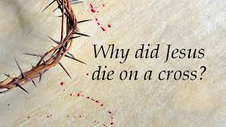
Permission to Sin? NO
Christ died for every sin we ever have or ever will commit; He paid the price. That does not mean, as some suggest, that we can continue in sin! Jesus saves us from sin, not in sin.
“This goody-goody religion that makes light of sin and that is forever dwelling upon the love of God to the sinner, encourages the sinner to believe that God will save hiim while he continues in sin and he knows it to be sin. This is the way that many doing who profess to believe present truth. The truth is kept apart from their life and this is the reason it has no more power to convict and convert the soul” E.W. 3 Selected Messages, p. 155

Slide 12
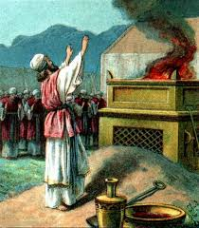
Christ Our Advocate
1 john 2:1 “My little children, these things write I unto you, that ye sin not. And if any man sin, we have an advocate with the Father, Jesus Christ the righteous.
Hebrews 7:25 “Wherefore he [Christ] is able to save them to the uttermost that come unto God by him, seeing he ever liveth to make intercession for them”

Slide 13
What Does Our Advocate Do?
An advocate is an ally. In this way, Christ intercedes for us on our behalf, like a lawyer would do for a client. Moreover, Christ is an empathetic counselor, because He was tempted in ALL ways, just as we are.
“For we have not an high priest which cannot be touched with the feeling of our infirmities; but was in all points tempted like as we are, yet without sin” Hebrews 4:15

Slide 14
Another Amazing Gift!
Jesus presents us to the Father! He being the Son of God and equally God
represents us to God! What a gift. The Son, the One who lived a perfect life, became our sacrifice and priest, also pleads our case to the Father in Heaven. Being that Jesus’ words have the most persuasion, this is an unspeakable gift from God. Once again, Jesus proves His love for us!

Slide 15
Christ Our Way
Literally Our Way, and Our example
“Let not your heart be troubled: ye believe in God, believe also in me. In my
father’s house there are many mansions: if it were not so, I would have told you.
I go to prepare a place for you. And if I go and prepare a place for you, I will
come again, and receive you unto myself: that where I am, there ye may be also”
John 14:1-3
Christ’s death, offering, ascension, and continual service in the sanctuary to save
fallen man has lifted humanity from fallen race, to the throne of God.
Mrs. White Acts 1:11 Holy Humanity Taken to Heaven

Slide 16
Jesus Claims…
I am the WAY, the TRUTH and the LIFE: no man cometh unto the Father,
but by me—John 14:6
Thy WAY, Oh God, is on the sanctuary—Psalm 77:13
“by His death He began that work which after His resurrection He ascended to complete in heaven”-E.W. GC, p. 489.

Slide 17
How is Jesus Our Way
Jesus is actually literally our way into heaven, He is the door to God, the bridge that reconnects the repentant sinner with a Holy God. Jesus has lifted man to throne of God, when such an act was both undeserving and inconvenient to do so.
Moreover, Jesus is our example, our proof, that a fallen human life can attain victory over the bondage of sin. That we can indeed submit ourselves to God, and through the indwelling of the Holy Spirit, think, act, and be righteous---another amazing gift.
Jesus is our Blessed Hope in so
many ways!!!!

Slide 18
Proof that Jesus expects us to follow His example…
Luke 6:46-49-We are expected to apply our teachings, not continue in sin.
Matthew 16:21-24—Christ expects nothing short than the absolute denial of self unto death
Mrs White: Matt. 16:24-Travel, the Cross, up From, Living for Self
BUT I DON’T THINK I CAN DO THAT---you can’t but Christ can: How?
Happiness Digest p. 33
What Was His Example?
Temptations, Followed Law over
man, went around teaching and healing, attended church and worshiped God, went through the sanctuary process of baptism/offering/high priestly duties, this cup pass from me,

Slide 19
Mere Belief is NOT enough
Not every one that saith unto me, Lord, Lord, shall enter into the kingdom of heaven; but he that doeth the will of my Father which is in heaven. Many will say to me in that day, Lord, Lord, have we not prophesied in thy name? and in thy name have cast out devils? And in thy name done many wonderful works? And the will I profess unto them, I never knew you: depart from me, ye that work iniquity (know good and do evil)—Matt. 7:21-23
Mrs. White: Matt. 7:21-23- A Profession is not enough
Thou believest that there is one God,
thou doest well: the devils also believe, and tremble. But wilt thou know, O vain man, that faith without works is dead?—James 2:19,20

Slide 20
Christ Truly is the WAY
Saying that Christ is the Way is a loaded statement. As with all of His roles in this
sanctuary process, Christ is the way in more ways than one. Indeed, this is why He refers to Himself as “Alpha and Omega, First and the Last, The beginning and the End” in Revelation 22:13. He is literally our door, bridge, and keys into heaven. Through daily submission by faith, we become Sons and Daughters of the Living God, not taught by men, but pupils of the Holy Spirit, (if it were possible deceive the very elect—but its not possible!) which also performs works through faith. Our obedience will be tested against persecution, sins, family, and possibly death. Indeed, Jesus died, He was a willing Son to a willing Father, we may be asked to do the same. As if that wasn’t spectacular enough, Jesus is not just our bridge, priest, sacrifice, and advocate, but He is also our perfect example—proving once and for all, that Satan was wrong when he said the law is unrealistic. Every aspect of Jesus’ roles in the Sanctuary proclaim God is Love, and as we will see, the services, objects, raiment, and prophecies will declare the same.

Slide 21
A Work Almost Complete
Why such a process to get humans to heaven? Couldn’t God just forgive us and translate us? Give us new minds and new characters?
--Maybe, it’s certainly within His power to do so, but what would that solve? Wouldn’t that prove Satan was right to question God’s character? If God just gave us all a free pass, with absolutely no penalty, how can He be 100% Just, while at the same time being 100% Mercy and 100% Grace? Moreover, God would be overriding our free will by saving man based based on one decision and moment without the opportunity to apply and grow. Also, Satan’s accusations would be well-founded if God chose this path because He would be implanting a new mind and new character forcefully instead of developmentally. God is not a God of indoctrination! He wants our whole hearts freely given, so that He can work a new creation in the individual—like the sanctuary, salvation is a process, justified by faith, but the sanctification process is the work of a lifetime, where the individual has the opportunity to grow and continually choose Christ and heaven over sin. Most importantly, the whole Christian faith is founded upon the relationship with God. If we repent and are zapped with new characters, when is the relationship developed? Is it also infused? If so, wouldn't that make it fake? Through the sanctification process we are able to see time and time again, that God is love, that His mercy endures forever, that He is longsuffering, good, just, Righteous, that His commandments are not burdensome, but perfectly understandable requests

Slide 22
The Problem of Sin
Why is it such a process in the sanctuary to save me?
I can answer this with a question. How can God save a sinner without saving the sin? How can He destroy the sin, but keep the sinner intact? How can God keep sin out of heaven, but still invite us in? SIN CANNOT BE IN HEAVEN. God in all His infinite wisdom has ingeniously and orderly, in a strict particular fashion, designed a system to abolish sin and ransom the sinner. Summed up quickly, breaking the law of God is an unpardonable offense--“the wages of sin is death; but the gift of God is eternal life through (in) Jesus Christ our Lord” Rom. 6:23. Man must die, but since God wants to save man, He has to find another way. Luckily for us, Jesus agrees before the foundation of the earth (Rev. 13:8) to be our substitute. “And almost all things are by the law purged with blood; and without shedding of blood is no remission” (Hebrews 9:22). From there Jesus entered into the heavenly Sanctuary by sprinkling His own blood upon the veil, and now on the mercy seat in the Holiest of all, where God is. He covers our sins with His blood, and like the day of atonement, will one day blot them out forever, with the promise that they will not be remembered.

Slide 23
Christ on Calvary
Ok, but why did Christ have to die then? Why not an angel or another person?
Why God?
For many reasons, first is that it is God alone that saves man, to Him be the exaltation and glorification. God grants us the gift of being His instruments, but we are not saviors. Also, the law is the only part of the Bible that God insisted upon writing with His Own Finger. His inspiration on another did not write it; HE DID HIMSELF. It is of unspeakable value, therefore breaking it is an enormous trespass. The Bible teaches that “Thy righteousness is an everlasting righteousness, and thy law is the truth”—Psalm 119:142; The Law is eternal (119:60). The Law is perfect (Ps. 119:7; Jm 1:25); the Law is good (1 Timothy 1:80), holy and just (Rom. 7:12). An angel or human being does not even come close to the level of the Law.
However, the are 3 beings that have identical characteristics—the Bible describes God as righteous (Ps 145:17); “THE LORD OUR RIGHTEOUSNESS”—Jeremiah 23:6. Moreover, Paul states that there is no human that is righteous, not one, or even one that seeks God! (Romans 3:10, 11). But the Lord is listed as truth eternal (Deuteronomy 33:27---and many more!). “As for God, his way is perfect”—God is perfect. God is Good (Ps. 136:1). God is Holy (Is. 43:15) and Just (Job 34:12). Only God is equal with the Law. Therefore only He could fulfill the penalty of the Law as a substitute.

Slide 24
Continued…
Mrs. White writes: PP 63 & 67- Read—One equal with the Law could die for the
requirements of the Law, nothing less than God Himself was required. Sin is no small issue! It pains me that some “professed” Christians make such light of sins. Sin is literally a declaration of war against God, no matter how we categorize it.
Most Hopeful and loving of all… Jesus did come and die for the sin of the whole world, but it’s so much more than that. He proved to the angels why sin is wrong, that He is good and trustworthy and deserving of our worship, He saved a world that was not logically worth saving; what world in the universe is equal with God?
But here is the best part… Ready? IF no one headed

